Slide 1
Website Editors’ Group Meeting
September 28, 2023
-Eric Turner | eturner@mtsac.edu
Notes:
This session will be recorded

Slide 2
Agenda
Did you Know?
Sneak peek of the new Mt. SAC homepage
Survey and Drawing
Review of the select webpages and features
The new Accessibility homepage
Questions and answers

Slide 3
Did You Know?
Company is coming for Accreditation:
  Please review the pages in your Web directory and update any old content
  Please send a help ticket for webpages that are no longer needed to: http://www.mtsac.edu/deleterequest
  All Mt. SAC employees receive a free 1-page website for
  your profile. Please update your profile: www.mtsac.edu/editprofile

Slide 4
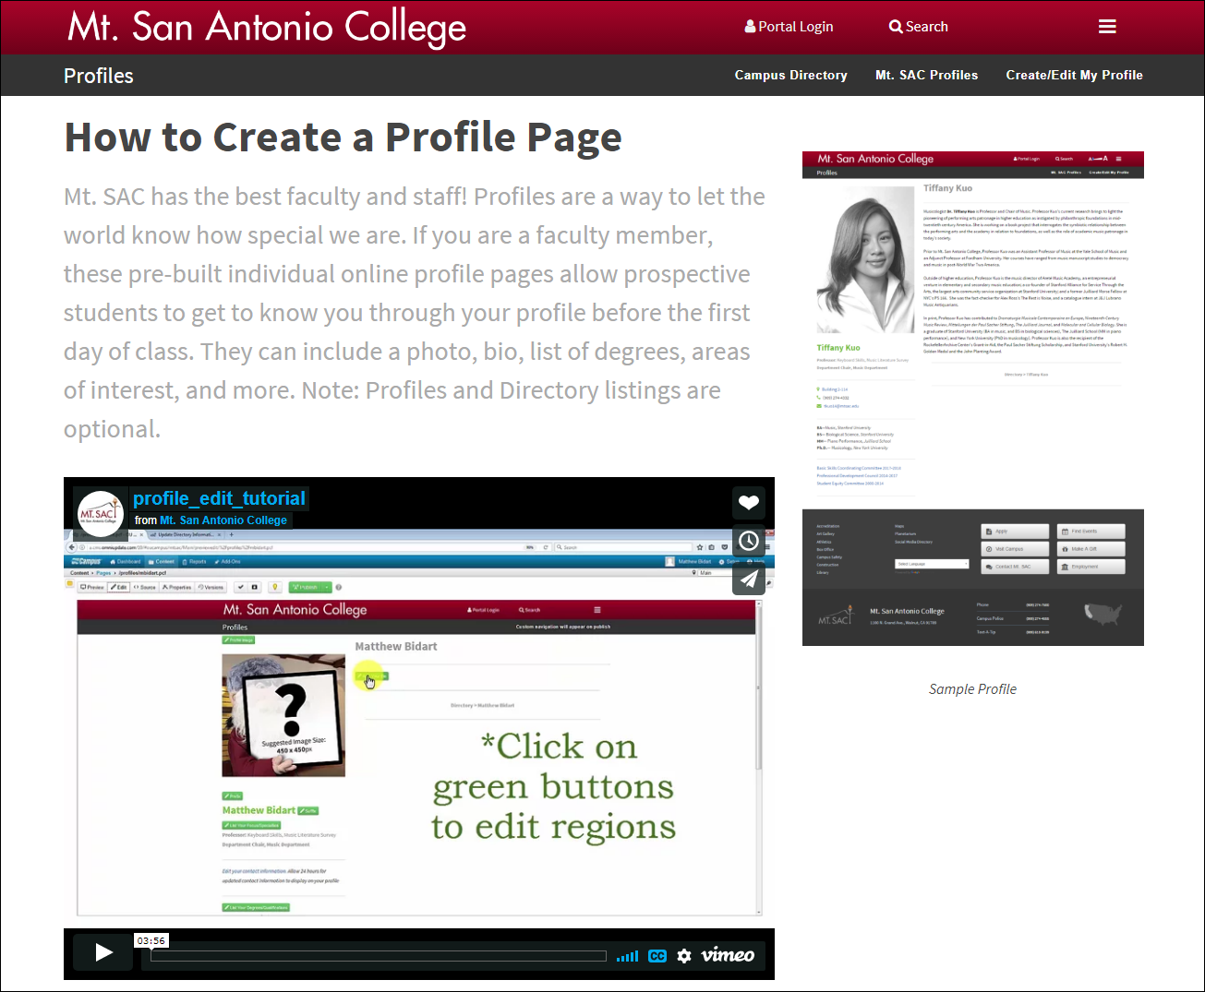
Did You Know? – Profile Pages
How Do I Start Editing My Profile Page?
www.mtsac.edu/profiles/start

Slide 5
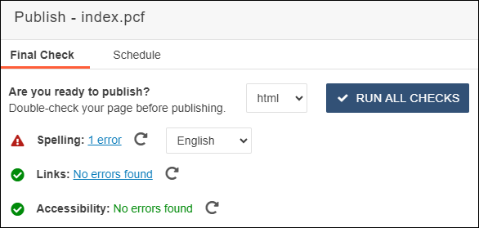
Did You Know? – Broken Link Scanning
An automated check of broken links will be mandatory when pages are published starting on Monday, 10/2/2023.

Slide 6
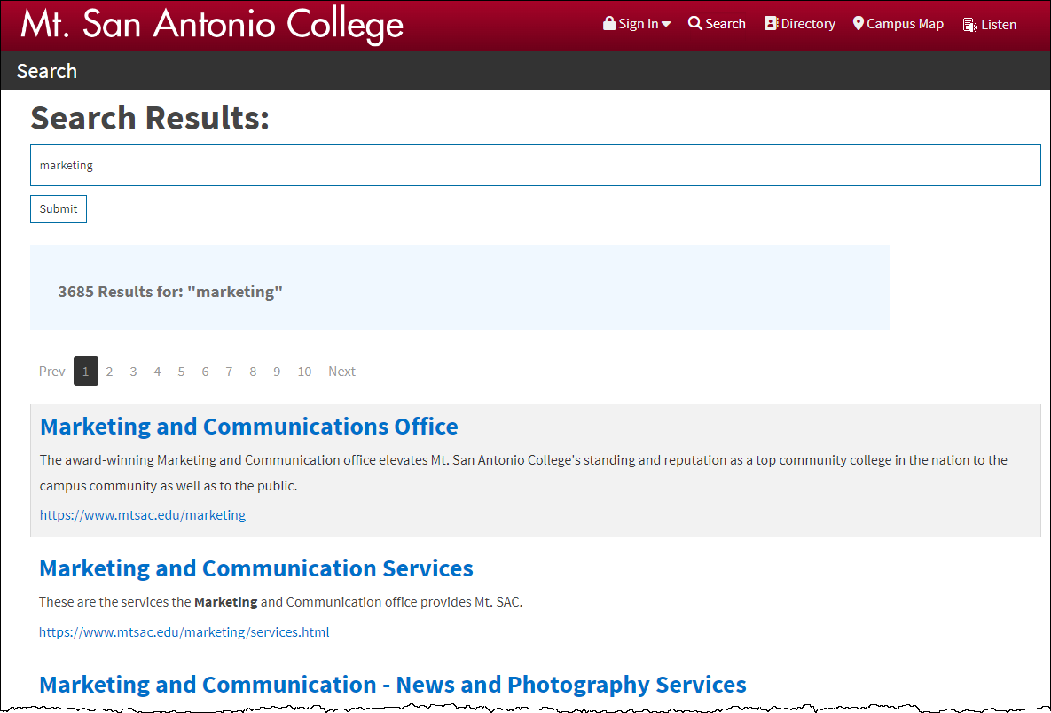
Did You Know? – Spotlight Search
You can request a Spotlight Search for your department or program at
www.mtsac.edu/searchrequest

Slide 7
Let’s See It…
The new homepage will launch on Monday, 10/2/2023

Slide 8

Survey Time
Please take answer a brief survey to give us your feedback on the
new Mt. SAC homepage.
Homepage Feedback Link
Drawing for Modern Campus backpacks with the following items:
Modern Campus Water Bottle
Vanilla Scented Candle
USB Power Bank

Slide 9
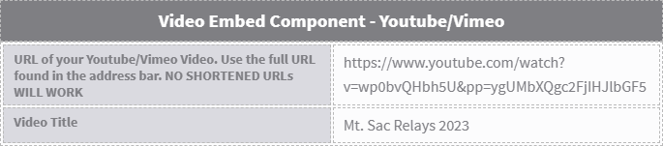
New Features
Snippet/Component Highlights 2023
Accordions
Career Coach Data
Modal Buttons
YouTube/Vimeo Video Embed Component (Must be Captioned)

Slide 10
Webpages
Ten pages you should check out:
www.mtsac.edu/accreditation/college_accreditation/2024/
www.mtsac.edu/smokefree/smokefree-landingpage.html
www.mtsac.edu/sce (Laura Sherwood)
www.mtsac.edu/ce (Matt)
www.mtsac.edu/realestate
www.mtsac.edu/construction
www.mtsac.edu/purchasing
www.mtsac.edu/sustainability/
www.mtsac.edu/accessibility
www.mtsac.edu/campusmap
www.mtsac.edu/business

