Slide 1
All Faculty Should Have a Biographical Profile to Help Students Find You Online
presented at Faculty Flex Day
Facilitated by
Eric Turner and Evelyn Ojeda
August 25, 2017
Notes:
Eric welcomes

Slide 2
Agenda
What is a Profile?
Profiles are optional
Profiles are responsive
What is the Campus Directory?
Common Questions
Academic Departments
Services & Administrative Offices
Buildings
People

Slide 3
Ready for a Story?...
Mt. SAC has great faculty.
Shouldn’t we promote them?

Slide 4
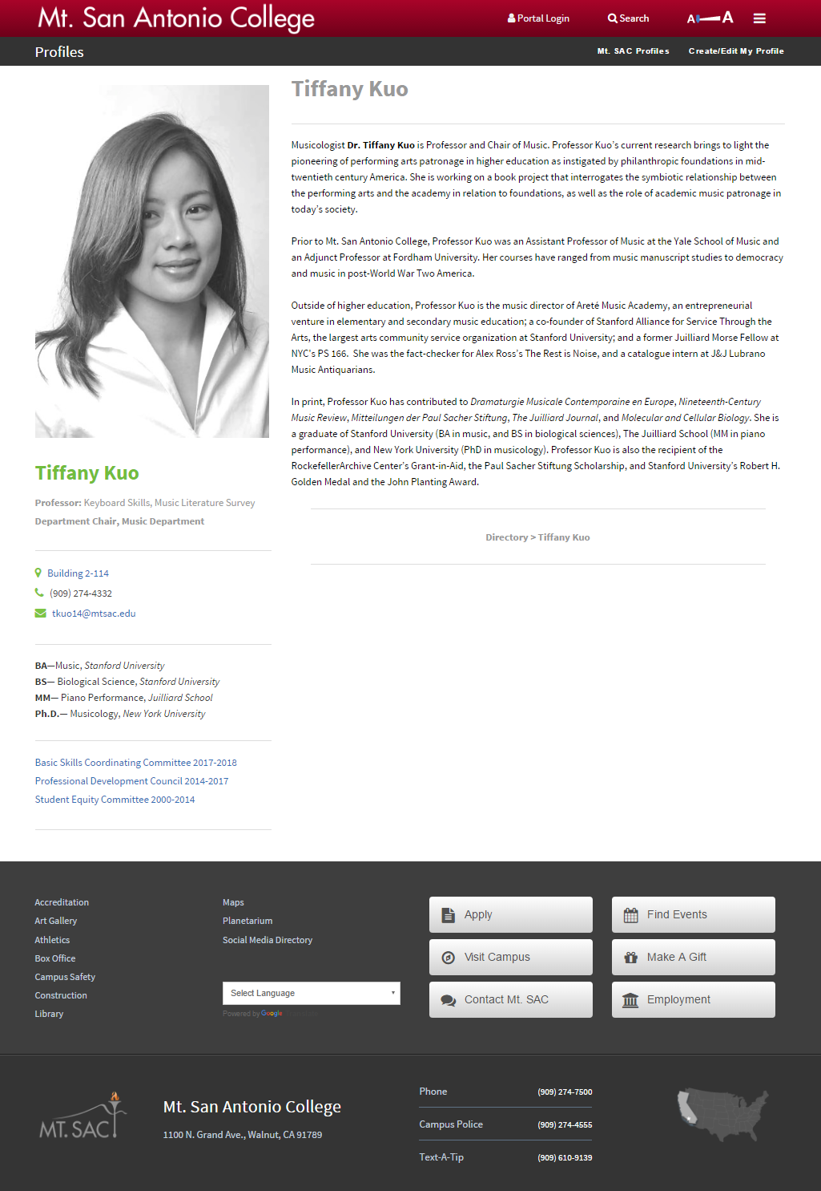
What is a Profile?
A “mini website” that offers biographical and areas of interest information to your readers

Slide 5
Profiles are Optional
Some people do not want their pictures on the Web
You must “Opt In” for your profile to be listed in the Campus Directory

Slide 6
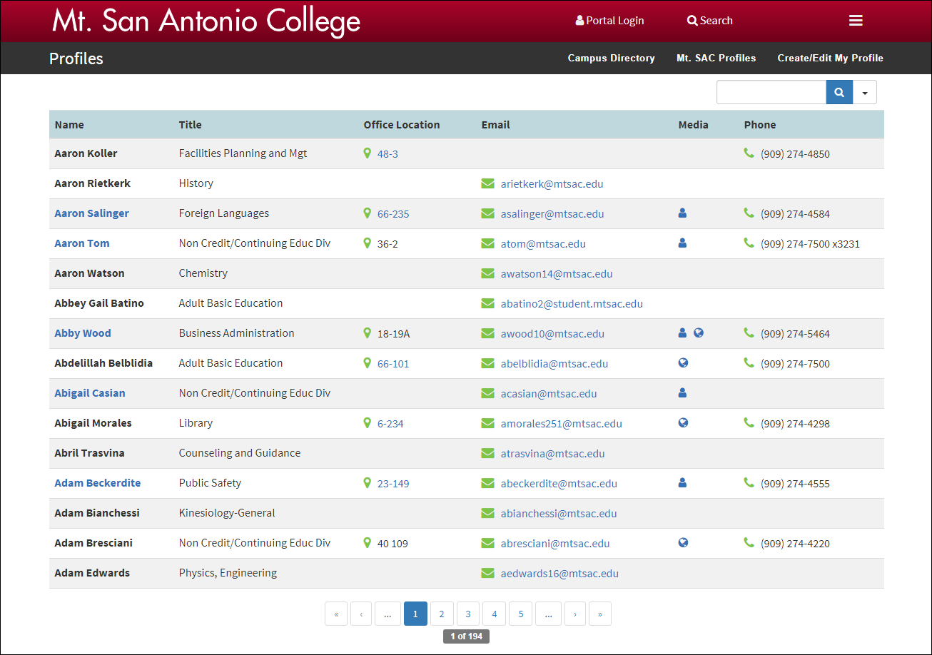
Master List: www.mtsac.edu/profiles

Slide 7
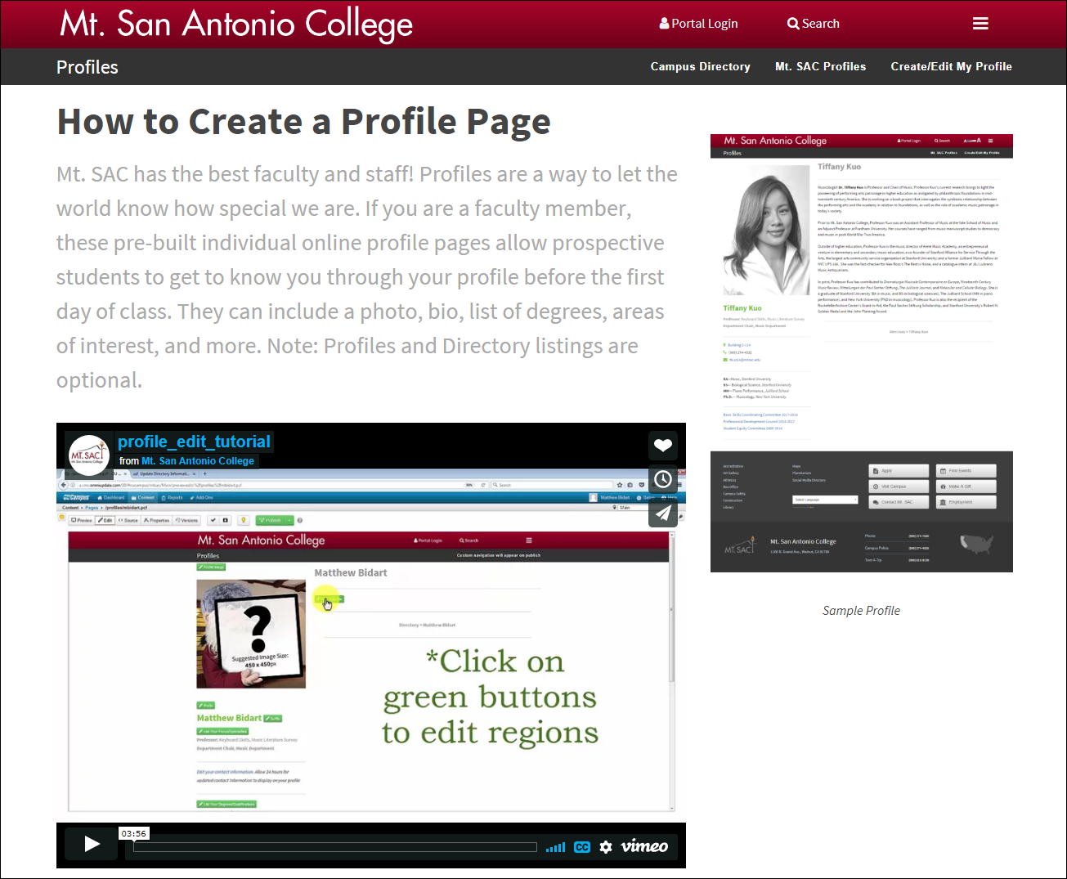
How Do I Start?
www.mtsac.edu/profiles/start

Slide 8
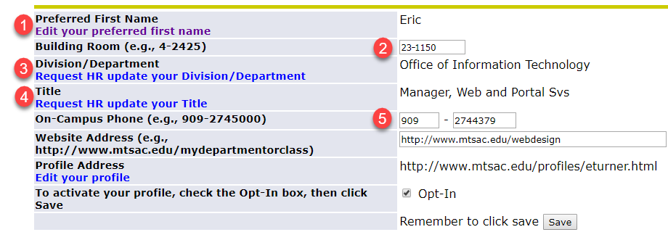
Update Directory Information in Banner
You may want to:
Add a Preferred First Name (e.g., “Bill” for William)
To update your Building & Room Number
To request an updated Division/Department
To request an updated Title
To update your phone number

Slide 9
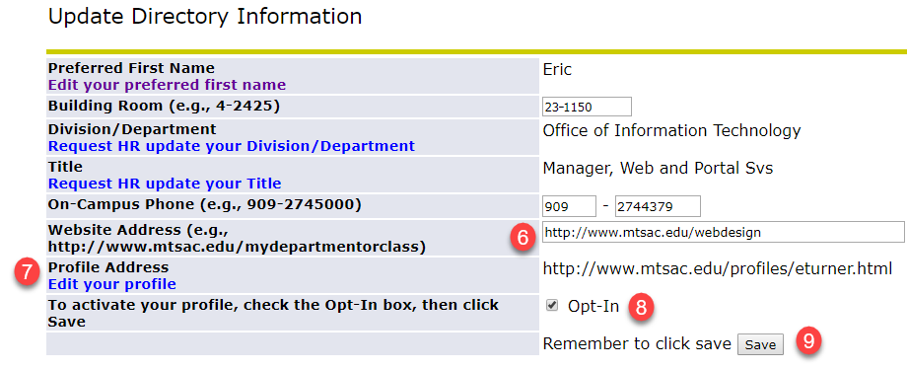
Banner Configuration (Continued)
Enter/Update your Mt. SAC web address (if you have one)
Edit your profile address (Done for you by default)
Check the Opt-In checkbox
Click Save

Slide 10
Click Link to Edit Your Profile

Slide 11
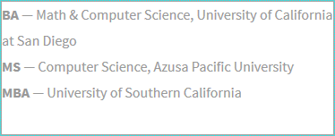
Edit Your Profile
Click the Edit button
Click the green button next to an editable region
Clear out sample text and enter your own

Slide 12
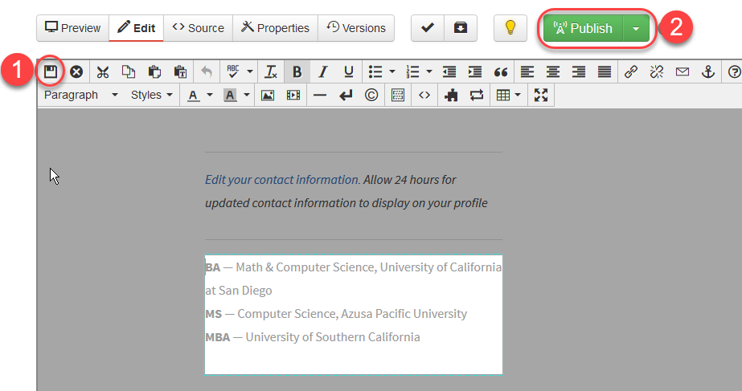
Save & Publish

Slide 13
Adding Photos
Click the Profile Image button
Click the Insert Picture Button icon in the toolbar
Click the Browse button
Click Photos Folder button
Click Upload
Click the Add button or drag your photo from your computer
Click Start Upload
Click Insert
Click the Save icon
Publish your photo or let IT know your photo is ready

Slide 14
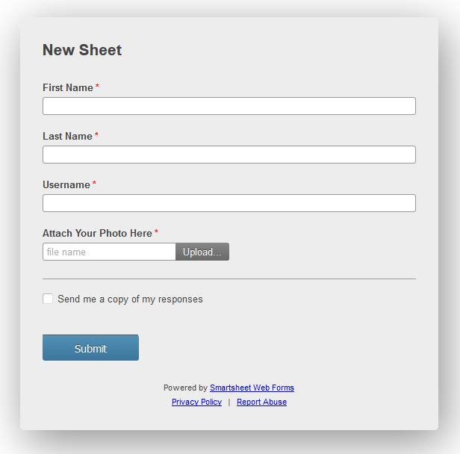
Request a Photo Publish
www.mtsac.edu/profiles/request

Slide 15
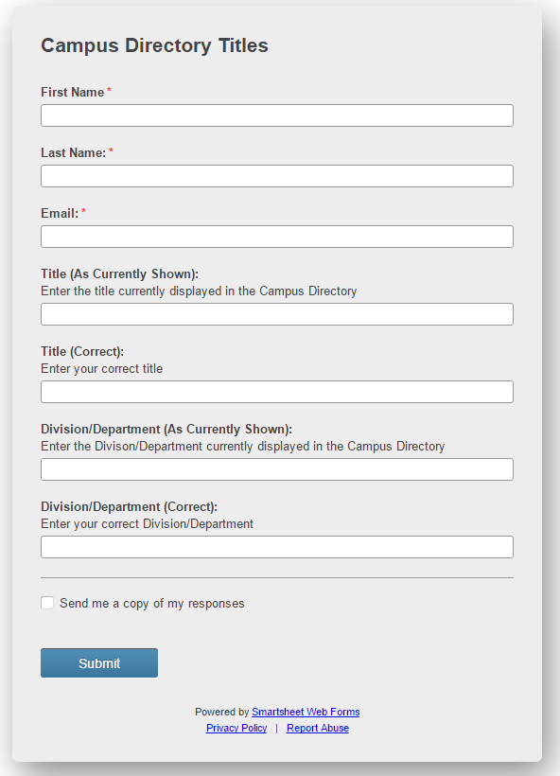
To Request Title or Department Changes
www.mtsac.edu/directory/request

Slide 16
Have You Had Any of These Challenges?
How do I get a hold of my department chair?
What is the email address of my colleague?
Where is building 10?
How do I see someone’s profile?

Slide 17
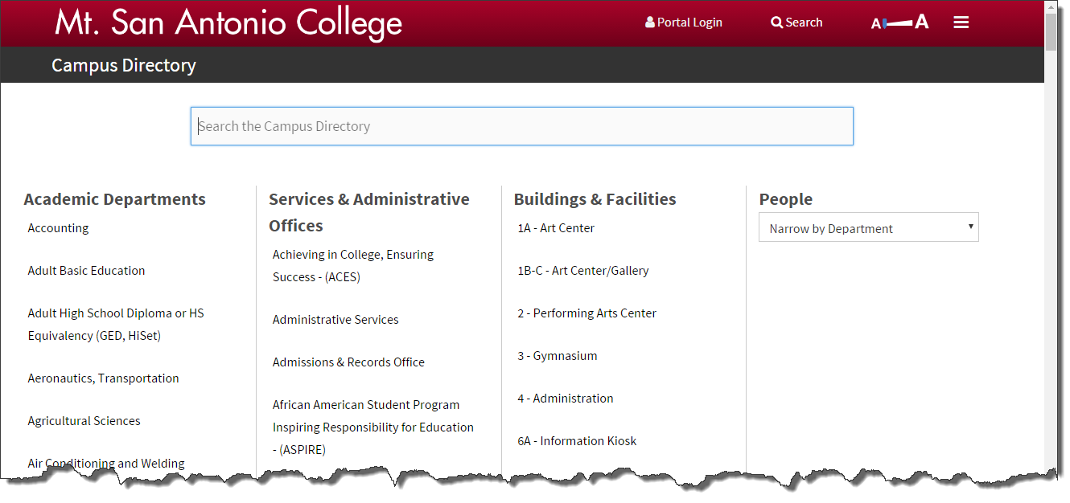
www.mtsac.edu/directory

Slide 18
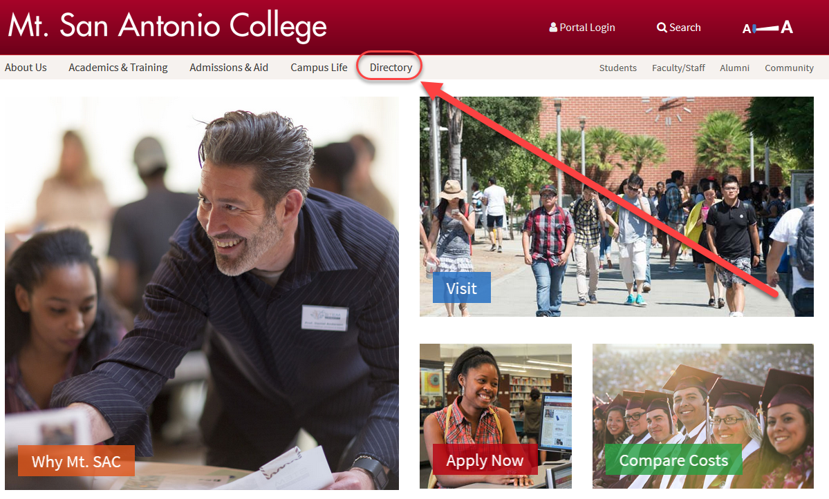
Homepage Link

Slide 19
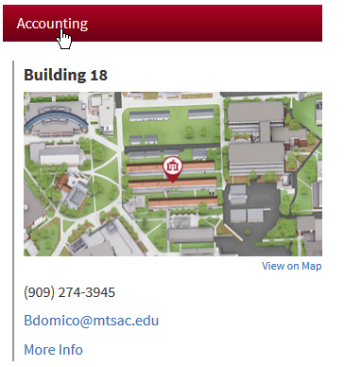
Academic Departments

Slide 20
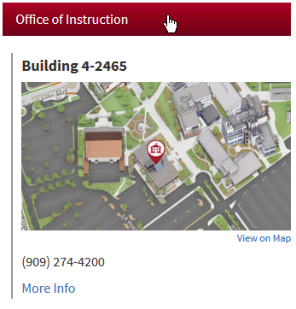
Services & Administrative Offices

Slide 21
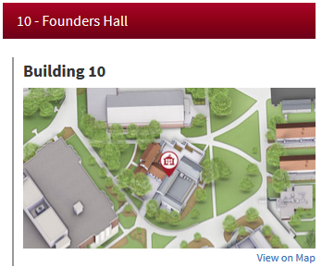
Buildings & Facilities

Slide 22
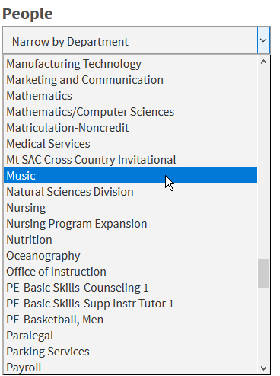
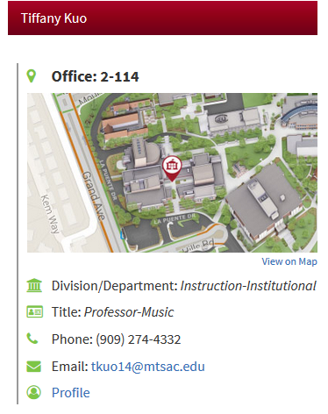
People Search

Slide 23
Let’s See IT…
http://www.mtsac.edu/directory
http://www.mtsac.edu/profiles

