Slide 1
OmniUpdate OU Campus v11

Slide 2
What’s New?
Redesign of the interface:
Modern Dashboard
Recently Visited Content
My Checked-Out Content
Enhanced WYSIWYG Editor
Simplified Navigation
Accessible Screens that are keyboard navigable
Menus that open on click
Three dot More Actions menu
Notifications Stack
Unpublished Changes Status Icon
View Published Page
Final Check

Slide 3
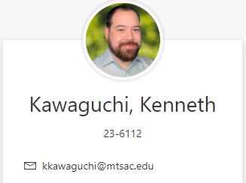
IT’s New Trainer

Slide 4

Preview Video

Slide 5
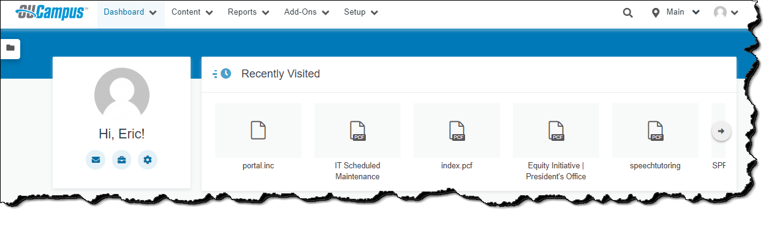

Dashboard: www.mtsac.edu/omniupdate
Editable Profile Picture (Uses Gravatar)
Recently Visited Section
My Checked-Out Content
Notes:
User avatar and settings (https://support.omniupdate.com/learn-ou-campus/administration/setup/users.html#usersettings): Your user avatar is set via Gravatar, a third-party website that uses your avatar on any Gravatar-enabled site. Make sure you use the same email address for Gravatar that you use for your OU Campus account.

Slide 6

New Blue Button

Slide 7
WYSIWYG Editor

Slide 8
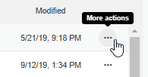
More Actions Ellipsis

Slide 9

Toggle Header Collapsed or Expanded

Slide 10
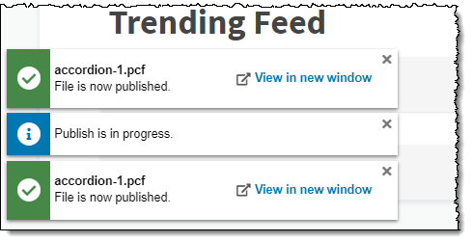
Stacked Notifications

Slide 11
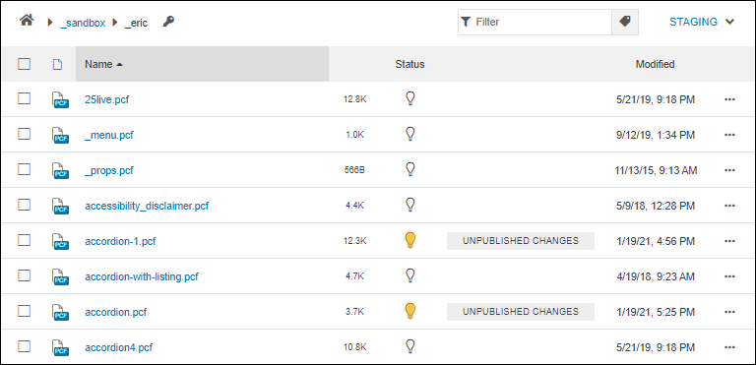
Unpublished Changes

Slide 12
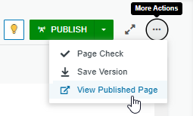
Eric’s Favorite New Feature

Slide 13
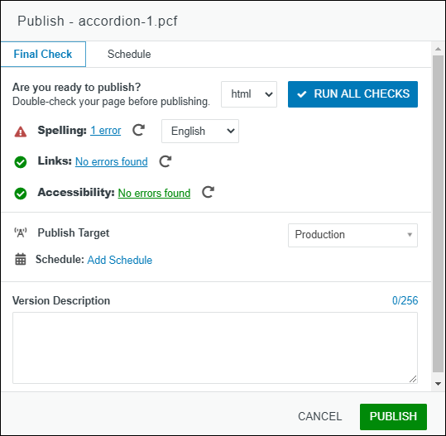
Final Check

Slide 14

Questions

