Slide 1
What is New with the Website?
presented to
Mt. SAC Website Editors
presented by
Eric Turner, Web and Portal Services
April 27, 2017
Notes:
Eric welcomes

Slide 2
Agenda
What is the Campus Directory?
  Common Questions
  Academic Departments
  Services & Administrative Offices
  Buildings
  People
What is a Profile?
  Profiles are optional
  Profiles are responsive
Have You Used a Snippet Lately?
  What is a Snippet?
  Mt. SAC’s Template Dilemma (Review)
  Favorite Gadgets
  Snippet Voting
  Live Demo / Sneak Peek
Hands-On Training to follow

Slide 3
Have You Had Any of These Challenges?
How do I get a hold of my Dean/Manager?
What is the email address of my colleague?
Where is Building 10?
How do I see someone’s profile?

Slide 4
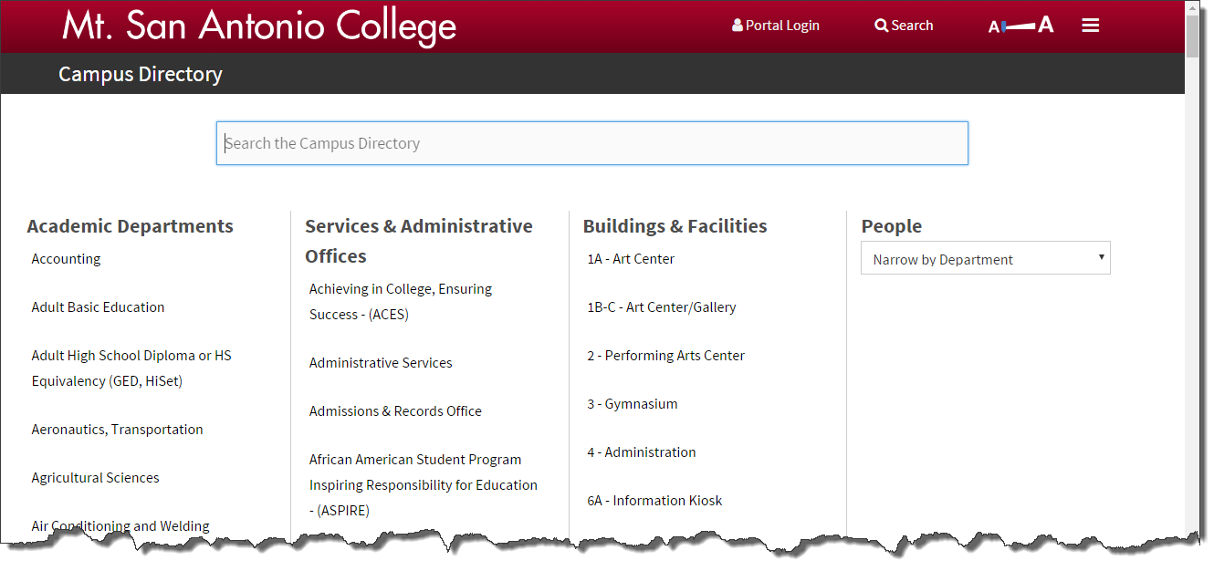
www.mtsac.edu/directory

Slide 5
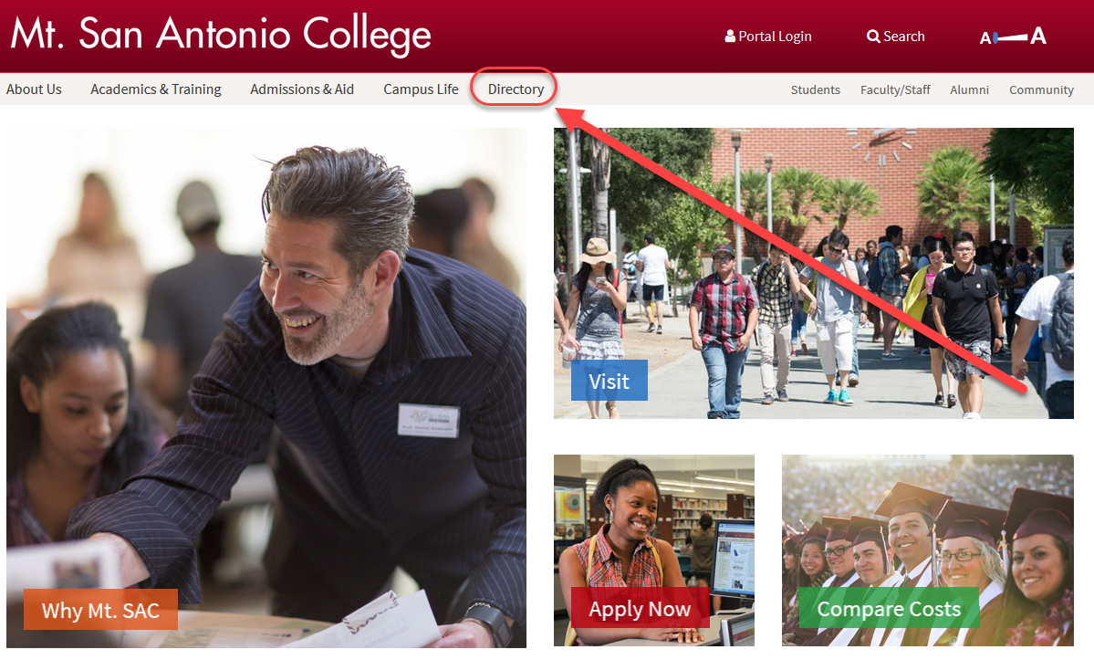
Homepage Link

Slide 6
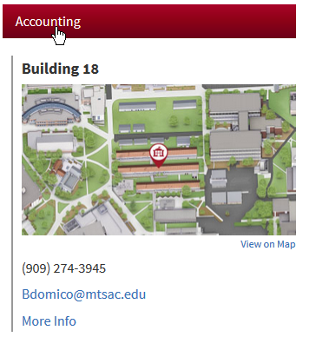
Academic Departments

Slide 7
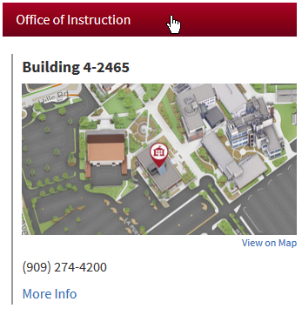
Services & Administrative Offices

Slide 8
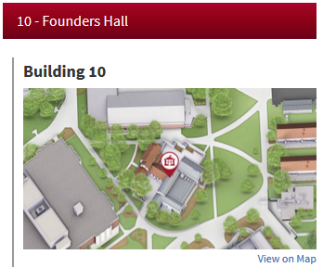
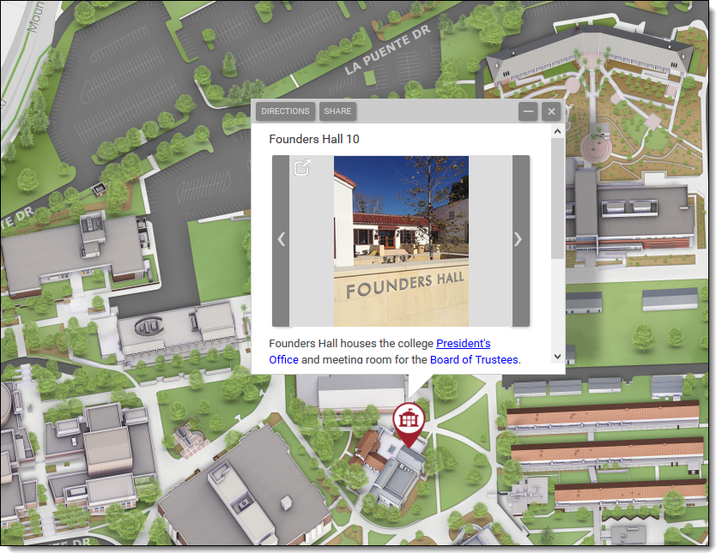
Buildings & Facilities
Where is Building 10?

Slide 9
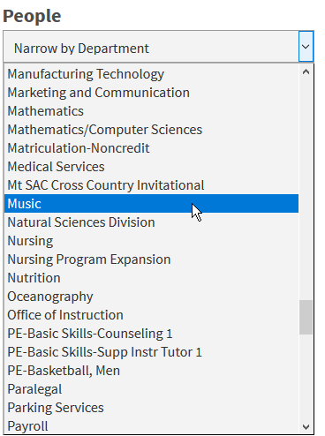
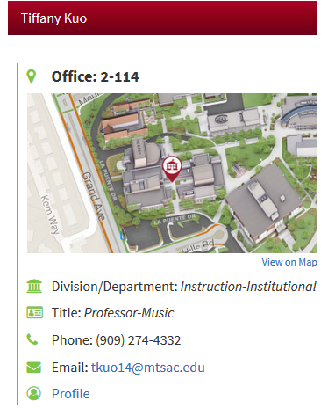
People Search

Slide 10


Ready for a Story?...
Mt. SAC has great faculty.
Shouldn’t we promote them?

Slide 11
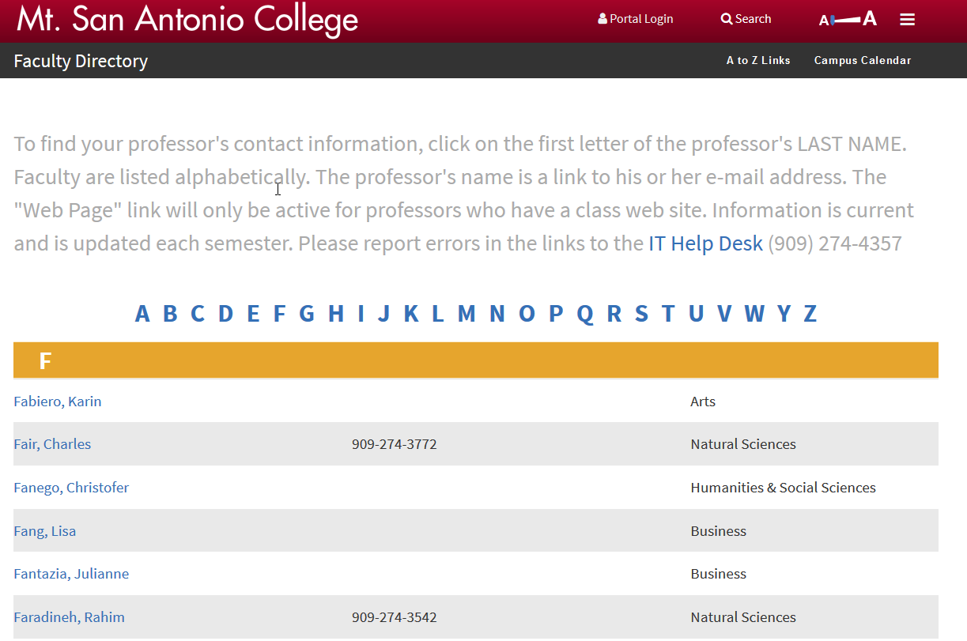
What is This?

Slide 12
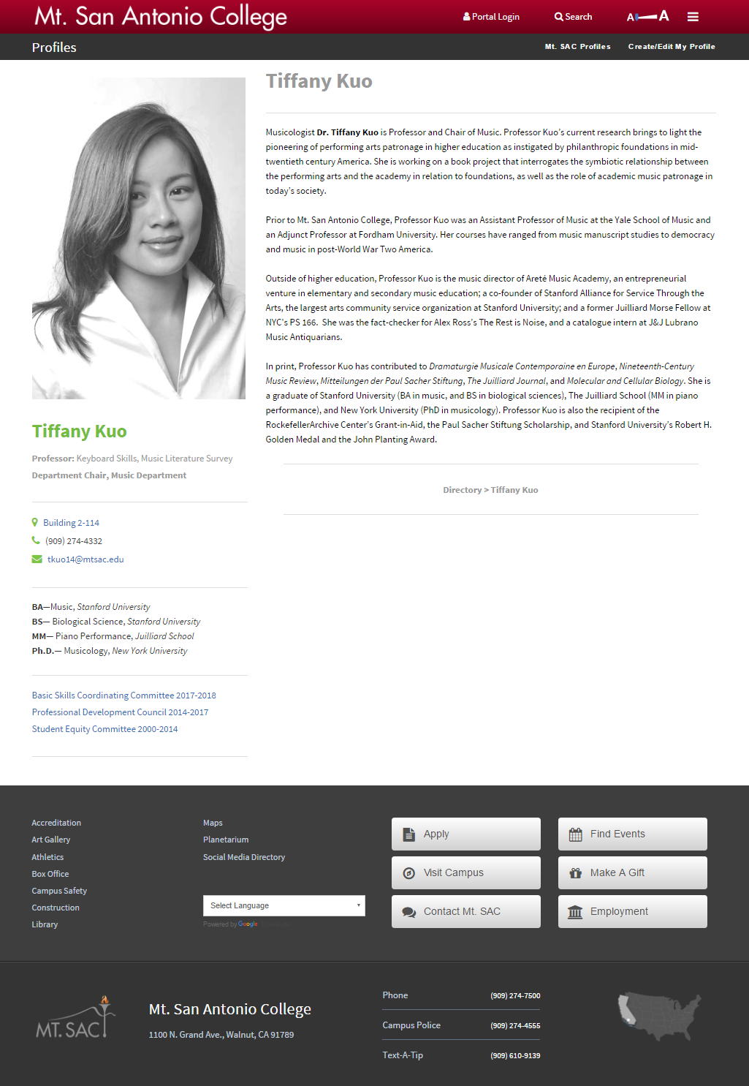
What is a Profile?
A “mini website” that offers biographical and areas of interest information to your readers

Slide 13
Profiles are Optional
Some people do not want their pictures on the Web
You must “Opt In” for your profile to be listed in
the directory
www.mtsac.edu/profiles/start

Slide 14
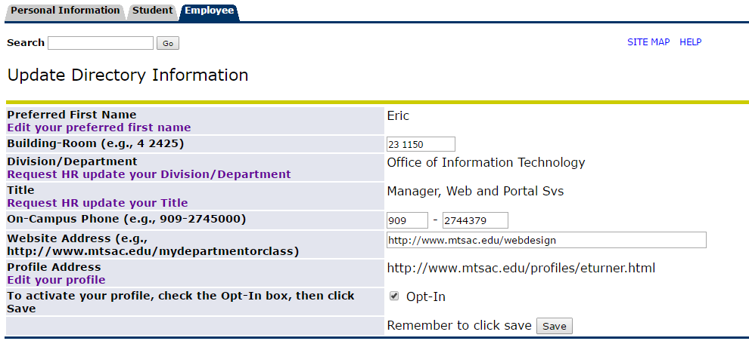
Login to Banner
Correct Contact Information or Request an Update
Check “Opt In” (Only if you want a Profile)
Click Save

Slide 15
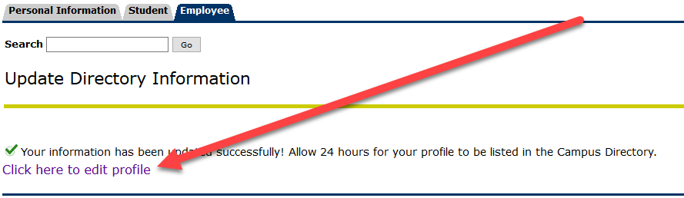
Click Link to Edit Your Profile

Slide 16
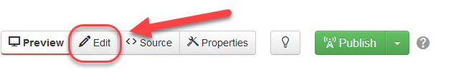
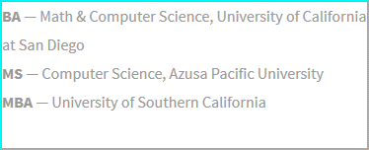
Edit Your Profile
Click the Edit button
Click the green button next to an editable region
Clear out sample text and enter your own

Slide 17
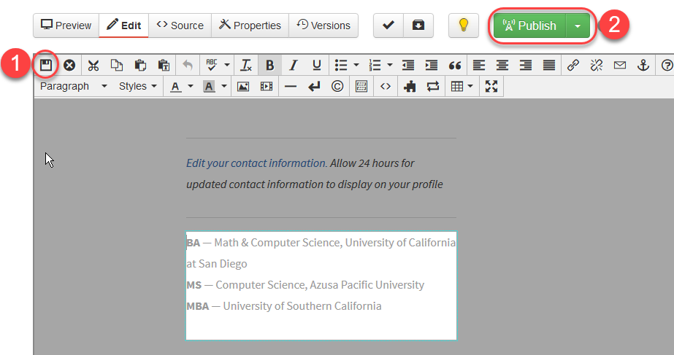
Save & Publish

Slide 18
Adding Photos
Click the Profile Image button
Click the Insert Picture Button icon in the toolbar
Click the Browse button
Click Photos Folder button
Click Upload
Click the Add button or drag your photo from your computer
Click Start Upload
Click Insert
Click the Save icon
Publish your photo or let IT know your photo is ready

Slide 19
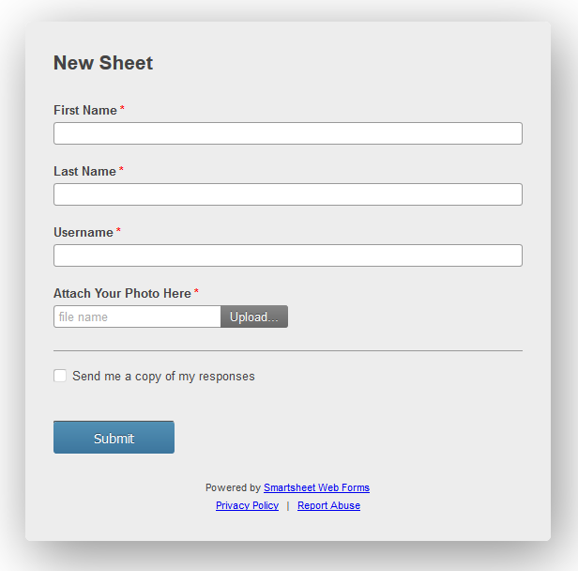
Request a Photo Publish
www.mtsac.edu/profiles/request

Slide 20
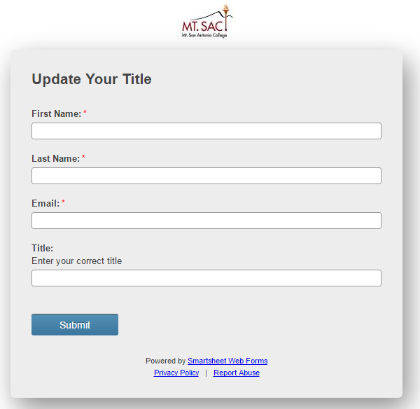
To Request Title Update
www.mtsac.edu/directory/request

Slide 21
Let’s See IT…
http://www.mtsac.edu/directory
http://www.mtsac.edu/profiles

Slide 22
Have You Used a Snippet Lately?
If Not, You are Missing Out.

Slide 23
Agenda
What is a Snippet?
Mt. SAC’s Template Dilemma
Favorite Gadgets (Review)
Snippet Examples
Live Demo/Sneak Peek

Slide 24

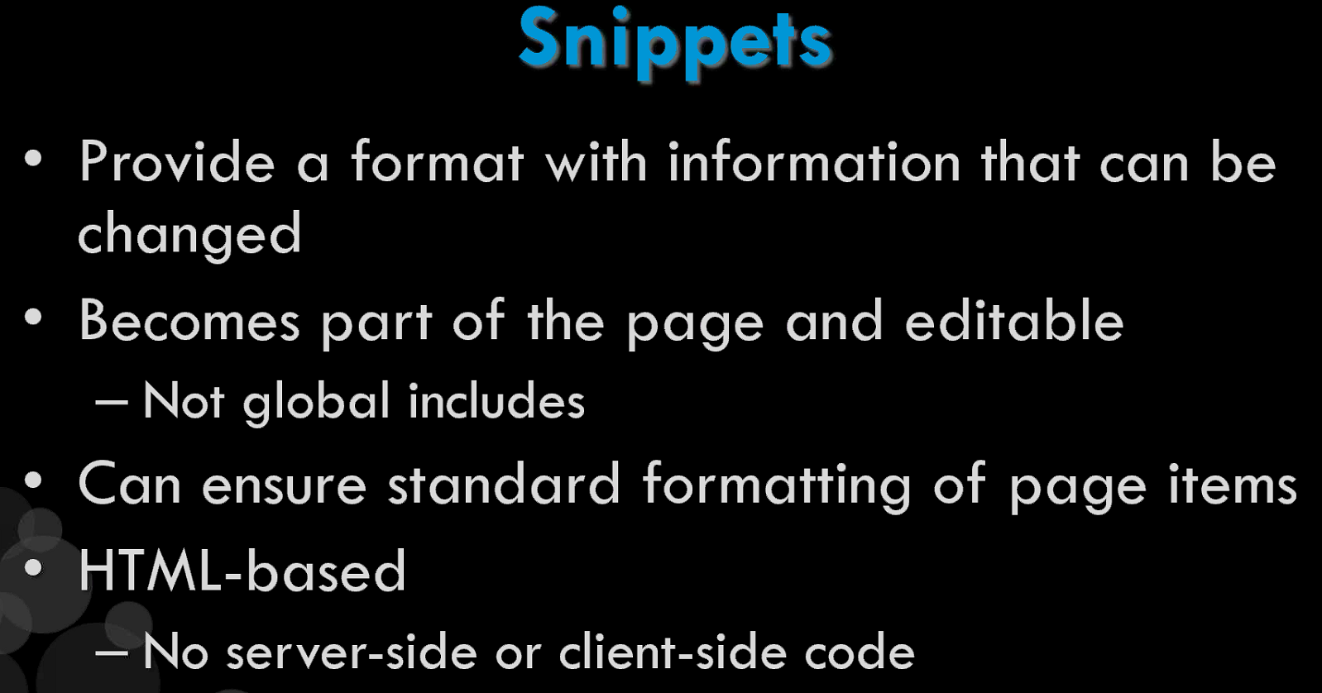
What is a Snippet?
Snippets are reusable files that are available to be inserted on a page via the WYSIWYG Editor or with the Snippet’s Gadget
Example Uses:
  Table structure
  Image placeholder with caption
  Formatted HTML
  Non-recurring formatted text

Slide 25
What do you see below?

Slide 26
What Do You Envision Here?
Did you see a fabulous department or program website?
Unless you are a Web Designer, most people need a little help

Slide 27
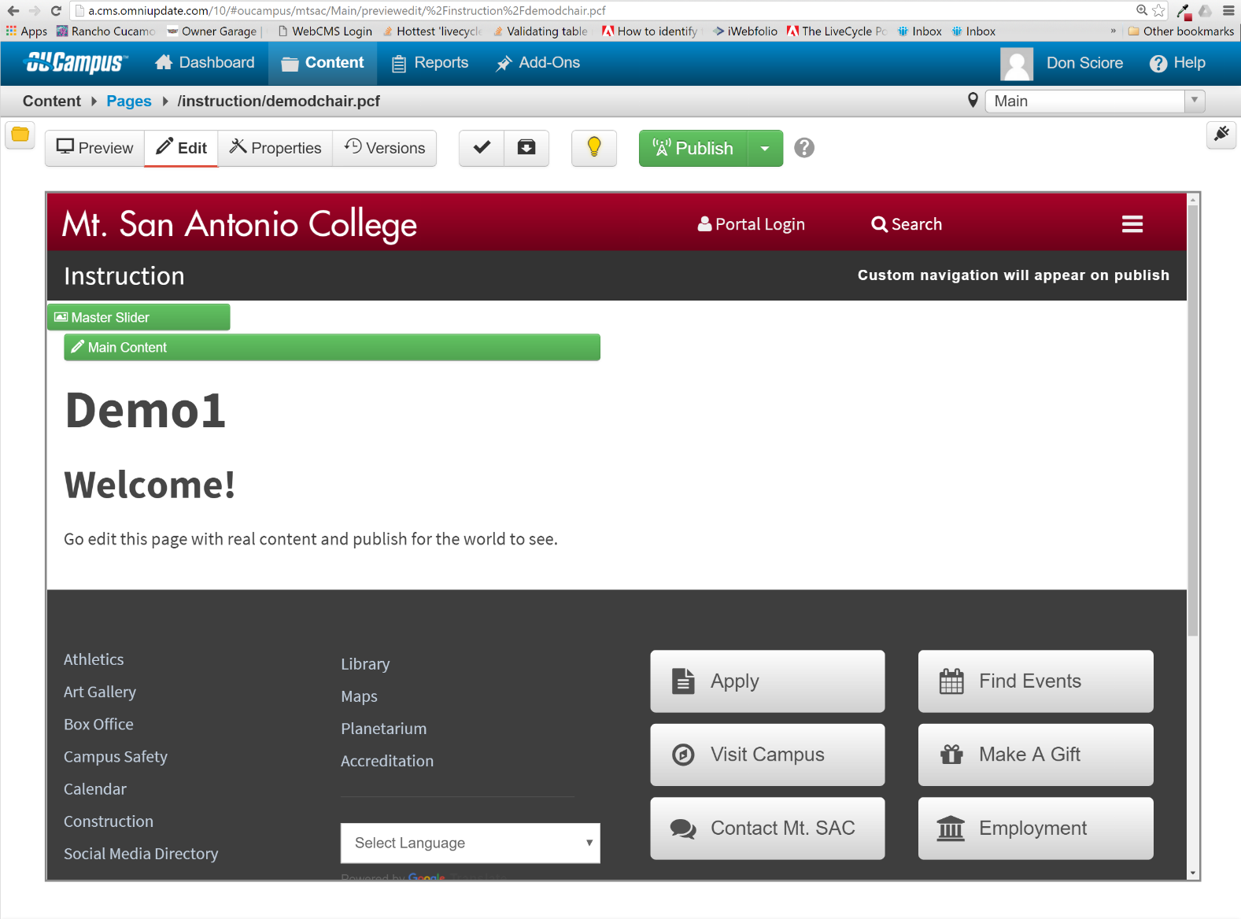

Slide 28

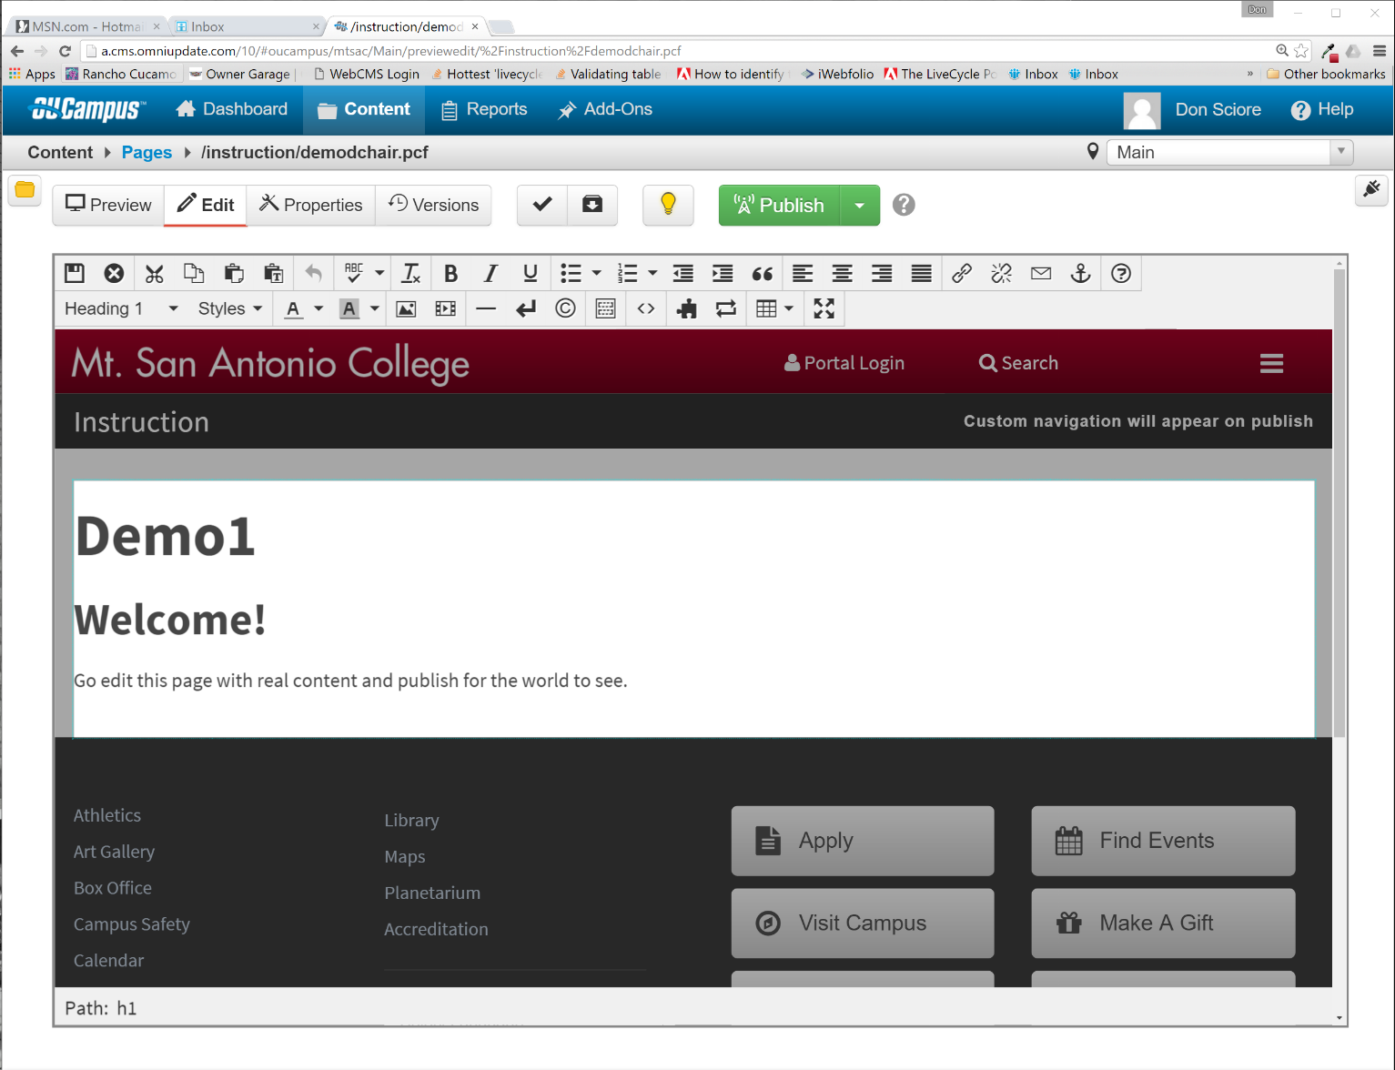

Slide 29
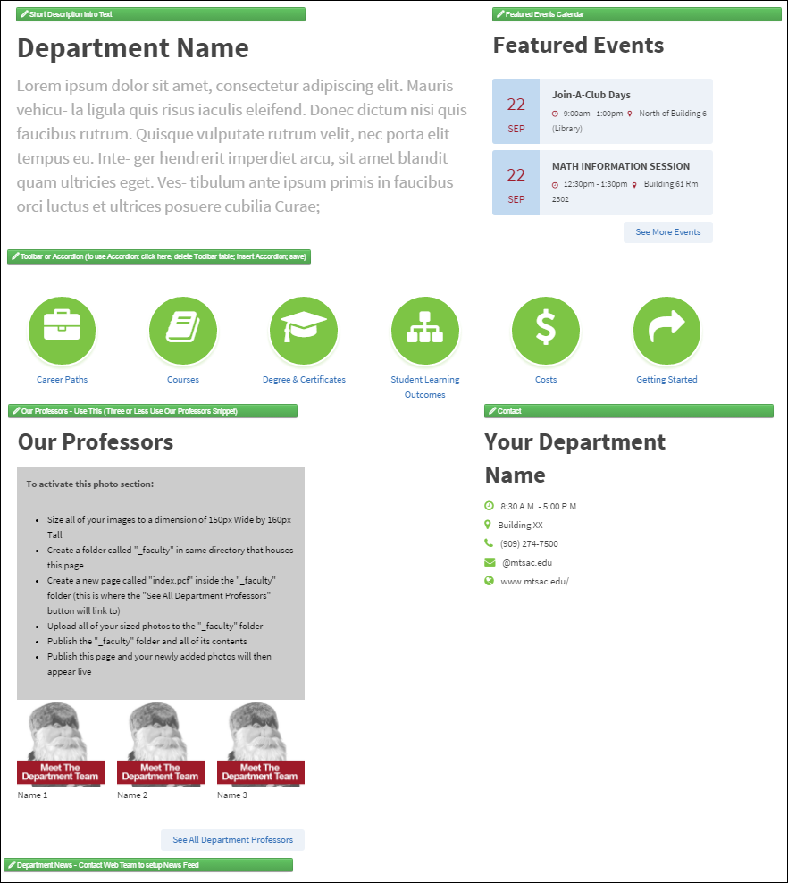
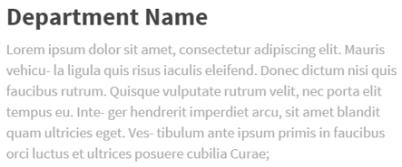

“Sometimes even the wisest of men and machines can be in error.”
Optimus Prime--Transformers (1984)

Slide 30


Slide 31
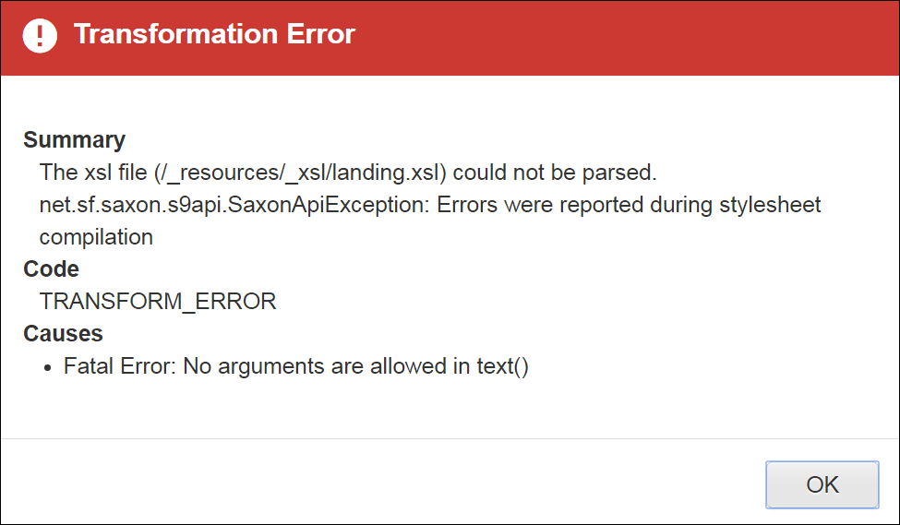
Transformation Errors are Expected
To Remove Error: Revert to a previous version
If Transformation Errors persist, call the Web Team
Important! Save and Publish each time you edit a new section

Slide 32
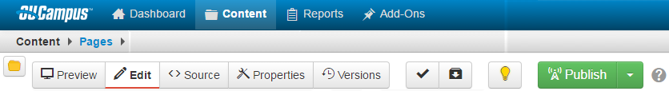
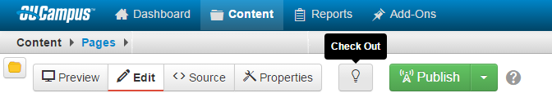
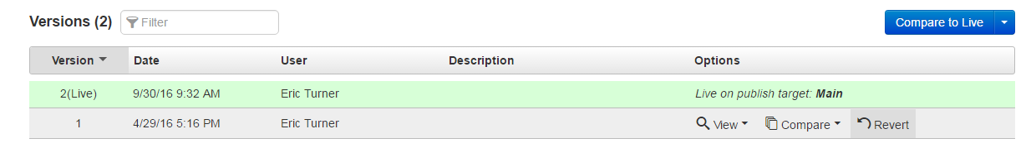
Revert to Remove Transformation Errors
Check Out the Page
Click Versions
Save and Publish
If Transformation Errors persist, call the Web Team

Slide 33

What is a Table Transformation Snippet?
Table Transformation (Snippet)
A way to format data input by a user into an HTML Table in the OmniUpdate CMS
Uses a combination of HTML and XSLT

Slide 34

What is XSLT?
Extensible Stylesheet Language Transformations
A language for transforming web documents into other formats such as HTML, plain text or XSL Formatting Objects
XPath used to select nodes of HTML table.

Slide 35


Advantages of Using Snippets
Eliminates the need for an end user to touch any code
Introduces Pre-formatted web code that can be used in a drag/drop fashion. Some examples of snippets include:
  RSS News Feeds
  Accordion style Content Areas
  Social Media Integration
  Campus Calendar Events
  Campus Catalog

Slide 36
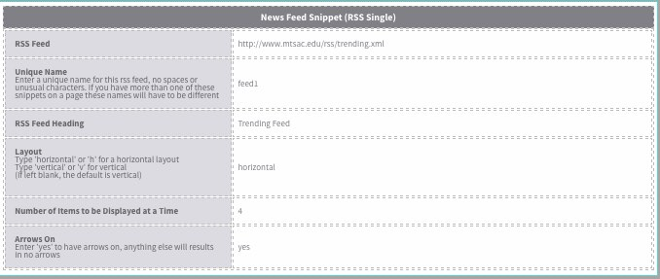
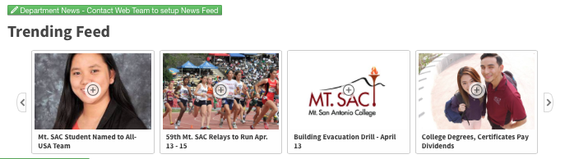
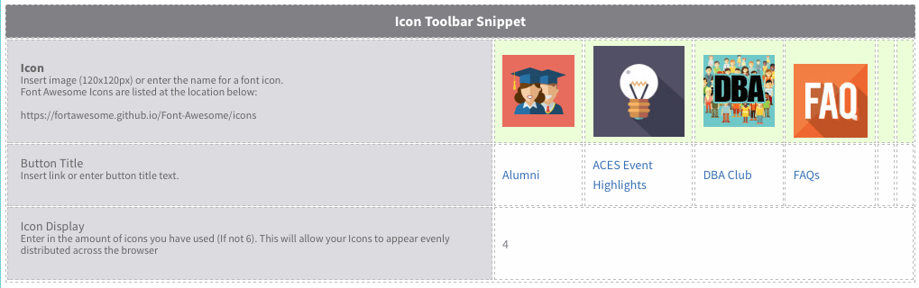

Examples of snippets

Slide 37
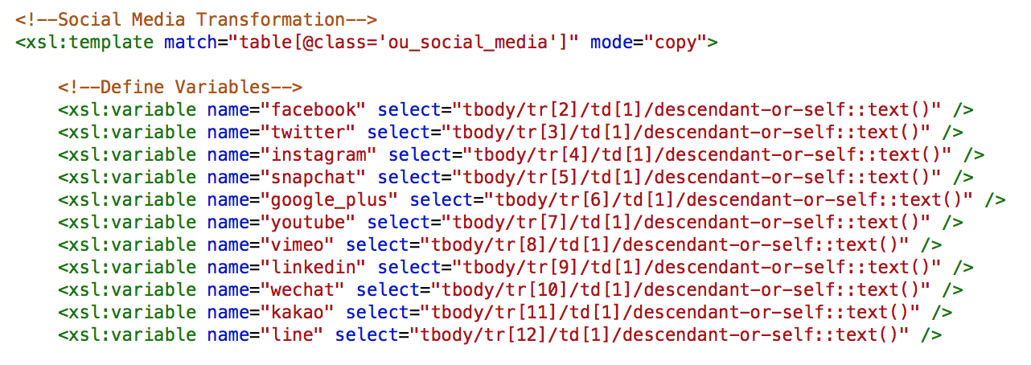
Sample XSLT Snippet Code

Slide 38
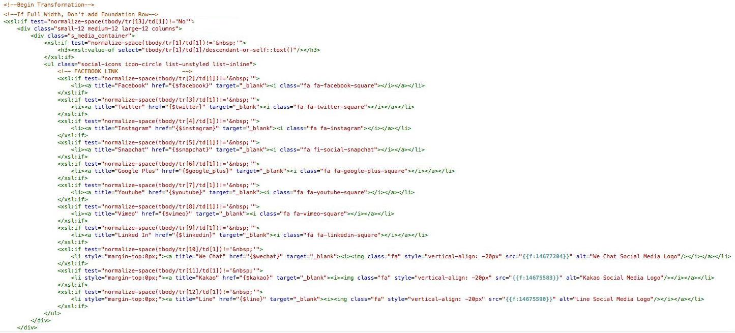

Sample XSLT Snippet Code

Slide 39
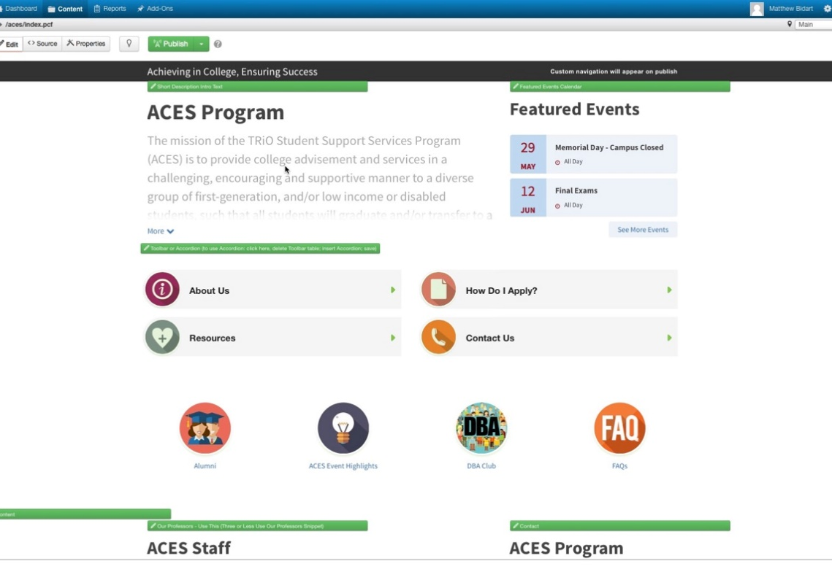
Usage of Snippets in Templates
Added control over layout
Added symmetry between pages
Library of drag/drop options
More intuitive than our initial page layout
A preview of all of the snippet options can be seen at:
mtsac.edu/webdesign/
mtsac.edu/webdesign/topten.html

Slide 40
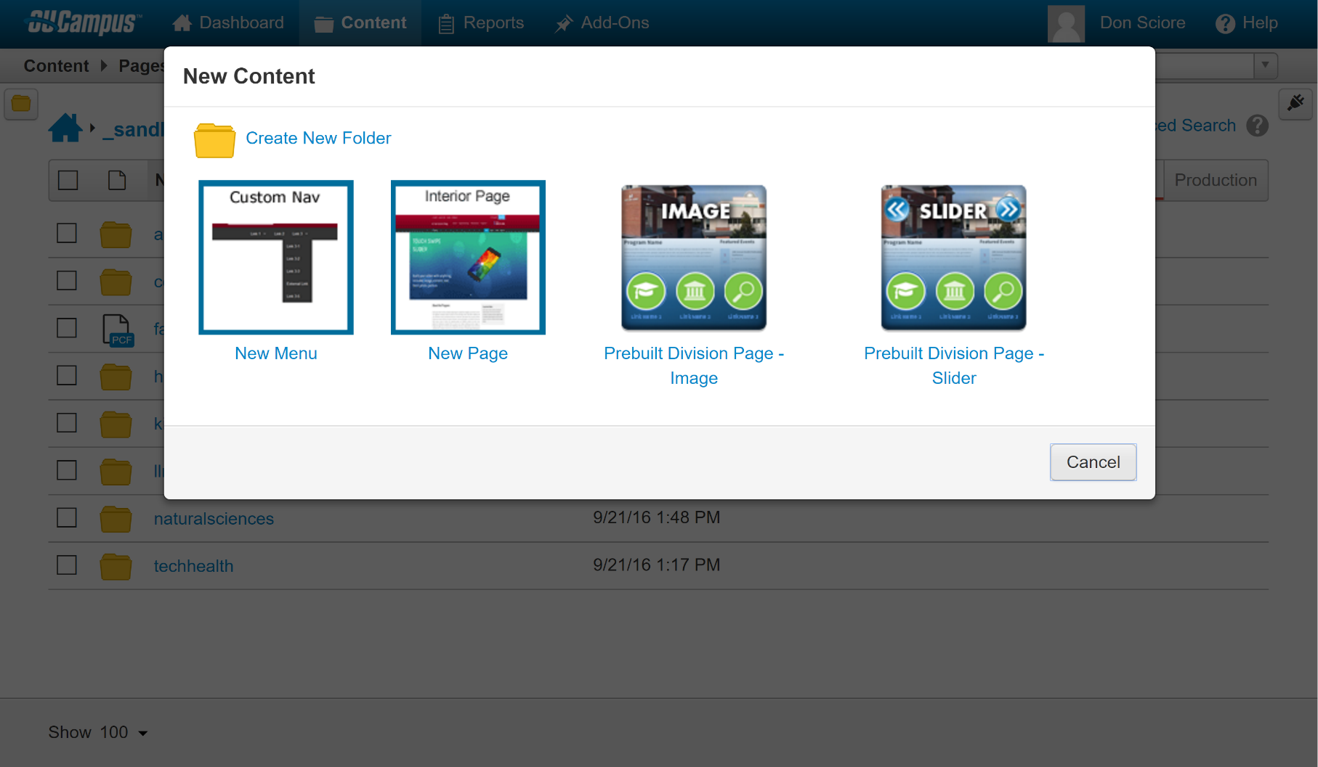


Slide 41
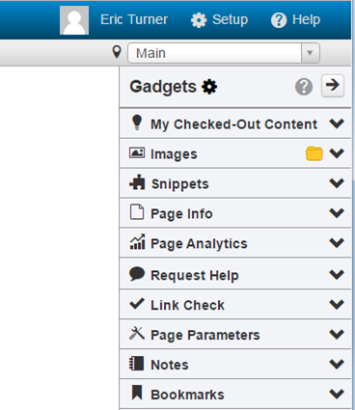
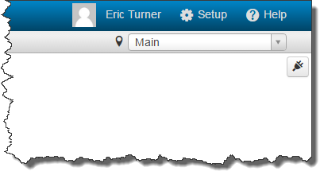

Gadgets (Review)
Snippets
Images
My Checked Out Content
Link Check
Bookmarks

Slide 42
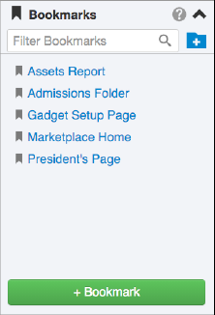

5. Bookmarks
Link to Pages
Organize in Folders
Search and Reorder Links

Slide 43
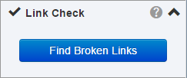

4. Link Check
A quick and easy way to check links on the current page
All broken links are automatically highlighted on the page
Repair them easily or send a report to someone who can

Slide 44
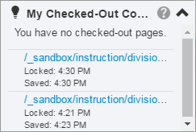
3. My Check-Out Content
Make sure your pages are checked in
Displays the same information as the dashboard gadget

Slide 45
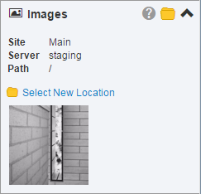
4. Images
Drag and Drop Previously Uploaded Images into the any Editable Region
Drag and Drop Images From the Images Gadget onto Your Local Computer

Slide 46
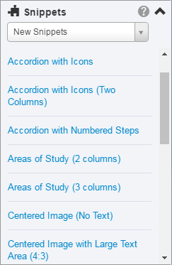
1. Snippets
Drag and Drop Snippets into Any Editable Region

Slide 47
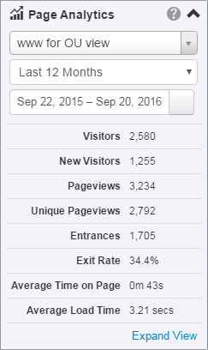
Honorable Mention: Page Analytics
Get the same page statistics as provided by Google Analytics using this gadget

Slide 48
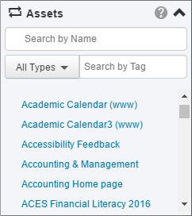
Assets (Welcome Back!!!)
Assets Gadget behaves the same as the Snippets Gadget
Drag and Drop Assets into Any Editable Region

Slide 49
Ready to see some Snippets?

Slide 50

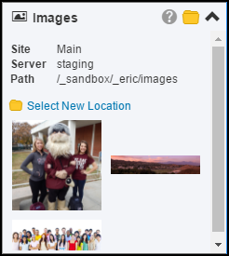
Large Image

Slide 51
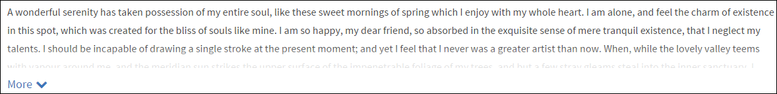
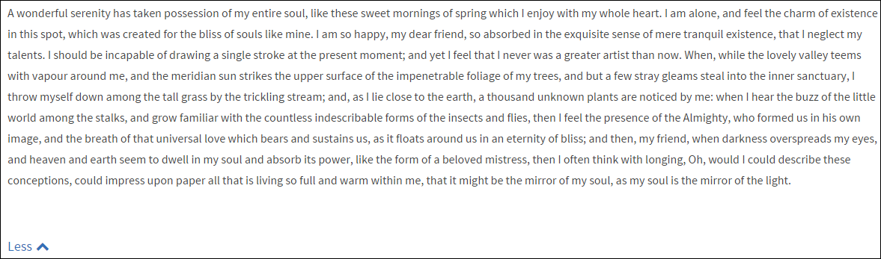
Text Read/More

Slide 52
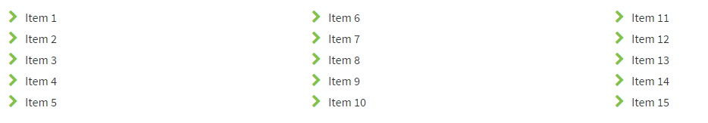
Chevron Lists

Slide 53

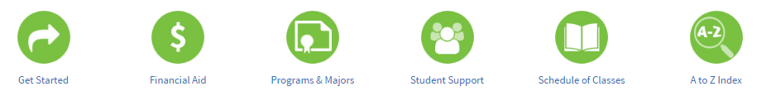
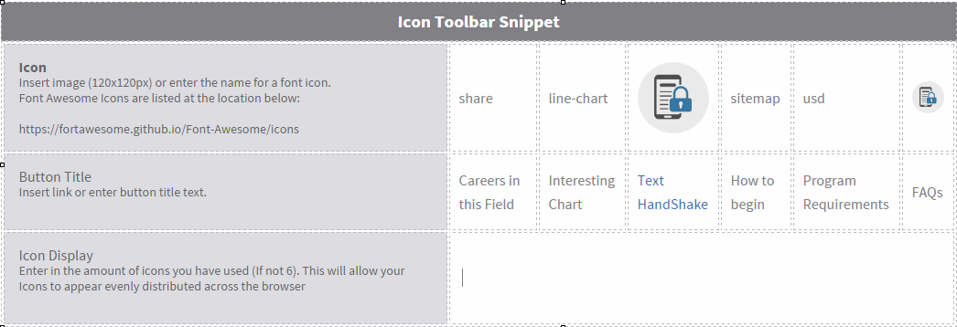
Toolbar

Slide 54
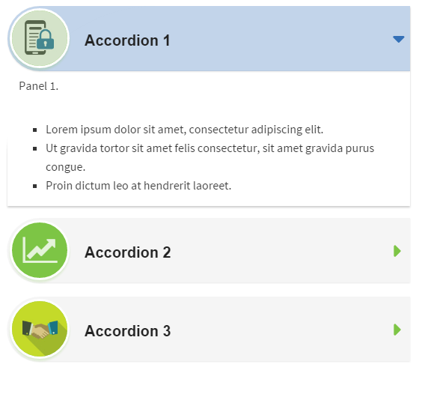
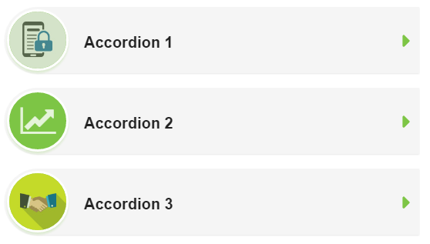

Accordion

Slide 55

Accordion with Icons

Slide 56

Areas of Study

Slide 57


Social Media

Slide 58

Catalog Entry

Slide 59


News Feed

Slide 60


Responsive Tables
ADA accessible
Look great on desktop or mobile

Slide 61


Other Favorite Snippets
Featured Events
Multi-Column Layouts
A to Z (Folder-Level)

Slide 62

Notes:
Poll Title: My Favorite Part of Breakfast Was...
https://www.polleverywhere.com/free_text_polls/OtXd0Egw5A6p8zC

Slide 63

Notes:
Poll Title: Have you been to an OmniUpdate Editor's User Group Session Before?
https://www.polleverywhere.com/multiple_choice_polls/iwg3EDihEDBwEHX

Slide 64

Notes:
Poll Title: Which is Your Favorite Snippet?
https://www.polleverywhere.com/multiple_choice_polls/ore0lxNrTaG5ROS

Slide 65
Let’s See IT…
http://www.mtsac.edu/outraining/topten.html

