Slide 1
Do You Post or Email Documents to Students? Learn How to Make them Accessible to All…
It’s the Law!
-Eric Turner | eturner@mtsac.edu | (909) 274-4379

Slide 2

What does “accessibility” mean to you?
Website accessibility is actively designing, developing, and creating content in such a way that it does not hinder any person from interacting with the website. - Web Access Initiative (WAI)
A website is accessible when everyone, regardless of ability or disability, can use it and get the information they need.

Slide 3
Accessibility--Non-Technical Definition
Usable by someone who…
  Cannot use a mouse
  Cannot hear
  Cannot see
  Cannot easily distinguish color differences
  Uses assistive technology (adaptive hardware and software) to access
  the system
Used with permission from the High-Tech Center Training Unit (www.htctu.net)

Slide 4
I Need to Post or Send a Message, Does It Need to Be Accessible?
Know what the Law says…
Run an Accessibility Scan
Whenever possible, use a webpage instead of a PDF document
Documents can be made to be read-only in their native form (i.e., you are not required to make them PDFs)

Slide 5
What Information Must be Accessible?
Emergency Notifications
Decisions adjudicating administrative claim or proceeding
Program or policy announcements
Notices of benefits, program eligibility, employment opportunity, or personnel action
Formal acknowledgements of receipt
Survey questionnaires
Templates and forms
Educational and training materials
Used with permission from the High-Tech Center Training Unit (www.htctu.net)

Slide 6
Know What the Law Says Regarding Accessibility
The law has been refreshed and as of January 18, 2018 institutions (anyone who receives federal funding) must ensure websites, emails and MORE are accessible or face possible litigation!
1,700 cases pending with the Office of Civil Rights (OCR)
The OCR tasked College of the Siskiyous to make their online courses/websites accessible by the next term or take them down
Faculty can be held personally liable (e.g., LACCD Lawsuit $1,000,000)

Slide 7
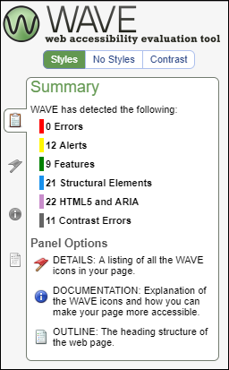
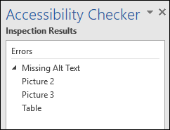
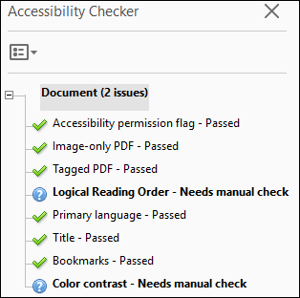
Scan Your Pages and Documents
Webpages:
WAVE (https://wave.webaim.org/extension)
  Office Documents:
  Use built-in Accessibility Checker
PDF Documents:
  Use Adobe Acrobat Pro scanning tool

Slide 8
Tag Your Documents
What are Tags and when do I need them?
Tags allow people to navigate a document in a similar way visual users navigate
Apply Tags to make your document is accessible to screen readers
  Documents without Tags have:
  No clear navigation
  No understanding of pictures or links
  No organization for screen readers
  Documents with Tags:
  Are easy to navigate
  Have descriptions for pictures and links
  Have an organized layout

Slide 9
Tags (Continued)
Types of Tags
  • Heading Tags
  • Image Alt. Tags
  • Table Alt. Tags
  • Table Heading Tags
  Other Considerations
  • Color
  • Lists
  • Metadata

Slide 10

Can you tell the difference between these two documents?
To those who use their eyes to read documents: there is no difference
To a screen reader: One document is organized, one is not. One document is searchable, one is not!

Slide 11
Creating Accessible Documents from Scratch
Microsoft Office (Word, PowerPoint, etc.)
  Links
  Images
  Styles & Structure
  Tables
Used with permission from the High-Tech Center Training Unit (www.htctu.net)

Slide 12
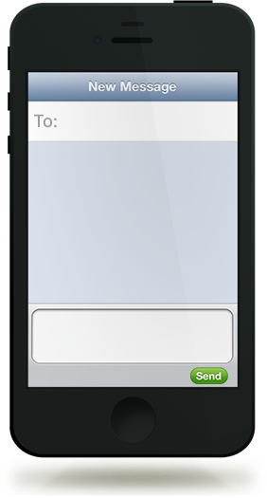
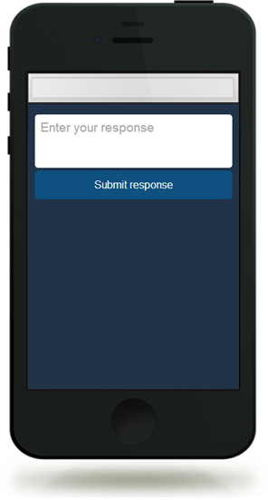
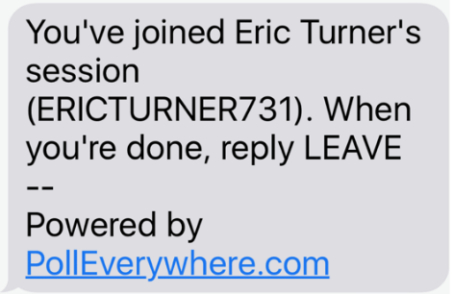
Ready for another Quiz?
  Text ericturner731 to 37607
Use a text message
From any browser
Pollev.com/ericturner731
37607
  Or
ericturner731
  Vote at http://pollev.com/ericturner731

Slide 13

Links: The Khora Art Exhibit Question
The Art Gallery wants to add a link to their webpage for their new exhibition. What is the best link description?
  You are cordially invited to experience Khôra. For more information, click here.
  You are cordially invited to experience Khôra. For more information, click here.
  You are cordially invited to experience Khôra.
  You are cordially invited to experience Khôra, the Art Gallery’s latest exhibition.
  Text (A, B, C, or D) to 37607

Slide 14
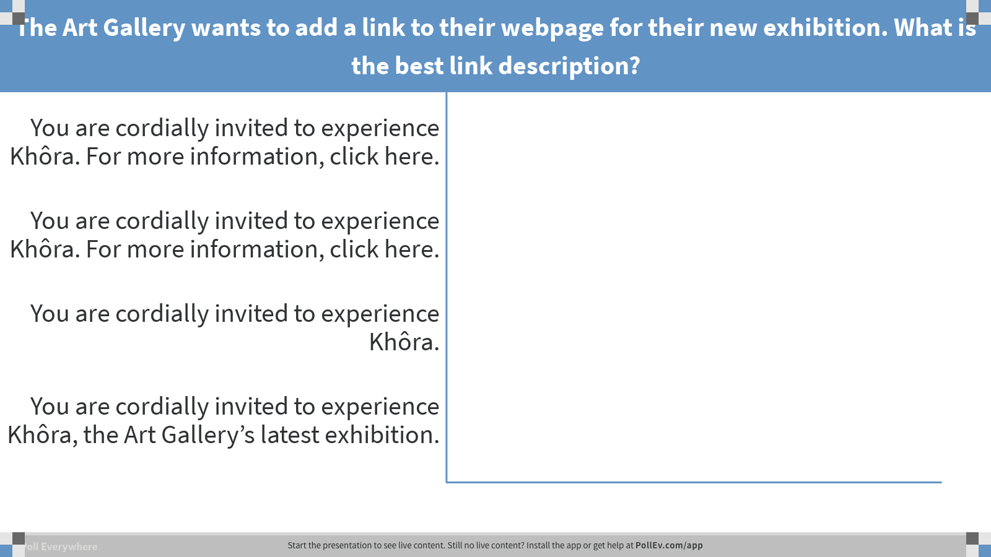
Notes:
Poll Title: The Art Gallery wants to add a link to their webpage for their new exhibition. What is the best link description?
https://www.polleverywhere.com/multiple_choice_polls/Wjk8YhNwBwgOCfZ

Slide 15

Images: Which is the best alternative text for this image?
  Text (A, B, C, D, or E) to 37607
    “Image”
    “Two girls and a boy leaning over”
    “Three smiling students”
    “Image of three smiling students”
    “Girl with blue shirt and shell necklace, next to girl with black shirt and hoop earrings, boy with plaid shirt in second row.”

Slide 16
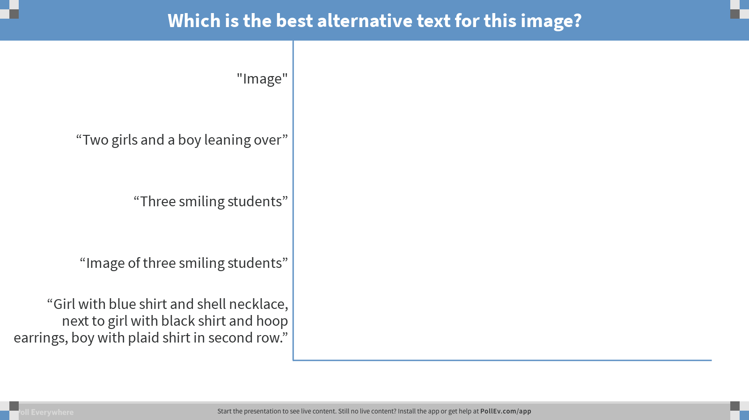
Notes:
Poll Title: Which is the best alternative text for this image?
https://www.polleverywhere.com/multiple_choice_polls/7wkfF8UT0ZpUd2l

Slide 17
Would your answer change if I told you this was for the Fashion Design page?
    “Image”
    “Two girls and a boy leaning over”
    “Three smiling students”
    “Image of three smiling students”
    “Girl with blue shirt and shell necklace, next to girl with black shirt and hoop earrings, boy with plaid shirt in second row.”

Slide 18
Styles: Check Headings
In Word, Heading Tags are called “Heading Styles”
Make sure headings and sub-headings are in logical sequential order
Is this order correct?
H1
H2
H3
H4
H2
H3
H4
H2
H3
H4
H1
H3
H3
H4
H2
H3
H4
H2
H3
H4
H1
H2
H3
H4
H2
H3
H4
H2
H3
H4
< H2 is Missing!

Slide 19
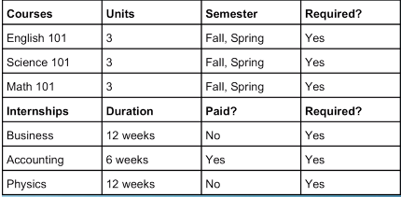

Tables
Is this table Okay?

Slide 20
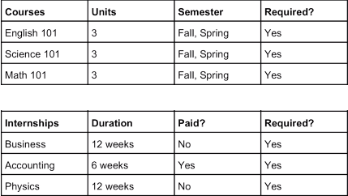


Tables
Is this table Okay?
Keep Each Table to one page if possible
Do not use tables for formatting only
Do not use nested tables or columns

Slide 21
Other Considerations: Color
  Colors should not be used to communicate information
  If you were to use red text to communicate bad information and green text to communicate good information
      Those who use screen readers would not get that information
      Those who are color blind would not get that information
  Use bold or italics to communicate information
  If you use color, it must be high contrast (i.e., dark text on light background or vice-versa)
  Color Test (http://www.mtsac.edu/accessibility/colortest)

Slide 22
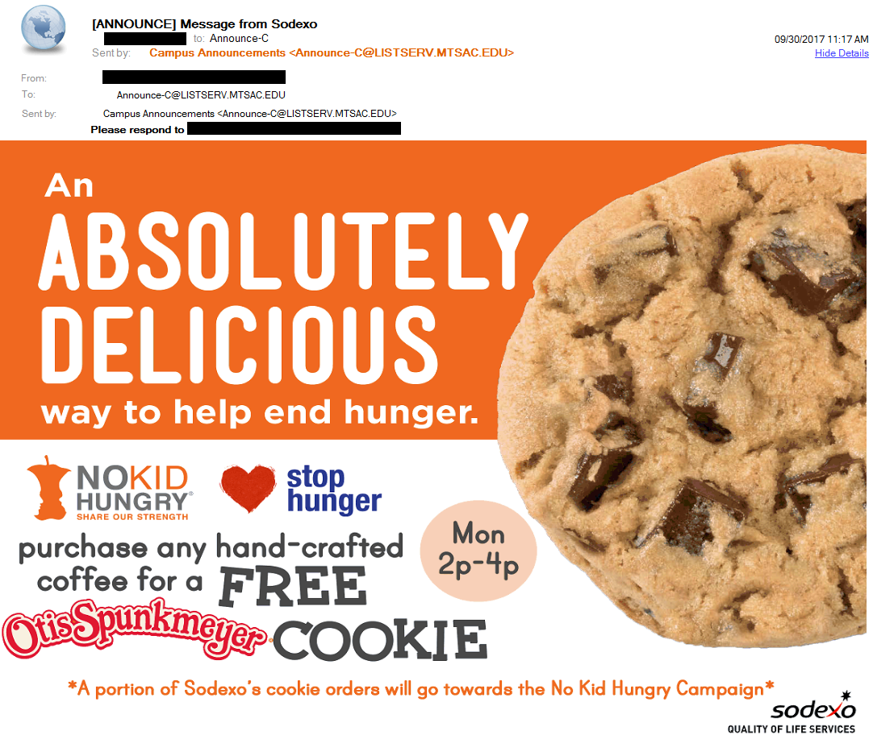
Is this a good email?
Yes
No
Maybe
  Text (A, B, or C)
  to 37607

Slide 23
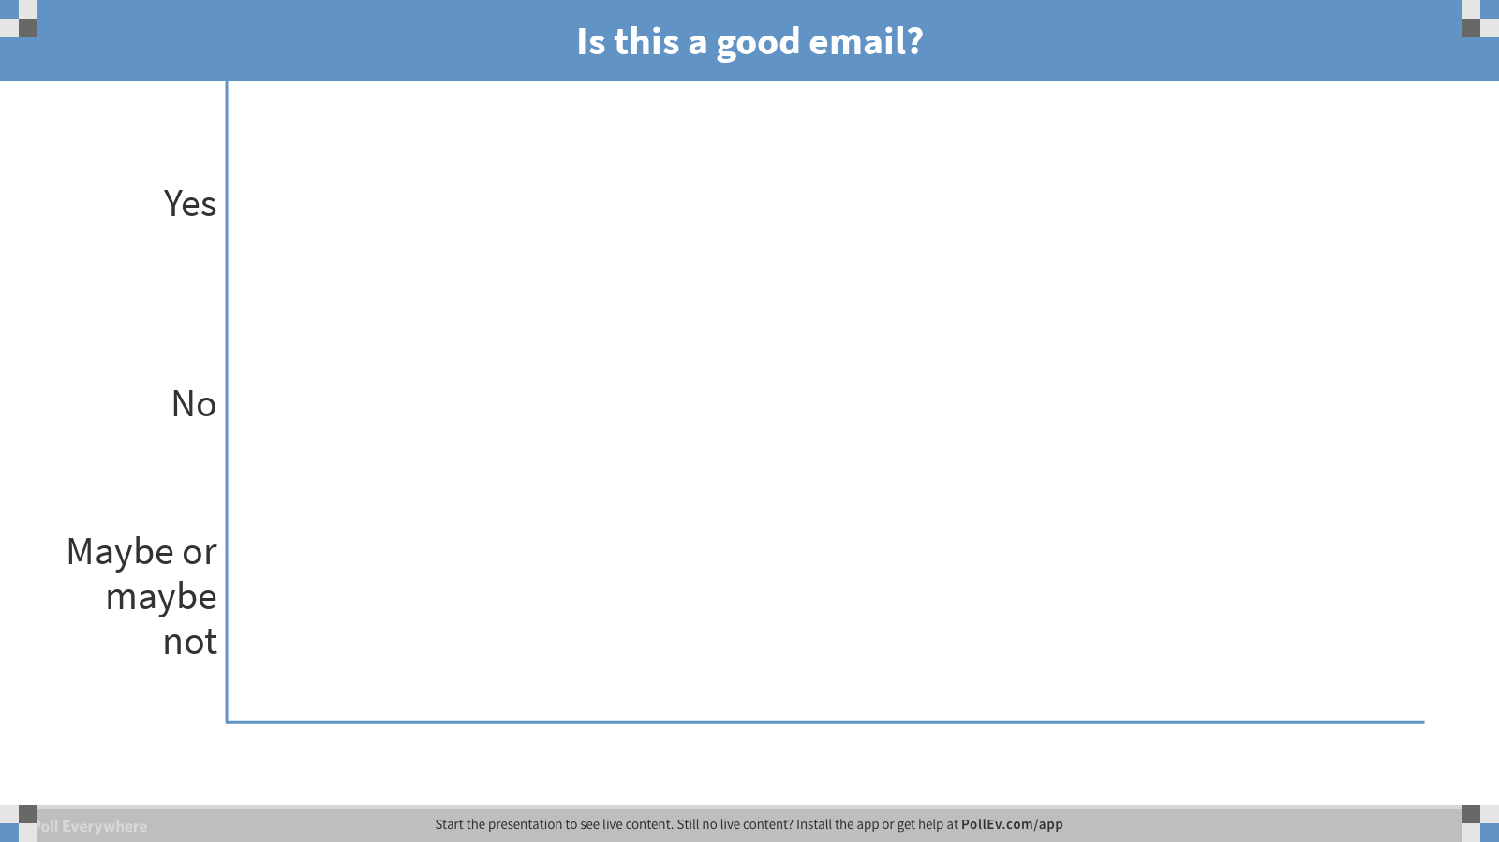
Notes:
Poll Title: Is this a good email?
https://www.polleverywhere.com/multiple_choice_polls/tTx9C9FgKWYGKD9

Slide 24
My Email is Required to be Accessible if
  Text (A, B, C, D, or E) to 37607
  I am sending to all employees
  I am only sending to a small group, all of whom I know
  I am only sending to one other person
  My email contains a survey
  My email contains educational or training material

Slide 25
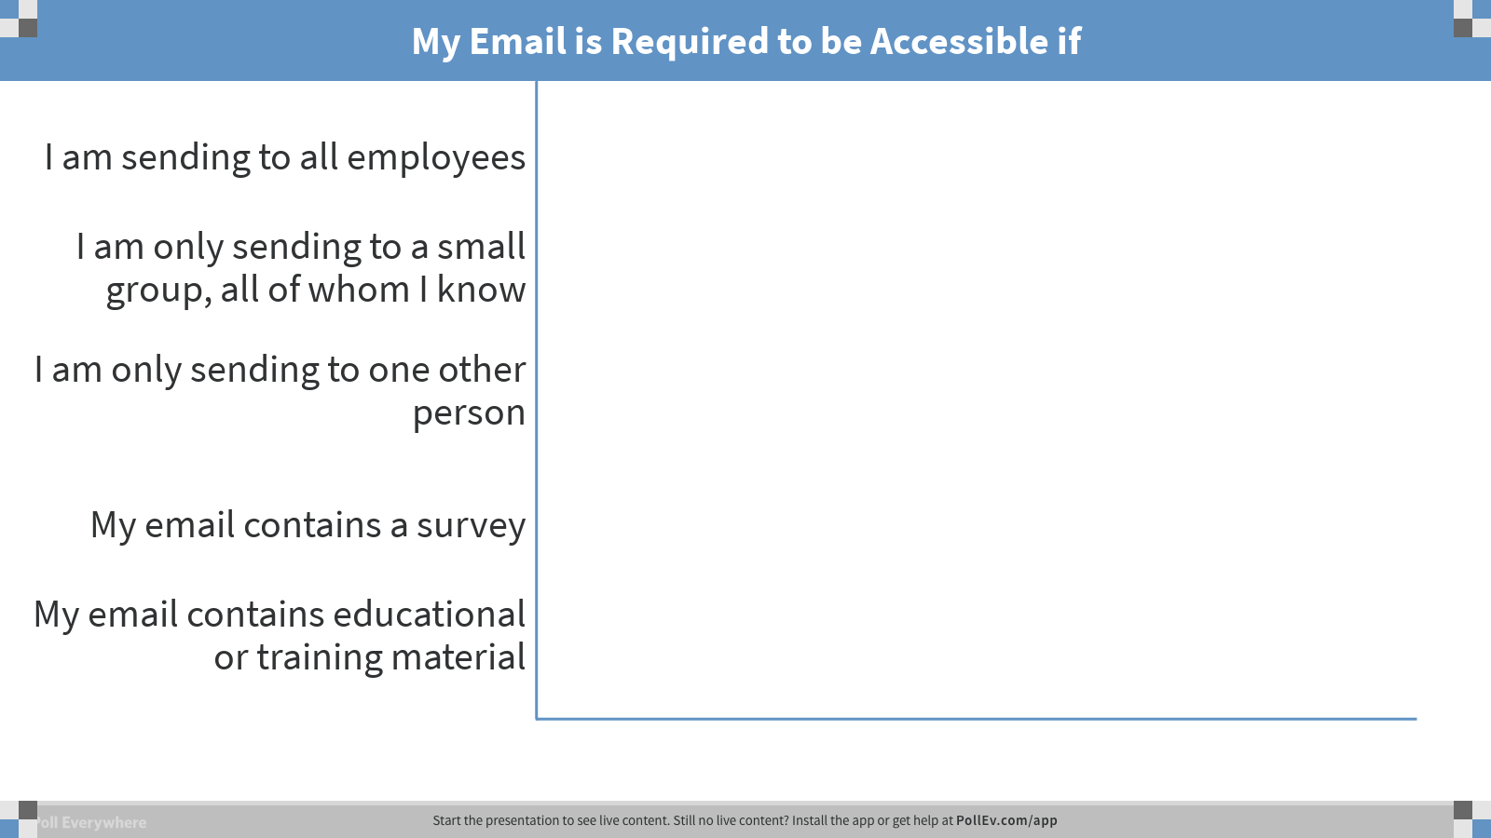
Notes:
Poll Title: My Email is Required to be Accessible if
https://www.polleverywhere.com/multiple_choice_polls/WWHI21ygMtnOTIn

Slide 26
Resources
Need help making an accessible document?
  Check the Accessibility webpage for instructions and FAQ: www.mtsac.edu/accessibility
  Send a document to us for conversion: www.mtsac.edu/pdfrequest
Other Resources:
Color Oracle (http://colororacle.org/)
WAVE (https://wave.webaim.org/extension)
Email (http://www.mtsac.edu/accessibility/announce-c.html)
Word Exercise (http://www.mtsac.edu/accessibility/wordexercise.html)

