Slide 1
Website
New Features
presented to
Mt. SAC Website End User’s Group
presented by
Uyen Mai, Marketing and Communication
Eric Turner, Web and Portal Services
March 18, 2016
Notes:
Eric welcomes

Slide 2
Agenda
Website State of the Union
Tips for Working in OmniUpdate
New Features Overview
  Sitecues
  Google Translate
  Search
Helping People Find Your Page
  Search relies on Page Title, Keywords, and Description
  Check for Broken Links, Spelling, ADA Accessibility and Readability
Web Design Site (www.mtsac.edu/webdesign)
  Snippets, News Feeds, Calendars
New Modules: 3-D Map, Online Catalog
Phase II

Slide 3

State of the Union
What do you think of the new website?
How can we improve the website?
What resources or assistance do you need?

Slide 4

Who Is Your Audience?
Prospective Students
Current Students
Faculty
Staff
Alumni
Community

Slide 5

What is your website saying in Beijing?

Slide 6


Give Your Audience What They Need
Give Viewers What They Expect to Find

Slide 7
Give Your Audience What They Need
Give Viewers What They Expect to Find
  Don’t Make Me Think
Engage Your Viewers

Slide 8
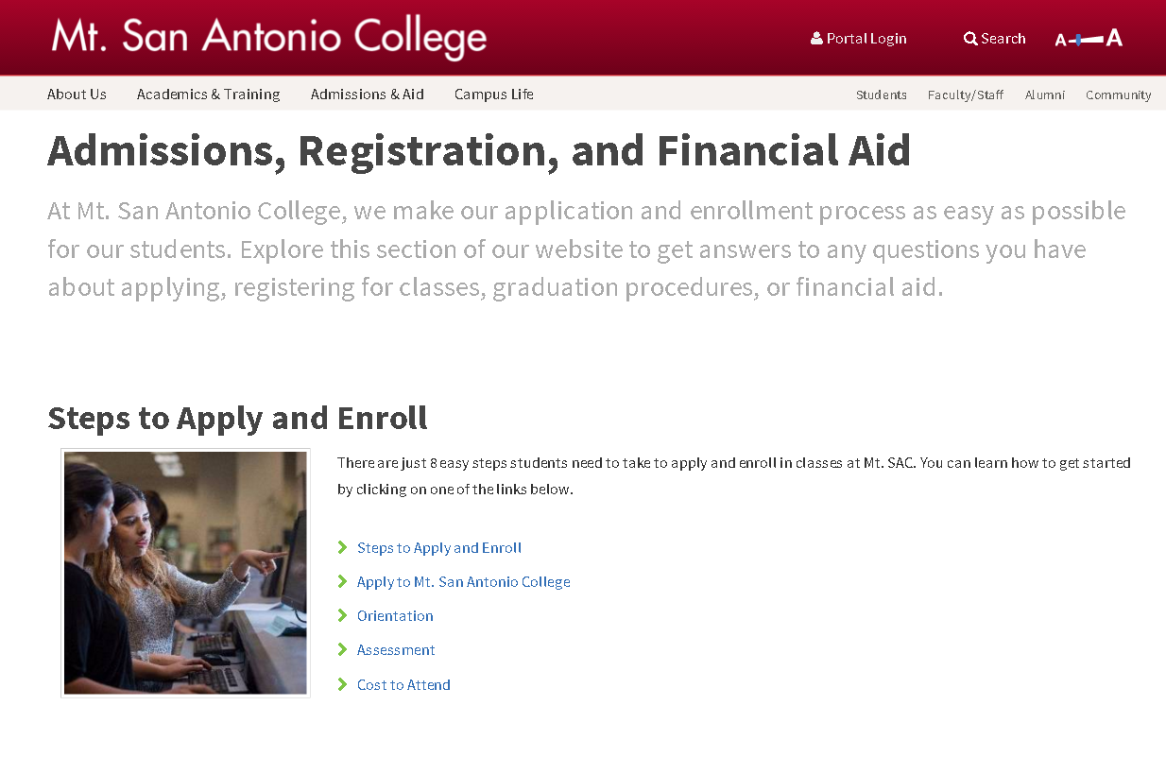
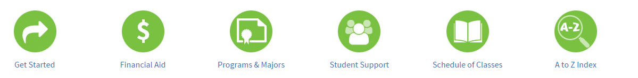
Engage Your Audience
Encourage Viewers to Explore

Slide 9
Give Your Audience What They Need
Give Viewers What They Expect to Find
  Don’t Make Me Think
Engage Your Viewers
  Encourage Viewers to Explore
Your Audience is Expecting More

Slide 10

Viewers are comparing us to the best websites in the world
Showcase Mt. SAC’s Uniqueness
Deliver the Right Content (Updated and Accurate)
Does your webpage reflect the quality of our institution?
    Prospective students think the quality of the website reflects the quality of the education they will receive if they come here

Slide 11
Write It for the Web
Academic Writing vs. Web Writing

Slide 12
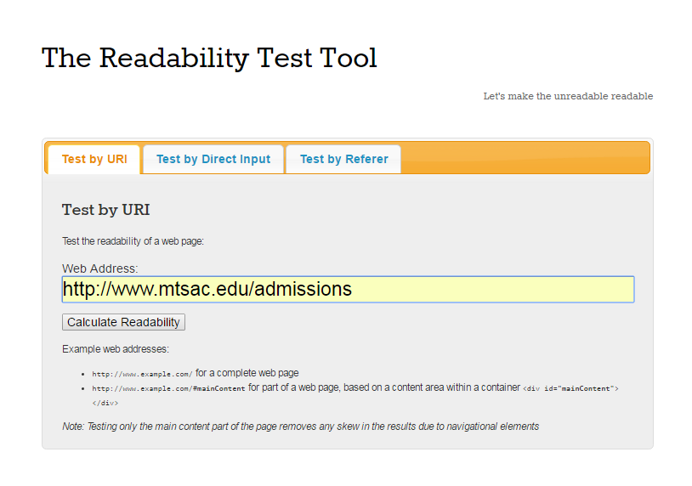
Are You Smarter Than a Fifth Grader?
www.read-able.com

Slide 13
Write It for the Web
Academic Writing vs. Web Writing
People Scan; The Don’t Read

Slide 14
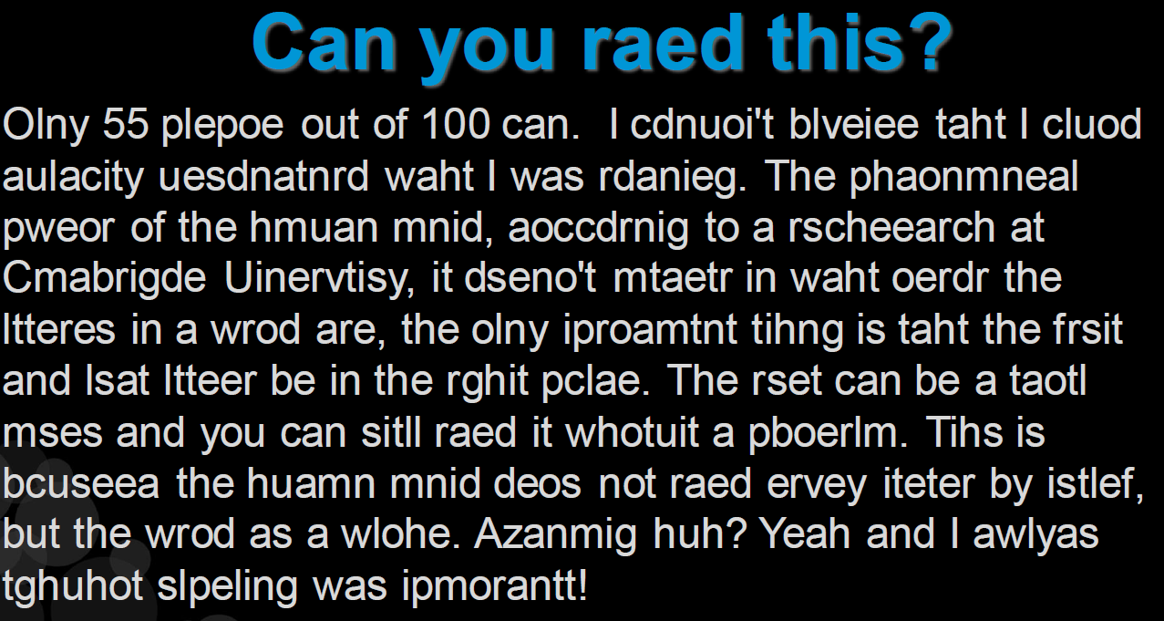

Slide 15

Write It for the Web
Academic Writing vs. Web Writing
People Scan; They Don’t Read
Less Is More: Cut, Cut, Cut Some More, Cut Until You Cry

Slide 16

Write It for the Web
Academic Writing vs. Web Writing
People Scan; The Don’t Read
Less Is More: Cut, Cut, Cut Some More, Cut Until You Cry
Information Signposts
  Landing Pages
  Pictures
  Icons
  Buttons
  etc.

Slide 17
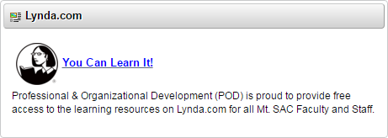
Lynda.com
Writing for the Web is available to you through the portal via Lynda.com (see www.lynda.com/Web-Content-Strategy-tutorials/Writing-Web/180104-2.html)
Here is a sample:
  People Scan: http://www.lynda.com/Web-Content-Strategy-tutorials/People-scan-dont-read/180104/362238-4.html (3 Min)
  Signposts: http://www.lynda.com/Web-Content-Strategy-tutorials/Create-information-rich-signposts/180104/362247-4.html

Slide 18
Best Practices
Help People Find Your Page
  Search relies on:
    Page Title
    Keywords
    Description
Keep your Pages Updated and Accurate
  Check for:
    Broken Links
    Spelling
    ADA Accessibility
    Readability

Slide 19
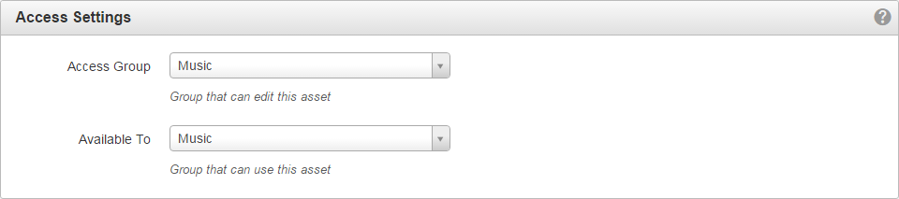
Best Practices (Continued)
Images
  Choose Images with people looking at you (i.e., with minimal
  side views)
  Choose Images that do not contain the back of people’s heads
Assets
  Set Access Settings Appropriately

Slide 20
Naming Conventions
Example (Format Department/Program – Page Name):
  Aeronautics – Certificates
  Marketing – Contact Us

Slide 21

New Feature Set: Let’s Look at It…

Slide 22
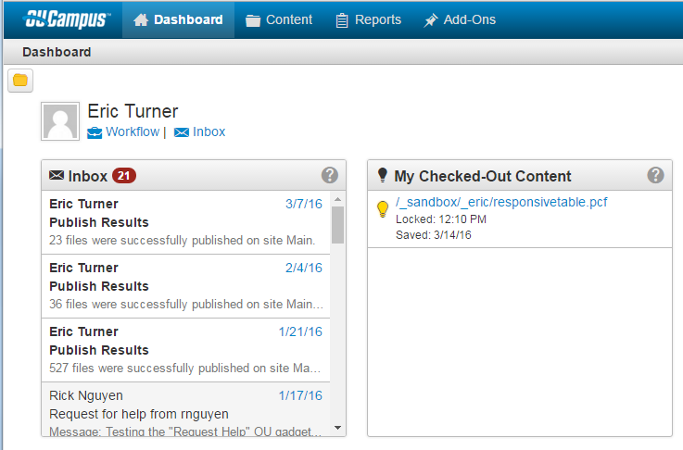
Tips
Notes:
My Checked out Content
Chrome Duplicate Tabs
Always Upload to Staging Not Production
Use Checkbox and Publish vs. Hover

Slide 23

What Does This Symbol Mean in OmniUpdate?
Bookmarks
Notes
URL Shortener
Images
Link Check

Slide 24
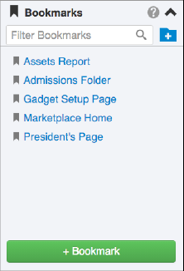

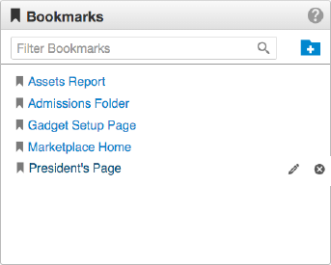
Bookmarks
Link to Pages
Organize in Folders
Search and Reorder Links

Slide 25
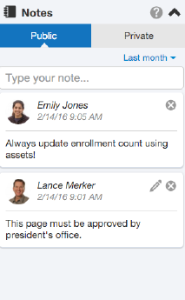
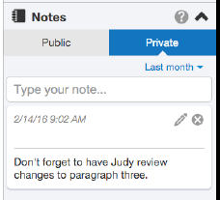
Notes
Add Public and Private Notes to Any File
Add Notes to Files and Assets
Filter Notes by Date Range
Edit and Delete Notes with Ease

Slide 26
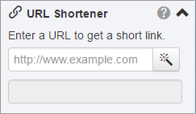
URL Shortner
Convert long URLs into shortened URLs
Cut and Paste or drag short link onto your page

Slide 27
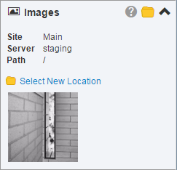
Images
Drag and Drop Previously Uploaded Images into the WYSIWYG Editor
Drag and Drop Images From the Images Gadget onto Your Local Computer

Slide 28
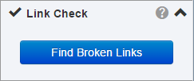

Link Check
A quick and easy way to check links on the current page
All broken links are automatically highlighted on the page
Repair them easily or send a report to someone who can

Slide 29
New Snippets
Responsive Tables
Multi-Column Layouts
Accordion
News Feeds
A to Z (Folder-Level)
www.mtsac.edu/webdesign

Slide 30
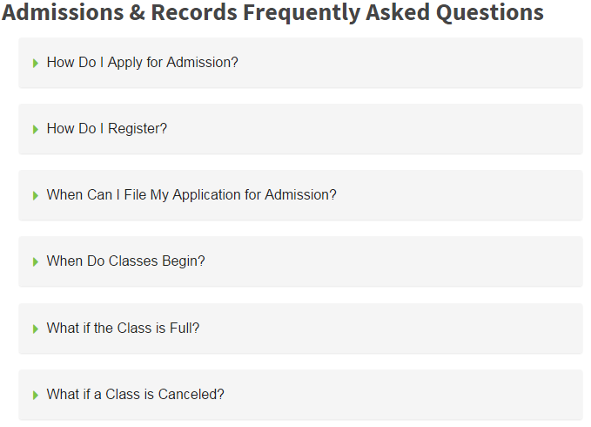
Accordion

Slide 31
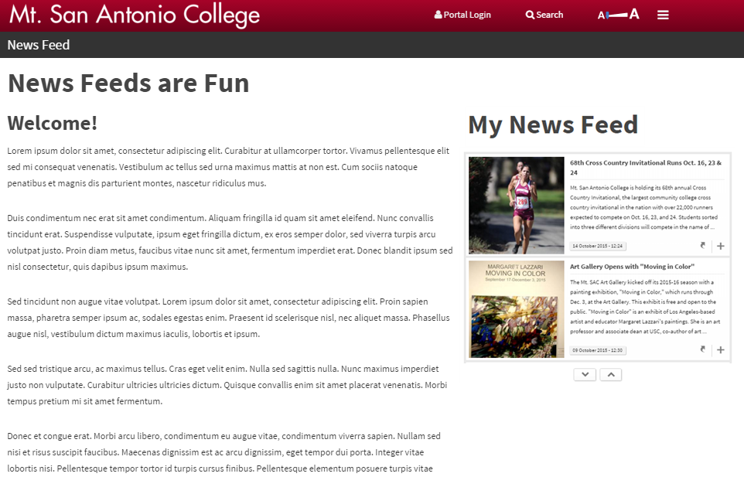
News Feeds (RSS)

Slide 32
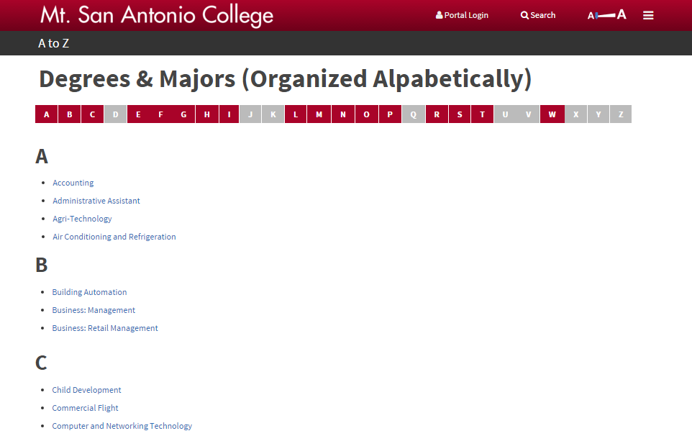
A to Z (Folder Level) List

Slide 33
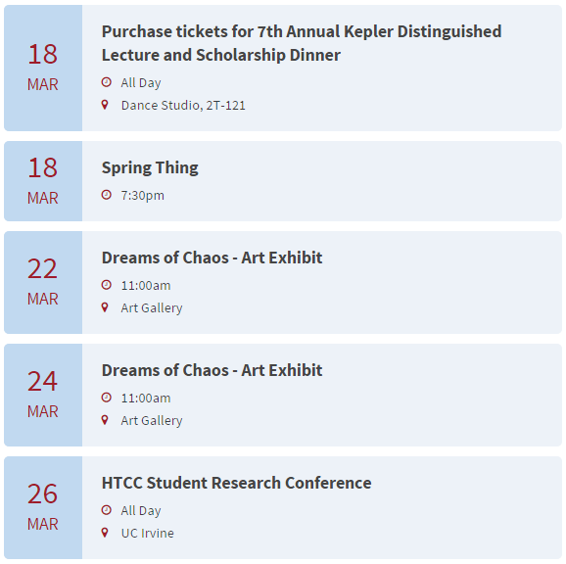
Master Calendar
Add a Department/Program Calendar to Your Website
Link Your Calendar to the Master Calendar
Request Your Event
Be Featured on the
Master Calendar
www.mtsac.edu/writingcenter

Slide 34
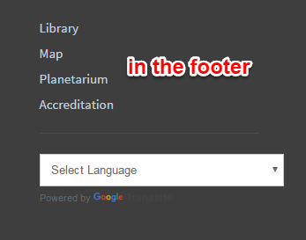
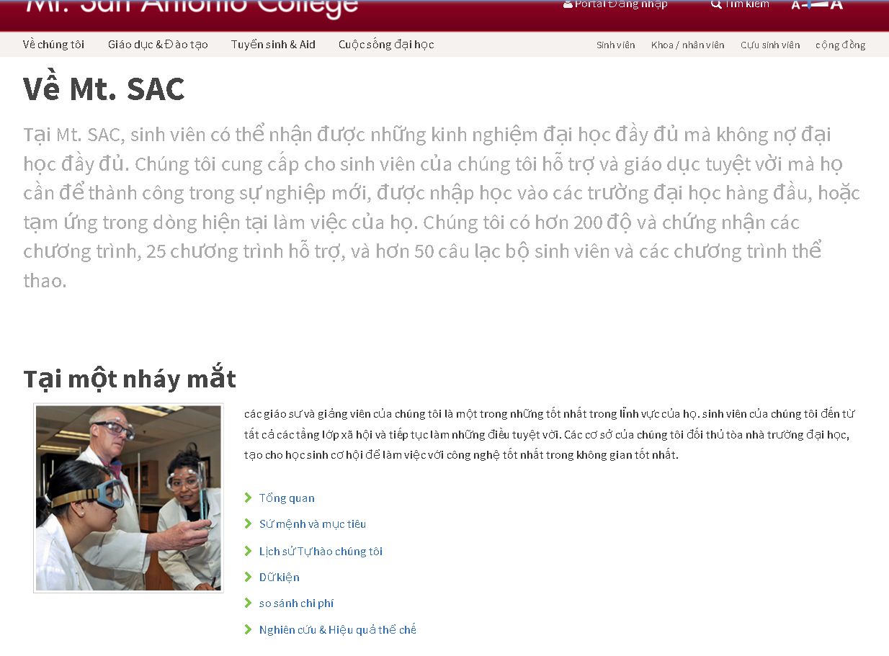
Google Translate
Notes:
At the footer of the website, we added Google Translate. It has dozens of languages and can help people navigate the campus in another language. Is it perfect? No. It’s automated and that can cause challenges, however, it’s better than giving non-native speakers zero alternatives. With our tight resources, manually translating our site in Spanish and Mandarin is unrealistic.

Slide 35
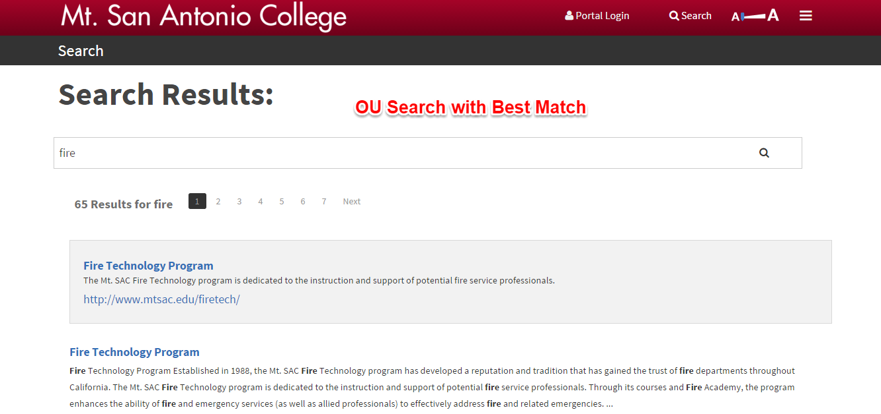
Search with Best Match
www.mtsac.edu/search/request
Notes:
The Search is being programmed. To be a Best Match, submit your request to Eric Turner.

Slide 36
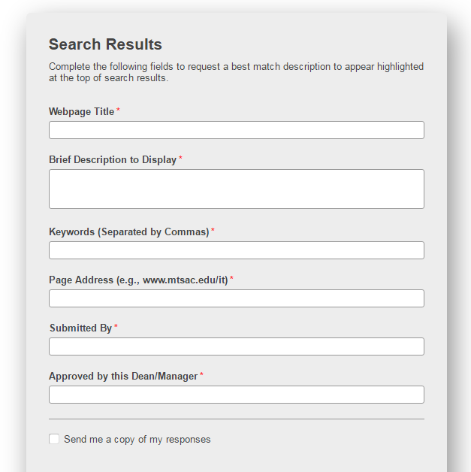
Request a Best Match for Your Page

Slide 37
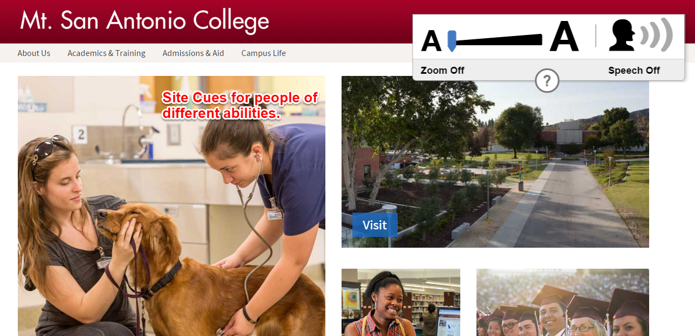
Sitecues for Accessibility
Zoom a page to desired level
Have the website read aloud by highlighting text and pressing the space bar
Notes:
Site Cues has been implemented and helps people of different abilities by zooming into text and also reading text.

Slide 38
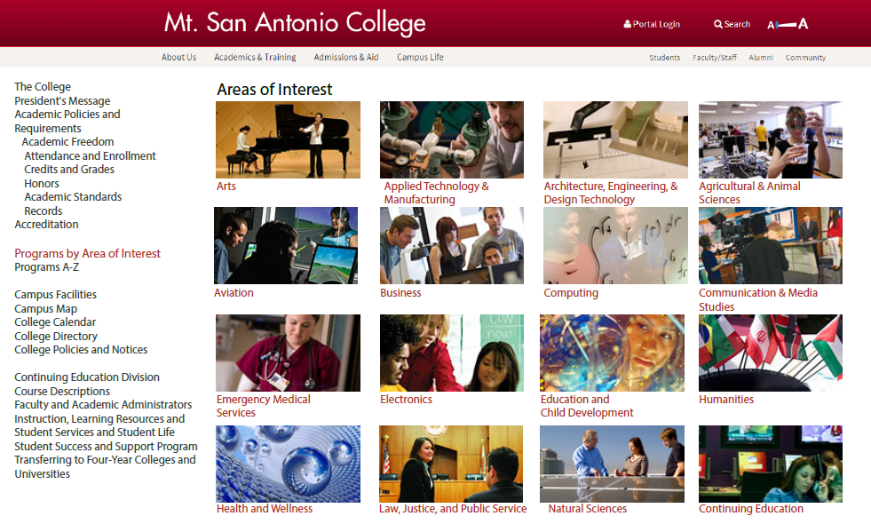
Online Campus Catalog (Coming Summer 2016)

Slide 39
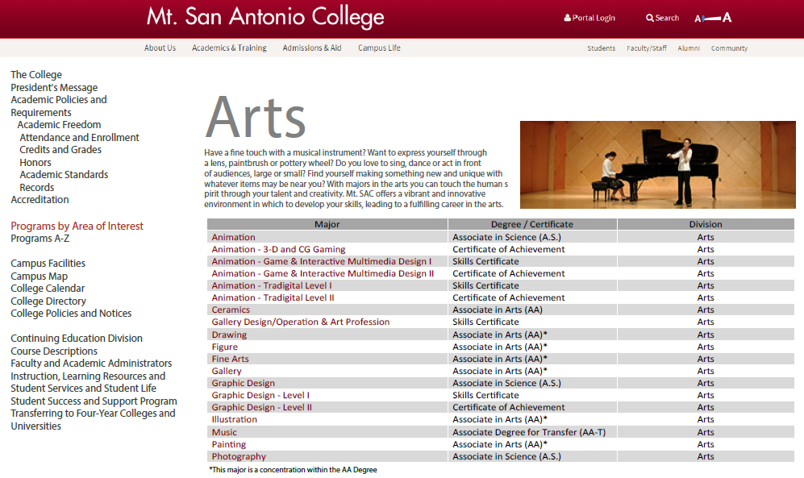
Online Campus Catalog (Continued)

Slide 40
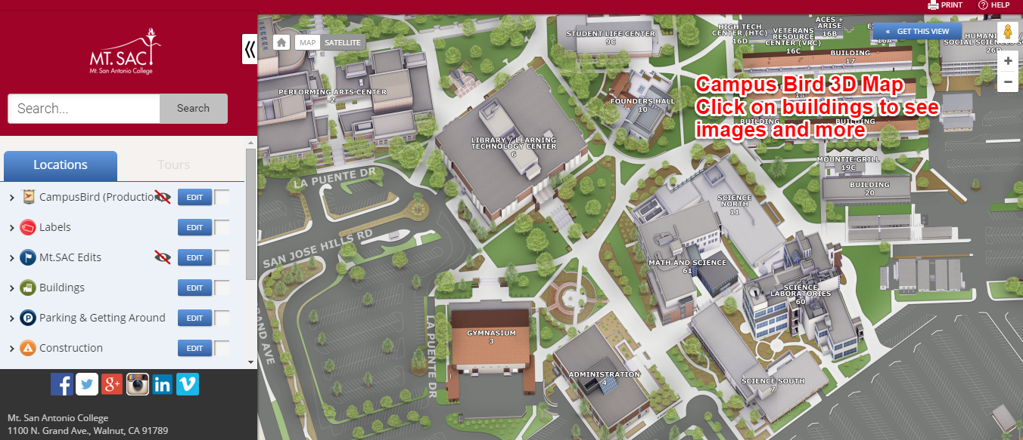
3-D Campus Map
Sneak Preview
Notes:
Coming this spring is a modernized campus map with 3D rendering. If you click on a main building, you’ll see a description and photos and sometimes a website.

Slide 41
What’s next?
Plan for Phase II

Slide 42
Phase II – We do it all again
Step 1
Step 2
YIELDS: Strategy, sitemap, scale
Step 3
Research
YIELDS: Data and context for understanding
Strategy
Design
Step 4
Development
YIELDS: Transfer to web environment, new content
Step 5
Asset Management
YIELDS: Implementation and long-term plan
Preliminary
Pre-planning
YIELDS: Identify goals, process
YIELDS: Establishes look/feel, architecture
Notes:
Phase 2 will likely focus on the Department Level pages. Results of research will also inform what the web team needs to prioritize. However, we remind the campus that the SCOPE of the project will be limited by staffing, resources, timeline. We wish we could do everything at once, but with a 3-member core team and staff that has been stretched thin, it’s not realistic.

Slide 43
What’s next?
Plan for Phase II
Recruit for Phase II Advisory Board
Survey of faculty, staff, students
User group meetings launching for advanced features
Web writer to continue with search engine optimization
Add-On Modules need to be fully implemented
  Directory
  3D Map and Tour (Facilities)
  CourseLeaf Catalog (Instruction-led Initiative)

Slide 44
Hands-On Training
10:30 A.M. - Hands-on Practice with Pre-designed Web Features, Building 17-1
1 P.M. - Hands-on Practice with Pre-designed Web Features, Building 17-1
3 P.M. - Hands-on Practice with Pre-designed Web Features, Building 17-1

Slide 45
QUESTIONS?

