Slide 1
Web Accessibility
Quiz
Presented by Eric Turner, Web and Portal Services
November 2, 2017
Notes:
Eric welcomes

Slide 2

Which is the best alternative text for this image?
  “Image”
  “Two girls and a boy leaning over”
  “Three smiling students”
  “Image of three smiling students”
  “Girl with blue shirt and shell necklace, next to girl with black shirt and hoop earrings, boy with plaid shirt in second row.”
Would your answer change if I told you this was for the Fashion Design page? Yes

Slide 3

The Art Gallery wants to add a link to their webpage for their new exhibition. What is the best link description?
  You are cordially invited to experience Khôra. For more information, click here.
  You are cordially invited to experience Khôra. For more information, click here.
  You are cordially invited to experience Khôra.
  You are cordially invited to experience Khôra, the Art Gallery’s latest exhibition.

Slide 4

The Culinary Arts department wants to add a new Frequently Asked Questions page. What is the best page title?
  FAQ
  FAQs
  Frequently Asked Questions
  Culinary Arts Frequently Asked Questions
  Culinary Arts Frequently Asked Questions | Mt. SAC

Slide 5
Page Titles
Our Accessibility consultant says the best answer is:
  For Homepages (e.g., index.html or Department Pages)
Culinary Arts Frequently Asked Questions| Mt. SAC
    Note: the ‘|’ (pipe) can be replaced by - or :
    This separates the branding from the page title phrase
  For Lower-Level Pages (i.e., non-Homepages):
Culinary Arts Frequently Asked Questions
    Page titles should be descriptive and concise
    Keep it to 7-8 words and less than 64 characters
    Brand can be omitted for lower non-homepages

Slide 6
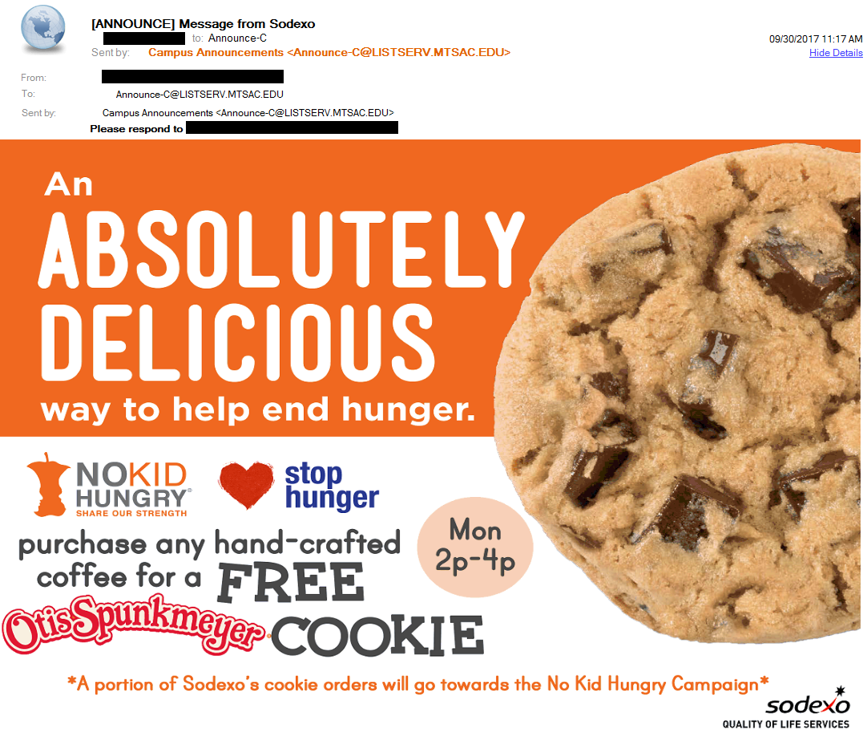
Is this a good email?
It is generally not a good idea to scan a flyer and send it via email
  Text should be text and not in graphic form
  Graphics must have meaningful alternative text
  Large images waste storage space and data plans

