Slide 1

Programs

Slide 2
Navigating

Slide 3
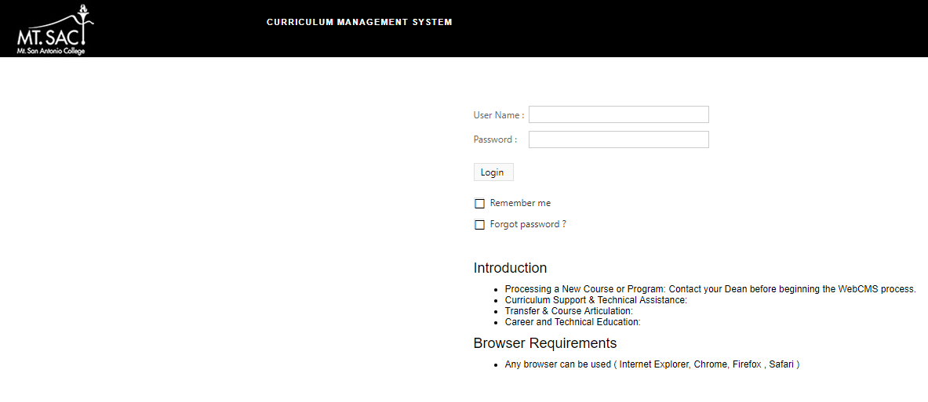
Access webCMS 10
WebCMS 10.0 Link or www.mtsac.edu/curriculum
Username: Mt. SAC Credentials
Password: test
Recommended Browser: Google Chrome

Slide 4
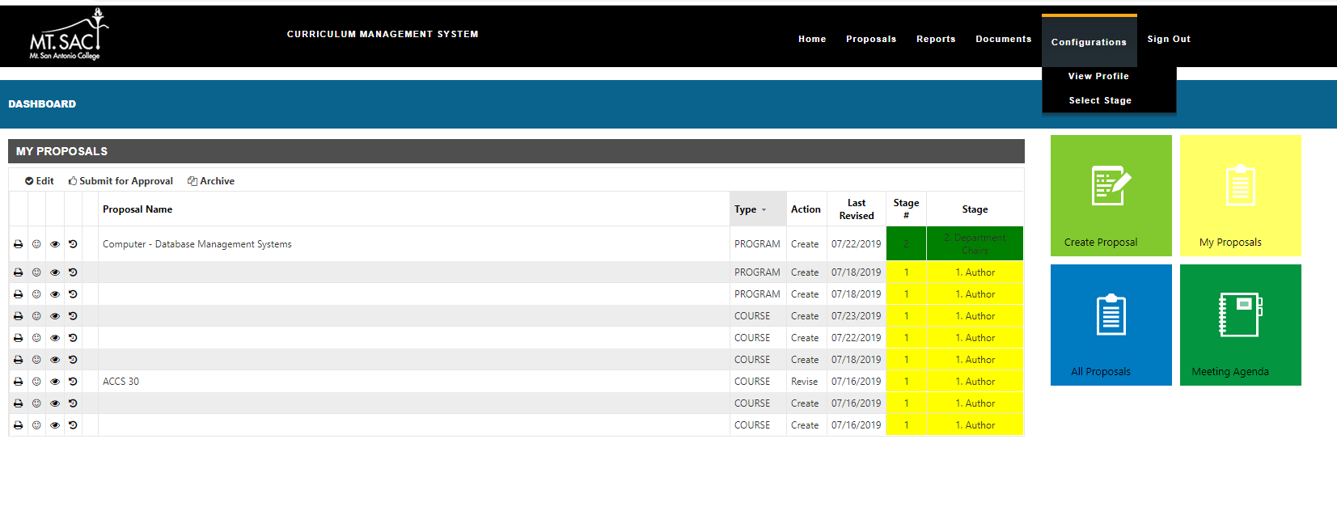
The Dashboard
Ribbon Menu
Dashboard will appear
My Proposals summary displays

Slide 5

The Dashboard
Can also be viewed by selecting My Proposals
Quick Links to make Edits, Submit for Approval and Archive.
All of your proposals will display with an indicator of the current stage.

Slide 6
The Dashboard
Create Proposal – Create a new program or course.
My Proposals – View your current program and course proposals.
All Proposals - View all current program and course proposals.
Meeting Agenda – View minutes/ documents.
1
2
3
4

Slide 7
Creating a Proposal

Slide 8
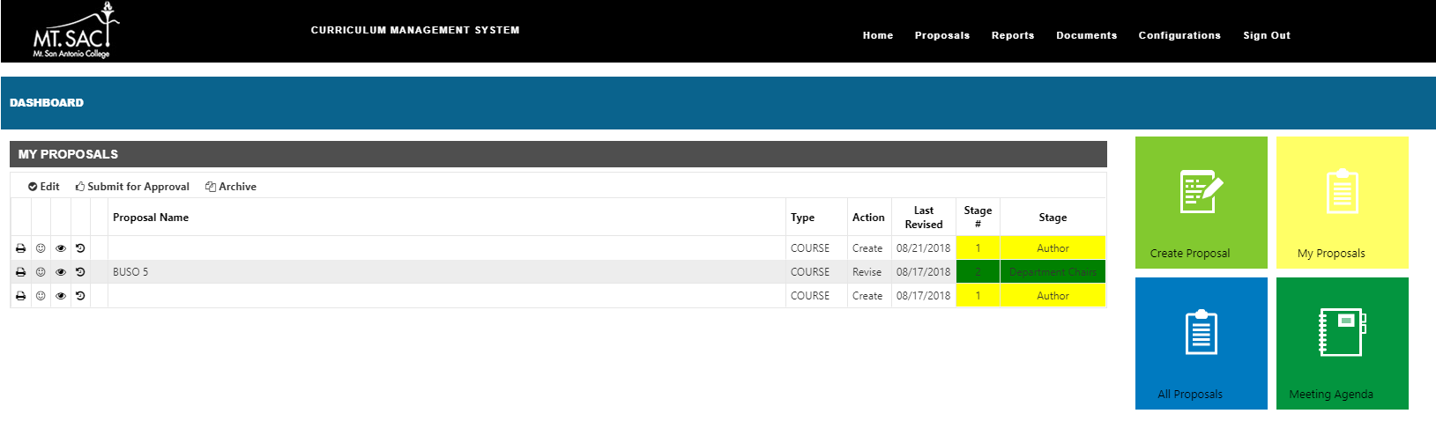
The Dashboard – 1. Create Proposal
1. Create Proposal – Create a new program or course
1

Slide 9
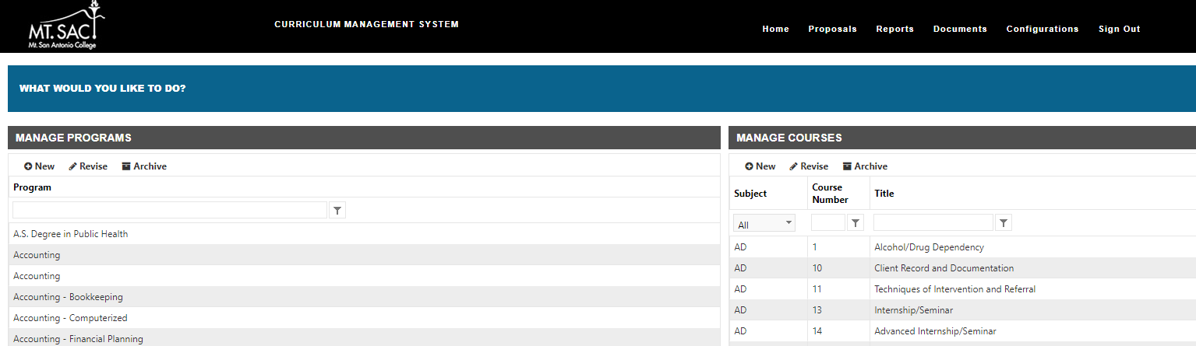
1. Create Proposal - Programs
Add New Program
Revise Program
Archive Program
Filter by Program Name

Slide 10
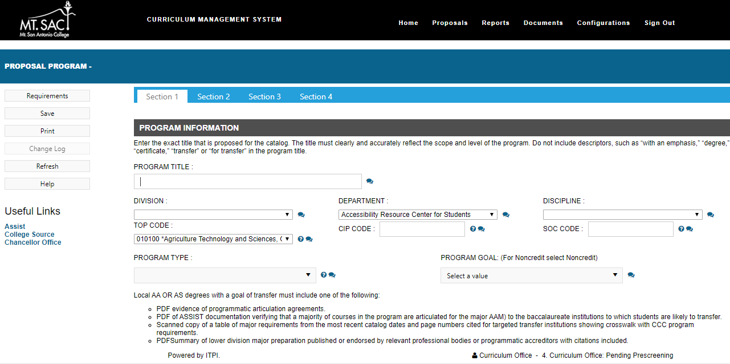
1. Create Proposal – Programs (Section 1)
*You will notice comment bubbles next to required fields. These bubbles will enable you view comments from Curriculum Office and will be highlighted when there is a comment available.
Enter detailed information for the new program proposal

Slide 11
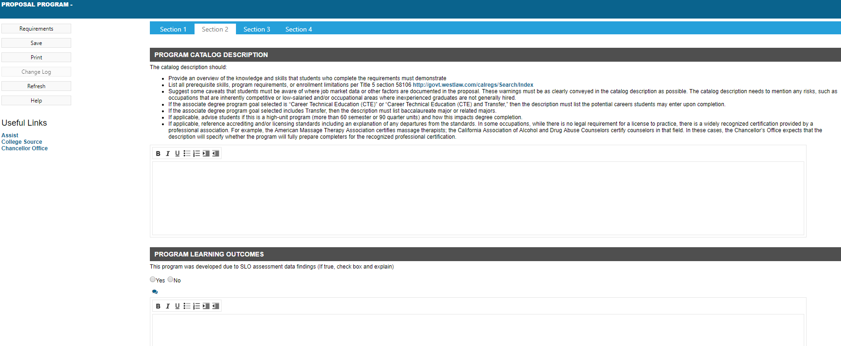
1. Create Proposal – Programs (Section 2)
Enter detailed information for the new program proposal

Slide 12
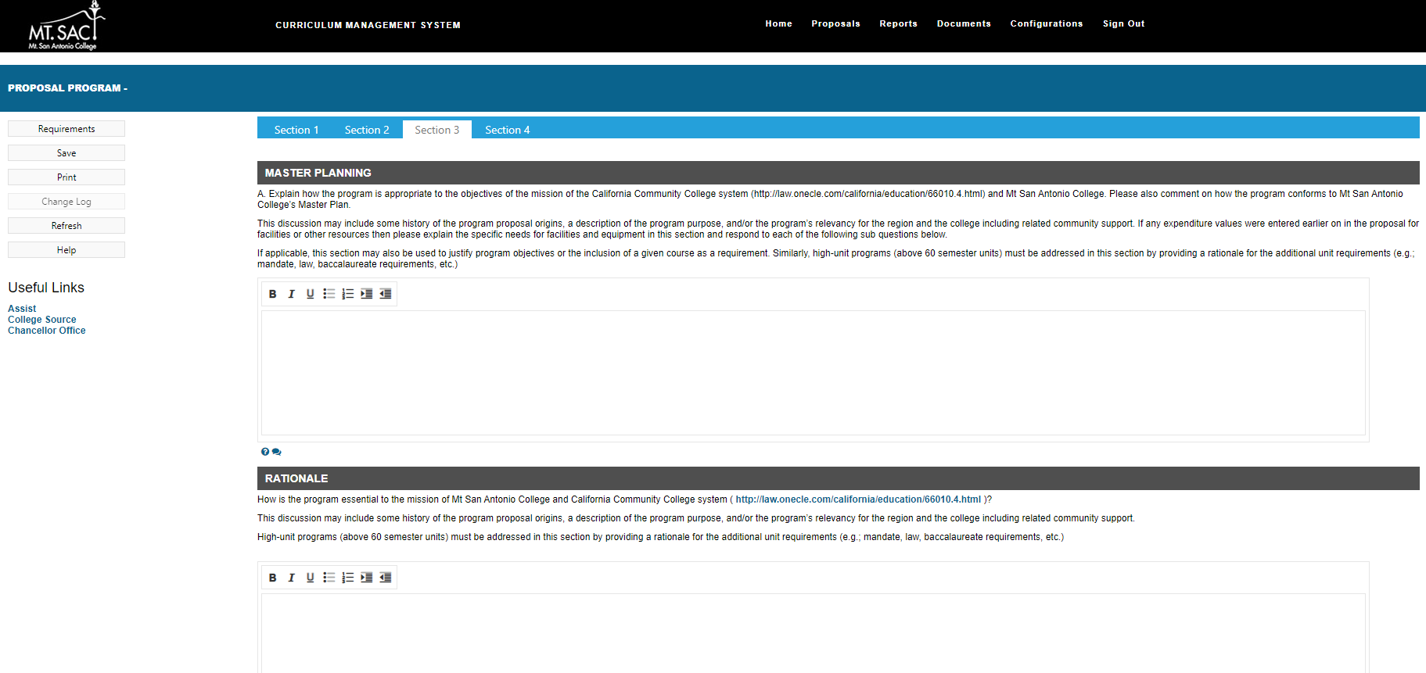
1. Create Proposal – Programs (Section 3)
Enter detailed information for the new program proposal

Slide 13
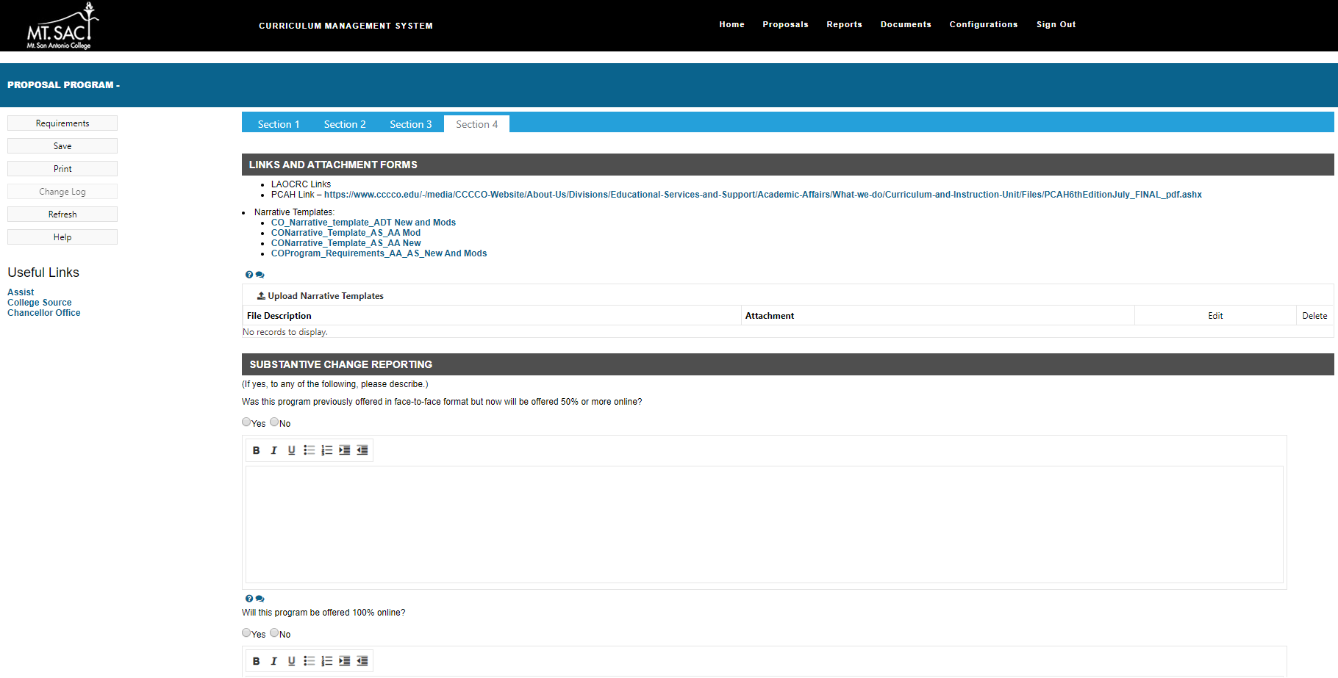
1. Create Proposal – Programs (Section 4)
Enter detailed information for the new program proposal

Slide 14
Adding Courses to your Program Proposal

Slide 15
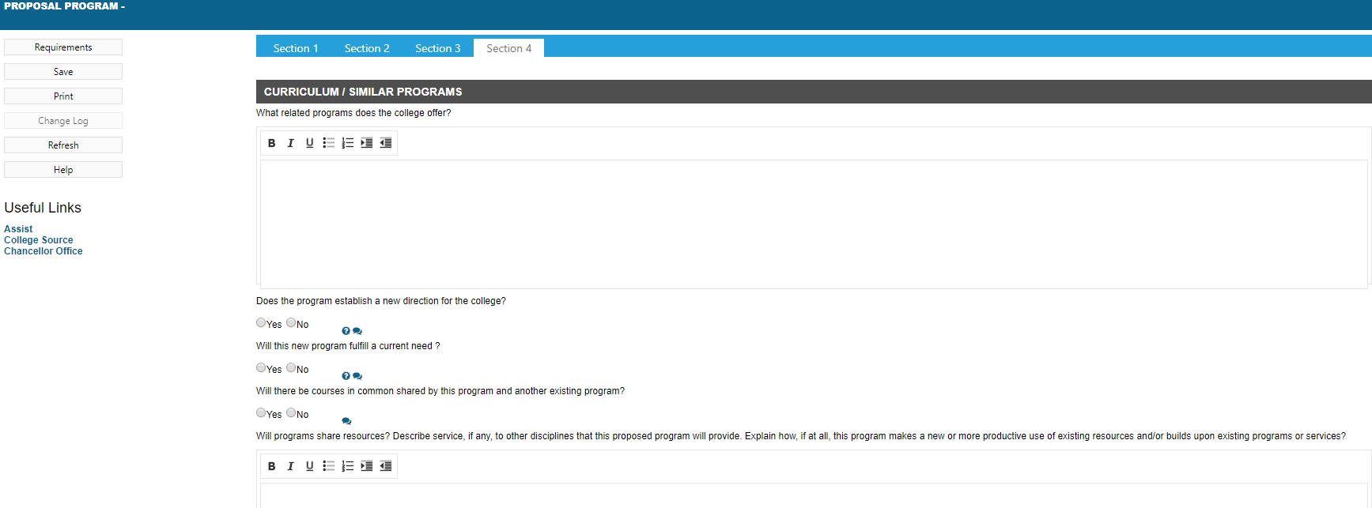
Adding Requirements - Programs
Select Requirements

Slide 16
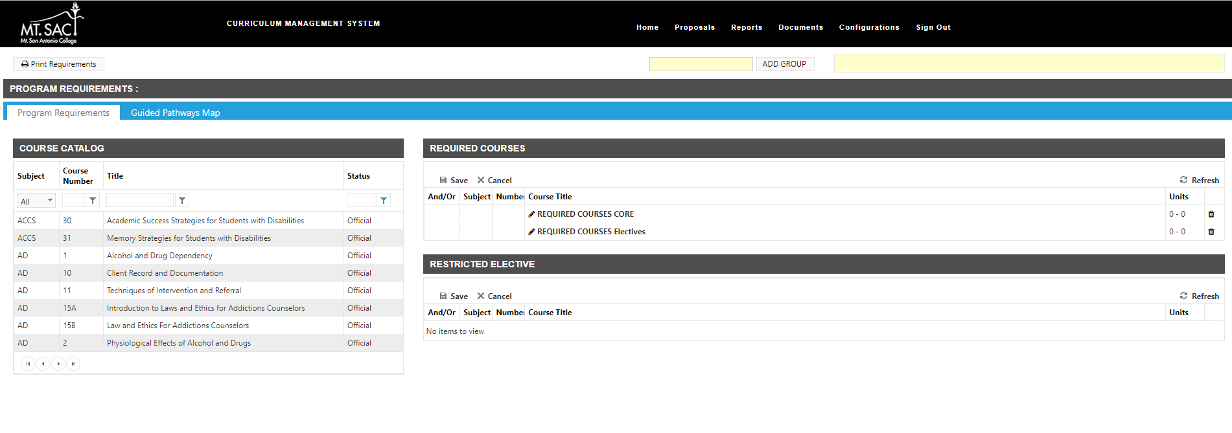
Adding Requirements - Programs
Able to apply filters for: Subject, Course number, title or Status
Able to apply filters for: Subject, Course number, title or Status
Course Catalog will display
Drag and Drop feature

Slide 17
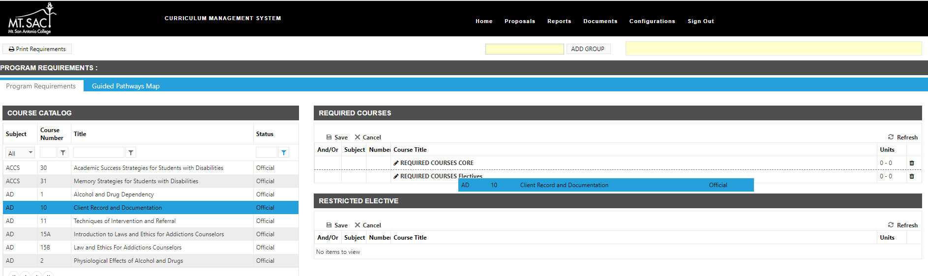
Adding Requirements - Programs
*Ensure you drag and drop all courses first into the builder and saving before adding any “&” / “Or”.
Select Course, then drag to the Required Courses Section and drop where applicable: CORE or Electives

Slide 18
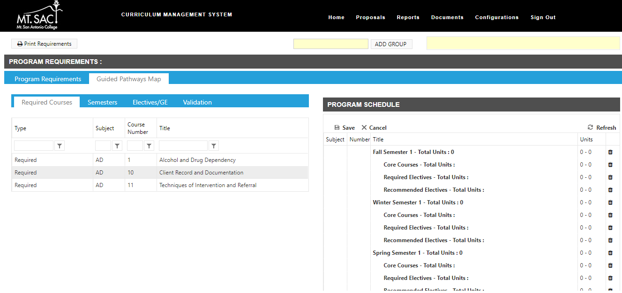
Adding Requirements - Programs
*Once courses have been added to Program Requirements, they are available for the Program Schedule via the Guided Pathways Map tab.
Select Course, then drag to the Program Schedule Section and drop where applicable by Semester, essentially building out a pathway map.

Slide 19
Navigating Programs continued…

Slide 20
The Dashboard – 2. My Proposals
2. My Proposals – View your current program and course proposals
2

Slide 21
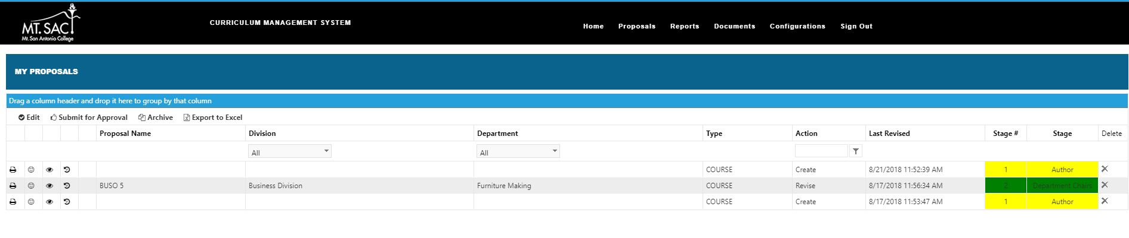
2. My Proposals
Full menu displays with detailed information for your proposals (both Programs & Courses)

Slide 22
2. My Proposals
Quick Links to make Edits, Submit for Approval, Archive and Export to Excel for only your proposals.

Slide 23
The Dashboard – 3. All Proposals
3. All Proposals - View all current program and course proposals.
3

Slide 24
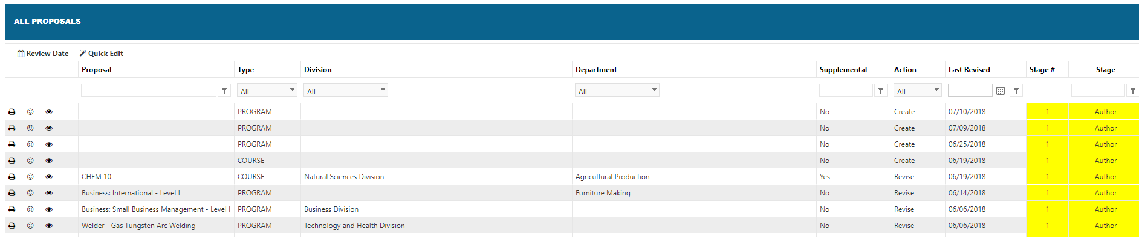
3. All Proposals
Full menu displays with detailed information for all Proposals (both Programs & Courses)
Filters can be applied.

