Slide 1
Creating Proposals – Credit Courses
WebCMS 10.0

Slide 2
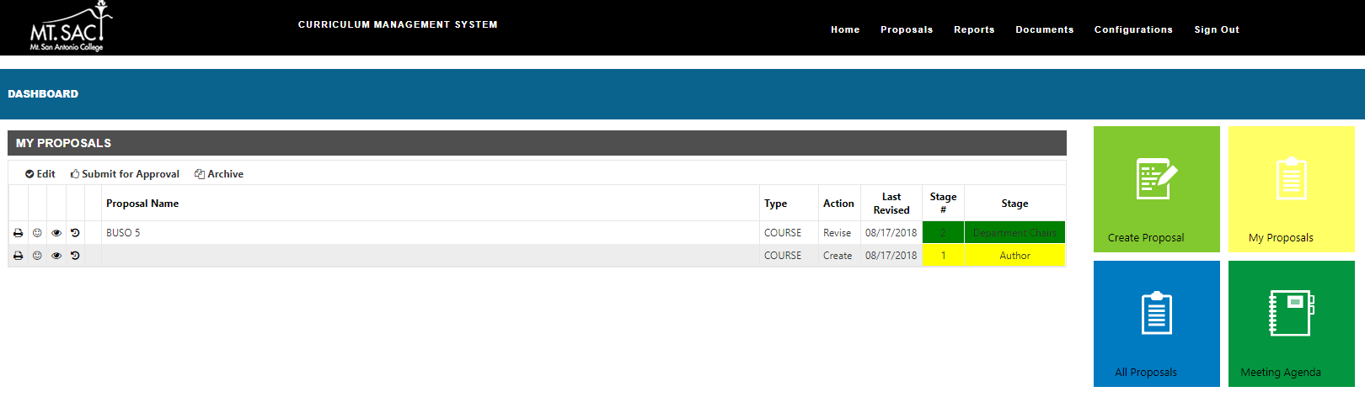
The Dashboard – 1. Create Proposal
1. Create Proposal – create a new program or course.
1

Slide 3
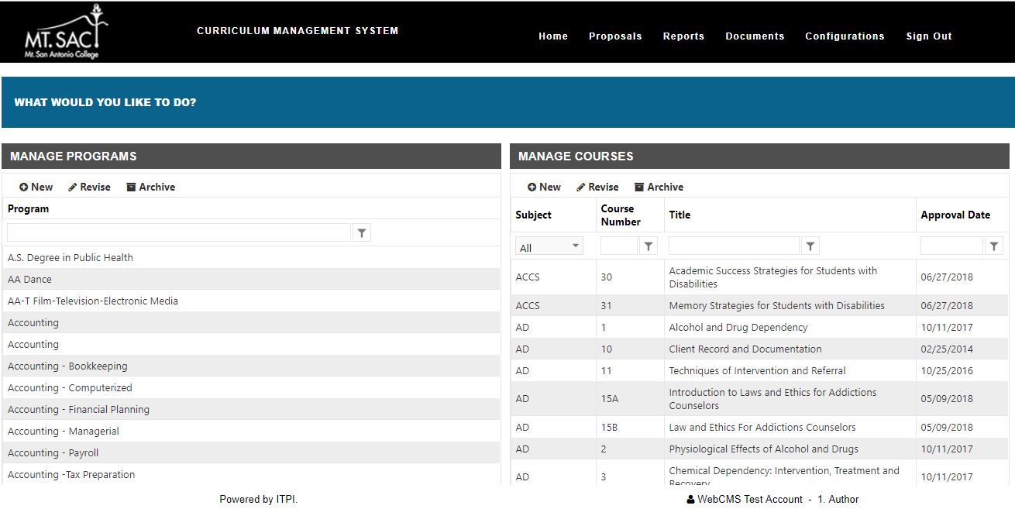
1. Creating a Proposal - Course
Add a new course.
Modify a course.
*Filter by course prefix, title, and number.

Slide 4
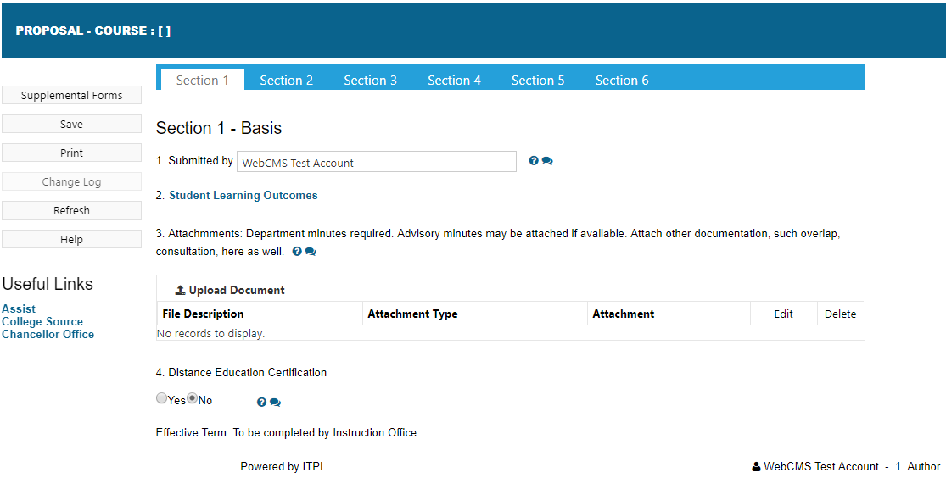
1. Create Proposal – Course (Section 1 - Basis)
*You will notice comment bubbles next to required fields. These bubbles will enable you view comments from Curriculum Office and will be highlighted when there is a comment available.
Enter detailed information for the new course proposal.

Slide 5
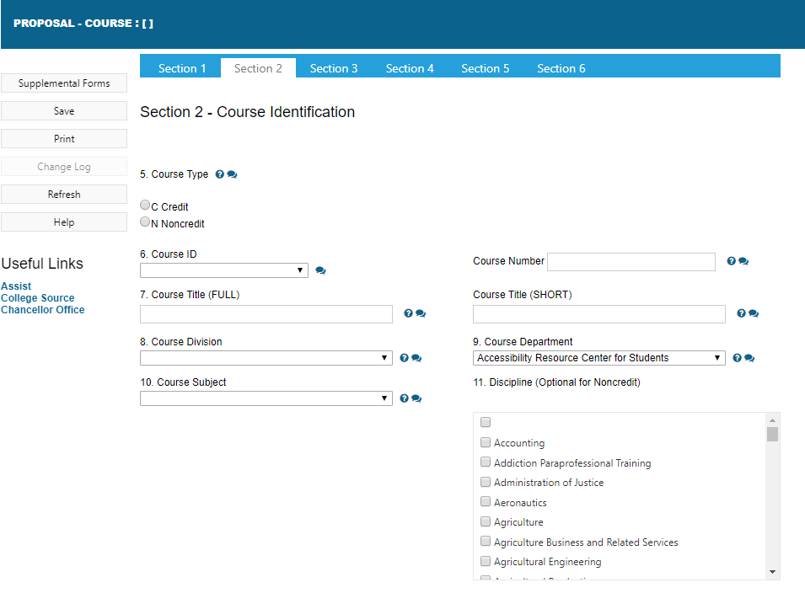
1. Create Proposal – Course (Section 2 – Course Identification)
*If credit is selected, only fields necessary for credit will appear.
Select Credit.
Enter detailed information for the new course proposal.

Slide 6
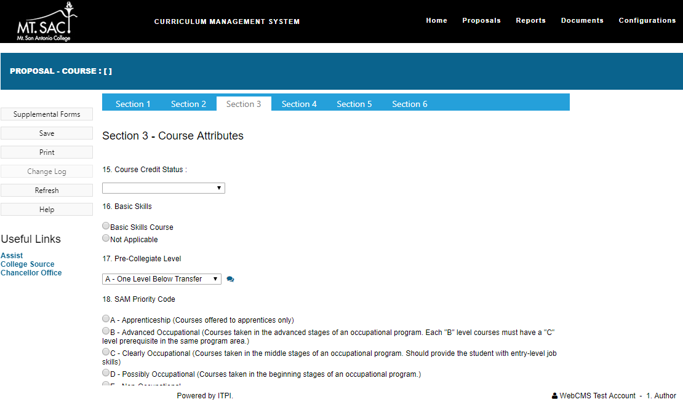
1. Create Proposal – Course (Section 3 – Course Attributes)
Enter detailed information for the new course proposal.

Slide 7
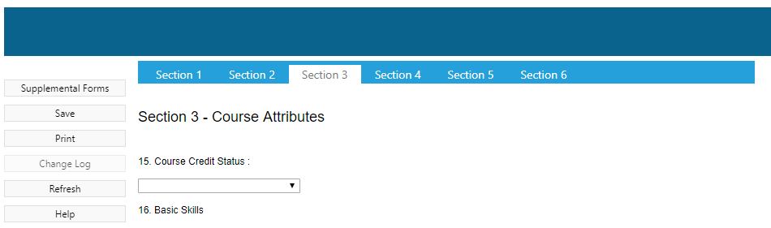
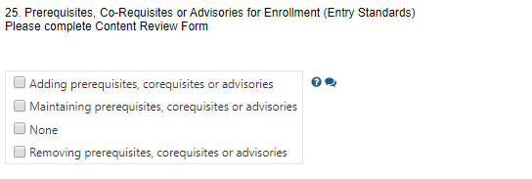
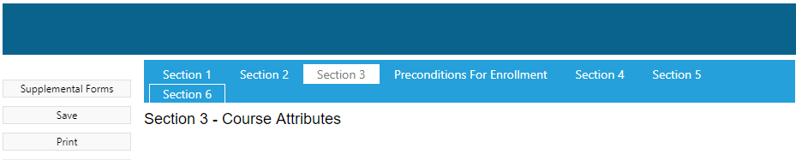
1. Create Proposal – Course (Section 3 – Preconditions for Enrollment)
In Prerequisites, Co-Requisites or Advisories for Enrollment: if Adding, Maintaining or Removing is selected. A new section will appear for entry.

Slide 8
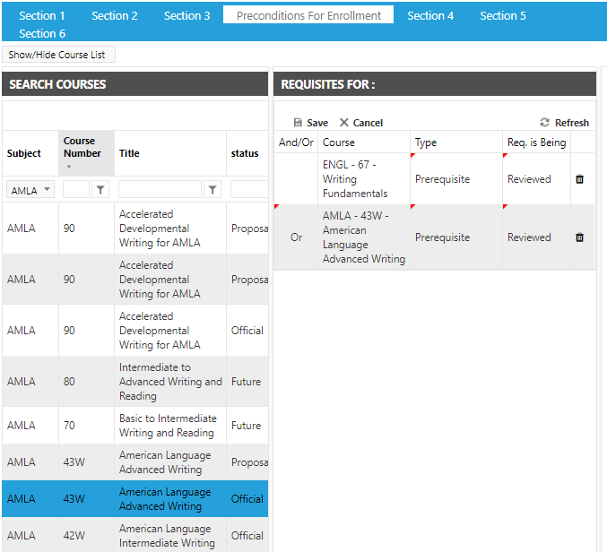
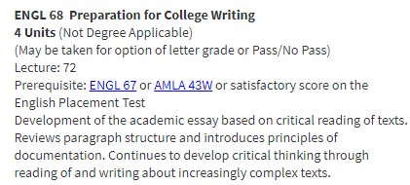
1. Create Proposal – Course (Section 3 – Preconditions for Enrollment)
Example:
4. Make sure to Save.
4.
1.
3.
1. Simply filter or sort for Subject.
3. Add And/ Or, Type and Requisite is being criteria.
2.Drag and drop course into the right box.
2.

Slide 9
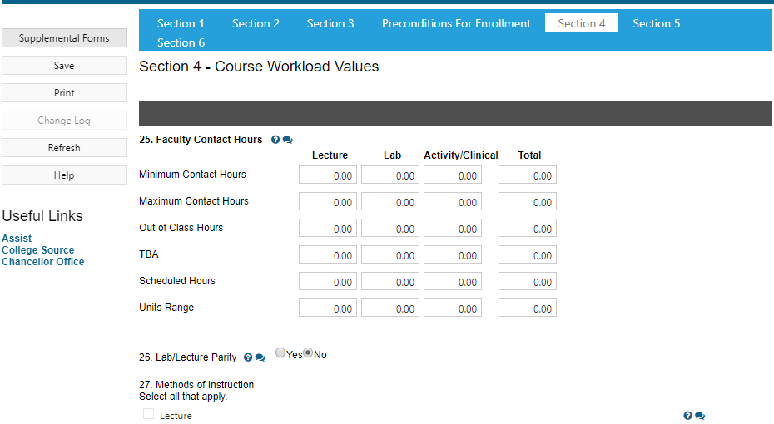
1. Create Proposal – Course (Section 4 – Workload Values)
*Matrix will calculate Units based off of hours.
Enter detailed information for the new course proposal.

Slide 10
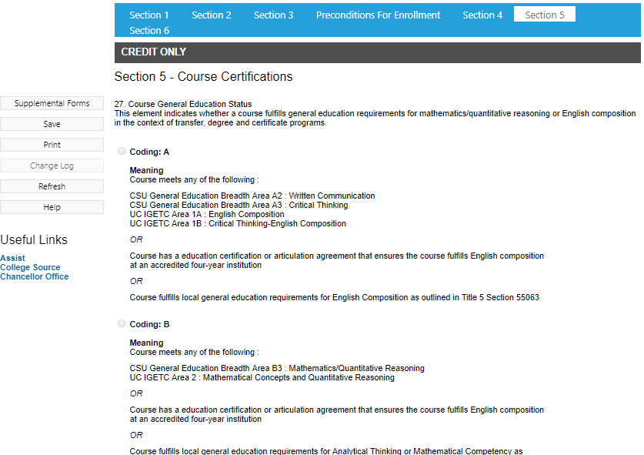
1. Create Proposal – Course (Section 5 – Credit Courses Certifications)
New CB 25, 26 and 27 selections available.
Enter detailed information for the new course proposal.

Slide 11
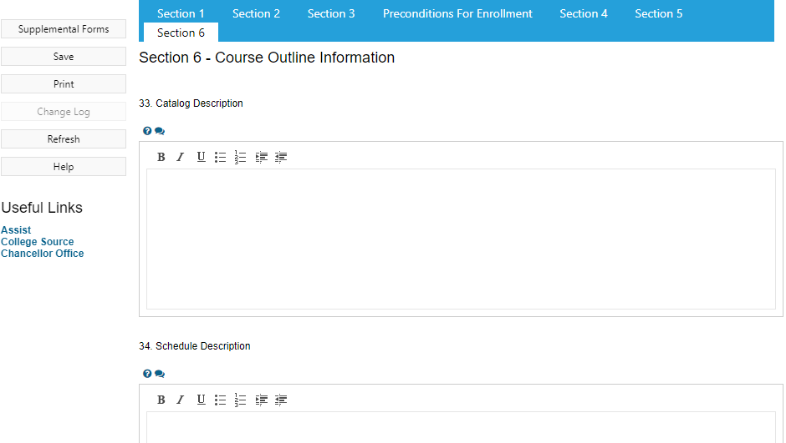
1. Create Proposal – Course (Section 6 – Course Outline)
Enter detailed information for the new course proposal.

Slide 12
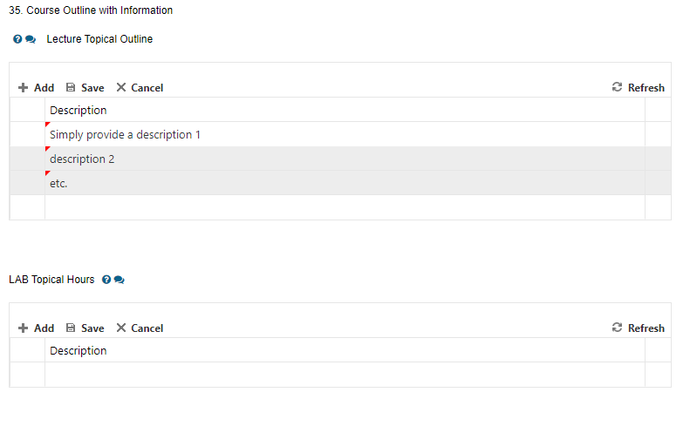
1. Create Proposal – Course (Section 6 – Text Entry #1)
*There are fields that require for the author to “add” text.
3. Select Save.
2. Add Description.
*to add more, simply select add again.
1. Select Add.

Slide 13
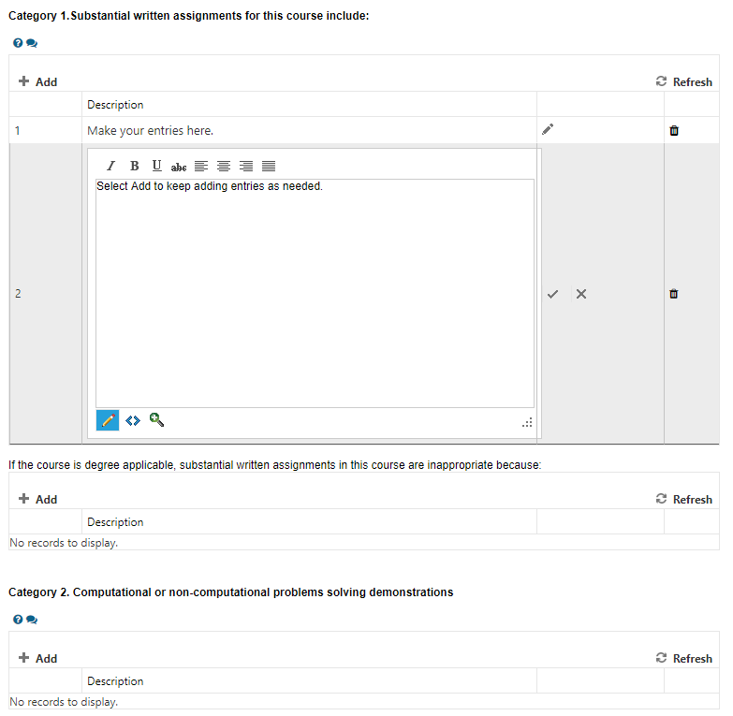

1. Create Proposal – Course (Section 6 – Text Entry #2)
2. Make entry.
1. Select add.
*There are other fields that contain additional text boxes.
3. Select checkmark to save.
*Repeat this process as necessary for additional entries.
Make sure to save!

Slide 14
Submit for Approval

Slide 15
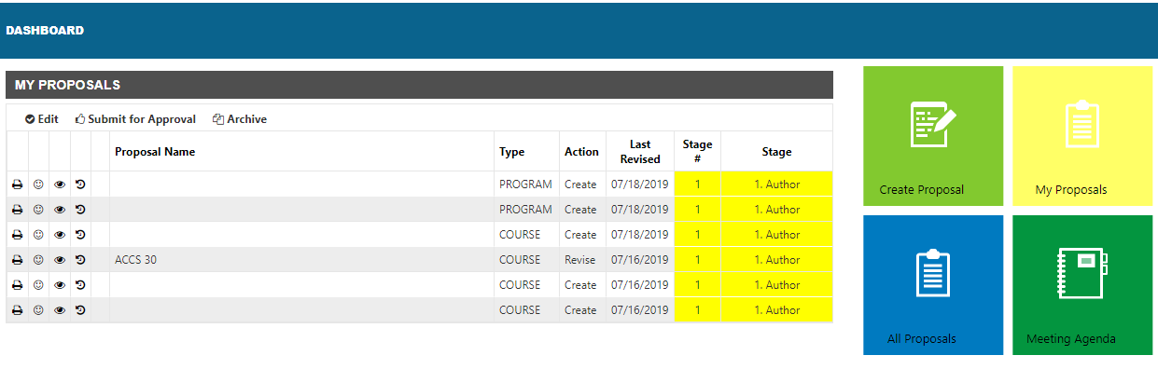
Submitting for Approval
2. Submit for approval.
1. Locate proposal on dashboard.

Slide 16
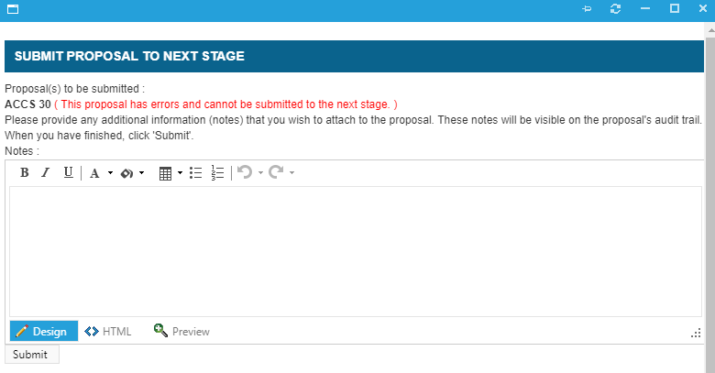
Submitting for Approval
3. New Window will populate. If any issues are found, the proposal cannot be submitted to next stage.
4. Ability to add comments.
5. Select submit.

Slide 17
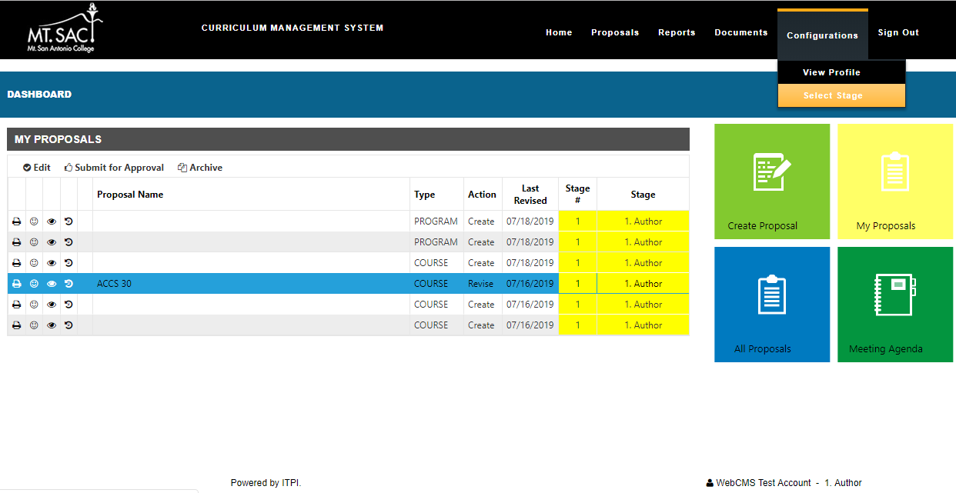
Select Stages - Author
1. Select Configurations.
*Authors will have access to Stages 1, 5 and 9 in the WebCMS process.
2. Select stage.
3. Bottom of page will identify what stage you are currently in.

Slide 18
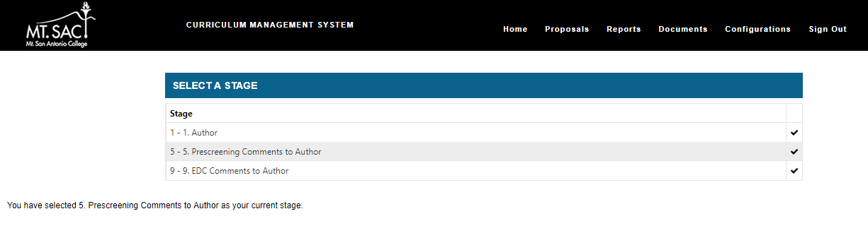
Select Stages - Author
4. Select the checkmark to be able to work in that stage.
5. Bottom of page will update the new stage you selected.

