Slide 1

Supplemental Forms

Slide 2
Distance Learning

Slide 3
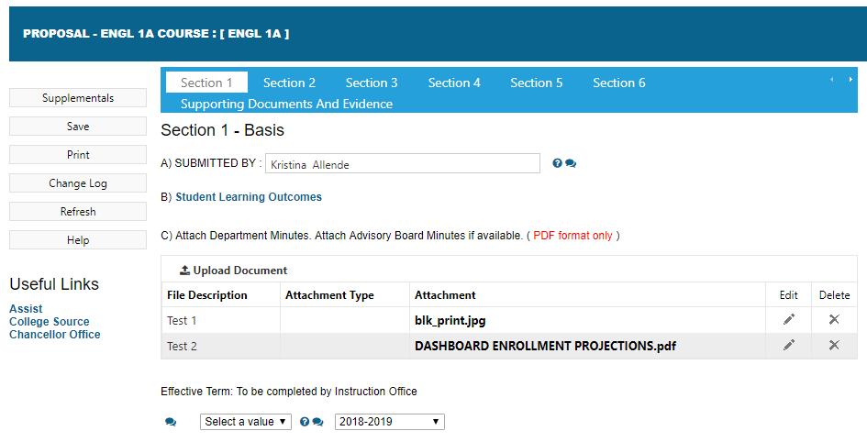
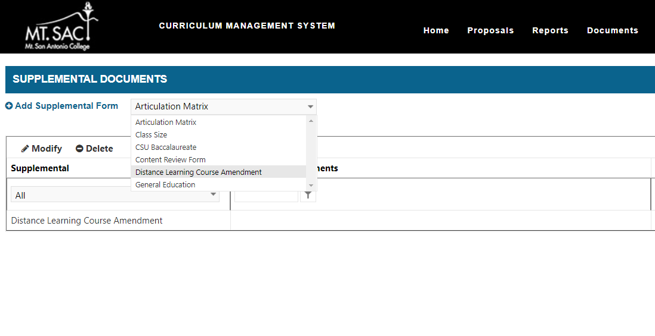
Supplemental Forms location
1. Select Course, then Select Supplementals.
3. Add Supplemental Form
2. Select your desired Supplemental Form.

Slide 4
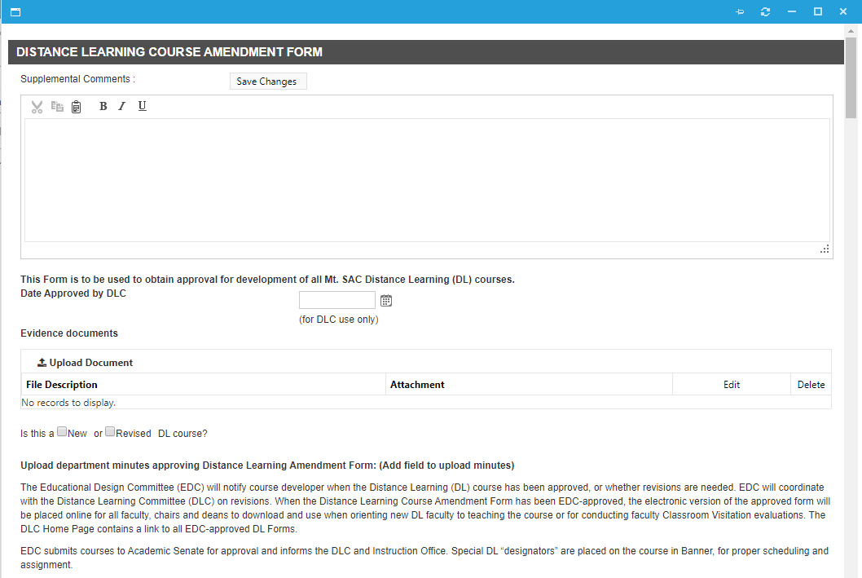
Distance Learning Supplemental Form
Enter information into all applicable fields.
4. Enter Comments
5. Upload Documents
6. Select New, Revised DL Course

Slide 5
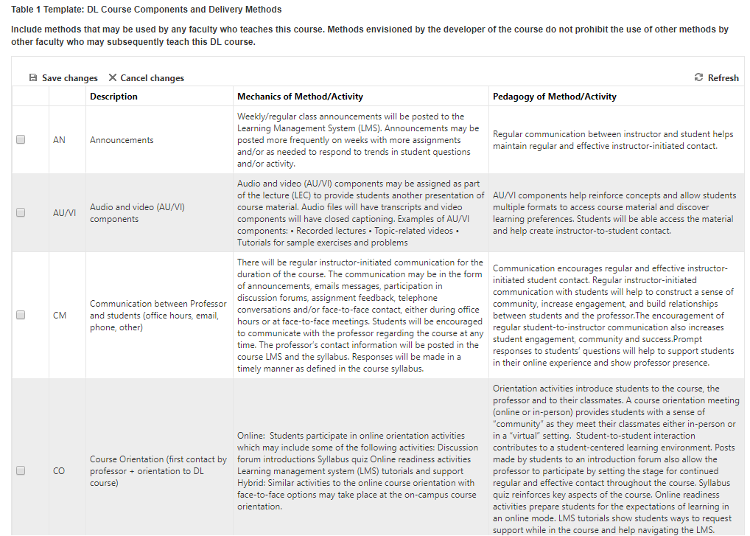
Distance Learning Supplemental Form – Table 1 Method Abbreviation
Table 1 Appears with Course Components and Delivery Methods.
7. Select Methods of Abbreviation

Slide 6
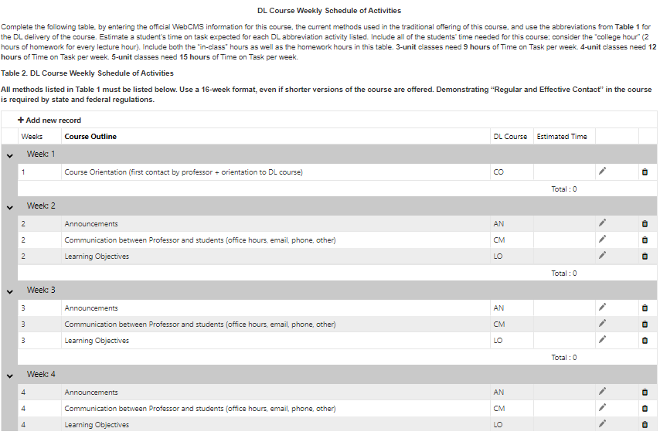
Distance Learning Supplemental Form – Table 2 Course Weekly Schedule
9. Manage any course outline by selecting Edit.
Table 2 appears with pre-populated course outline of records. Simply adjust the time estimated times on the right.
8. Remove any Course Components or Delivery Methods if not needed.

Slide 7
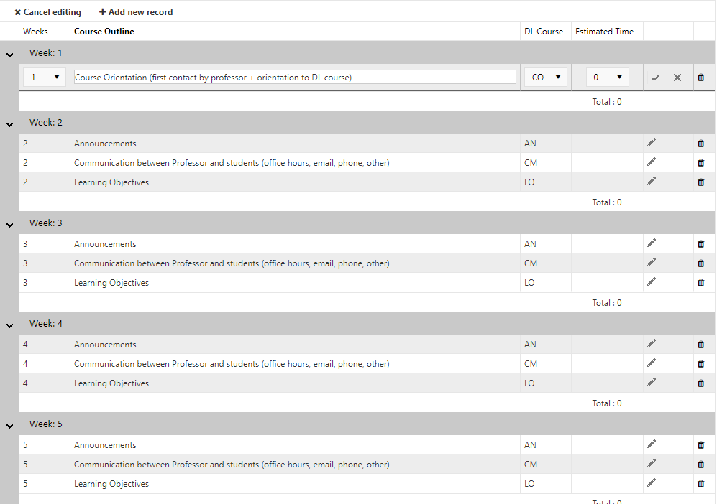


Distance Learning Supplemental Form – Table 2 Course Weekly Schedule
11. Make sure to Save!
*In Edit Mode, you can make any updates for the week.
10. Select Methods of Abbreviation from dropdown values.
10. Select Estimated Time from dropdown values.

Slide 8
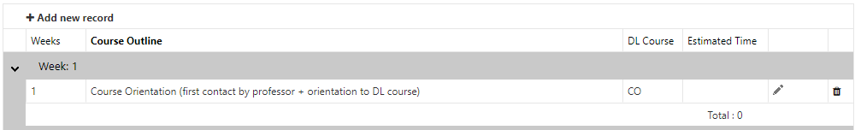
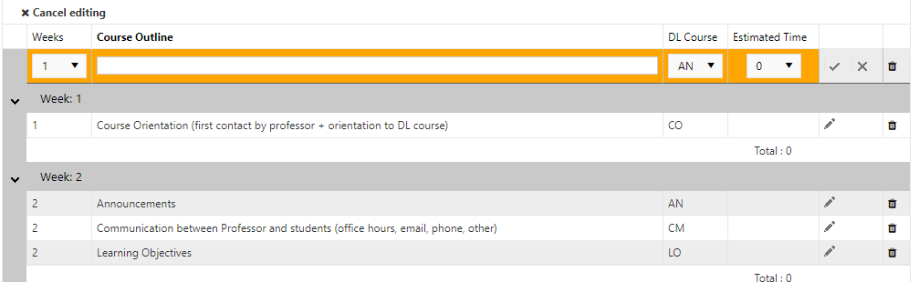

Distance Learning Supplemental Form – Course Weekly Schedule Add Record
To add a new course outline select Add New Record, this will populate a blank row underneath Week 1 that can be placed in any Week # you want to Add New Record to.
12. Enter Week Number for the new record.
13. Select to Save new week record.

Slide 9
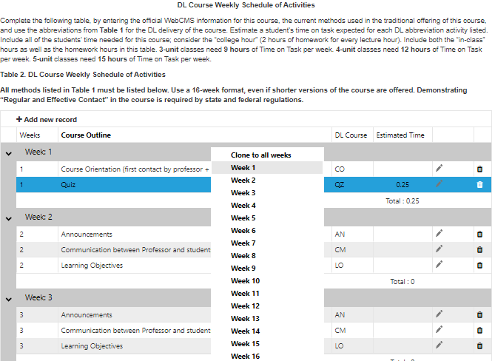
Distance Learning Supplemental Form – Course Weekly Schedule Add Record
*You can also copy any common course outline to any specific week(s).
Simply right click on any course outline and “copy” to all weeks or to a specific week.

Slide 10
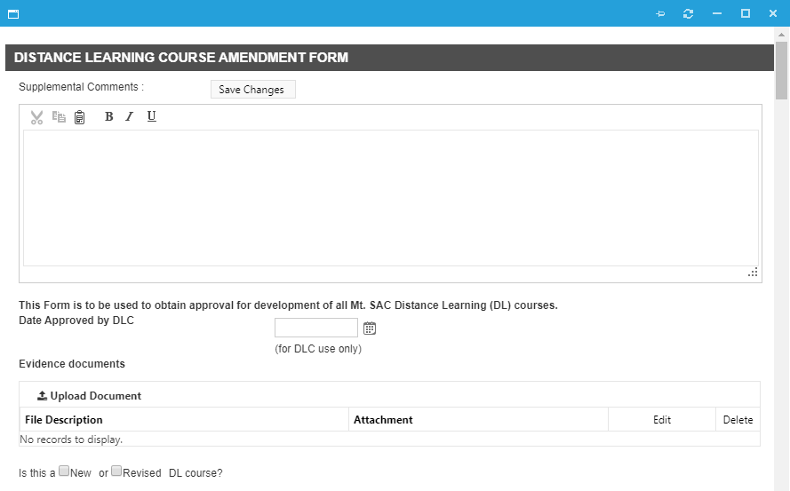

Distance Learning Supplemental Form – Course Weekly Schedule Add Record
Make sure to Save Changes.

