Slide 1


Programs in the Charter College of Education
Cal State LA
Ana Zambrano
Recruitment advisor specialist
ccoe

Slide 2
About the CCOE
The Charter College of Education (CCOE) at Cal State L.A. is the only public college of education in the United States with the distinguished “charter” identity offering an extensive portfolio of 57 academic programs of differing types including undergraduate, graduate (including a joint Ph.D. with UCLA and an Ed.D., the first-ever independent doctoral-level program offered at the university), teaching & professional credentials, as well as academic certificates.

Slide 3


ANYONE CAN EARN A TEACHING CREDENTIAL
What degree to you need to become a teacher?
Degree Options?
Anyone with a degree can earn a teaching credential, if they meet the demands of the teaching credential agency
HOWEVER! If you choose a teacher prep program, you might qualify to waive one of the exam requirements and you benefit from paying lower tuition for the credential program

Slide 4
About Cal State LA
College of Arts & Letters
Art
Communication Studies
English
Liberal Studies
Modern Languages and Literatures
Music, Theatre & Dance
Philosophy
Television, Film, & Media Studies
College of Business & Economics
Accounting
Economics and Statistics
Finance and Law
Information Systems
Management
Marketing
Charter College of Education
Applied and Advanced Studies in Education
Curriculum and Instruction
Special Education and Counseling
College of Engineering, Computer Science, & Technology
Civil Engineering
Computer Science
Electrical and Computer Engineering
Mechanical Engineering
Technology
College of Health & Human Services
Child and Family Studies
Communication Disorders
Criminal Justice & Criminalistics
Kinesiology and Nutritional Science
Nursing
Public Health
Social Work
Youth Agency Administration(Certificate Program)
Applied Gerontology (Certificate Program)
College of Natural & Social Sciences
Anthropology
Biological Sciences
Chemistry and Biochemistry
Geosciences and Environment
History
Latin American Studies
Mathematics
Natural Science (Interdisciplinary Program)
Physics and Astronomy
Political Science
Psychology
Sociology
College of Ethnic Studies
Academic Programs
English Language Program
International Office
International Summer Session
Open University
Professional Development and Training
Study Abroad
Study in L.A.
Summer Session
Test Preparation
Asian and Asian American Studies (Interdisciplinary Program)
Chicanx Studies
Pan-African Studies
Honors College
Nursing
Public Health
Social Work
Youth Agency
Administration (Certificate Program)
Applied Gerontology (Certificate Program)
College of Professional and Global Education

Slide 5
Colleges With Teacher Preparation Options
College of Arts & Letters
Art
English
Liberal Studies
Music, Theatre & Dance
Charter College of Education
Urban Learning
College of Engineering, Computer Science, & Technology
Industrial Technology
College of Health & Human Services
Child and Family Studies
Kinesiology and Nutritional Science
College of Natural & Social Sciences
Biological Sciences
Chemistry and Biochemistry
Geosciences and Environment
History
Mathematics
Natural Science (Interdisciplinary Program)
Physics and Astronomy
College of Ethnic Studies
Chicanx Studies
The teaching credential program is housed in the Charter College Of Education
These programs have a teacher preparation component
Some have an Integrated Teacher Preparation option (pursue the teaching credential while completing your undergraduate degree)
Others prepare you with content (the subject you will teach)

Slide 6
BA in Child Development
Two options
  General Option
  Teacher Prep Option (not always available for transfers)
NOTE: Transfer students generally cannot pursue the teacher prep option with CHDV due to excess units but you can start the credential before you graduate
Child-centered– The major focuses on the development of the child

Slide 7
BA in Liberal Studies
Three options:
  General Option
  Teacher Prep in Elementary
  Teacher Prep in Special Education
Interdisciplinary– it takes from different disciplines to prepare you in a broad education

Slide 8
Chicanx Studies
Three options:
  General Option– degree-only
  Elementary Subject Matter Teacher Preparation: Traditional Option
  Elementary Subject Matter Teacher Preparation: Integrated Option
Interdisciplinary program that pulls from literature, social science, education, politics, pop culture, social media, immigration, public health, social policy, and social justice and the impact on the Chicana/o and Latina/o community.

Slide 9
BA in Urban Learning
Four options:
  Teacher Prep in Elementary Education
  Teacher Prep in Education Specialist
  Teacher Prep in Dual Credential
  Teaching & Learning (degree-only)
Interdisciplinary family- and community-centered and it emphasizes how education impacts urban communities

Slide 10
What Are You Looking for?
Program Options At the CCOE
Undergraduate programs
BS in Rehabilitation Services
BA in Urban Learning
Post-baccalaureate teaching credentials
Multiple Subject
Education Specialist
Graduate Degrees
MA in Education ( 9 options)
MA in Special Education (8 options)
Single Subject
MA in Ed Tech
MA in Educational Administration
Professional/ Advanced Degrees
EdD
PhD
Certificates/Authorizations

Slide 11
The CCOE Prepares…
Preschool, Elementary, Middle, & High School Teachers
Special Education Teachers Across all Grade Levels
Reading Specialists
School Counselors
Rehabilitation Counselors
School Psychologists
School Administrators & Leaders
Researchers
Instructional Technology Specialists

Slide 12
Bachelor of Science in
Rehabilitation Services
what does this major prepare you for?

Slide 13
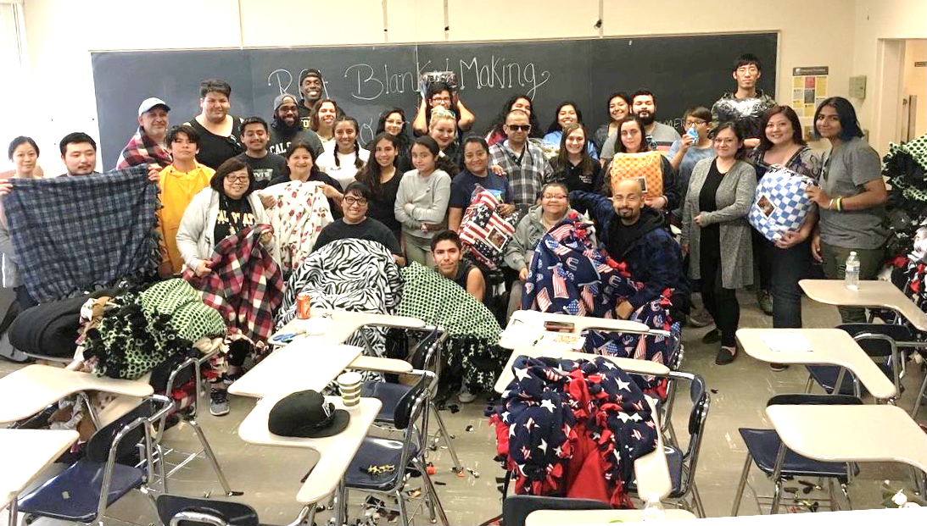
Interesting Fact:
BS In Rehabilitation Services
Cal State LA is the only university in California that offers a major in Rehabilitation Services.
Careers in Human Service examples of professions include:
  Human Services Caseworker/Case Manager
  Job Developer or Job Placement Specialist
  Supported Employment Coordinator
  Disability Center-Resident Counselor
  Parole and Probation Officer
  Vocational Service Coordinator
  Homeless/ Domestic Violence Shelter Coordinator
  and many more!
Learn More About Us:
  www.calstatela.edu/rehab
We have a very active Student Association
(Rehabilitation Services Association—RCA) that works with the community, helps you network, and prepares you in your field

Slide 14
BS in Rehabilitation Services
General option
Two options:
Both prepare you to work with marginalized communities
ABA Option
Prepares you to in the human services sector.
Prepares you to work with students and adults with Autism, behavior support, and other disabilities

Slide 15
BS In Rehabilitation Services
LOWER GE
LOWER GE’S/
Upper GE’s
DEGREE COURSEWORK
Year 4
DEGREE COURSEWORK/Fieldwork
DEGREE COURSEWORK/Fieldwork
Year 3
Year 1
LOWER GE
LOWER GE
Year 2
DEGREE COURSEWORK/Upper GE’s
DISCLAIMER:
This is a general roadmap!
Everyone’s degree progress is unique & it is important that you meet with your academic advisor for support with your schedule

Slide 16
Bachelor of Arts in Urban Learning
What does this major prepare you for?

Slide 17
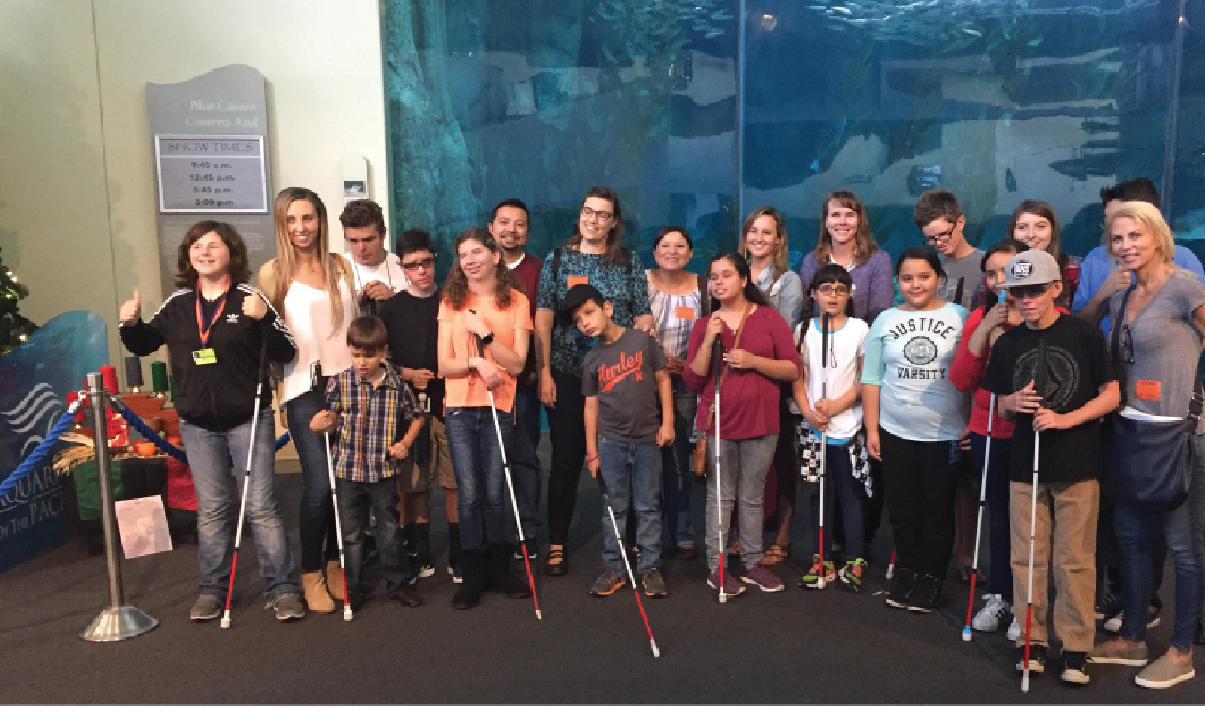
Interesting Fact:
BA in Urban Learning
Careers in Education
  We prepare teachers for high-demand urban schools in a one-of-a-kind program.
  Benefit: Give back by going back! Teach in schools where well-prepared teachers are most needed.
Fun Fact: We have cohorts! Study in a small learning community with students like you.
Learn about us:
https://www.calstatela.edu/academic/ccoe/programs/ulrn
We have a new Student Association
(Urban Learning Student Association—ULSA) that serves as support, helps you network, and prepares you in your field

Slide 18
The BA in
Urban Learning
Teacher Prep in Multiple Subject (Elementary Education)
Teacher Prep in Education Specialist
Teacher Prep in Dual Credential
Four options
Teaching & Learning
Prepares elementary teachers
Prepares Special Ed Teachers
Prepares both elementary and Special Ed teachers
Degree only Option

Slide 19
SPED Credential Options & Pathways
Early Childhood
Mild/Moderate
Moderate/Severe
Visual Impairments
Physical & Health Impairments
Birth to age 5
Early Intervention, All disabilities, Autism
K – 12th grade (up to age 22)
Learning Disabilities, Intellectual disabilities, Autism, ADD, Emotional Disturbance
K – 12th grade (up to age 22)
M/S Intellectual Disabilities, Autism, M/S Emotional Disturbance, Multiple Disabilities
Birth- to 12th grade (up to age 22)
Physical/Orthopedic Impairments, Autism, Traumatic Brain Injury
Birth- to 12th grade (up to age 22)
Visual Impairments, Blindness, Deaf-Blindness

Slide 20
BA in Urban Learning
LOWER GE/
CSET waiver courses
CSET waiver courses/ upper GE’s
DEGREE COURSEWORK/CSET WAVIER COURSES
Apply to cred program
DEGREE COURSEWORK/
Start pre-req credential courses
Year 4
DEGREE COURSEWORK/
Credential courses
DEGREE COURSEWORK/
Credential courses
Year 5
DEGREE COURSEWORK/
Credential courses
Student teaching
Apply for graduation
Year 3
Year 2
Year 1
LOWER GE/
CSET waiver courses
LOWER GE/
CSET waiver courses
DISCLAIMER:
This is a general roadmap!
Everyone’s degree progress is unique & it is important that you meet with your academic advisor for support with your schedule

Slide 21
Degree/Major Breakdown
Undergraduate:
University Requirements
Lower GE
Upper GE
R/E
Civic Learning
Degree requirements
Major courses
Directed electives
Credential
Pre-req (intro courses)
Methods & Strategies
Student teaching
Graduate (MA) degree
Specialty courses

Slide 22
GENERAL TRANSFER INFORMATION
Transfer Admission Requirements
Completion of at least 60 transferrable units
Completion of college-level English Composition, Oral Communication, critical thinking, and quantitative reasoning (math with a C or better)
  Minimum 2.0 transferrable GPA
  Good academic standing at last college attended
All majors at Cal State LA have major-specific criteria. They are listed here:
https://www.calstatela.edu/admissions/major-specific-criteria

Slide 23
Ideal Transfer Requirements For Urban Learning
(NOTE: The courses listed below are listed in Cal State LA; your community college counselor/advisor can help you locate the equivalent at your current school or refer to ASSIST.org for equivalents):
Requirements to transfer: Minimum GPA: 2.4 GE to transfer or AAT | Required General Education Courses (grade of C or better): ENGL 1010: Written Composition COMM 1100: Oral Communication Quantitative Reasoning (math/stats) BIOL 1010: General Biology | At least one of the following history courses (grade C or better): HIST 1010- World History since 1500 HIST 2010- US history to 1877 | Additional recommended preparation for transfer students (grade of "C" or better required) ENG 2700 – Why Literature Matters CHDV 1400 – Development Across the Lifespan (Conception to Adolescence) HIST 2010 – United States History to 1877

Slide 24
Exam Changes!
CBEST: If you have a B or better in a college-level class will cover the CBEST
CSET for Multiple Subject –Interdisciplinary degrees.
  Urban Learning : Any Option
  Liberal Studies : Any Option
  Child Development : Option 2
  Chicanx Studies : Option 2 and Option 3
CSET for Single Subject Candidates
  Agriculture
  Art
  Business
  Dance
  English
  World Language (in any of the languages for which there is a credential)
  Health Science
  Home Economics
  Industrial and Technology Education
  Mathematics
  Music
  Physical Education
  Science (including Biology, Chemistry, Geoscience or Earth and Space Science, and Physics)
  Social Science
  Theater

Slide 25
Beyond A Bachelor’s Degree
It’s never too early to start thinking of a tentative plan after graduation. Things to consider are:
What are your career goals?
What do you want to be an expert in?
What population do you want to work with?
Do you plan on working in higher education?

Slide 26
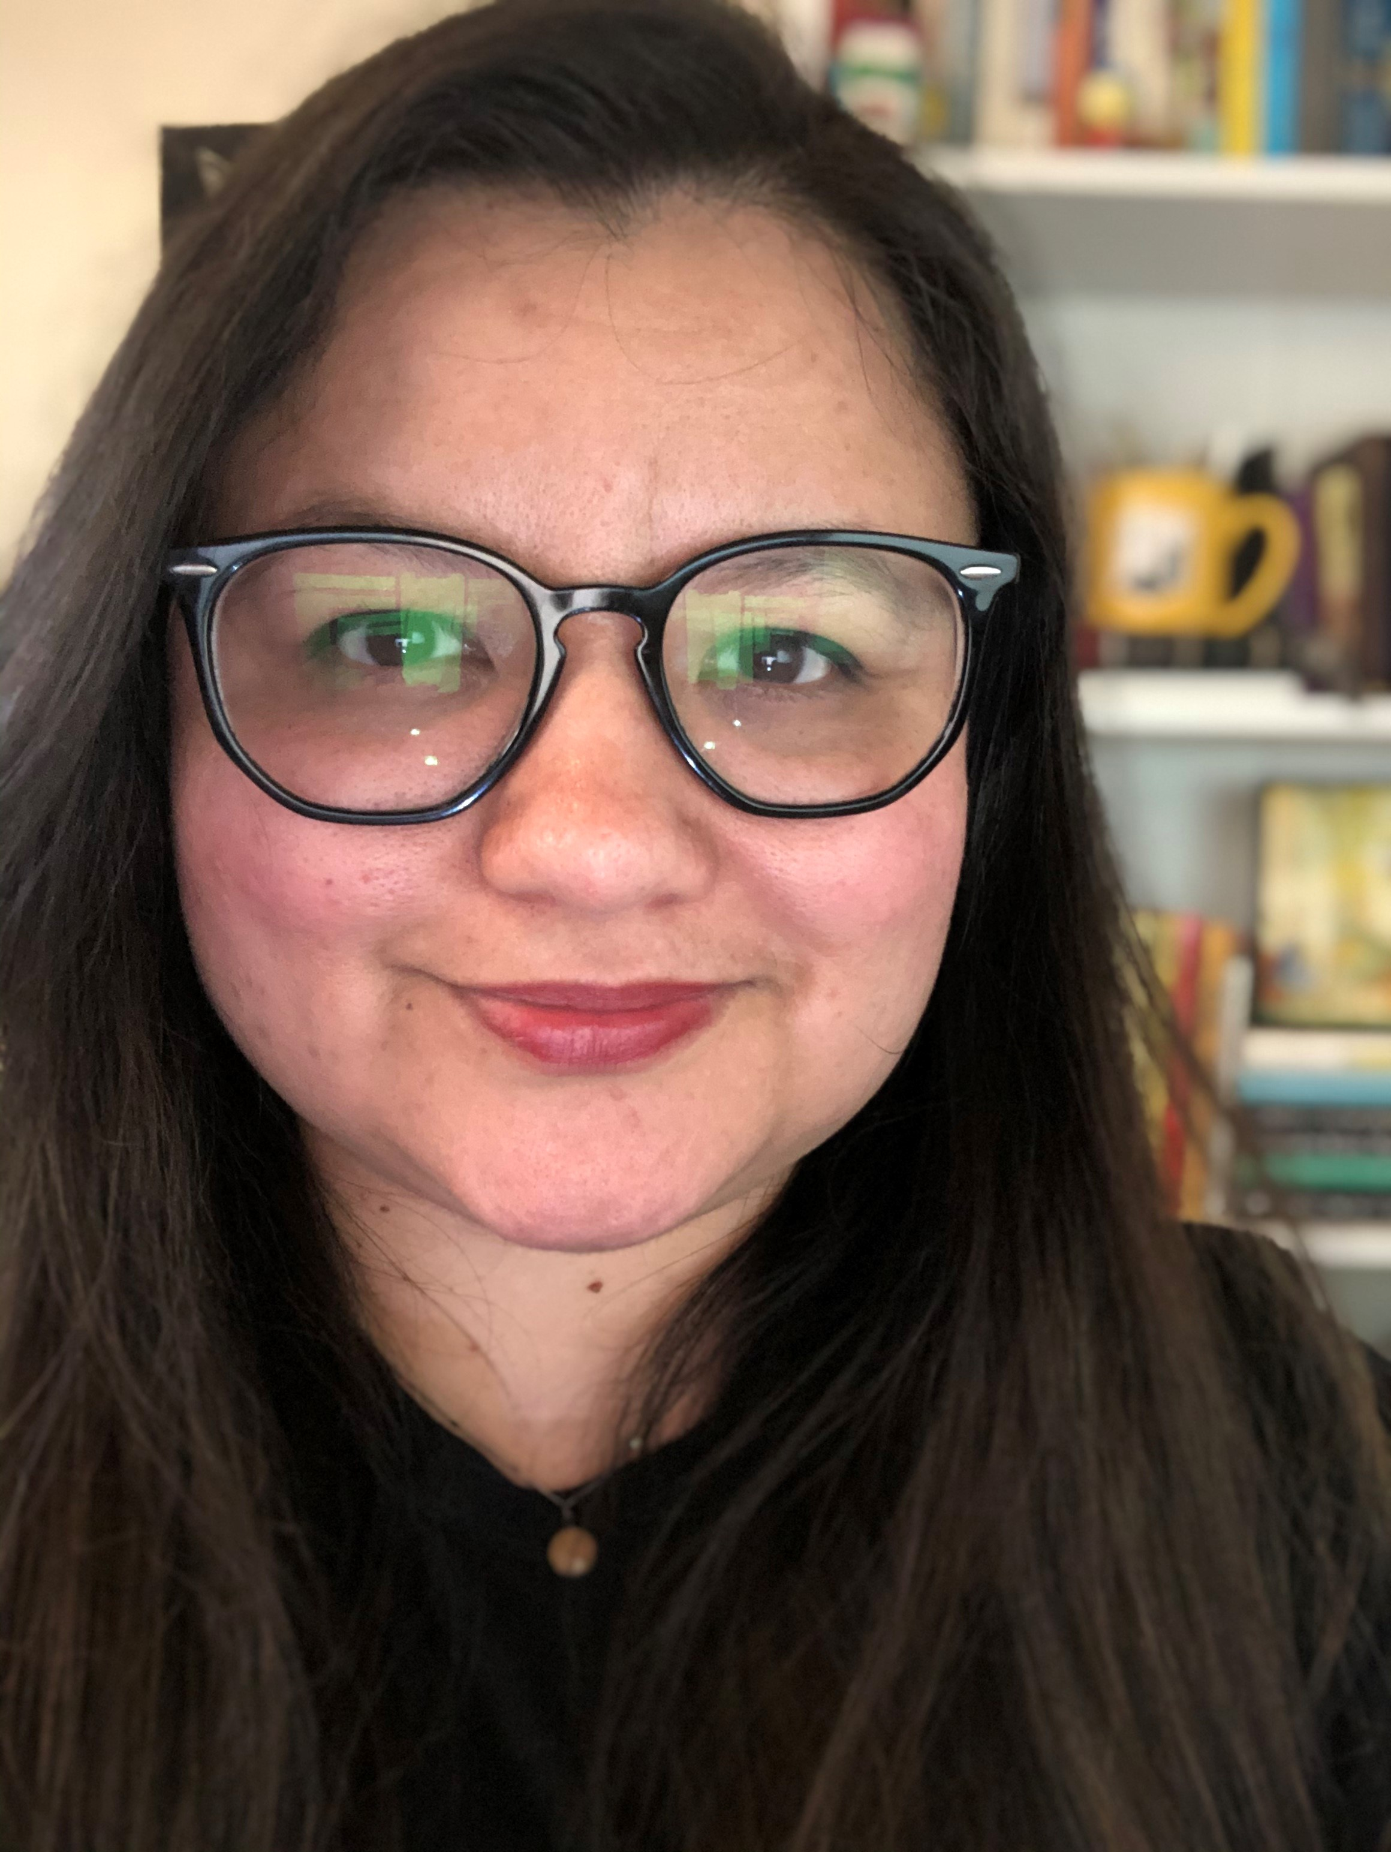
Contact Us
Ana Zambrano
  azambra7@calstatela.edu
  Cell: 323-212-5362 (text me!)
  Personal Availability EABNavigate Link: https://calstatela.campus.eab.com/pal/BOaSQrRybF
  Zoom ID: 467 319 291
  https://calstatela.zoom.us/j/467319291

