Slide 1
Transfer 101: UC/CSU
Mt. San Antonio College

Slide 2
Presentation Agenda
What is transfer?
California State University (CSU) system
University of California (UC) system
How can the transfer center help you?

Slide 3
What is transfer?
Transfer
If you want to earn a bachelor’s degree you can do up-to the first half of your degree at Mt. SAC.
Then you must apply to transfer to a four-year university or college.

Slide 4
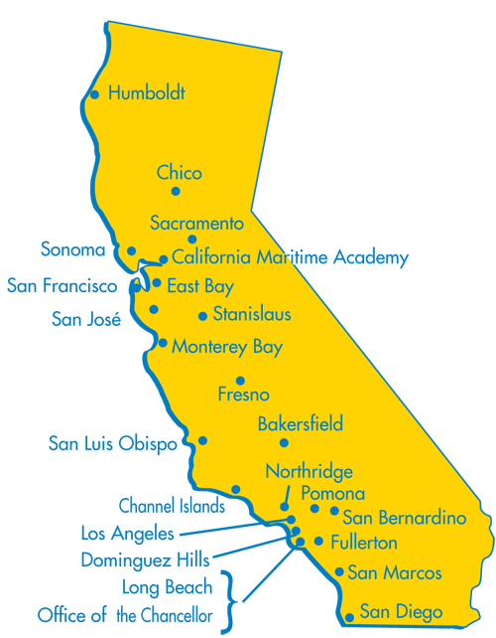
California State University (CSU)
23 campuses
Offer bachelors, masters, some doctoral degrees, teaching credentials.
www.calstate.edu/apply

Slide 5
CSU: What is required to transfer?
60 + CSU transferrable units*
30 units of general education
Golden 4 (“C” grade or better)
Freshman composition, College math, Critical thinking, and Oral communication
Minimum 2.0 GPA**
*Impacted majors may have additional requirements. See a counselor for more information.
*2.0 GPA does not guarantee admissions, especially competitive majors.

Slide 6
When to apply for admission
Not all CSUs accept mid-year transfers.
Complete all admission requirements by the end of spring prior to transfer.
To be accepted for: | You must apply:
FALL semester or quarter | October 1 - November 30 of the previous year
WINTER quarter | June 1 – 30 of the previous year
SPRING semester or quarter | August 1 – 31 of the previous year
SUMMER quarter | February 1 – 28 of the same year

Slide 7
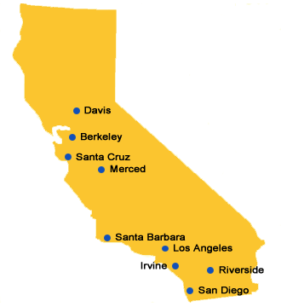
University of California (UC)
9 undergraduate campuses:
Offer bachelors, masters, doctorate (PhD, EdD), professional degrees (MD, law, dentistry), teaching credentials.
www.universityofcalifornia.edu/apply

Slide 8
UC: What is required to transfer?
60 + UC transferrable units*
7 core GE classes
Minimum 2.4 GPA**
*Select majors may have additional requirements. See a counselor for more information.
**2.4 GPA does not guarantee admissions, especially competitive majors.

Slide 9
When to apply for admission
All Currently, most UCs accept Fall applications only!
Complete all admission requirements by the end of spring prior to transfer for Fall transfer.
To be accepted for: | You must apply:
FALL semester or quarter | November 1 - November 30 of the previous year
WINTER quarter | July 1 – 31 of the previous year
SPRING semester or quarter | October 1 – 31 of the previous year

Slide 10
Upper Division Transfer
General Education courses Major prerequisites or preparation courses Elective courses (if needed)
60 transferable
units
WARNING: Transfer requirements are subject to change. Please meet regularly with a counselor and view campus admissions websites regularly to stay updated. Do not rely on your friend who transferred last year!

Slide 11
How can Transfer Services help you?
Meet with University representatives.
Attend one of our university tours.
Take part in our University Transfer Fairs in fall & spring.
Attend our transfer workshops
Transfer application, financial aid, and many more.
Sign up to Transfer List serve.

Slide 12
Where can I get help?
Transfer Services
Counseling Center
Workshops
Transfer fairs
University tours
Transfer conference
Meet with university representatives
Undecided major workshops
Appointments to make an education plan
Learn about transfer requirements for specific college/universities

Slide 13
Questions?
Career & Transfer Services
Bldg. 9B, Second Floor
(909) 274 - 6388
www.mtsac.edu/transfer
Join our Transfer List-Serve to find out about upcoming events:
http://www.mtsac.edu/transfer/listserv.html
To schedule a counseling appointment call:
Bldg. 9B, Second Floor
(909) 274 – 4380
www.mtsac.edu/counseling

