Slide 1
Mount San Antonio Community College District
Workers’ Compensation Reporting and Company Nurse Program
Presented by,
Duetta Wasson, Director of Safety and Risk Management
Andrea Solorzano, Mt San Antonio Risk Management Specialist
Loyola Batiste, Risk Management Analyst, CSRM, SIP
, 2023

Slide 2
DISCLAIMER
Keenan is an insurance brokerage and consulting firm. It is not a law firm. We do not give legal advice.
The discussion and materials provided are for informational purposes only and no opinion, suggestion, or recommendation shall constitute or should be construed as legal advice.
This material is provided as a general summary. Members are advised to consult with their own legal counsel for a determination of their respective legal rights, responsibilities and liabilities, including the interpretation of any statute or regulation, or its application to your business activities.

Slide 3


Program Benefits for District
The injury hotline serves as the first point of contact to report workplace incidents/injuries – assists District Risk Management with compiling information for the completion of the 5020 for reporting the injury to Keenan and reduces claim reporting lag time.
The Program helps take the burden off supervisors by allowing Company Nurse to answer the question, “Should an employee be seen by a doctor or go to an emergency room”? Reduction in emergency room visits (triaged to MPN clinic/provider)
Increased focus on return to work through physician integration
Injury reports are sent instantly to all involved parties in the WC process (i.e. District, Keenan and clinic/provider)

Slide 4

Program Benefits for Employees
Immediate access to a caring medical professional (RN) for evaluation
Nurses specialize in occupational injuries
24/7 nurse intake and follow up
Medical Provider paperwork is faxed immediately when referral to medical care is needed - reduces employee wait
  Paperwork will include the pre-filled Temporary Prescription Card.

Slide 5
What is Company Nurse?
Registered Nurse Hotline, Staffed 24/7/365 Days Per Year
  Translators available for up to 170 different languages
The injured employee first speaks with an Injury Care Coordinator who:
  Gathers employee information
  Gathers preliminary incident information
    The 5W’s Who, What, When, Where and Why
  Facts are documented for the 5020 the Employers First report of Injury
Next, the Injury Care Coordinator will transfer the employee call and collected information to a Registered Nurse who:
  Assesses the injury, per AMA Medical Advice (standards used for all work related injuries)
  Recommends the most appropriate level of care and/or treatment
  Refers the injured employee to either self-care, designated clinic, or emergency room
Notes:
Registered Nurse Hotline. The first person is a Injury Care Coordinator who will gather all the facts of the incident. The ICC will transfer the employee to a RN who will assess the injury and make a recommended for the most appropriate level of care. CN takes the burden off a supervisor from making the decision, “Do I need to see a doctor”.
CN also files report w/ El Camino and medical provider.

Slide 6
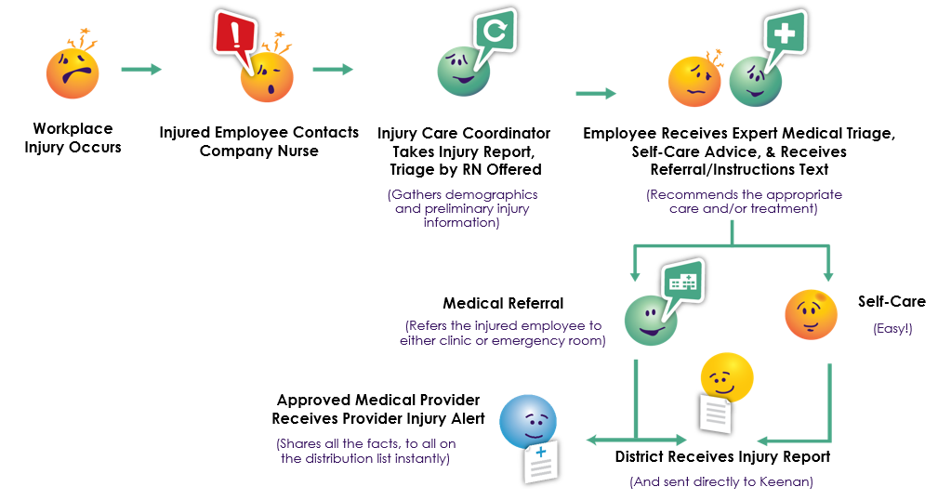
What happens when the injured worker calls?
Notes:
This is the matrix of a injury call to CN. After all demographcis have been recorded, referral to RN for medical triage. 2 outcomes, self-care or referral for med tx.
IF EE is unable to call. For example, transported by ambulance, then the supervisor can call.

Slide 7
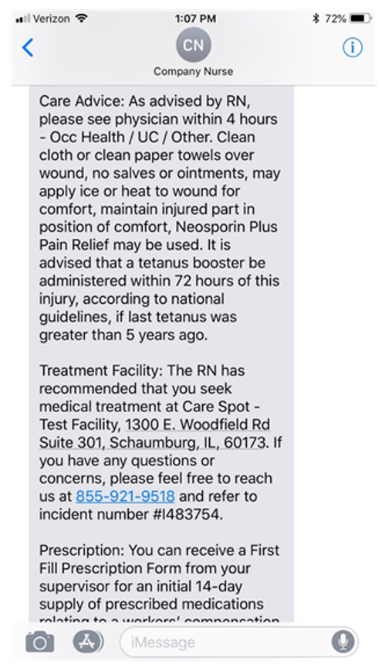
Text to Injured Worker
  The injured worker will have the option of receiving a text message with either the self care recommendation or the medical facility information.
Notes:
Option to receive a tx message w/ self care or medical facility info

Slide 8
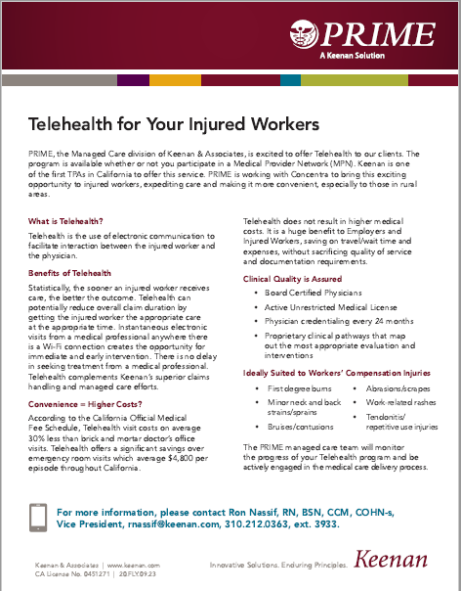
Telehealth Available
Telehealth is available for qualifying injuries. Company Nurse will triage and make the referral directly to Concentra Telehealth for:
• Grade I/II upper/lower extremity
strains/sprains
Minor neck and back strains/sprains
Bruises/contusions
Minor burns
Abrasions/scrapes
Contact dermatitis/rashes
Tendonitis/repetitive-use injuries
Bloodborne pathogen exposures
Notes:
Telemedicine is available. These are the qualifying injuries for telemedicine

Slide 9
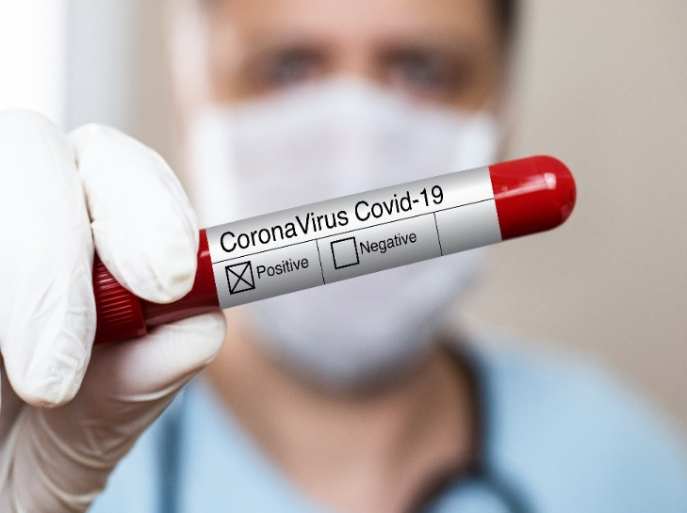
Covid Cases
Company Nurse will triage cases based on the CDC Covid guidelines and document contact tracing for the District.
Notes:
CN also triage COVID cases and document for the District

Slide 10
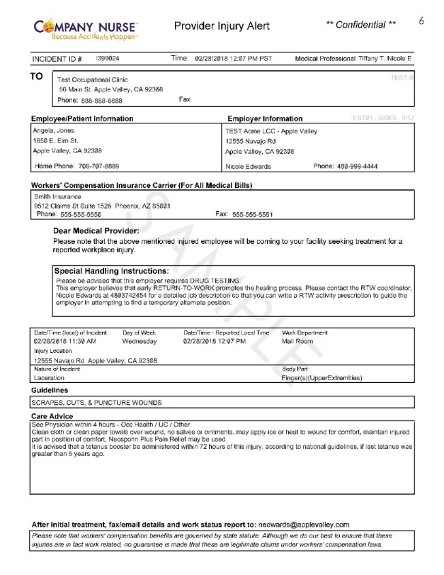
Medical Provider Alert
  Faxed to medical treatment provider prior to the arrival of the injured employee; contains:
    Employee demographic info
    District and workers’ compensation carrier data
    Injury Information and Triage details
    Paperwork will include the pre-filled Temporary Pharmacy Card.
Notes:
If EE is directed toa medical facility, a copy of the medical approval is faxed over to the provider prior to the arrival of the employee. It included injury information, WC carrier info.

Slide 11

Company Nurse Injury Reporting video
Notes:
Let’s watch a short 6 minute video clip on Company Nurse. We have CN stickers w/ toll free number and search code if you have to call.

Slide 12
What’s the process?
An incident, injury or illness occurs
Employee reports incident to their immediate supervisor
Employee contacts Company Nurse
Employee follows care guidance provided by Company Nurse
Notes:
Quick summary

Slide 13
Supervisor – Flow chart
Employee Completes/ Managers Collects:
Manager Completes:
Managers Report of Occupational Injury/Illness
Submit all information to Risk Management within 24 hours
Call Company Nurse
Declination of Treatment
Take pictures of where the incident took place
Secure any equipment involved
Identify witnesses & collect statements
DWC-1 and/or
Notes:
Summary of Supervisor’s duties

Slide 14
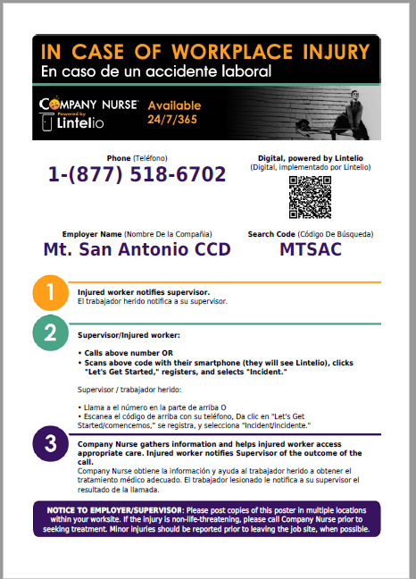
Company Nurse materials (Posters)

Slide 15
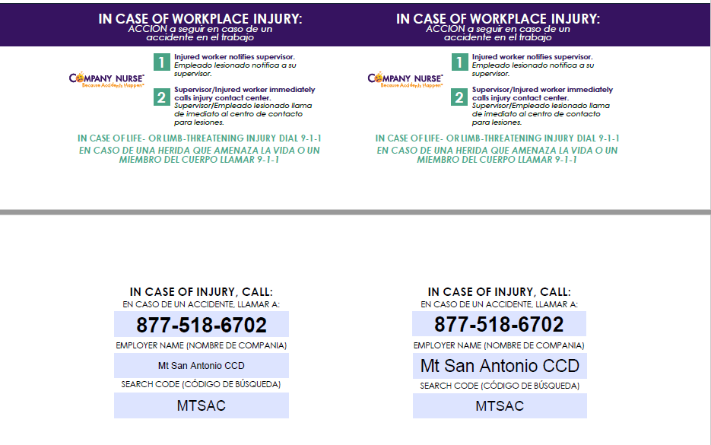
Company Nurse materials (wallet cards & stickers)

Slide 16
What Would You Do?
Classified employee Tad Bunny falls off a ladder and lands on both knees on the concrete floor. The accident is witnessed by Department Supervisor Kevie Wonder. Tad Bunny is in pain but thinks he can walk it off. Tad ask Supervisor Wonder if he should walk it off or go to the doctor. What should Supervisor Kevie Wonder recommend? Please select the one CORRECT answer:
A. Go home and put some dirt on it.
B. Advise Tad Bunny to quit and move to Antarctica.
C. Call Company Nurse to report the injury and receive appropriate medical referral.
D. A and B
Certificated employee Larry Styles slips and falls in a puddle of water in the hallway. The incident is unwitnessed. Mr. Styles immediately reports the incident to Dean Cabe Bryant. Mr. Styles calls Company Nurse and initially declines medical treatment. Two days later, Mr. Styles is having neck pain and headaches. What should Mr. Styles do? Please select the one CORRECT answer:
A. Request a meeting with Dean Cabe Bryant and Dean Barq O’Neal
B. Mr. Styles should call Company Nurse again to request a medical referral to a frontline provider.
C. Write a love song about slipping and falling in water.
D. Go home and put some dirt on it.
Classified employee Hennifer Lopez hurts her low back lifting some boxes. Ms. Lopez reports the injury immediately to Manager Ken Affleck. Ms. Lopez tells Mr. Affleck that she would prefer to speak in her native language when reporting the injury to Company Nurse. Manger Affleck consults with another Manager, Dr. Bee Yonce. . What should Managers’ Affleck and Yonce recommend to Ms. Lopez?
A. Have an All manager meeting with Deans Lex Rodriguez, JK Zee, and Kat Dogge.
B. Move to Antarctica with Tad Bunny and live happily ever after.
C. A and B
D. Call Company Nurse because they have interpreters in over 170 different languages.
Notes:
Since this is an educational institution. Pop Quiz on what we have learned today.

Slide 17
Any questions?
Please have a safe day

