Slide 1
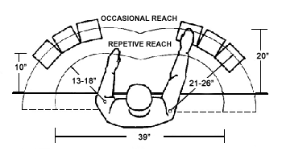
Workspace ergonomics
Always maintain a neutral position
Items on your workstation should be placed within a reasonable parameter of your workspace

Slide 2
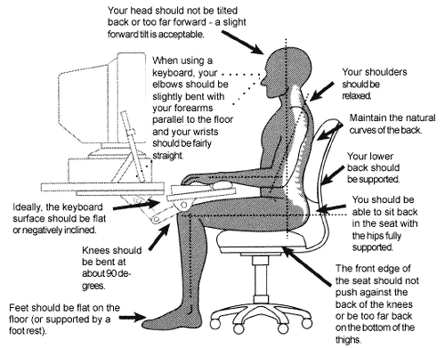
Office Ergonomics - workstation

Slide 3
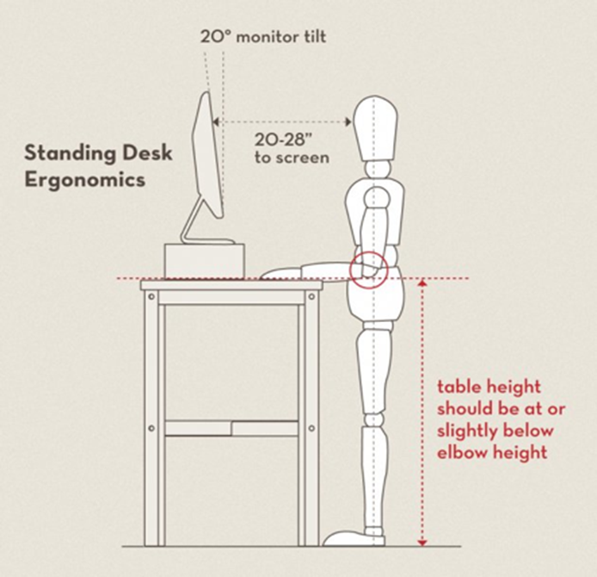
Office ergonomics – standing workstation

Slide 4
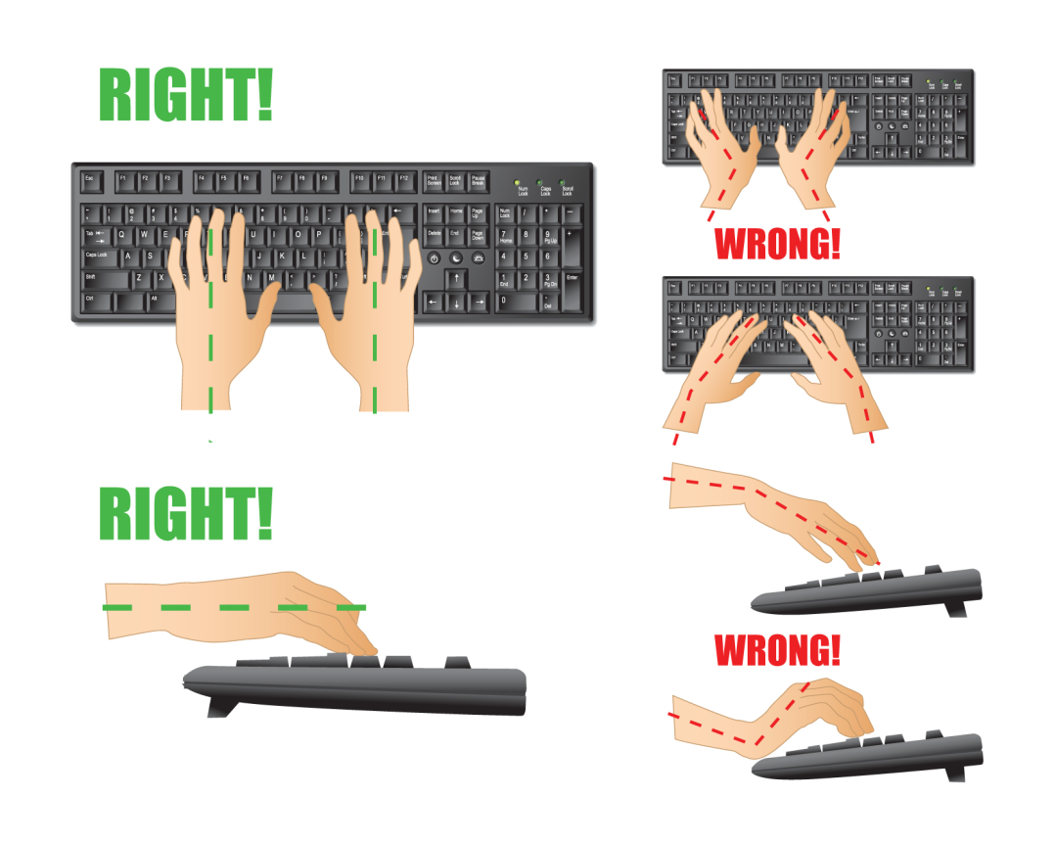
Office ergonomics - keyboard

Slide 5
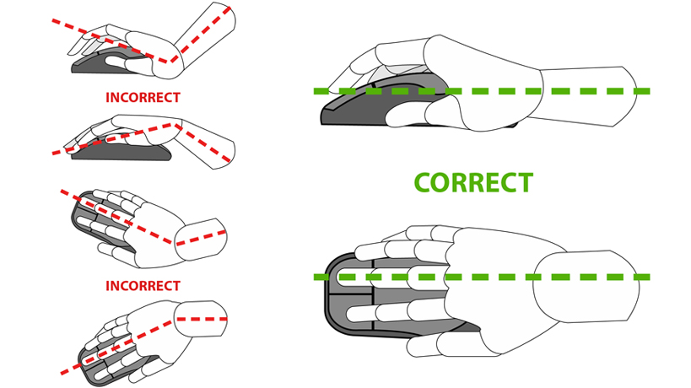
Office ergonomics - mouse

