Slide 1
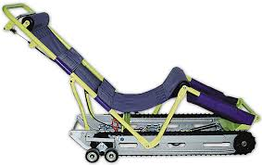
Garaventa Evacuation Chair
Guidelines
Garaventa
Evac-Trac CD7
Presented by Risk Management
Mt. SAC

Slide 2
Agenda
Training DVD – Youtube demo.
Terminology
Evacuation Chair Operating Instructions
Things to Consider
Hands-on Training

Slide 3
Youtube Training Demonstration
https://www.youtube.com/watch?v=zM6LHHKASxY

Slide 4
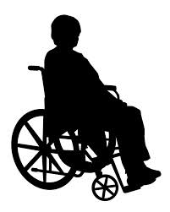
Things to Consider
Communication
  Always ASK someone with a disability how you can help BEFORE attempting any rescue technique or giving assistance.
  Ask how he or she can best be assisted or moved, and whether there are any special considerations or items that need to come with the person.
Varying Abilities
  Persons with disabilities have varying mobility ranges and limitations.
Verbal cues - State the following:
  “Tell me how to move you.“
  “Are you able to move”
  “Can you support yourself”

Slide 5
Safe Operation of Evacu-Trac:
CHECK THE STAIRWAY- Do not use on spiral, damaged or stairs with loose carpeting. Use caution on wet or slippery stairs.
DO NOT OVERLOAD - Do not use with a passenger heavier than (350 lbs).
ENSURE SEAT LATCH IS LOCKED - Do not place a passenger in the chair unless the seat frame is fully opened and locked. Check the indicator window. If it is blue, the seat is properly locked.
SECURE THE PASSENGER - Do not use Evacu-Trac without securely restraining the passenger using the safety straps provided.
WEAR APPROPRIATE FOOTWEAR - Do not wear high-heeled or slippery shoes when operating Evacu-Trac.

Slide 6
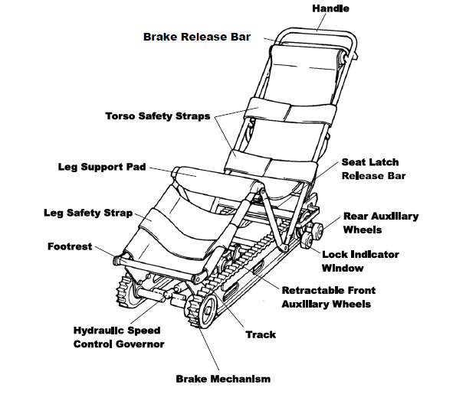
Terminology

Slide 7
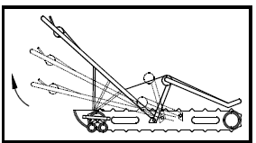
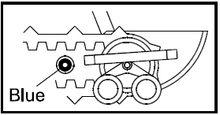
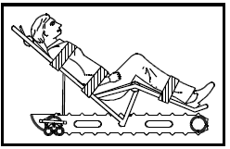
Instructions for “Set-up and Loading”
The Handle
Place on a flat surface. Grasp the end of the Handle.
Pull it out and up in a quick motion.
The seat will latch into its locked, open position.
Locked Position
Ensure chair is properly locked in open position.
Check the Indicator Window on the side of the frame.
If it is blue the seat is properly locked.
Transfer
Move the passenger into Evacu-Trac.
Fasten Safety Straps.
If you cannot be certain that the passenger’s arms will remain in his or her lap, the arms should be wrapped inside the torso safety straps.

Slide 8
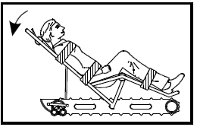
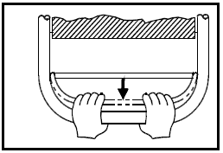
Rolling the chair: The handle & Break Release
1. To roll on a flat surface push down on the handle.
2. Then squeeze the Brake Release Bar with both hands.
  This will deploy the Front Auxiliary Wheels, making the chair easier to push.
  Do not try to lower the Front Auxiliary Wheels by pulling the Brake Release Bar without first pushing down on the Handle.
  This may stretch the Brake Cable.
Caution: When operating Evacu-Trac on stairs always wear footwear with flat soles.

Slide 9
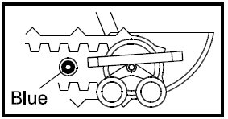
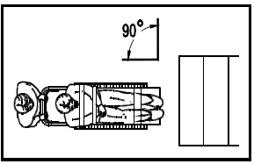
Turning the Chair
3. To turn on a flat surface, press down on the Handle and pivot the chair on the Rear Auxiliary Wheels.
4. Position the chair at the top of the stairs, at a right angle (90º) to the stairway, with the passenger facing towards the stairs.
Operating the chair near the inner core of a stairway will facilitate turning corners at landings.
Rear Auxiliary Wheels.

Slide 10
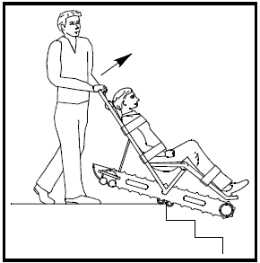
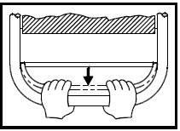
Descending the Stairs
5. Approaching the first “nose” of the Stairs
Push the chair forward until the Front Auxiliary Wheels drop off the top step.
At this point the chair will stop.
To prevent chair from immediately descending, release your grip on the Brake Release Bar.
This will engage the Track Parking Brake until you are ready to descend.
Lift the handle and tilt chair to the angle of the stairs.
6. Descending the Stairs
To descend the stairs, squeeze the Brake Release Bar.
To slow the descent speed, if desired, simply loosen your grip on the Release Bar.
This will partially engage the Brake.

Slide 11
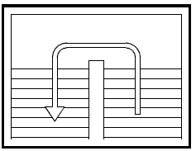
OPERATING ON STAIRS
7. Stopping the Chair
To stop Evacu-Trac on the stairs, slowly release the Brake Release Bar.
8. At the Landings
Push down on the Handle and turn Evacu- Trac with all the weight on the Rear Auxiliary Wheels.
Keep to the inside of the corner for maximum turning clearance.
Align the machine at a right angle to the stairs and proceed down the next flight.

Slide 12
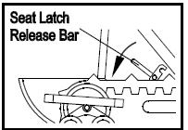
OPERATING ON STAIRS
9. Applying the Breaks
Find a flat surface to park Evacu-Trac. Let go of the Brake Release Bar.
This will lower the front section of the Tracks to the floor, preventing the unit from rolling. Remove the passenger.
10. Closing the Chair
Unlock the Seat Latch by pushing down on the red Seat Latch Release Bar.
Push down and forward on the Handle to fold Evacu-Trac closed.

Slide 13
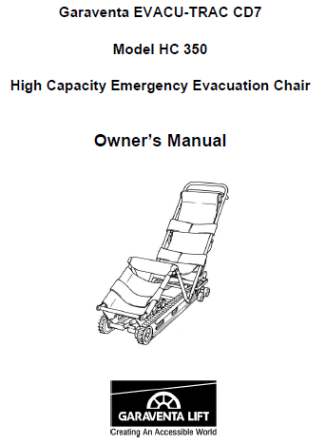
Thank you for assisting the College in with our Emergency Response Plan!
For additional information please refer to the Owner’s Manual

Slide 14
Hands-on Training at the Stairwell

