Slide 1
Mt. San Antonio College
Emergency Preparedness Training
Presented by: Risk Management and Public Safety

Slide 2
Emergency Response Training Overview
The purpose of this training is:
to prepare personnel to effectively respond to an event.
to prepare personnel to effectively manage an event.
to minimize or prevent effects caused by an event

Slide 3
A G E N D A
    Part 1 (Mt SAC College Emergency Response Overview)
    Emergency Management Structure - NIMS/ICS – IC, Building Marshals and Floor Captains.
    Evacuation Procedures – IC and Building Personnel Responsibilities
    Building Evacuation Plan
    Radio Protocol – Communications
    Emergency Assembly Areas
Part 2
Shelter in Place Procedures

Slide 4
Definitions
Incident Commander - the person responsible for all aspects of an emergency response; including quickly developing incident objectives, managing all incident operations, application of resources as well as responsibility for all persons involved.
National Incident Management System (NIMS) - a comprehensive, national approach to incident management that is applicable at all jurisdictional levels.
Incident Command System (ICS) - a standardized, on-scene, all-hazards incident management approach that:
Allows for the integration of facilities, equipment, personnel, procedures and communications.
Enables a coordinated response among various jurisdictions and agencies.
Establishes common processes for planning and managing resources.
Emergency Assembly Area (EAA) - an evacuee assembly location
Building Marshal – college personnel that report to the EAAs and communicate with the Incident Commander during an event.
Floor Captain – college personnel that have been trained to assist in evacuations efforts which direct evacuees to the to EAAs.

Slide 5

You are a “Disaster Service Worker”
CA Gov’t Code § 3100:
“… all public employees are hereby declared to be disaster service workers.”

Slide 6
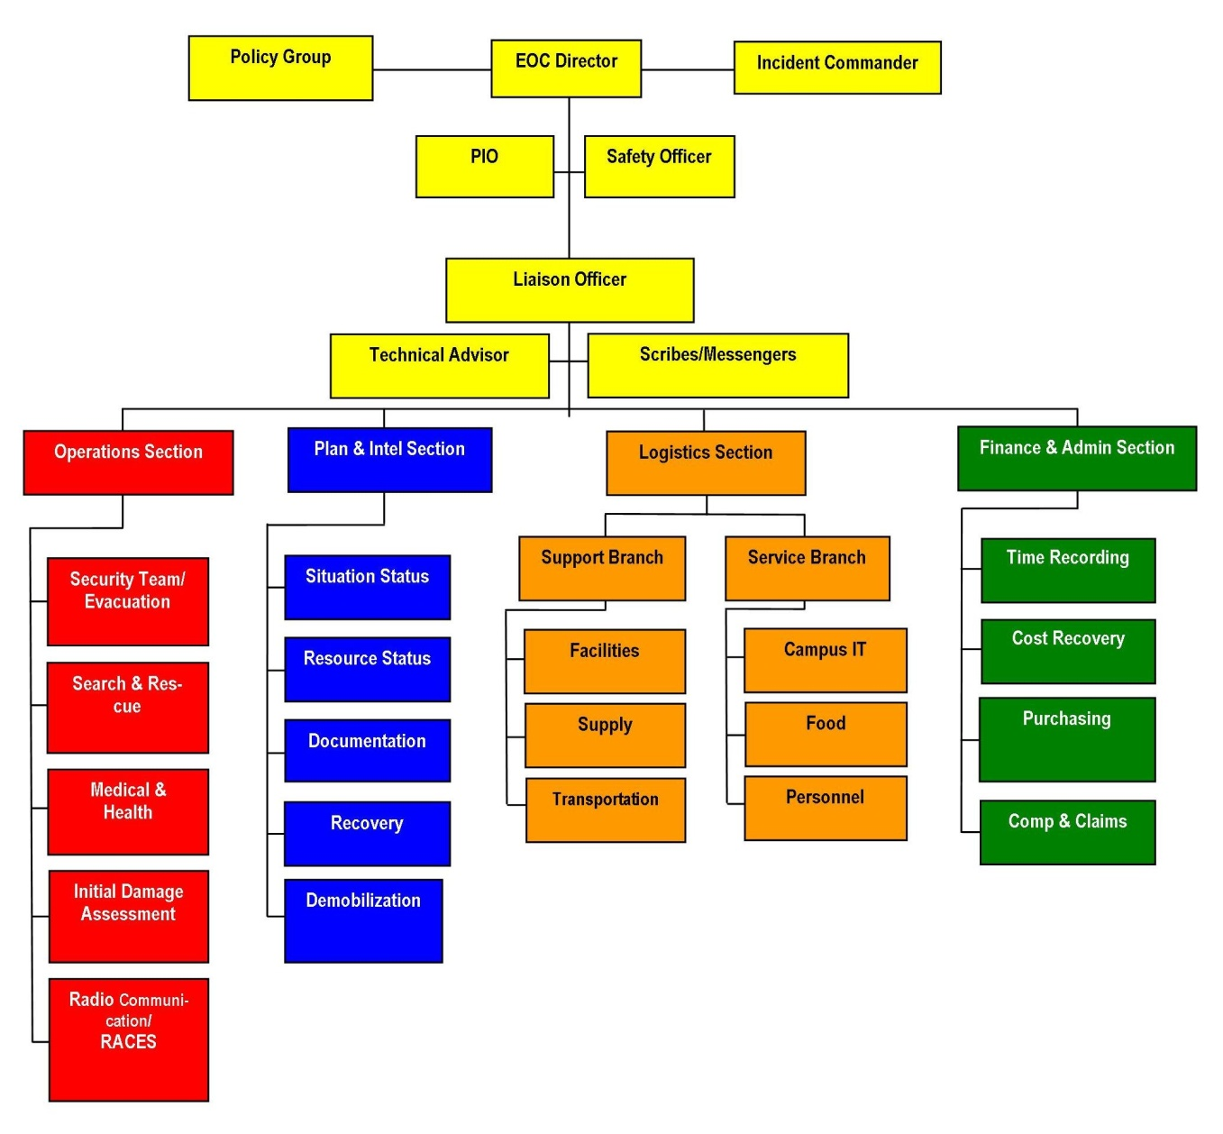
Two Primary Functions
EOC Function Chart
Field Level Function Chart
Building Marshal
Floor Captain
Floor Captain
Floor Captain
Floor Captain
Faculty/You
The College conforms with the National Incident Management System (NIMS), and utilizes the Incident Command Structure (ICS)
6
Notes:
Do you know where the fire extinguishers are in your building?
Do you know where to assemble during an evacuation?
If something were to happen right now, where would you assemble?

Slide 7

Evacuation
In the event of an evacuation, Choose Your Assembly Area
Know Your Role, and Help Evacuate
Building evacuation will occur via one of the following mechanisms:
When a building evacuation alarm is sounded; or
Notified by a Public Safety Officer, or by a Building Marshal or Floor Captain
When a signal to evacuate the building is sounded, walk quickly to the nearest marked exit and ask others to do the same.
When you evacuate your office, classroom or designated work area, you should have a pre-designated place to meet after evacuation (a.k.a., Emergency Assembly Areas).
During evacuations, assist those in need or the disabled to safely exit the facility. Know when to avoid elevators and be aware of alternate exit routes.

Slide 8
Evacuation
Once outside the building, move to a designated Emergency Assembly Area, take note of who is there, who did not/could not evacuate, and who may have chosen to go home. Share information with the Building Marshal/Floor Captain(s).
Keep streets and walkways clear for emergency vehicles and personnel.
An Incident Command post may be established on campus where emergency personnel will meet to share and disseminate information.
In the event of a full-scale campus closure, Building Marshals/Floor Captains will receive notification in their Assembly Areas of next steps. Faculty/staff leadership roles will continue during a full-scale evacuation.
DO NOT return to an evacuated building unless directed to do so by a Campus Safety Officer or by a Building Marshal or Floor Captain.

Slide 9
Building Marshal & Floor Captain
Responsibilities
Special Populations
Suggestion – Prior to a Drill

Slide 10
Responsibilities
Building Marshals and Floor Captains lead and implement evacuations.
Building Marshals report directly to the designated Emergency Assembly Area and wait for Floor Captains and others to arrive.
Floor Captains – during the evacuation, direct all building occupants to evacuate to the nearest Emergency Assembly Area.
At the Emergency Assembly Area
  Wait for further communications.
  Floor Captains report to the Building Marshal on the status of the event.
  ALL CLEAR - The Building Marshal waits to hear from the Incident Commander if an All Clear has been given, then informs others to return to the building(s).
The Building Marshal passes the All Clear to the Floor Captains, students, and others.

Slide 11
Evacuation for Special Populations
Faculty and staff who are mobility impaired should inform their Building Marshal and Floor Captain of their usual work area and of special assistance that may be needed in the event of an emergency.
Arrange in advance assistance for those that may need help in the event of an evacuation or other emergency.
Assign specific individuals to those that may need support.
Mobility-impaired individuals should be aware of exit routes and the designated Emergency Assembly Areas.

Slide 12
Suggestions – Prior to the Drill
Building Marshal
  Know your plan, evacuation routes and EAA’s.
  Have your Building Evacuation Plan handy- At a minimum, have a clipboard in hand with a list of Floor Captains and staff
  Collaborate with other Building Marshals in your area to make sure you have enough coverage.
  Meet with Floor Captains and staff prior to drills for planning & coverage.
  Identify persons with mobility challenges – assign staff to provide assistance.
Floor Captains
  Assist Building Marshal with dissemination of information and scheduling of meetings
  Attend all training and meetings
  Know your building layout and evacuation routes
  Identify the EAA’s in the immediate vicinity of your building

Slide 13
Summary of Responsibilities
Building Marshal
  Don your orange vest, radio and clipboard.
  Report to the EAA
  Once Floor Captains have arrived take attendance of your staff.
  Listen to communications on the radio (Channel 1)
  Respond to Incident Commander when you are directed.
  Wait for the “All Clear” and inform Floor Captains of the “All Clear”.
Floor Captain
  Don your yellow vest and radio.
  Sweep/comb the building as you evacuate.
  Ask others to evacuate
  Faculty – lead students to EAA’s.
  Report to the Building Marshal at the EAA and provide status update.
  Once “All Clear” has been announced - Inform students/staff to return to your area.

Slide 14
Radio Protocol
Incident Commander (IC) or designee –
Provides communications, makes contact to others
Provides instructions to all responders - Facilities, Security, Building Marshals and others.
Primary person giving an “All Clear” (Channel 1).
Radio Spokesperson- (Channel 1)
On behalf of the IC - Provides communications during the drill or event.
Building Marshals – (Channel 1 & alt. channel for communicating with Floor Captain)
Wait to be contacted by the “radio spokesperson” providing communications.
Respond to “radio spokesperson” of situation status.
Floor Captains - (Alt. Channel as designated by Building Marshal)
Listen to the radio as you report to the EAA and to the Building Marshal
Be on “Stand-by ready to assist.
Radios lines should be open, there is to be one primary voice - (Radio Spokesperson) providing direction and instructions.

Slide 15
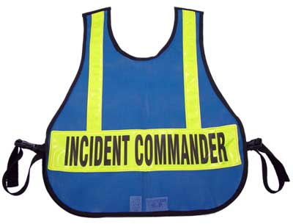
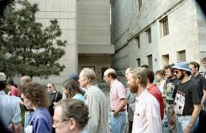


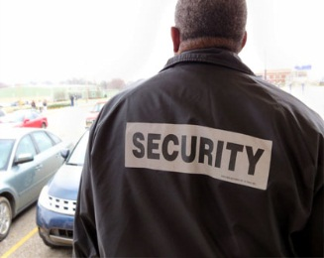
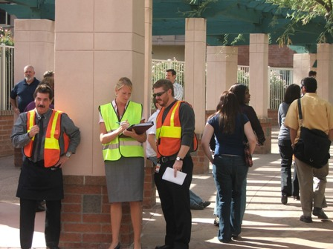
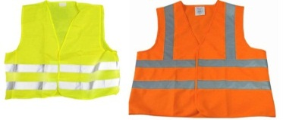

Communication Flow
Incident Commander, Admin., Facilities, Security, Radio Spokesperson – Channel 1
“All Clear”
EMERGENCY
ASSEMBLY
AREA
Building Marshal/Floor Captain – Channel 1
“Lead Evacuation”

Slide 16
Emergency Assembly Areas

Slide 17
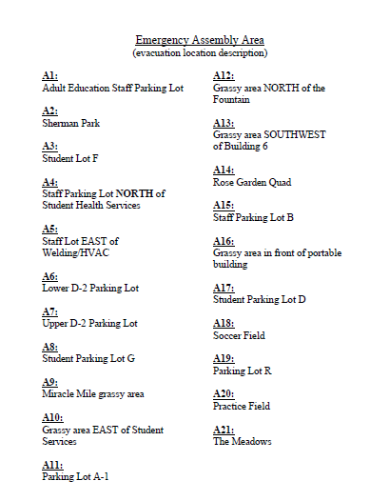

Slide 18
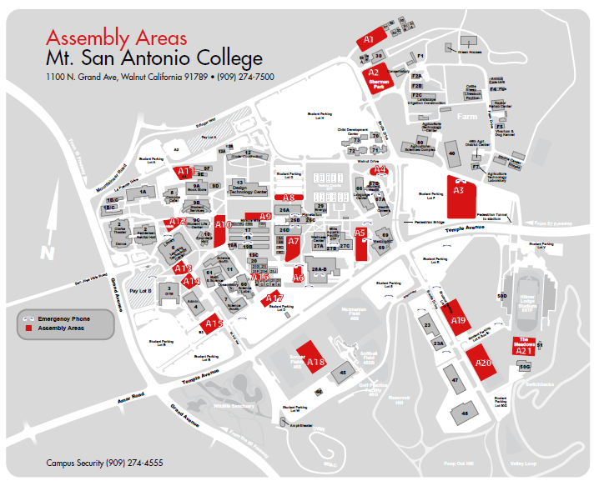

Slide 19
Shelter in Place – Lock Down Guidelines

Slide 20
Shelter in Place
Some emergencies require you to take shelter. In the event that you are required to shelter-in-place or can not exit your building due to a danger outside the building, please consider the following:
Move to an interior room or area away from windows.
Do not use elevators.
Bring everyone into the room.
If available, take a radio or television with you to monitor the news.
Shut and lock all windows and doors.
Make a list of who is there and be prepared to provide this information to Public Safety.
Keep calm and review evacuation procedures with staff members.
If available, check your Mt SAC email regularly for messages giving you further instructions.
Stay where you are until otherwise notified by emergency personnel.
Silence your cell phone, if warranted

Slide 21

Active Shooter/Civil Disturbance
How you respond to an active shooter or a civil disturbance will be dictated by the specific circumstances of the encounter.
If you find yourself involved in an active shooter situation, remain calm and use these guidelines to help you plan your strategy:
Proceed to a room and lock the door if possible. Use furniture to block the door(s).
Turn off lights and get down on the floor below window level and take cover behind or underneath something that will conceal you (such as a desk, table, cabinet, etc.) and remain silent
Get out of building or area if safe to do so

Slide 22
Active Shooter/Civil Disturbance
If safe, dial emergency services - 9-911
Public Safety –
  From a campus phone extension 4555
  From a cell phone: 909.274.4555
You may also contact Public Safety from a blue emergency phone located at various locations on campus. Keep cell phone on vibrate.
Advise dispatcher of what is taking place, and:
  Inform dispatch of your location.
  Remain in place until the police, or public safety staff member that is known to you, give you the all clear.
  Do not respond to any voice commands unless you are certain the command is coming from a police officer or public safety personnel.

Slide 23
Resources
1. Building Evacuation Plan:
http://inside.mtsac.edu/departments/admin/risk/emergency-preparedness.html
2. Emergency Quick Reference Guide:
http://inside.mtsac.edu/departments/admin/risk/emergency-preparedness.html
3. View videos (1. Shots Fired on Campus 2. Run, Hide, Fight): https://myportal.mtsac.edu)
4. Sign up for the Connect Ed Mass Notification System: https://myportal.mtsac.edu
5. Review the campus emergency procedures:
http://inside.mtsac.edu/departments/admin/risk/emergency-preparedness.html

Slide 24
Questions?
Risk Management and Public Safety staff thank you for your attendance and participation

Slide 25
Feedback from Debrief
(March 18 , 2014 drill)

