Slide 1
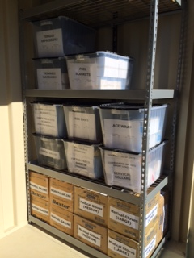
Inside the shed

Slide 2
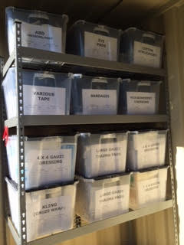
Inside the shed

Slide 3
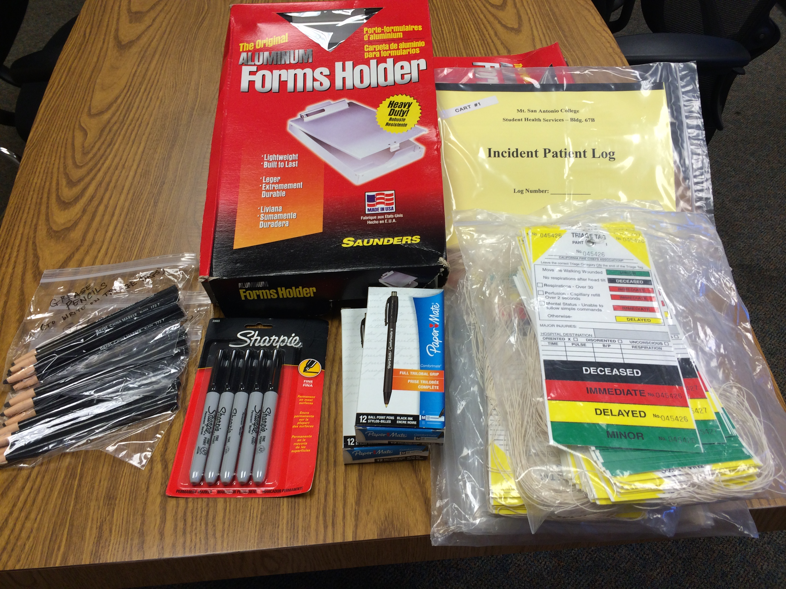
Clerical supplies/Triage tags

Slide 4
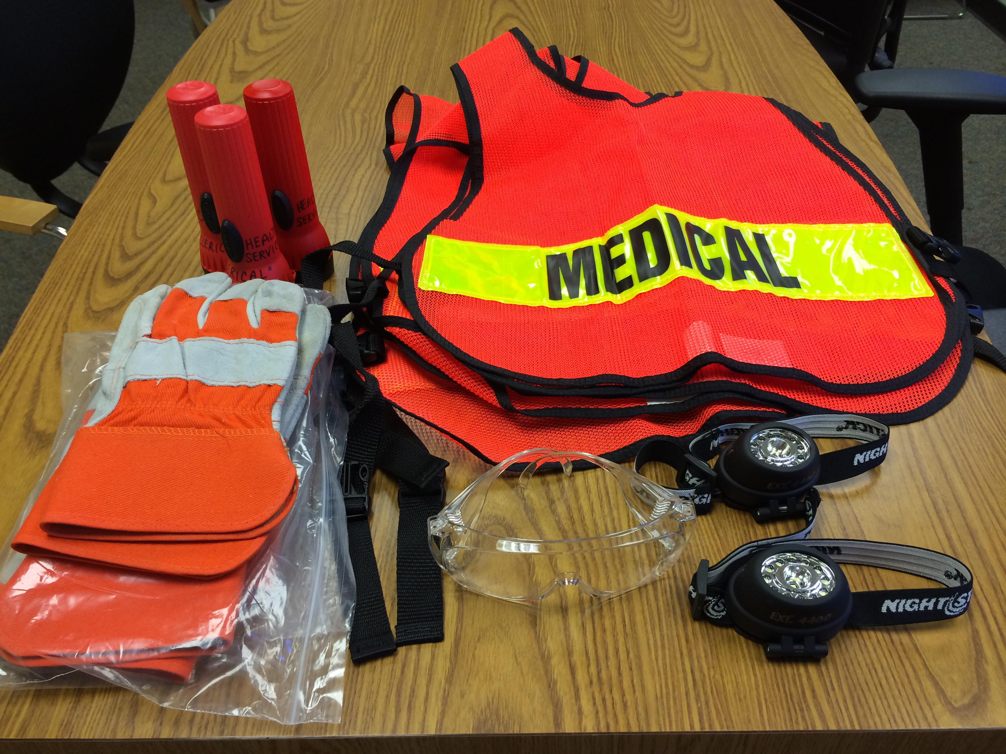
Personal protection supplies

Slide 5
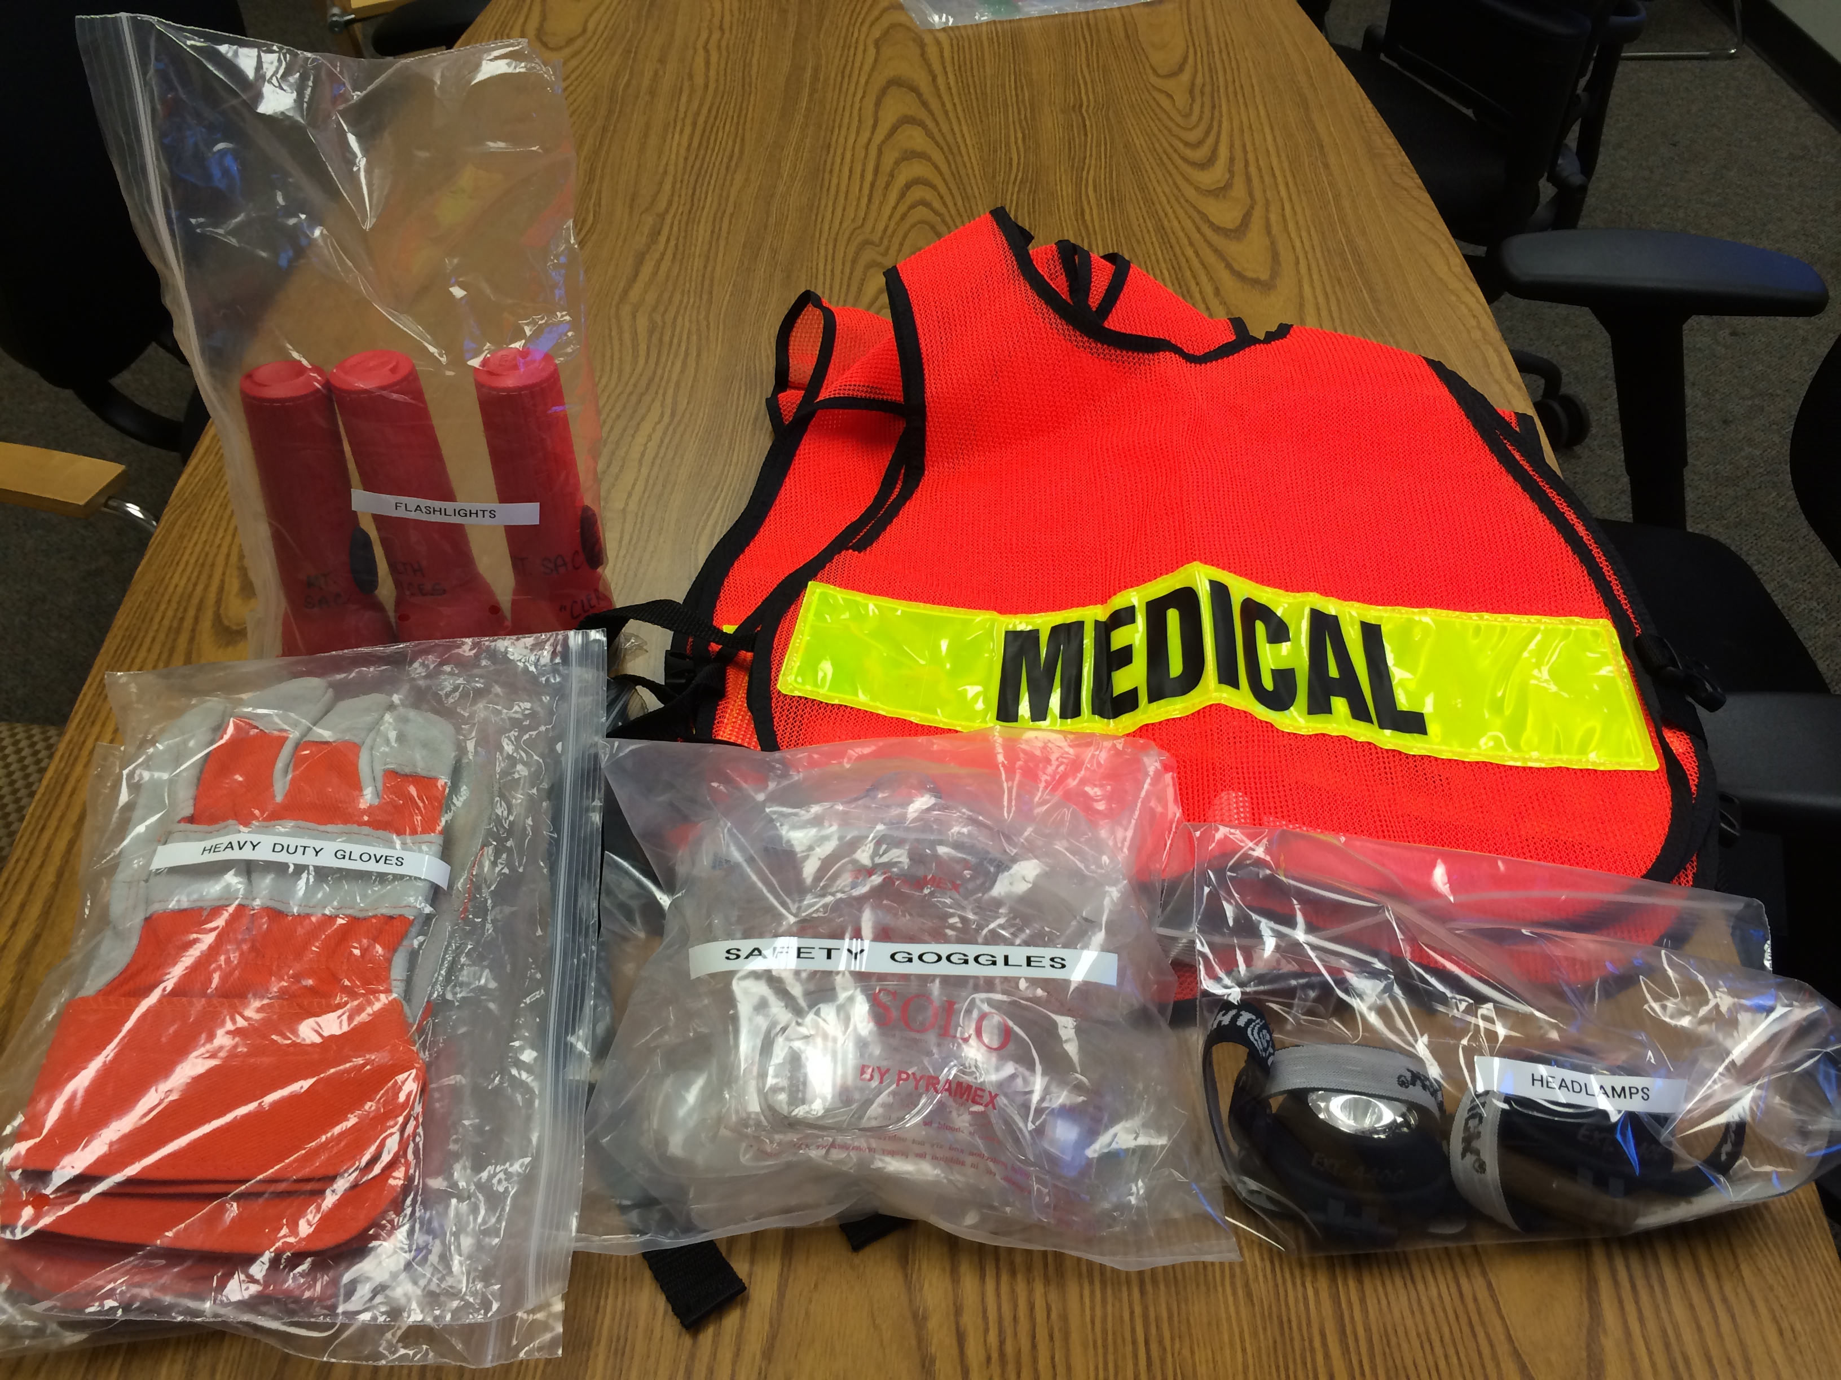
Packed personal protection supplies

Slide 6
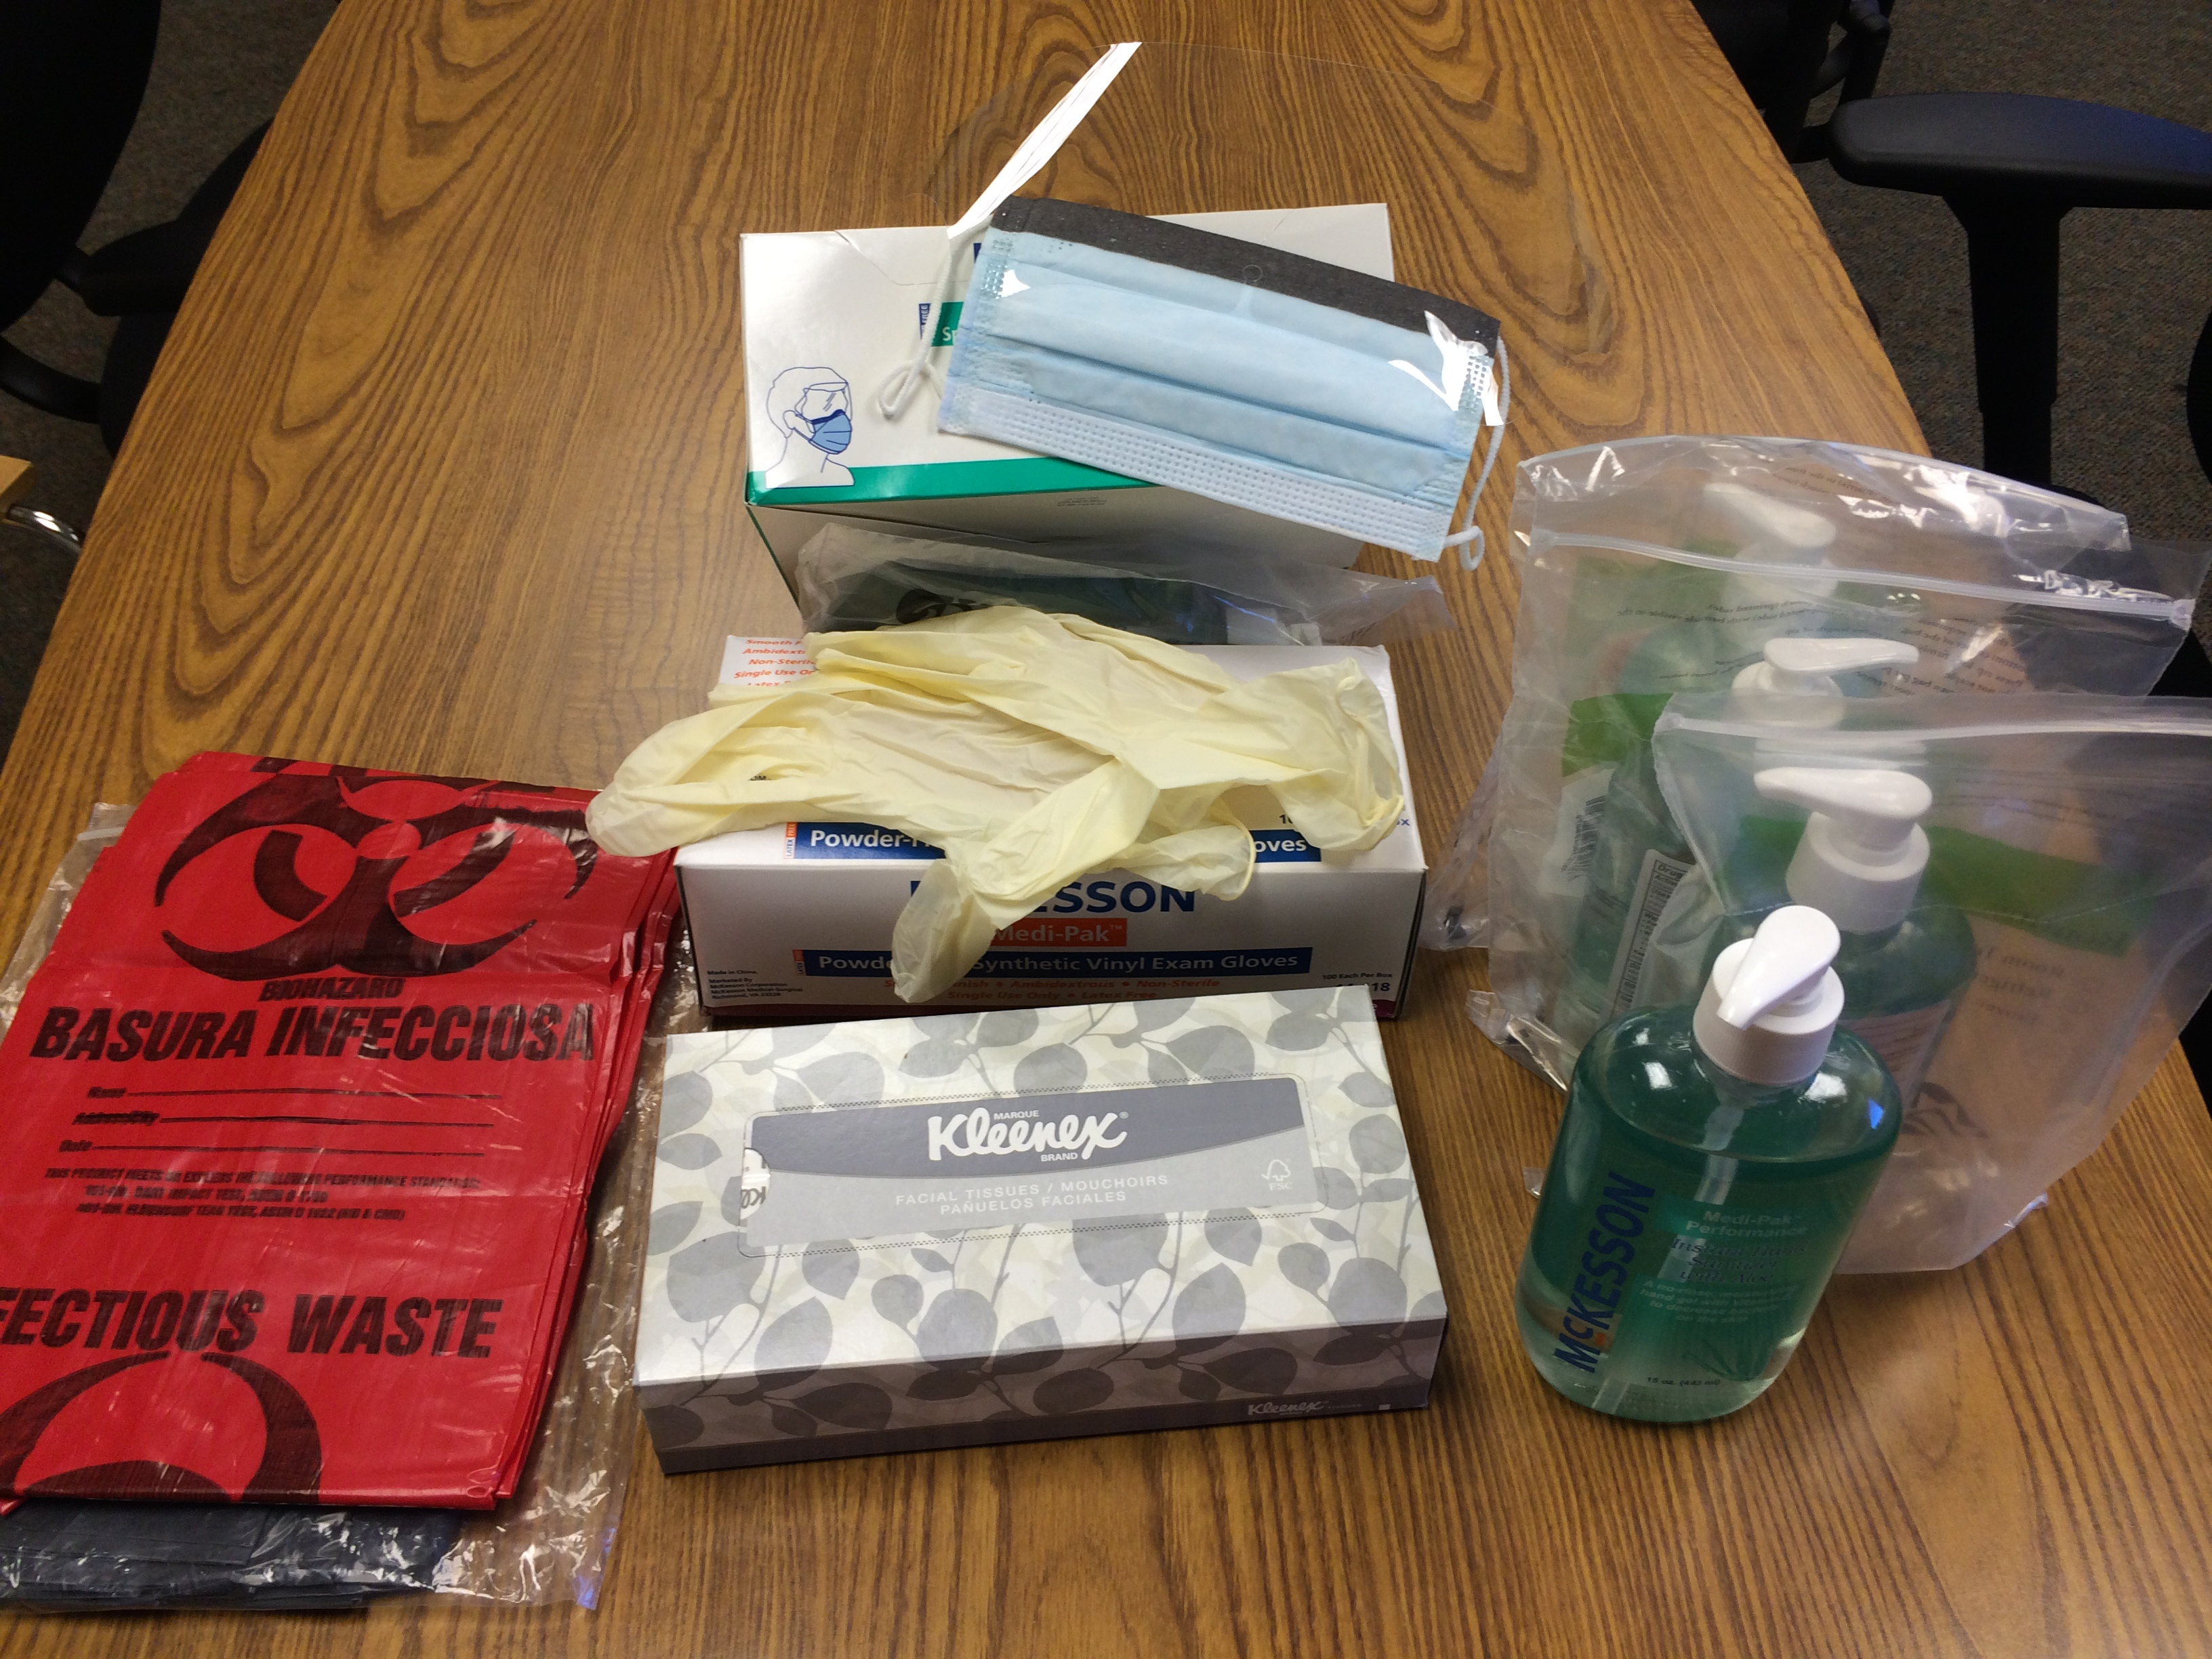
Personal protection supplies

Slide 7
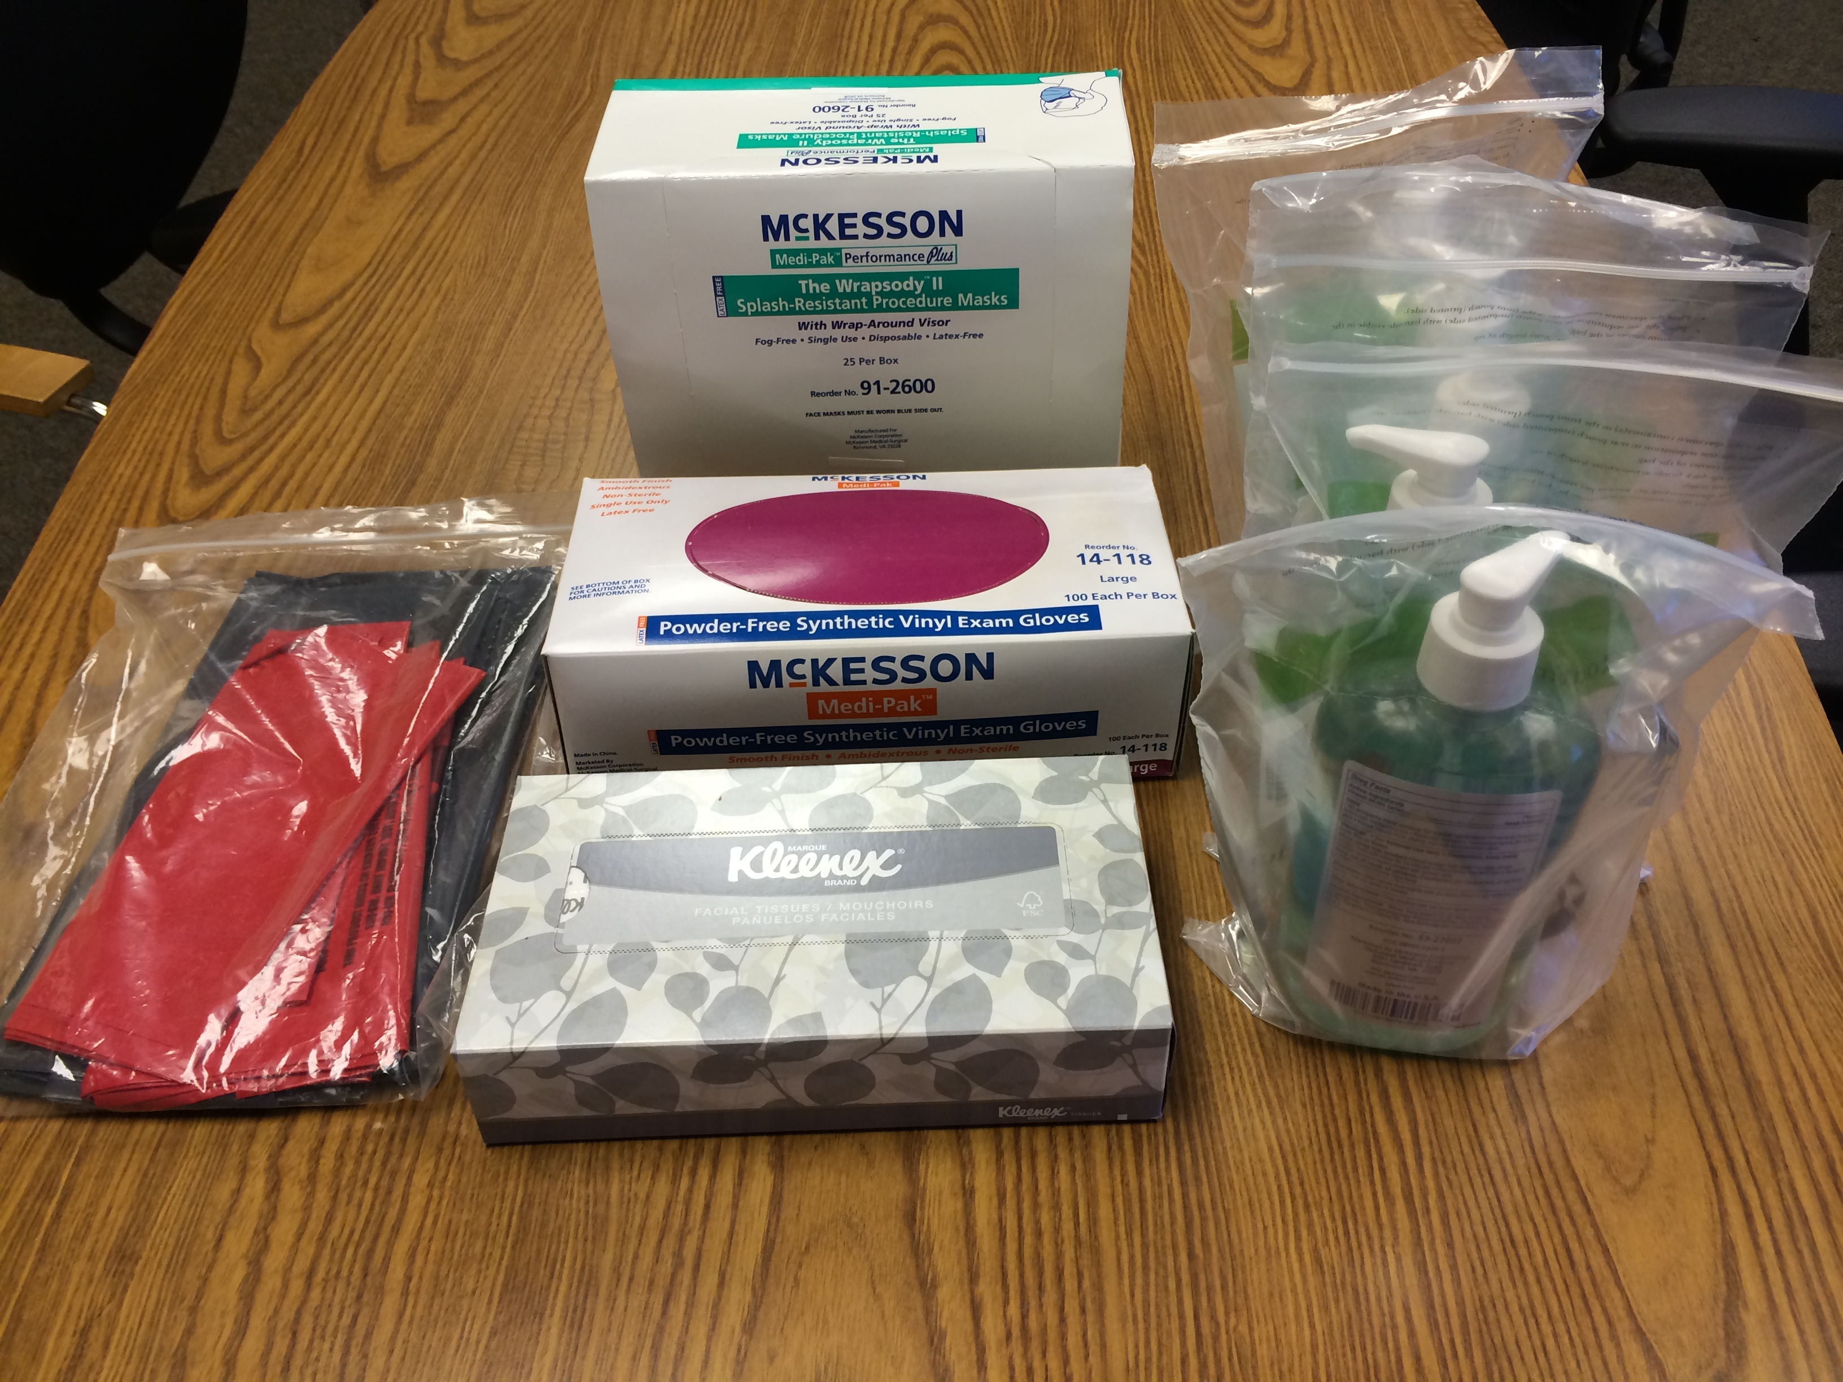
Packed personal protection supplies

Slide 8

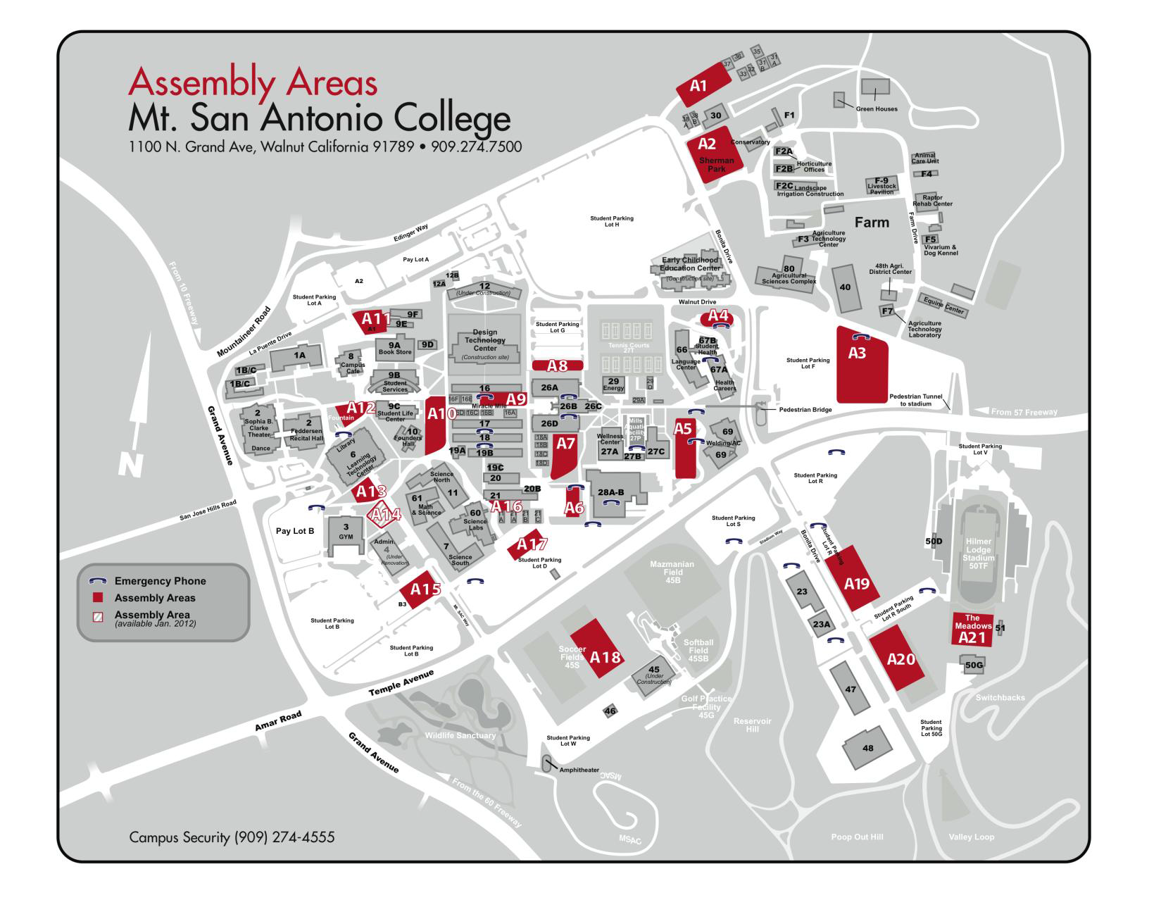
Site of the 3 sheds

Slide 9
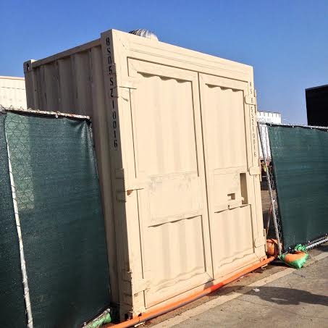
Shed by East of building 9B

Slide 10
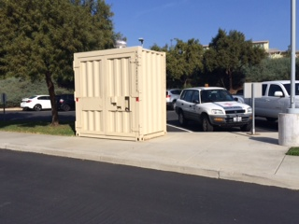
Bin at Parking lot outside back door of Health Service

Slide 11
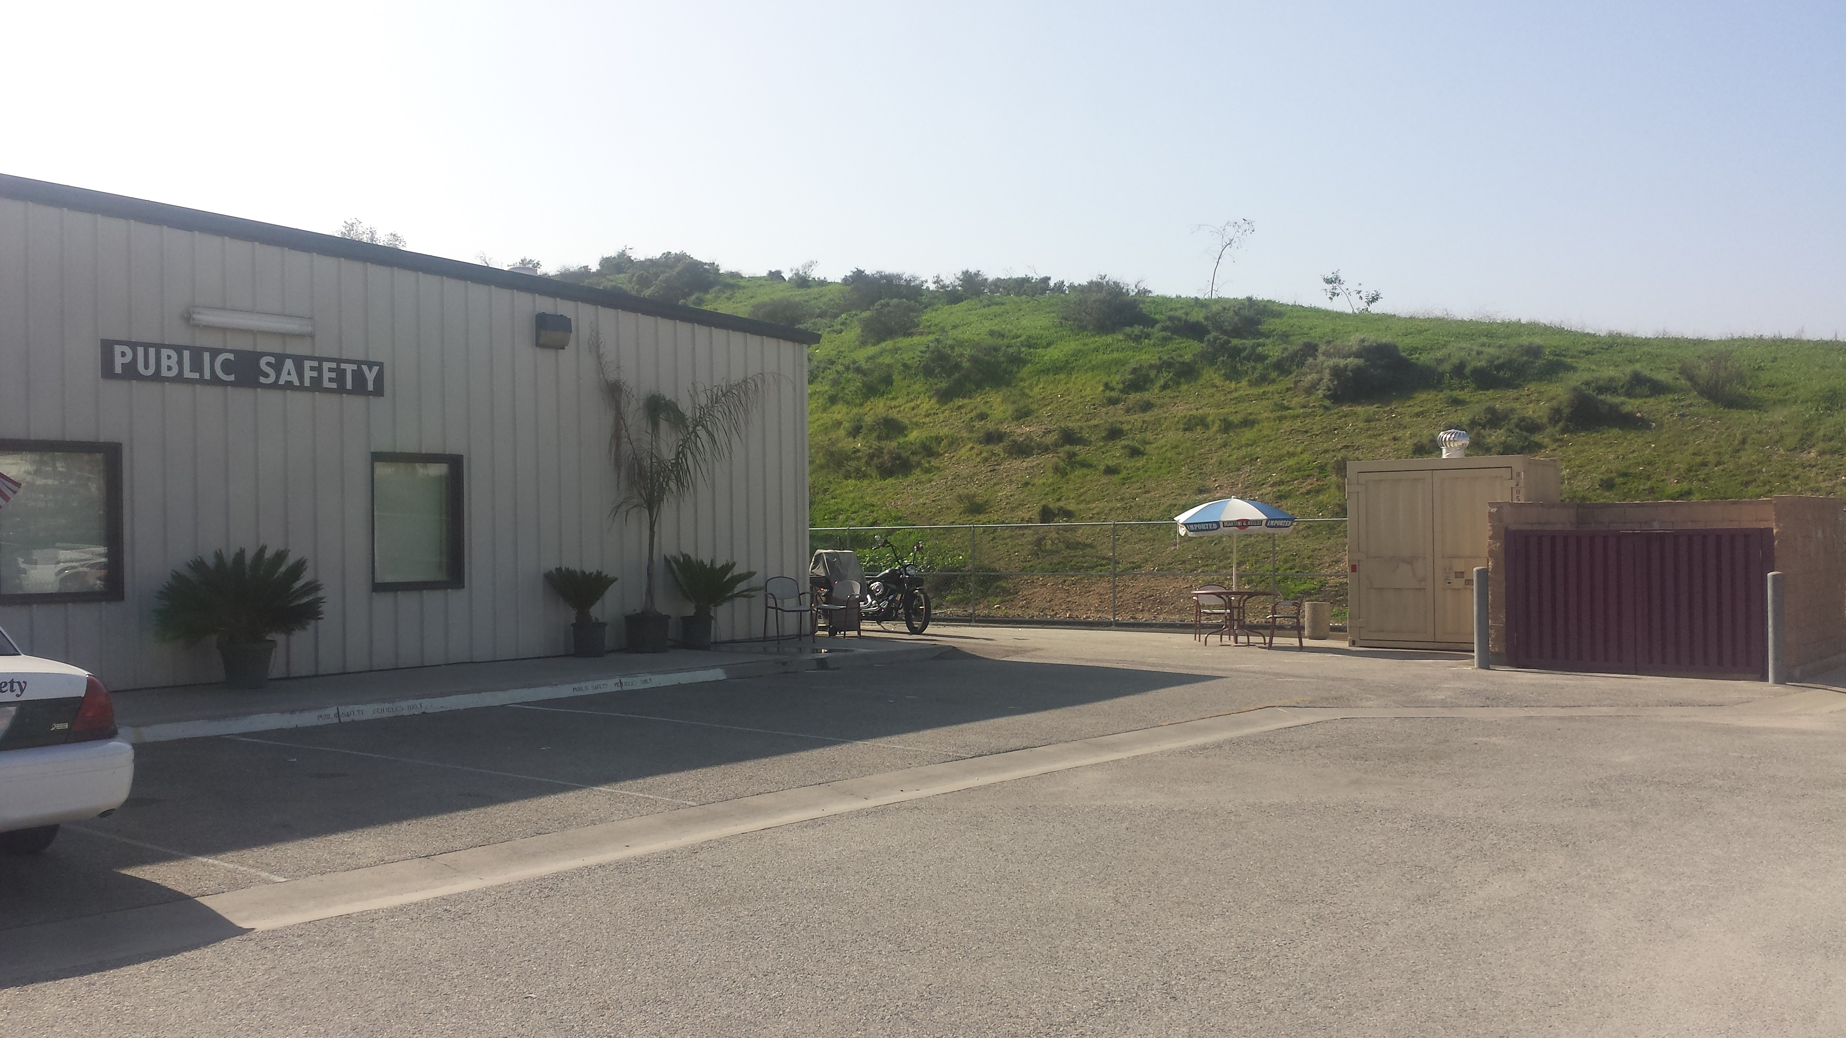
Shed at public safety

Slide 12
Supply inventory for the 3 sheds
Long rigid wooden splints (cushioned fabric-covered) 12
Short rigid wooden splints (cushioned fabric-covered) 6
Thick polyester blankets (twin size) 4
Yellow laminated blankets 19
Foil blankets 30 (packed per dozen) +14 individual
Fitted paper sheets (disposable) 16 individual
Large paper sheets, poly-backed (disposable) 50
Corregated splints – medium length ( adult arm or small child leg) 5 boxes of 3 dozen each + 82

Slide 13
Corregated splints–long length (adult leg) 4 boxes/dozen
Corregated splints-short length (Child arm) 12 individual
Cervical collars ( cushioned, fabric covered) 3 individual
Triangle bandages 27 dozen (packaged)+6 individual
4” ACE wrap 22 boxes/10 +1dozen loose
2”and 3”ACE wrap 64 individual loose
Red bags 11 pkgs
Medical gloves - medium 8 cases (10 boxes/100 each per case) +33 loose boxes
Medical gloves – large 19 loose boxes (100 gloves per box)
ABD dressings 875 individual

Slide 14
4x4 dressings (100 to 200 per sleeve) 141 sleeves
Kling ( gauze wrap) 103 dozen (packaged per dozen)
Bandages (minor cuts + wounds) 25 boxes (100 per boxes)
Eye pads 12 boxes (packaged individually per 50=600 ea)
Wound closure strips 12 boxes (packaged 50 per box)
Various tape ( porous, paper, transpore) 53 dozen 9b0xed per dozen) +16 loose
Normal saline -1 liter bottle s 16 dozen
Cotton applicators 11 boxes (1000 applicators each)+20 loose pkgs (of 100 applicator each)

Slide 15
Medical vests 10 individual
Medical tags 9 packages /50 =450 each
Metal storage clipboards 4
Tongue depressors 1500 individual ( packaged in 2box)
Long blue cotton/poly drapes 1 case of 50 drapes
Adaptic ( moist, non adherent dressings 539 individual
Telfa (dry non adherent dressings 177 individual
Medical flag with stand 1 individual set in a bag
Isolation gowns 100 (packaged in set of 10)

Slide 16
Blood pressure + stethoscope 8 sets
Trauma scissors 26
Airways- adult 19
Airways – child 12
Tourniquets 26
Bloodstoppers kits 9
Medical scissors 7
Bandage scissors 14
Hemostats (clamps) 2
Splinter forceps 5
Fine tweezers/forceps 24
Ammonia ampules 22 boxes (10-12 ampules per box)

