Slide 1
Emergency Preparedness
Safety and Risk Management
Melonee Cruse – Emergency Services Manager
Duetta Langevin – Director of Safety and Risk Management
Risk Management/Administrative Services

Slide 2

Preparedness includes having supplies, knowing what to do, and where to get information or assistance.
For Home, Work or Vehicle emergency supply checklists visit:
  www.ready.gov
  https://www.redcross.org/get-help/how-to-prepare-for-emergencies.html

Slide 3
Know who to call to report emergencies
Call Police & Campus Safety to report:
    Serious injuries
    Crime, suspicious persons or packages
    Students who are
      An immediate danger to self or others
      Demonstrating dangerous or violent behavior
      Carrying a weapon
      Using threatening behavior
  Opt in to the Emergency Notification System
  Police & Campus Safety (909) 274-4555 or 911 from a campus phone

Slide 4
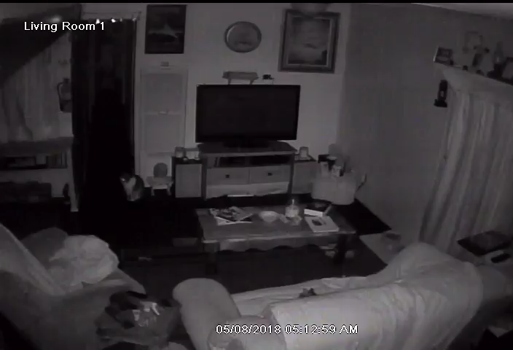
Know what to do in an emergency
Early morning earthquake May 08, 2018
Watch the cats eyes.
Emergency procedure posters are in classrooms.

Slide 5
Know your roles & responsibilities in an emergency
REMEMBER YOU ARE A LEADER
  Review emergency procedures and locate your emergency resources BEFORE you need them. Students look for instructors to give directions in an emergency, provide a briefing on emergencies in your syllabus:
    Where the fire extinguishers are located in the room
    Eyewash stations in the classrooms or lab rooms
    First Aid Kit, etc.
  Participate in drills, attend emergency training. District employees are Disaster Service Workers. Get training.
  Know who your Building Marshal, Building Manager and Floor Captains are in your building
  Classroom awareness for students that may need extra assistance during an emergency evacuation.

Slide 6
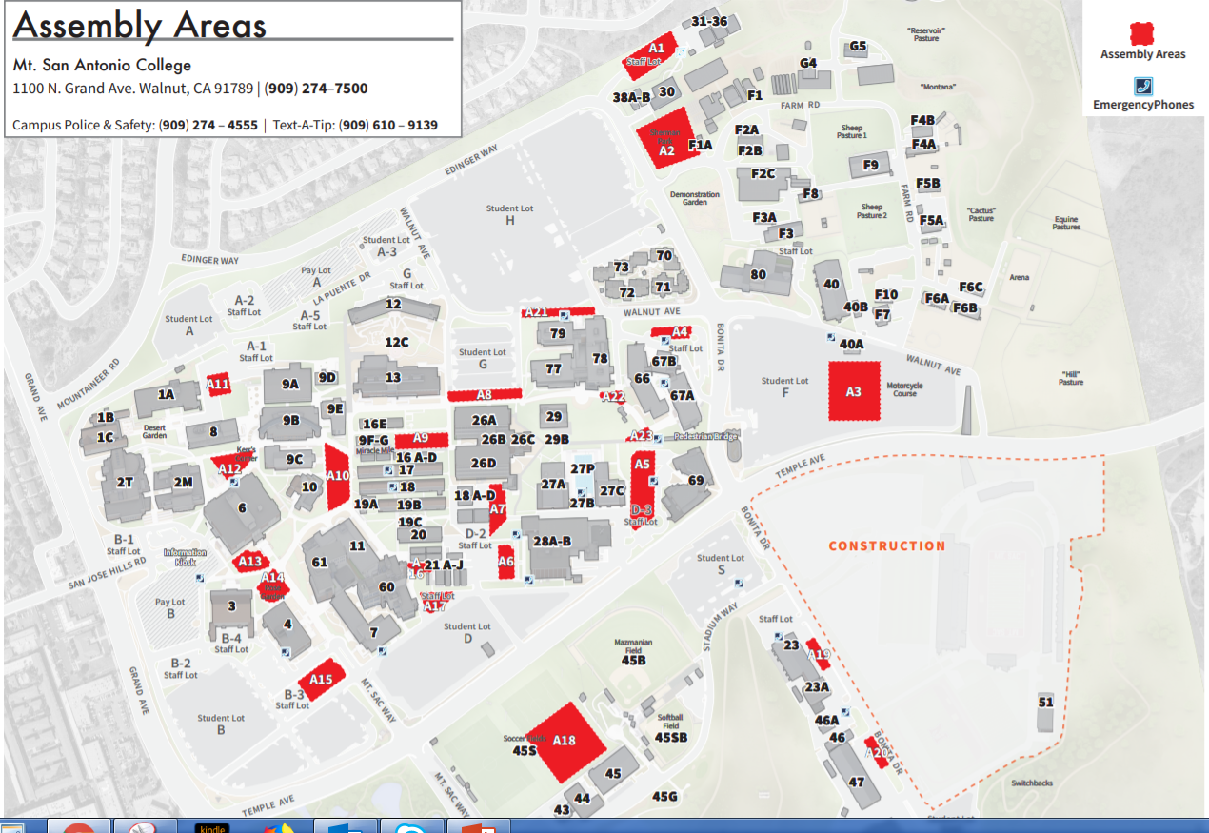
Know how to evacuate
Know exit routes out of the building.
Assist those with disabilities or challenges. Ask them how to assist.
Assembly at the evacuation assembly site. Take roll.
Return when announced it is safe or “all clear”.
www.mtsac.edu/maps

Slide 7
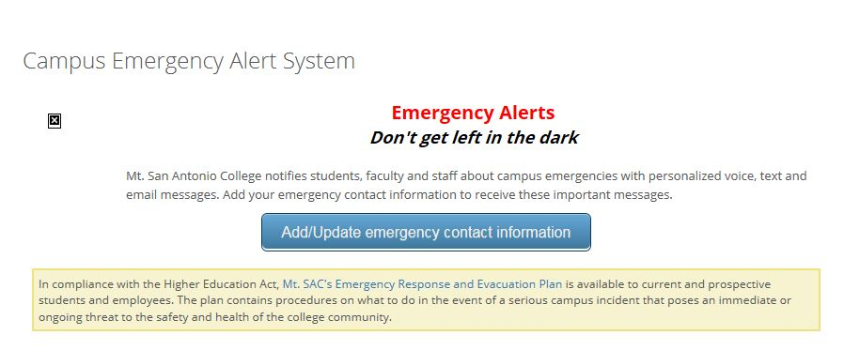
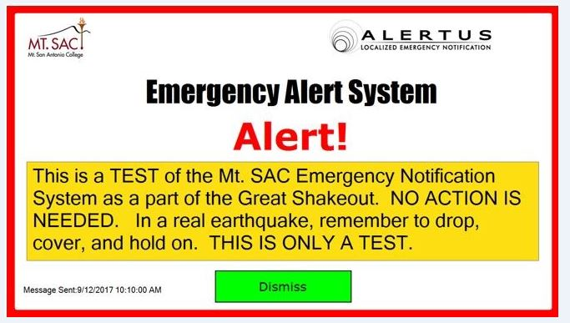
Know how to receive a campus
Emergency Alert
Emergency Alerts are sent to phones and email
Computer Desktop Display Emergency Alert
Sign up in the Mt. SAC Portal
Automatically displays on your Mt. SAC computer screen if you are logged onto the network.

Slide 8
Attend Training
    Disaster Service Worker
    ICS/SEMS/NIMS
    Active Shooter
    Fire Extinguisher
    Building Evacuation Team
    CPR/First Aid
    Campus Emergency Response Team (CERT)
    Emergency Preparedness Week - 1st & 2nd week of October
    Fall & Spring building evacuation drills
Look for announcements and sign up on POD Calendar - www.mtsac.edu/pod

Slide 9
Safety and Risk Management
    Workers Compensation
    Safety and Compliance Training
    Third Party Auto Accident
    Student Accidents
    Field Trip Guidelines and Forms
    Affiliate Agreements and Contracts involving work exp.
    Students and Service Animals
    Safety/Hazard Reporting

Slide 10
Workers Compensation Injuries
Assess situation call 911 if an emergency situation
Immediately notify risk management x 5501 and then email forms to riskmanagement@mtsac.edu
Forms that need to be provided to employees/student workers/technical students
  Workers Comp Policies and Procedures
  Employee/student workers/technical students need to complete the employee section on the Managers Report
  DWC – 1 Form
  Medical Release Forms – all 3
  Authorization for treatment – provide to employee
  Temporary Pharmacy Card – to fill prescriptions related to the injury
  Prime RX Letter
  Covered Employee Notification of Rights Materials – PRIME ADVANTAGE
Forms that Dean/Faculty would complete:
  Complete the Manager’s Report and send the employee for medical treatment

Slide 11
Third Party Auto Accidents
On Campus auto accident:
Contact Campus Safety x 4555 (909-274-4555) or 911 from campus phone
Contact Risk Management x 5501 (909-274-5591)
Off Campus auto accident obtain the following information and report to Risk Management:
Name, phone, address, auto insurance information of the other party
Location of accident – i.e.: intersection of Temple and Grand
Who if anyone received a ticket as a result of the accident
Who was the responding agency i.e.: state patrol, city police, sheriff
Report number with name of the individual that completed the report
TAKE PICTURES

Slide 12
Field Trip Guidelines and Forms
NO – in classroom travel coordination unless using the College transportation vehicles
otherwise let the students develop their own travel plans
Special events related to curriculum should be reviewed with Risk Management prior to commencing the event
Forms can be located at
www.mtsac.edu/risk/riskmanagement/fieldtrip&studyabroad
    Field Trip Waiver
    Medical Release form

Slide 13
Student Accidents
Injury to student workers/technical training students – go through workers compensation
  Contact Risk Management x 5501
Student On Campus:
  Refer student to Health Services – Bldg. 67A or 9E
  Health Services will complete the claim form
Student Off Campus IE.: Field Trip
  Contact 911 if an emergency
  Refer to Medical Release and Field Trip consent forms for emergency contact information

Slide 14
Students and Service/Emotional Support Animals
AP3440 - is guidelines discussing service/emotional support animals for the campus
If the professor is having difficulty with a situation involving a student that has a service/emotional support animal in class then refer the student to ACCESS or HR for assistance
If you as the faculty member have allergies to certain animals and a student has registered for your class, then contact HR for assistance – HR ext 4225

Slide 15
Affiliate Agreements, Contracts and Work Experience Program contracts
All Agreement and Contracts must be approved by Risk and include the following:
Dual Indemnification clause – protects the College against claims that the College has no control over –
”The parties hereto shall indemnify and hold each other harmless their perspective trustees, officers, and agents from any and all claims, losses, damages or injuries to persons or property, and all costs, expenses and reasonable attorneys' fees incurred in connection therewith, caused by the negligent acts of the indemnifying party, its agents or employees arising out of the performance of this Agreement.”
Insurance Requirements to include coverage for following:
  General Liability
  Professional Liability
  Auto Liability

Slide 16
Safety Training and Hazard/Safety Suggestions
Teach Safety as part of the curriculum in your classroom
Safety training for your staff contact risk management we have many options:
  In Person training
  Online training
  Classroom training
Hazard/Safety Suggestion: wet floor, trip hazard, noise hazard
  Form can be found on Risk Management website – www.mtsac.edu/risk
  High hazard situation – please contact Risk Management ASAP – x 5501, riskmanagement@mtsac.edu

Slide 17

Thank You & see you in Training!
Duetta Langevin
Director of Safety and Risk Management
dlangevin@mtsac.edu
909-274-5508
Melonee Cruse
Emergency Manager
mcruse1@mtsac.edu
(909) 274-5567
Andrea Solorzano
Risk Management Specialist
asolorzano14@mtsac.edu
909-274-5501

