Slide 1

OnBase Training for requistioners
Mt. San Antonio College

Slide 2
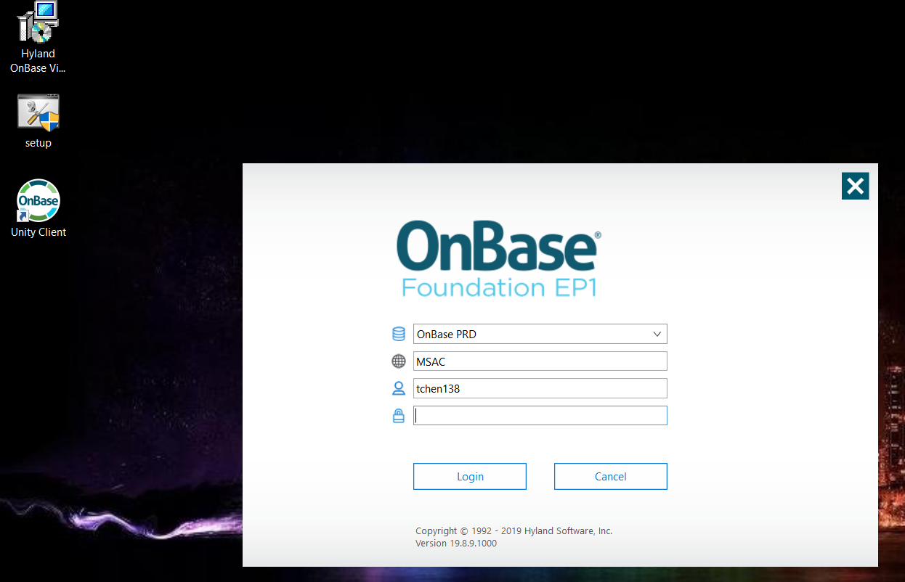
Logging in with your single sign on

Slide 3
Table of contents
Import & Index
Retrieval
Appending
Retrieval for Change Orders
Cross Referencing
How to log off completely

Slide 4
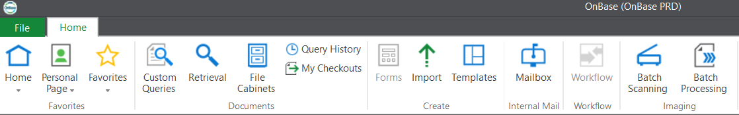
Overview
The On Base Unity Client is Mt. SAC’s Enterprise Content Management system that is used to store, scan, and retrieve documents.
Your access is granted based on you manager/supervisor’s request
After IT installs the software, login by double clicking on the OnBase Unity Client on your desktop and use your windows credentials to login.
The ribbon (views and functionality will vary by access levels, see example below):
The goal is to have a paperless environment to save time and cost. This will improve efficiency and processes.

Slide 5
Topic One
Import & Index

Slide 6
What you can import?
Any file type will be converted to image format with the Hyland Virtual Printer. All file types in OnBase need to be in image format (*PDF formats will not detect existing documents and therefore, will not append*)
Quotes from the internet, emails, and scans. You can also browse for the file if it’s an image format already.
You can import the pages you want by specifying the page number you want to upload (ex. You have pages 1-10, you can just upload page 5)

Slide 7
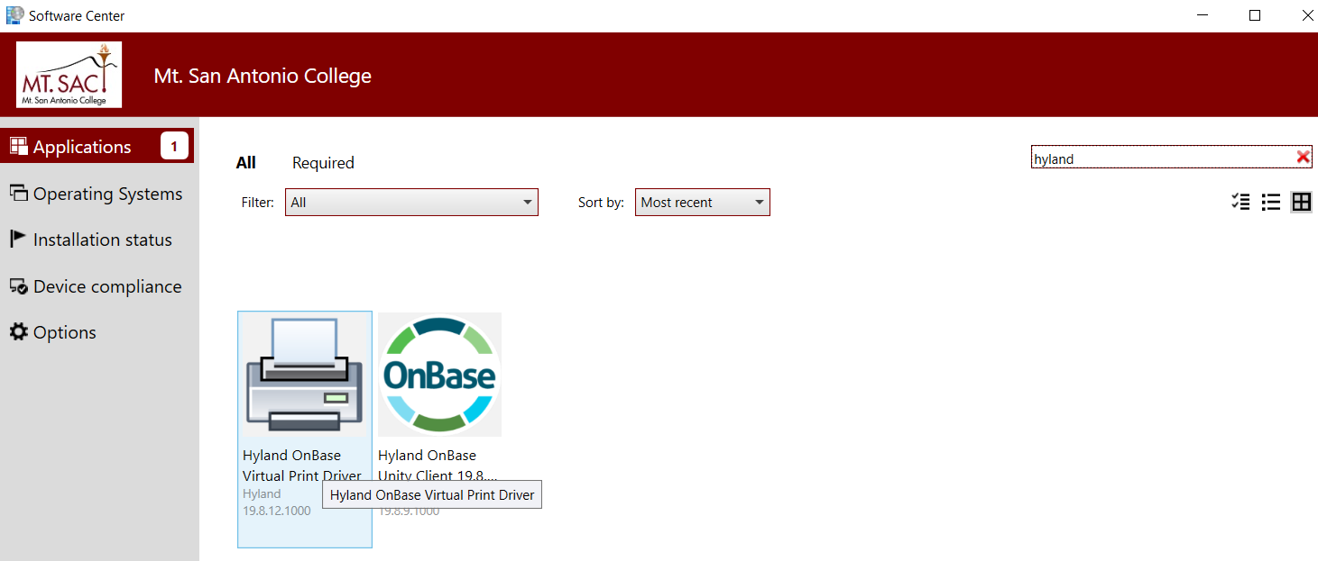
Hyland virtual printer
Step 1:
If you have Windows, search for your Software Center and then search for the Hyland Virtual Printer Driver. Install it, you don’t need IT’s login credentials. If you don’t have the maroon theme color, you don’t have the latest Software Center, you will need to contact the helpdesk@mtsac.edu to have them update/install it for you..

Slide 8
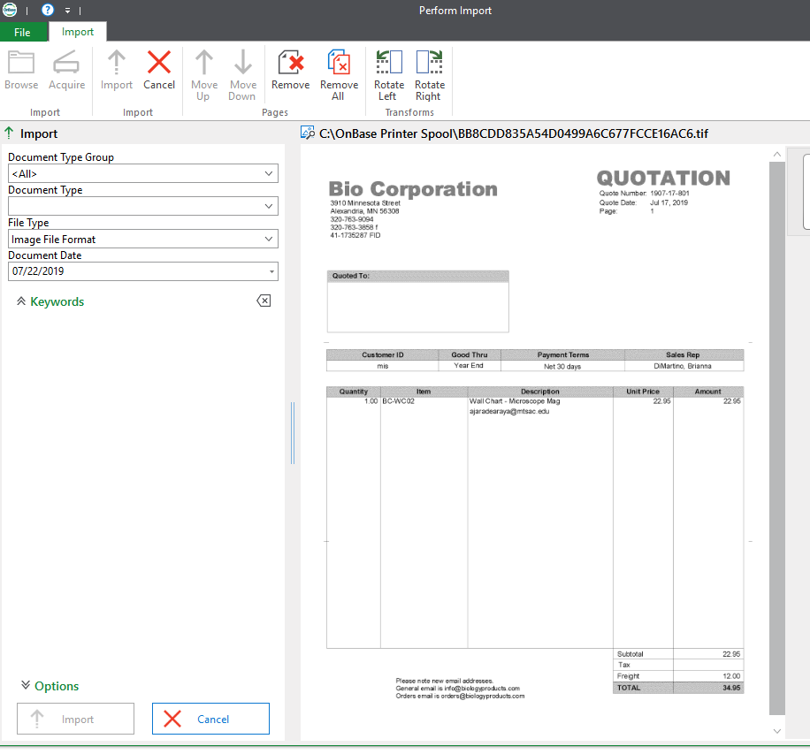
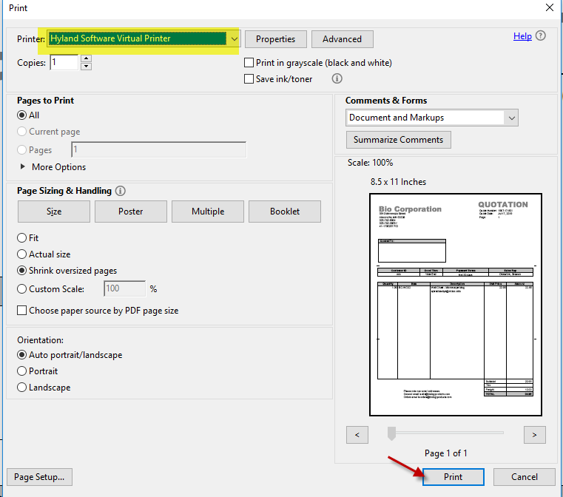
Hyland virtual printer
Step 2:
Click File, Print, and select Hyland Virtual Printer from the Printer Dropdown list. Click Print.
Step 3:
The document will automatically open in OnBase

Slide 9
How to Import
This is where you will be uploading all your requisition back up
There are two ways to import:
If you have a scanner on your desk, go to Import on your ribbon, click on Acquire on the upper left side, select your scanner, adjust your settings (color, grayscale, simplex, duplex), and click Scan. Document will be uploaded waiting to be indexed.
Once you have the Hyland Virtual Printer installed and have your document open, click on File, Print, select the Hyland Virtual Printer in your printer options and it will automatically take you into OnBase where you can index. (If the document doesn’t come up in OnBase when you click print, then log in to OnBase first, then use the Hyland Virtual Printer.)

Slide 10
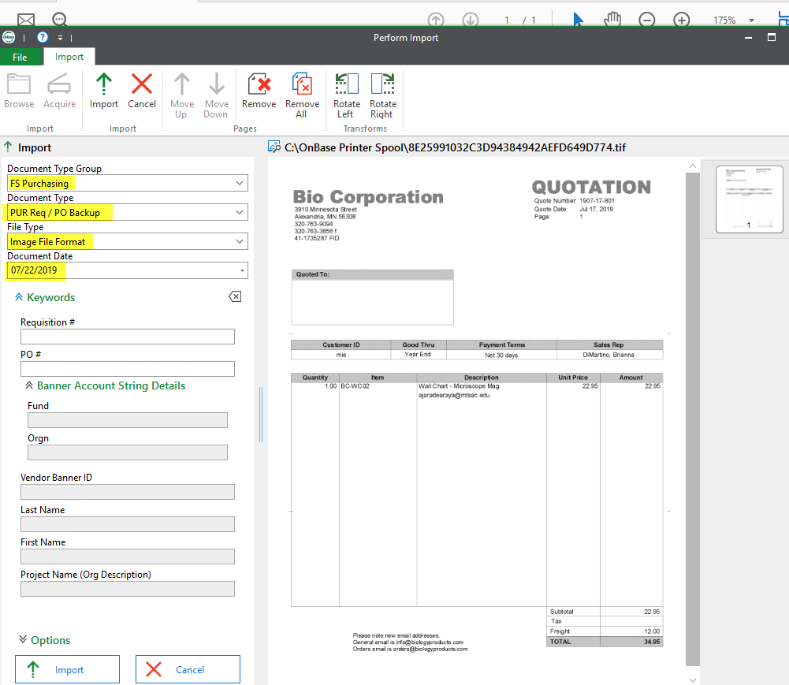
How to Index
This is done after uploading a document
Document Type Group: Select FS Purchasing from the dropdown
Document Type: Select PUR Req/PO Backup from the dropdown
File Type: Defaults to Image File Format
Document Date: Defaults to current date
Enter in your requisition number and tab. The rest of the fields will auto-populate (you must submit a req in Banner first or the fields won’t populate)
Once you have verified the information is correctly populated, click on Import when you’re done

Slide 11
Topic Two
Retrieval

Slide 12
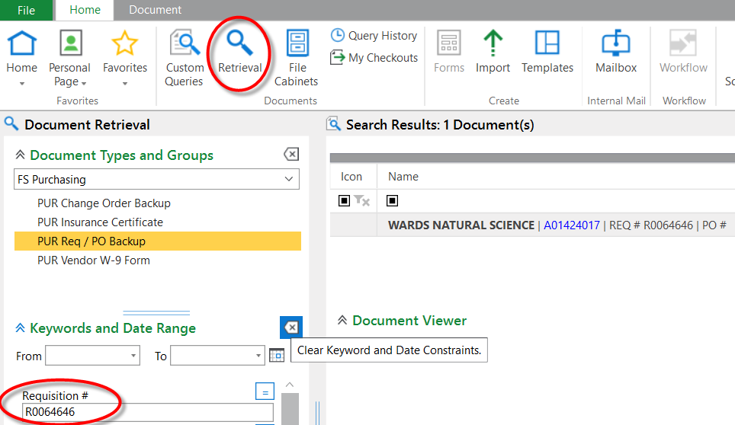
There are two ways to Retrieve documents
1. Retrieve
After you’ve imported your document and want to check if it’s in the system, click on Retrieval
Under Document Types and Groups, click on FS Purchasing, then select PUR Req / PO Backup
Type in the requisition number, click on Find or press Enter
If a PO # has been assigned, you can enter the PO to retreive

Slide 13
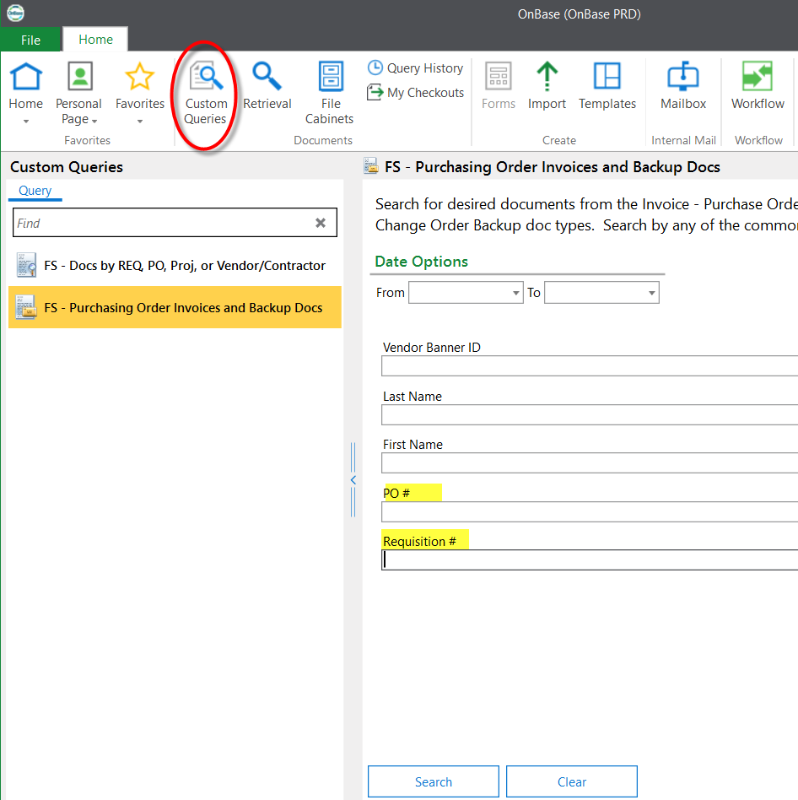
There are two ways to Retrieve documents
2. Custom Queries
  After clicking on Custom Queries, two options come up. You can search documents by either one
  You can search within any of the fields by putting an asterix (*) in front and back of the keyword (in banner it’s “%” which is the wildcard)
  Type in the Req #, PO #, or search by vendor in the last name i.g. *Office*

Slide 14
Topic three
Appending (Combining) Documents

Slide 15
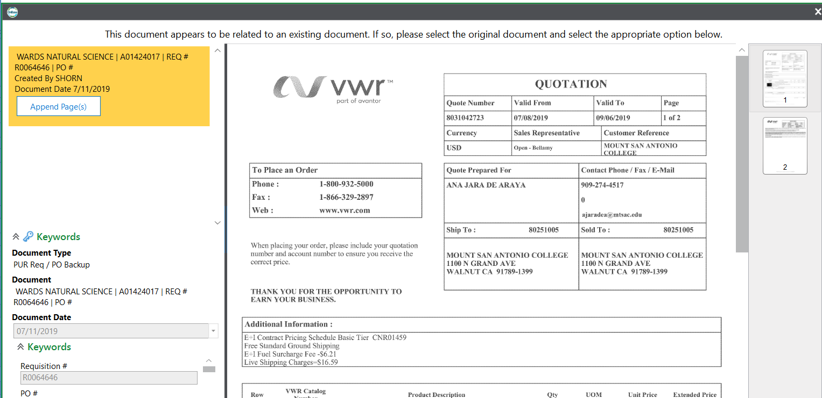
How to append
Import your document either directly through OnBase, the Hyland Virtual Printer, or by scanning
Index with the same Req # and you will get a message to append
Click on Append after verifying that’s the document you want to append to

Slide 16
Topic four
Change Order Process

Slide 17
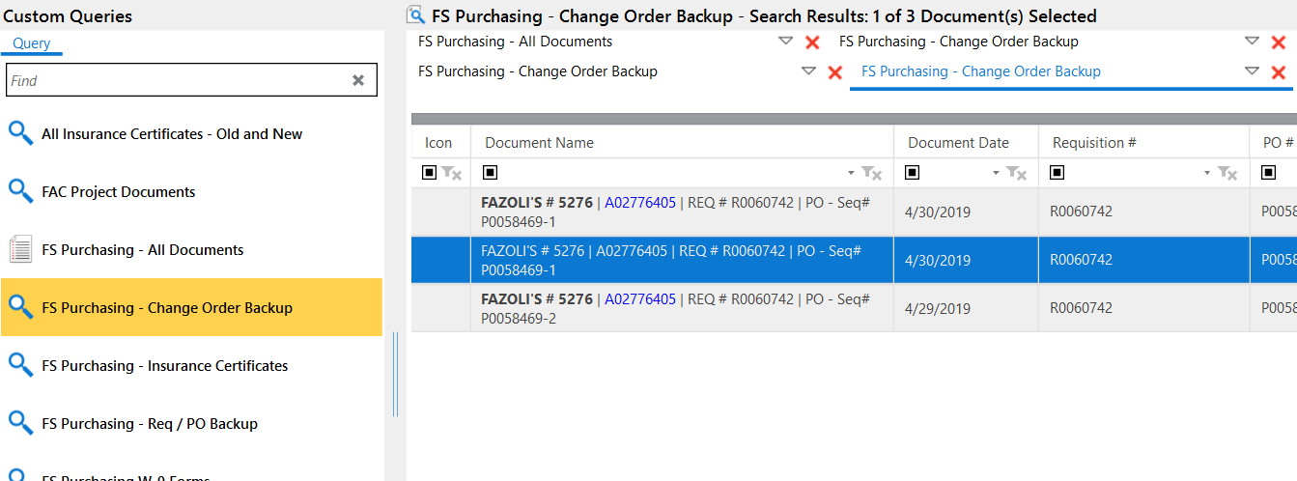
change order process
Still email purchasing@mtsac.edu change order requests and Purchasing will upload the request in OnBase. After Purchasing confirms change order has been done, you can retrieve at any time.
How to view/retrieve change orders
Select Custom Queries, type in the Req or PO #
A listing of all change orders will come up along with the C/O number
Select the one you want to view and the document will come up (example: P0058469)
OR you can click on Retrieval and type in the PO # with the sequence # after the PO (P00xxxx-1, P00xxxx-2, etc)

Slide 18
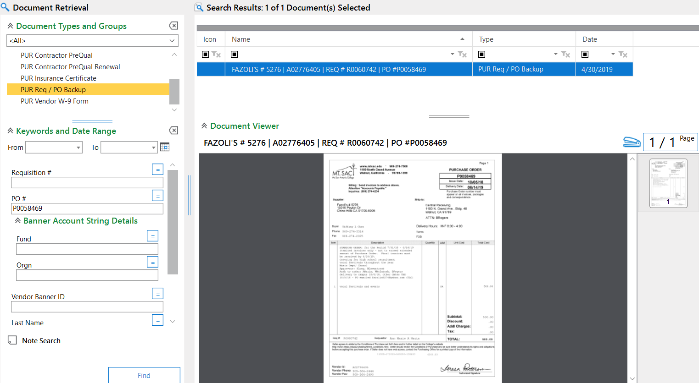
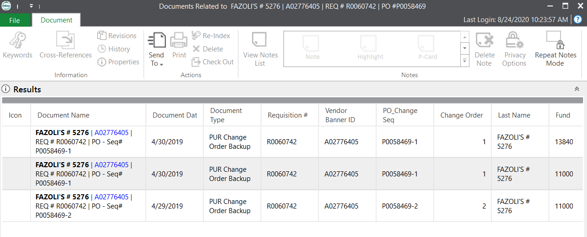
Cross referencing
If you want to see if there are any change orders associated with just entering in the the purchase order, you can either view all by going into the Custom Queries and entering in the PO #, then scroll to the right to the Change Order sequence column.
OR
If you click on Retrieval and have the Document Viewer preview, double click on the preview and a list of change orders will come up to view

Slide 19
Key Tips to Remember
If a document doesn’t get closed out properly, it will remain locked by the user which prevents editing. To unlock, log out of OnBase and log back in. A message will come up to view locked documents, users may remove the locks at that time.
Once Onbase is installed on your desktop, check if you have the FS Purchasing doc type
All file types must be in Image File Format for the system to detect duplicates and append documents. That’s why it’s important to install the Hyland Virtual Printer by contacting IT or install yourself
Email purchasing@mtsac.edu if you need to re-index a req #, delete reqs, modify pages, or submit change order requests.
OnBase request forms should be sent to Angelic so she can sign off for IT to install on your desktop, make sure to follow up if you’re not set up within a week
You do NOT have to upload the requisition cover sheet anymore, just make sure you index correctly.
  Any additional notes can be put in OnBase & document text in Banner

Slide 20
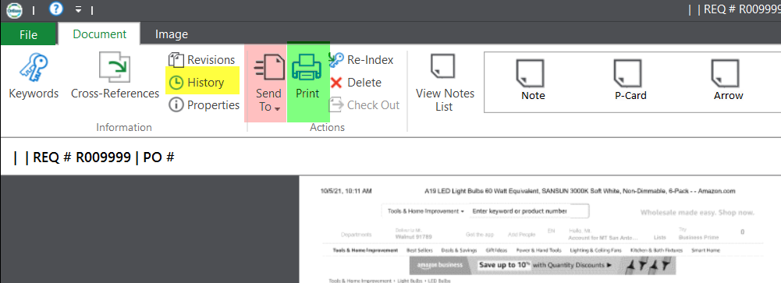
Other features
Email recipients by selecting the Document tab → Send To, double check your attachments to make sure they’re showing correctly
To view History (of recently opened documents), select the Document tab
Printing documents are also available in the Document tab

Slide 21
Topic five
Logging off completely

Slide 22
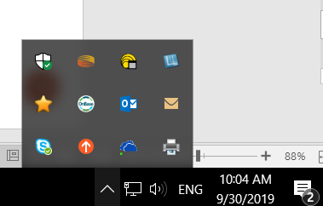
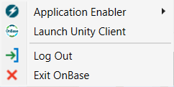
Logging off completely
Closing the window in On Base doesn’t mean you’ve completely logged off
If OnBase gets stuck for whatever reason, you will need to click on the up arrow on the lower right hand corner of your screen
Right click on the On Base icon and “Exit OnBase”
Now you can log back in

Slide 23
The end
You’re an expert now!

