Slide 1
Responding to the Community College Mission
Workforce, Job Creation and a Stronger Economy
Goals, Issues, Opportunities, Challenges, and Approaches
Opportunity for all. And that means that even as we’re creating new jobs in this new economy, we have to make sure that every American has the skills to fill those jobs.
President Barack Obama at Signing of the Workforce Innovation and Opportunity Act, July 2014
Bill Scroggins
and the Mt. SAC CTE Brain Trust Members
October 2014

Slide 2
Board of Governors Task Force: Workforce, Job Creation & a Stronger Economy
The Task Force will be asked to consider strategies and recommend policies and practices that would:
Prepare students for high-value jobs that currently exist in the State,
Position California’s regions to attract high-value jobs in key industry sectors from other states and around the globe,
Create more jobs through workforce training that enables small business development, and
Finance these initiatives by braiding existing state and federal resources.
“Responding to the Community College Mission: Workforce, Job Creation and a Stronger Economy” is intended as a thought piece to stir the imagination of those asked to carry out this important task.
Bill Scroggins & the Mt. SAC CTE Brain Trust
Quoted from Task Force on Workforce, Job Creation and a Stronger Economy, Board of Governors, September 2014 Retreat

Slide 3
Goals for Workforce Training, Job Creation and a Stronger Economy
Offer Competency-based, Industry-Driven Awards in a Career Ladder Structure
Close the Skills Gap
Assure Student Completion of Career Pathways
Assure Degrees and Certificates are Portable
Provide Clear Pathways to College Regardless of Entry Point
Provide CTE Faculty Professional Development

Slide 4
Goal #1: Offer Competency-based, Industry-Driven Awards in Career Ladders
“So we have ready-to-work people looking for work. And we have ready-to-fill jobs that employers can’t fill. If we want to continue our economic recovery, grow our middle class and ensure a prosperous future, we’ve got to match them up… But here’s the rub: too often, they [employers] can’t find workers who have the skills they need.”
Thomas E. Perez, U. S. Secretary of Labor
The California Community College Workforce Training System will:
design and offer degrees and certificates that are based on job competencies needed by employers, that have multiple entry-exit-and-reentry points matching career ladders, and that respond to labor market demand in a timely manner.

Slide 5
Goal #2: Close the Skills Gap
The California Community College Workforce Training System will:
assure that students who complete those degrees and certificates master those competencies and transition smoothly to the workforce.
To close the skills gap, community colleges will need to build capacity for identifying unfilled labor market needs and ensure that career education and training programs are targeted to address those high-need areas.
American Association of Community Colleges in Empowering Community Colleges to Build the Nation’s Future

Slide 6
Goal #3: Assure Student Completion of Career Pathways
The California Community College Workforce Training System will:
assure effective and efficient career pathway retention and completion rates for all students.
  Part of a Career Pathways System [is] moving from the acquisition of core skills and credentials for job entry on through increasingly higher levels of relevant skills and credentials to advance to higher levels of employment.
  James Austin in Portable, Stackable Credentials-A New Education Model for Industry-Specific Career Pathways

Slide 7
Goal #4: Assure Degrees and Certificates are Portable
“Anticipate workforce development needs to community colleges in regional economic and workforce development networks to improve alignment of career pathways.”
Strategy C5 in System Strategic Plan for the California Community Colleges—Preparing the Foundation for California’s Future
The California Community College Workforce Training System will:
assure that degrees and certificates will be portable regionally and statewide.

Slide 8
Goal #5: Provide Clear Pathways to College Regardless of Entry Point
The California Community College Workforce Training System will:
provide clear pathways and preparatory competencies so that those entering college career cohorts are well prepared to succeed regardless of their entry point be that from high schools, regional occupation programs, adult education programs, or upon referral from a partner agency or an employer.
“Career pathways should include alignment of secondary and postsecondary education with workforce development systems and human services along with multiple entry and exit points.”
U.S. Department of Education in Advancing Career and Technical Education (CTE) in State and Local Career Pathways Systems”

Slide 9
Goal #6: Provide Professional Development & Student Support
The importance of professional development cannot be understated. Students need the assistance of a wide variety of effective, well-trained, and motivated personnel on campus. Faculty and staff can benefit from the most up-to-date training on meeting the needs of all students to ensure that an inclusive and accessible environment is provided at our campuses.
Chancellor Brice Harris, Letter supporting AB 2558 (Williams)
The California Community College Workforce Training System will:
provide professional development for faculty and support services for students to attain industry-driven competencies.

Slide 10

Issues
What issues must be addressed for the California Community Colleges to achieve these goals?

Slide 11
Summary of Issues
Lack of Competency Based Awards
Limited Response to Labor Market Demand; Limited Portability of Awards
Skills Gaps and Limited Work-Based Learning
Pathways for Career Readiness Neither Specify Needed Preparatory Skills Nor Recognize Previously Acquired Skills.
Awards Do Not Include Occupational Foundational Skills
Barriers to Incumbent Worker Training
Limited Integration with Other State Agencies
Funding Based on an Academic Model

Slide 12
Issue #1: Lack of Competency
Based Awards
Degrees and certificates list a set of courses passed rather than a set of job related competencies achieved.
“Skills certifications are becoming the ‘new currency’ in the marketplace. Employers are seeking clear ways of determining what workers know and are able to do on the job. Workers are seeking alternatives or add-ons to degrees to demonstrate marketable competencies.”
Building a Manufacturing Talent Pipeline, The Manufacturing Institute, October 2014

Slide 13
Issue #2: Limited Response to Labor Market Demand; Limited Portability of Awards
The number and job focus of degrees and certificates do not adequately meet labor market needs of employers.
Degrees and certificates are not widely accepted as meeting the requirements for employment either regionally or statewide.
The extensive timeline for development and approval of curriculum is not responsive to the time demands of employers.
“It means connecting companies to community colleges that can help design training to fill their specific needs.”
President Barack Obama,
State of the Union,
January 28, 2014

Slide 14
Issue #3: Skills Gaps and
Limited Work-Based Learning
Employers report gaps between skills acquired in training and skills needed for employment.
Work Based Learning is neither widely offered nor well integrated into program curricula.
“We have lots of unfilled positions. We know there are people looking for jobs but they don’t match the skill set that we need from them. We just can’t find the people.”
Employer quoted in Hiring and Higher Education: Business Executives Talk about the Costs and Benefits of College, Steve Farkas, 2011
“EARN AND LEARN. Offer work-based learning opportunities with employers – on-the-job training, internships, pre-apprenticeships, and Registered Apprenticeships – as training paths to employment.” Ready to Work: New Actions to Expand Job-Driven Training and Broaden the Pathway to the Middle Class, White House, July 2014

Slide 15
Issue #4: Pathways for Career Readiness: Preparatory & Previously Acquired Skills
Skills needed to prepare for entry into career programs are not well articulated with the various entry pathways: high schools, ROPs, adult ed, referrals.
Entering students are neither required to be career ready nor are their pre-existing competencies assessed and credited.
“Young people need multiple and flexible pathways to success that meet their varied needs-combining education, training and supportive services.”
Youth and Work: Restoring Teen and Young Adult Connections to Opportunity, The Annie E. Casey Foundation
“Career pathways should include credit for prior learning and other strategies that accelerate the educational and career advancement of the participant. U.S. Department of Education in Advancing Career and Technical Education (CTE) in State and Local Career Pathways Systems

Slide 16
Issue #5: Awards Do Not Include Occupational Foundational Skills
Certificates generally do not specifically include occupational foundational skills, and associate degrees are based on academic general education content rather than on occupational foundational skills.
“What we found was disturbing: more than half our young people leave school without the knowledge or foundation required to find and hold a good job.”
What Work Requires of Schools: A SCANS Report For America 2000, The Secretary’s Commission On Achieving Necessary Skills, U.S. Department Of Labor, June 1991
ACT Foundational Skills
Applied Mathematics
Applied Technology
Business Writing
Locating Information
Observation
Reading for Information
Teamwork
Technical Writing

Slide 17
Issue #6: Barriers to
Incumbent Worker Training
Statutes, regulations, and campus practices inhibit the ability of community colleges to provide direct training to incumbent workers. State agencies providing incumbent worker training are under-resourced and not well coordinated.
71% of U.S. workers are in jobs for which there is either low demand from employers, an oversupply of eligible workers, or both. Unless we can find a way to educate the American workforce for the complexities of the knowledge economy, we risk leaving hundreds of thousands of workers behind.”
Help Wanted: Projections of Jobs and Education Requirements Through 2018, Anthony P. Carnevale, June 2010

Slide 18
Issue #7: Limited Integration with Other State Agencies
Community colleges do not have the flexibility to adapt to the intake and outcome requirements of other state and local agencies which provide job training nor do those agencies have significant incentives to encourage such partnerships.
“Align multiple agency state plans to address statewide goals and priorities, and identify and resolve inconsistencies in program measures, goals, and rules to improve program alignment and outcomes.”
California’s Strategic Workforce Development Plan: 2013-17

Slide 19
Issue #8: Funding Based on an Academic Model
Community college funding is based on enrollment and categorical allocations.
The census funding model does not support the workforce model of competency attainment which is time-bound neither by the length of the instruction cycle nor by the time-on-task needed to reach competency.
Current categorical funds do not fully support the higher cost of CTE facilities, supplies, equipment, technical support, and professional development.
“Differential costs are those that are caused by specific requirements for the delivery of a CTE program such as specialized equipment, required specific additional staff for the program, specialized program accreditation. Explore the possibility of a revision of the funding method for California Community Colleges to include an average differential reimbursement factor for high cost CTE programs.”
Report of the CCCT CTE Task Force on Differential Funding for CTE Programs, Jim Moreno and Andreea Serban, January 2013

Slide 20
What Lies Ahead?
Opportunity
Challenge
A Path Forward

Slide 21
Opportunities, Challenges & Approaches
#1
Opportunity: There is a current laser focus on California’s need for job training.
Challenge: California’s system of workforce training and economic development is fragmented.
Approach: Drive change within the community college system toward the needs of our partner agencies.

Slide 22
Opportunities, Challenges & Approaches
#2
Opportunity: The Student Success Initiative has produced tectonic and rapid changes.
Challenge: Workforce training has not been much affected by the Student Success Initiative.
Approach: Look for CTE Success strategies that mirror Transfer Success strategies.

Slide 23
Opportunities, Challenges & Approaches
#3
Opportunity: Employers are well aware that their competitive edge depends on skilled workers.
Challenge: Many business sectors do not have a structure that produces a collective voice for employers.
Approach: Employ intentional, multiple approaches to identify business sector regional partnerships.

Slide 24
Opportunities, Challenges & Approaches
#4
Opportunity: The CTE Enhancement Fund produced engaged discussions within CTE Regional Consortia.
Challenge: Regional Consortia are not well prepared for a major role in workforce planning or funding.
Approach: Build on lessons learned from implementing the CTE Enhancement Fund and Doing What Matters.

Slide 25
Opportunities, Challenges & Approaches
#5
Opportunity: The Associate Degree for Transfer shifted decisions from college to state level through a state-mandated faculty-driven process.
Challenge: The CTE partnership will involve CCC faculty working with business and industry representatives.
Approach: Seek state mandate and funding to reform the CTE program development and approval processes

Slide 26
Opportunities, Challenges & Approaches
#6
Opportunity: California’s economic recovery has enabled the state to invest in its economic future.
Challenge: The current window of opportunity for reform may close soon.
Approach: Implement California’s Strategic Workforce Development Plan: 2013-17.

Slide 27
Opportunities, Challenges & Approaches
#7
Opportunity: College and High School CTE programs are attracting major state and national funding.
Challenge: Rebuilding vocational and adult education offerings after severe cuts will not be easy.
Approach: Build on AB 86 Adult Education Regional Consortia as the basis for change in the broader High School/ROP-to-College Pathway arena.

Slide 28
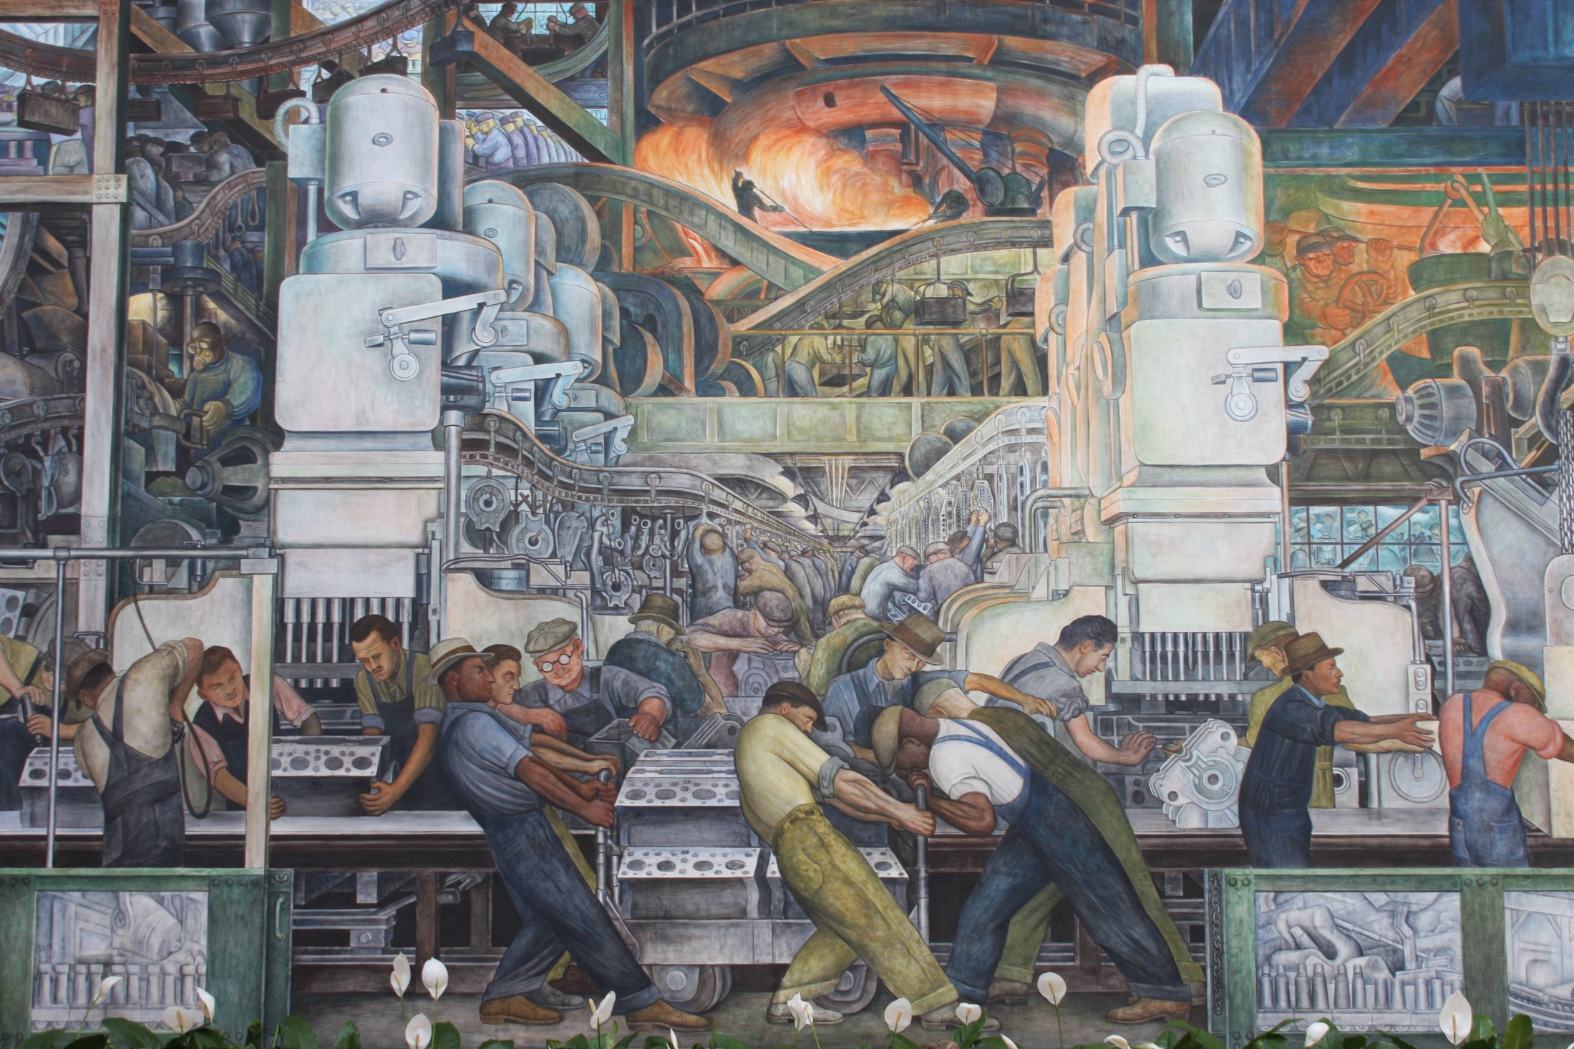
NOW THE WORK BEGINS
Diego Rivera’s Mural “Industry” on the North Wall
of the Detroit Institute of Art, 1933

