Slide 1


Why a Guided Pathways Framework
&
Lessons Learned
Dr. Irene Malmgren, Emeritus Vice President, Instruction
Dr. Bill Scroggins, President & CEO
October 24, 2018
Notes:
Bill – Welcome & Intro’s

Slide 2
What is Guided Pathways?

Slide 3
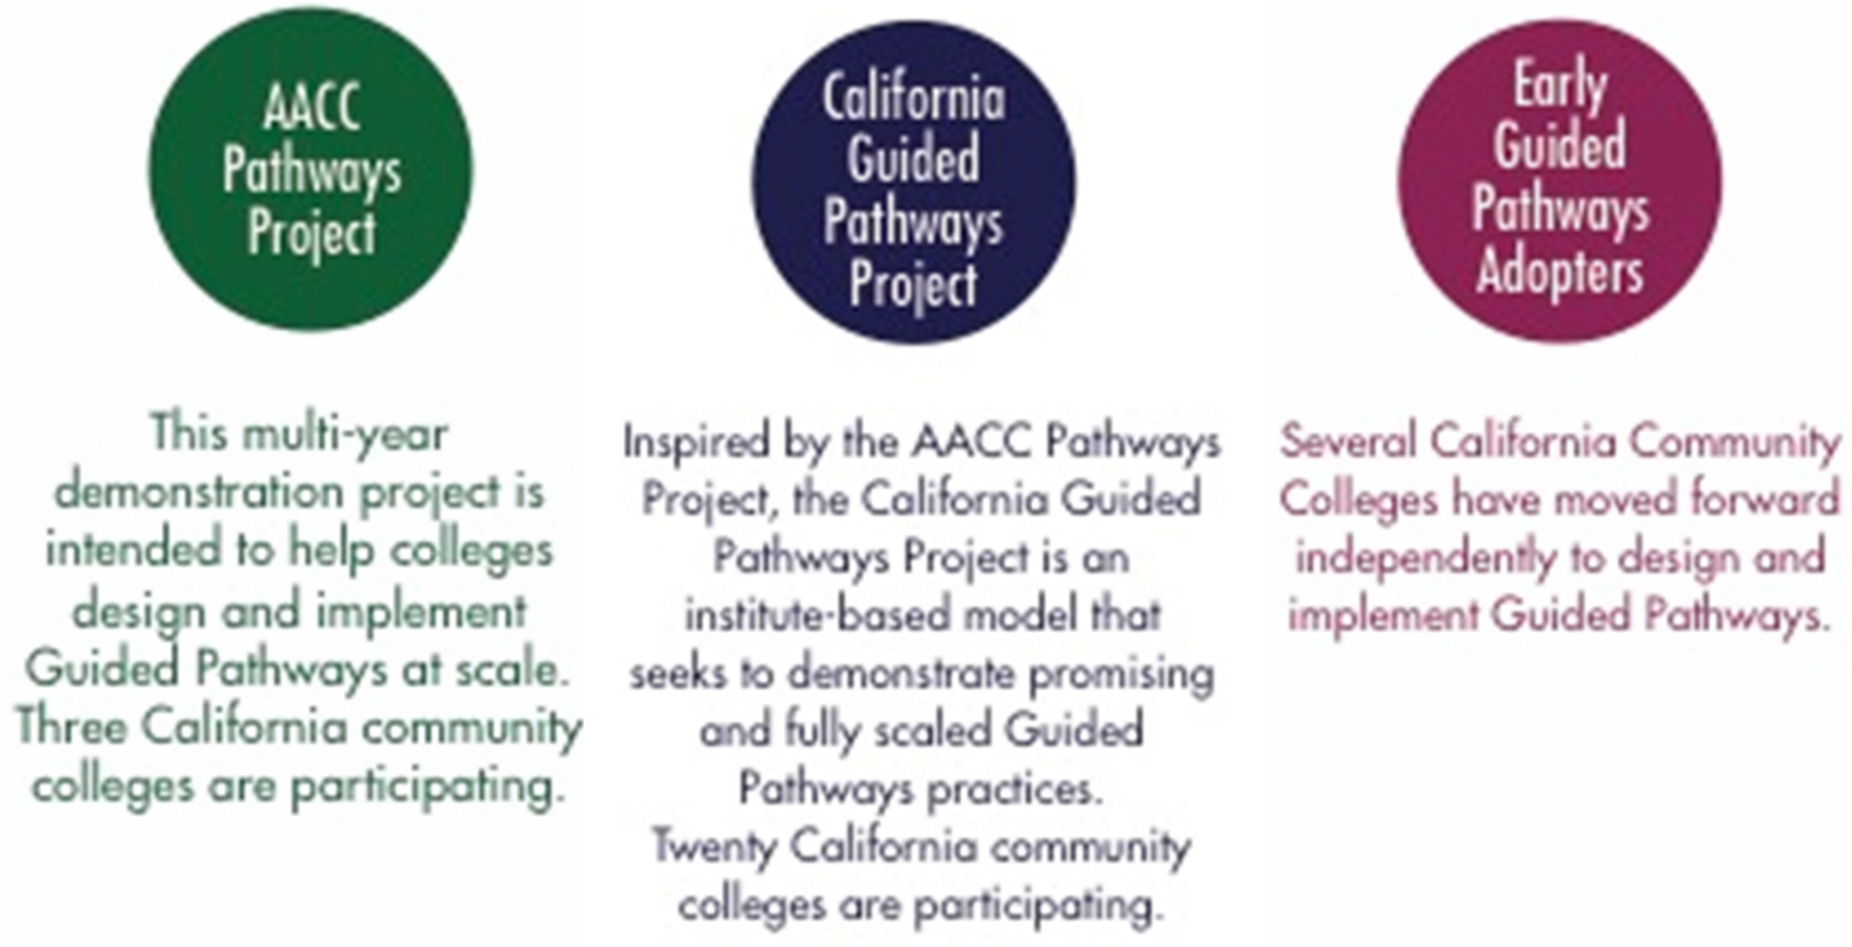

Slide 4
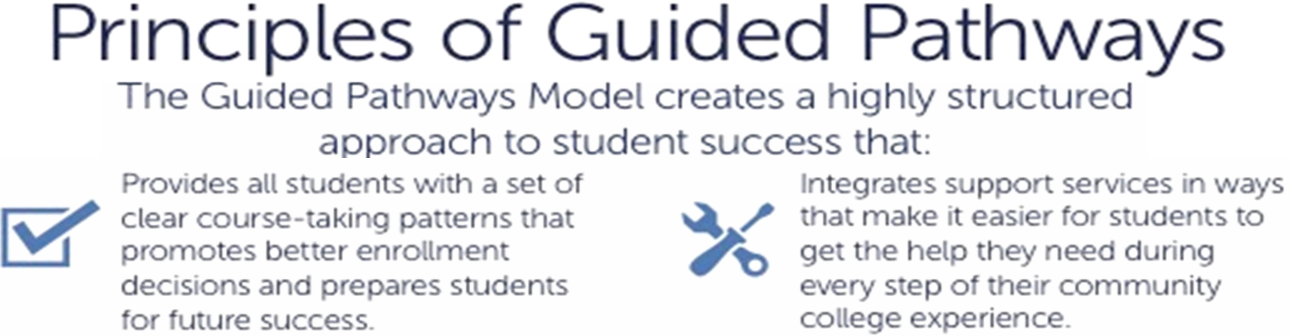

Slide 6
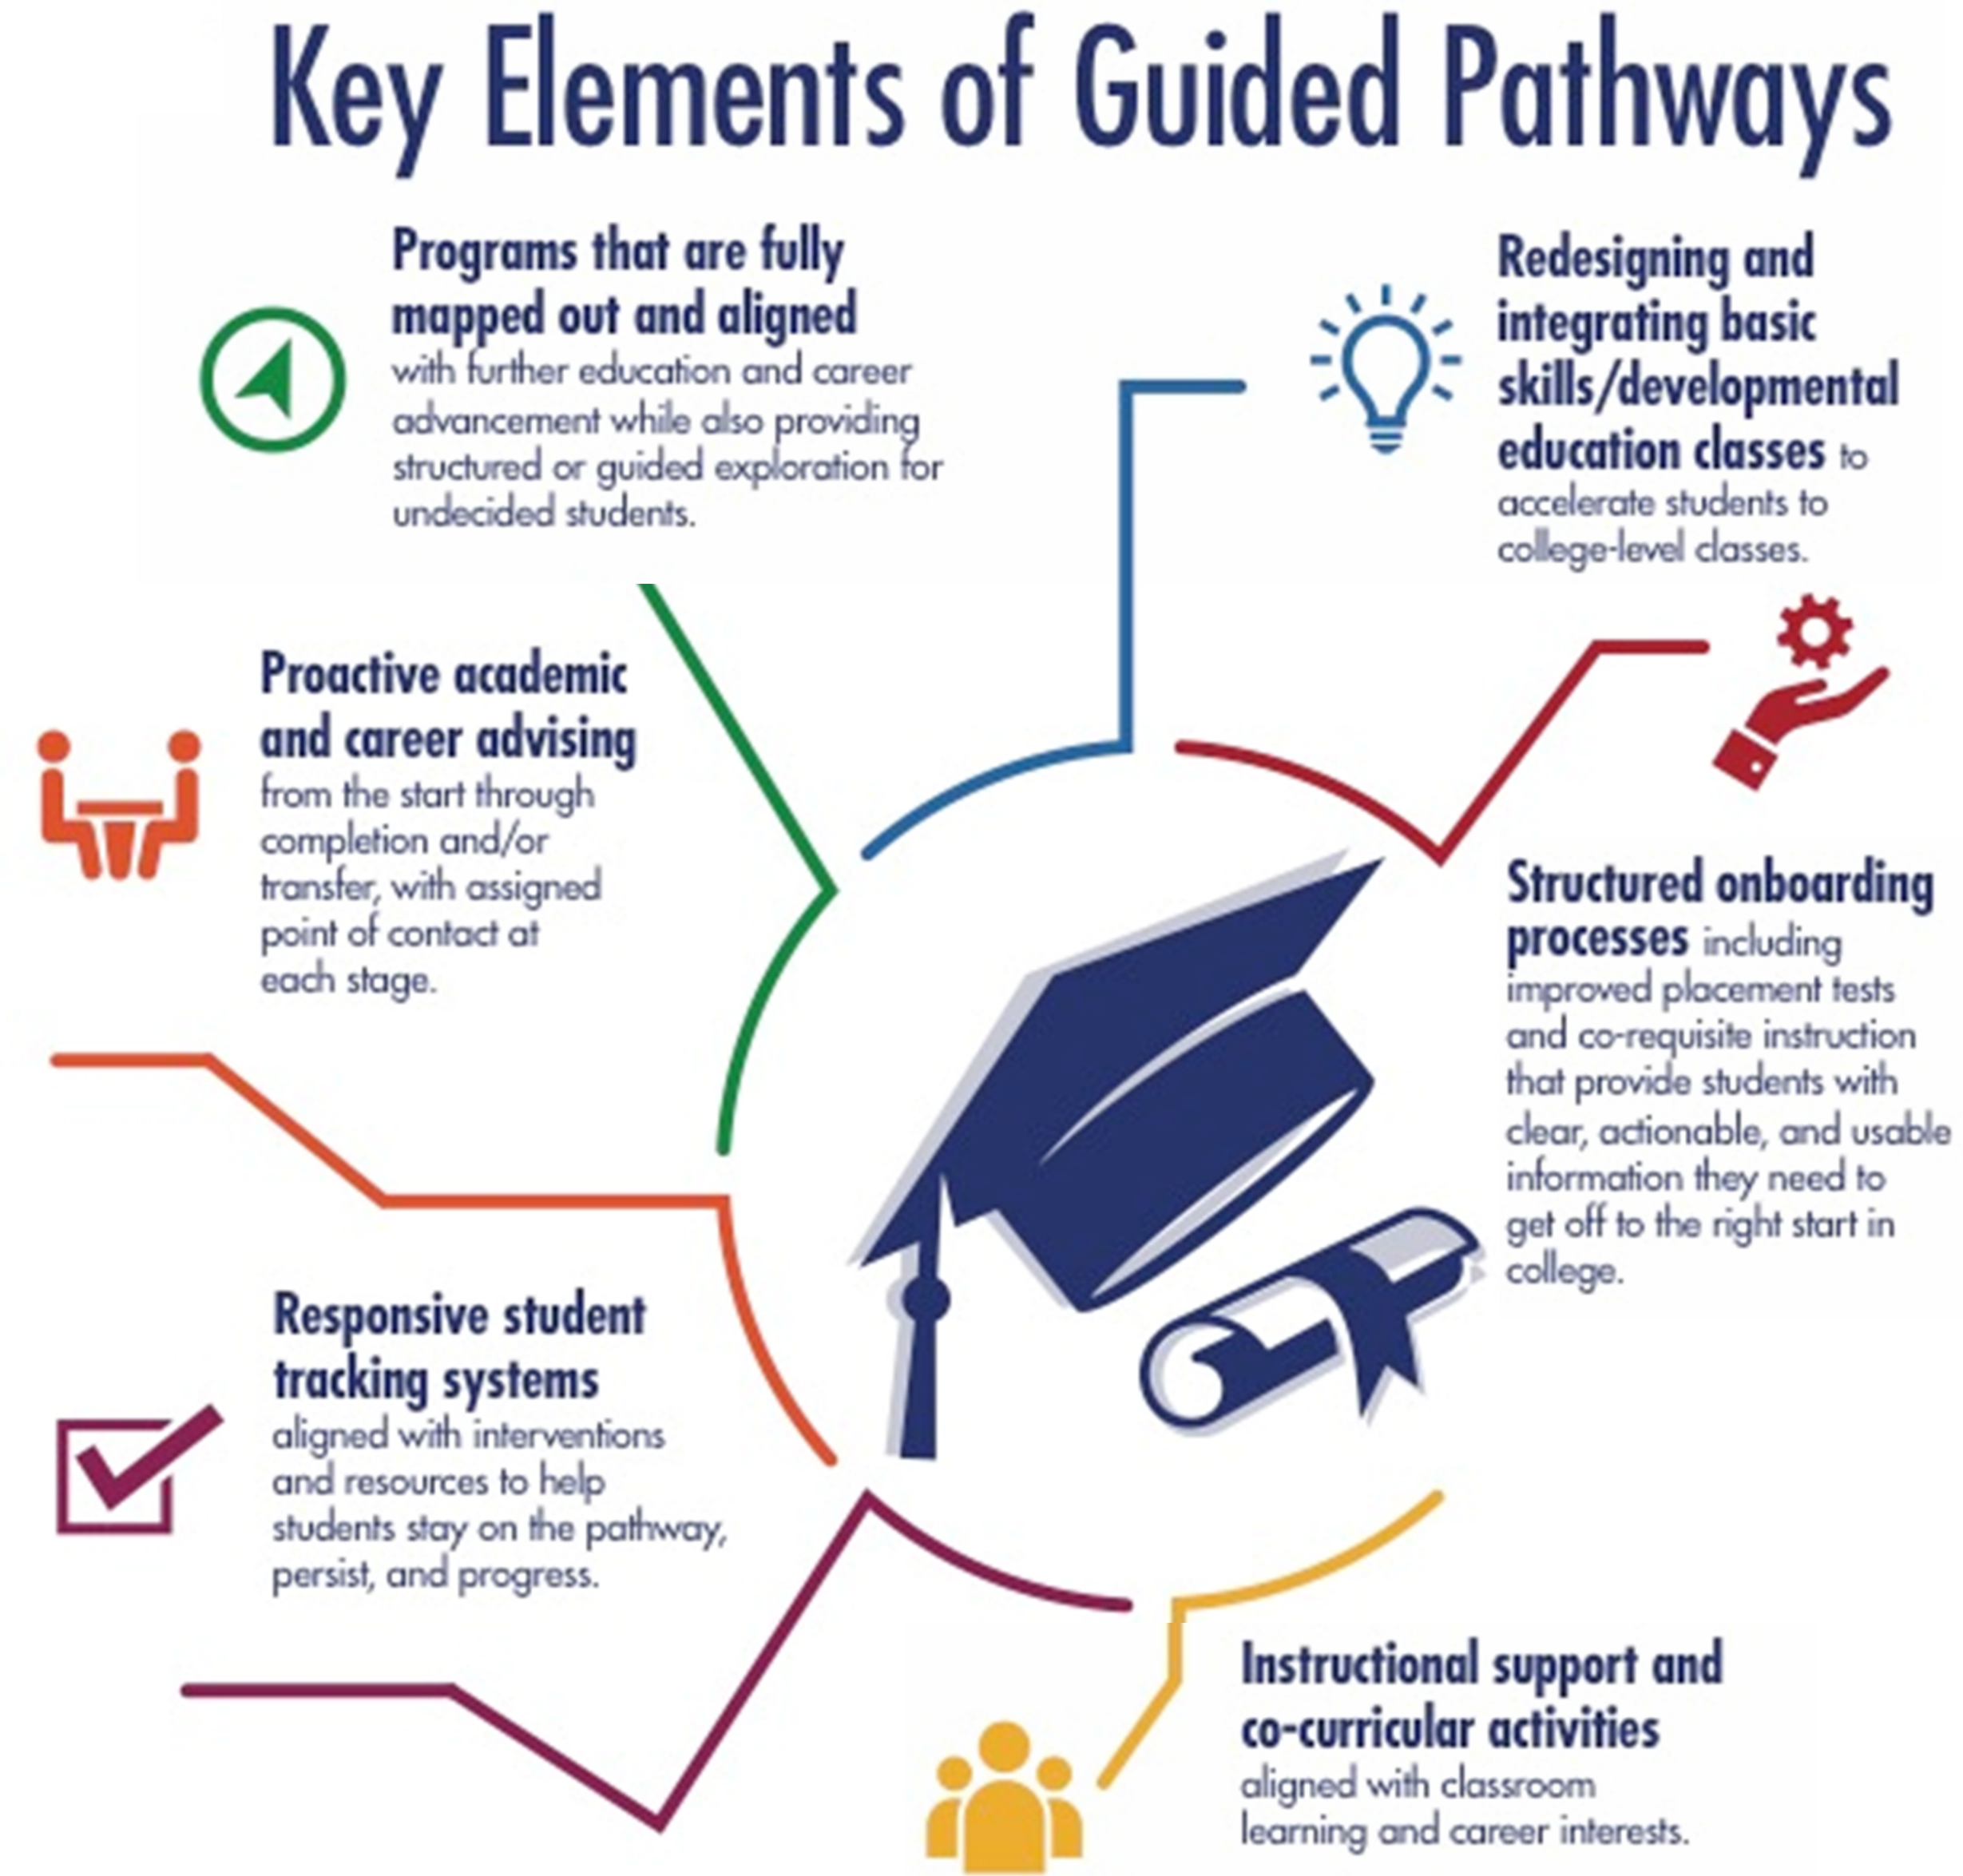

Slide 7
What is “Guided Pathways?”
  Making college ready for students rather than
  making students ready for college.
  Mt. SAC GPS: Guided Pathways to Success
Notes:
Bill

Slide 8
Consider Dynamics of Change
CIO: Is GP a framework for managing student success?
  Increase graduates
  Work with faculty
  No guidelines!!
  CSSO: What funding changes are happening?
  No Student Equity or Student Success
  New Block Grants and Promise Programs
  CBO: What is impact of new funding formula?

Slide 9
Elements for Success
CEO
Relationship with faculty
Avenue to work with Counseling and Assessment
          Note: You can’t do this by yourself!
Critical element: develop partnerships to find mutual solutions

Slide 10
Why Guided Pathways?
Uses lessons learned from Student Success, Student Equity, and Basic Skills to bring to scale
Attacks barriers at each step on the students’ path
  Uses the collective knowledge of faculty
  Creates flexible solutions that fit students with different needs
  Transforms the entire institution
  Does not “bolt on” another fix
  Adapts technology in ways students actually use
  Makes bold changes in laws, regulations, processes
Notes:
Bill

Slide 11
What “Guided Pathways” is
NOT
Guided Pathways is NOT curriculum reform but rather focuses on structure and scheduling
Guided Pathways is NOT administratively driven but rather provides administrative support for faculty driven reforms
Guided Pathways does NOT limit student choices but rather provides clear, structured experiences and advice for students to make informed choices
Guided Pathways is NOT a vehicle to eliminate programs and reduce general education options but rather enables students to better understand:
  which program to choose and how to move through that program and
  which general education courses fit with their program of study
Notes:
Bill

Slide 12
AACC Pathways
The guided pathways model is designed to help students:
  clarify their goals
  choose and enter pathways that will achieve those goals
  stay on those pathways
  and master knowledge and skills to advance in the labor
  market and successfully pursue further education.
Notes:
Bill

Slide 13
GPS at Mt. SAC
Getting Started: Pathways Workgroup
  Membership
College President | Coordinator of Learning Communities
VP Instruction | 3 Faculty Members, Counseling
Associate VP Instruction | 2 Faculty Members, Learning Assistance
Associate Dean Instruction | Faculty Member, Math
VP Student Services | Faculty Member, English
Director of Research | Dean of Humanities
Research Assessment Analyst (2017: Added Noncredit Faculty) | Dean of Counseling
Notes:
Irene

Slide 14
GPS at Mt. SAC
    Getting Started: Pathways Workgroup
      Meeting Schedule – twice/month
  Are you started? What are you doing?
      Work group
      Meeting schedule
      Purpose statement
Notes:
Irene

Slide 15
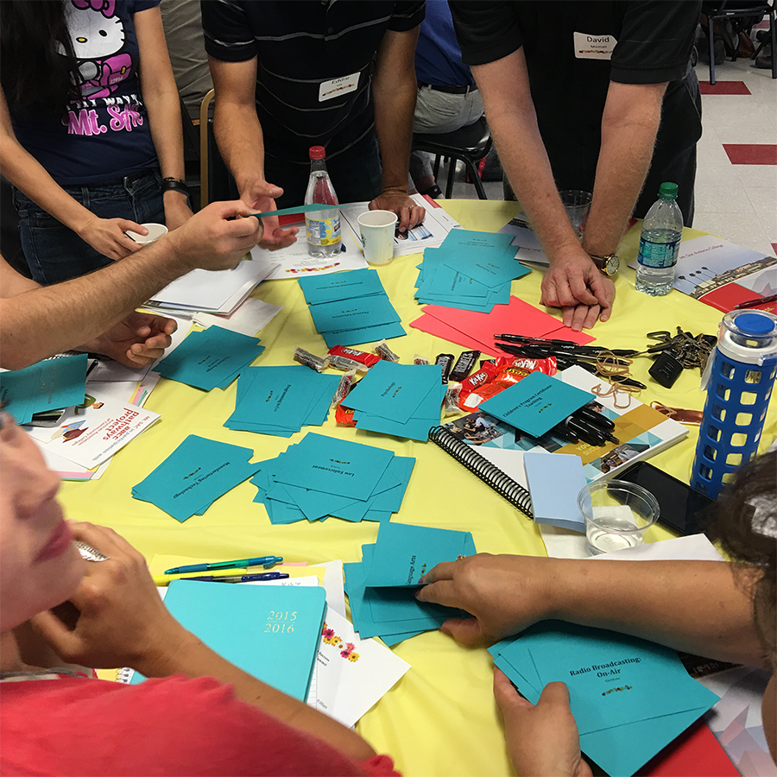
GPS at Mt. SAC
Spreading the Word: Local Workshops
Academic & Student Services Spring
Master Planning Summit, May 13, 2016
Summer Pathways Institute,
August 22-23, 2016
Fall Pathways Institute,
October 21, 2016
Contextualized Learning Discussion
December 2, 2016
Accurate Placement & Equity,
May 12, 2017
Notes:
Irene

Slide 16
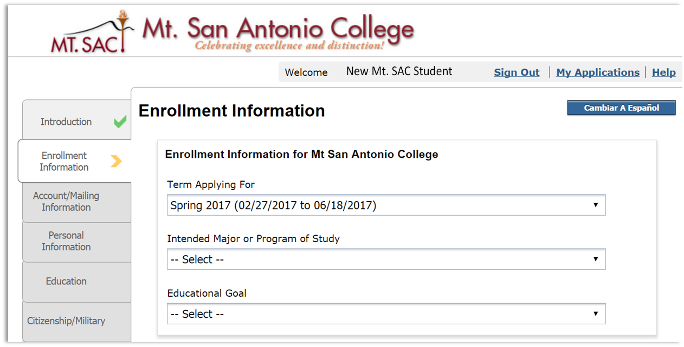
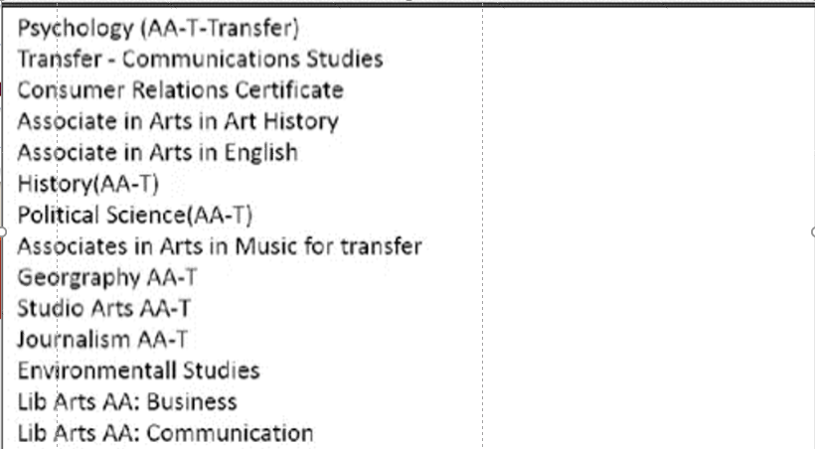
Academic & Student Services
Spring Master Planning Summit
May 13, 2016
Dr. Rachel Baker: Cafeteria Choices vs. Informed Buckets of Options
Notes:
Irene

Slide 17
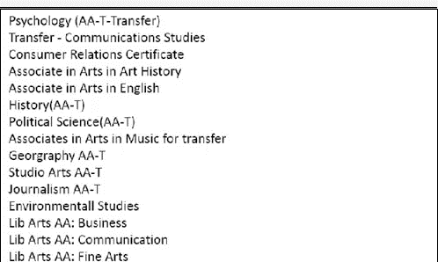
Academic & Student Services
Spring Master Planning Summit
May 13, 2016
Dr. Rachel Baker: Cafeteria Choices vs. Informed Buckets of Options
Notes:
Irene

Slide 18








Academic & Student Services
Spring Master Planning Summit
May 13, 2016
Identifying Career Clusters
Teaching & Education
Humanities & Communication
Sciences
Aviation, Electronics, & Manufacturing
Art & Design
Plants & Animals
Health, Wellness, & Public Service
Business & Information Technology
Notes:
Margie: include student creation of career choices
350 + first-time students in summer bridge

Slide 19
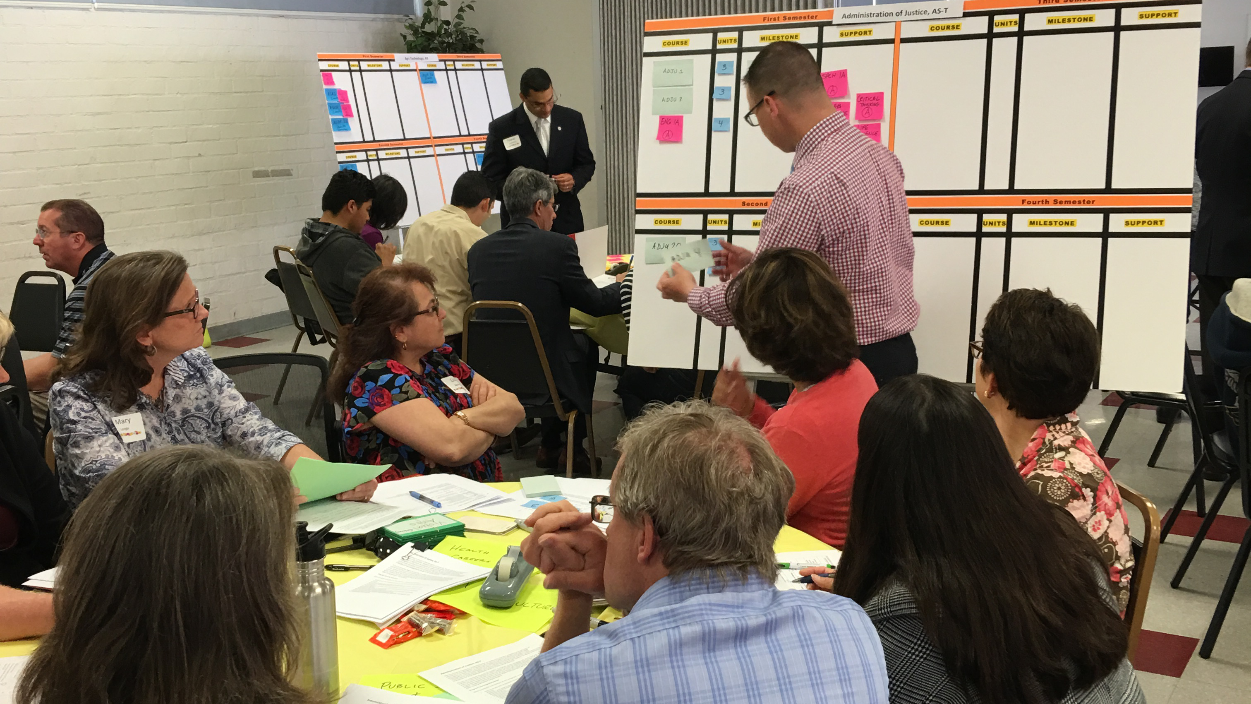
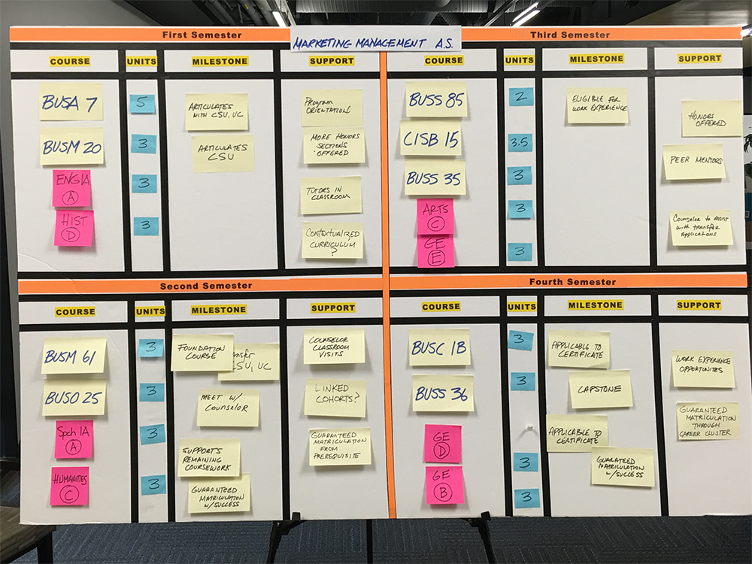
Academic & Student Services
Spring Master Planning Summit
May 13, 2016
Building a Pathway
Notes:
Tom/Margie: Intro to mapping
Mapping a program other than your own

Slide 20
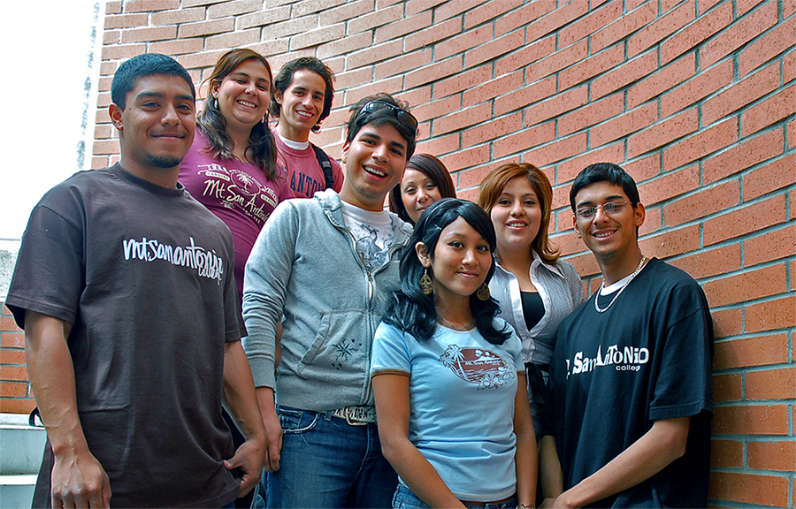
Summer Pathways Institute
August 22 & 23, 2016
Why Contextualized Learning & Career Clusters?
85%
Place into basic skills English
77%
Place into basic skills math
Notes:
Irene

Slide 21
First Math Course Taken*
LERN 48
LERN 49
MATH 50
MATH 51
MATH 71
Milestone | Throughput | Milestone | Throughput | Milestone | Throughput | Milestone | Throughput | Milestone
72% | 72%
63% | 45%
68% | 31% | 71% | 71%
52% | 16% | 55% | 39%
61% | 10% | 71% | 28% | 79% | 79%
53% | 5% | 62% | 17% | 65% | 51%
64% | 3% | 63% | 11% | 70% | 36% | 70% | 70%
56% | 1.9% | 59% | 6.4% | 65% | 23% | 60% | 42%
68% | 1.3% | 71% | 4.5% | 73% | 17% | 75% | 32% | 67%
Math
LERN 48 Ultimate Success
Progression
LERN 49 Ultimate Success
Progression
MATH 50 Ultimate Success
Progression
MATH 51 Ultimate Success
Progression
MATH 71 Ultimate Success
*academic years 2008-2009 through 2012-2013
RIE, John Barkman, 5/18/2016
Notes:
Irene

Slide 22
First English Course Taken*
LERN 81
ENGL 67
ENGL 68
ENGL 1A
Milestone | Throughput | Milestone | Throughput | Milestone | Throughput | Milestone
73% | 73%
59% | 43%
72% | 31% | 79% | 79%
59% | 18% | 67% | 53%
77% | 14% | 82% | 43% | 84% | 84%
67% | 9% | 70% | 31% | 70% | 59%
77% | 7% | 82% | 25% | 83% | 49% | 70%
English
LERN 81 Ultimate Success
Progression
ENGL 67 Ultimate Success
Progression
ENGL 68 Ultimate Success
Progression
ENGL 1A Ultimate Success
*academic years 2008-2009 through 2012-2013
RIE, John Barkman, 5/18/2016
Notes:
Irene

Slide 23
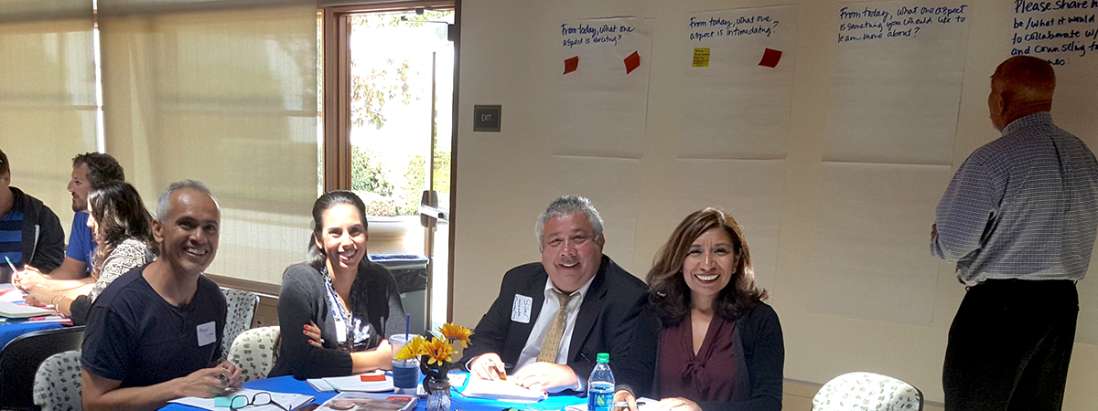
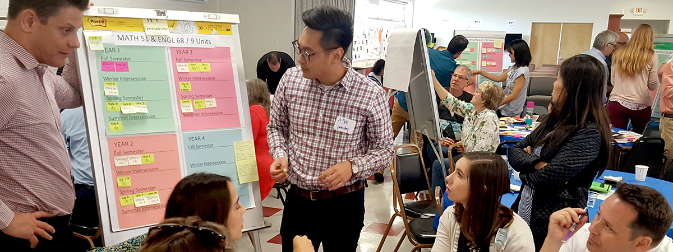
Summer Pathways Institute
August 22 & 23, 2016
Breakout 1: Facing your fears about contextualization
  Basic Skills Faculty & Counseling Faculty
Breakout 2: Mapping programs the Mt. SAC way
  Instructional Faculty & Counseling Faculty
Notes:
Margie/Tom

Slide 24
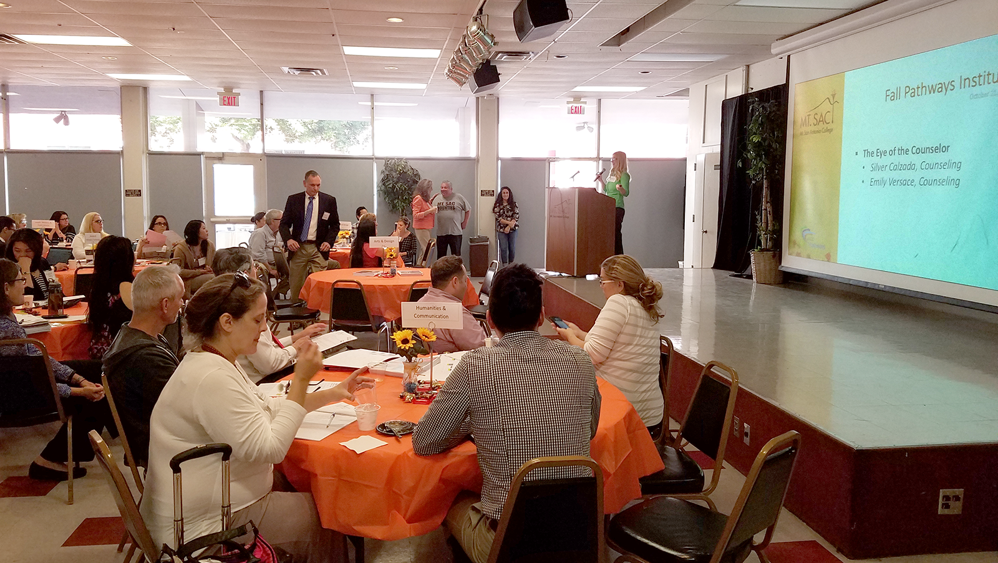
Fall Pathways Institute
October 21, 2016
The Eye of the Counselor
“On-Boarding” Planning Retreats
Orientation includes Career Assessment &
Career Clusters
Liaison Counselors
“Inescapable” Counseling
Notes:
Tom

Slide 25
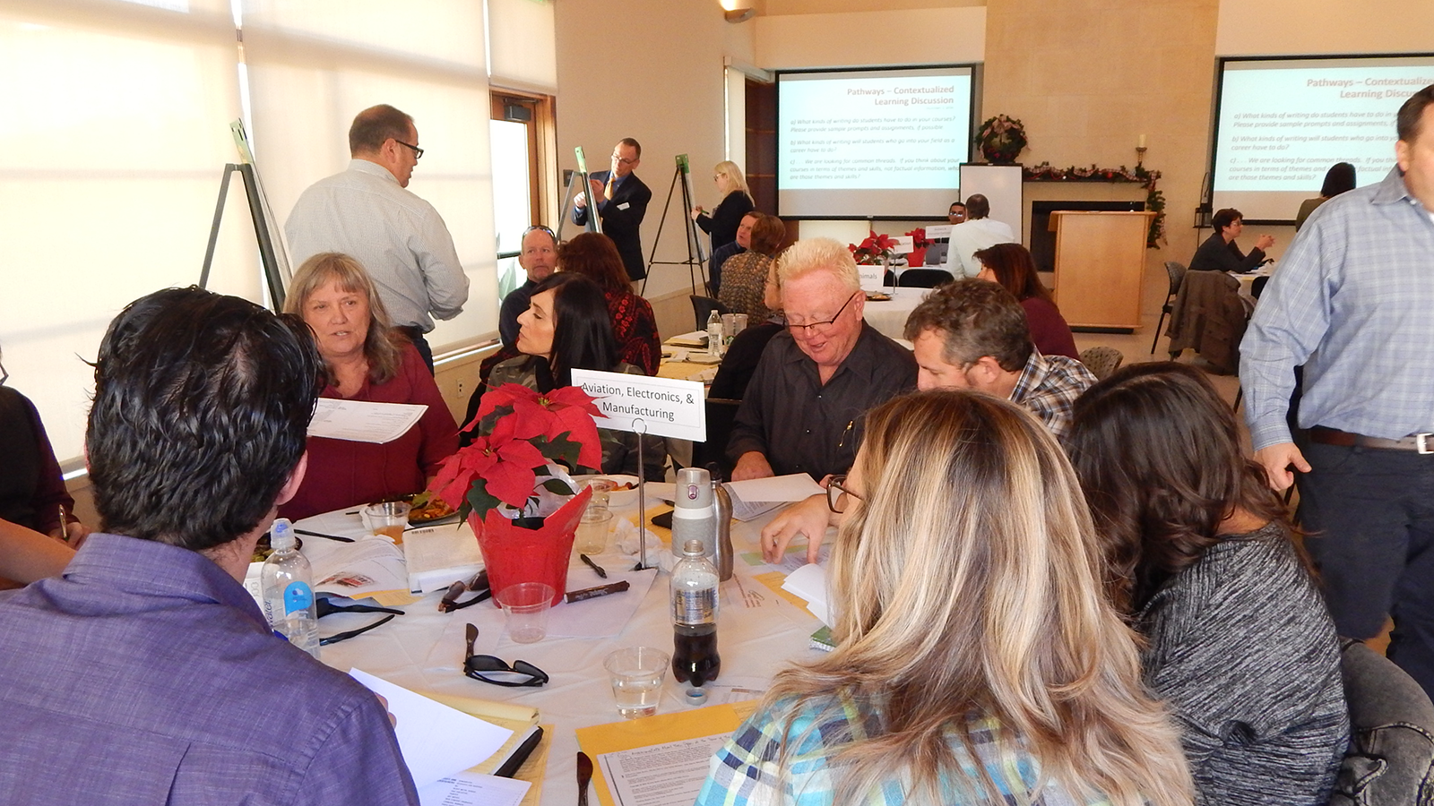
Contextualized Learning:
A Discussion
December 2, 2016
Stop. Breathe. Discuss.
Notes:
Irene/Margie

Slide 26
Simultaneous Efforts
  Communication with Students
        Landing pages
        Catalog redesign
            Organized around career clusters
        Protocol for text messages
            Registration and financial aid
  Research
        Keeping the data in front of us
  Instructional Web Pages
        Include Program/Degree/Certificate Maps
Notes:
Tom

Slide 27


Slide 28


Slide 29


Slide 30
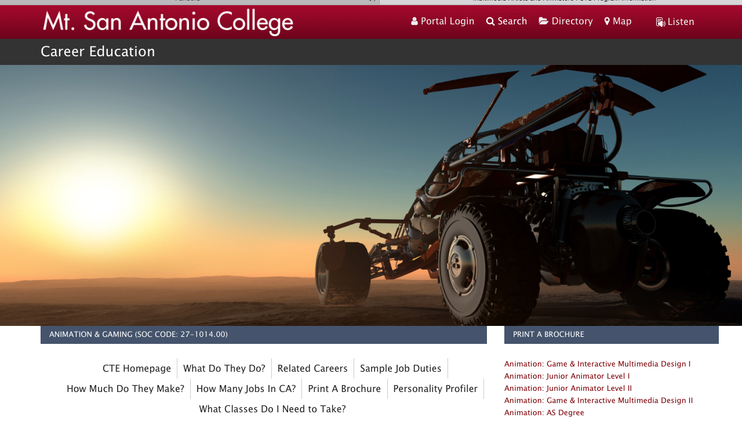

Slide 31
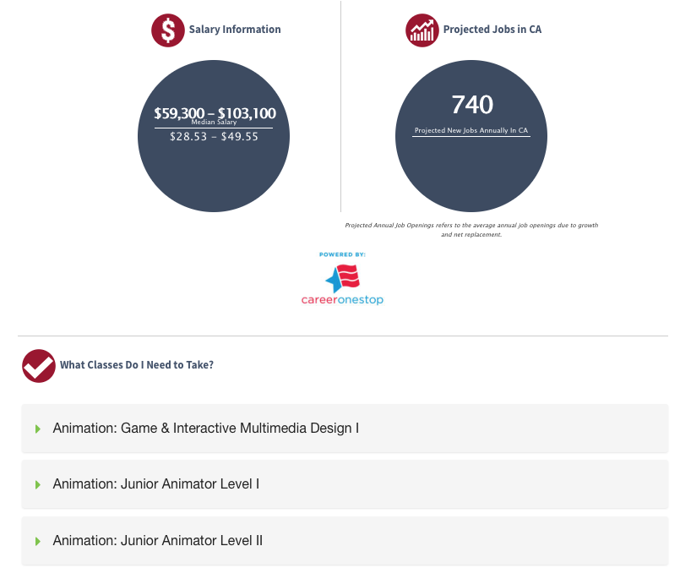

Slide 32
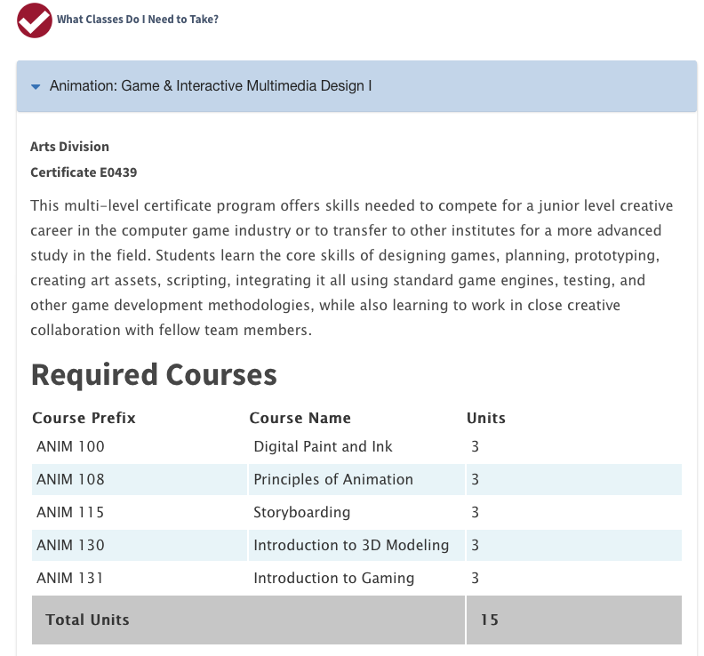

Slide 33
Simultaneous Efforts (continued)
  Accurate Assessment and Placement Planning
        Math, English, ESL
        Fall 2017, Spring 2018, and Fall 2018
        Outcome: New assessment and placement practices

Slide 34
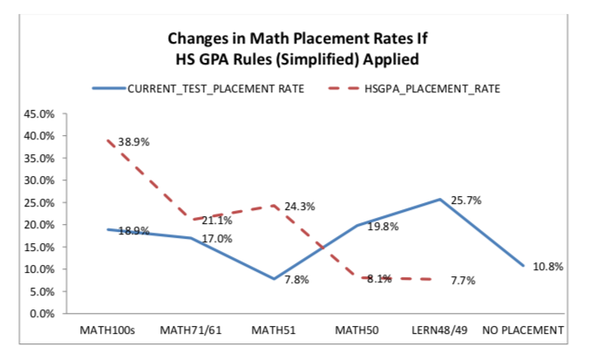

Slide 35
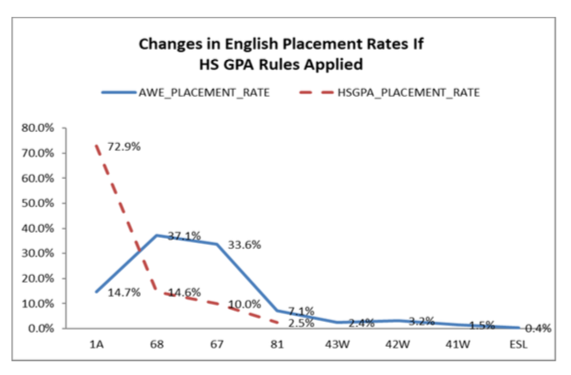

Slide 37

Assessment Questionnaire
& Multiple Measures
        Faculty driven
        Climate of innovation and support
          Look for areas that are ready for change and support them
        Instruction and Counseling Faculty work together
        Dialog continues
          Counseling, Department Faculty, Research and IT

Slide 38
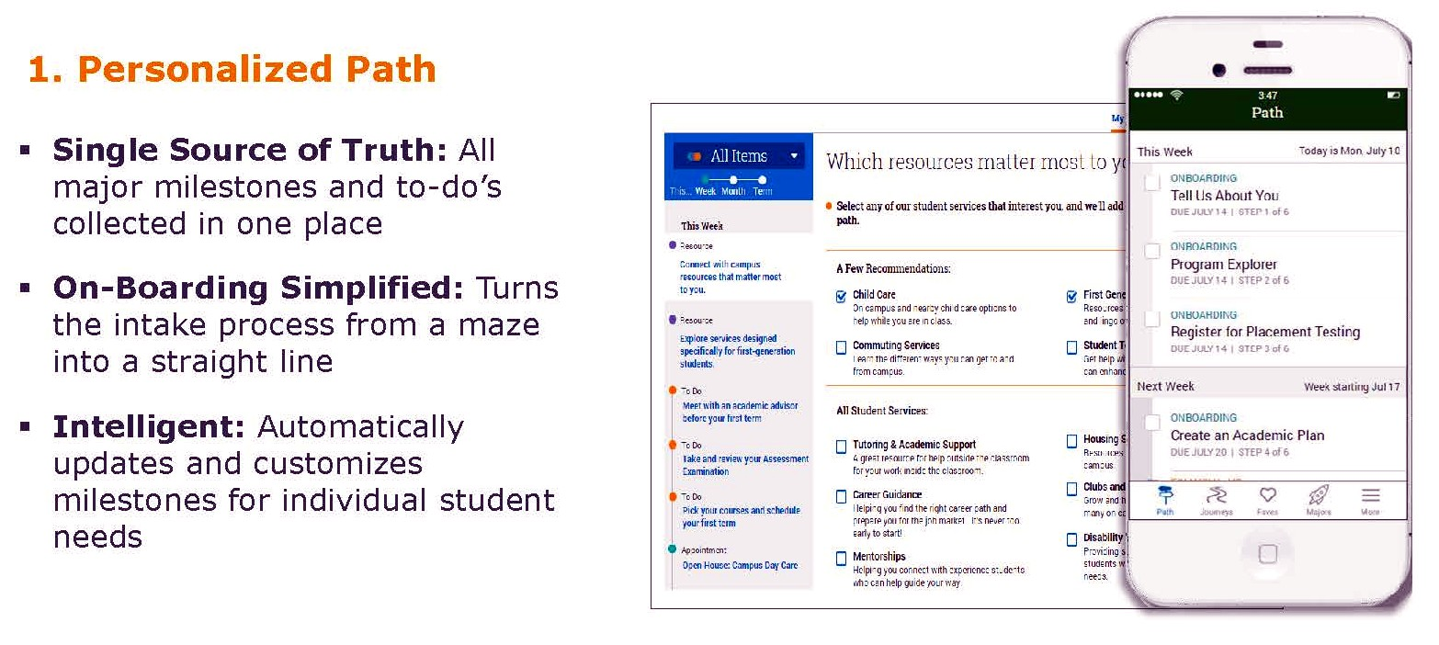
EAB Navigate: Onboarding to a Path
Compatible with Banner and Degree Works

Slide 39
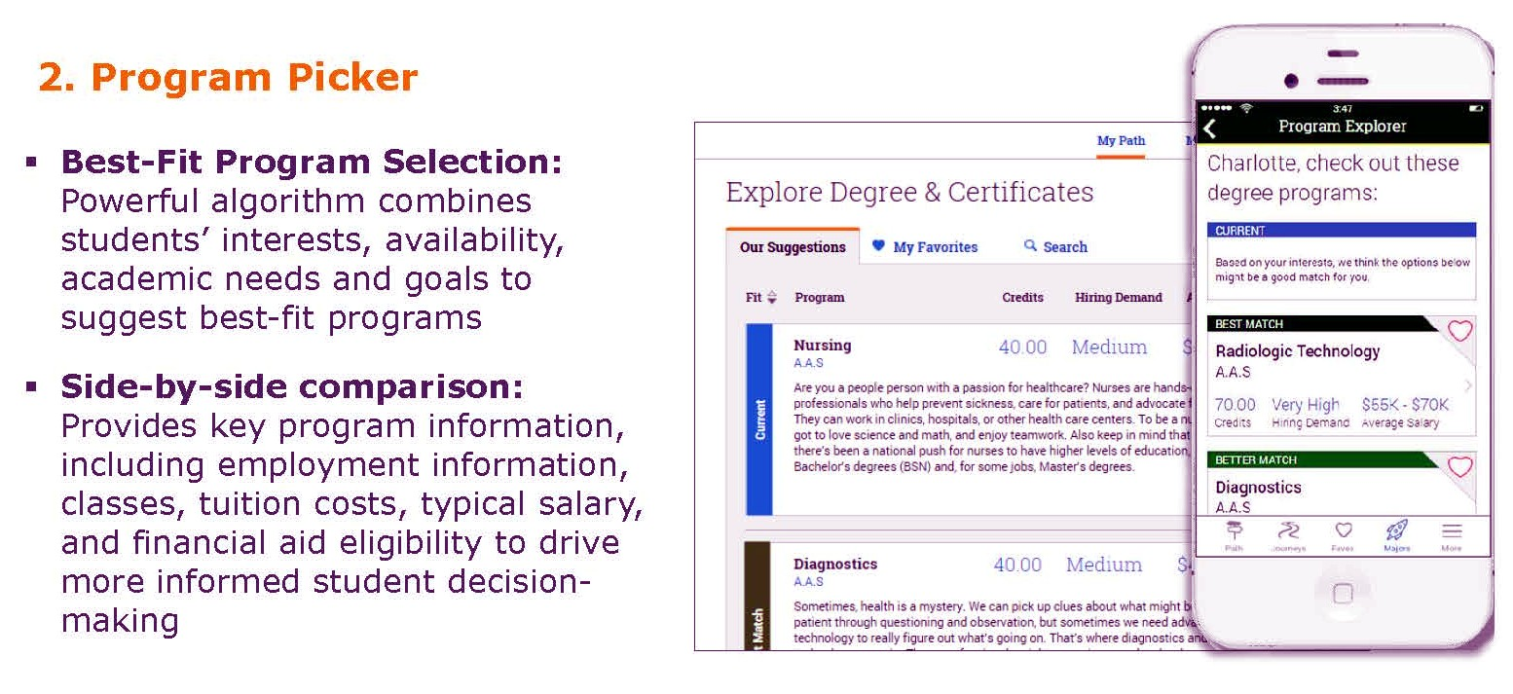
EAB Navigate: Program Selection
Catalog Program Descriptions

Slide 40
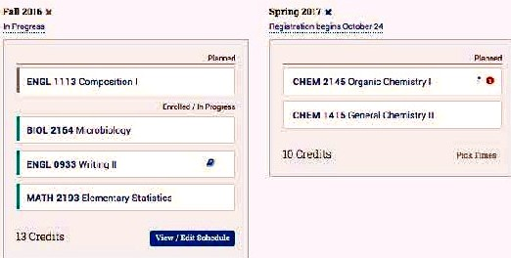
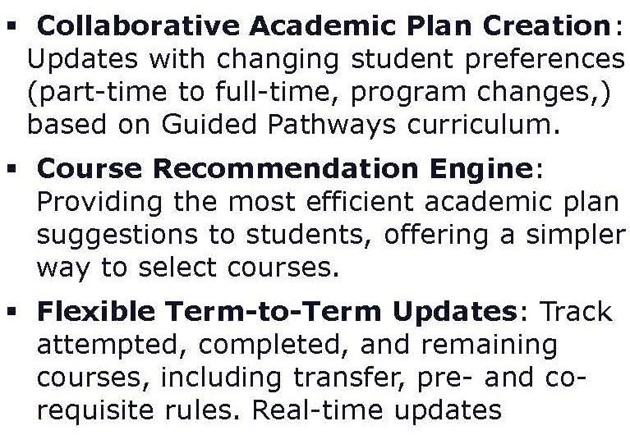
EAB Navigate: Educational Planning
Mt. SAC uses Degree Works Ed Plan Overlay

Slide 41
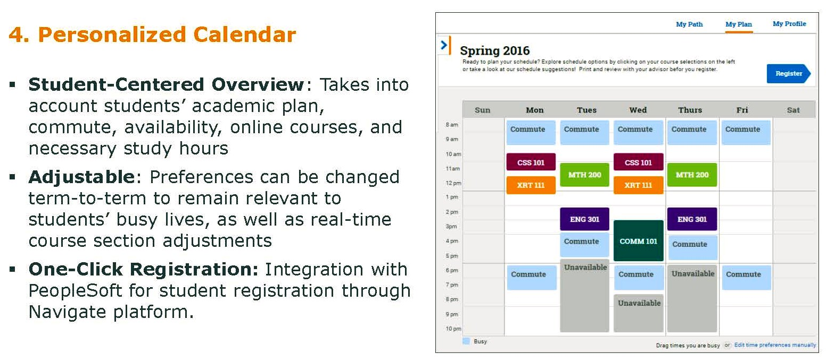
EAB Navigate: Build Schedule & Enroll
Also in Mobile App with One-Click Registration

Slide 42
Governance Changes
Steering Committee
Academic Senate and Subcommittees
Senior Management Subject Matter Members
Collegial Consultation Procedures and
General Policy Direction Implementation
Advisory Committee ▪ Research
Subcommittee Co-chairs
Academic Senate Reps ▪ Onboarding, Mapping
and Middle Managers and Communication
Communication and
Coordination ▪ Academic Support and Professional Development

Slide 43
Mt. SAC: Best Practices
  Start with research
  Build coalitions / working groups
      Pathways Steering Group (classified, managers, faculty)
      Counseling / Discipline faculty meetings
      Counseling planning retreats
  Involve students at all stages!!
  Get multiple perspectives on the pathways
      Counselors, students, and non-discipline faculty see programs differently
  Changes must happen on multiple fronts
      Process, systems, and planning
Notes:
Bill

Slide 44
Mt. SAC: Experience & Observations
Highlights good work we are already doing
Encourages looking at the College/programs from the student perspective
Produces a critical self-examination of programs
Departments examining scheduling practices
Dialogue between counseling faculty and program faculty
Illustrates the importance of faculty buy-in
Collaboration between campus groups done the “Mt. SAC way”
CA GP provides funding and adds complexity
Notes:
Bill

Slide 45
