Slide 1
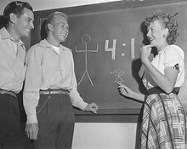
California Community Colleges
Then, Now & When
Mt San Antonio College
Bill Scroggins
President & CEO
January 2017
Glendale College, 1948
Glendale College, 2016

Slide 2
College Trends
Impact of College
College Going Rate
Cost of College

Slide 3
Growing Impact of College
Jobs % Require Some College 20 percent in 1950 28 percent in 1973 59 percent in 2007 | College Going Rate 29.4 percent in 1950 49.3 percent in 1980 62.5 percent in 2010
Bachelor’s Degree Attainment 6 percent in 1950 15 percent in 1980 30 percent in 2010 | Minimum Wage $0.75 in 1950 $3.10 in 1980 $7.25 in 2010

Slide 4
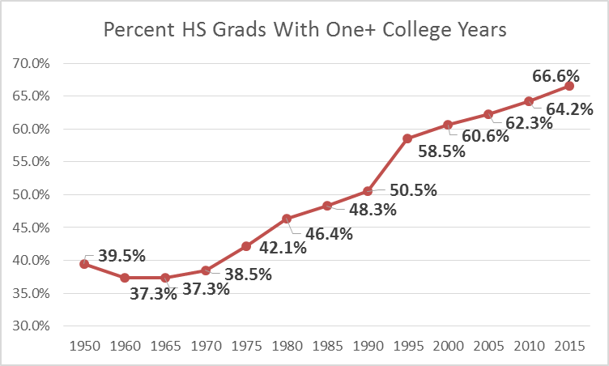
Growing Enrollment in College

Slide 5
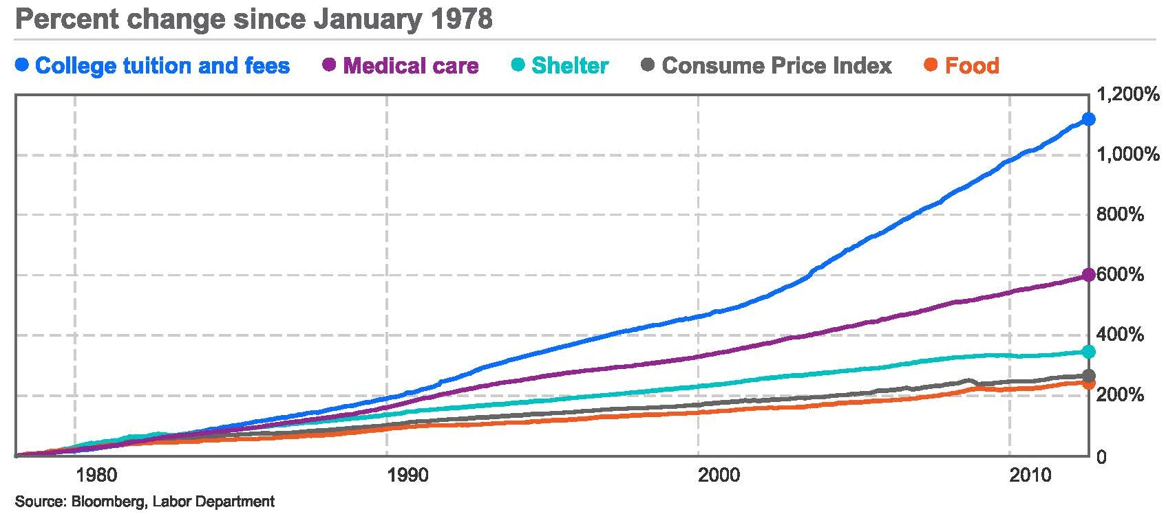
Growing College Cost

Slide 6
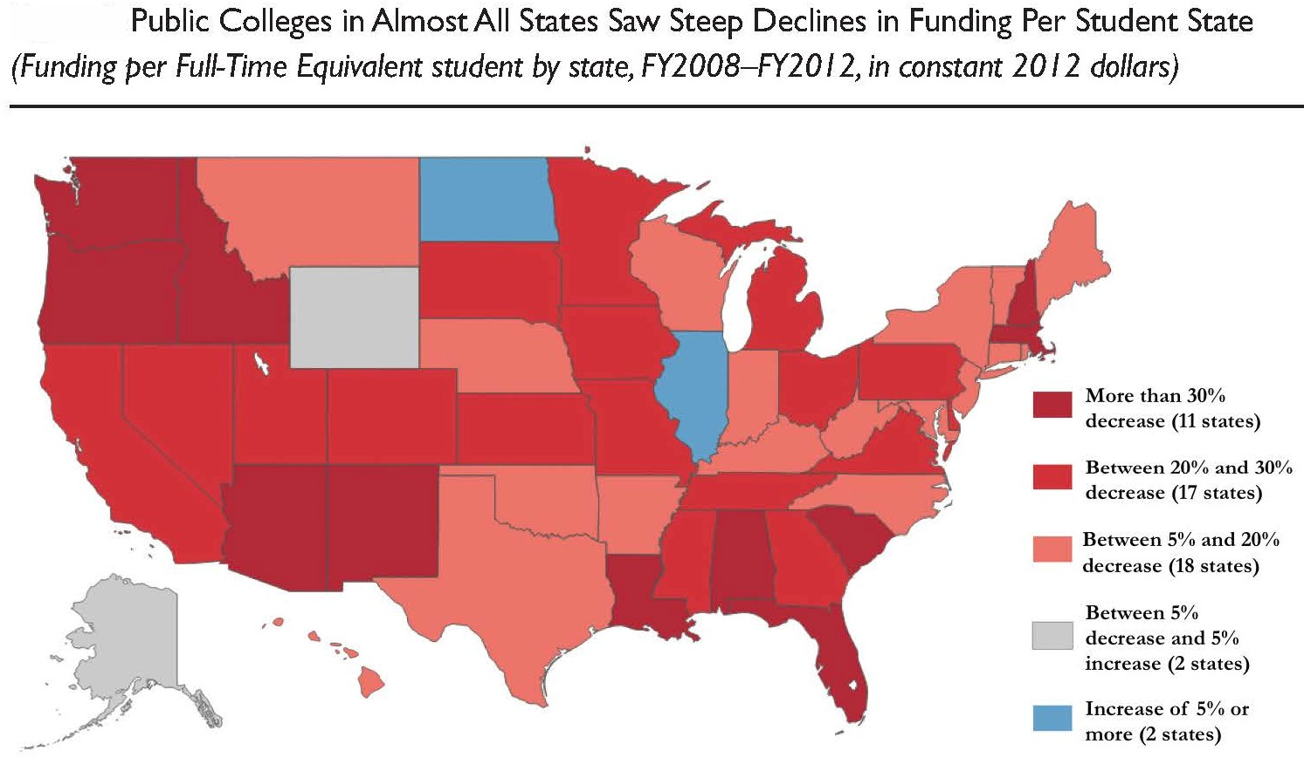
State $ Per FTES Decline in U.S.
Declining state support for Higher Ed is a national problem.

Slide 7
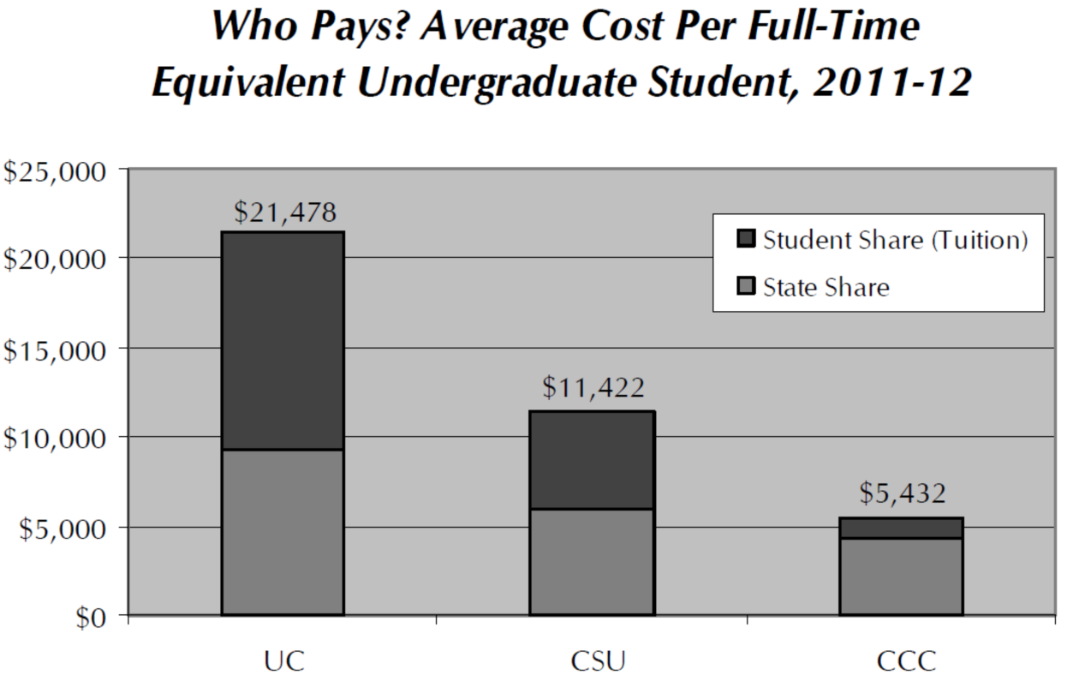
UC, CSU, CCC Cost Differential

Slide 8
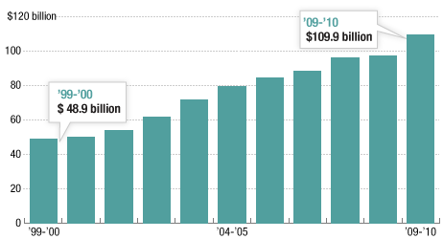
Student Debt $867 Billion & Growing
Additional Student Load Debt Added Each Year
Source: College Board

Slide 9
Trends in Educational Level
Demographics
California vs Nation
Need for Education
Quality of Life

Slide 10
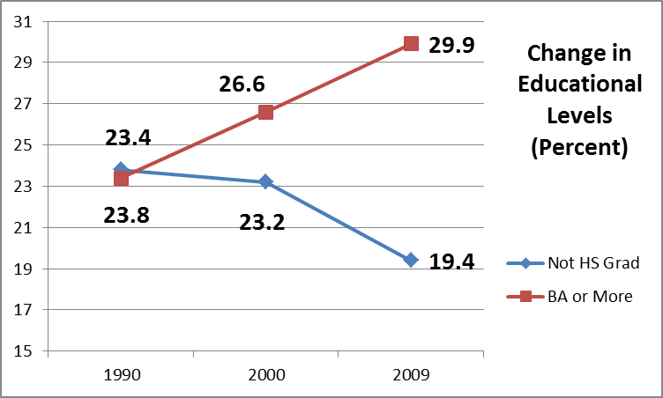
CA Educational Levels Have Improved

Slide 11
But California is Falling Behind
Year | 1970 | 2004
CA | 63% | 81%
US | 55% | 85%
Δ | +8% | -4%
% >25 Who Are HS Grads:
% >25 With BA:
Year | 1990 | 2000 | 2010
CA | 23.4% | 26.6% | 29.9%
US | 20.3% | 24.4% | 27.9%
Δ | +3.1% | +2.2% | +2.0%

Slide 12
The Demographic Challenge
CA Hispanic population has increased 28% since 2000.
53.6% of those 18 or under in CA are Hispanic.

Slide 13
And the Need is Still HUGE
Nearly 25% of adults in California are functionally illiterate.
More than 5.3 million adults in California have yet to earn a high school diploma or pass the General Educational Development (GED) exam.
27% of Californians between the ages of 18 and 44 are unprepared for postsecondary education for “middle-skill” jobs which represent the largest share of jobs in California, now and in the future.

Slide 14
Education = Quality of Life
A B.A. holder will spend 23% more time employed than a high school graduate.
Earning a B.A. doubles income relative to a high school diploma.
22% of those with less than a HS degree live in poverty; 10% with a HS degree are in poverty; <5% with a BA or more are in poverty.
The incarceration rate is 85% lower for B.A. holders and half with some college.

Slide 15
Historic Value of a BA Degree
Economic: Lifetime Earnings 84% Greater
Civic: Voting Rate: <HS 29%, ≥BA 77% (Age 25-44, 2008)
Enrichment: Enjoyment of Travel, the Arts

Slide 16
Challenges and Opportunities
Degree Attainment
Jobs, Jobs, Jobs

Slide 17
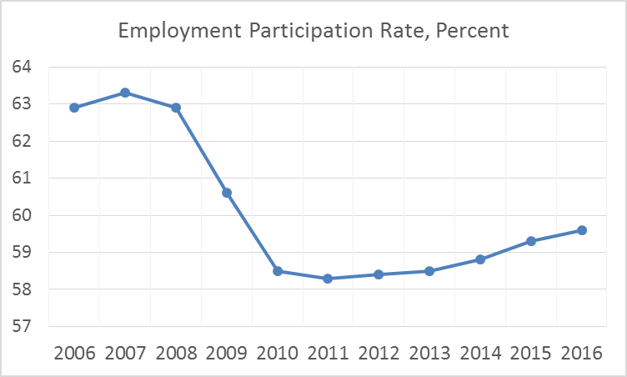
Challenge: Jobless Recovery
New Jobs pay 23% less than those lost in the recession
U.S. Bureau of Labor Statistics

Slide 18
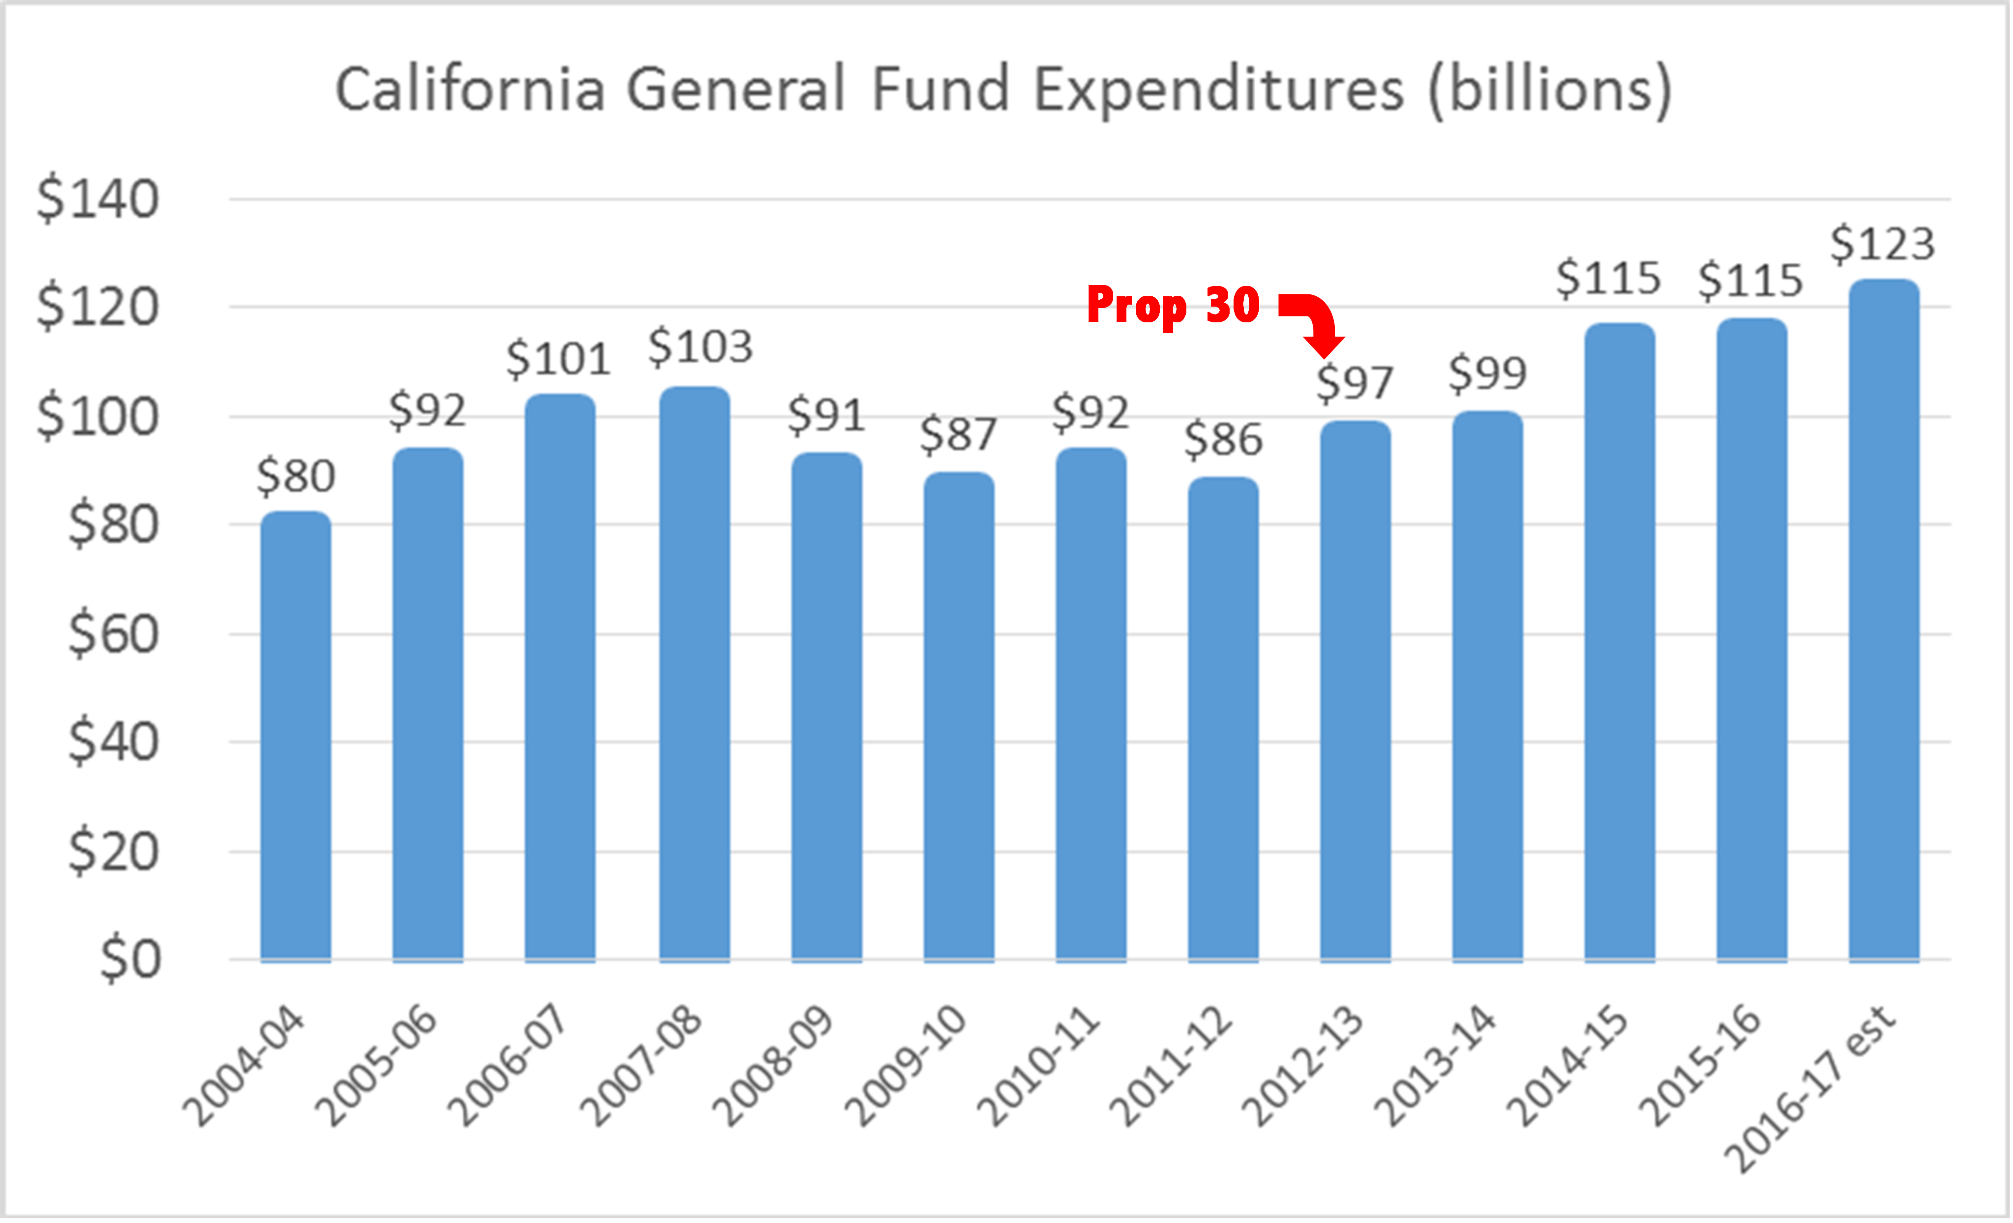
Opportunity: State Budget Recovery
Legislative Analyst Office

Slide 19
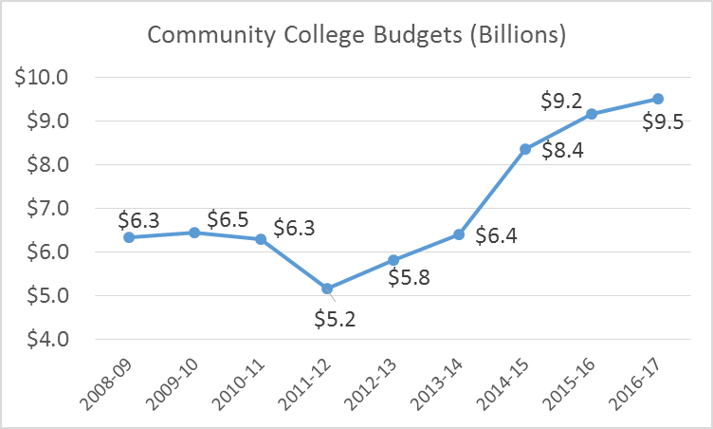
Opportunity: Community College Budget Recovery
Funding:
Access
Success
Equity
Job Training
California Community College Chancellors Office

Slide 20
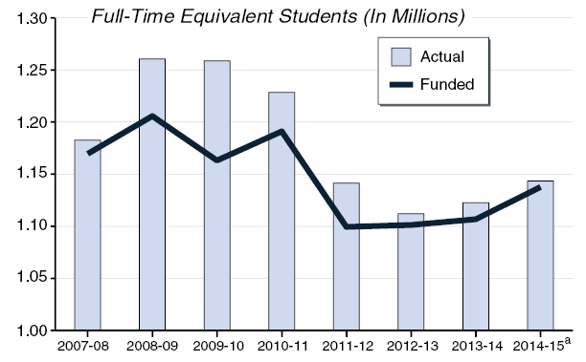
Challenge: Even with $$$,
System Growth is Slow
Community Colleges Statewide Have Not Restored Pre-Recession Enrollment
California Community College Chancellors Office

Slide 21
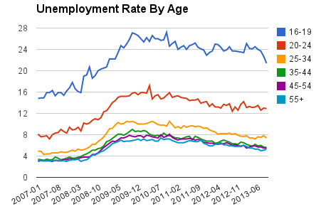
Challenge:
Youth Unemployment
Bureau of Labor Statistics

Slide 22
Opportunity: Workforce Training
CCC Workforce Plan: 25 Recommendations
2016-17 Budget: $200 M Workforce Funding
Salary Surfer at salarysurfer.cccco.edu

Slide 23
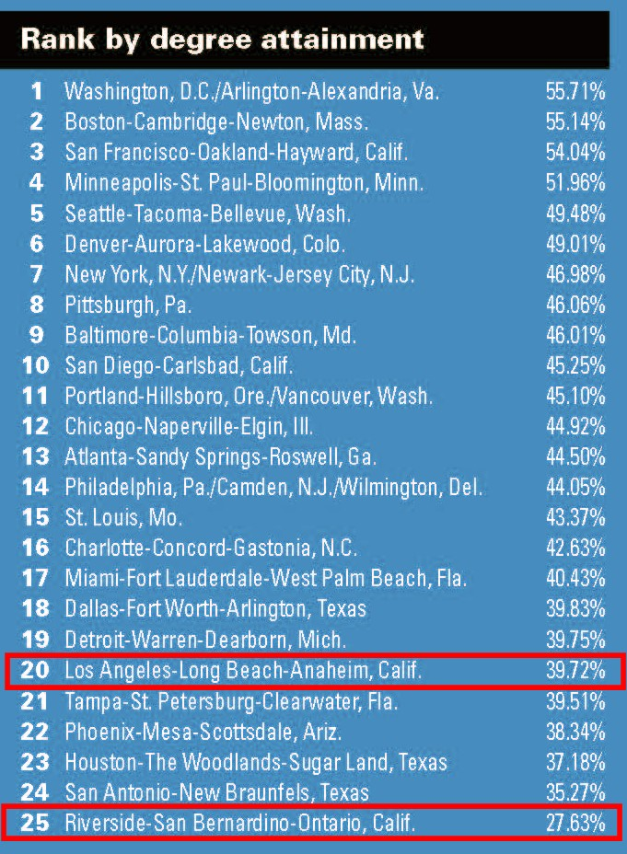
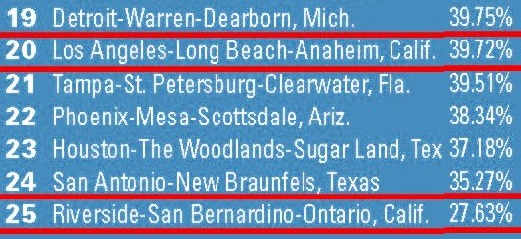
Challenge:
Degree Attainment
Los Angeles Average
Inland Empire Below
A Stronger Nation, Lumina Foundation, April 2016

Slide 24



Opportunity: BA in Community Colleges
State: 15 Pilot Colleges offering BA’s
Mt. SAC on-campus Bachelor’s Degrees
  Nursing: thru Mt. St. Mary College
  Business: thru University of La Verne
  Aviation Mgt: thru Southern Illinois U
  Fire Science Mgt: thru Southern Illinois U

Slide 25
Opportunity: Education = Jobs & $$$
Unemployment & Annual Earnings: U.S. Bureau of Labor Statistics, 2015

Slide 26
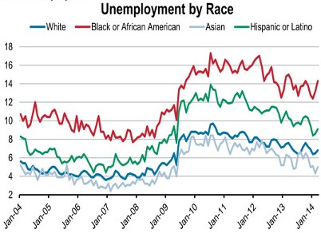
Challenge: Minority Unemployment

Slide 27
Opportunity: Mt SAC Deg/Cert/Transfer
Completion: Degree, Certificate, Transfer Ready (2009 cohort to 2015)
CCCC Scorecard: scorecard@ccccoledu

Slide 28

What Does the Future Hold?

