Slide 1

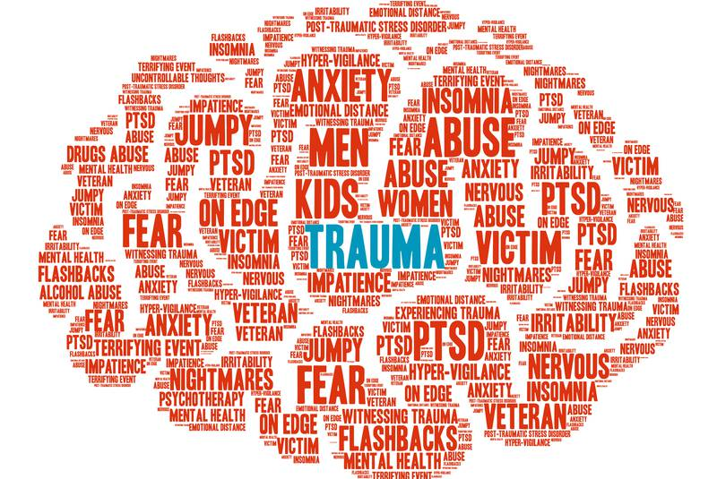
Trauma-Minded Planning for Fall
Stacy Bacigalupi
Ginger Klee

Slide 2
“Welcome to Fall 2020” takes on a new meaning this year
The world we are living in is different than it was just 6 months ago…
  COVID-19 Pandemic
  Racial tensions elevated
  Protests
  Online/remote education, counseling, advising, supporting
  Among others
As a result, we are experiencing trauma (Davidson, 2020)
Trauma/anxiety is a cognitive burden that must be addressed (Davidson, 2020)
Notes:
Last flex day was Feb. 21 – 6 months ago today

Slide 3
Addressing Trauma and What it Means for us
Quick poll to see where we are
How has the transition to online/remote instruction affected you?
Trauma → distraction
Trauma → physical and emotional distress → increased cognitive load
Notes:
Poll first
Discuss results
Are you feeling depressed, anxious, unfocused, like there’s not enough time in the day? – Children at home? Caregiving for a relative?
What we know is that trauma leads to distraction
It also leads to physical and emotional distress which leads to increased cog load
Increased cognitive load means that even if our workload has remained the same, the amount of time it takes to complete a task takes longer than it had in the past, because there is more that our brains and minds are working on at any given time.
If you have

Slide 4
What is trauma?
What is a traumatic event?
What qualifies as trauma?
What makes something traumatic?
Big t’s & little t’s
Traumatic experiences often involve a threat to life or safety, but any situation that leaves you feeling overwhelmed and alone can be traumatic, even if it doesn’t involve physical harm.
It’s not the objective facts that determine whether an event is traumatic, but your subjective emotional experience of the event.
The more frightened and helpless you feel, the more likely you are to be traumatized.

Slide 5
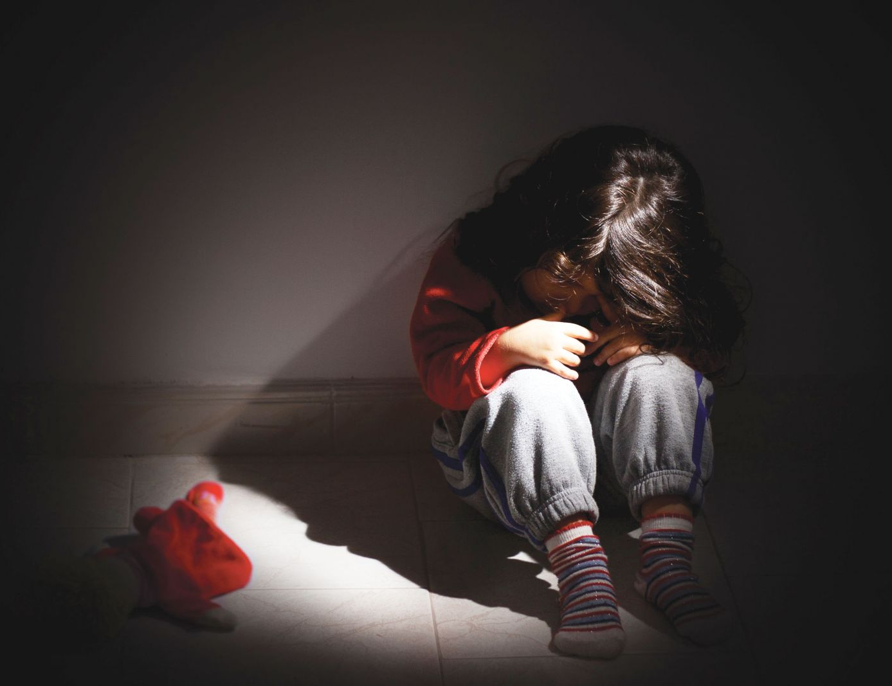
What Makes Something Traumatic?
It happened unexpectedly.
You were unprepared for it.
You felt powerless to prevent it.
It happened repeatedly.
Someone was intentionally cruel.
It happened in childhood.
Does this pandemic and/or current events fit this?

Slide 6
Acute Stress VS PTSD VS C-PTSD
Acute Stress Disorder usually occurs within 1 month after exposure to a traumatic stressor (Big t’s) involving some of the same symptoms of PTSD
  Lasts a minimum of 3 days and maximum of 1 month
PTSD is usually related to a single event, an event that is more time limited, and is usually caused by Big t’s
C-PTSD is from chronic trauma that continues or repeats for months or years at a time and can be a combination of Big t’s and little t’s
  Intruding thoughts, difficulty controlling impulses, anxiety, hypervigilance
  The “Microaggressions of trauma”
  Can involve emotional flashbacks→ sudden and prolonged regressions to the frightening and abandoned feeling-states of childhood
    Flashback doesn’t have to be auditory or visual, but instead it is a feeling

Slide 7
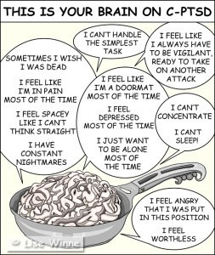
PTSD and C-PTSD Symptoms
  Emotional numbness
  Avoidance of people, places, and thoughts connected to the event
  Poor emotional regulation
  Poor concentration
  Poor memory
  Poor sleep
  Hypervigilance/Hyperarousal - exaggerated startle response
  Fight/Flight/Freeze/Fawn
  Flashbacks – reexperience of the trauma

Slide 8
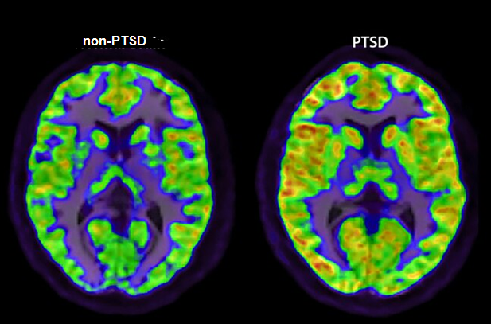
PTSD and the Brain
Trauma → increased cortisol in the brain → impaired mental performance and regulation of emotions
Trauma → overactive amygdala & lowers activity in prefrontal cortex & shrinks hippocampus
Trauma → brain is more active → more distraction and more fatigue

Slide 9
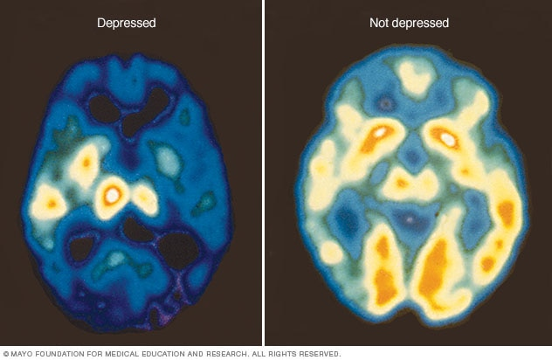
If left untreated, risks increase for:
Disturbances in academic and professional functioning
Depression
Suicidal ideation and attempts
Substance abuse
Reckless behavior
High-risk sexual behavior
Gang participation
Notes:
61.3% of youth with PTSD develop a problem with marijuana, compared to 26.9% of youth who do not have PTSD.

Slide 10
Adjustment Disorder
Perhaps not a full blown trauma, but rather an adjustment disorder
Caused by going through a stressful life event
  Anything that’s new can qualify – it’s a new experience so they do not know how to manage it (increased cognitive load)
Symptoms:
  Anxiety and depression (because of significant disruption in life)
    Reaction is stronger than otherwise would be expected

Slide 11



Being a leader during a pandemic can lead to vicarious trauma
As professors and staff, we are leaders!
Vicarious trauma is real→ an accumulation of exposure to the pain of others that can result in burnout-like symptoms
  Grief, anxiety, sadness; isolation, insomnia, apathy, substance use, etc.

Slide 12
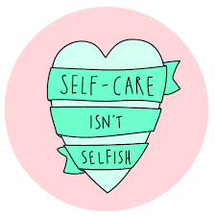
What can I do?
Give and receive support from your colleagues!
Create a method or routine to “end” your workday
Practice what you may be encouraging your students to do
  Use emotion regulation resources
  Self-Care!
  Ask for help
  Show empathy
  Acknowledge the difficulty in the situation
  Be flexible
  Modify assignments
Notes:
Mindfulness, meditation, gratitude journaling, deep breathing, take mental health days

Slide 13
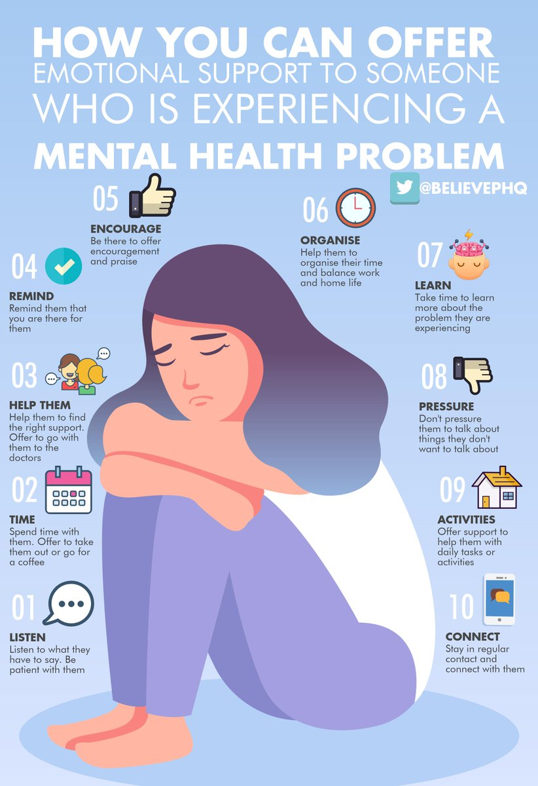

We need connection!
Notes:
Think of some ways you can connect with others, including your students.

Slide 14

Building Resiliency
Resiliency is the capacity of individuals to cope successfully in the face of significant change, adversity, or risk.
  The capacity changes over time and is enhanced by protective factors in the individual and environment.
Protective Factors are behaviors, characteristics, and qualities inherent in some personalities that will assist in recovery after exposure to a traumatic event.
Characteristics include:
  The capacity to make realistic plans and take steps to carry them out
  A positive view of yourself and confidence in your strengths and abilities
  Skills in communication and problem solving
  The capacity to manage strong feelings and impulses
Notes:
How resilient are you?
How can you build up your resiliency?

Slide 15
Resources and Skill Building

Slide 16
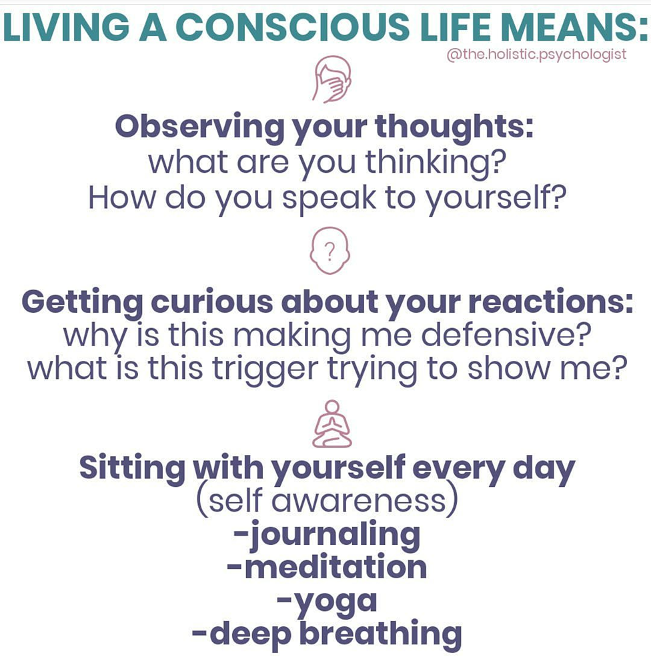
Mindfulness and Distress Tolerance
Notes:
Mindfulness & Distress Tolerance

Slide 17
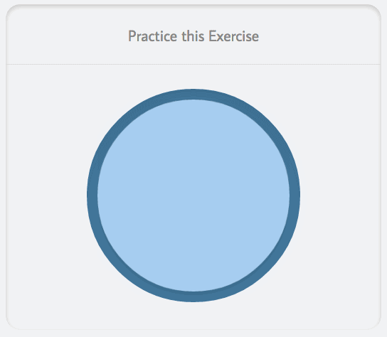
Mindful Breathing
To use the 4-7-8 technique, focus on the following breathing pattern:
  empty the lungs of air
  breathe in quietly through the nose for 4 seconds
  hold the breath for a count of 7 seconds
  exhale forcefully through the mouth, pursing the lips and making a "whoosh" sound, for 8 seconds
  repeat the cycle up to 4 times

Slide 18

1-Minute Mindfulness Exercise
Before you get started, sit in a comfortable position, with feet touching the floor, ankles uncrossed, and hands resting beside you or on your thighs
Set a timer for 1 minute
Close your eyes
Listen only to the *sounds around you – try to find 5 sounds in and around you
  Only focus on those sounds
  If a thought comes into your mind, acknowledge it and send it away to be dealt with later
Your breathing should be slow, calm, and deliberate
*If sounds isn’t relaxing to you, try a different sensory outlet
  (e.g., sight, smell, touch, or even taste!)

Slide 19
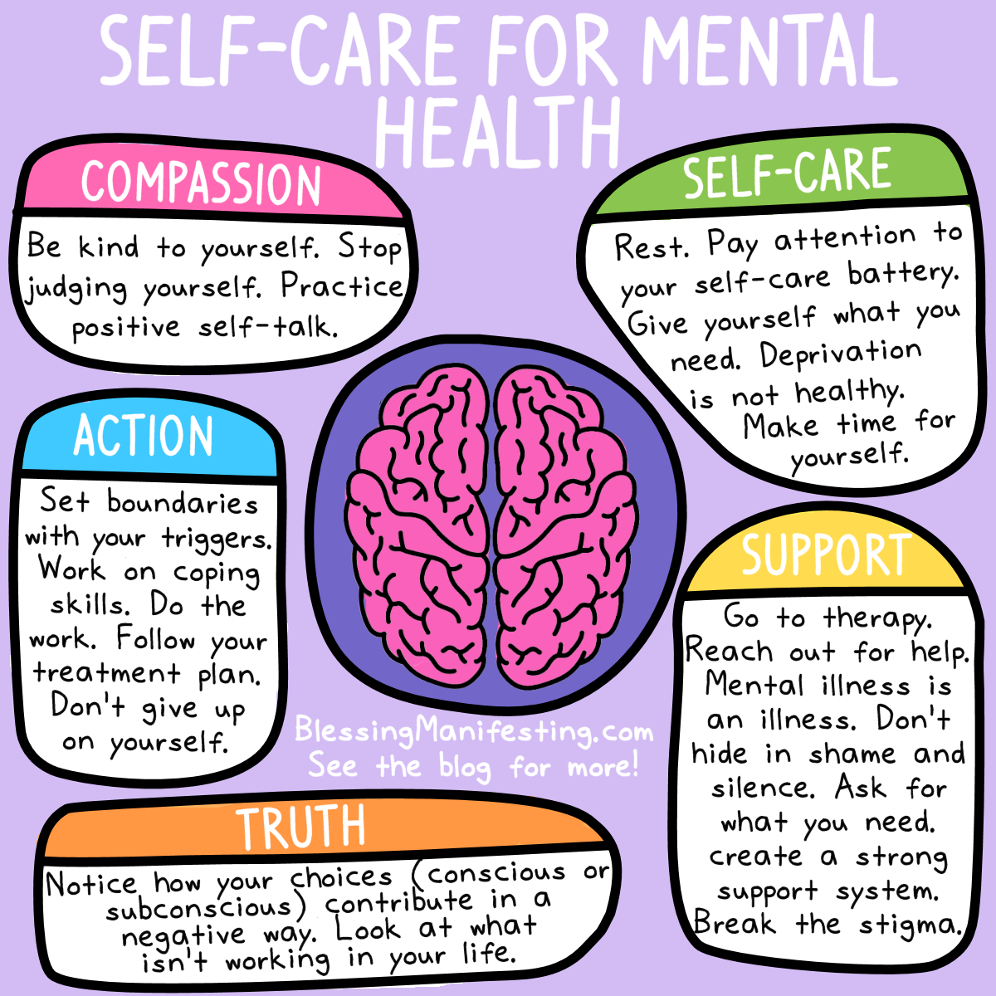


Self-care isn’t selfish

