Slide 1










EMOTIONAL INTELLIGENCE FOR THE NEXT GENERATION: TOOLS FOR CULTIVATING EUDAIMONIA AS WE REIMAGINE WORK
by Jorge Cherbosque, Ph.D. UCLA Staff & Faculty Counseling Center
310-794-0245
jorge@chr.ucla.edu 10920 Wilshire Blvd., Suite 380
Los Angeles, CA 90025

Slide 2


`

Slide 3

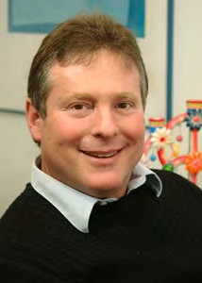















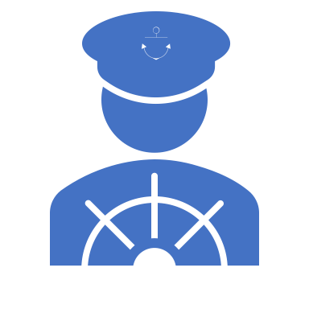




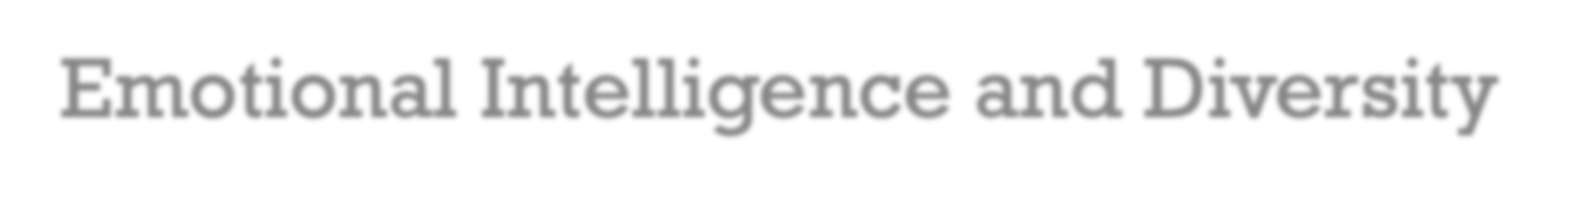











MY JOURNEY
Competitive Swimmer for Mexico- Becomes Marco Polo
Co-Director of The UCLA Staff and Faculty Counseling Center
Partner and Co-Creator of the Emotional Intelligence and Diversity Institute
My work passion: Being a “Social Architect” through
  Happiness and success
  Emotional Intelligence and Diversity
Leadership
  From TGIF To TGIH
  UniCability: the intersection of your passion and your talents
  Becoming an A+ Human Being

Slide 4




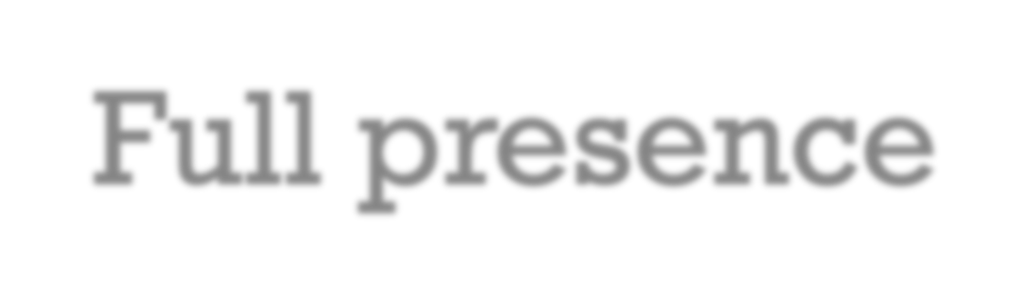
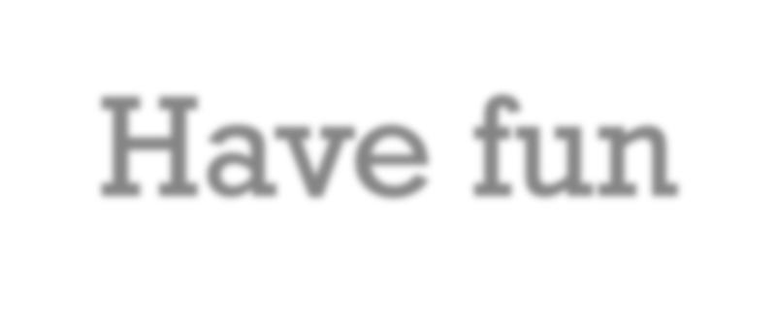

GROUND RULES
Confidentiality
Full presence
Have fun

Slide 5

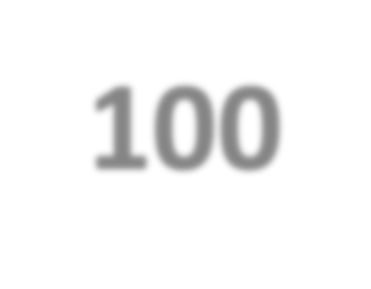
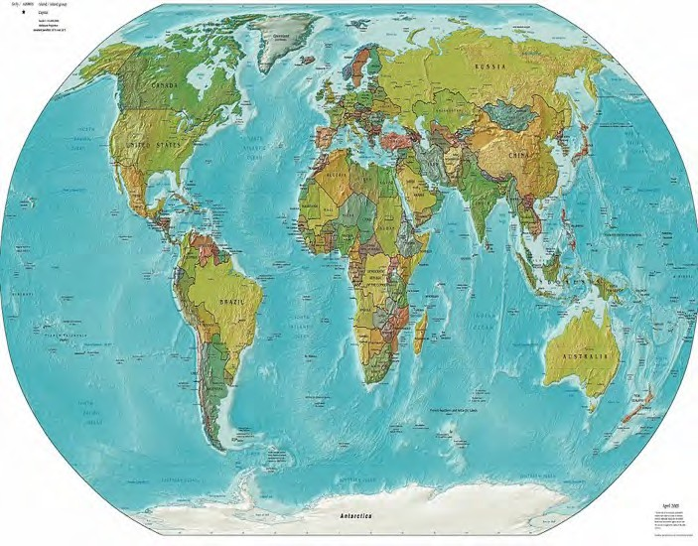
BLUE ZONE STUDY: THE “SECRET” LIVING UP TO 100
It’s all about: IKIGAI, relationships, meaning and connection!
5 Blue zones:
1.
2.
3.
4.
5.
Okinawa, Japan Sardinia, Italy Ikaria, Greece Nicoya, Costa Rica Loma Linda, California
Plant base diet
Portion control
Body movement
Ikigai- “Flow”
Connection-community
© Bashert 2020

Slide 6


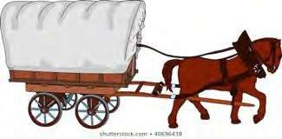
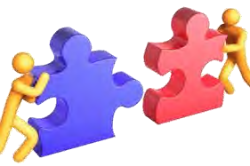
THE GRANT STUDY: THE “SECRET” TO HAPPINESS
It’s all about relationships and connection!
“Happiness is only the cart, love is the horse.” George Valiant (Triumph of Experience). “Without supportive, loving relationships, you will not be happy.”
Love is really all that matters. Full stop!
Connection at work is crucial.
“Strong relationships are the strongest predictor of life satisfaction.” Feeling connected to our work is far more important than making money
or achievingThet7r5a-YedariSttiuodynThaatlFsouundcTcheeSsecsre.ts To A Fulfilling Life – The Huffington Post. “What Makes Us Happy? The Atlantic – June 2009
© Bashert 2020

Slide 7
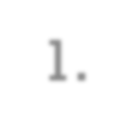
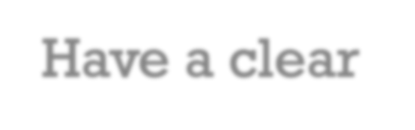

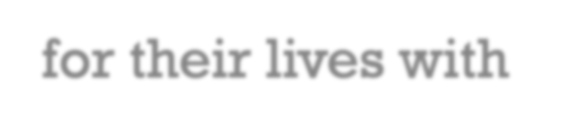
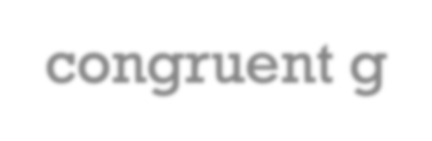
















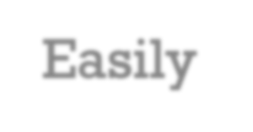








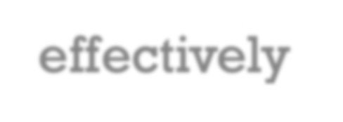




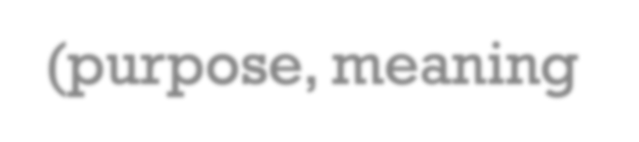













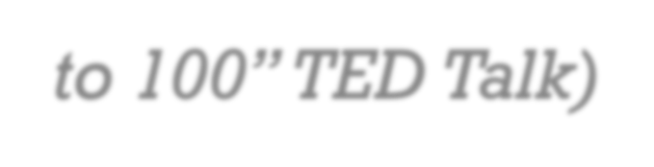
Have a clear vision for their lives with congruent goals
Have a great ability to navigate change
and demonstrate resilience
Express curiosity and are open to
feedback and self improvement
Easily connect, create meaningful attachment, communicate, and resolve conflict effectively
Have a sense of IKIGAI (purpose, meaning and contribution)
Cultivate gratitude
6
CHARACTERISTICS OF EMOTIONAL INTELLIGENT, SUCCESSFUL AND JOYFUL INDIVIDUALS
(Studies conducted by Claremont University as featured in the Happy film documentary and Dan Buettner’s book The Blue Zone and “How to Live to 100” TED Talk)

Slide 8






One of the greatest benefits of 2020-2021 for me personally was to rediscover the concept of Eudaimonia.
Eudaimonia is a Greek word commonly translated as happiness; however, a more accurate translation has been proposed to be the condition of human flourishing; “the pursuit of virtue excellence, and the best within us” (Huta & Waterman, 2014).
Eudaimonia is a moral philosophy that defines right actions as that which leads to the “well-being of the individual.”
Eudaimonia is based on what it means to live a human life well; a life with purpose and meaning.
TOOLS FOR CULTIVATING EUDAIMONIA AS WE REIMAGINE WORK

Slide 9














A spirit of generosity
CORE ELEMENTS OF EUDAIMONIA
Resilience
Purpose, meaning, and commitment to the common good
Selflessness
Optimism and being inspirational

Slide 10




WHY COVID -19 IS SO DIFFICULT FOR US:
Brings together 3 very strong factors that impact us emotionally –
Uncertainty
Lack of control
Danger

Slide 11



Uncertainty – what will our “new normal” look like?
Comfortable with remote work; we’ve adapted and are used to it.
MAJOR CHANGE AGAIN?
Re-opening is eliciting a re- emergence of fears.
Two-thirds of workers are worried about the transition.

Slide 12
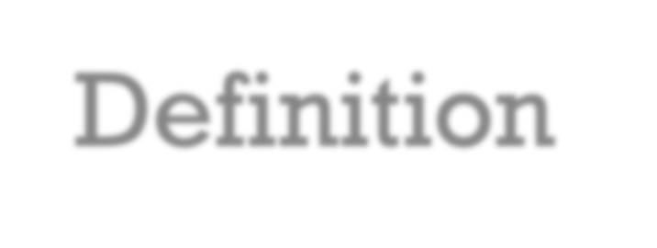









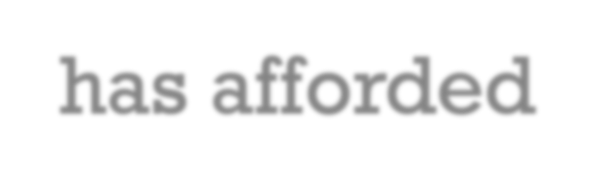









Definition –to wrap or enclose tightly, as if in a cocoon; to envelop or surround protectively.
Remote work has afforded many employees the ease of working from home – safety, convenience, autonomy, and flexibility.
COCOONING FOR ONE-YEAR PLUS

Slide 13


Health exposure (masking compliance, new variants, surge, non-vaccinated staff, etc.)
Commuting time + traffic again
ANTICIPATORY ANXIETY
Social interactions
Disruption to established daily routines
Uprooting geographical relocation
Increased stress from moving to a “faster way of life”

Slide 14









1.Change and uncertainty are constant realities that trigger powerful feelings. The ability to manage our reactions to them is key to effectiveness.
2. We have the ability to metathink, the power to change our reactions through our thinking. We can learn to use our higher brain to modify our kneejerk reactions.
FOUR RESILIENCE PRINCIPLES
3. There are tools, techniques and discoveries from neuroscience that can guide us in developing resilience and effectiveness.
4. Research is unequivocal: there is power in community. We need each other, and our connections are a source of support and longevity.

Slide 15




NORMAL RESPONSES TO COVID-19
Fear, frustration, anger, sadness, irritability at the chronic situation
Loss and Grief
Exhaustion
Isolation
Reassessment of life priorities
Greater self awareness

Slide 16








5 FACTORS IN RECOVERY FROM ADVERSITY & STRESS (PTSD) TO POST TRAUMATIC GROWTH (PTG)
5.
Hope
1.
Sense of Safety
4.
Self- Efficacy
2.
Calming
3.
Connect
Dr. Patricia Watson, Material Center for PTSD The Schwartz Center for Compassionate Healthcare

Slide 17

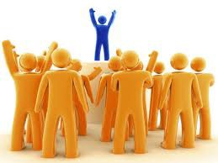
WHAT IS EMOTIONAL INTELLIGENCE? HOW CAN IT SUPPORT THE DEVELOPMENT OF EUDAIMONIA?
Emotional Intelligence is the ability to use our emotions and cognitions as a source of energy so that we can communicate, motivate, manage change, inspire, persuade and resolve conflicts with others in an effective and respectful way.

Slide 18















5 EMOTIONAL INTELLIGENCE SKILLS THAT SUPPORT THE DEVELOPMENT OF EUDAIMONIA AS WE REIMAGINE WORK
Connection
Creating strong and genuine connections at work.
Trust
Building psychological safety; cultivating trust.
Purpose/ Efficacy
Embracing purpose and meaning in building resilience.
Change
Understanding the human reaction to change.
Hope/ Ownership
Cultivating joy, hope and positive narratives in the workplace.

Slide 19



THE GRANT STUDY: CONNECTIONS IS THE “SECRET” TO HAPPINESS
It’s all about relationships and connection!
“Strong relationships are the strongest predictor of life satisfaction.” Feeling connected to our work is far more important than making money or achieving traditional success.
George Valiant (Triumph of Experience): “Without supportive, loving relationships, you will not be happy.”
The 75-Year Study That Found The Secrets To A Fulfilling Life – The Huffington Post. “What Makes Us Happy?
© Bashert 2020

Slide 20






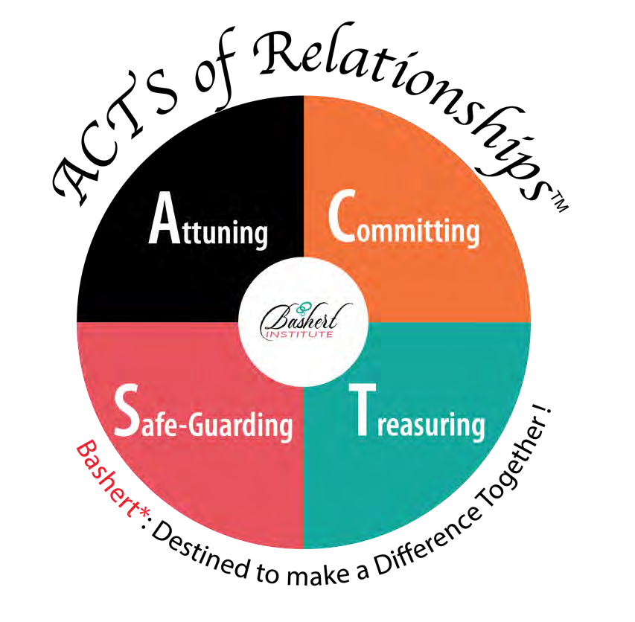
1. CREATING STRONG AND AUTHENTIC CONNECTIONS AT WORK:
ACTS OF RELATIONSHIPS
© Bashert 2020

Slide 21



BASIC REQUIREMENTS FOR CREATING EXTRAORDINARY RELATIONSHIPS
Do you get me? Do you really understand who I am?
Do you value me? Do you show it in a way that I need you to?
Do I feel safe being vulnerable with you?
Are you there for me? Do you “have my back”?

Slide 22


















CONNECTION EXERCISE
1.- A SHOULDER TO CRY
2.-A BRAIN TO PICK
3.-A HAND TO BE YOUR CHEERLEADER
4.-A KICK IN THE PANTS

Slide 23


PSYCHOLOGICAL SAFETY IS A CRITICAL DRIVER OF:
High-quality decision making
Healthy group dynamics
Extraordinary interpersonal relationships
Greater innovation and effective execution
2. RESEARCH SHOWS THAT…

Slide 24
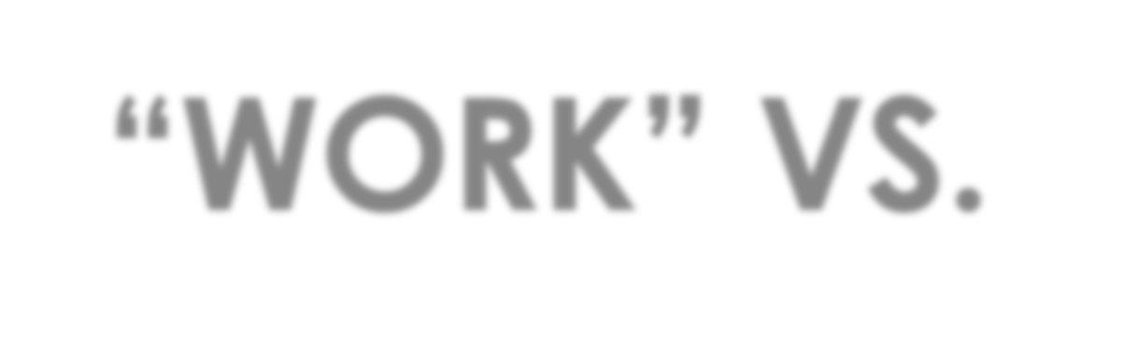




Many managers have found that previously off-limit topics– such as child- care, health risk comfort levels, and challenges of family members–are increasingly required for joint decisions about how to reintegrate your return to work.
“WORK” VS. “NON-WORK” DISCUSSIONS
TRUST is needed today to enable productive conversations in this challenging and uncertain territory.

Slide 25



One thing that is common to every individual, relationship, team, family, organization, nation, economy, and civilization throughout the world…
One thing which, if removed, will destroy the most powerful government, the most successful business, the most thriving economy, the most influential leadership, the greatest friendship, the strongest character, and the deepest love…
On the other hand, if developed and leveraged, one thing that has the potential to create unparalleled success and prosperity in every dimension of life…
Yet, it is the least understood, most neglected, and most underestimated possibility of our time. That one thing is trust.
- Stephen M.R. Covey
“THAT ONE THING IS TRUST”

Slide 26


BUILDING TRUST
We show up as our authentic selves and give others space to be vulnerable and open.
We engage in honest, candid communication with one another.
We follow through on our commitments.
We prioritize the well- being of one another and the organization.
We seek to understand others’ experiences and perspectives without judgment.
Young Presidents’ Organization

Slide 27

HOW TRUSTWORTHY ARE YOU? (1 = LOW, 5 = HIGH)
 | RESPECT: I demonstrate respect towards everyone. | 1 | 2 | 3 | 4 | 5
 | INTEGRITY: I demonstrate integrity – I walk the talk. | 1 | 2 | 3 | 4 | 5
 | VULNERABILITY: I demonstrate vulnerability easily. | 1 | 2 | 3 | 4 | 5
 | CONFIDENTIALITY: I demonstrate confidentiality always. | 1 | 2 | 3 | 4 | 5
 | HEALING: I demonstrate a willingness to heal hurt. | 1 | 2 | 3 | 4 | 5
 | ALIGNING: I communicate my expectations at all times. | 1 | 2 | 3 | 4 | 5
 | LISTEN: I demonstrate empathetic listening always. | 1 | 2 | 3 | 4 | 5
8 | COMMITMENTS: I demonstrate keeping commitments always. | 1 | 2 | 3 | 4 | 5
1
2
3
4
5
6
7

Slide 28

SCORE THE TRUST LEVEL THAT YOU DEMONSTRATE
08 - 16 | You demonstrate very low trust behaviors.
17 - 24 | You demonstrate low trust behaviors.
25 - 32 | You demonstrate high trust behaviors.
33 - 40 | You demonstrate very high trust behaviors.
Trust Behaviors of Extraordinary Relationships and Teams
Jorge Cherbosque, Ph.D. Adapted from: The Speed of Trust. 2011 Covey Link

Slide 29



TRUST | SAFETY
PSYCHOLOGICAL SAFETY QUIZ
YOUR TEAM’S TRUST QUOTIENT
Let us now take a moment to reflect on what are the factors that will bring a sense of psychological safety to you

Slide 30


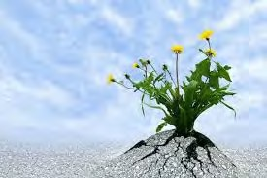




RESILIENCE
An ability to recover from or adjust easily to misfortune or change
Bouncing back from problems and stuff with more power and more smarts
Being able to navigate the human side of change
‘What lies behind you and what lies in front of you, pales in comparison to what lies inside of you’ - Ralph Waldo Emerson

Slide 31







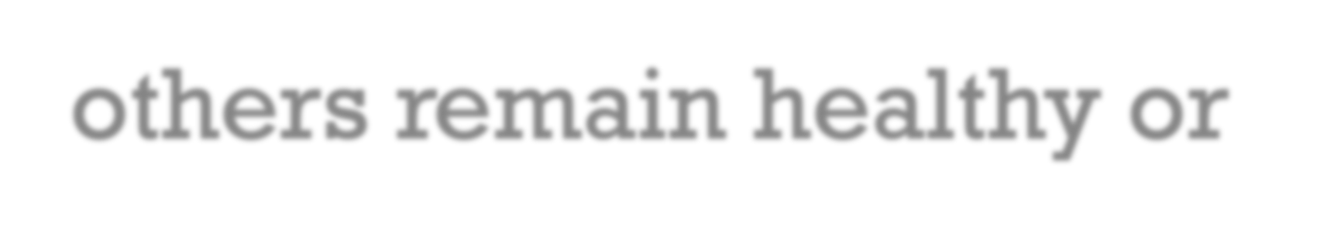

QUESTION?
Why is it, when several people are exposed to the same stressor, that some of them break down while others remain healthy or even thrive?

Slide 32



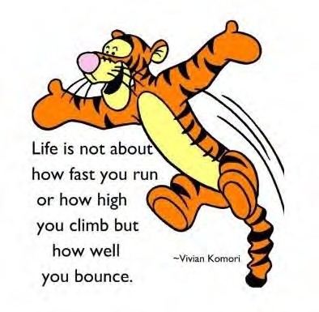
3. EMBRACING PURPOSE AND MEANING IN BUILDING RESILIENCE
Attributes of Resilience
Sense of purpose and meaning
Flexibility
Tolerance of ambiguity
Proactivity
Acceptance of reality
Positive attitude
Focused vision
Self-confidence

Slide 33



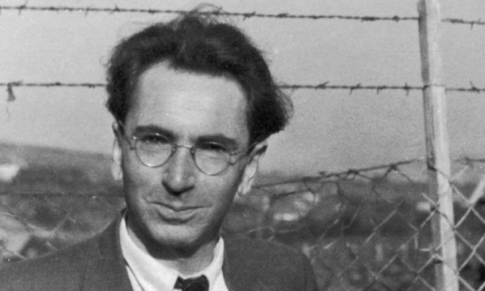

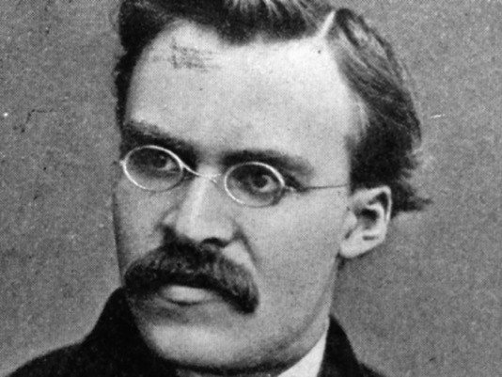
3. EMBRACING PURPOSE AND MEANING IN BUILDING RESILIENCE
“Everything can be taken from a man but one thing: the last of the human freedoms – to choose one’s attitude in any given set of circumstances, to choose one’s own way.” - Viktor Frankl
“He who has a why to live can bear almost any how”
- Nietzsche

Slide 34




WHAT’S YOUR PERSONAL BRAND?

Slide 35
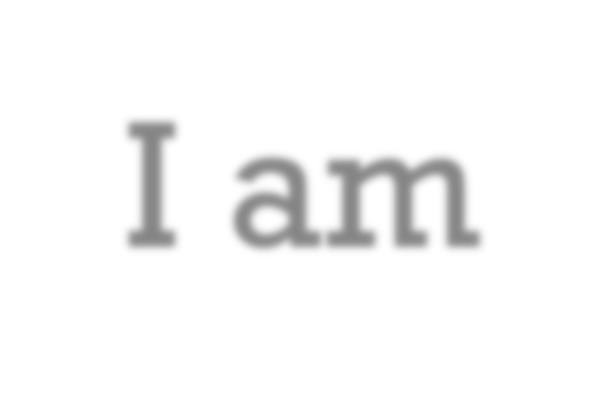







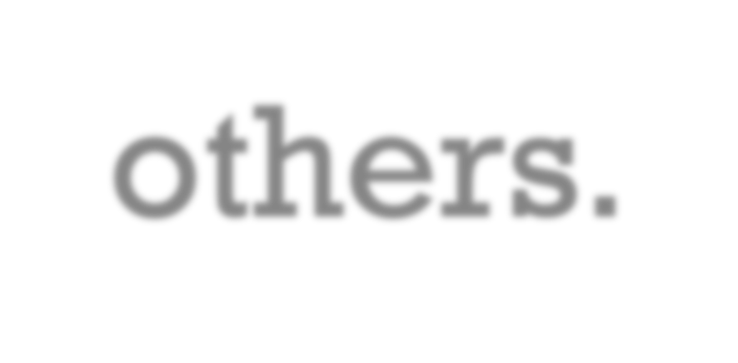
I am…
A Global, Loyal Family men. Who is commited to heal himself and others by bringing : joy, connection, passion and transformation to others.

Slide 36


EFFECTIVENESS
Self-Efficacy is defined as “people’s beliefs about their capabilities to produce
effects”.
Definition by Bandura (1997)

Slide 37



HOW TO MAP YOUR LIFE
EXPERIENCES
GROWTH
CONTRIBUTIONS

Slide 38









Love Relationships
Friendships
EXPERIENCES
Adventures
Environment

Slide 39

GROWTH
HEALTH AND | INTELLECTUAL | SKILLS | SPIRITUAL LIFE
FITNESS | LIFE

Slide 40

CREATIVE LIFE
CAREER
CONTRIBUTION
FAMILY LIFE
COMMUNITY LIFE

Slide 41





ACTIVITY: CREATE YOUR OWN PYRAMID (3MINS)
THE 6 THINGS (VALUES, GOALS, BEHAVIORS OF MY DESIRED LIFE IN THE NEXT 2 YEARS)
My example:
Practicing mindfulness and gratitude
Developing ER Institute
Relationship with my daughters(every day calls, shabath)
Learning 2 new things Book group and film
Financial Stability, work with a coach
Vitality/peloton

Slide 42

OUR WORK/TEAM ROADMAP:
THE 6 THINGS (VALUES, GOALS, BEHAVIORS OF MY DESIRED WORK/TEAM EXPERIENCE NEXT 2 YEARS)

Slide 43

THE PAST YEAR

Slide 44
5 FACTORS IN RECOVERY FROM ADVERSITY & STRESS (PTSD) TO POST TRAUMATIC GROWTH (PTG)
5.
Hope
1.
Sense of Safety
4.
Self- Efficacy
2.
Calming
3.
Connect
Dr. Patricia Watson, Material Center for PTSD The Schwartz Center for Compassionate Healthcare

Slide 45

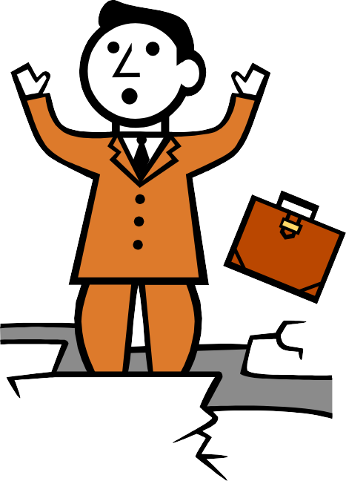


STRESS WITHOUT DISTRESS

Slide 46



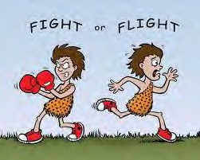




SYMPATHETIC NERVOUS SYSTEM
Increases blood pressure
Increased heart rate
Increased sweating
Decreased digestion
Real or imagined threat

Slide 47







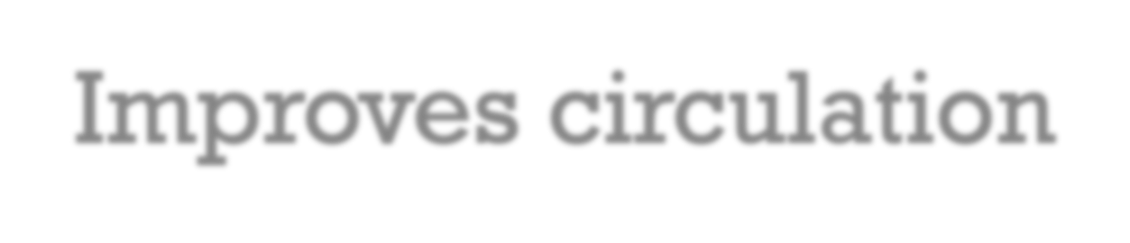

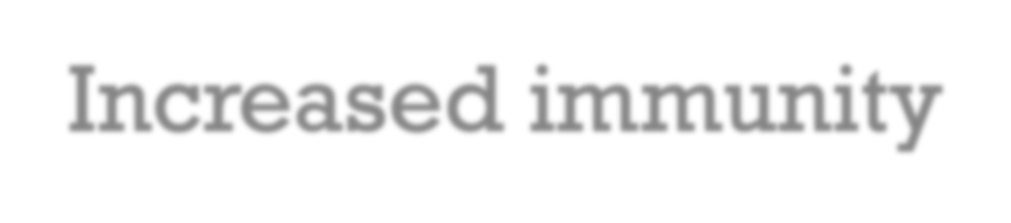

PARA-SYMPATHETIC NERVOUS SYSTEM
Promotes relaxation and healing
In charge of maintenance, ex. sleep
Improves circulation
Decreased blood pressure
Increased immunity
Offsets stress response

Slide 48
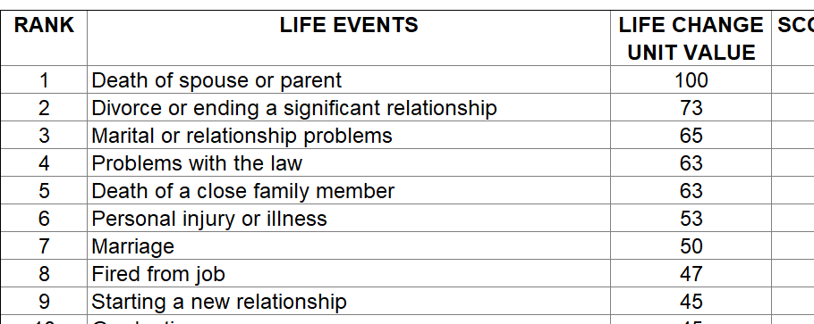



THE HOLMES AND RAHE SCALE LIFE STRESS SCALE
Within the past year, have you experienced…

Slide 49


SOURCE OF CALMING

Slide 50
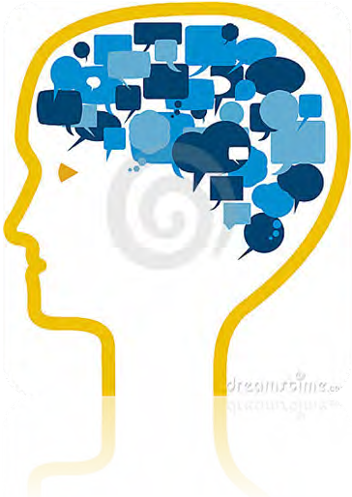



WHAT IS YOUR
CHATTERBOX?

Slide 51









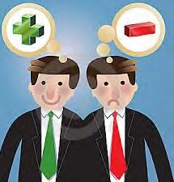


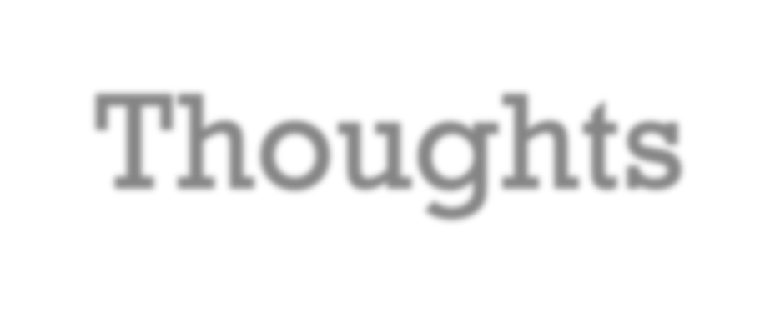
POWER OF THE MIND: FROM HOMO SAPIENS TO HOMO NARRAN'S
(WE ARE STORY-TELLERS)
Our Chatterbox: SELF- TALK
Positive and Negative Thoughts

Slide 52
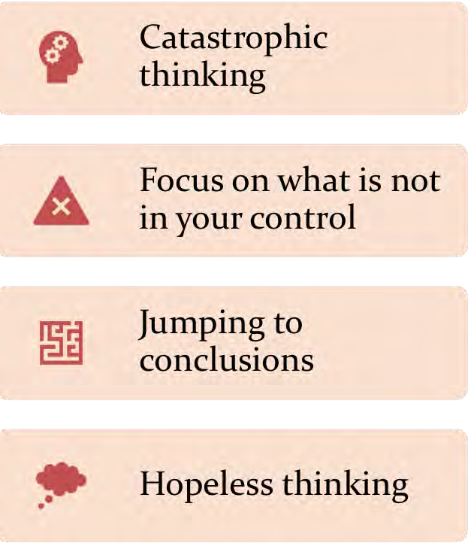





CALMING OUR DYSFUNCTIONAL SELF-TALK

Slide 53
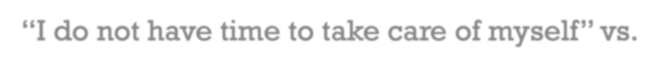

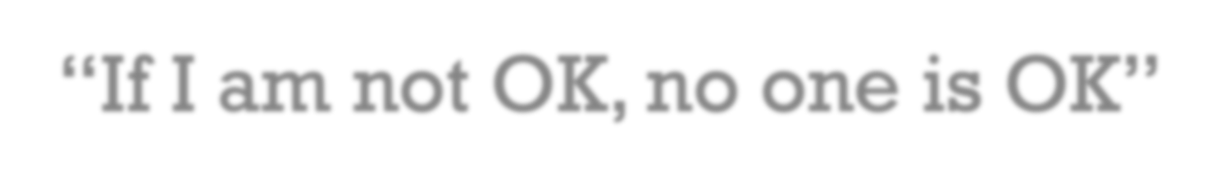
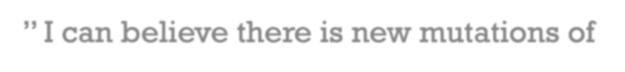

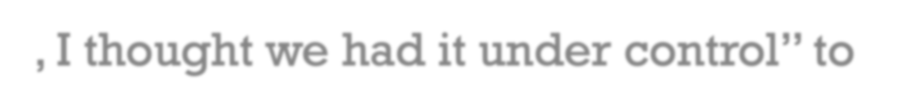

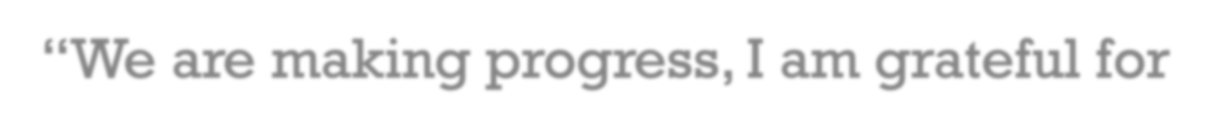

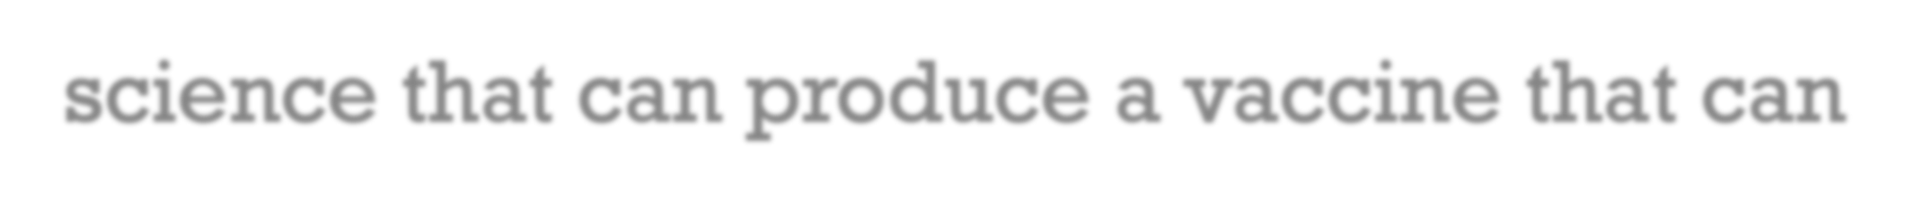

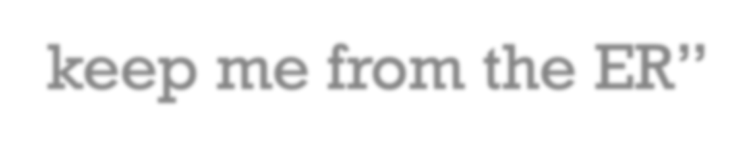

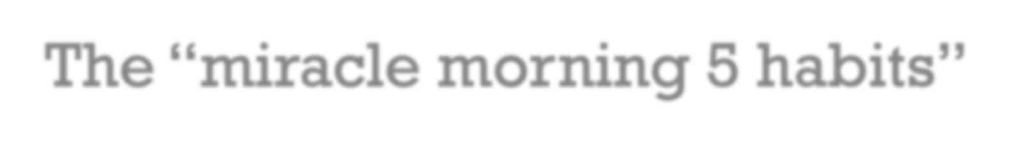








“I do not have time to take care of myself” vs. “If I am not OK, no one is OK”
” I can believe there is new mutations of covid, I thought we had it under control” to “We are making progress, I am grateful for science that can produce a vaccine that can keep me from the ER”
EXAMPLES OF INTERNAL MINDSET SHIFTING AND THE POWER OF AFFIRMATIONS
The “miracle morning 5 habits”
Mindful meditation
Affirmation
Exercise
Music/Book
Set an intention for the day
Gratefulness Journal

Slide 54





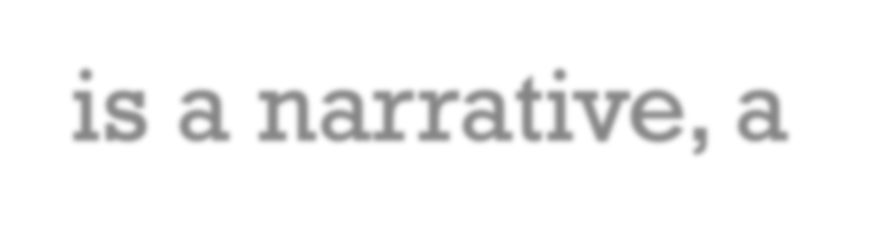

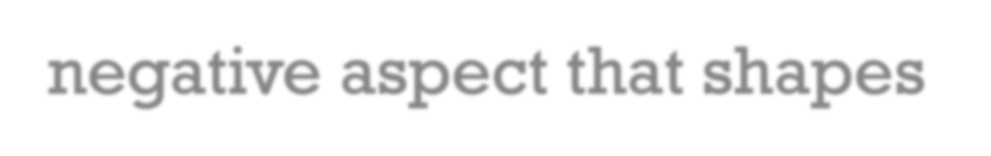
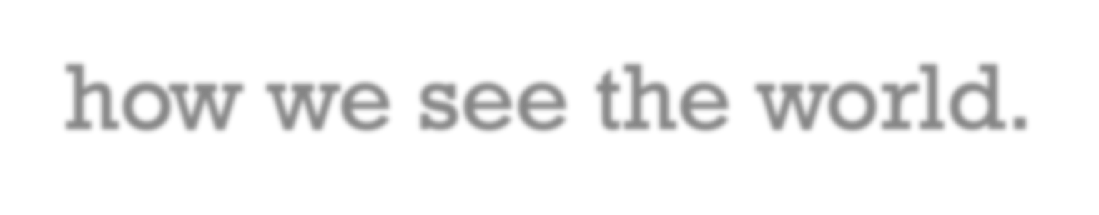
UNDERSTANDING YOUR FORMATIVE EXPERIENCES, PERSONAL AND TEAM SCHEMAS
A schema is a narrative, a story; something positive or negative aspect that shapes how we see the world.

Slide 55


POSITIVE/MALADAPTIVE SCHEMAS
Examples of positive stories, schemas, or paradigms:
Life is full of abundance.
What matters is the process, not the end result.
I can make a difference.
Examples of maladaptive stories, schemas, or paradigms:
Interdependence makes you weak.
Terminations are always
traumatic.
You can’t trust people.

Slide 56


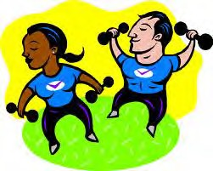
EXERCISE TO EXPLORE OUR QUESTIONS: WHAT ARE YOUR FORMATIVE EXPERIENCES AND
SCHEMAS?

Slide 57



















A FORMATIVE EXPERIENCE-LIFE PERSPECTIVE
Event: Mothers Death at 13
Importance: mom as the glue of the family
  Positive narrative: live life to the fullest
Negative narrative: fear of dying, separation
  Feelings: love for life, fear
Key Schema: Not all endings are traumatic.

Slide 58













A FORMATIVE EXPERIENCE- DIVERSITY
Event: Swimming for Mexico
Importance: helped my self-esteem
Positive narrative: exposure to diversity, culture and global travel
  Negative narrative: who am I( Mexican, Jewish..?)
Feelings: connection, achievement, fear of rejection
Key Schema: Don’t give others the power to define you..
Proud of my diverse background, Work hard and love what you do.

Slide 59

CALMING SHIELD

Slide 60












MINDFULNESS
A strategy to keep attention in the present
“Paying attention in a particular way, without judging”
Calm acceptance of what is occurring in the moment
No intent to change anything
Awareness of every thought and emotion
Allows feelings to emerge without resistance
Accepting them without letting them stick, like clouds that are in front of you but can go away

Slide 61







4. THE HUMAN
REACTION
TO CHANGE

Slide 62


RESEARCH SHOWS…
The Center for Creative Leadership has found that the primary causes of derailment in our professional life involved deficits in emotional competence, primarily:
Difficulty handling change
Inability to work in a team
Poor interpersonal relations

Slide 63











“CHANGE” PERSONALITIES
Innovators
<3% of the population
Enthusiastic about all things new
See changing technology as fundamental advances for humankind
Like discontinuity
Are forgiving of details
Early
Adopters
<14% of the population
Are visionaries
Welcome fundamental breakthroughs
Envision benefits
See compelling advantage
Are change agents / revolutionists
Early Majority
about 35% of
the population
Pragmatists
Like
evolution, not revolution
Like
incremental change
Are practical
Like well- established references
Late Majority
about 35% of the population
Are conservative
Like well- established standards and sources of support for anything new
Will want things packaged and easy to use
Laggards
<14% of the population
Will focus on how things were
Will resist anything new
UCLA Staff & Faculty Counseling Center

Slide 64



PEOPLE DO NOT FEAR CHANGE; THEY FEAR LOSS.
UCLA Staff & Faculty Counseling Center

Slide 65


Security: People no longer feel in control; they are uncertain of what the future holds.
Competence: People feel that they no longer know what to do and are embarrassed to admit it.
Relationships: Familiar contact with co-workers, managers, customers, friends, or family may be disrupted; people lose their sense of belonging to a team or family.
UCLA Staff & Faculty Counseling Center

Slide 66


Sense of Direction: People lose an understanding of where they are going and why; the meaning and mission become muddled.
Territory: People experience an uncertain feeling about the area that used to be theirs, whether workspace, job assignment, or home.
UCLA Staff & Faculty Counseling Center

Slide 67



EMOTIONAL STAGES OF CHANGE

Slide 68
THE PHASES OF TRANSITION THROUGH CHANGE
Scott and Jaffe
Denial
Commitment
PAST
FUTURE
Resistance
Exploration

Slide 69









3 WAYS TO SUPPORT THE HUMAN SIDE OF CHANGE
Help
Identify
Provide
Help people mourn losses.
Identify the possibilities and opportunities open in this new reality.
Provide the knowledge and skills necessary to be successful in this new reality.
UCLA Staff & Faculty Counseling Center

Slide 70



5. HOPE
“Hope is that thing inside that insists, despite all evidence to the contrary that something better awaits us if we have the courage to reach for it, work for it, and fight for it.”
- Barack Obama

Slide 71



WHY IS HOPE IMPORTANT? AND WHAT IS IT?
Research shows that a sense of hope impacts health, life satisfaction, mental well-being, tolerance for pain and performance.
Hope is both a trait and a cognitive process; it can be developed towards a mindset of growth.

Slide 72



4 BELIEFS THAT HOPEFUL PEOPLE SHARE
The future will be better than the present.
I have the power to make it happen.
There are many paths to my goals. 4.None of them is free of obstacles.
- Shane Lopez, Ph.D.

Slide 73












THE TRIANGLE OF HOPE
The Triangle of Disappointment/Despair
Motivator-Coach Challenge and Inspirer
The Victim Sadness
The Rescuer Fear
Transform
ME
The Persecutor Anger
Goal Creator Doer
Empower Assertion
Eva Kedar Ph.D.

Slide 74


ROLES WE PLAY

Slide 75


LEARNED OPTIMISM (3P MODEL)
EXPLANATORY STYLE
(Bad Events)
PESSIMIST
yes
yes yes
OPTIMIST
no
no no
PERSONAL
PERMANENT
PERVASIVE
EXPLANATORY STYLE
(Good Events)
PESSIMIST
no
no no
OPTIMIST
yes
yes yes
PERSONAL
PERMANENT
PERVASIVE
Martin Seligman Ph.D.

Slide 76








































Assertiveness is the ability to honestly express your opinions, feelings, attitudes, and rights, without undue anxiety, in a way that doesn't infringe on the rights of others.
Advantages of Assertiveness Skills in Communication
There are many advantages of assertiveness skills in communication, most notably these:
Assertiveness helps us feel good about ourselves and others
Assertiveness leads to the development of mutual respect with others
Assertiveness increases our self-esteem
Assertiveness helps us achieve our goals
Assertiveness reduces anxiety
Assertiveness protects us from being taken advantage of by others
TAKING OWNERSHIP OF YOUR LIFE THROUGH COURAGE AND ASSERTIVENESS

Slide 77


The Safety Promise: My Universal Rights and Relational Duties
To create a safe space for the relationship we need to identify our relationship rights and duties:
A. You have the Universal Right to:
make mistakes
be the final judge of your feelings and accept them as true
have your own opinions and convictions
say no
ask for what you need
be heard
B. You have the Relational Duty to:
listen attentively and keep the synergy and support
assume good will in the intentions of others
keep your ego in check (Ego is your Enemigo)
treat others with respect
take ownership for your own action
admit when you are wrong
Select your top 3 for A and B. Which rights are the most difficult to ask for? Which duty would be the most meaningful if your partner fulfills?
© Bashert 2020

Slide 78











DEBRIEF
What are some revelations/insights that you gained from doing this exercise?
Which other Universal Rights or Relational Duties need to be added?
What are the most essential elements for you to create safe relationships? How do they apply to forum?
© Bashert 2020

Slide 79






EXERCISE TO EXPLORE THE QUESTIONS:
WHO IS YOUR LEADERSHIP HERO?

Slide 80



THE LEADERSHIP CHALLENGE

Slide 81

THE FOUR AGREEMENTS
 | BE | BE IMPECCABLE WITH YOUR WORD
 | DON’T TAKE | DON’T TAKE ANYTHING PERSONSALLY
 | DON’T MAKE | DON’T MAKE ASSUMPTIONS
 | DO | ALWAYS DO YOUR BEST

Slide 82
































THE LEADERSHIP CHALLENGE
CHALLENGE THE PROCESS
  Search for opportunities
  Experiment and take risks
B . INSIPIRING A SHARED VISION
Envision the future
Enlist others
ENABLING OTHERS TO ACT
  Foster collaboration
  Strengthen others
D. MODELING THE WAY
Set the example
Plan small wins
E. ENCOURAGING THE HEART
Recognize individual contribution
Celebrate accomplishments
“Leadership is an attitude; it is not about a position.”
Jim Kouse & Barry Posner
1/10/22
82

Slide 83




“Heart of the matter conversations(HM)”
Facts-observables
Brain-thoughts
Heart-Feelings
Soul-Needs

Slide 84









EMPATHY IS …
Identifying Feelings
Accepting Feelings
Responding to Feelings
Relating if you c

Slide 85

EMPATHY IS NOT …
Reassuring
Arguing/Defending
Giving the “facts”
Problem solving

Slide 86

CRITICAL BEHAVIORS FOR EMPATHY
Abandon your perspective
Suspend judgment
Active listen to the essence of the content and the feelings
Call upon your compassion and acceptance

Slide 87










GUIDED IMAGERY: ROOM OF SAFETY, ROOM OF HAPPINESS AND ROOM
OF HEALTH.

Slide 88


Economist Peter Drucker, when he became frail and could no longer consult with big business and government, used to hold retreats in his home. When the retreat was almost over, he used to say to the participants, “I do not want to hear how brilliant this retreat was. I want you to tell me what you're going to do differently on Monday.”

Slide 89



THANK YOU, AND TO YOUR EVERY SUCCESS!

