Slide 1
Coverletters
More than Just the Facts

Slide 2
Proving you’re qualified!
Resumes = FACTS
Coverletter = THE STORY
Coverletter’s Job =
To directly talk about
Minimum & Preferred Qualifications

Slide 3
Coverletter: prove you’re qualified
ALL minimum qualifications
ALL desired qualifications
Any other selection criteria

Slide 4
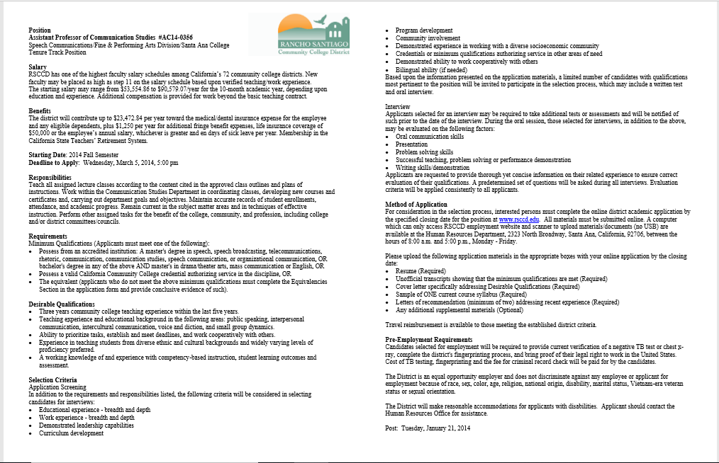

Slide 5
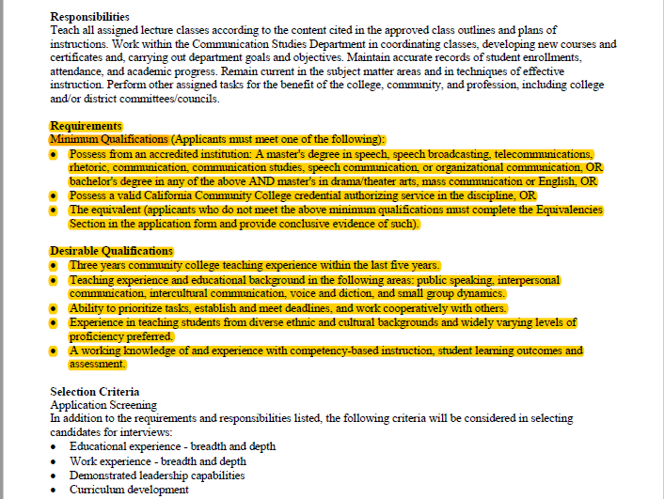

Slide 6
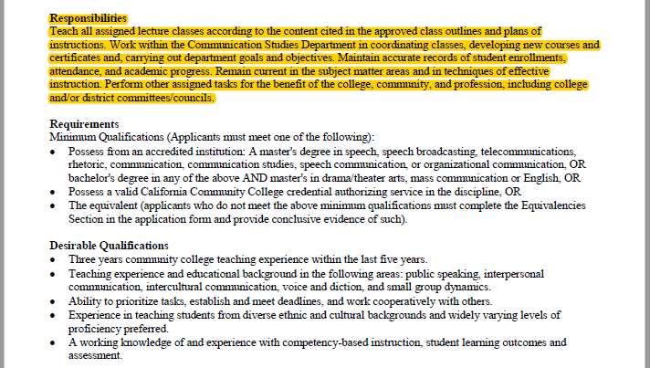
But wait…there’s more?

Slide 7
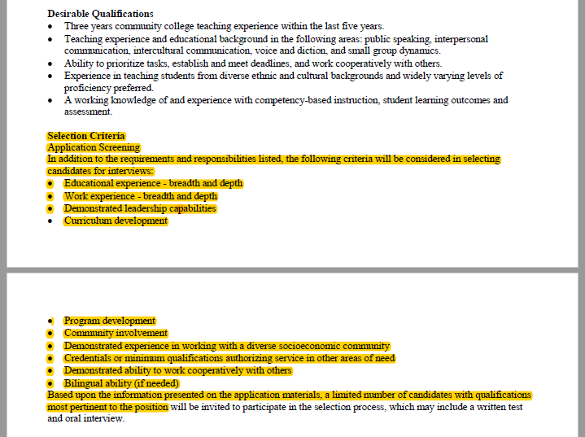

Slide 8
What if I don’t address every qualification?

Slide 9


Slide 10
Pro tips
Reader friendly (follow order, blt pts, float)
Express eagerness throughout
Let them realize you’re the “perfect fit”
Real examples: equity & diversity
Talk about students & teaching pedagogy
Connect yourself to their campus
Weave in their language
  job announcement
  mission statement
  department website

Slide 11
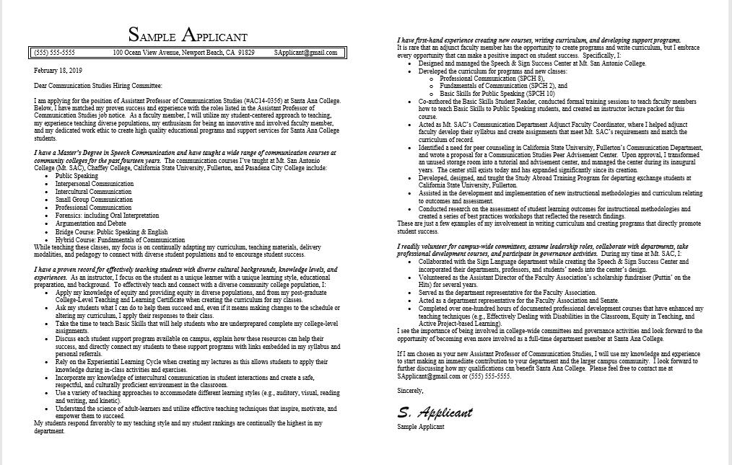
Reader friendly follow order, blt pts, float

Slide 12
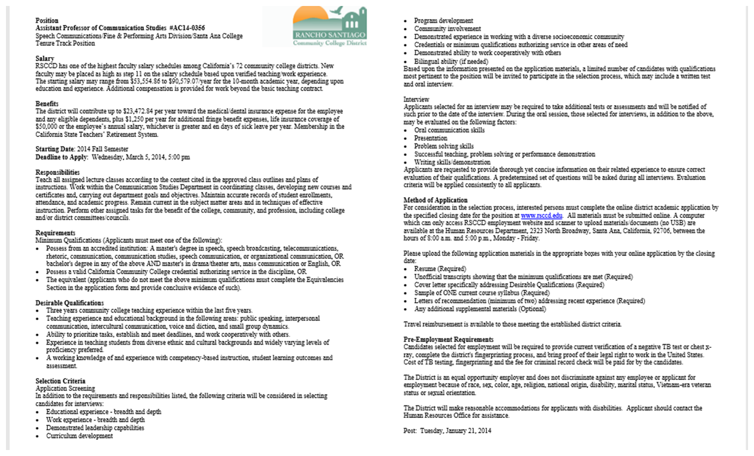
DOWNLOAD & SAVE THE JOB ANNOUNCMENT!

Slide 13
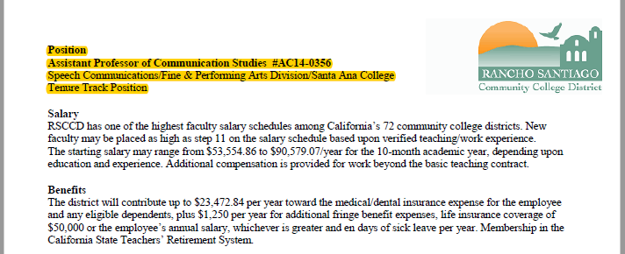
Why?
Reference for Letters of Recommendation

Slide 14
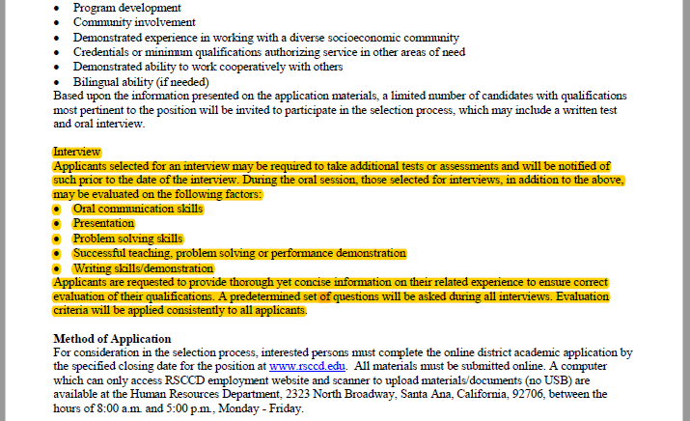
Why?
Reference for yourself

Slide 15
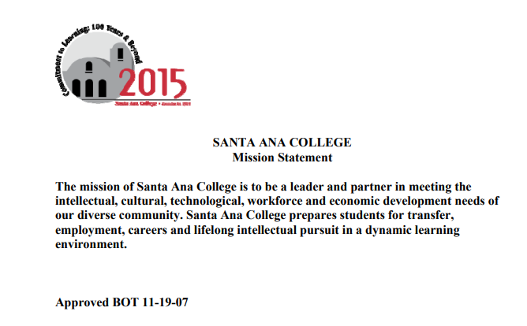
Use their language

Slide 16


Slide 17
Brand Yourself: file name
Don’t:
  Resume
  “The BEST Resume”
  The College’s Name
  Another College’s Name
Do:
  Your Name & Job Title
  Use Electronic Signature (don’t scan & upload)

Slide 18
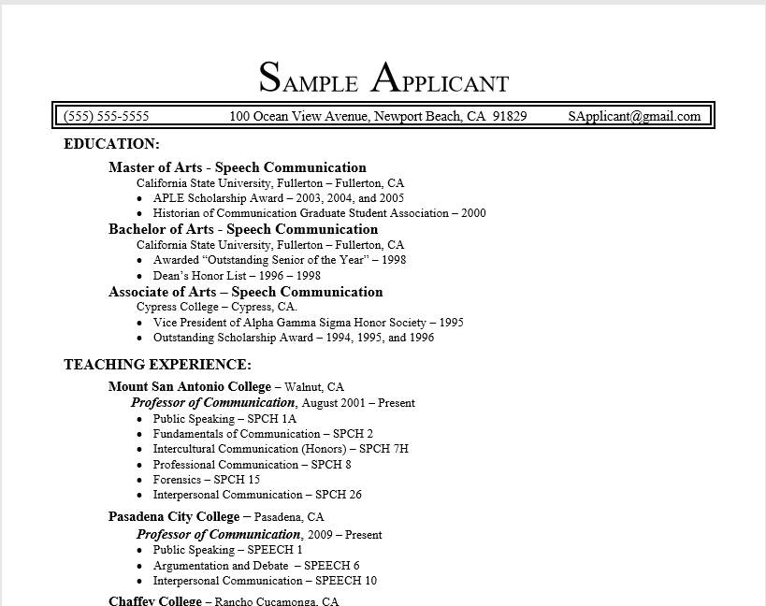
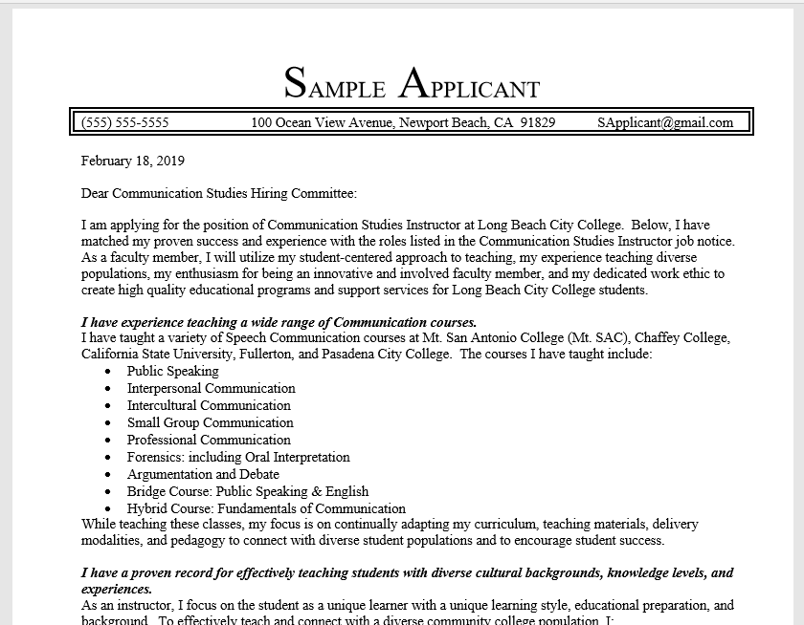
BRAND YOURSELF: Format

Slide 19


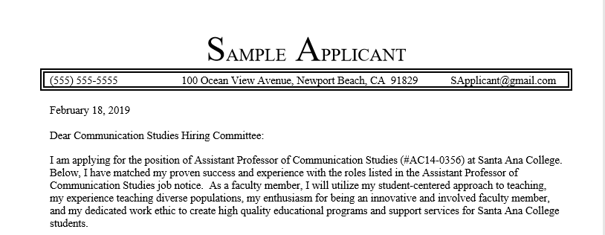
Step 3: state job title

Slide 20
Step 4: identify & Address qualifications
ALL minimum qualifications
ALL desired qualifications
Any other selection criteria

Slide 21
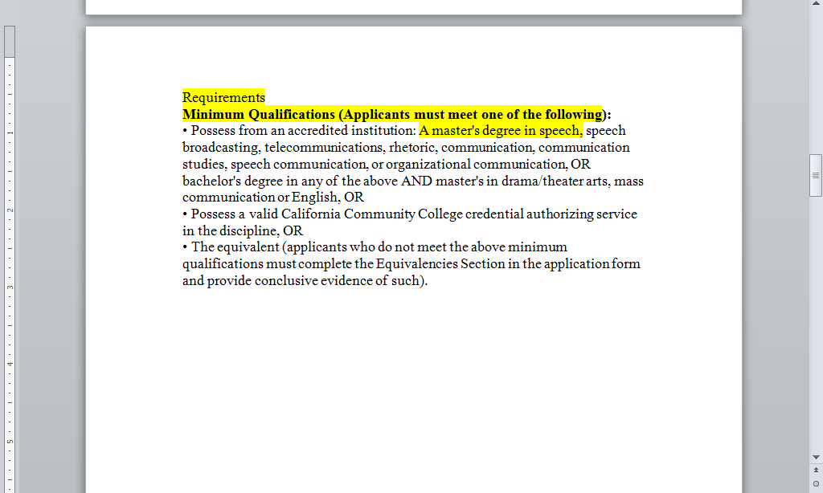
Address minimum qualifications first

Slide 22
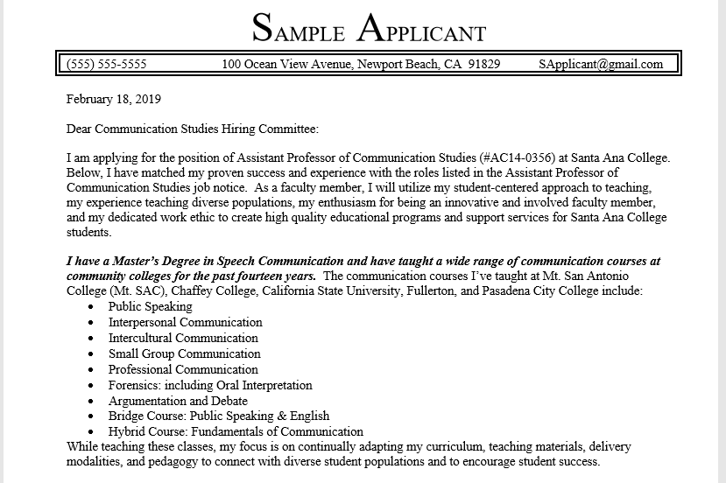

Slide 23
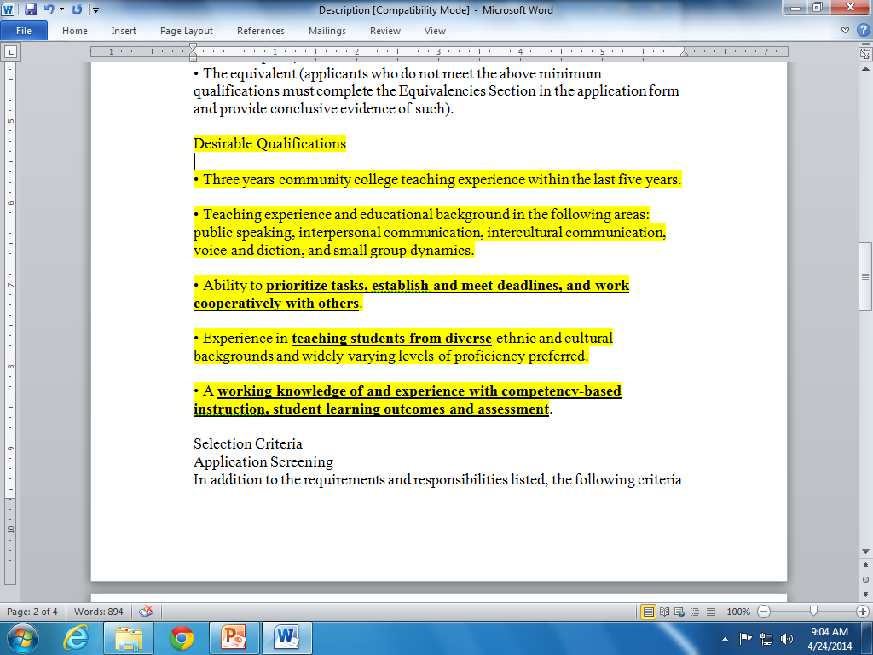
Weave in desirable qualifications

Slide 25
Give some qualifications more attention

Slide 26
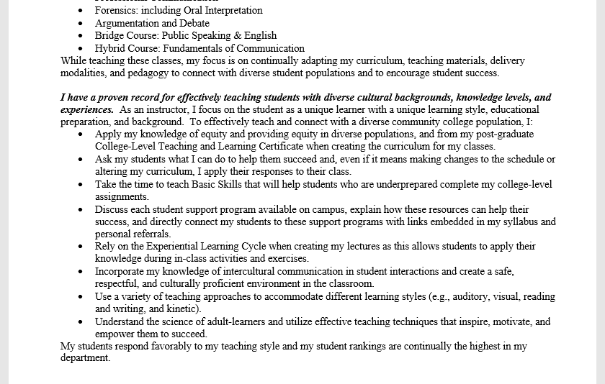

Slide 27
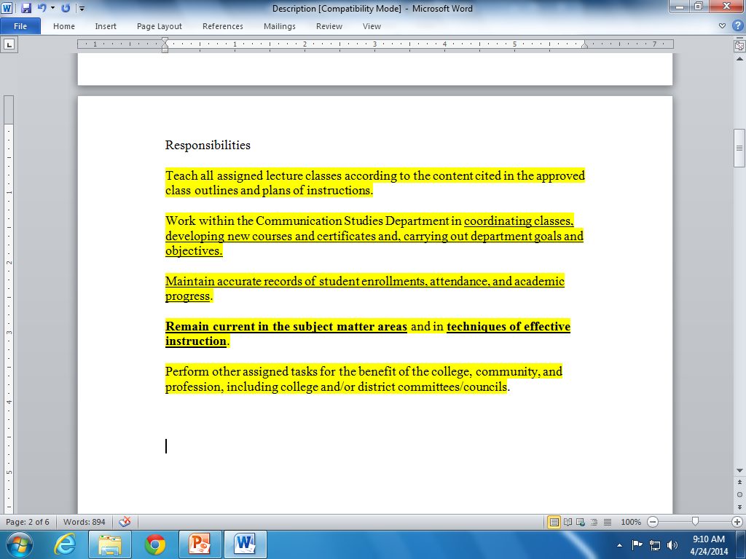

Slide 28
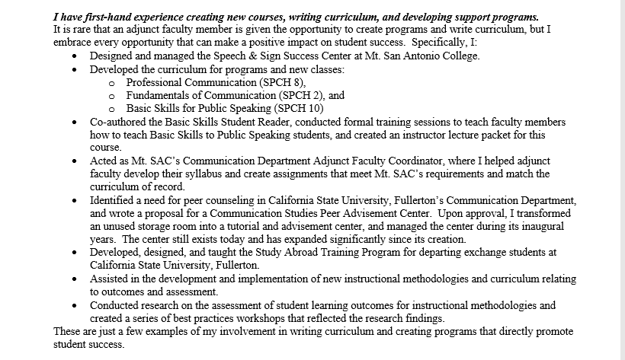

Slide 30
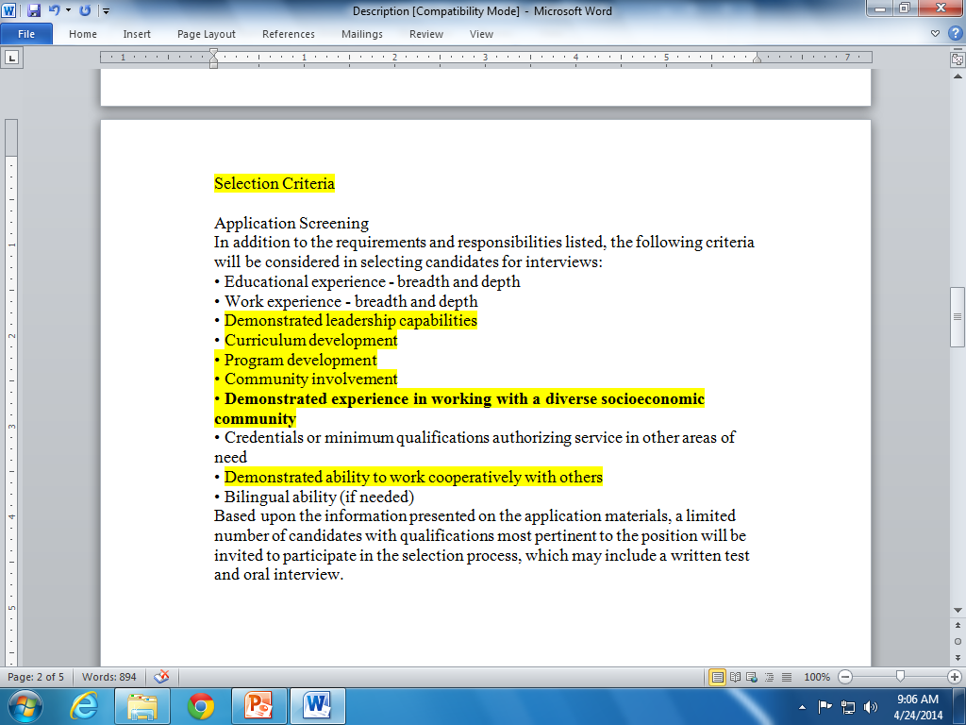

Slide 31
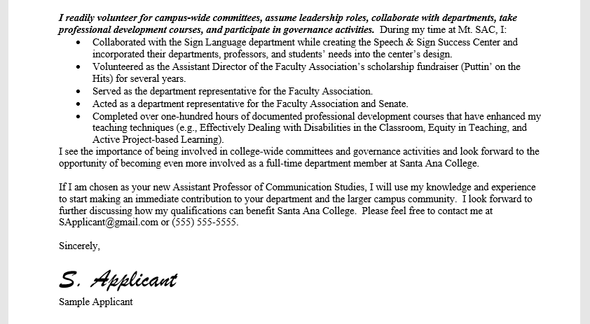

Slide 32
Personalize your Closing Statement

Slide 33
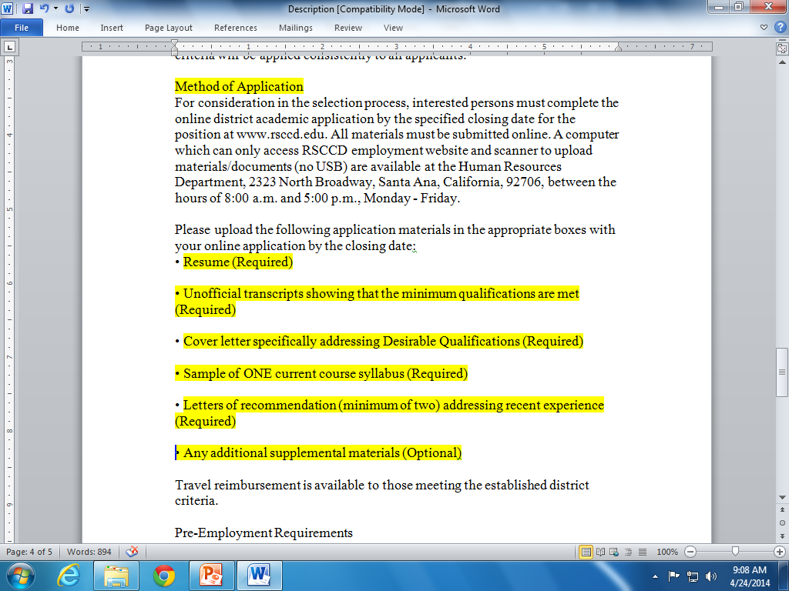
Finally…
Follow instructions carefully

Slide 34


