Slide 1
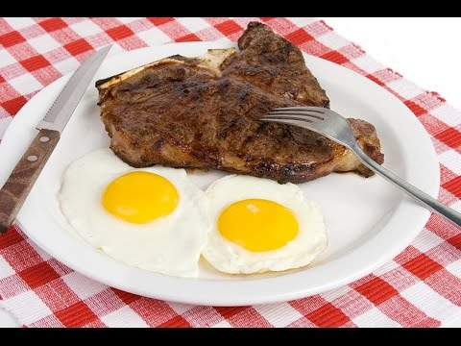
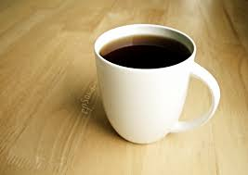

Eggs, Steak, and Coffee
LLSL11: Eggs, Steak, and
Coffee

Slide 2

Directions
Please make sure that you watch this as a slide show. Click at the bottom right of the screen to view slide show.
Use the headphones! Each slide contains narration.
To move to the next slide or to see the next picture, left click on the mouse or press the right arrow key on the computer keyboard.
Make sure you are answering the questions in your SDLA packet while you view the PowerPoint.

Slide 3
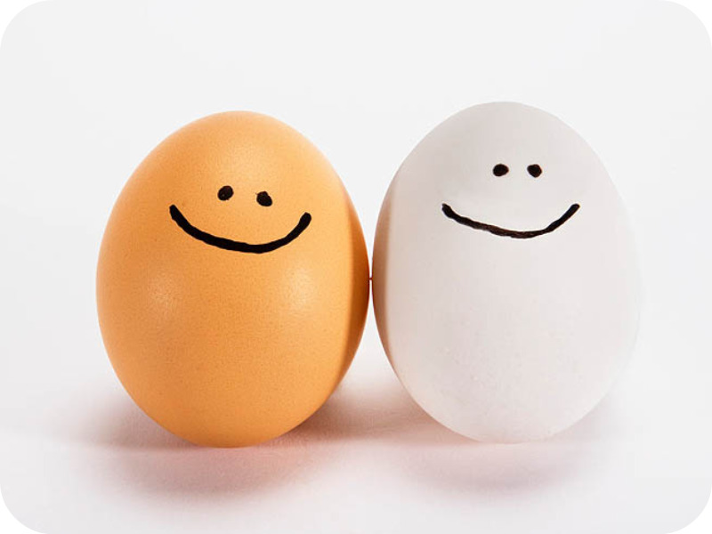
Eggs!

Slide 4
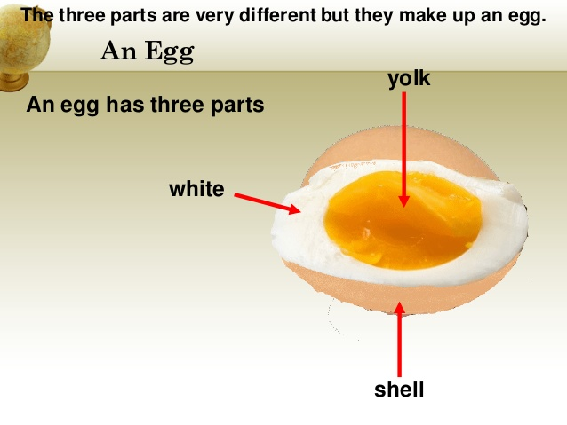
Parts of an Egg

Slide 5
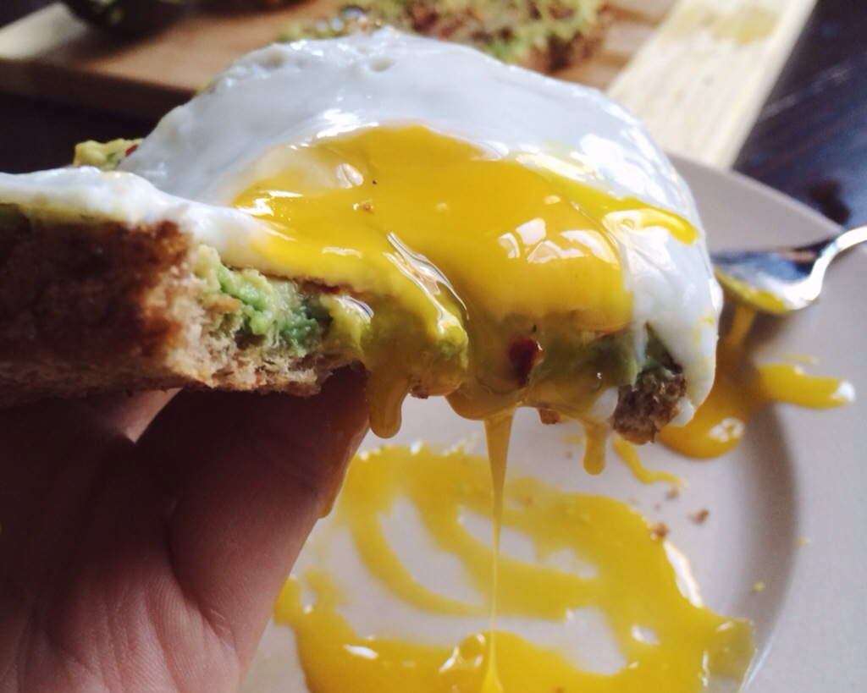
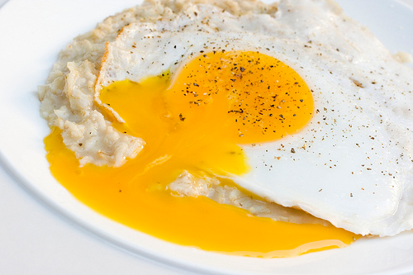
Runny Eggs
You might hear people say, “I like my eggs runny.”
Runny eggs means the egg yolk (yellow part) is not cooked.
If you don’t like your eggs “runny,” you can tell the waiter/waitress, “I don’t want my eggs runny.”

Slide 6
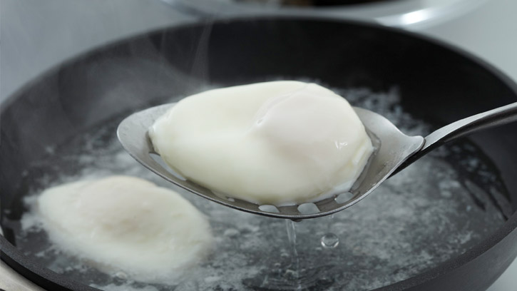

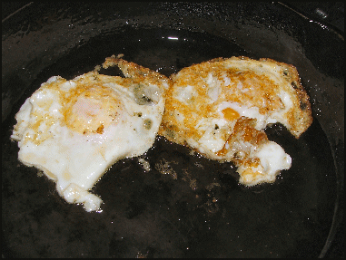
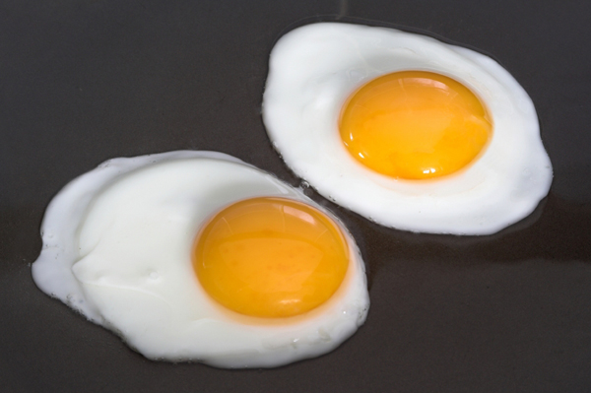
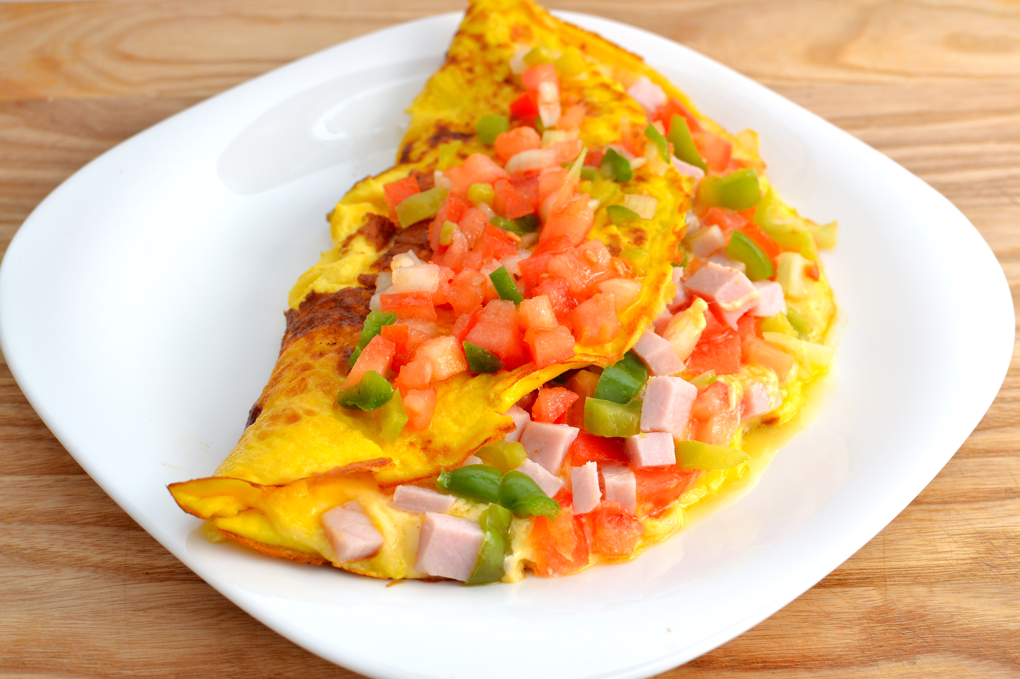
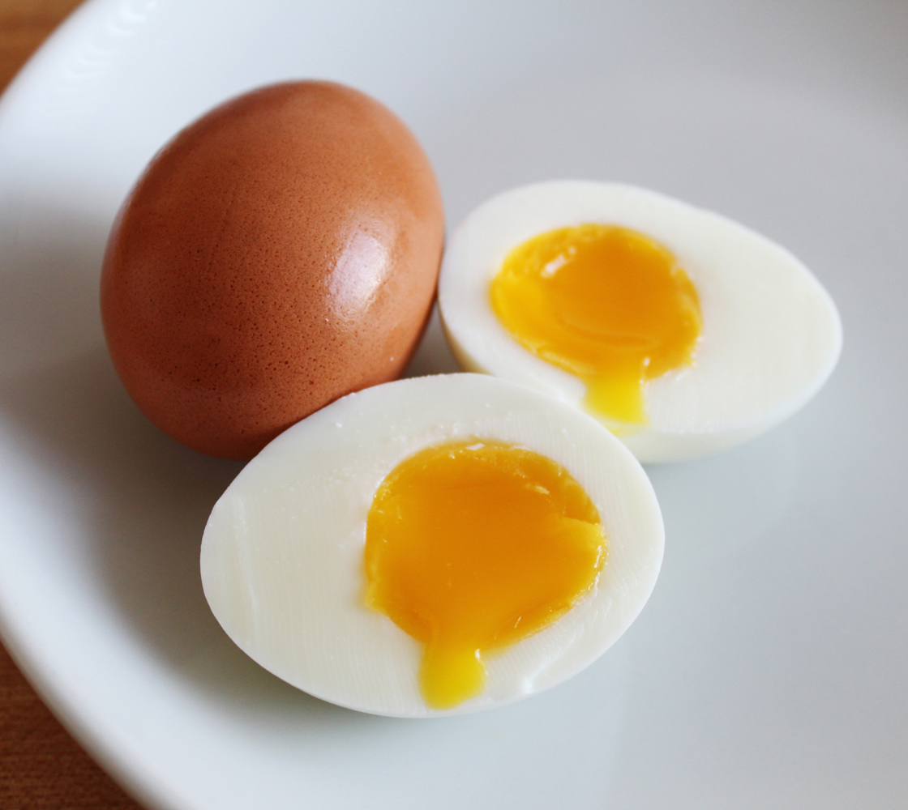

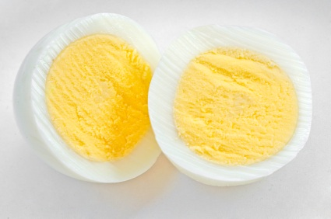

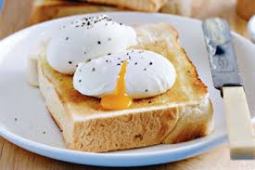
How do you want/like your eggs?
These are the most common ways to answer this question:
Scrambled
Hard boiled
Soft boiled
Sunny side-up
Over easy
Over medium
Over hard
Poached
Omelet

Slide 7
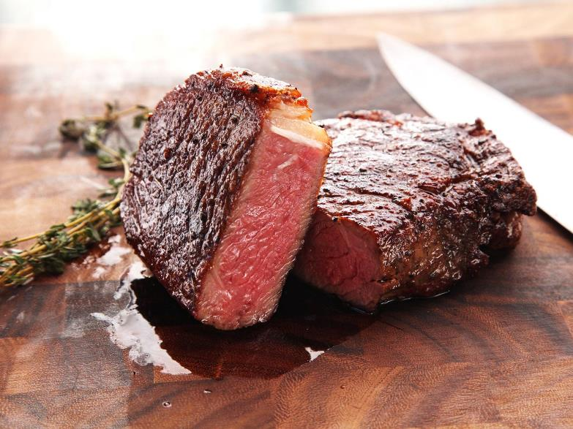
Steak!

Slide 8
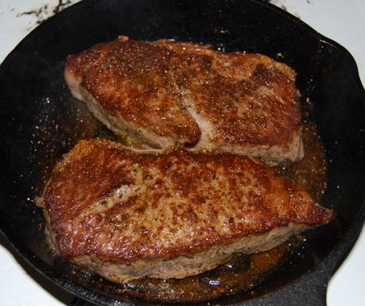
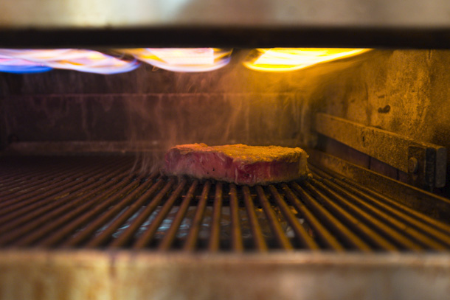
Words to know about Steak
Sear (verb)
Definition: to burn the surface of the steak.
  Seared is the adjective form of sear
Broil (verb)
Definition: to cook (food) directly over or under extremely high heat
  Broiled is the adjective form of broil

Slide 9
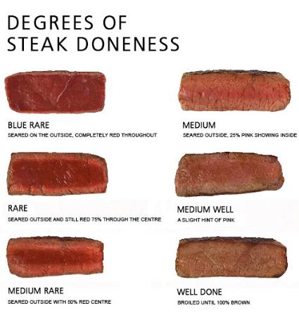
How do you want/like your steak (cooked)?
This question is often asked when you order a steak at a restaurant.
The easy way to remember is how red or pink you like your meat.
How much red or pink you like is called “doneness. ”

Slide 10

Coffee!

Slide 11
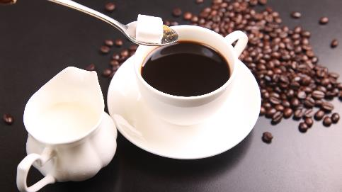
How do you want/like your coffee?
There are four things you should know when you order coffee:
  Regular or decaf
  Temperature (hot or iced)
  Milk or Cream
  Sugar

Slide 12


Regular or Decaf?
Regular
Decaf
Regular coffee is coffee that has caffeine.
Restaurants will serve you regular coffee unless you ask for decaf.
Decaf is short for "decaffeinated"
This means that it has less caffeine than regular coffee.

Slide 13
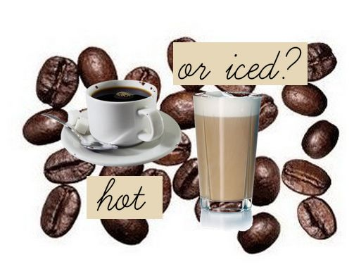
Coffee Temperature
You can order your coffee hot or cold.
Coffee will always be served hot
If you want your coffee cold, you ask for iced coffee.
It is not common to say, “cold coffee.”

Slide 14
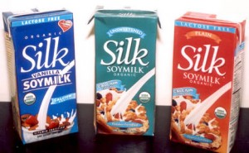
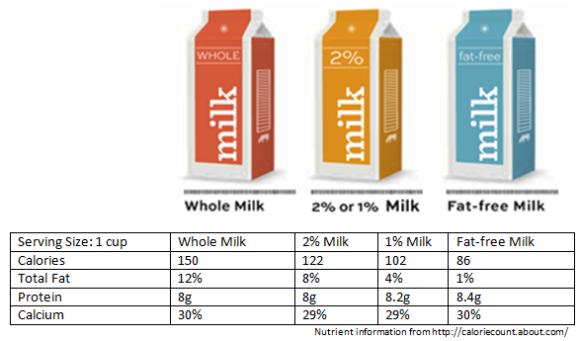
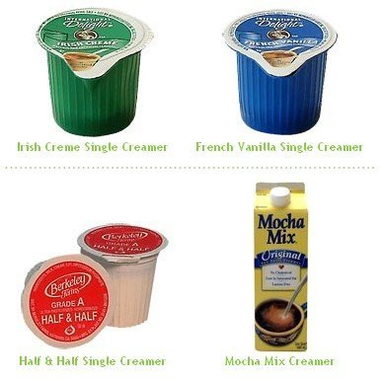
Milk or Cream
If you want milk in your coffee, there are many different types you can choose:
  Whole milk
  Reduced-fat milk (1% or 2% milkfat)
  Skim (no milkfat)
  Soy
If you want cream in your coffee, there are many different types you can choose:
  Half-and-half (½ cream ½ milk)
  Creamer

Slide 15
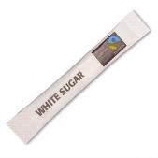
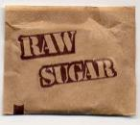
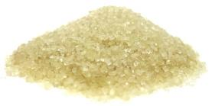
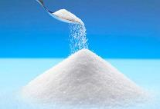
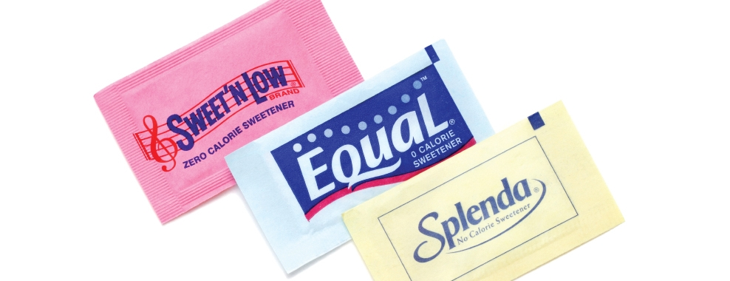
Sugar
You can also add sugar to your coffee. Here are some types of sugar:
  White sugar
  Cane/Raw sugar
  Equal
  Sweet ’n Low
  Splenda

Slide 16
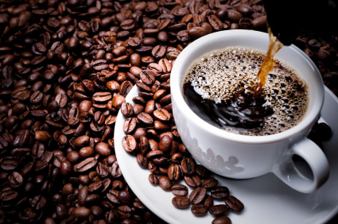
Black Coffee
Coffee without any cream or sugar is called black coffee.

