Slide 1
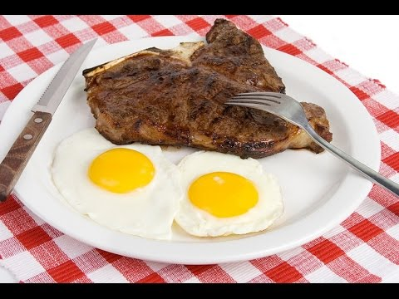
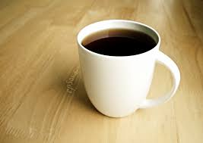
Eggs, Steak, and Coffee
SL30: Food and Drink
Preferences

Slide 2
Directions
Please make sure that you watch this as a slide show. Click at the bottom right of the screen to view slide show.
To move to the next slide or to see the next picture, left click on the mouse or press the right arrow key on the computer keyboard.
Make sure you are answering the questions in your SDLA packet as you go through the PowerPoint.

Slide 3
Parts of an Egg

Slide 4
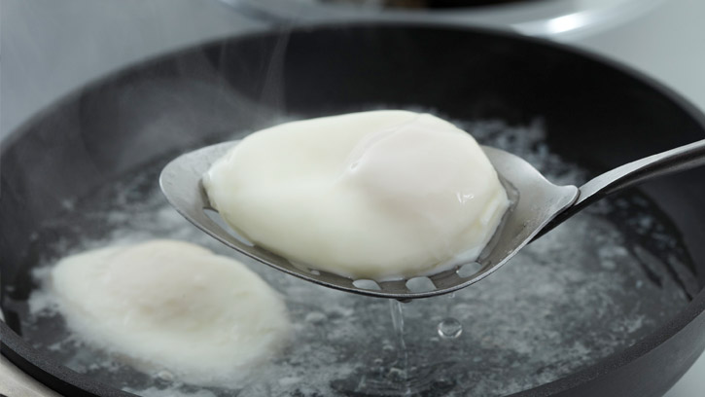
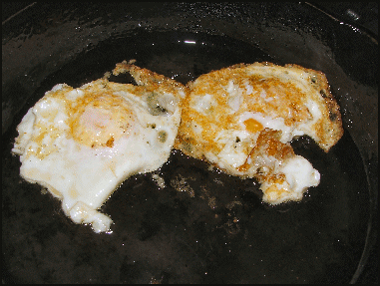
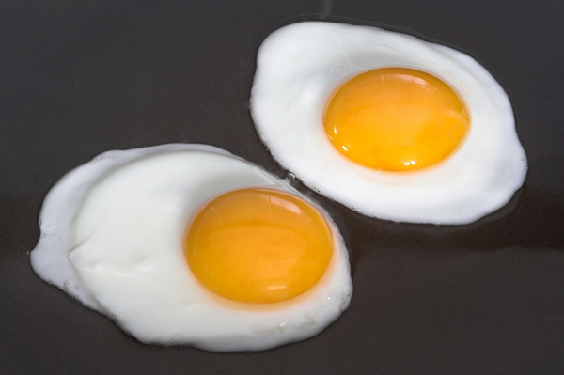
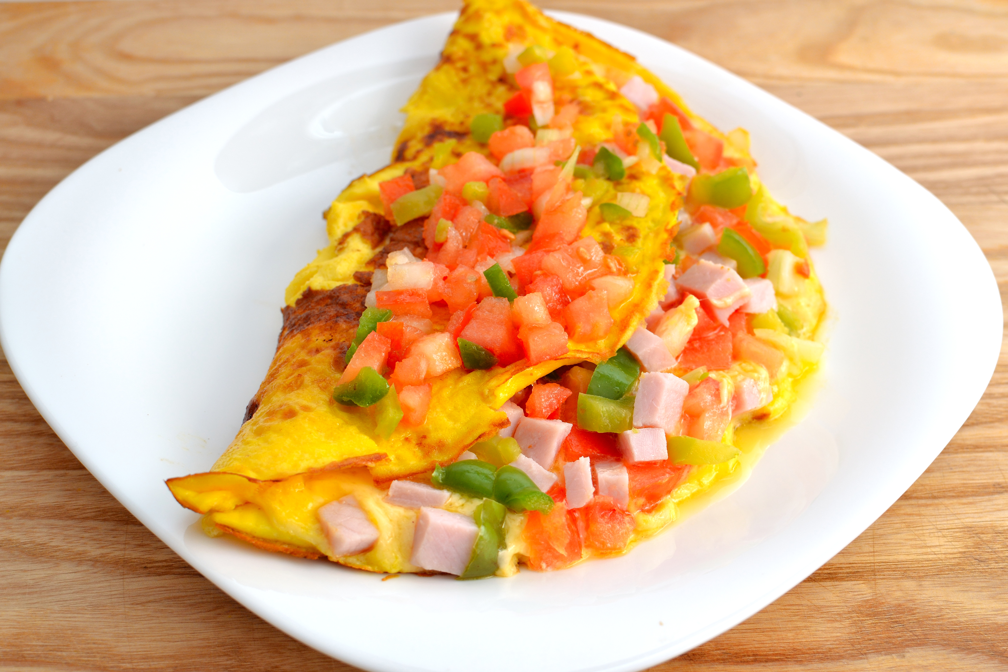
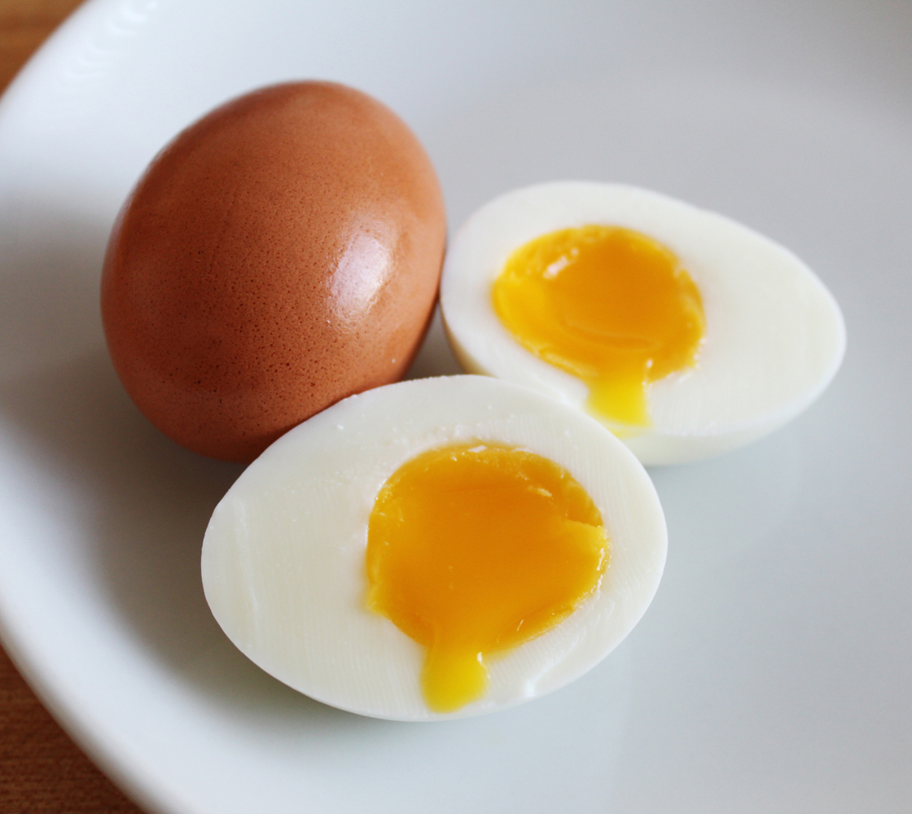
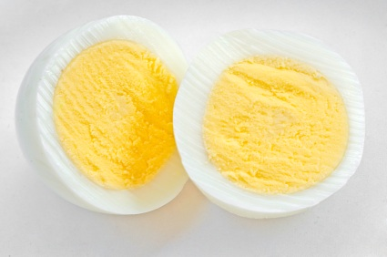
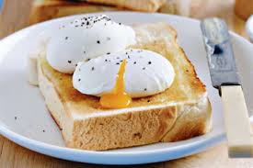
How do you want your eggs?
These are the most common ways to answer this question:
Scrambled
Hard boiled
Soft boiled
Sunny side-up
Over easy
Over medium
Over hard
Poached
Omelet

Slide 5
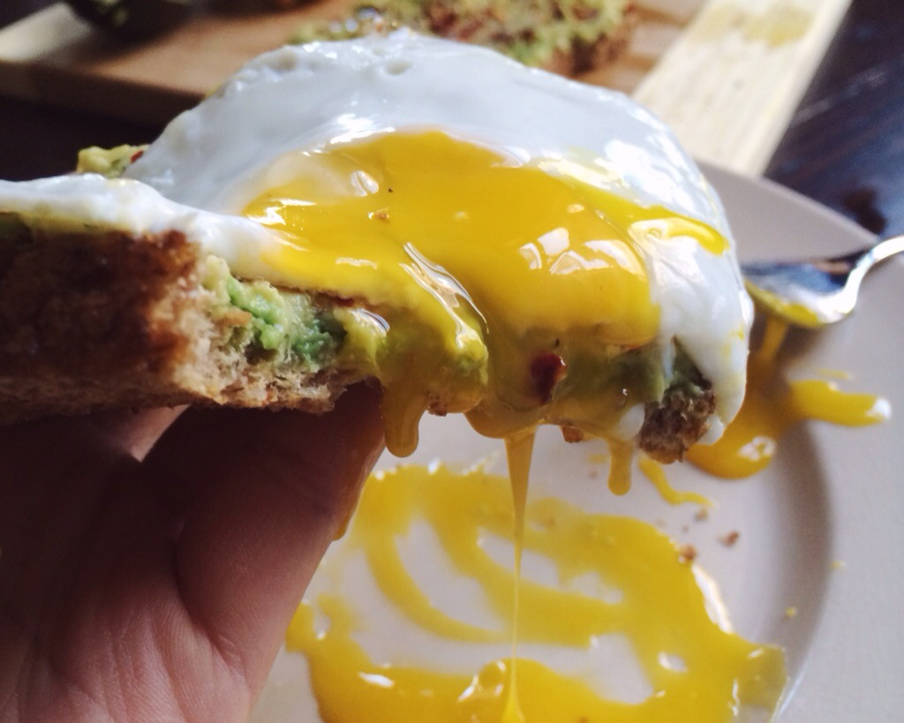
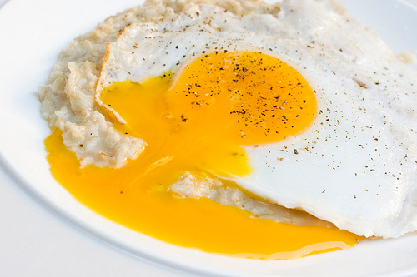
Runny Eggs
You might hear people say, “I like my eggs runny.”
Runny eggs means the egg yolk (yellow part) is not cooked.
If you don’t like your eggs “runny,” you can tell the waiter/waitress, “I don’t want my eggs runny.”

Slide 6
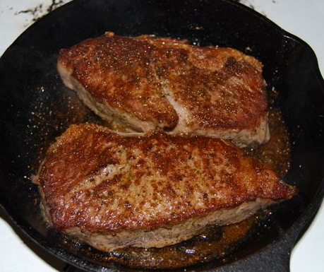
Words to know about Steak
Sear (verb)
Definition: to burn the surface of the steak.
Seared is the adjective form of sear
Broil (verb)
Definition: to cook (food) directly over or under extremely high heat
Broiled is the adjective form of broil

Slide 7
How do you like your steak cooked?
This question is often asked when you order a steak at a restaurant.
The easy way to remember is how red or pink you like your meat.
How much red or pink you like is called “doneness. ”

Slide 8
How do you like your coffee?
There are four things you should know when you order coffee:
Regular or decaf
Temperature (hot or iced)
Milk or Cream
Sugar

Slide 9
Regular or Decaf?
Regular
Decaf
Regular coffee is coffee that has caffeine.
Restaurants will serve you regular coffee unless you ask for decaf.
Decaf is short for "decaffeinated"
This means that it has less caffeine than regular coffee.

Slide 10
Coffee Temperature
You can order your coffee hot or cold.
Coffee will always be served hot
If you want your coffee cold, you ask for iced coffee.
It is not common to say, “cold coffee.”

Slide 11
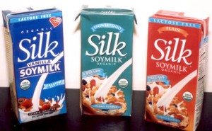
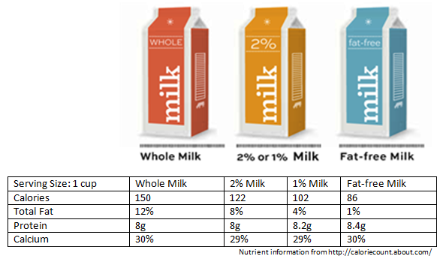
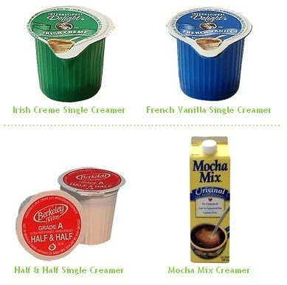
Milk or Cream
If you want milk in your coffee, there are many different types you can choose:
Whole milk
Reduced-fat milk (1% or 2% milkfat)
Skim (no milkfat)
Soy
If you want cream in your coffee, there are many different types you can choose:
Half-and-half
Creamer

Slide 12
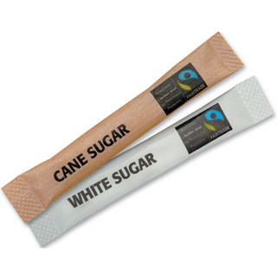
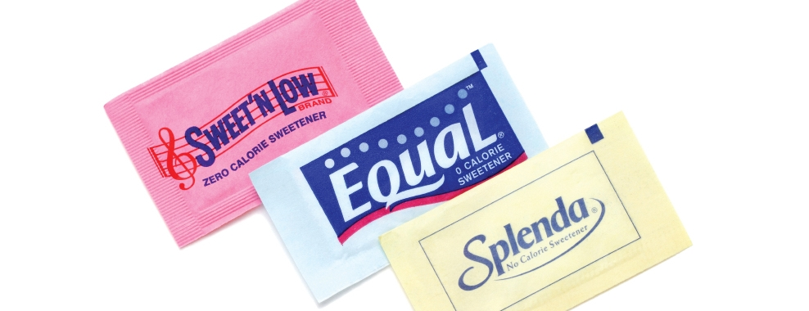
Sugar
You can also add sugar to your coffee. Here are some types of sugar:
White sugar
Cane/Raw sugar
Equal
Sweet’n – low
Splenda

Slide 13
Black Coffee
Coffee without any cream or sugar is called black coffee.

