Slide 1
Clery Act &
Campus Security Authority (CSA) Overview
Mt. SAC Athletics
2017-18 Compliance Meeting

Slide 2
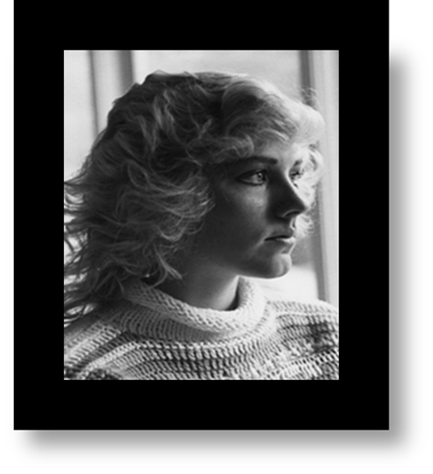
Clery Act? What’s That?
Jeanne Clery was a 19 year old freshman at Lehigh University in Bethlehem, Pennsylvania.
On April 5, 1986, she was murdered in her dormitory by a fellow student.

Slide 3
Her family learned that the school had concealed 38 incidents of violent crime on campus the year prior to Jeanne’s admission.
No federal or state law existed which required postsecondary institutions to disclose the status of crime on campus
In 1990, Congress enacted “The Clery Act”, that requires higher education institutions to report crime statistics to current & prospective students & employees.

Slide 4
But what does it have to do with us?
Many crimes and incidents are not reported to the police.
To ensure that students know about dangers on their campuses, the Clery Act requires institutions to gather and publish data for students and the general public.
When required reporting group are called:
  - Campus Security Authority or CSA’s
By reporting the crimes that are reported to them, CSA’s help provide accurate crime statistics

Slide 5
What makes me a Campus Security Authority?
Law Identifies Four Categories
  Campus Police Departments
  Individuals with Campus Security Responsibilities
  Individuals Designated by the Campus
  Officials with Significant Responsibility for Student and Campus Activities.
      Deans/Provosts
      Directors of Athletics
      Coaches
      Several other examples

Slide 6
Responsibilities
CSA’s are required to:
- Have knowledge of the Clery Act
- Report crime occurring on campus

Slide 7
Reporting
CSA’s are required, by law, to report incidences of crime brought to their attention.
They include the 9 Clery Crimes:
  Criminal homicide
  Sex offenses—forcible & non-forcible
  Hate crimes
  Aggravated assault
  Robbery
  Burglary
  Motor vehicle theft
  Arson
  Arrests & disciplinary referrals:
  - Violations of liquor, drug, & weapons laws

Slide 8
How do I report?
If you are informed of a Clery Crime by a victim witness:
  Keep them safe
  Fill out the reporting form with the facts
  Contact the Campus Police with your location
  Wait with the victim/witness until Campus Police arrive
  Contact the Division Office

Slide 9
Reporting
You must report if it occurred:
On campus
On public property adjacent to campus
On non-campus property owned or controlled by the college or a recognized student organization
    Contracted facilities

Slide 10
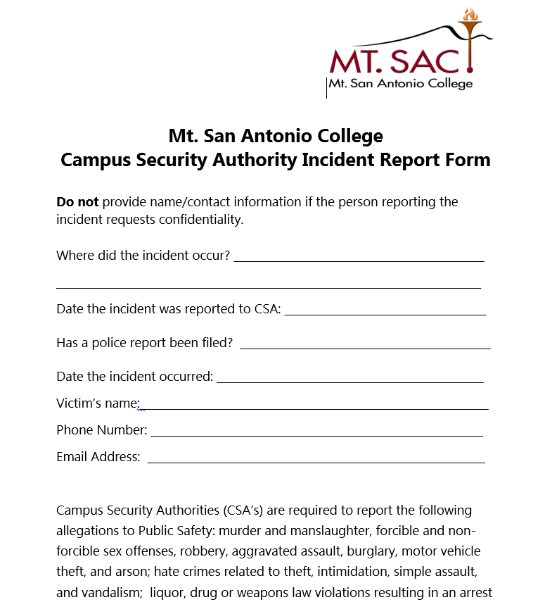

Slide 11
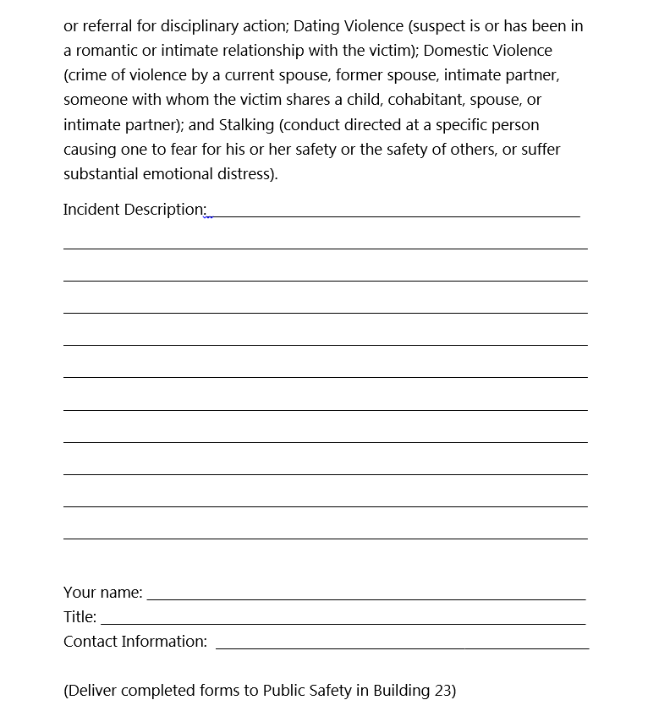

Slide 12
Do not report crimes, as a CSA, if:
A person tells you about a crime that occurred before he/she enrolled in the school OR
While he/she was away from campus and not involved in a college sponsored activity - e.g., at home, on spring break etc.

Slide 13
Mt. SAC POLICE DEPARTMENT
909-274-4555
CLERY COMPLIANCE OFFICER
  Deputy Chief Bob Wren - rwren@mtsac.edu

Slide 14
Questions?

