Slide 1
SLO Training Workshop
Welcome!
Winter 2013

Slide 2
Goals for today
Provide information and examples of the SLO process to help faculty use assessment to improve teaching and learning
Provide tools and training to department chairs to make the process understandable and user friendly

Slide 3
Agenda
Assessment Primer
Review SLO/PLO/GEO expectations for this semester
Answer questions throughout the session
Assist faculty with TracDat, the system we use to record our assessment efforts

Slide 4
Assessment Primer
Define student learning outcomes
Review “Guiding Principles for SLO Assessment” (2010)
  Created as a result of Resolution 2.03 by the ASCCC
Authentic assessment
“Closing the loop”

Slide 5
What’s an SLO?
  Measurable goals and results that are expected subsequent to a learning experience
  Types include knowledge (cognitive), skills (behavioral), or attitudes (affective behavior)
  Clear and assessable statements that define what a student is able to DO following a course or program
    Display evidence that learning has occurred at a specified level of competency

Slide 6
Highlight of ASCCC’s “Guiding Principles for SLO Assessment” (2010)
  “The Academic Senate views outcomes assessment as a productive activity that can improve teaching practices and thus enhance student learning” (p. 7)
  Faculty have primary responsibility and should fulfill that role positively and collaboratively
    Part-time faculty should be included wherever possible
  Faculty should use SLO results to improve curriculum, foster student success, or strengthen pedagogy
    Assessments should be “authentic” and ongoing

Slide 7
Highlight of ASCCC’s “Guiding Principles for SLO Assessment” (2010)
  College must supply the resources and personnel
  Faculty need the freedom to develop and employ a variety of assessments based on their situation
  Assessment data is not designed for and should not be used in the evaluation of faculty members
  Done well, SLO assessment will benefit the college and our students’ learning experience

Slide 8
Characteristics of
Authentic Assessment
  Students are asked to perform real-world tasks that demonstrate meaningful application of essential knowledge and skills
  Ongoing and formative
    Evaluating student performance to provide feedback to enhance student learning through improved curriculum, pedagogy, or interventions
    Both the student and the instructor discover what has been learned and what still needs to be learned

Slide 9
Creating Authentic Assessments
What should students know and be able to do?
What indicates students have met these standards?
What does good performance on this task look like?
How well did the students perform?
Craft a rubric for evaluation. (other tools)
TRADITIONAL ASSESSMENT | AUTHENTIC ASSESSMENT
Select a response | Perform a Task
Contrived | Real-Life
Recall/Recognition | Construction/Application
Teacher-Structured | Student-Structured
Indirect Evidence | Direct Evidence

Slide 10
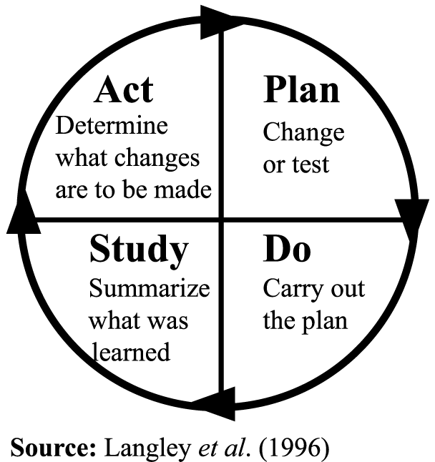
“Closing the Loop”
  SLO assessment should be an ongoing activity rather than a periodic exercise
  Assessment cycle needs to include “closing the loop”
    Faculty question ➔ Assessment ➔ Analyze data ➔ Discuss what was learned and what can be improved ➔ Repeat
    The results collected are not used by the College and are to remain anonymous for both faculty and students
  Faculty must reflect upon the data collected; determine if further actions are required
Notes:
These are some key ideas that permeate the literature on SLO assessment. There are a few issues that are unique to our College and we will provide some tips to help our faculty in the process…
Assessment can range from very simple, such as why do my students always fall asleep in Ch. 10, to much more rigorous disciplinary questions.

Slide 11
Assessment tips!
  Faculty should ask pointed questions as it relates to the content they expect students to master!
  Courses may have 1 - ∞ SLOs per course
  Measureable objectives may be used as SLOs
  From course-level to program-level to GEOs, SLOs should be in alignment
    Capstone courses may be utilized as program-level SLOs
  If the SLO process lacks value, areas should ask new questions and get additional support from OC

Slide 12
Spring 2013 Expectations
Every course needs to be assessed at least once by June 30
  The OC is recommending that every course-level SLO be assessed at least once every 3 years
Every program (degrees & certificates) needs to be assessed at least once by June 30
The OC will meet with GE areas D1 and E this semester to discuss their assessments & use of results
Go to outcomes.mtsac.edu to check your status

Slide 13
New Plan Highlights
The OC recommends a 3-year course rotation
  Courses and programs not assessed in a period of 5 years could be flagged for discontinuance, per the Academic Senate
Assessment data and use of results information should be discussed at a department meeting
The OC will be conducting a qualitative review of assessment work in alignment with the 4-year curriculum process, providing feedback to departments

Slide 14
Questions?
After answering questions, we will:
  Look at TracDat and provide training with this tool
  Show how to utilize capstone courses create program-level outcomes (PLOs)

