Slide 1
SLO Assessment Round Table
Welcome!
Friday, April 29
9:30am

Slide 2
Agenda
Reason for meeting
  Provide an initial dialogue that crosses all areas of the College
  Determine how we view our SLO assessment activities
  Gather information that will shape the 2011-12 process
    Foster those aspects that are beneficial
    Improve aspects that are inefficient or ineffectual

Slide 3
Agenda
Process
  Answer questions posted at every table
  Each table should have a recorder who gathers and lists collected information
  Groups will have 12 minutes to discuss each question
  Participants will move to the next table to answer the next question in the series

Slide 4
Agenda
Rules
  Be open and honest
  Encourage everyone in your group to participate
  See Barbara to determine how she correlated your badge picture with your personality type!

Slide 5
Any questions before we begin?

Slide 6
You have 12 minutes!

Slide 7
You have 2 minutes!

Slide 8


Please move on to the next table!

Slide 9
You have 12 minutes!

Slide 10
You have 2 minutes!

Slide 11

Please move on to the next table!

Slide 12
You have 12 minutes!

Slide 13
You have 2 minutes!

Slide 14
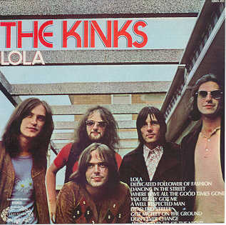
Please move on to the next table!

Slide 15
You have 12 minutes!

Slide 16
You have 2 minutes!

Slide 17

Please move on to the next table!

Slide 18
You have 12 minutes!

Slide 19
You have 2 minutes!

Slide 20

Please move on to the next table!

Slide 21
You have 12 minutes!

Slide 22
You have 2 minutes!

Slide 23

Please move on to the next table!

Slide 24
You have 12 minutes!

Slide 25
You have 2 minutes!

Slide 26
Review and comments
What does your area enjoy or find beneficial about our current student learning outcomes assessment process?
How embedded is the student learning outcomes assessment process in the ongoing workings of your area?

Slide 27
Review and comments
How often, and for how long, does you area spend time discussing SLOs?
What does your area find lacking, in need of improvement, or a barrier to full inclusion of SLO assessment into your area?

Slide 28
Review and comments
What do you think of the College providing resources for:
  Ongoing training of participants in SLO implementation?
  Departments to offer annual meetings with adjunct and full-time faculty to reflect upon and discuss assessment?

Slide 29
Review and comments
What do you think of our assessment plan using current College mechanisms:
  ePIE for recording purposes
  Curricular “measurable objectives” as SLOs
  Allowing for the creation of broad-based SLOs that would cross disciplines for use in multiple courses?

Slide 30
Review and comments
What do you think of faculty being strongly encouraged to:
  Include measureable objectives on all course syllabi?
  Include course-level SLOs on syllabi if they differ from the measureable objectives?

Slide 31
Thank you for your time!
The information shared today will be collected and transcribed, and will guide the process for next year.
If you would like to further shape the College’s assessment efforts, please consider serving on the Outcomes Committee for 2011-12!

Slide 32
