Slide 1
TracDat 5 for New Users
Assessment Primer
April 2016

Slide 2
Outcomes Assessment
What are student learning outcomes?
Why do we assess outcomes?
How do we assess them?

Slide 3
Student Learning Outcomes (SLOs):
are measurable statements about what a student will think, know, or do as a result of a learning experience or service
display evidence that learning has occurred at a specified level of competency
Notes:
Learning experiences occur in the classroom, in the field, in learning support areas, etc.
Level of competency – is the student developing, proficient, expert?

Slide 4
SLOs have five essential attributes:
Aligned
Central
Feasible
Meaningful
Measurable
Notes:
Alignment with department goals. Ensures you have evidence for annual planning process.
Central to the course, program or unit. Ensures good buy-in and widespread impact.
Feasible given your resources: human, time, technology, etc.
Meaningful to your faculty. Ensures you will complete it.
Measurable – use action verbs – so you can yield actionable data.

Slide 5
In addition to SLOs, Mt. SAC assesses:
Administrative Unit Objectives (AUOs)
Program Level Outcomes (PLOs)
Institutional Level Outcomes (ILOs)
Outcomes should be aligned:
AUO/SLO/CMO ↔ PLO ↔ ILO

Slide 6
Accreditation Standards (2002, 2014)
Accrediting Commission for Community and Junior Colleges
I.B.2. The institution defines and assesses student learning outcomes for all instructional programs and student and learning support services.
II.A.3. The institution identifies and regularly assesses learning outcomes for courses, programs, certificates and degrees using established institutional procedures. In every class section students receive a course syllabus that includes learning outcomes from the institution’s officially approved course outline.

Slide 7
Guiding Principles for SLO Assessment (2010)
Academic Senate for California Community Colleges
“The Academic Senate views outcomes assessment as a productive activity that can improve teaching…” (p. 7)
Use authentic, ongoing SLO results to improve curriculum, foster student success, or strengthen pedagogy
Take primary responsibility and fulfill role positively and collaboratively
Do not use assessment data to evaluate faculty

Slide 8
AP 4020 Program and Curriculum Development (2013)
Mt. San Antonio College
The Educational Design Committee or Curriculum and Instruction Council may propose inactivation of a course … [if]:
The course has not completed an outcomes cycle within the past five years.

Slide 9
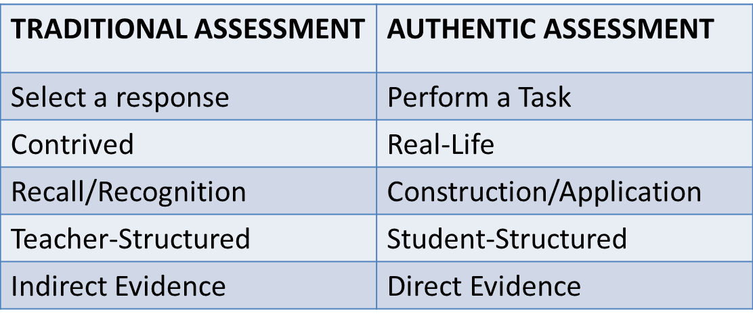
How do you create authentic assessment?
Students perform real-world tasks that demonstrate meaningful application of essential knowledge and skills.

Slide 10
Remember to close the loop!
Assessment cycle must include “closing the loop.”
Reflect upon the data collected
Discuss what was learned
Decide how to improve or sustain the results
Document this discussion in TracDat

Slide 11
Want additional tips?
Courses may have 1 - ∞ SLOs per course
Course measureable objectives may be used as SLOs
Assessment can be varied:
  Formative (mid-semester)
  Summative (end of semester)
Assessment should be an ongoing

Slide 12
Is help available?
Outcomes Coordinator
Outcomes Committee
Research and Institutional Effectiveness
Information Technology

Slide 13
Where do I find these resources?
  Guiding Principles for SLO Assessment
  Academic Senate for California Community Colleges, Adopted Fall 2010
  AP 4020 Program and Curriculum Development
  Mt. San Antonio College, Revised August 2013
  Accreditation Standards
  Accrediting Commission for Community and Junior Colleges, Adopted June 2014

