Slide 1
Return to campus –
Quick Tips and Resources
For Faculty
Notes:
The FLEX committee and Instruction Office wanted to give you a quick guide on where to find the most current information on campus COVID protocols and support, as well as navigating the campus during a great deal of construction. For those many of you who have not been to campus for 18 months, and those who are not yet returning, it is important that you are aware of the changes and are able to support students of yours that may have face to face classes and questions.

Slide 2
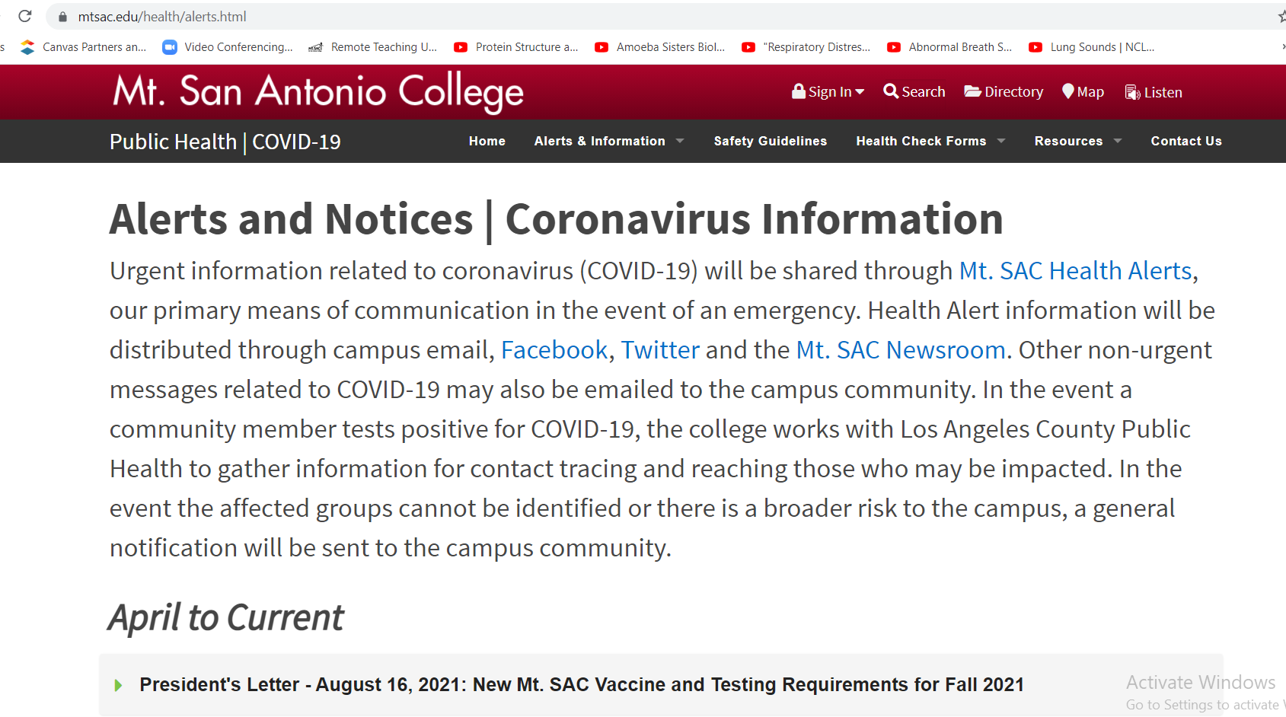
www.mtsac.edu/health has campus COVID information: ALERTS/ INFO
Notes:
There are two highly useful websites on campus for updated information as things continue to evolve in this long pandemic. The first is the health website. Here is where you can get updated alerts and notices to the entire campus community and see the president’s messages. This is a good place to send students as well.

Slide 3
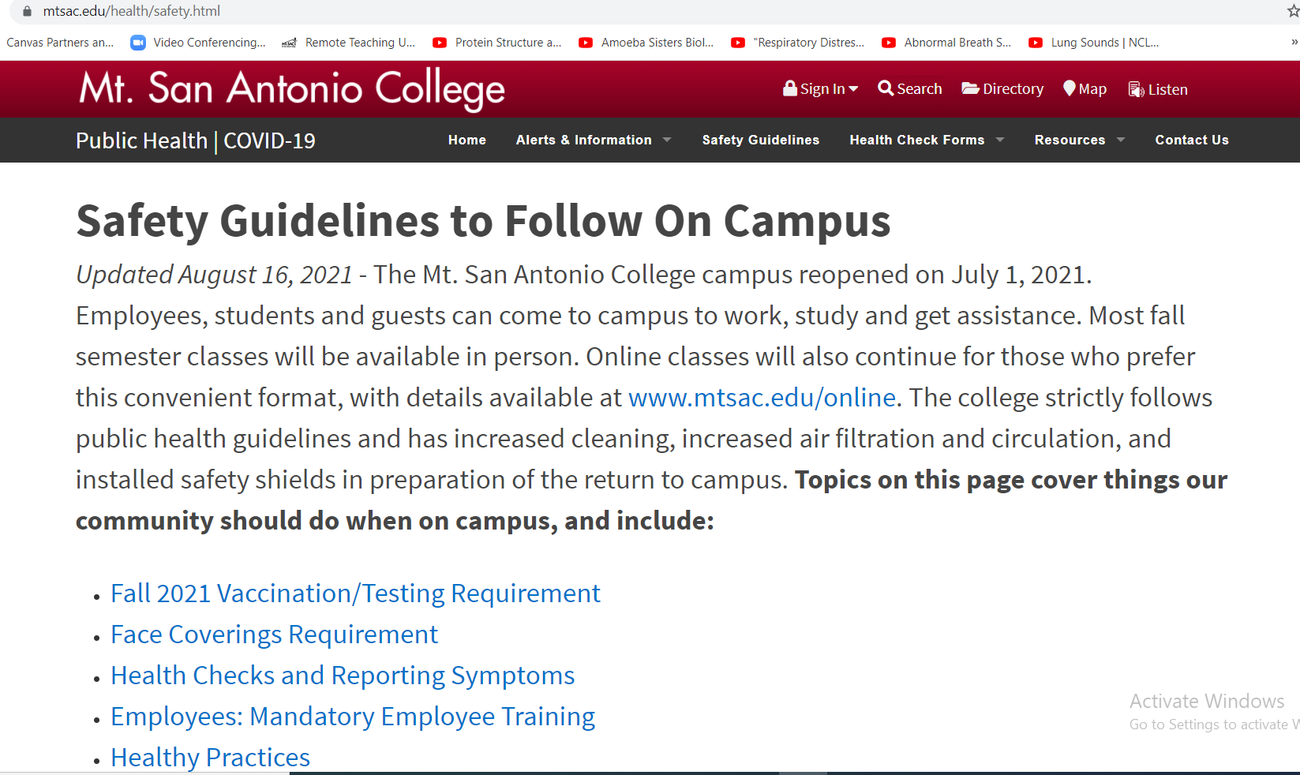
www.mtsac.edu/health has campus COVID information: SAFETY GUIDELINES
Notes:
On the health website you can also see Safety Guidelines, which provide the current protocols and requirements for being on campus and returning to work. Notably for all, if you’re sick, here is where you can get the forms to report that to HR for faculty and student health for students. We have a large number of contact tracers if necessary to insure that everyone exposed is informed.
Additionally, there are links here for faculty to use to take mandatory COVID training to return to campus and upload their vaccination forms if vaccinated. Links for testing if not vaccinated are coming; that is a new change within the week, so please check back.

Slide 4
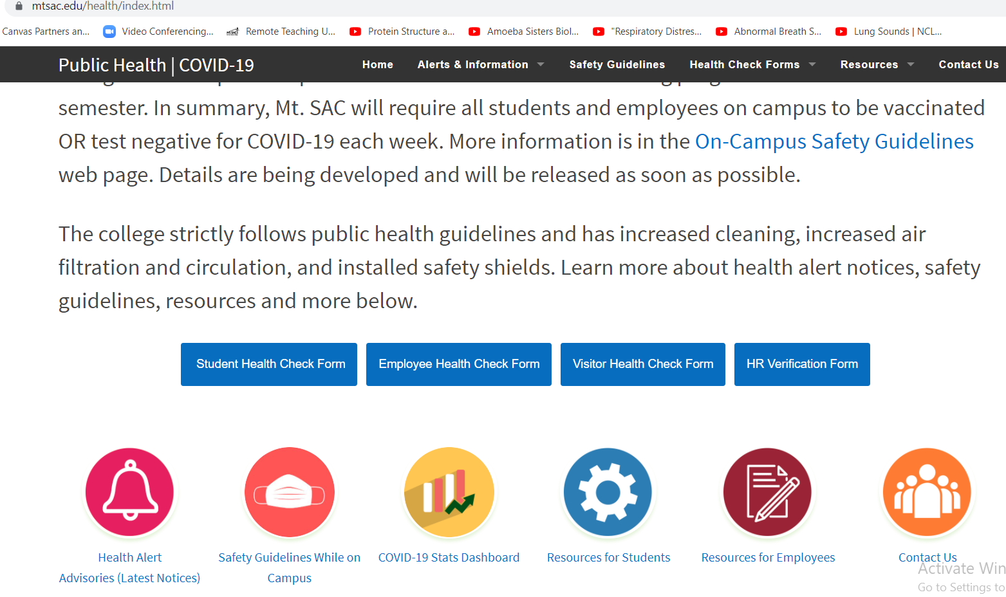
www.mtsac.edu/health has campus COVID information, FORMS & DATA
Notes:
At the bottom of the scroll, there are links to some of the functions mentioned previously, such as reporting forms for illness, as well as the dashboard to follow the campus known COVID cases or exposures.

Slide 5
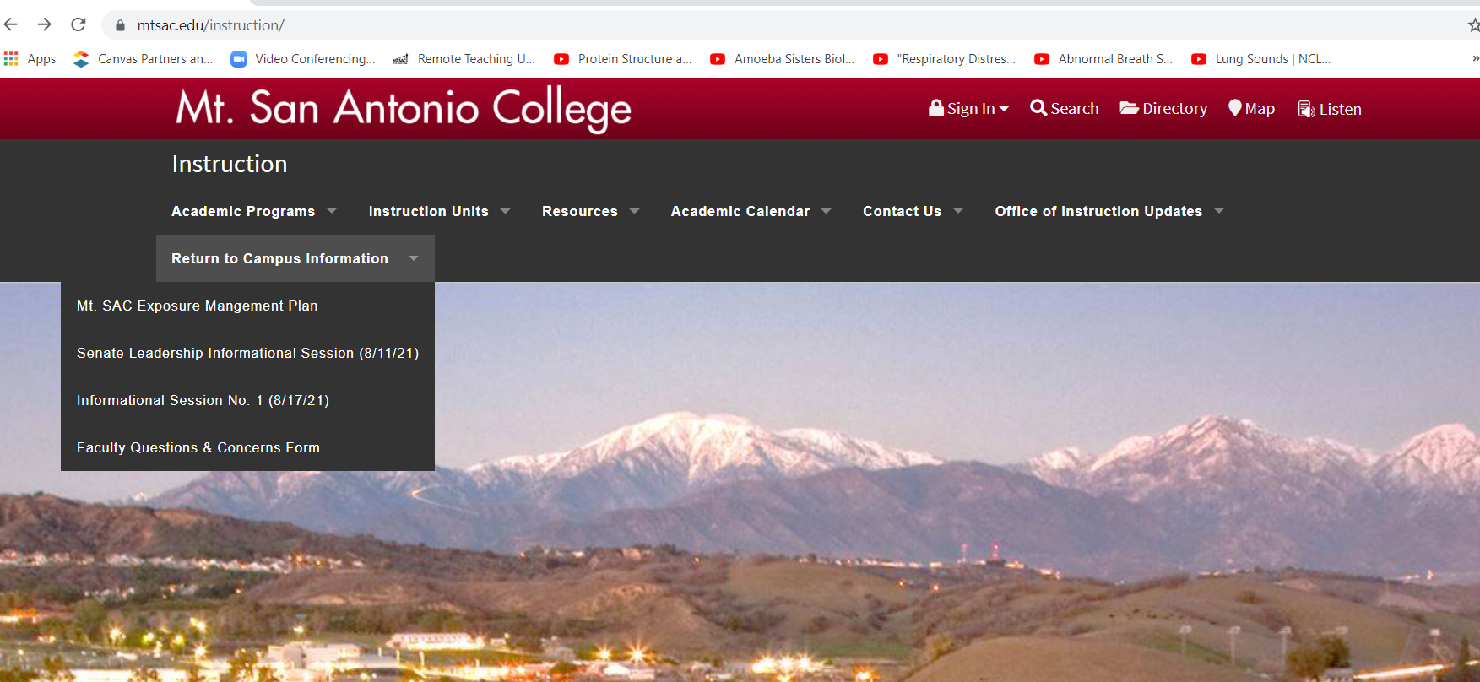
www.mtsac.edu/instruction for regular faculty updates from your VPI
Notes:
A second highly useful website for faculty to stay informed is the Instruction website. Here there is information housed on Return to campus information and a repository of the VPI messages from the Office of Instruction, so you don’t have to search the email inbox to find earlier communications. In addition, language for syllabi about masking and vaccination or testing will be added here to make it simple to pop into a syllabus. This is being created, but was not available to show at the time these slides were generated in this rapidly evolving situation. Please check on this page for the syllabus language.

Slide 6
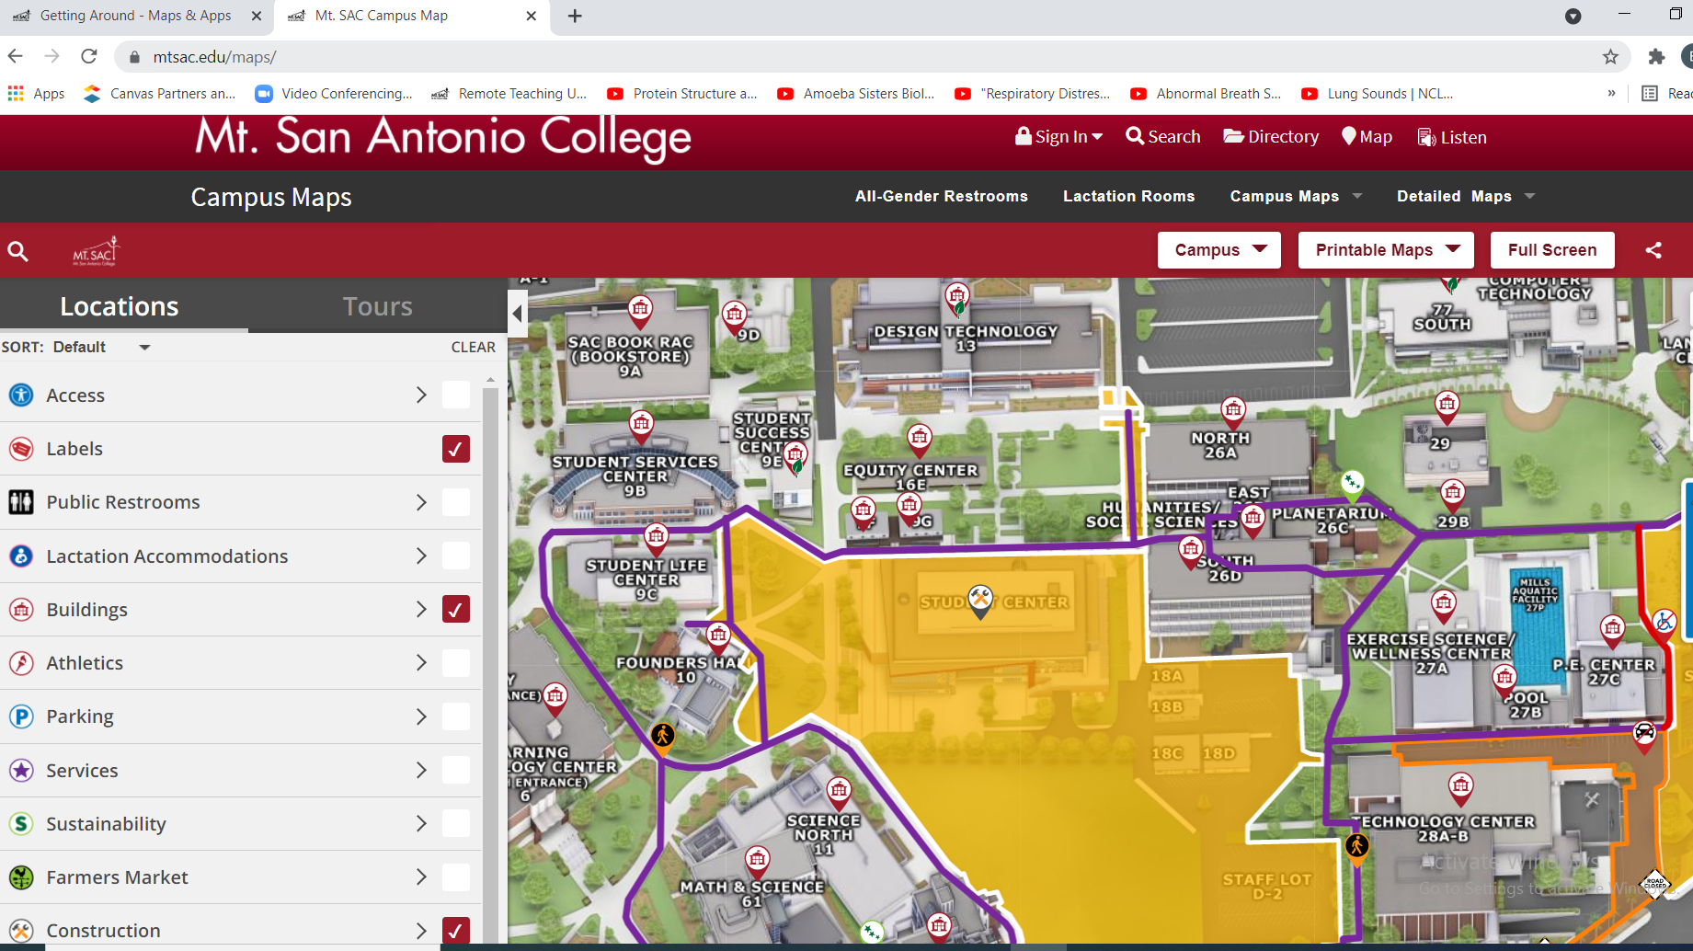
Mtsac.edu/maps/ = Interactive map
Locates: accessibility, construction, parking, restrooms, services, etc.
Notes:
This maps slide has the interactive information from Facilities showing construction areas, pathways to walk or accessibly move shown here in purple, and a variety of functions you can screen for, such as water stations, atm, bathrooms, building numbers and more. It is interactive, and also available as an app. This will be useful for faculty and staff, and is recently updated.

Slide 7
On campus class safety for face to face instruction in Fall 2021
Mt.SAC has been keeping on campus work safe since the pandemic began.
We have had classes for essential workforce training on campus since Summer 2020.
We have had construction ongoing during the entire pandemic.
We have adjusted safety guidelines to meet the risk through this entire pandemic.
Mt.SAC is committed to reopen safely to a broader student population this fall,
following Cal OSHA Emergency Temporary Standards,
and Los Angeles County Public Health Department guidelines.
We need faculty help to spread information and keep everyone safe.
Notes:
Most of you have not been on campus for over a year. (read slide)

Slide 8
Face masks are required for all with limited exceptions
Face masks are required for all indoors. Exceptions are rare.
              Masks will be available in classrooms.
              Masks will be dispensed in various locations around campus.
              Contact HR for employee accommodations.
              Contact ACCESS for student accommodations.
              Vaccination or weekly COVID tests are required. More information will come on implementing this. Please inform your students.
Students who do not comply are subject to disciplinary action, the same as cheating or other prohibited acts.
Notes:
Face masks are required, but there will be limited exceptions, such as medical and accessibility for deaf and hard of hearing students. Please remind your students to come to campus with masks. There will be masks in classrooms and available on campus for those who forget. Vaccination or weekly testing is required for those on campus. Information about how this will be implemented is coming soon, so please check on the health and instruction websites. Students who do not comply are subject to disciplinary action, same as cheating.

Slide 9
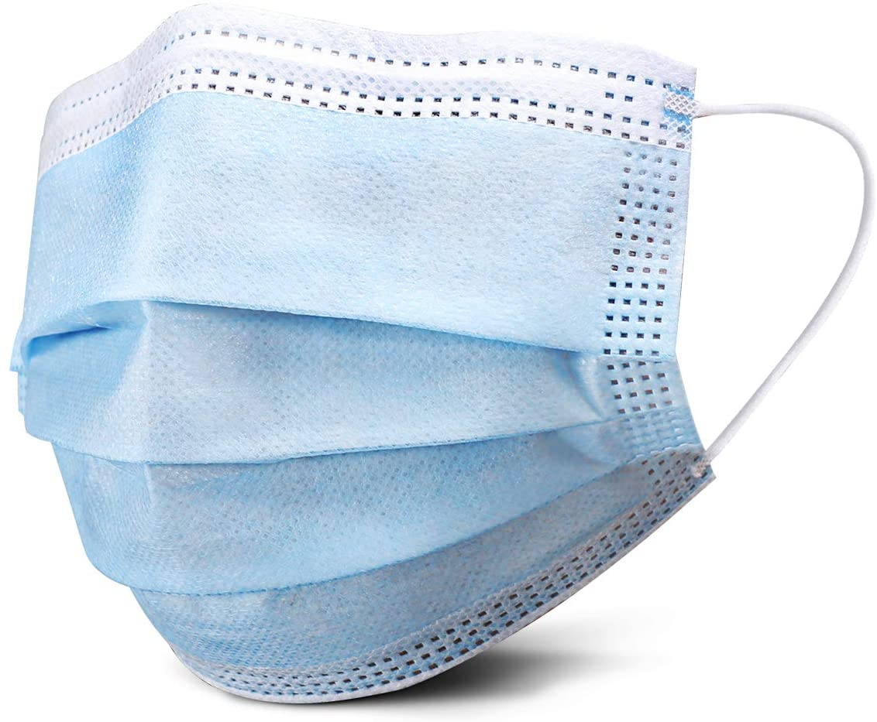
PPE and safety supplies:
Each classroom will be equipped with a PPE kit.
  The amounts of PPE in the kit varies, depending on enrollment in the room throughout the week.
If you need more PPE, please contact your Division Office to coordinate.
PPE kits contain:
  3-ply face masks
  Hand sanitizer
  Face shields
  Gloves, non-latex, size L
  Disinfectant wipes
Notes:
Person protective equipment or PPE such as 3-ply masks, gloves, and some face shields will be available in each classroom. Hand sanitizer and wipes will also be available. The amounts of the PPE will vary depending on the classroom enrollment. PPE will need refilling, so please contact your Division office to coordinate this as supplies get lower. Campus has large amounts of PPE to distribute as necessary.

Slide 10
COVID-19 (SARS-2) is primarily airborne transmission
Ventilation changes: We have upgraded all air filtration and flow
Tips for faculty in classrooms:
Masking indoors will reduce exposures. Please enforce this mandate. Masks will be available in classrooms and on campus.
Please do not over-enroll your classes. Look at occupancy limits.
Do NOT block open doors. The system is calibrated for closed classrooms.
The air circulating varies around a setpoint temperature. It will seem higher or lower at times. This is normal.
Incoming air may vary from the temperature setpoint control, especially on hot or cold days. This is normal.
If a room is too cold or too hot for occupants, please contact Facilities to get an adjustment.
Please consider a seating chart. This assists in reducing spread and assists with contact tracing.
Encourage students to wipe down their spaces. Wipes will be provided in classrooms.
Remind students to regularly hand wash and hand sanitize. Sanitizer will be available in classrooms and locations on campus.
Notes:
Since SARS-2 (COVID) is primarily airborne transmission, ventilation and air flow has been adjusted to ensure that all classrooms and indoor spaces are safe. Here are some tips to ensure that you minimize risk in face to face settings. (read slide)

Slide 11
Campus bathroom and high touch cleaning is the priority:
The high touch areas are the priority to clean.
  Day time custodial staff has increased from 3 to 15.
2. Custodial will handle accidents and spills. Contact Facilities for help.
3. Bathrooms will be cleaned multiple times a day.
  Please support custodial and remind students not to enter while cleaning is taking place.
  There will be additional mobile bathrooms for use.
  Learn where alternate bathrooms are located to assist students.
4. Contact facilities if there is a cleaning concern.
Notes:
Although SARS (COVID19) is not primarily transmitted by surface contact, we are cleaning campus to minimize potential exposure. Here are the important things to know. (read slide)

Slide 12
Students need support and flexibility
Water/ hydration:
Water refilling stations are on and will be cleaned. This water may not be refrigerated.
Drinking fountains are shut off for safety. Please direct students to refilling stations.
Bottled water will be available for students.
Stay home if ill or symptomatic.
Report symptoms to HR (faculty) or student health (students).
Consider being flexible on assignments and assessments.
Remember that students are worried and nervous too. Help guide them.
Notes:
Students are counting on you for guidance, reassurance and information. There are some changes for safety listed here. (read slide)

Slide 13
Thank you for helping to support a safe return.
There is a return to campus training today at 4.
Vice presidents from Administrative Services, Student Services and Instruction as well as the Deputy Director of Human Resources are there to answer your questions
Webinar ID 961 6904 8502
Notes:
Read slide. Have a safe and successful return to campus this Fall.
This slide is updated with training information for 4.

