Slide 1
2020 - 2021
E-sign In-Service
Student Articulation Request Form

Slide 2
Topics of Discussion
Student Articulation Request Form
Student E-Sign Process
Instructor E-Sign Process
Student transcripts
Due Dates

Slide 3
Student Articulation
Request Form
ELECTRONIC forms ONLY, no more paper forms
Forms are generated by the Articulation Office and routed electronically using Adobe Sign
Forms will only be sent to the approved and confirmed students listed on your Pre-Approval form
Streamlined forms are pre-populated making it easy for the student and instructor to fill out/sign

Slide 4
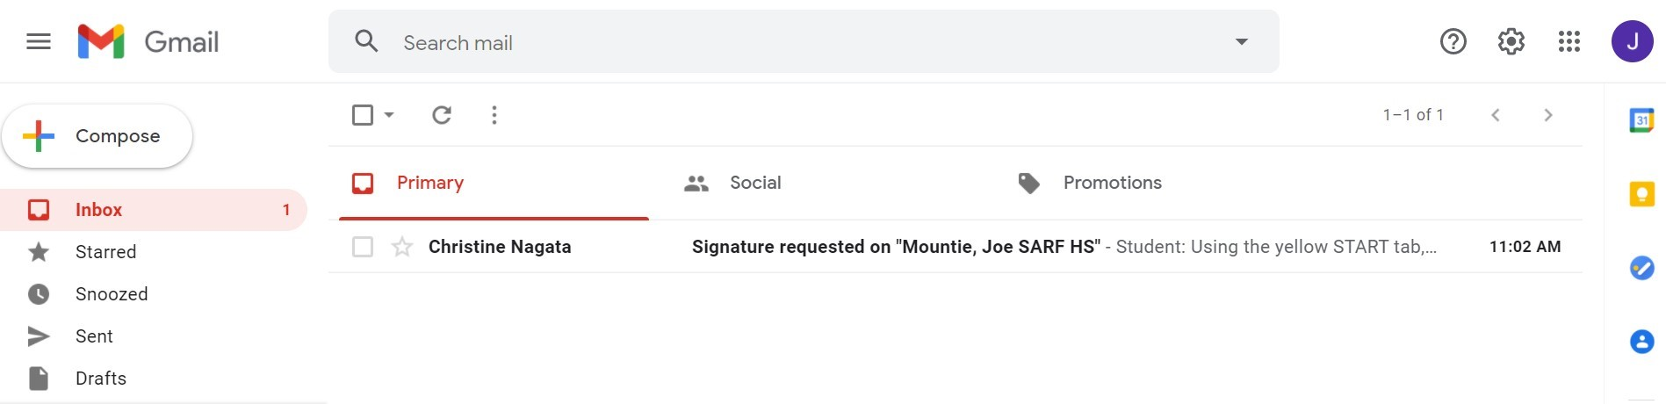
Student
E-mail Inbox

Slide 5
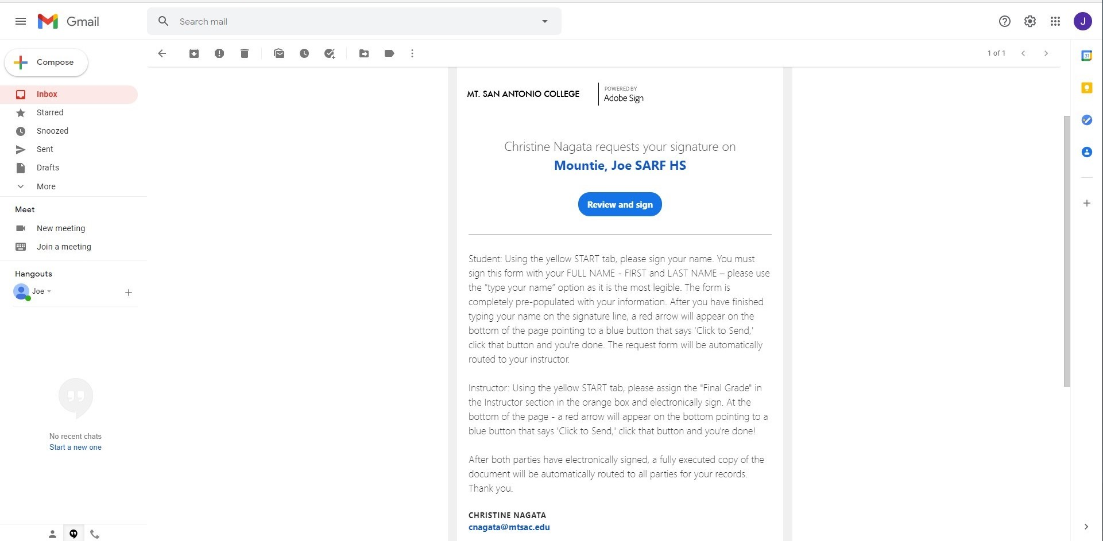
Instructions in Adobe Sign E-mail
Click here to open, review, and sign the form.
Instructions to fill out/sign form for both student and instructor

Slide 6
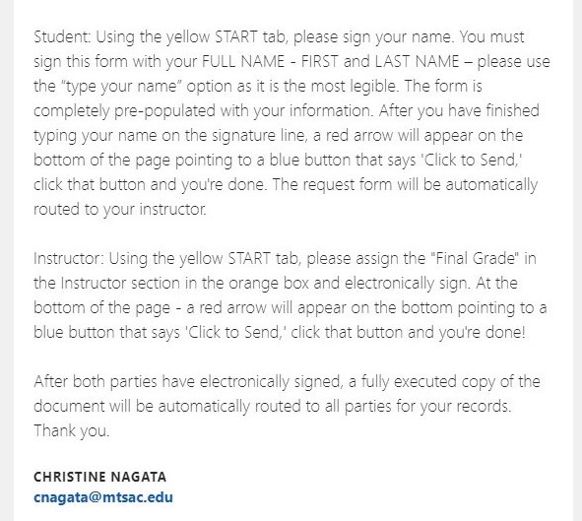
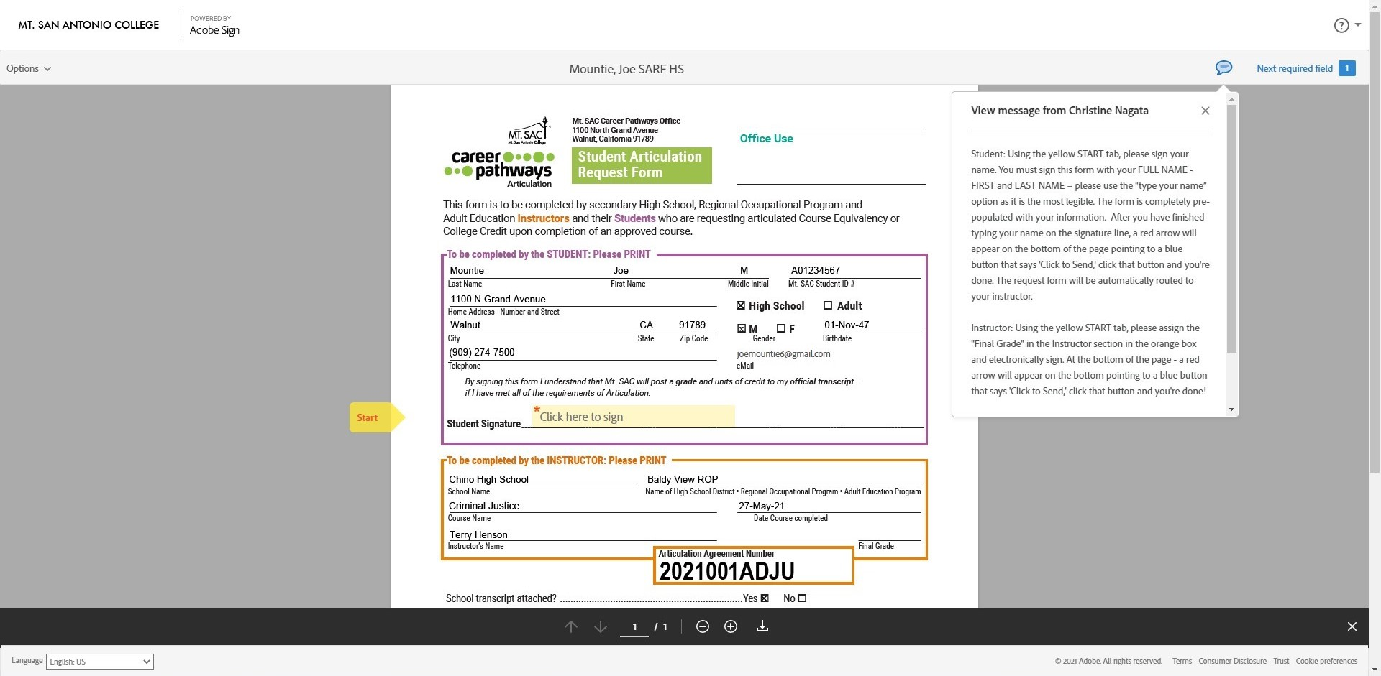
Student Section
Click the bubble icon to see instructions again
Student section is pre-populated, they ONLY need to SIGN the form.
Student gets TWO chances to sign the form correctly.

Slide 7
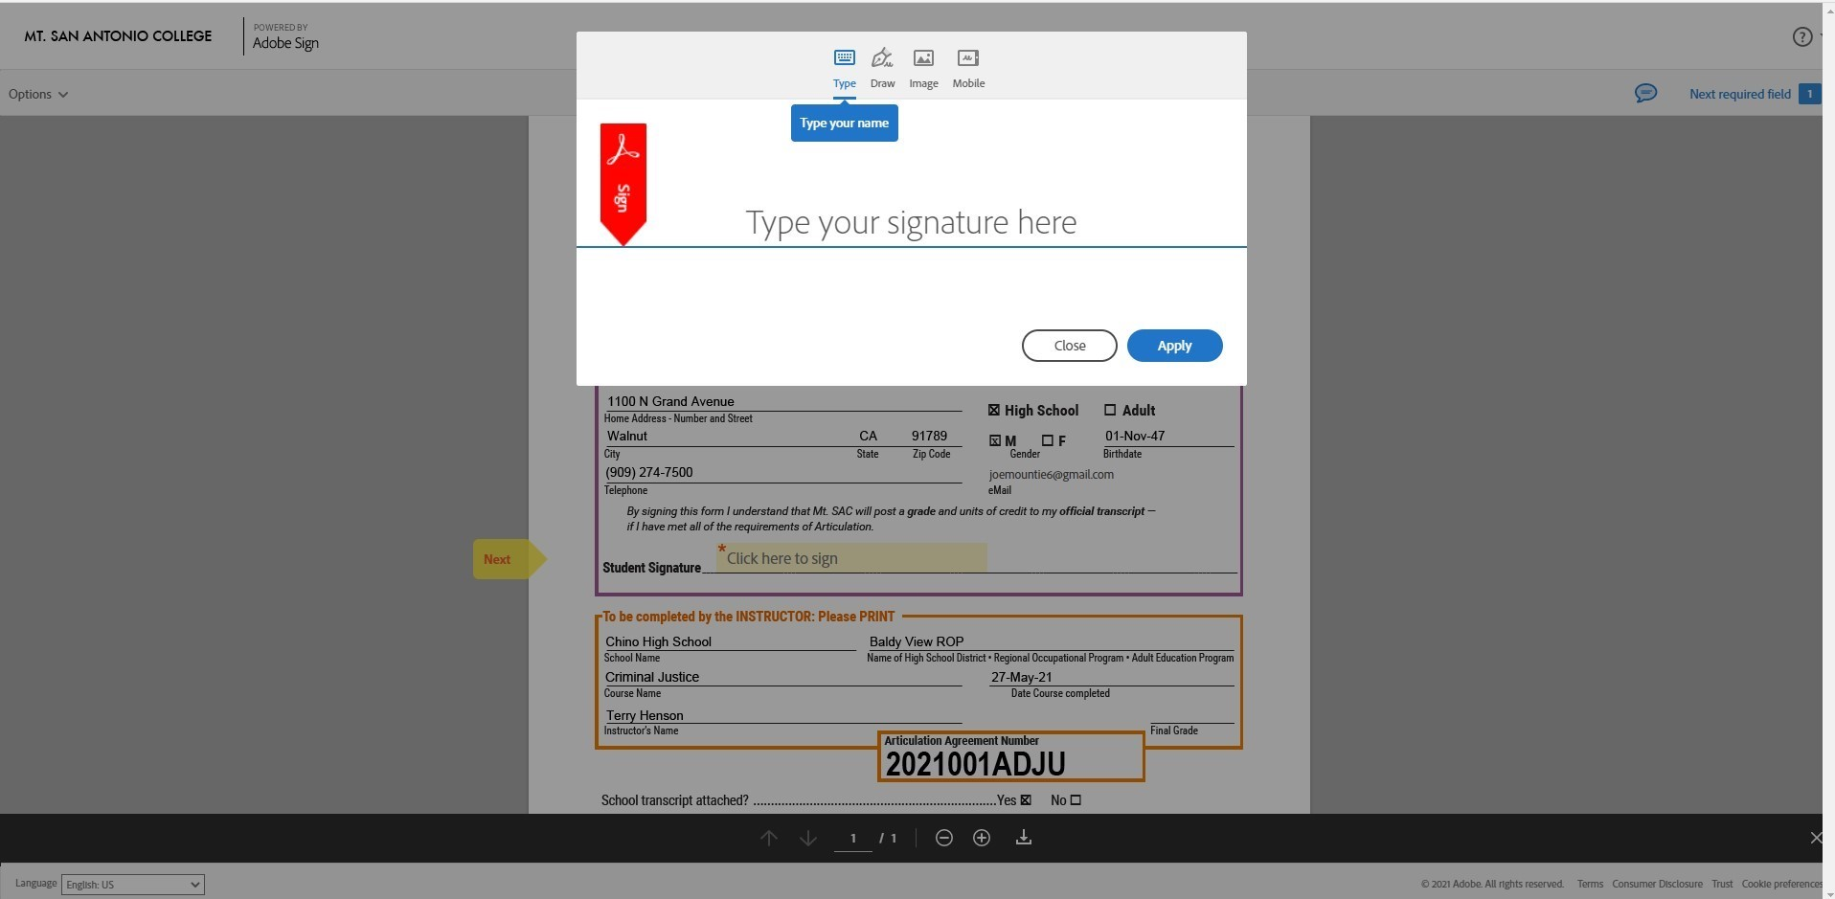
Student “Type Name” Option

Slide 8
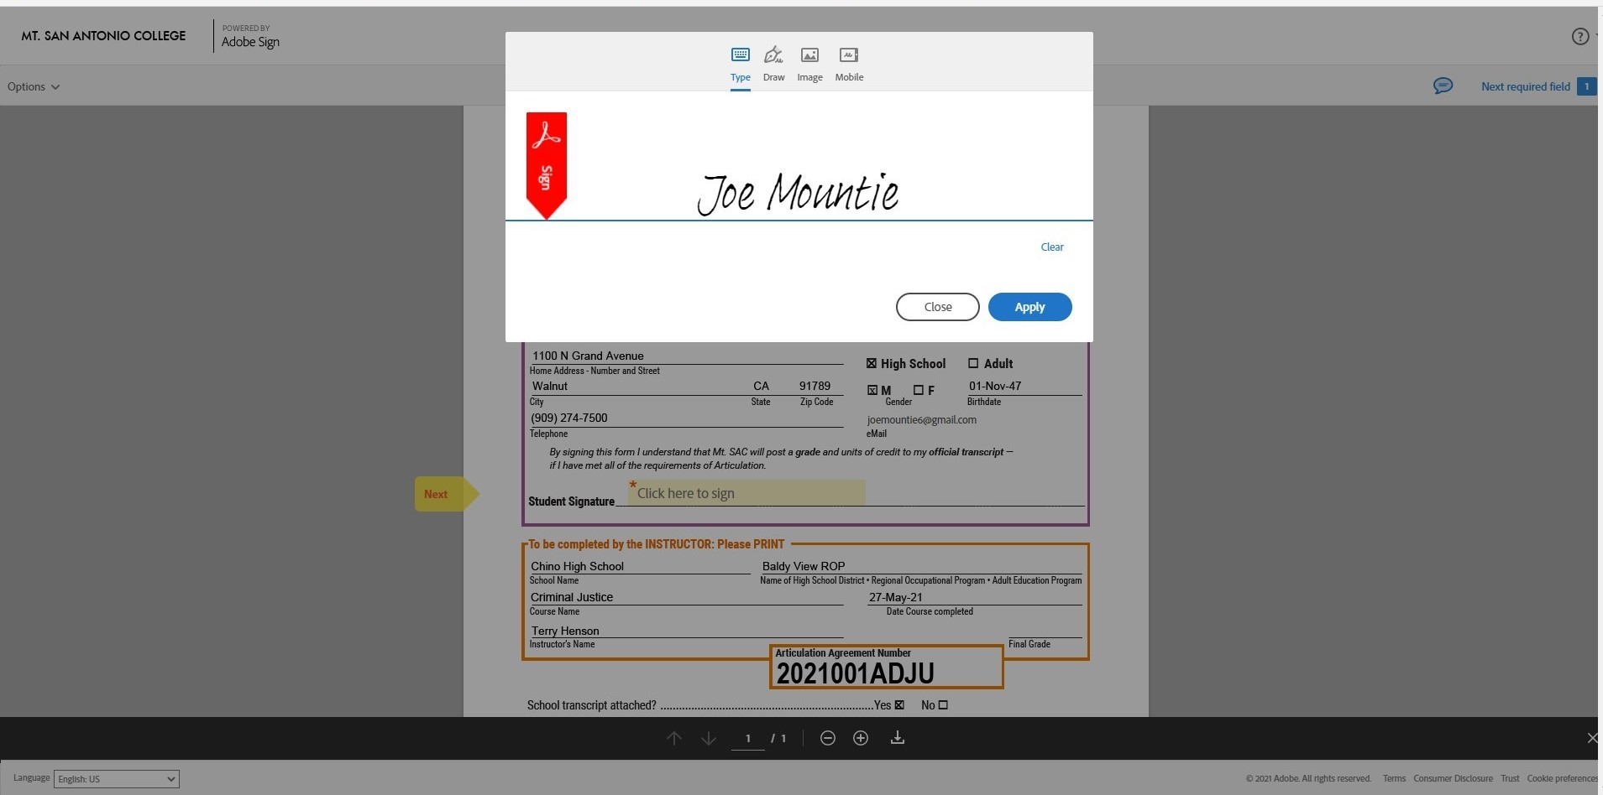
Student “Type Name” Complete
Click “Apply”

Slide 9
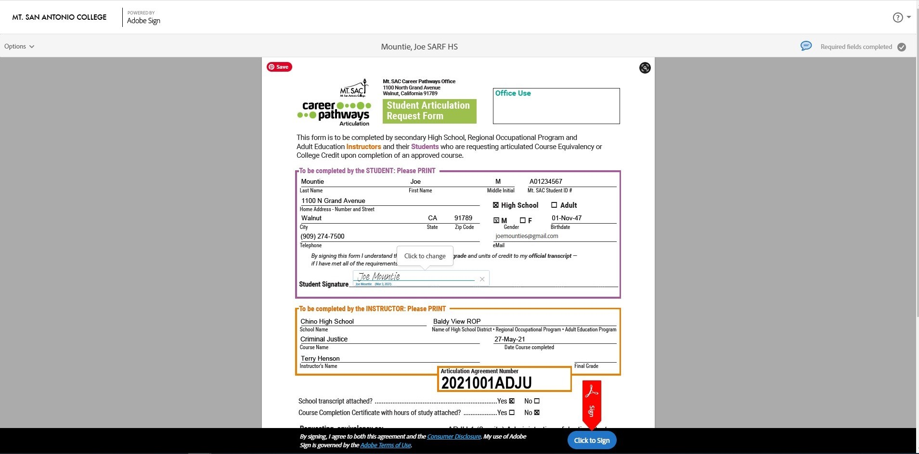
Student Click to Sign
When all required fields are filled/signed, a red “Sign” arrow will briefly appear telling the signer to click the blue “Click to Sign” button

Slide 10
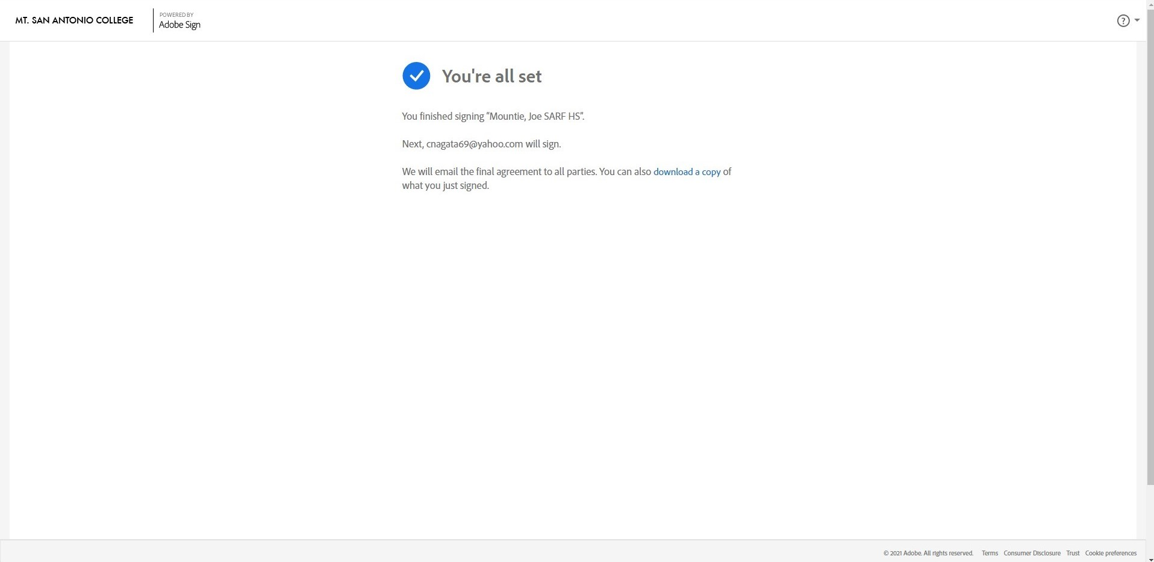
Adobe Sign Student Success Screen
Tells the student the form is being routed to their instructor for signature

Slide 11
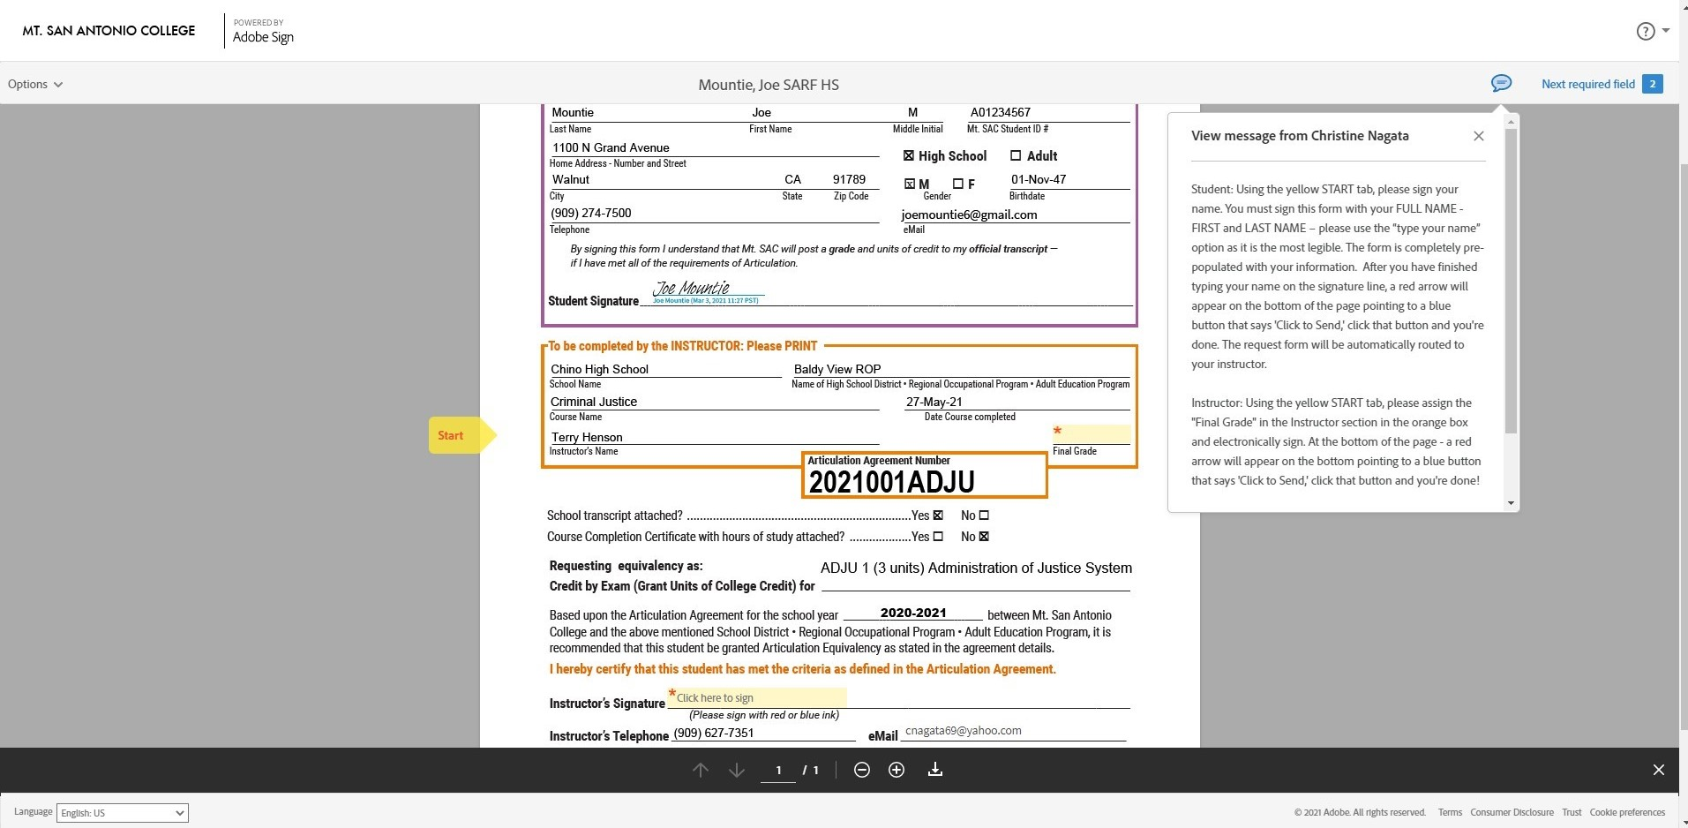
Instructor Section
Only TWO fields to fill/sign:
Final Grade
Signature
Instructors with EXAMS – please enter the grade the student is currently receiving in your class at the time of receipt.
Instructors without exams – you will hold onto the forms until you know your students’ final grades. *The final grade on the form must match the student transcript grade.

Slide 12
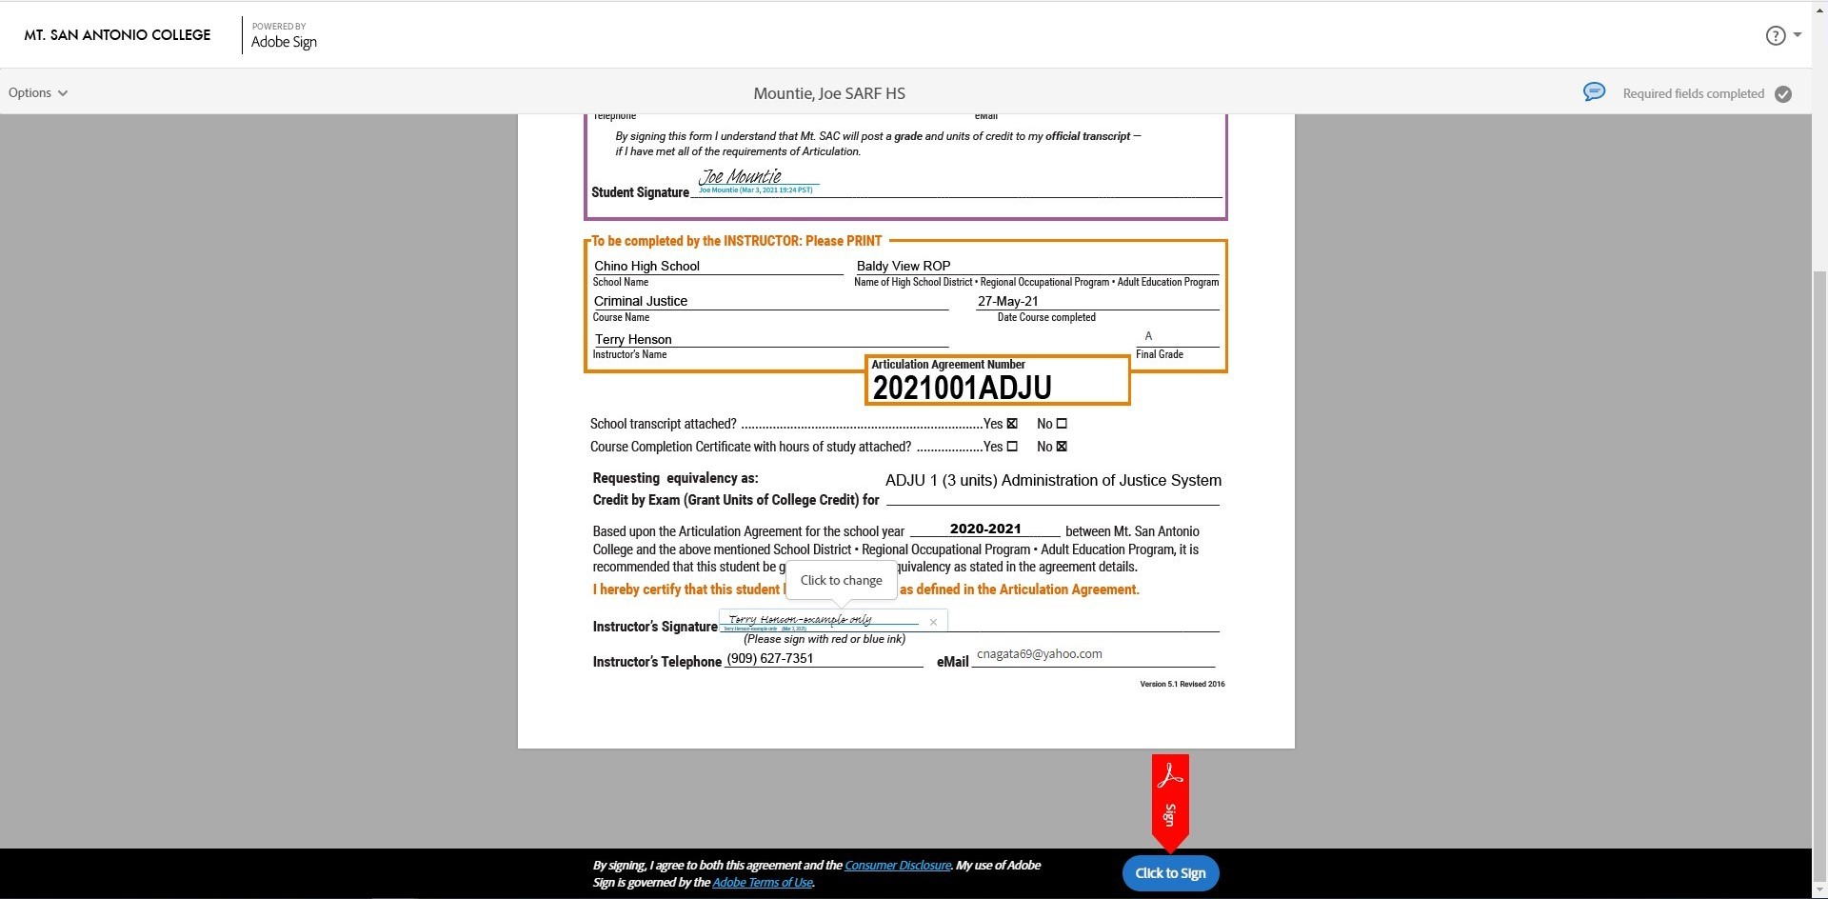
Instructor Click to Sign

Slide 13
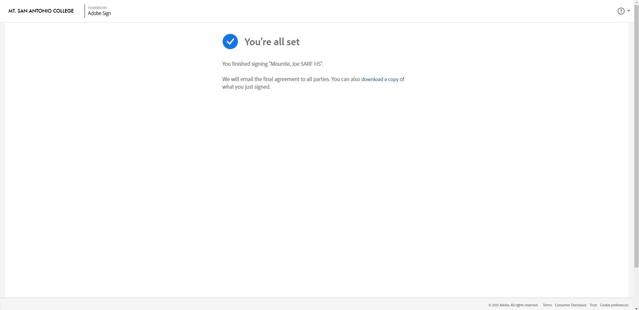
Adobe Sign Instructor Success Screen

Slide 14
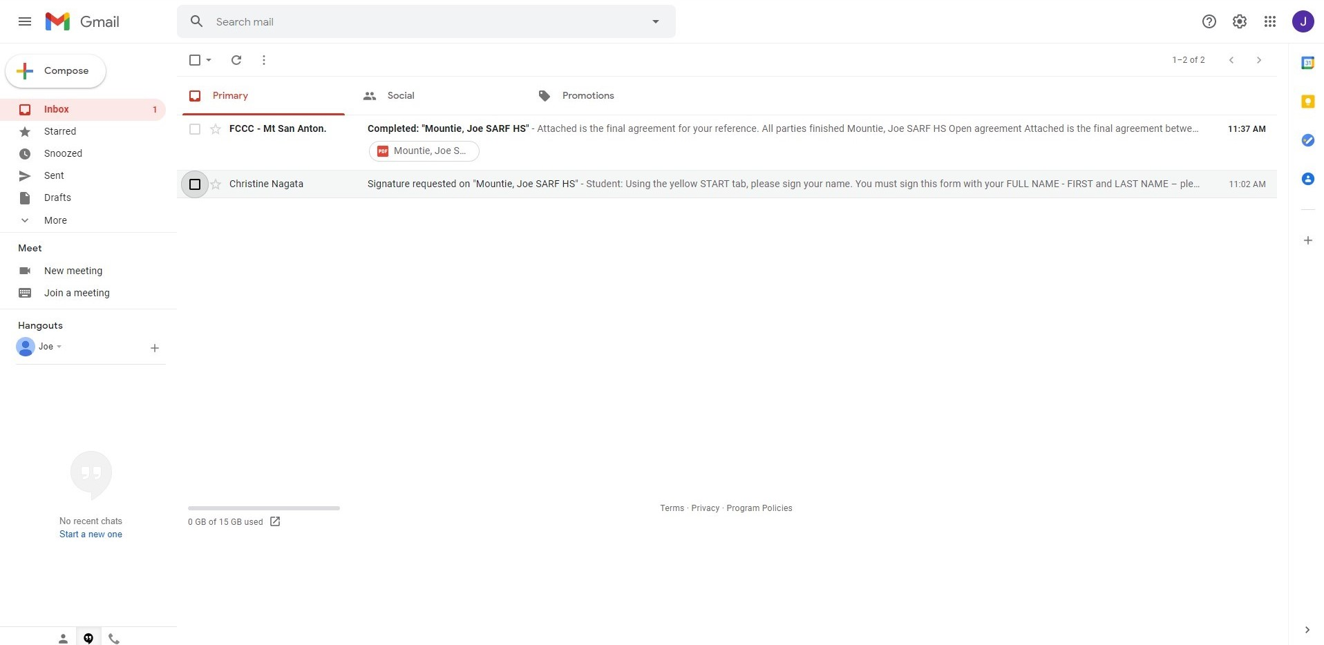
E-mail Inbox – Fully Executed Form
Notice that the e-mail containing the fully executed form comes from Mt. SAC; my name will not appear

Slide 15
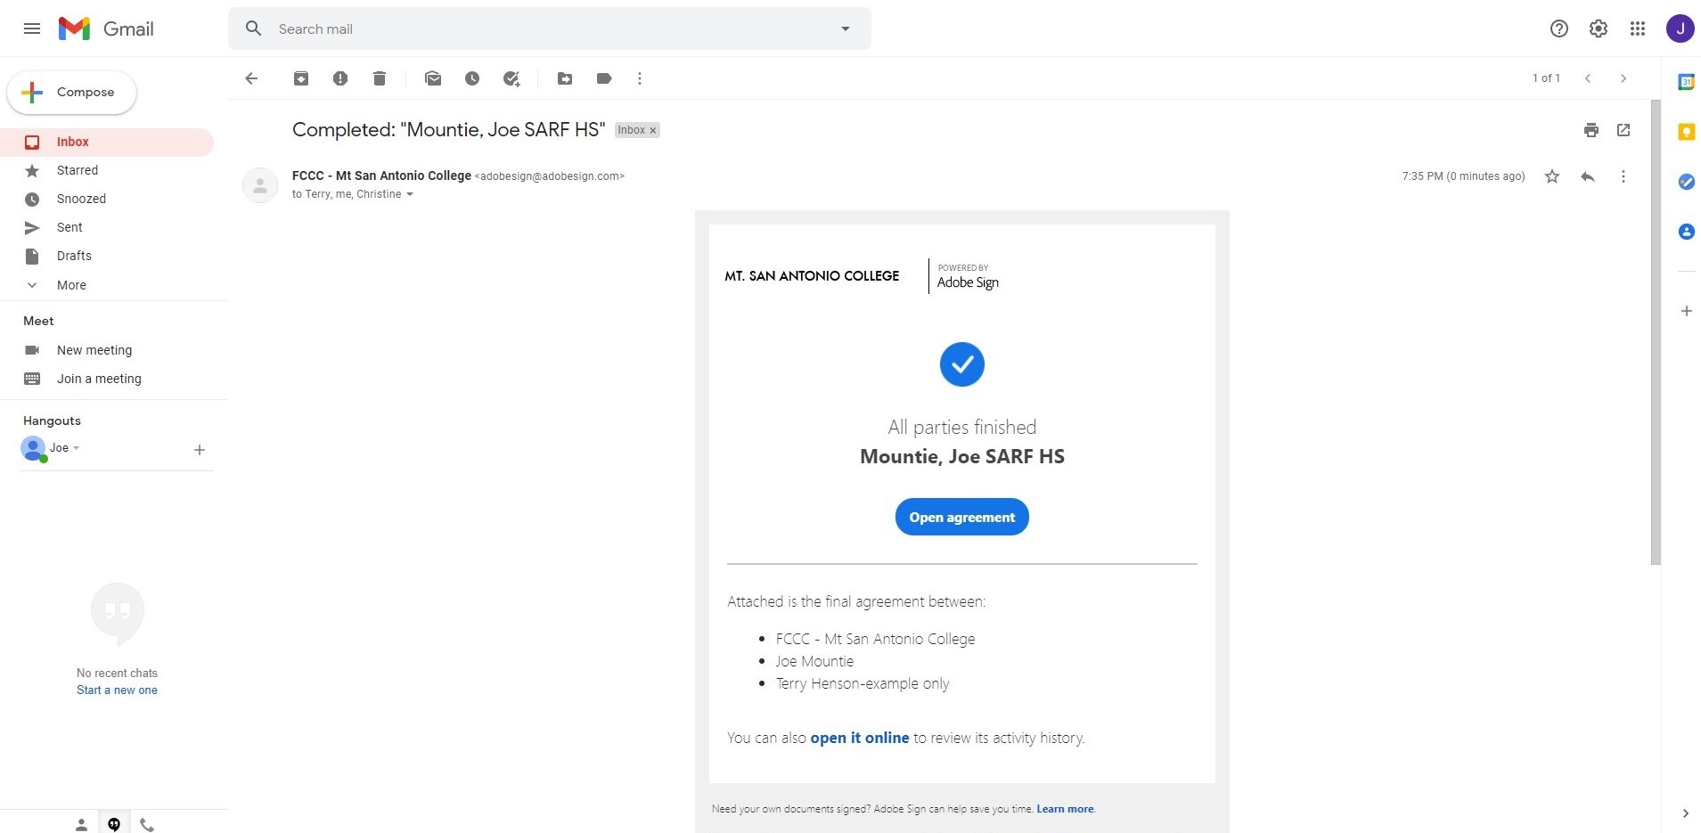
All Parties Open E-mail
Shows the three parties: Mt. SAC, student, instructor

Slide 16
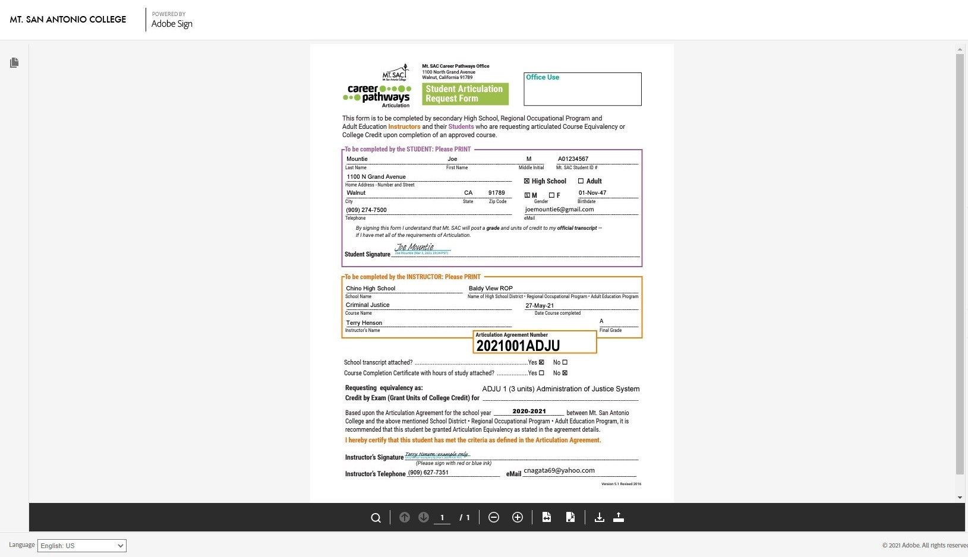
All Parties - Fully Executed Form

Slide 17
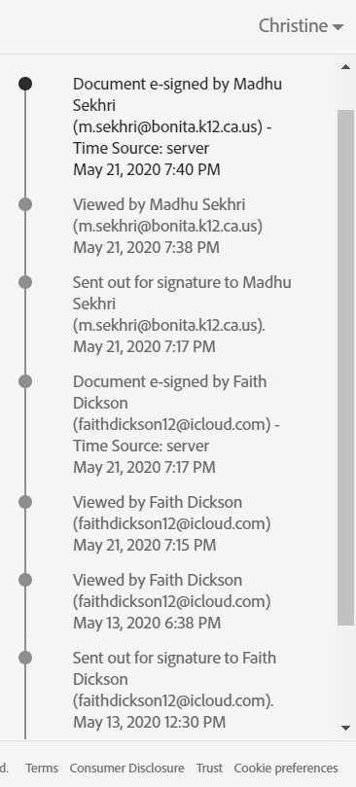
Adobe Sign Status
For any given document I can see the date and time it was sent, viewed and signed.
Status reports will be sent to instructors often to keep you updated on the status of your students’ forms.
If forms aren’t being viewed/signed in a timely manner a “reminder” will be sent through Adobe Sign which sends the form back up to the top of the signers e-mail inbox.

Slide 18
Student Transcripts
When Student Articulation Request Forms have been completed, the next step will be to submit your students’ unofficial transcripts.
Please send transcripts as PDF files to Marlene Ward mward@mtsac.edu using WeTransfer https://wetransfer.com/

Slide 19
DUE DATES
Instructors with EXAMS – Student forms and transcripts are due NO LATER than ONE WEEK prior to the scheduled exam.
Instructors with agreements that honor the high school grade – Student forms and transcripts are due as soon as the information is available. **A week before the end of your semester I will send a reminder via Adobe Sign so that the forms pop back up at the top of your e-mail inbox.

Slide 20
TL;DR – In Summary
Students only have to sign (type) their FIRST and LAST name on the form and they only have TWO chances to sign correctly
Instructors only have to fill in FINAL GRADE, sign the form and send in student transcripts
  Those with EXAMS return forms and send transcripts no later than ONE WEEK before the exam.
  Those without exams return forms and send transcripts at the end of the semester.

Slide 21

STUDENT FORM PROCESS COMPLETE
Questions or Problems?
Contact: Christine Nagata
cnagata@mtsac.edu
909-274-5893
Schedule: Tue 9 – 4:30
Wed 9 – 3:30
Thurs 9 – 4:30

