Slide 1

Account Claim & Canvas Exams
Spring 2023

Slide 2
Today’s Topics
Mt. SAC Account Claim (Portal) REQUIRED for all students
Accessing Canvas for Exams
Exam Types (Portfolio, Written, Combination formats)
Adding Honorlock Extension
Exam Scheduling & Results

Slide 3
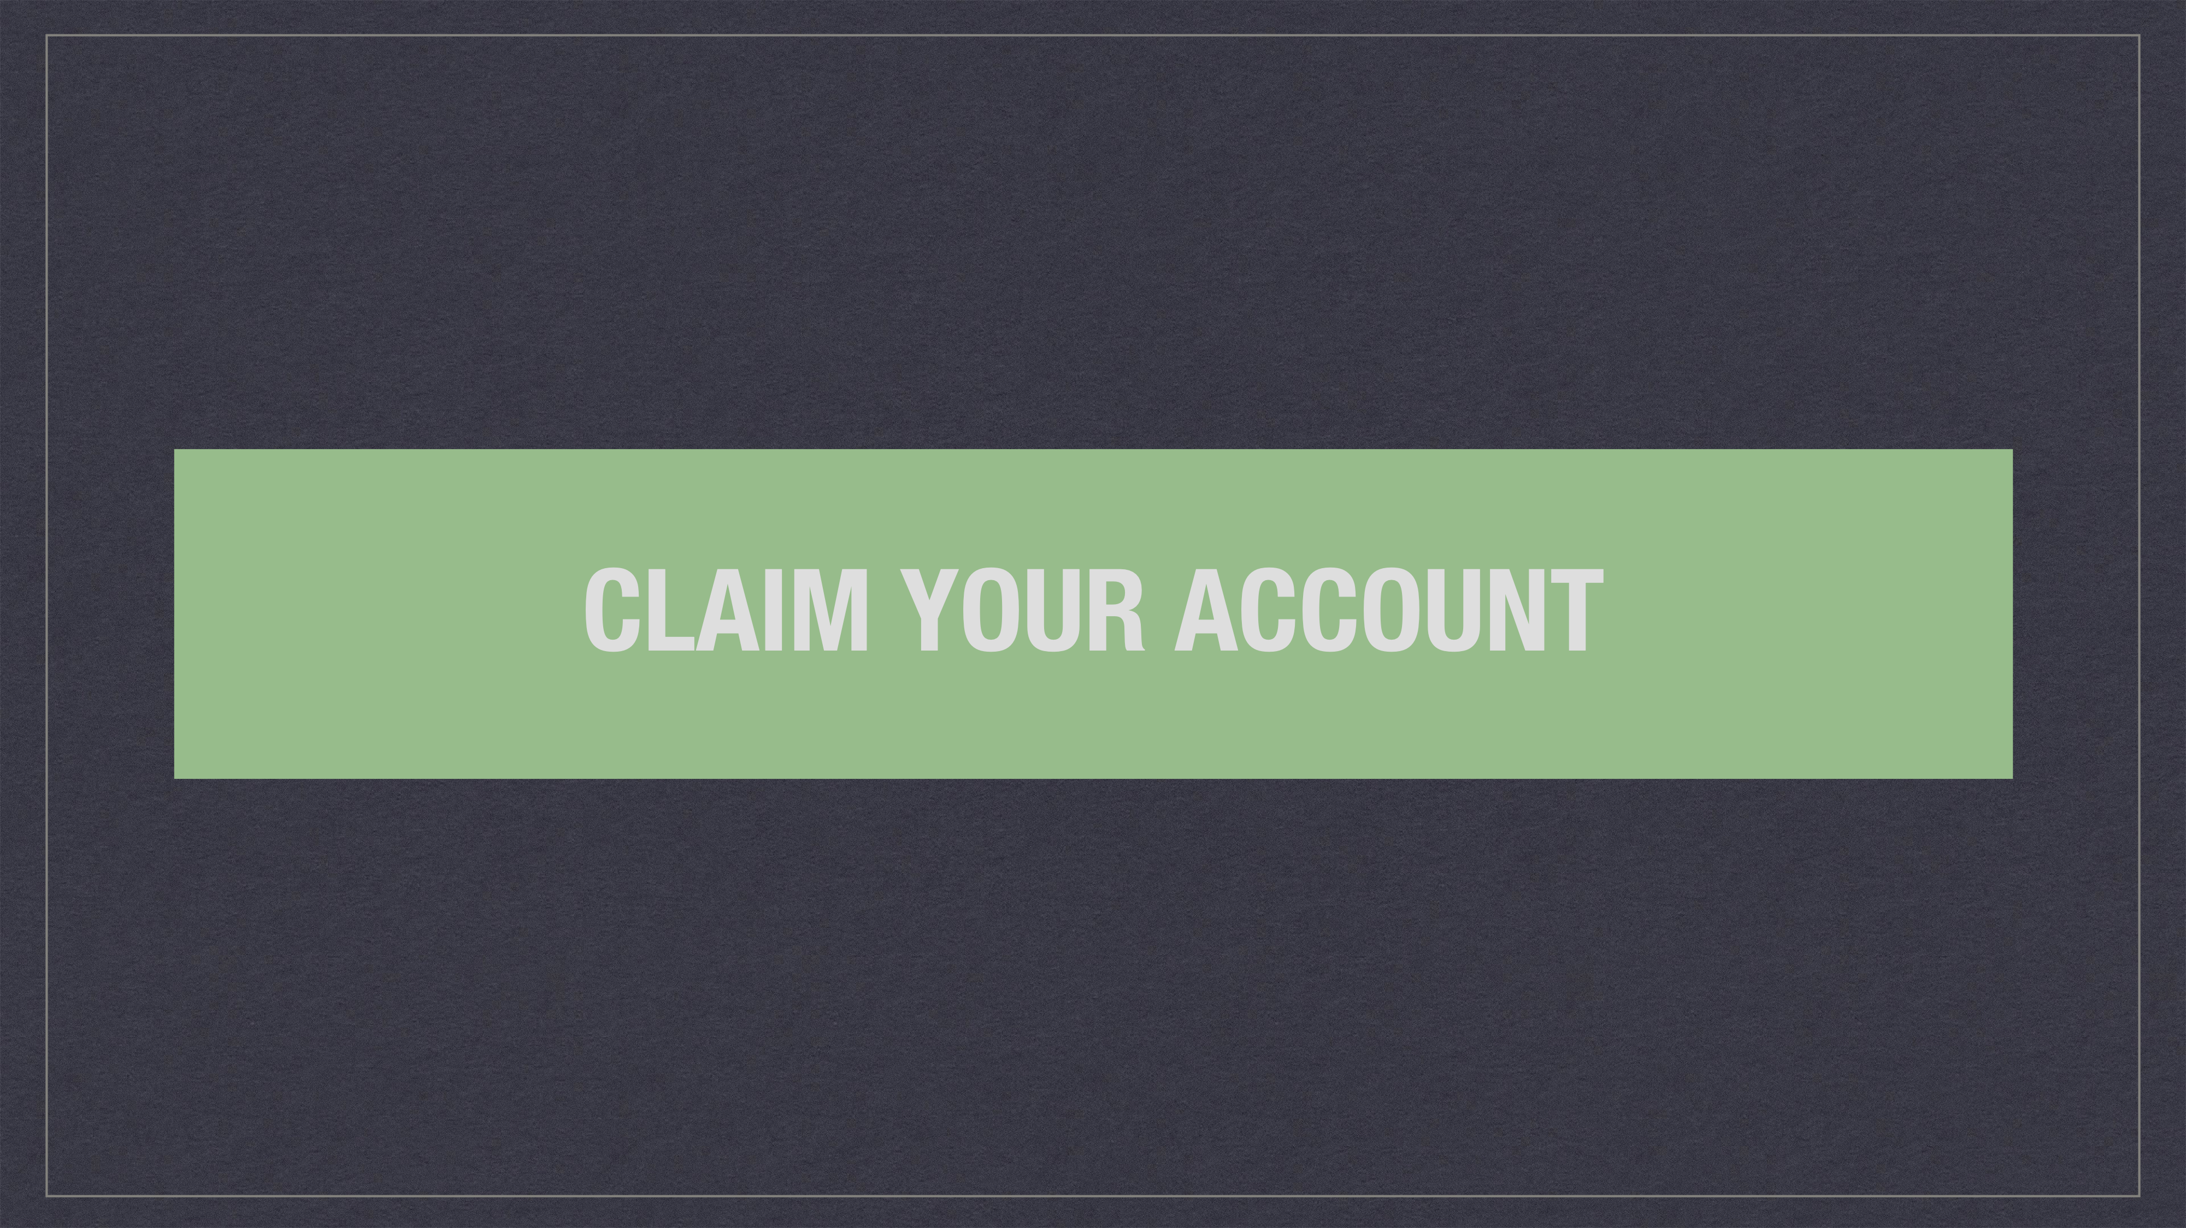
Notes:
At this point…
Completed application and received ID & username.

Slide 4
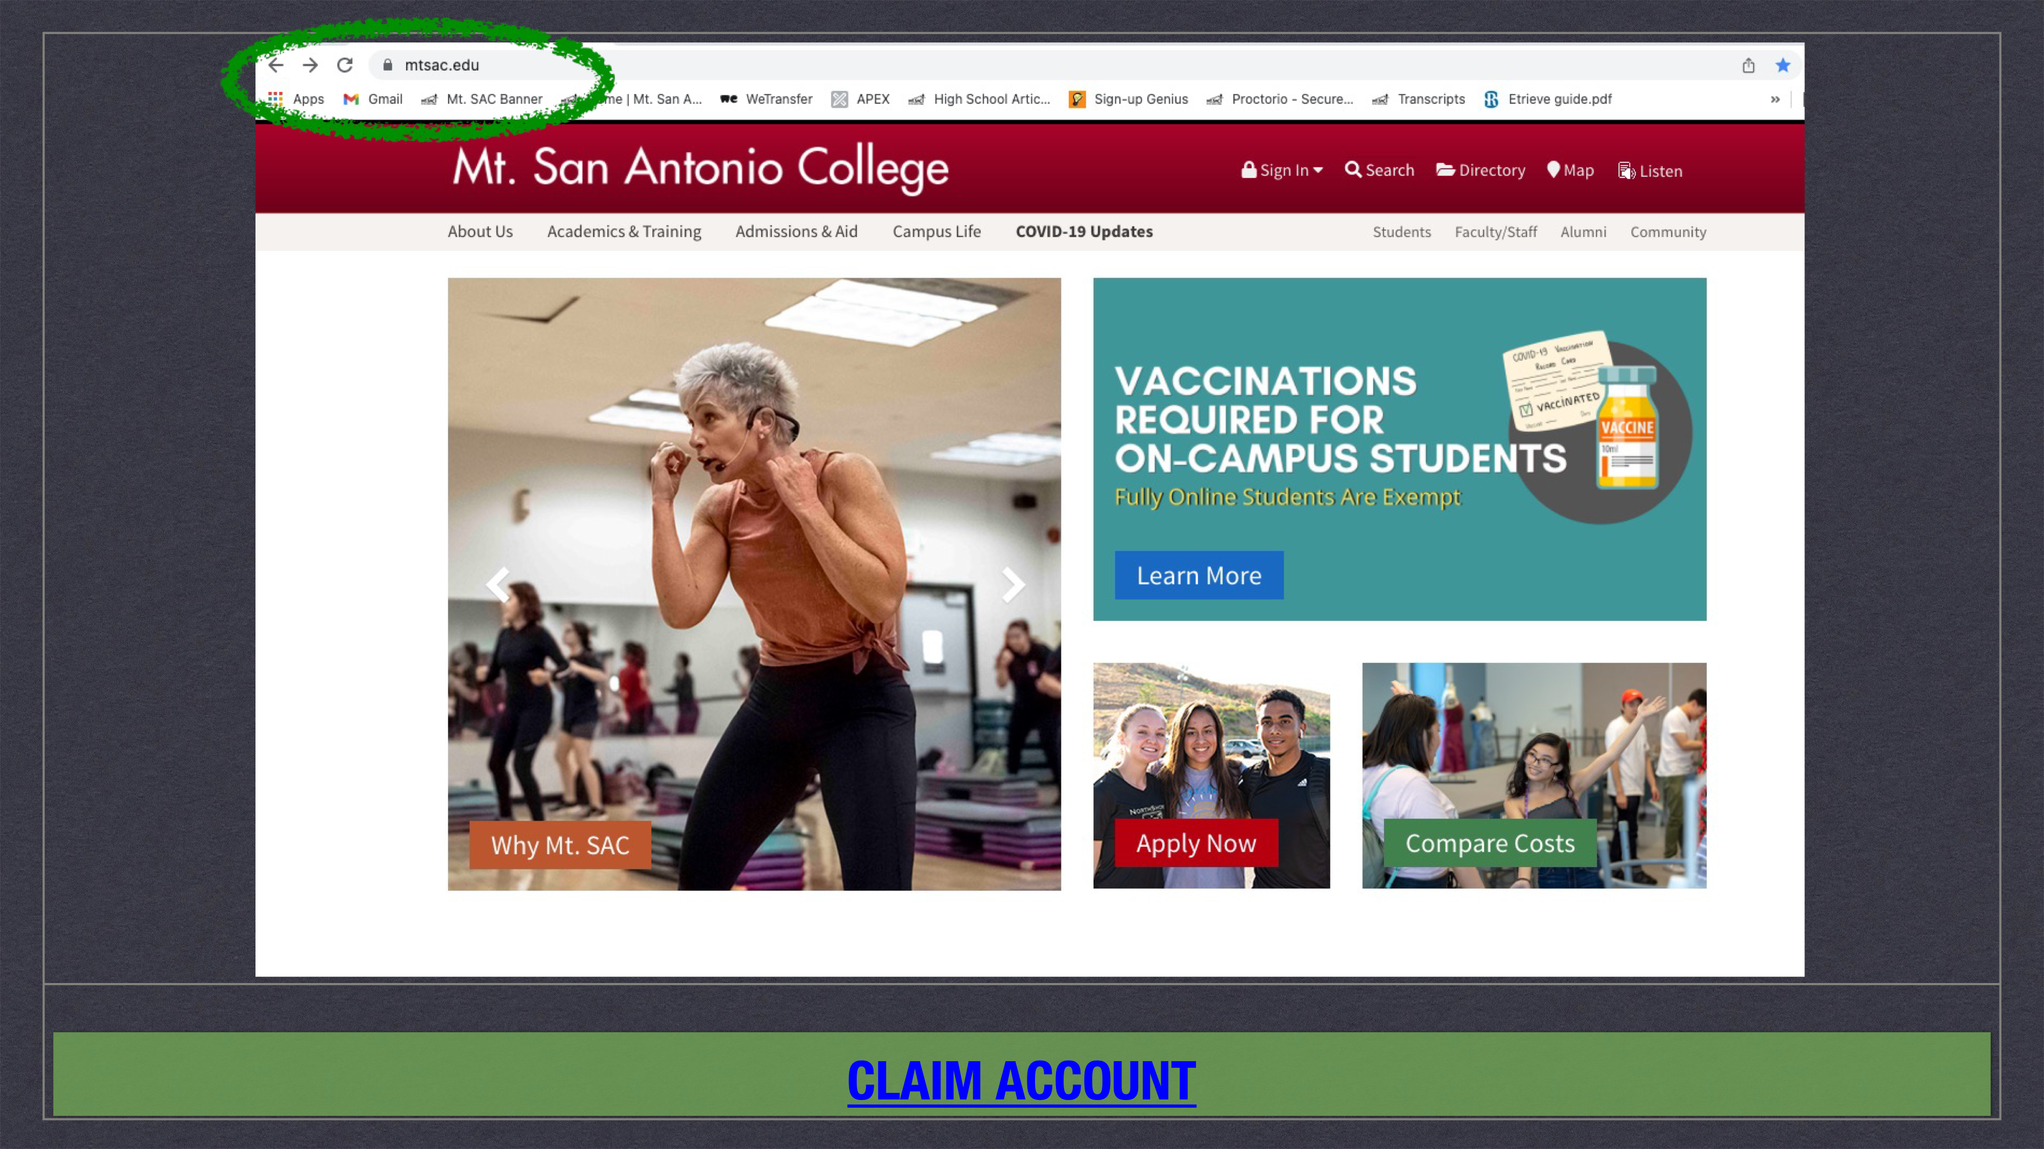

Slide 5
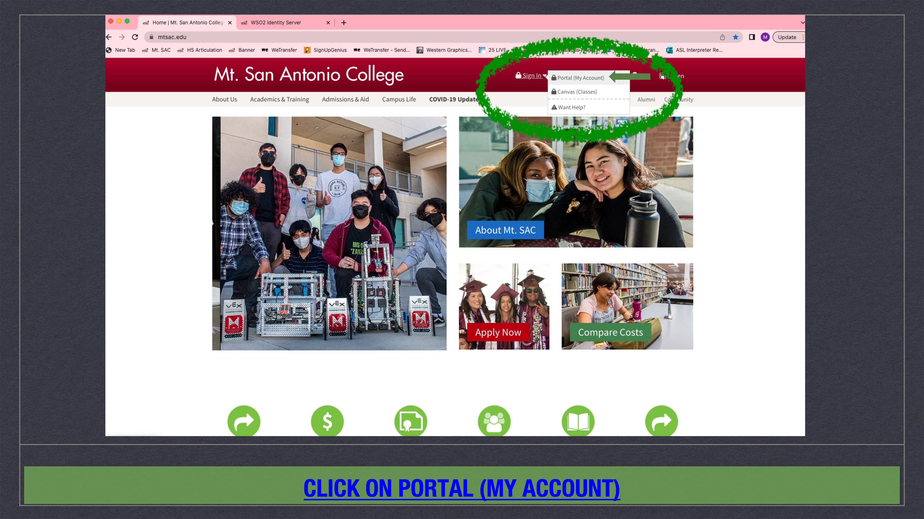

Slide 6
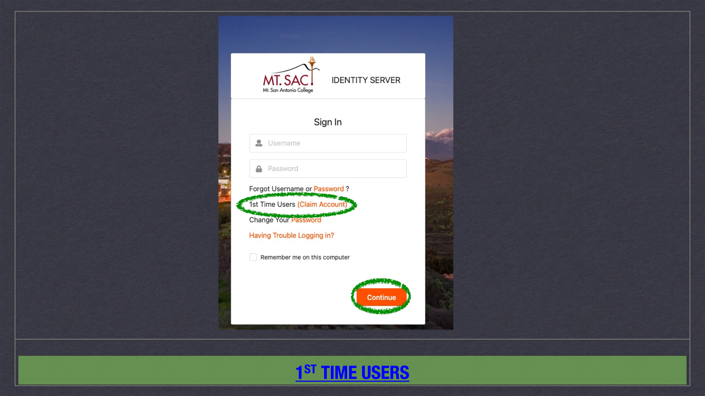
Notes:
Filled out application and received ID & username.

Slide 7
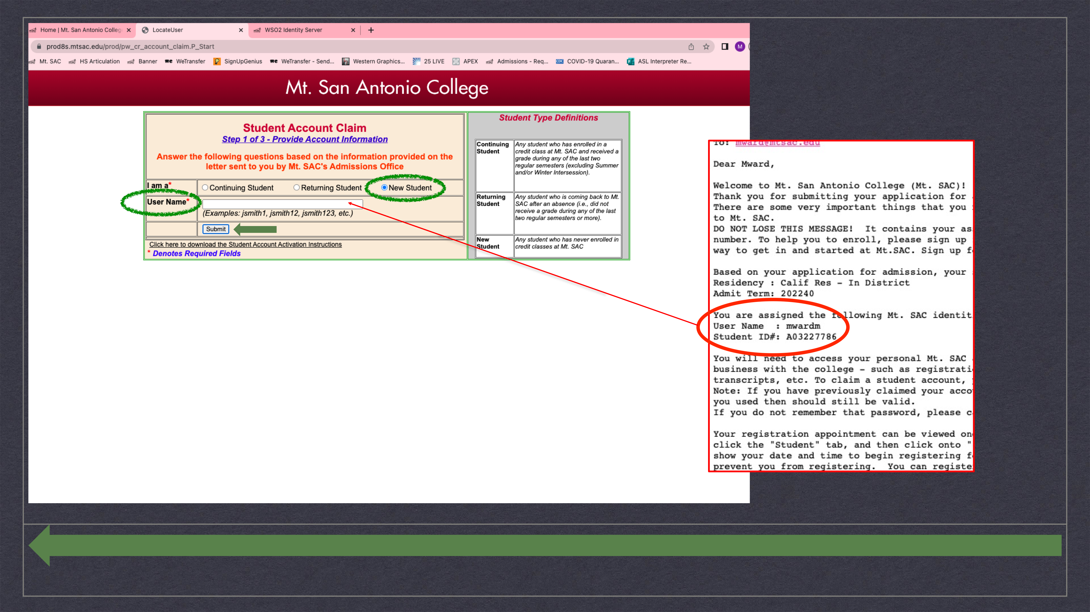

Slide 8
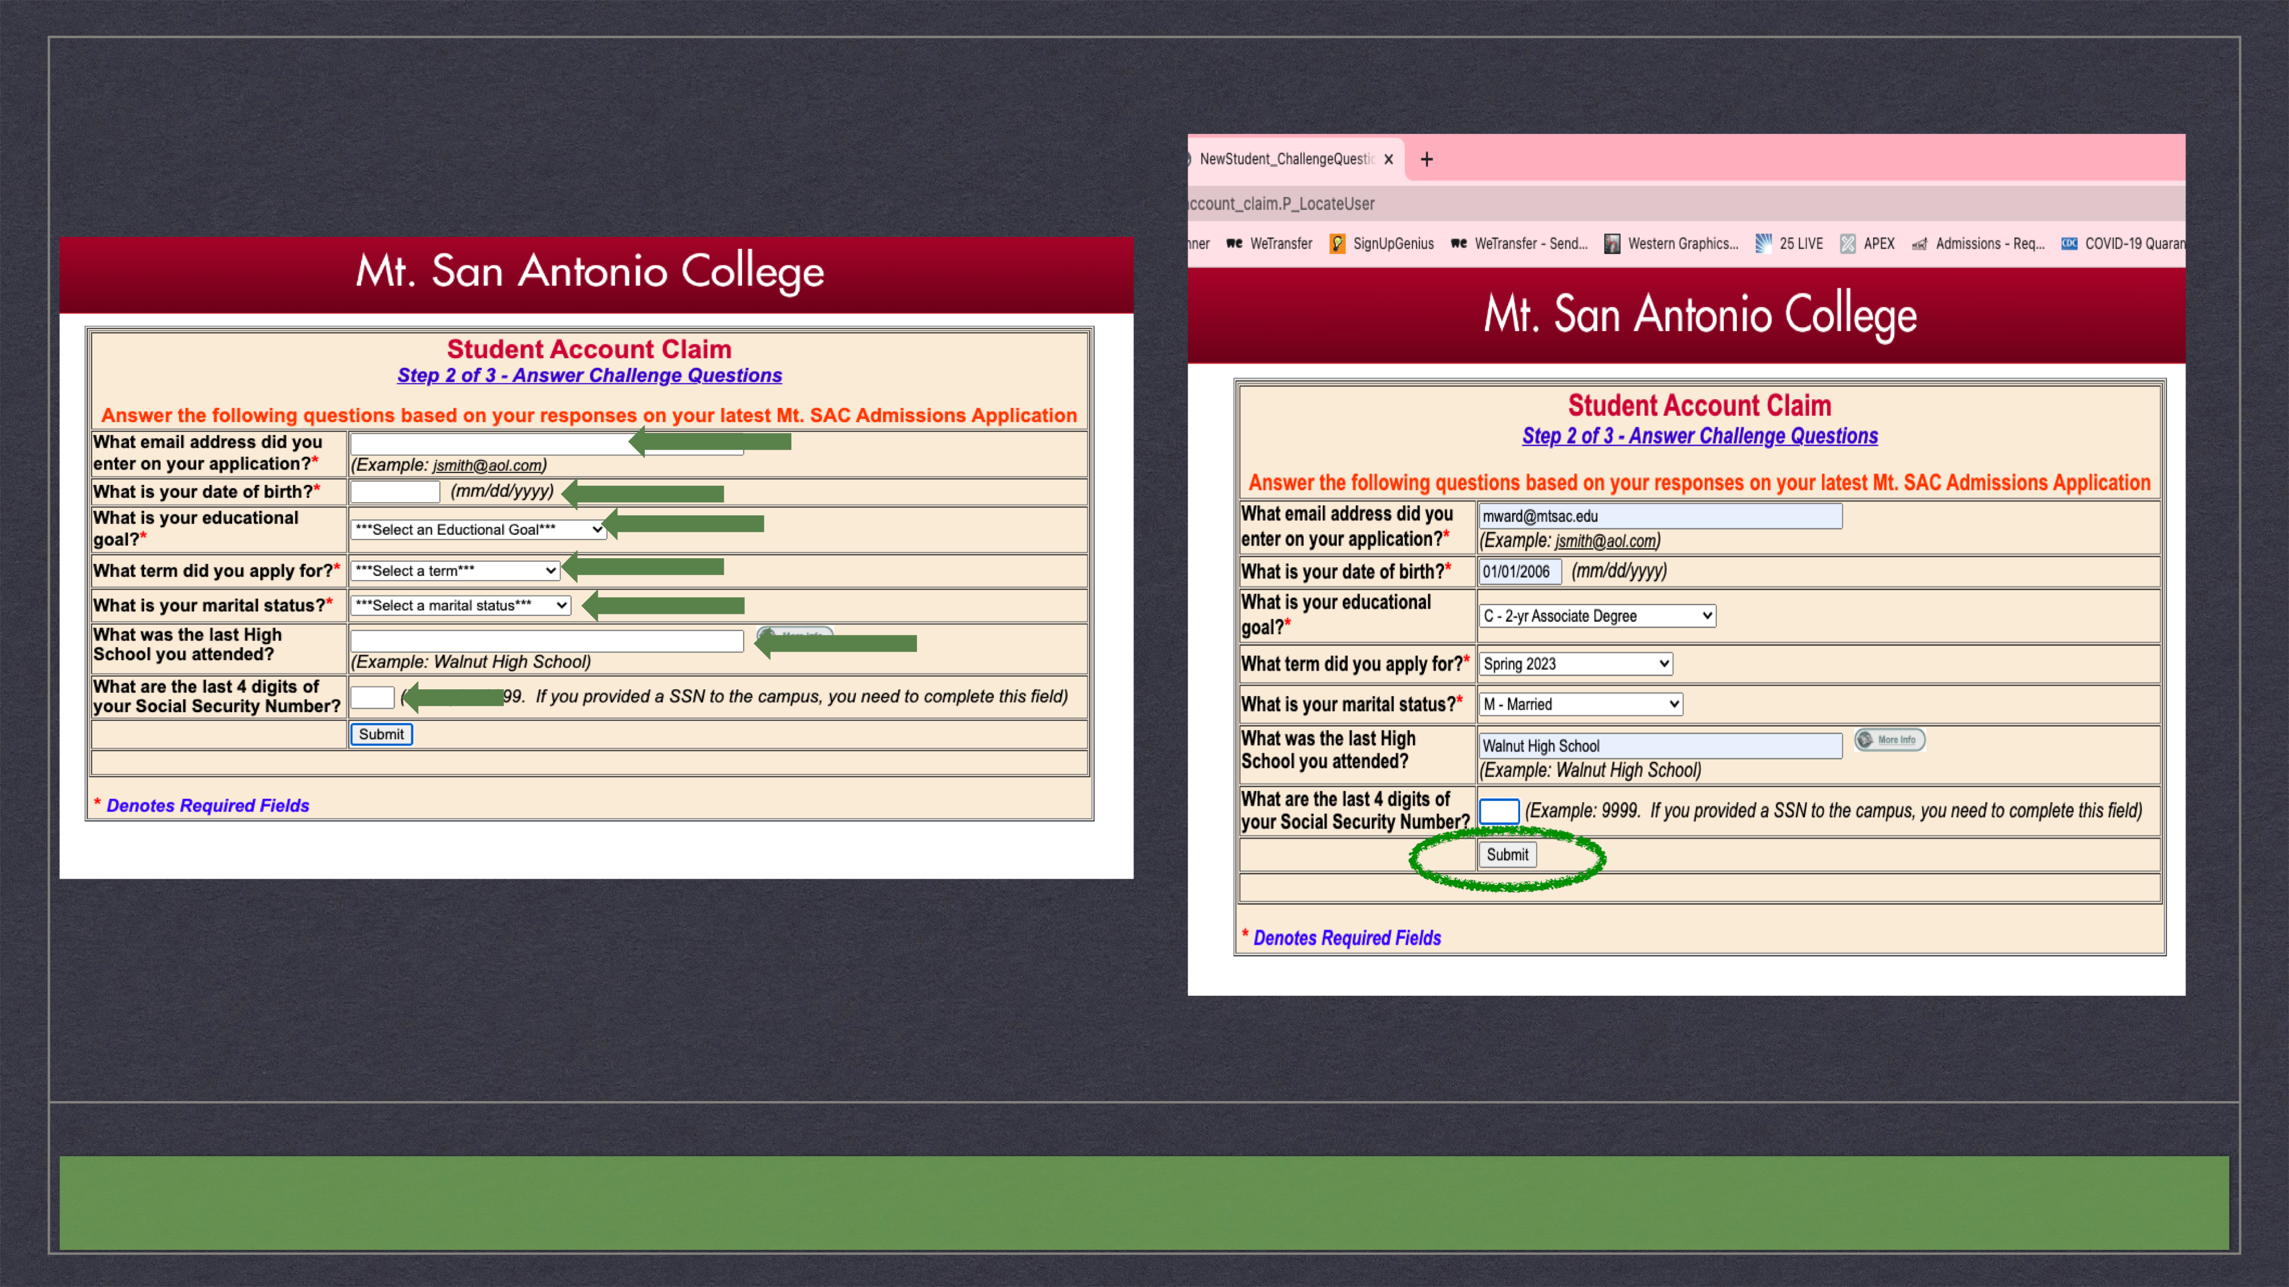
Notes:
Same answers as the application

Slide 9
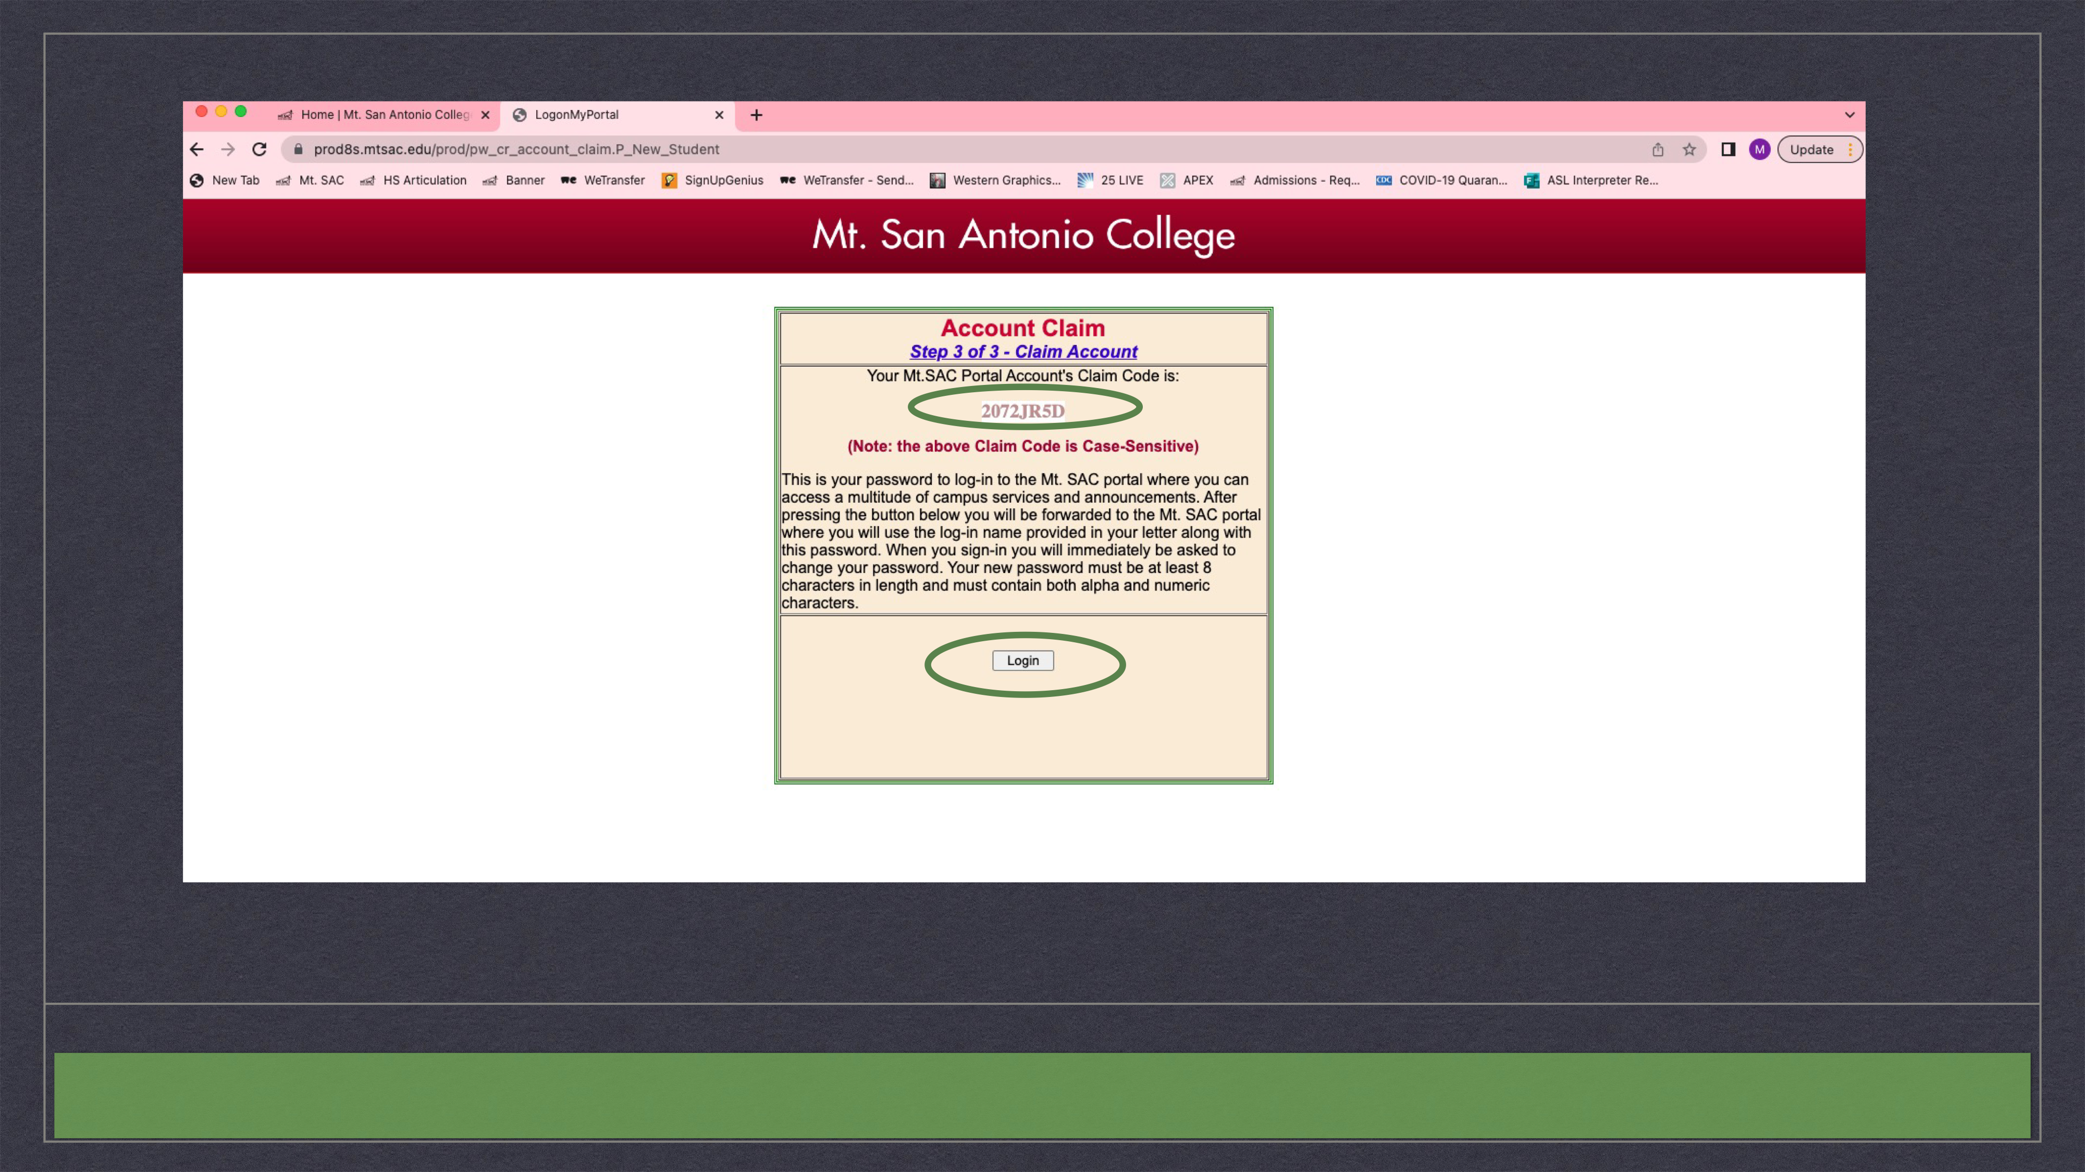
Notes:
Write down or screen shot the Claim Code.

Slide 10
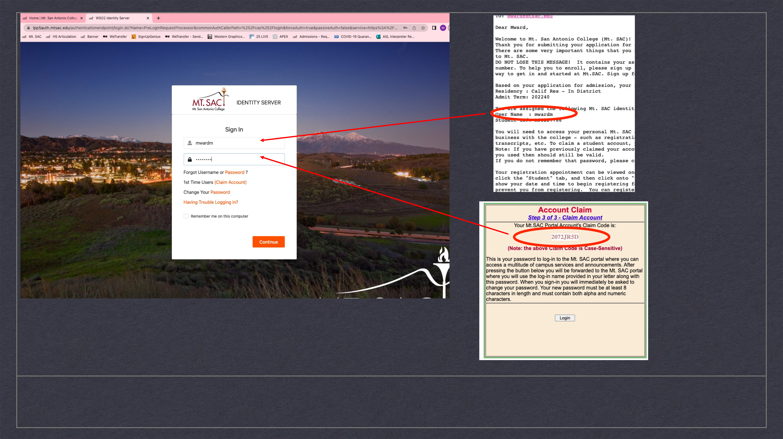
Notes:
Email: username & ID
Prompt to create a NEW password.

Slide 11
Accessing Canvas

Slide 12
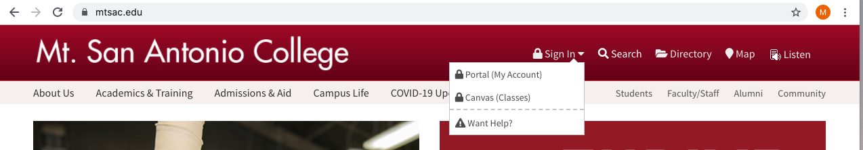
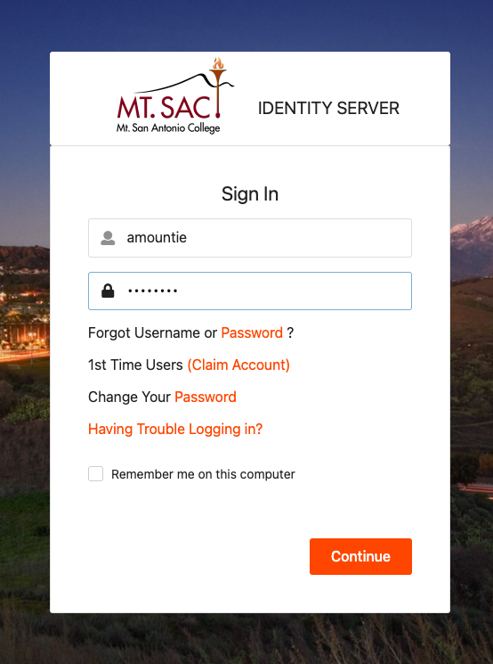
OPTION 1
Sign-in directly
to Canvas
Notes:
After account is established, students should sign-in directly to Canvas. When they sign-in they will use the assigned username & password they reset. PLEASE make sure students remember the password they set for themselves. If they forget, it is possible to have Mt. SAC Help Desk reset the password. This will only work during Help Desk working hours. Again, the time selected for the exam has ramifications. Please choose wisely.

Slide 13
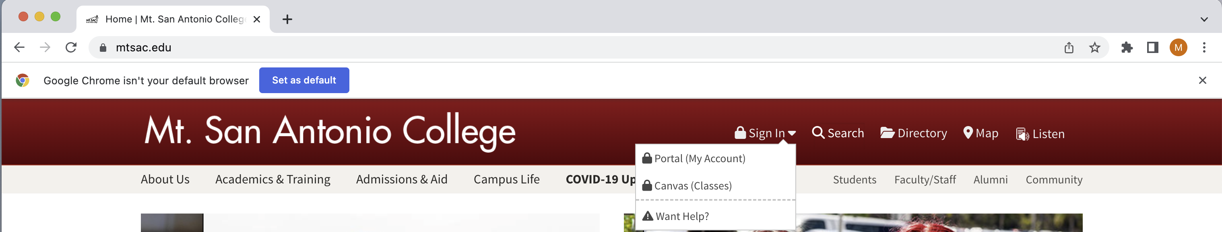
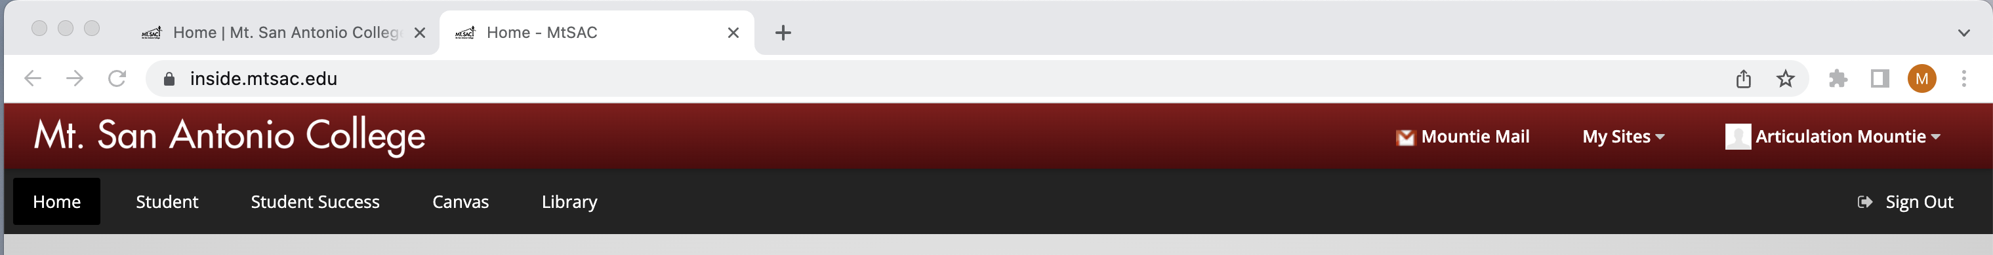
Navigate to Canvas
Option 2
Access from Mt. SAC Portal
Notes:
From the portal landing page, select Canvas to navigate to Canvas

Slide 14
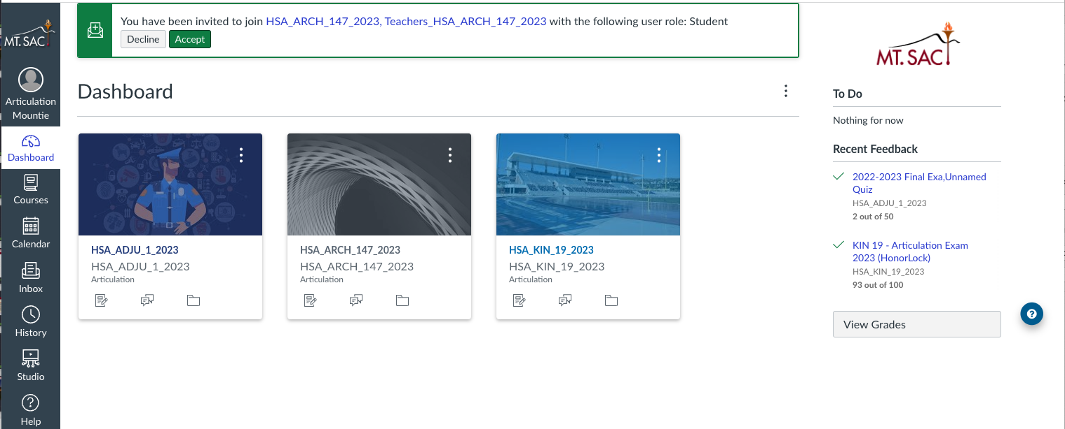
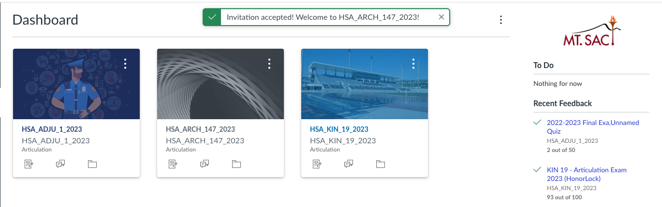
Accept Invitation to Course

Slide 15
  Troubleshooting
If students have difficulty accessing their portal, contact Mt. SAC’s Help Desk and request assistance. (909-274-4357)
Help Desk will ask for the student’s Mt. SAC ID and will verify the username that is linked to the account.

Slide 16
Portfolio Exams in Canvas
ARCH 141 & 147

Slide 17
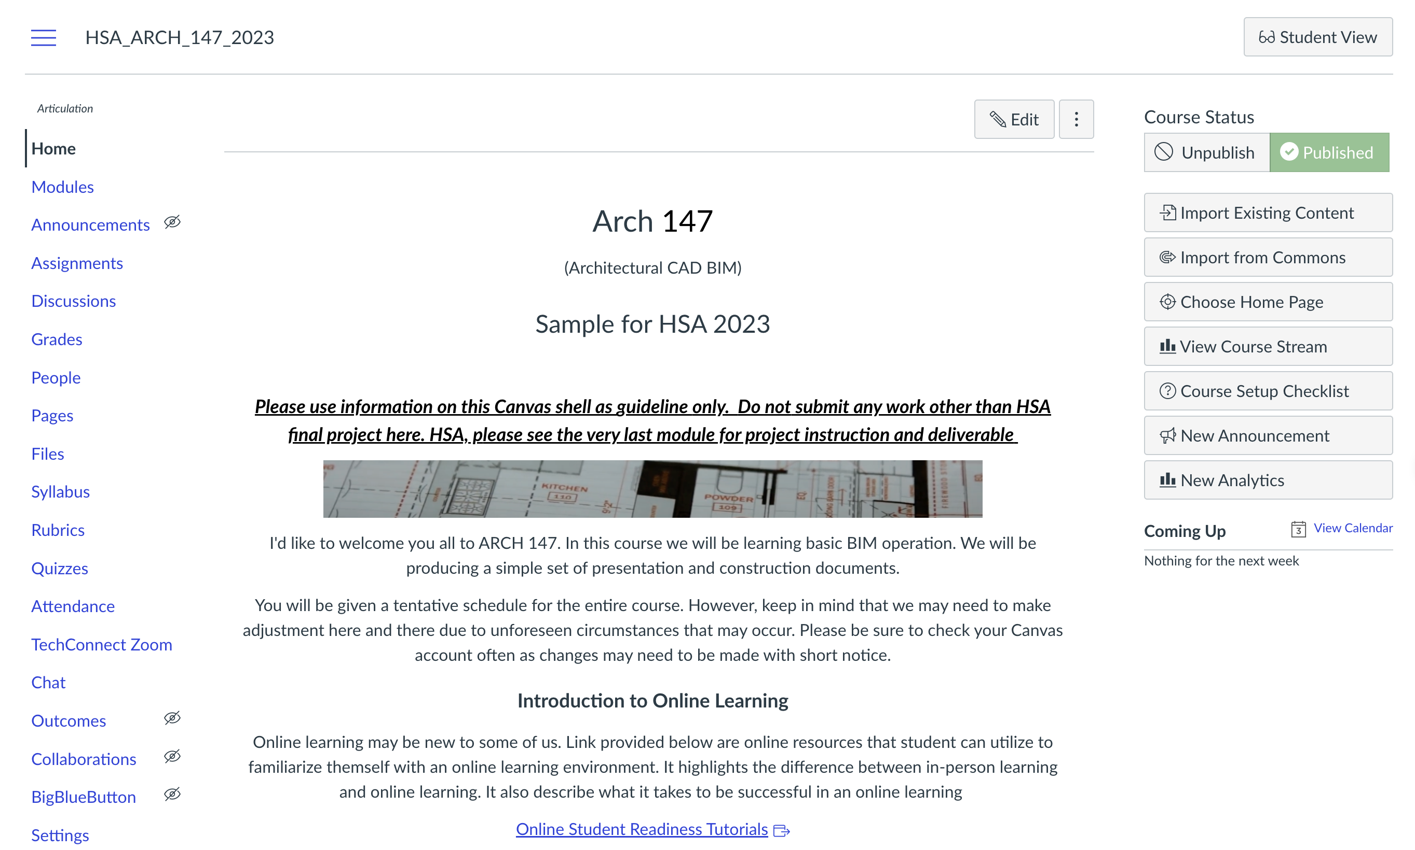

Slide 18
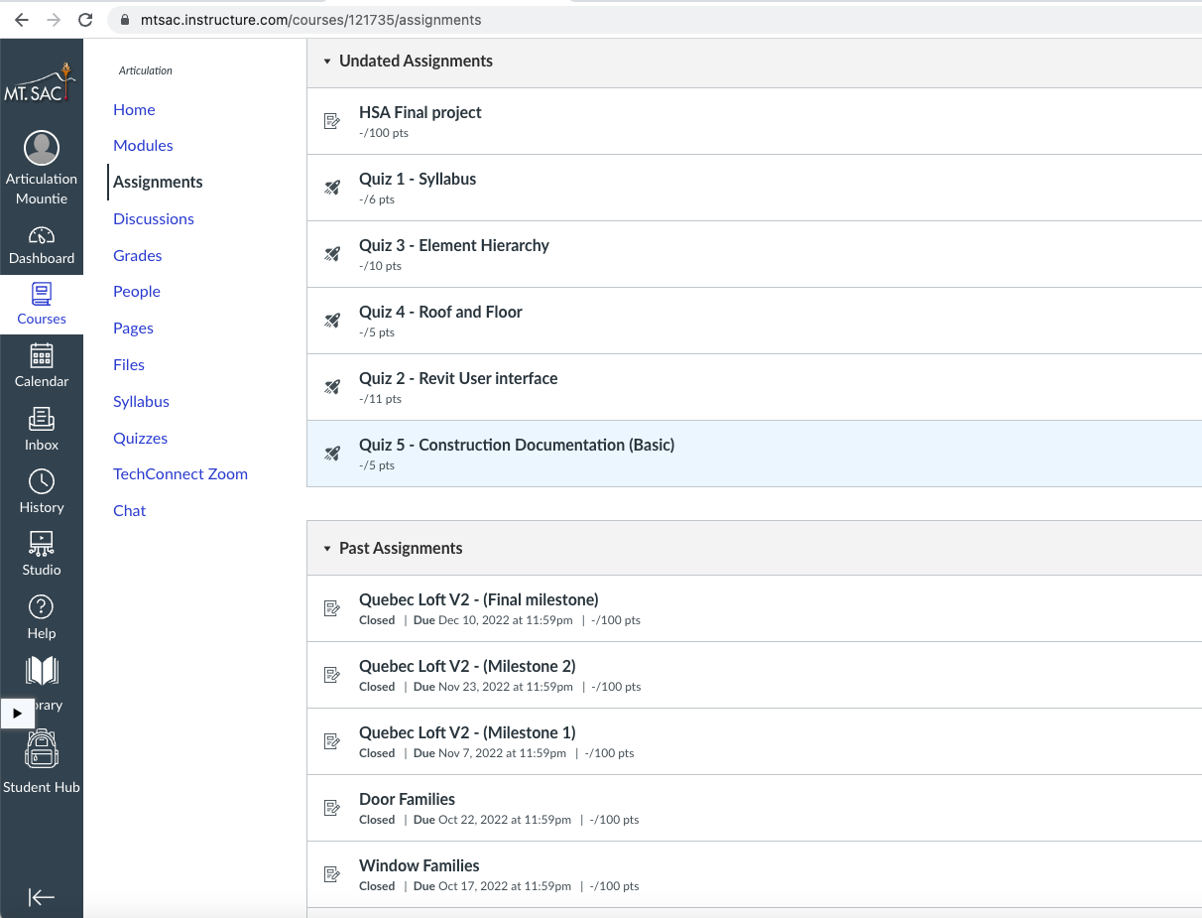

Slide 19
Written Exams in Canvas
ADJU 1 & 50 | CNET* | MUSA
AERO* | ENGR | PHOT 9
ASCI 1 | MEDI
CIS | MFG
* Alternate Exam Available

Slide 20
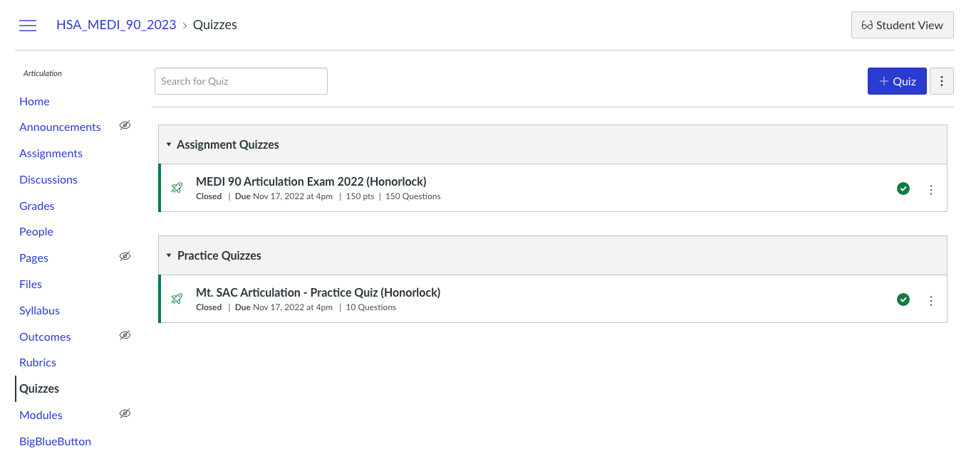

Slide 21
Combination Exams in Canvas
ANIM* | PHOT 10
KIN 19 | THTR
*This exam may switch to in-person instead of Canvas

Slide 22
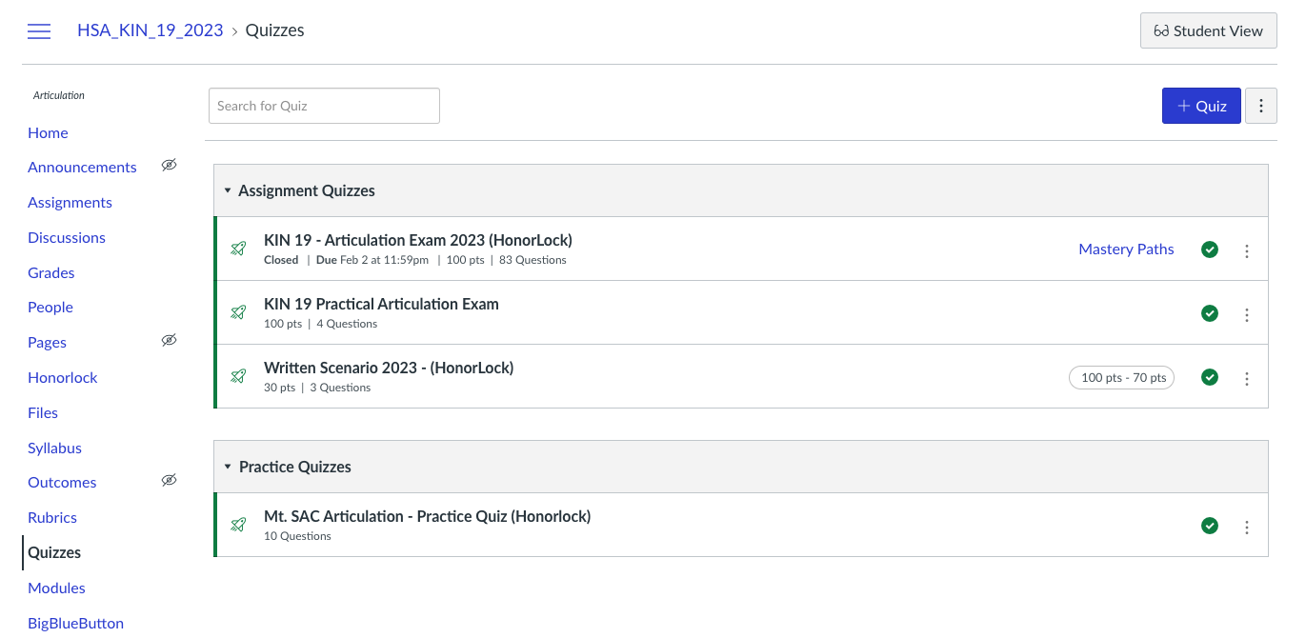
1
2

Slide 23
Adding Honorlock Extension
Notes:
**MW

Slide 24
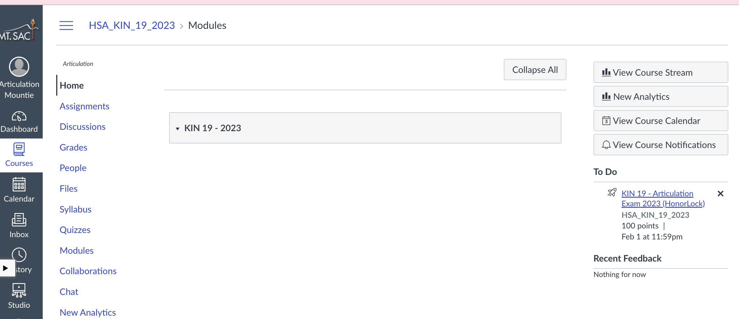
Notes:
Enter exam

Slide 25
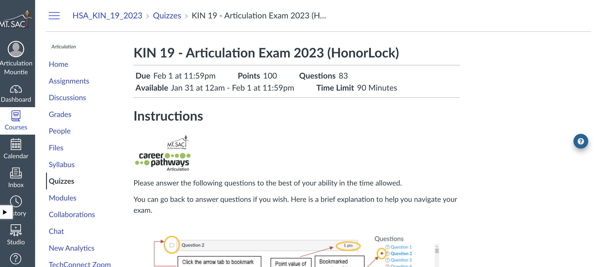
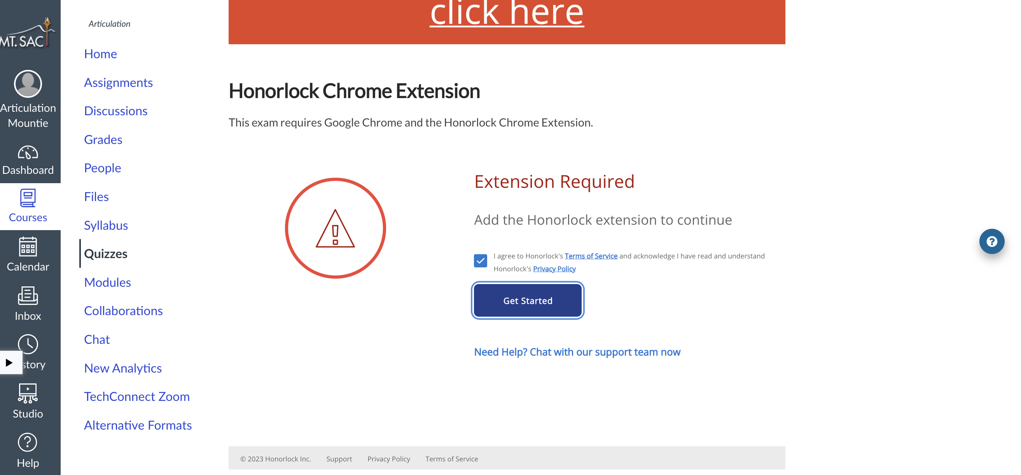
Notes:
Remind you to ADD extension. If you bypass it and start exam, you will be prompted to ADD Honorlock.

Slide 26
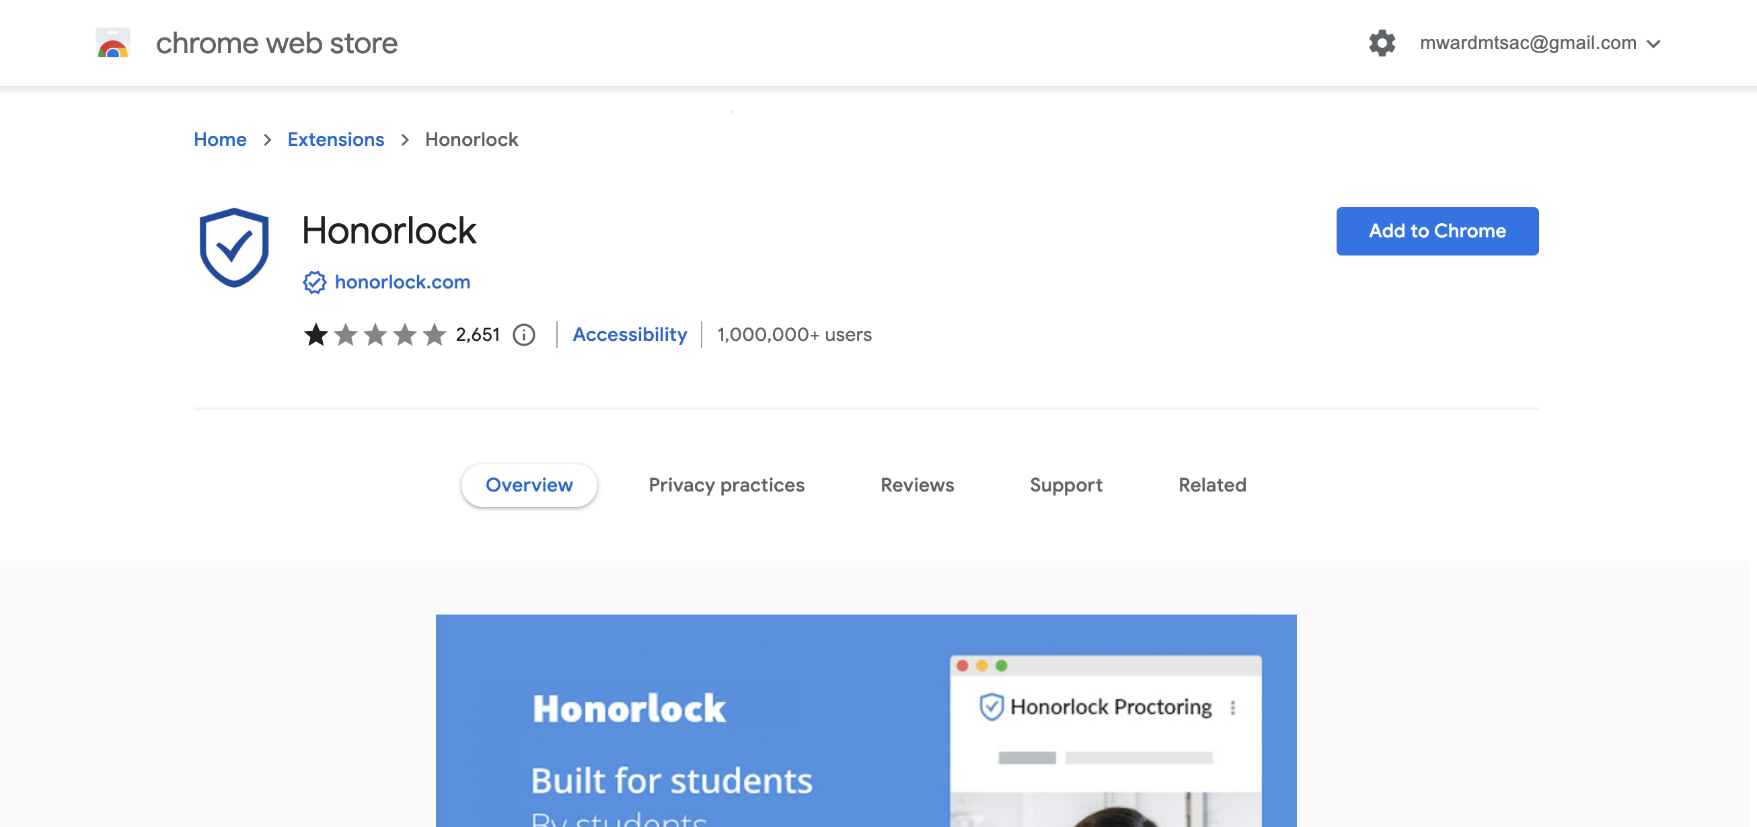
Notes:
Add to chrome

Slide 27
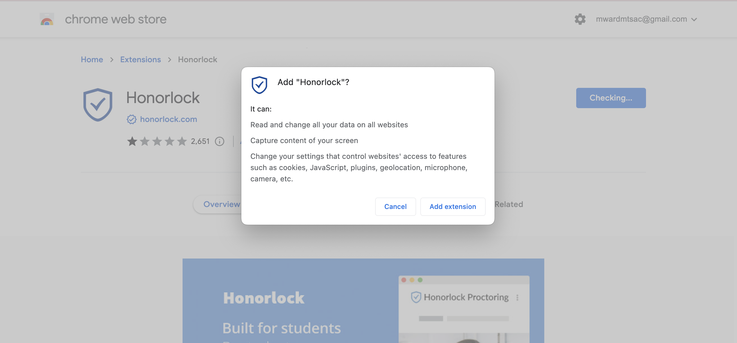
Notes:
ADD

Slide 28
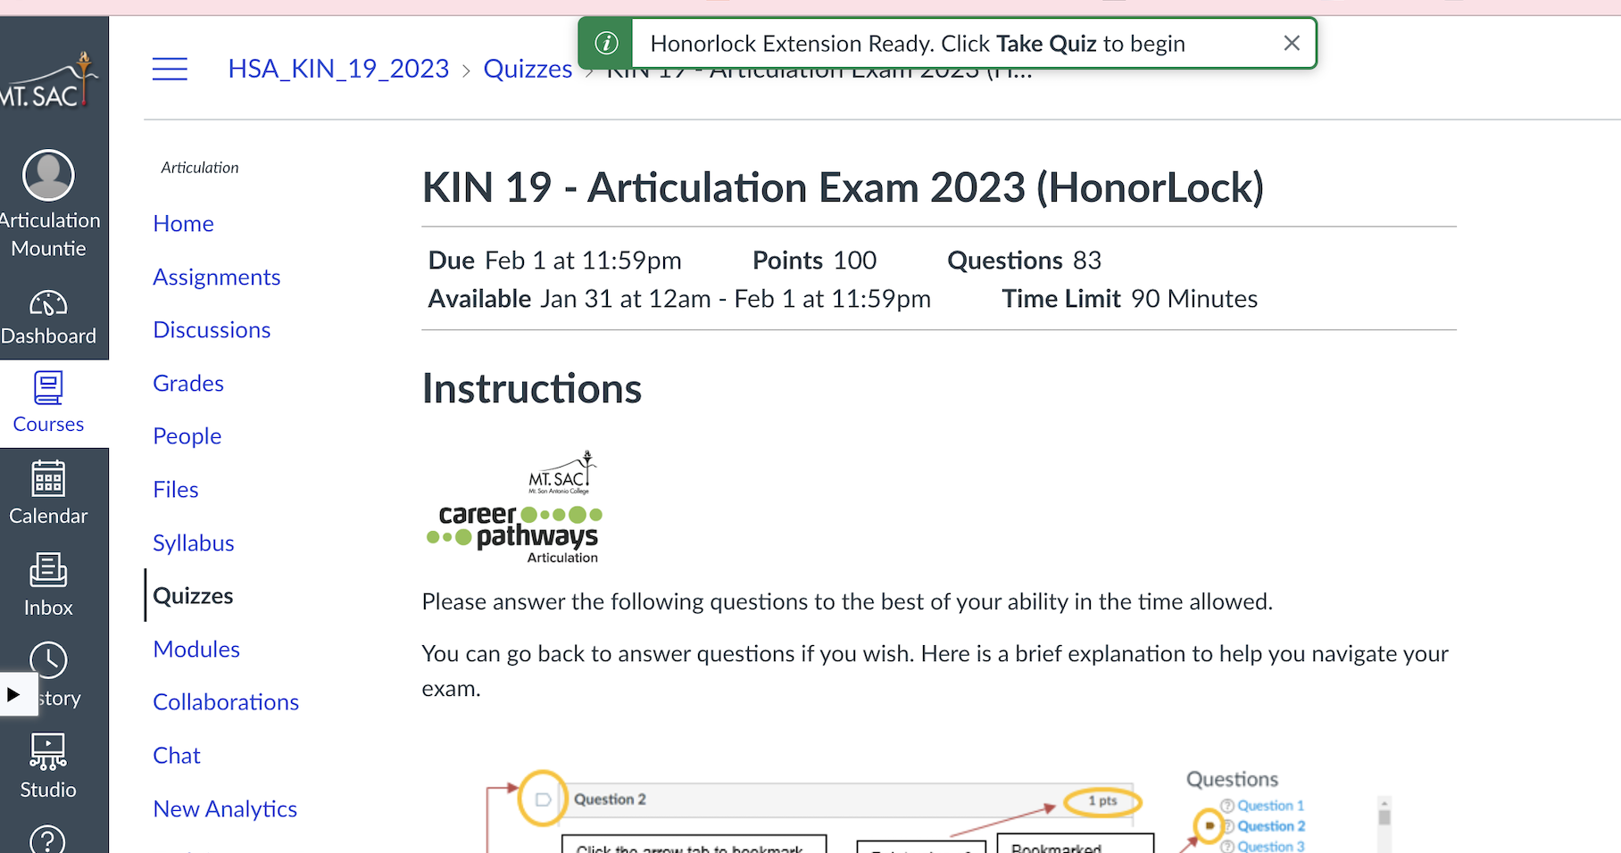
Notes:
Ready!

Slide 29
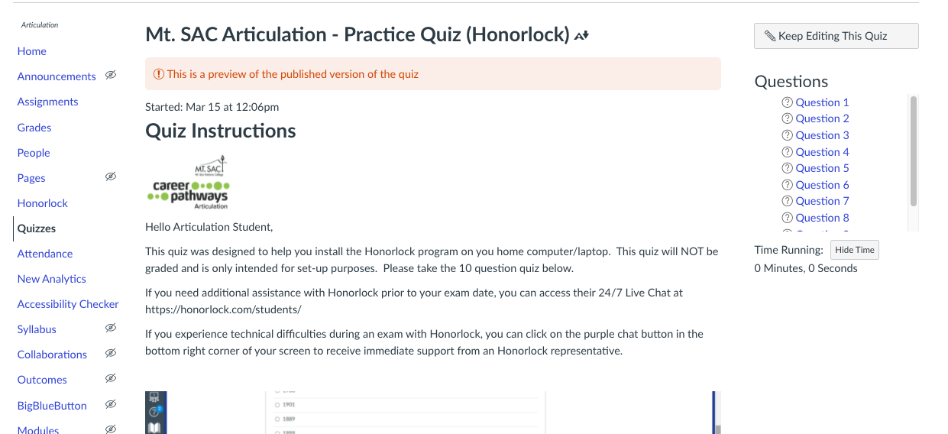
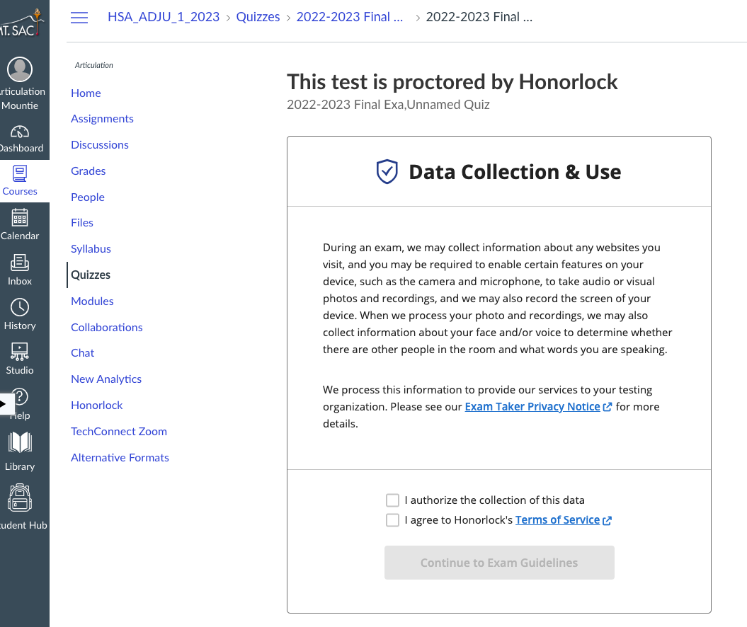
Notes:
Remind you that it will be recording you through your camera and microphone.

Slide 30
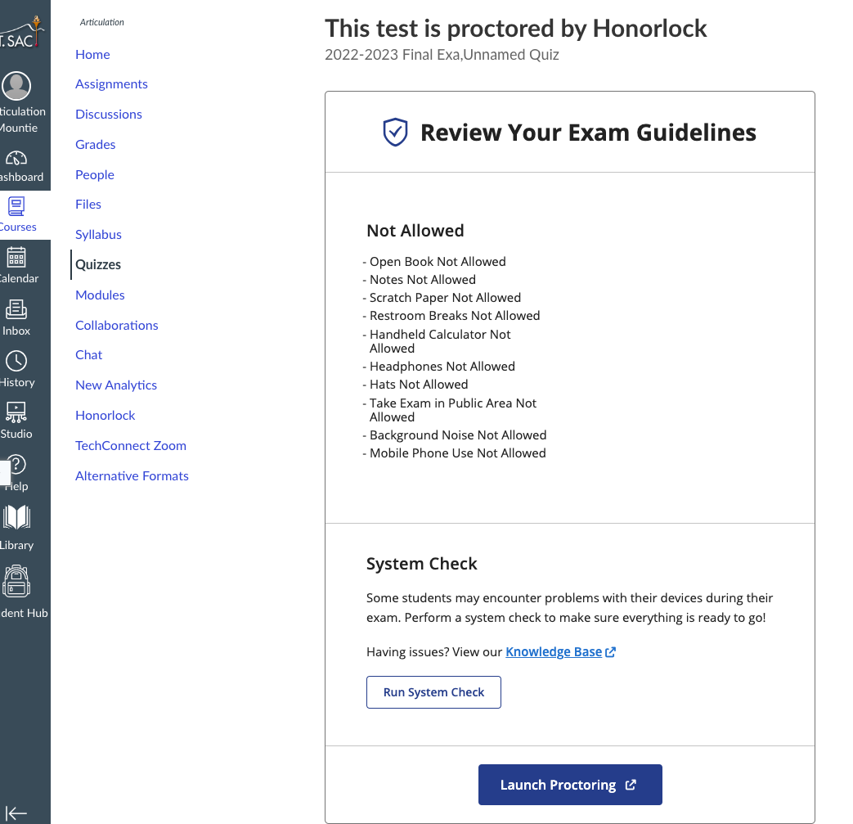
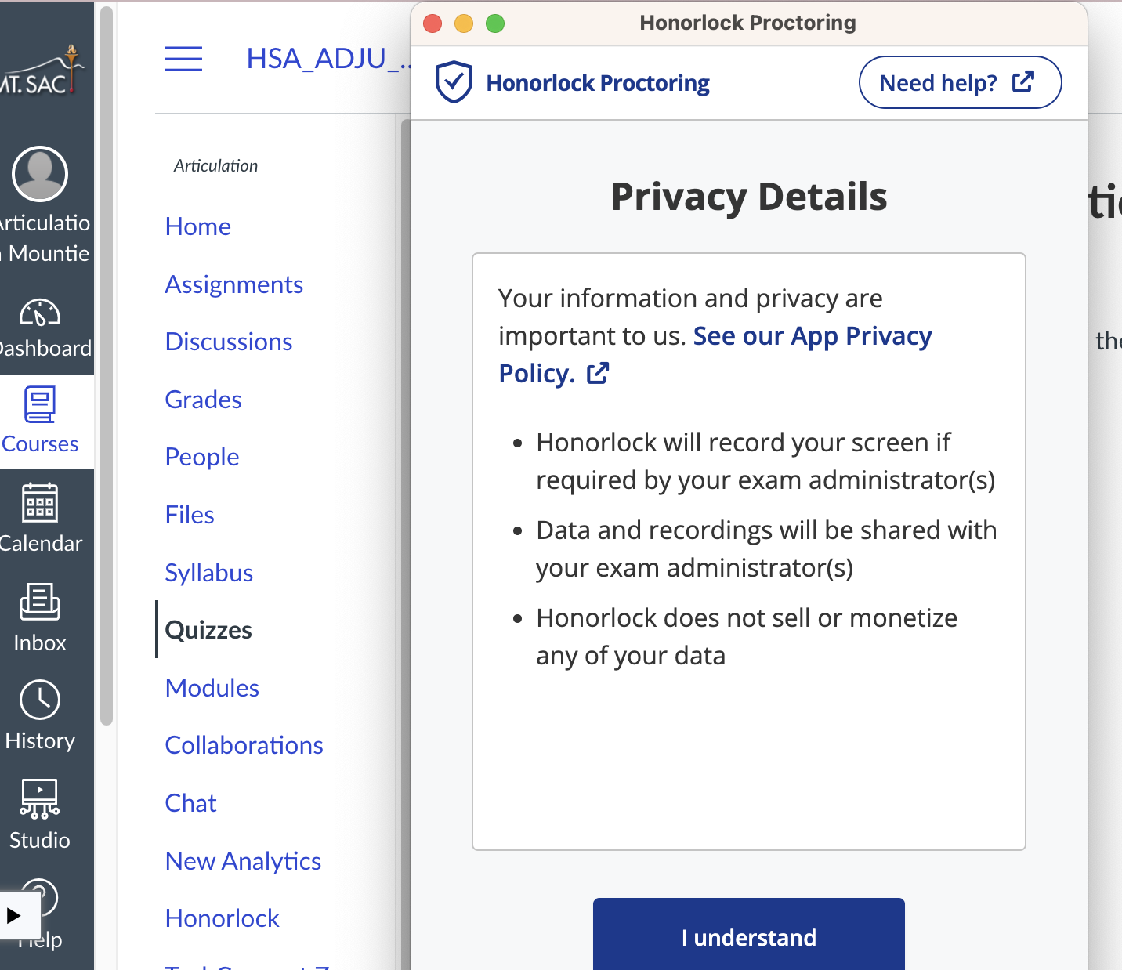
Notes:
Remind you that it will record your screen and shared with exam administrator.

Slide 31
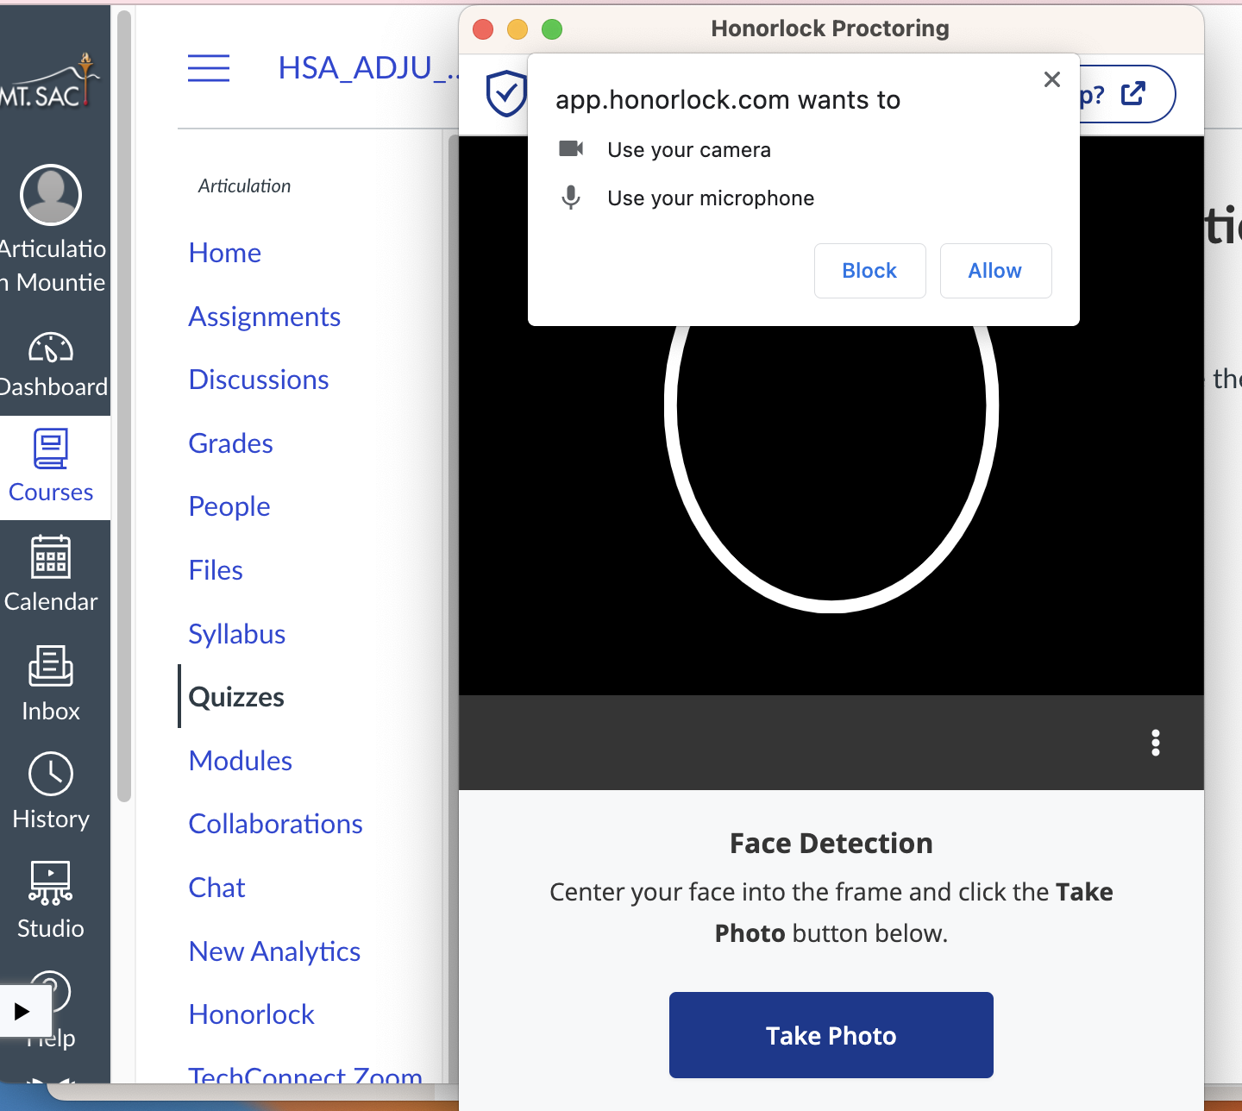
Notes:
Last step - Take a photo. Ask student to place face in the white circle.

Slide 32
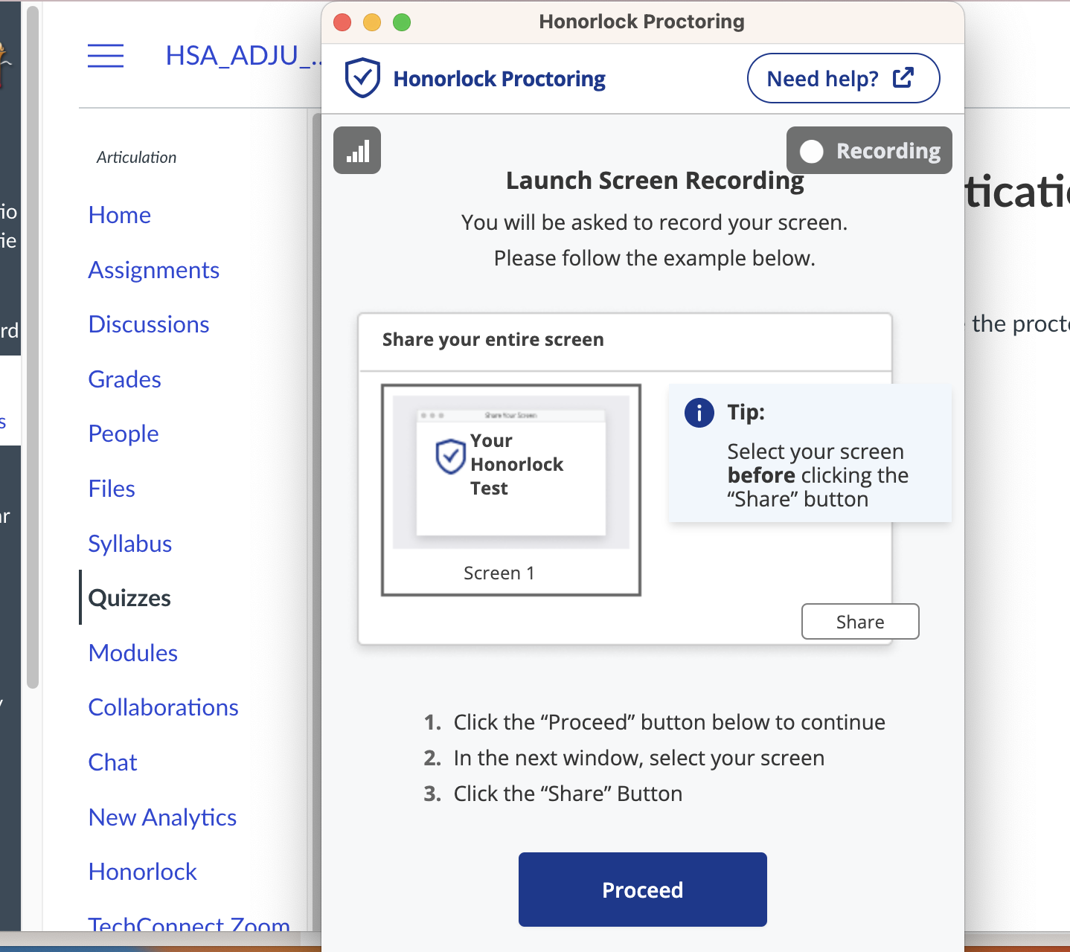
Notes:
All set!

Slide 33
Troubleshooting Honorlock
and/or Canvas
Typically when a student has difficulty accessing an exam, the cause is the Honorlock set-up.
The Articulation program NEVER requires a password to access an exam. This is an indication there is a problem with Honorlock.
Make sure your district will allow the honorlock extension.
Please use Honorlock 24/7 chat feature to request assistance. https://honorlock.com/support/
Notes:
***MW - last slide**

Slide 34
Exam Scheduling & Results

Slide 35
Articulation Process Steps
Student initiates the Student Articulation Request Form (SARF) no later than 3 weeks before the preferred exam date.
Teacher receives Etrieve email with link to student form
Teachers completes SARF
Teacher submits UNOFFICIAL transcripts to Marlene Ward
Teacher emails Marie Tyra preferred exam date and time
Marie will send confirming email with exam information and steps

Slide 36
Exam Considerations
When setting the exam date and time, please make sure students have an appropriate location to complete the exam, and adequate time.
If the articulation exam has Honorlock in place, students can take the exam at home. Honorlock serves as the proctor.
If a group of students will take the exam in a location that might cause more than one face to be captured on a student’s camera, please notify Marlene two weeks in advance of the exam. Modifications might be possible.

Slide 37
Exam Results
Faculty MAY set the exam to show students the final score at the end of the exam.
Some exams may allow students to review the exam to see what was missed.
Exam scores may be shared with the teacher associated with the agreement. Contact Marie for scores.
Grades are assigned in a separate system and are not shared with teachers.

Slide 38
Questions?

Slide 39
Thank you

