Slide 1

Mt. SAC Application
Notes:
Welcome & thank for participating
Introduce Team
Not being recorded

Slide 2
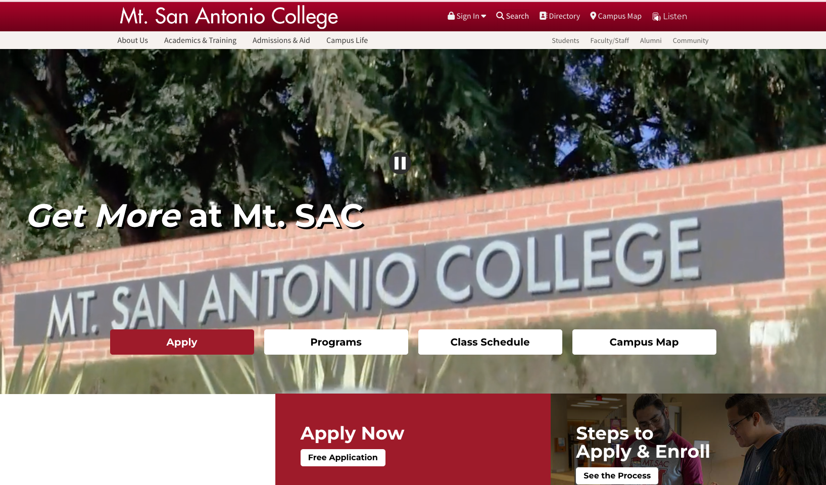


www.mtsac.edu
Notes:
step by step process on how to complete a Mt. SAC application
This video will provide you with the step by step process on how to complete a Mt. SAC application. If you are participating in the HS articulation program and it’s your first time applying, The application is your first step.
You can start your application by visiting www.mtsac.edu.

Slide 3
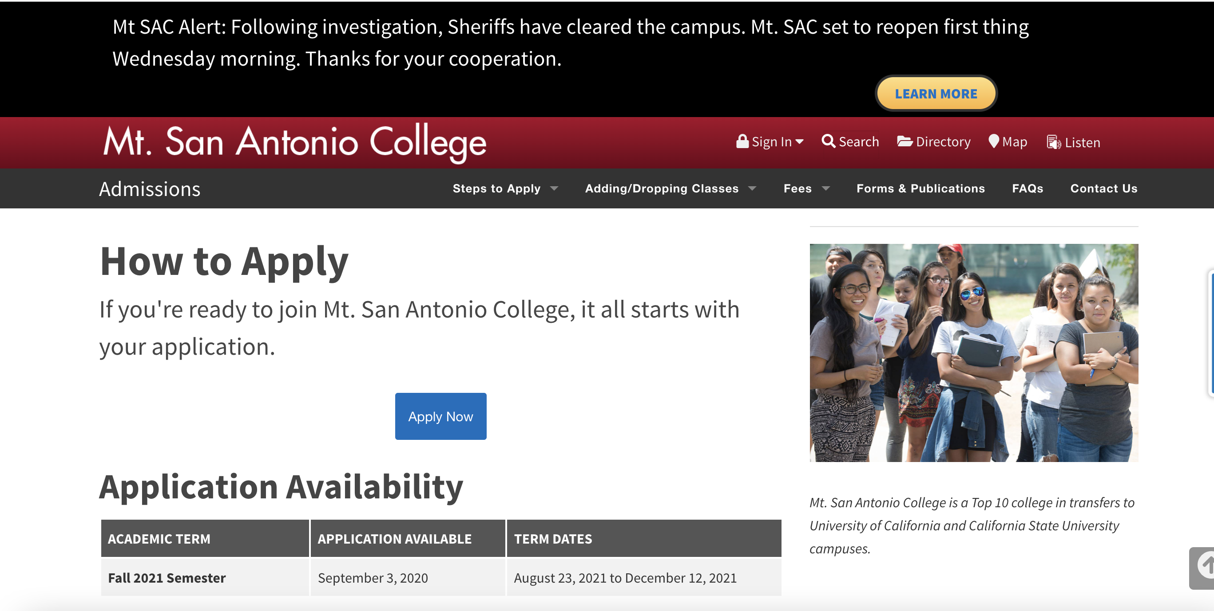


Slide 4


Slide 5
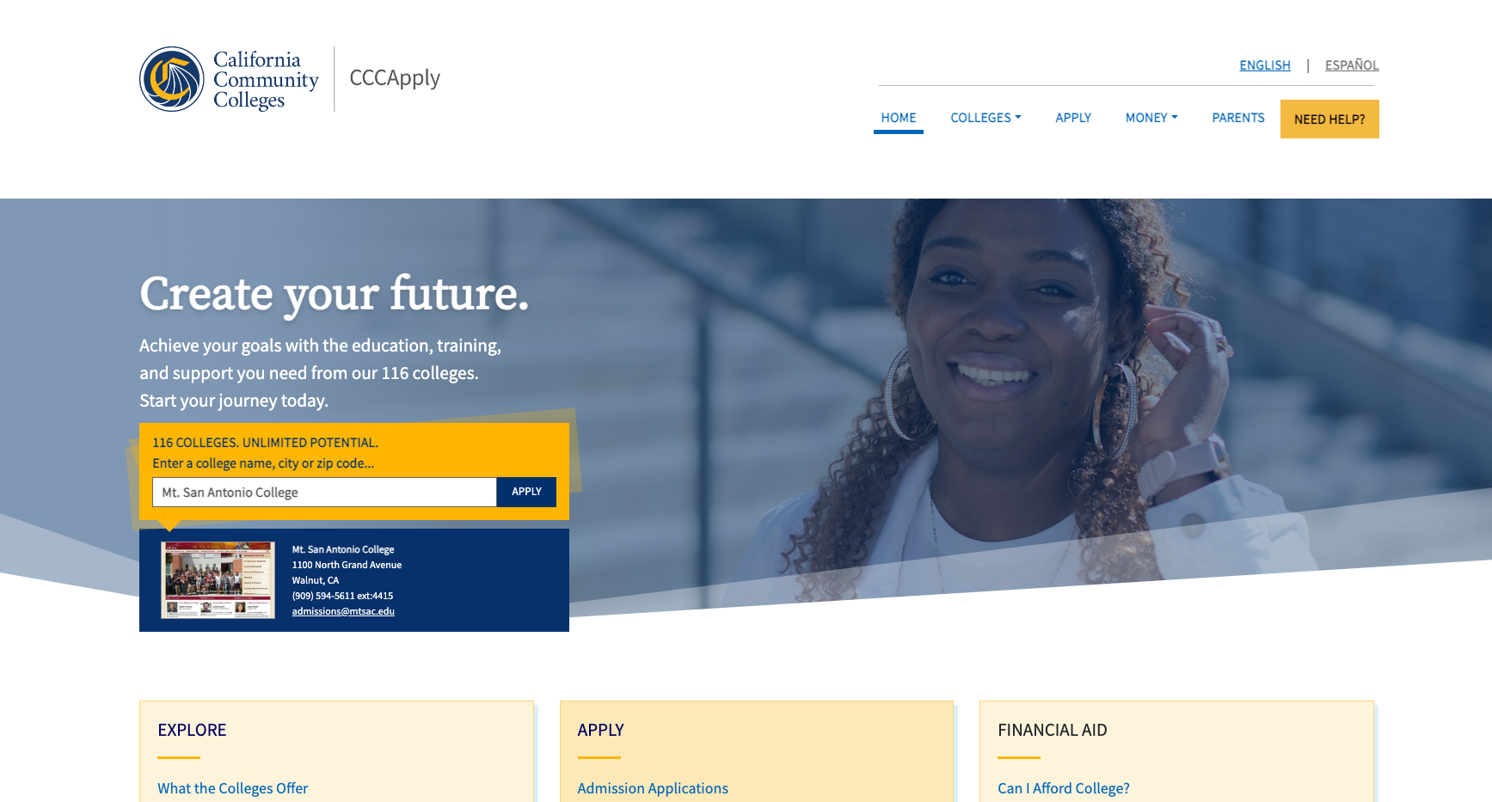

Slide 6
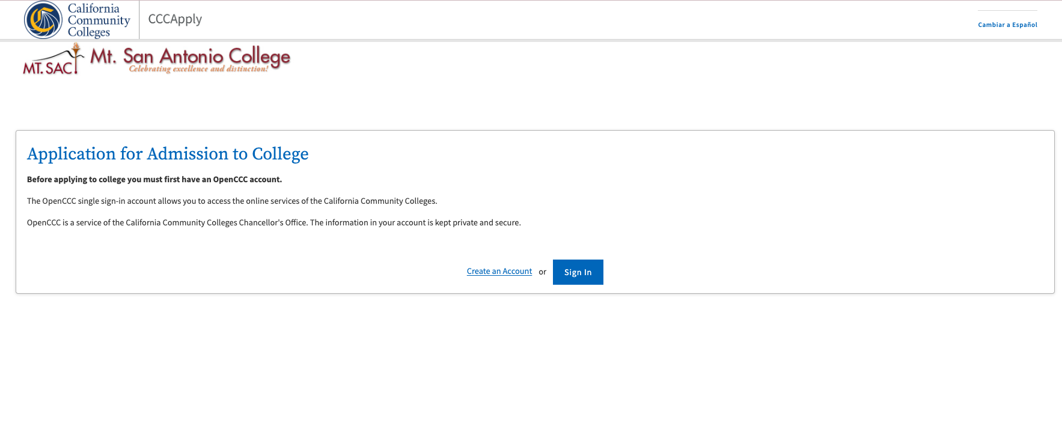

Slide 7
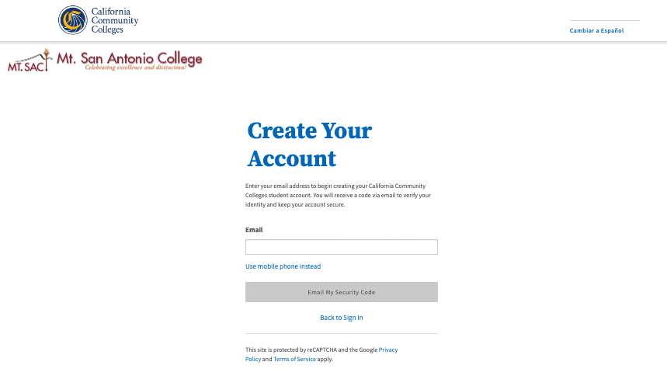
Option #1: Email
Notes:
First you will need to provide a personal email address that you check often, such as as (gmail, yahoo…etc) email.
Please Do Not use an assigned school district email.

Slide 8
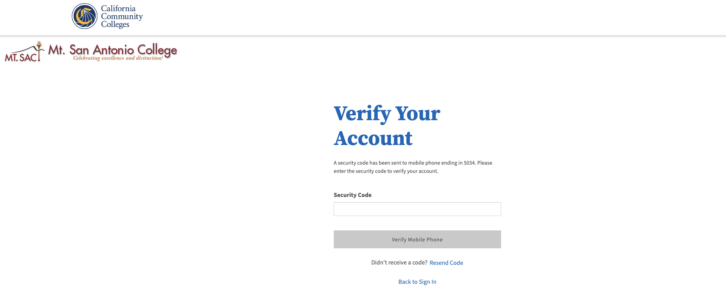
Option #2: Mobile Phone
Notes:
Both options will make send you a verification code to input.

Slide 9
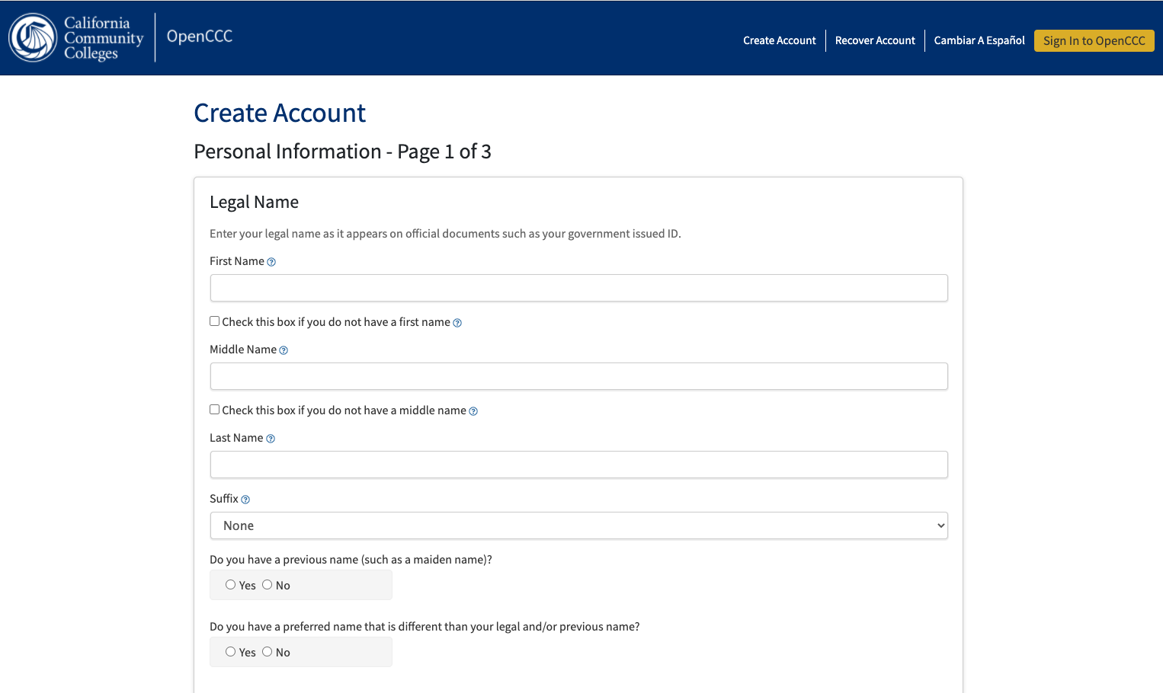

Slide 10
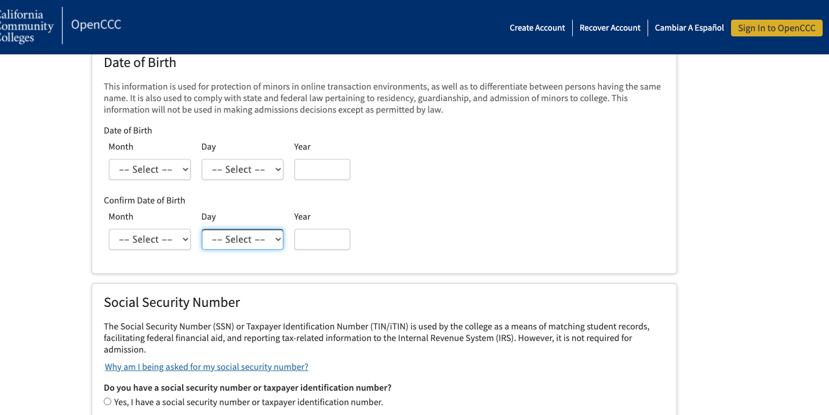
Notes:
DOB: error (Do not use current year) Use BIRTH YEAR
Social Security Number

Slide 11
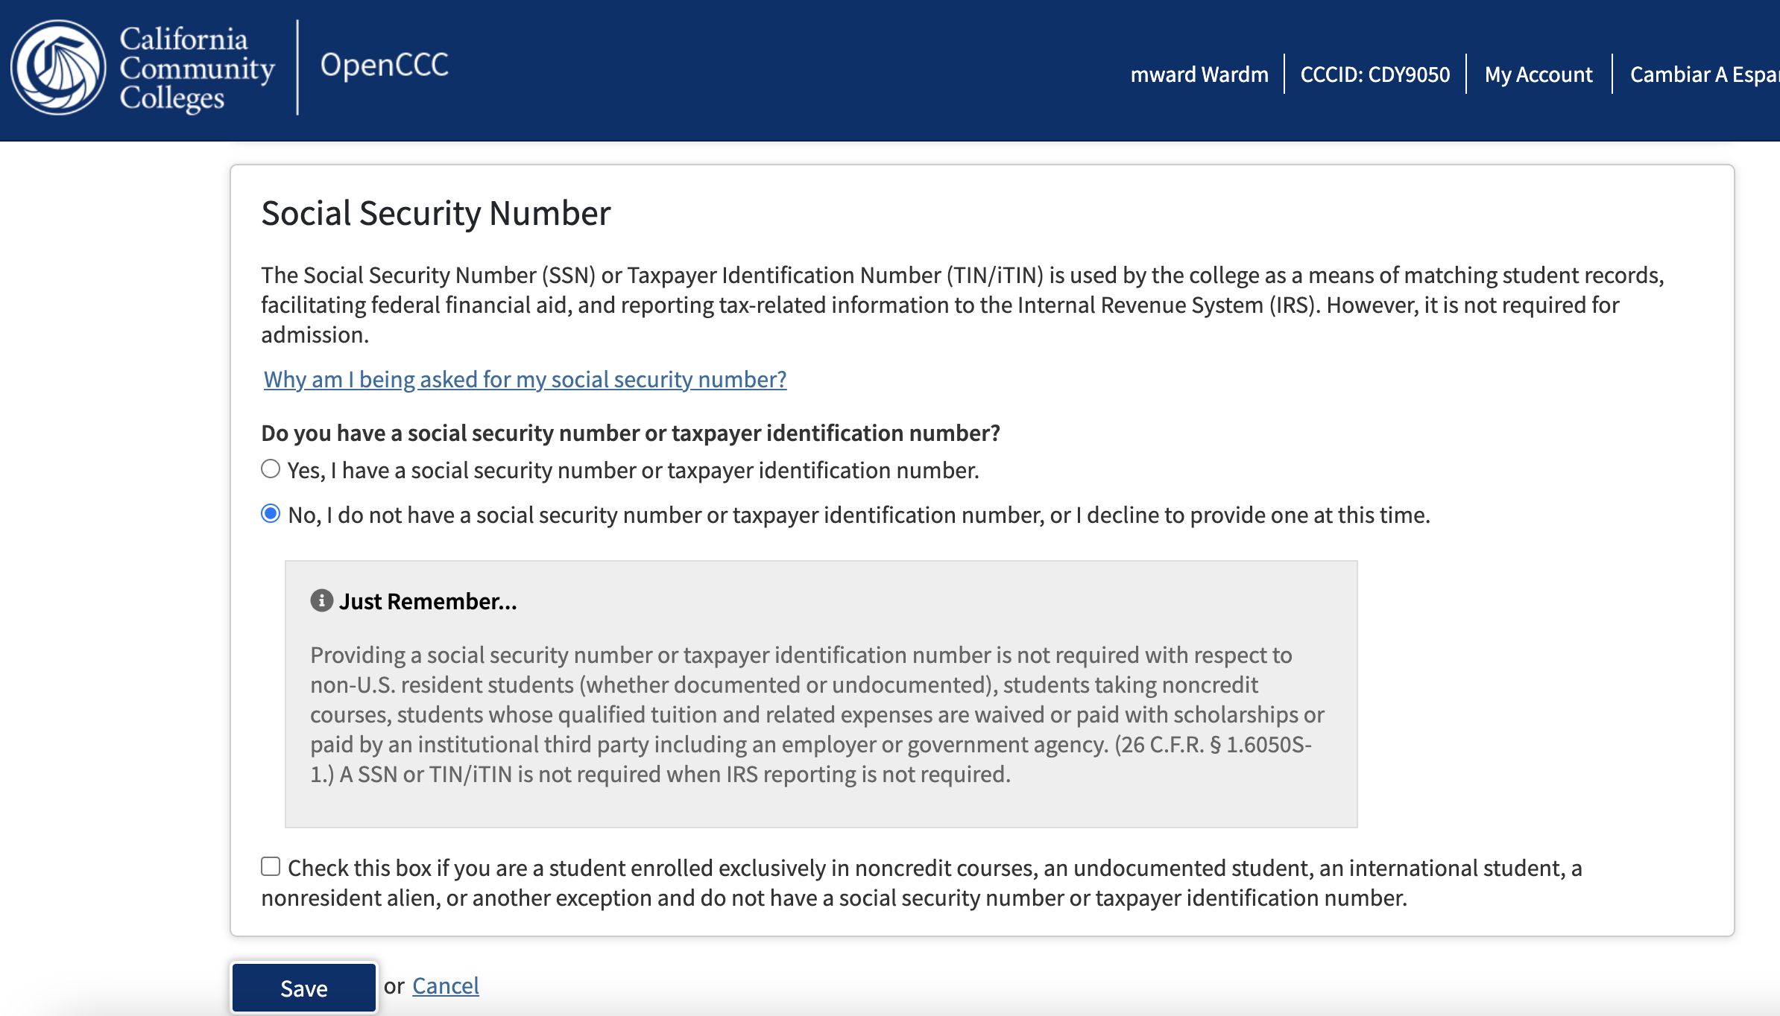

Notes:
If you do not have a social or can not provide one at this time… It’s ok. You can still complete the application.
Do NOT check box
Students will get an email informing them tax documents won’t be issued unless they bring their social security card to Admissions and Records.

Slide 12
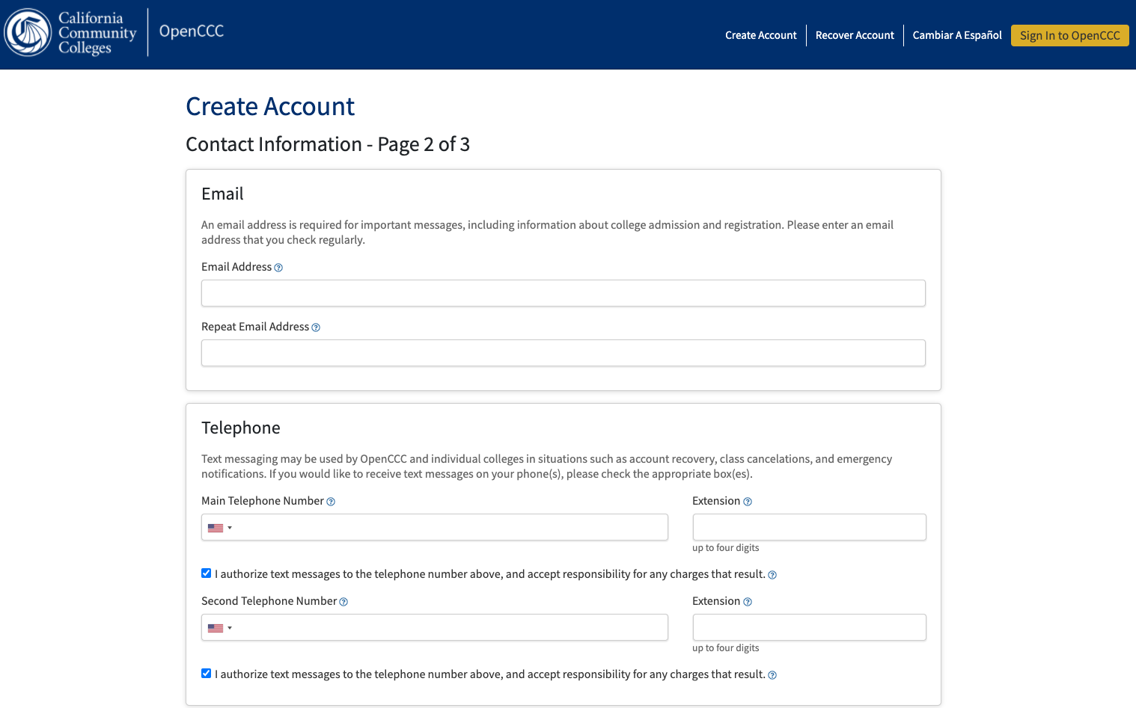
Notes:
Again, please make sure it’s a personal email address and NOT a school email address.
Please check for Errors/typos

Slide 13
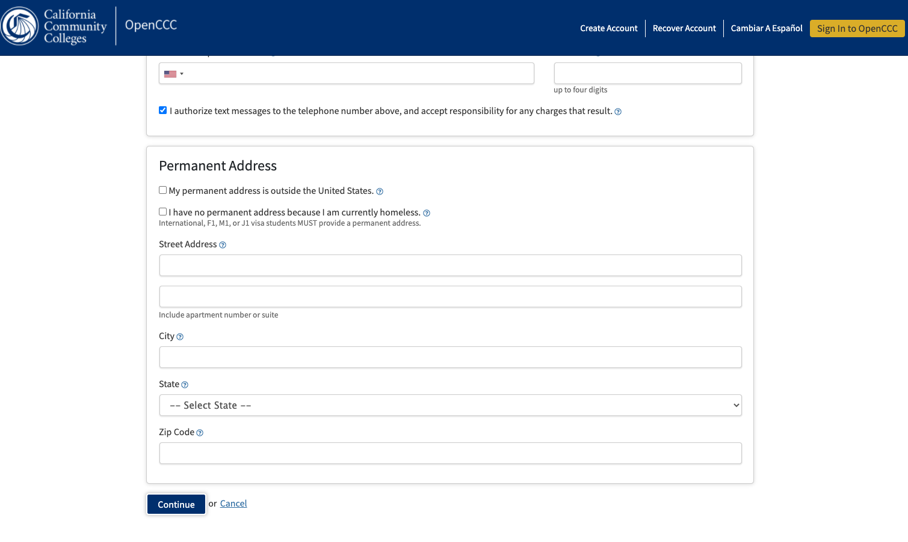

Slide 14
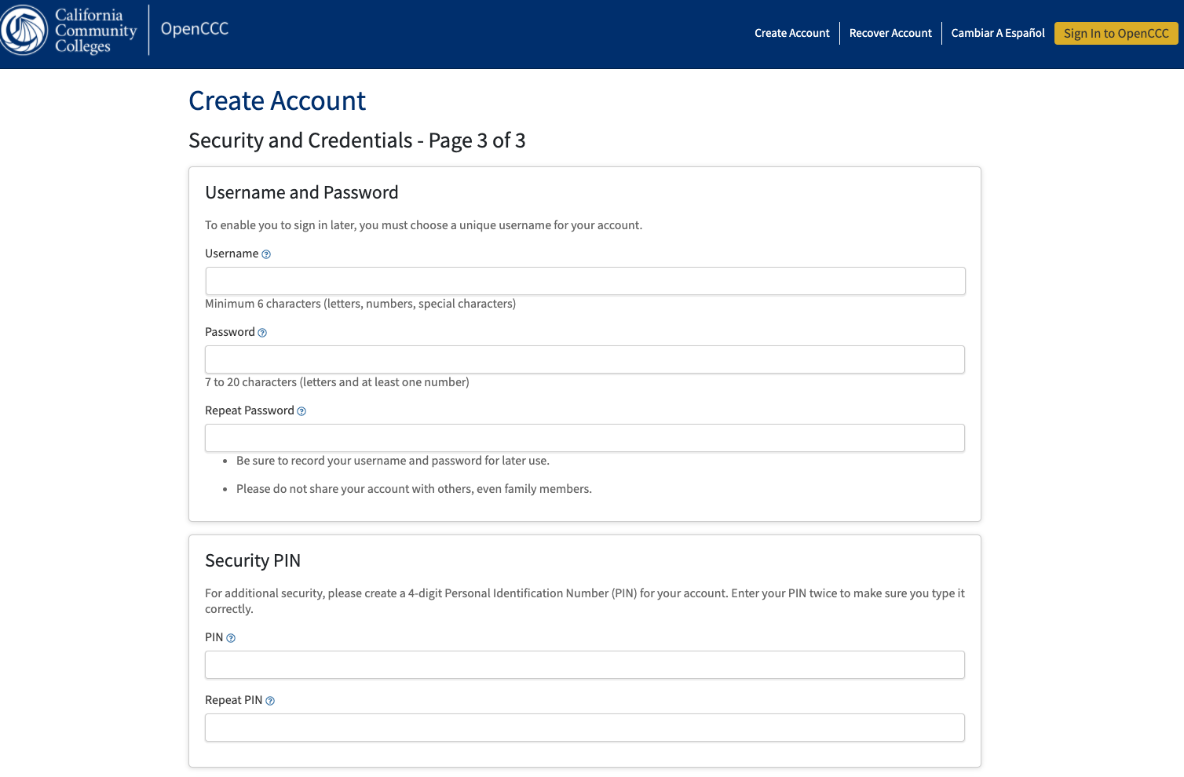

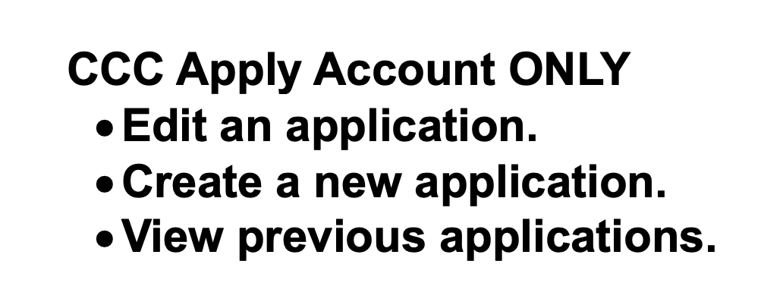
Notes:
CCC Apply ONLY : User Name/Password
User name/password will be used to access your OpenCCC account to create new applications and make edits to existing application.
At this point you can write down your user name, password and PIN so you do not forget your log in information. Make sure students write this information down or take a screen shot.

Slide 15
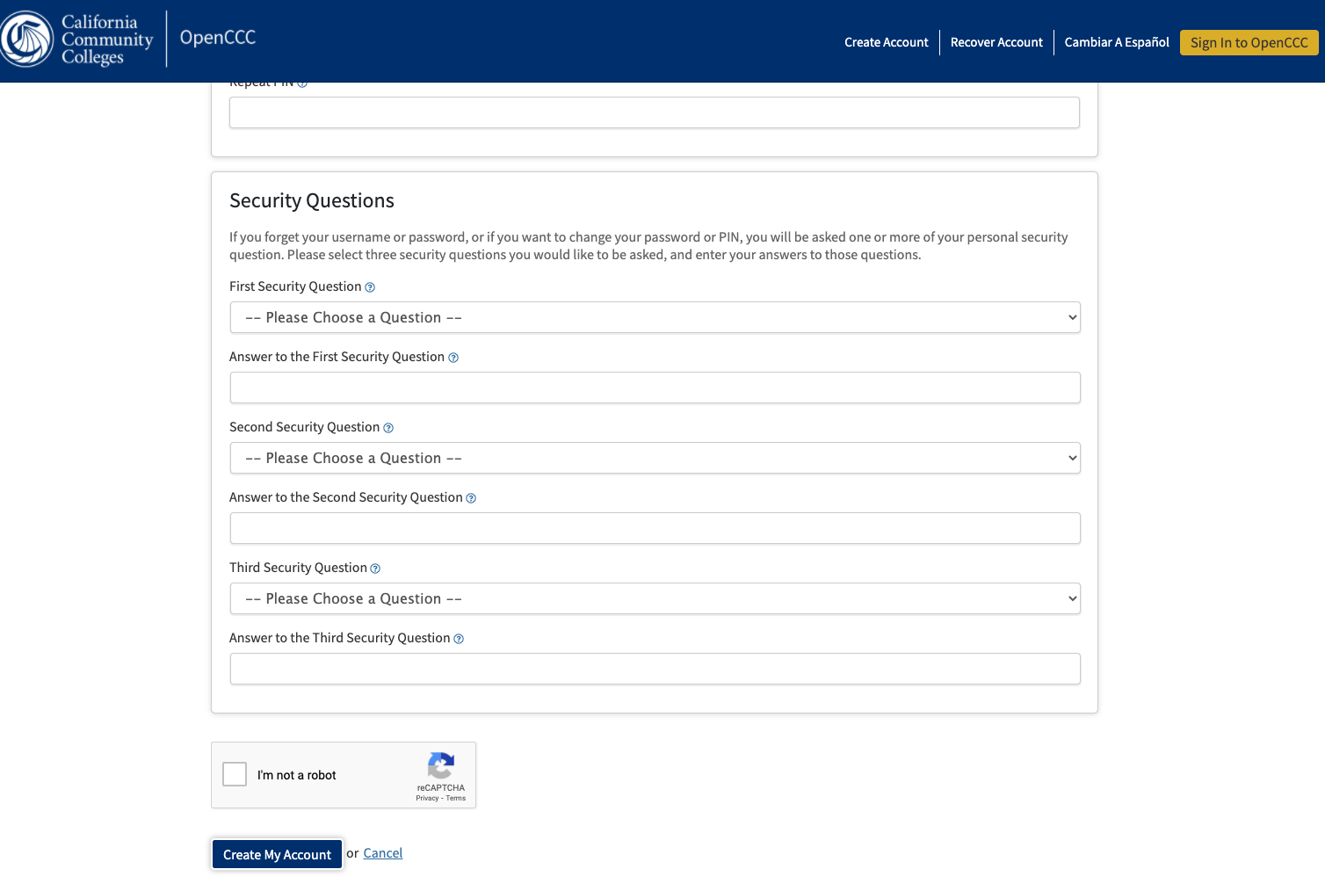

Notes:
Must answer all (3) security questions to move forward.

Slide 16
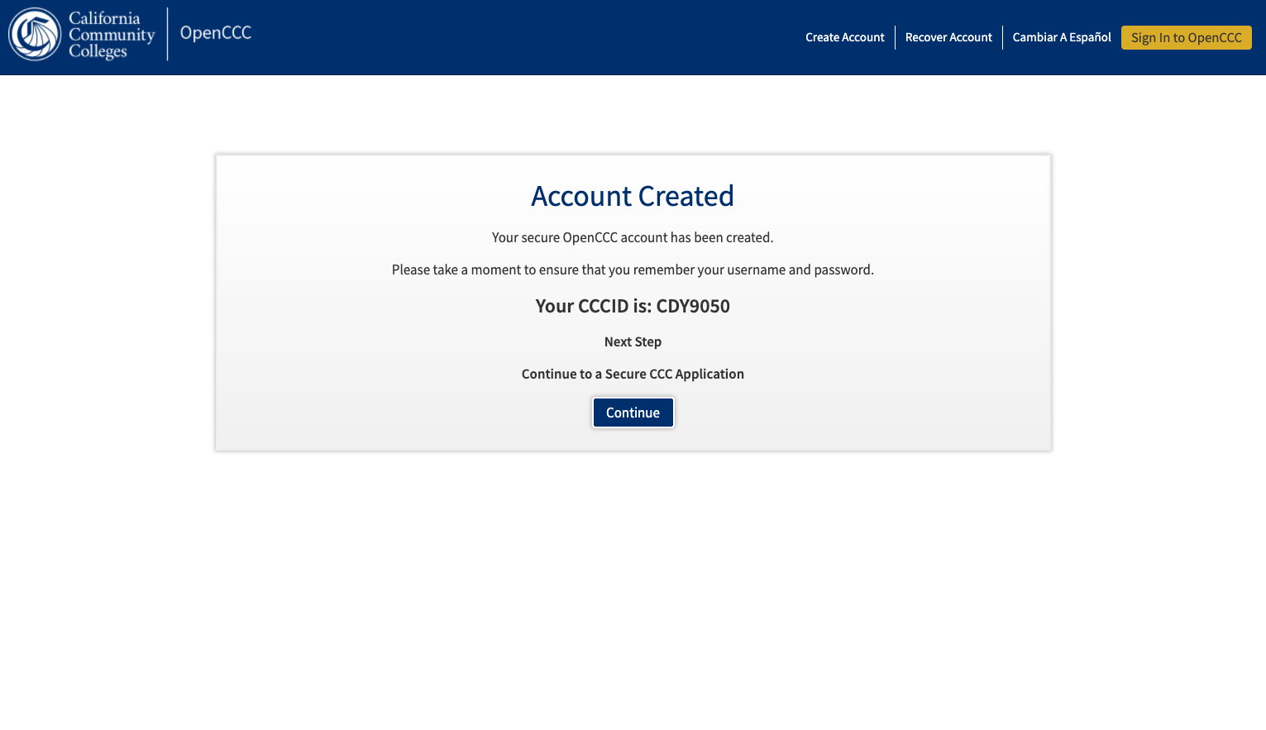

Click on CONTINUE
Notes:
OpenCCC Account: Not the mtsac “my portal”
*CCC account was created but NOT an application.

Slide 17
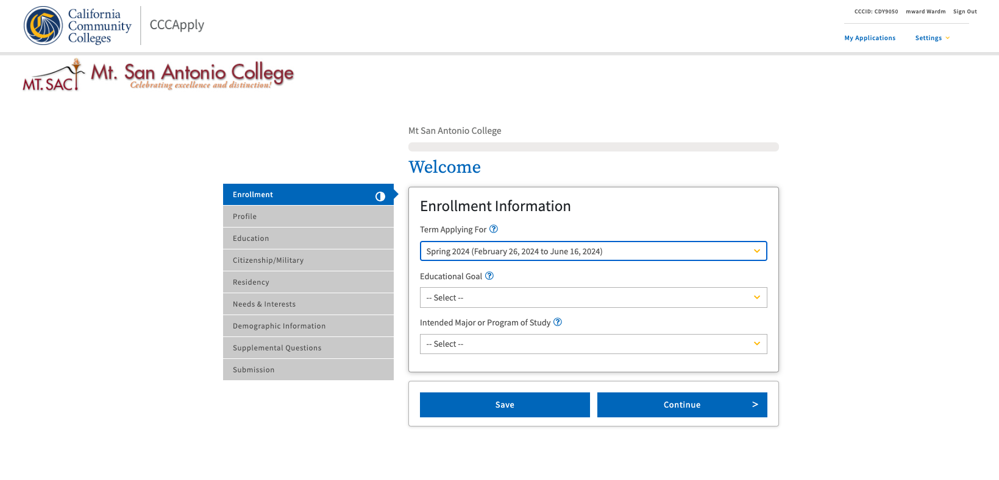
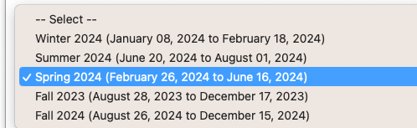
Notes:
Very Important: SPRING 2023
Do not leave empty.

Slide 18
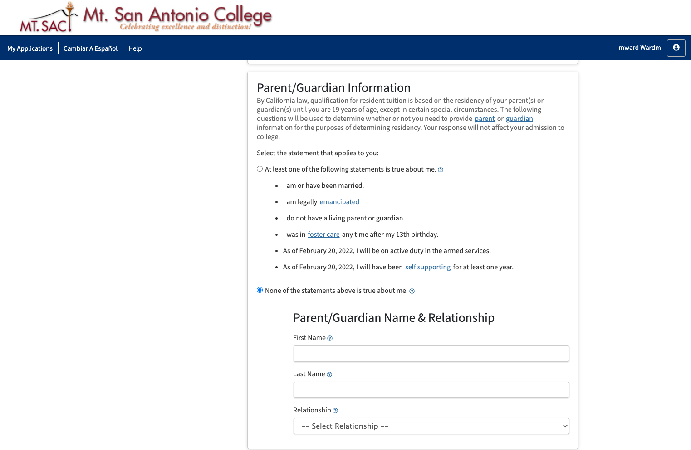
Notes:
Please check any boxes that may apply to you

Slide 19
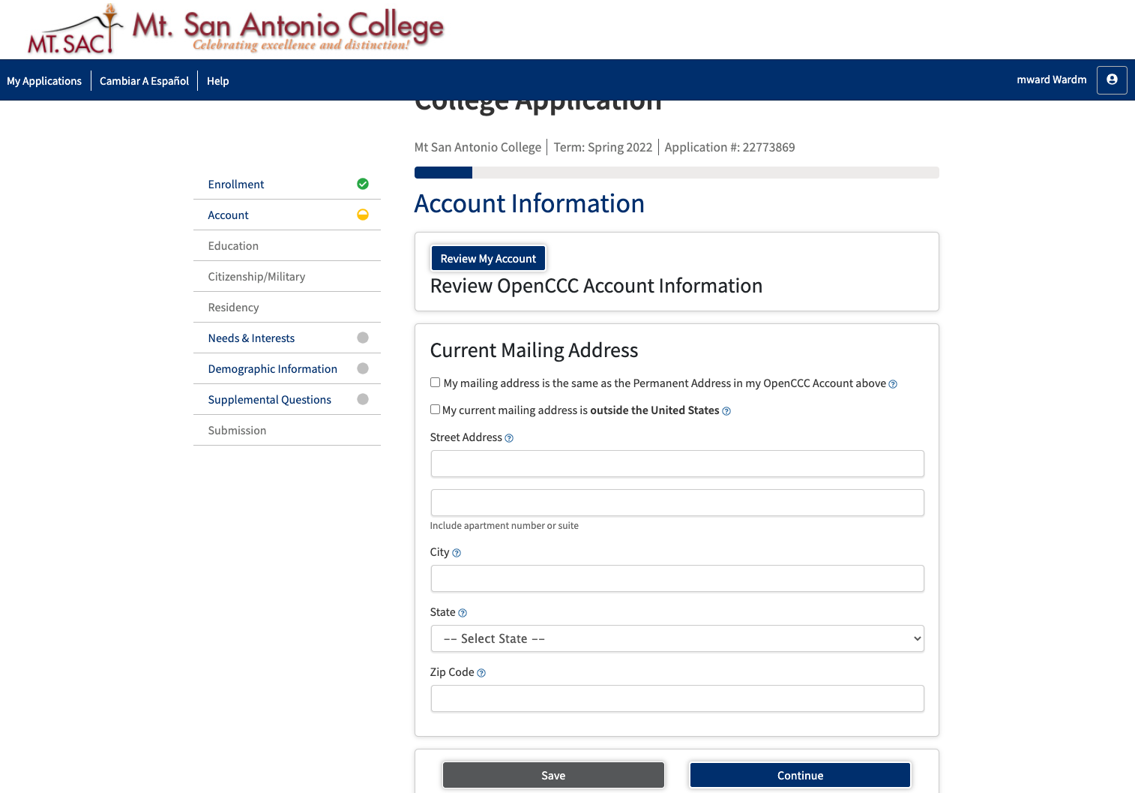

Notes:
If your mailing address is the same as the address you used earlier when creating your ccc apply account,
CLICK box- populate

Slide 20
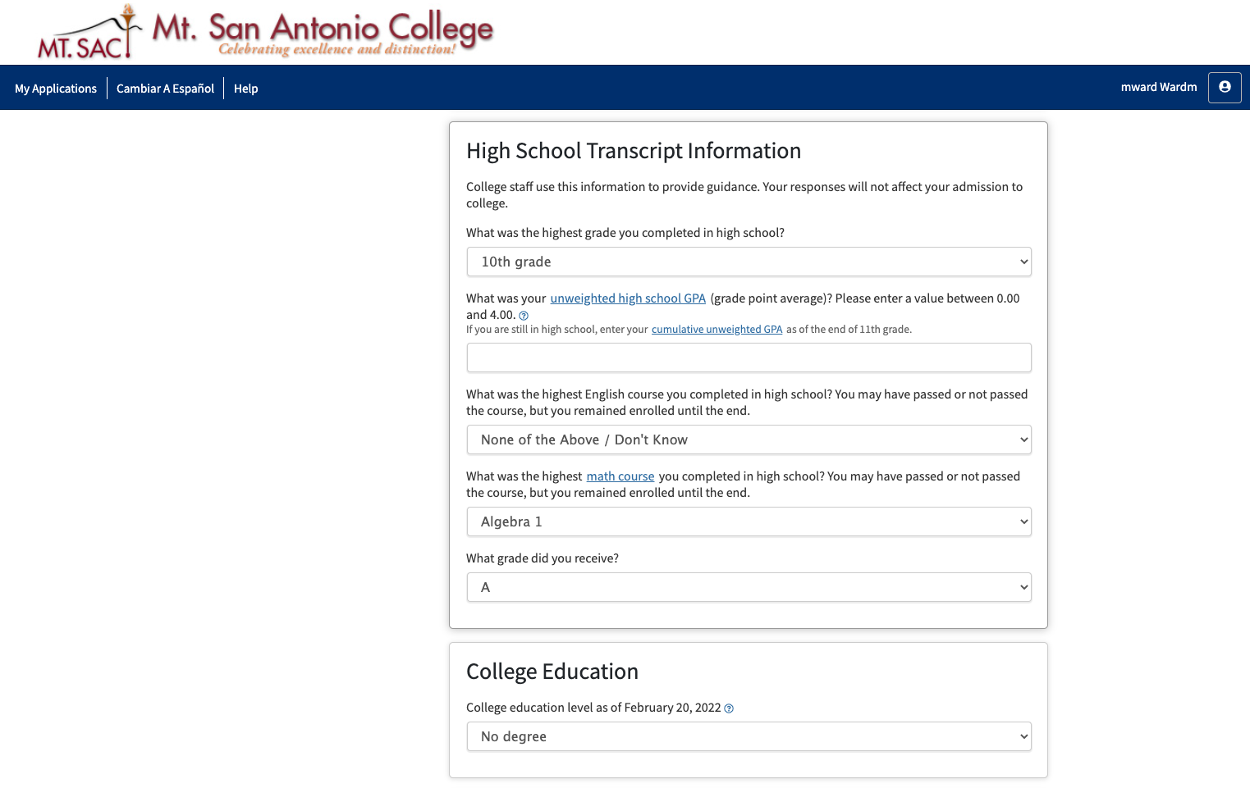
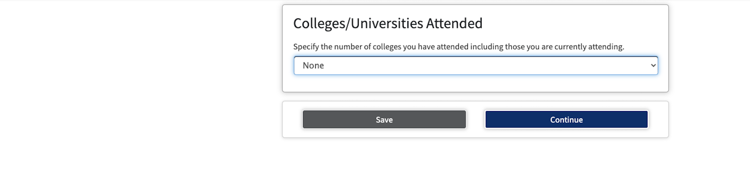

Notes:
Does not affect the application or the admissions process. These are standard questions for the application.

Slide 21
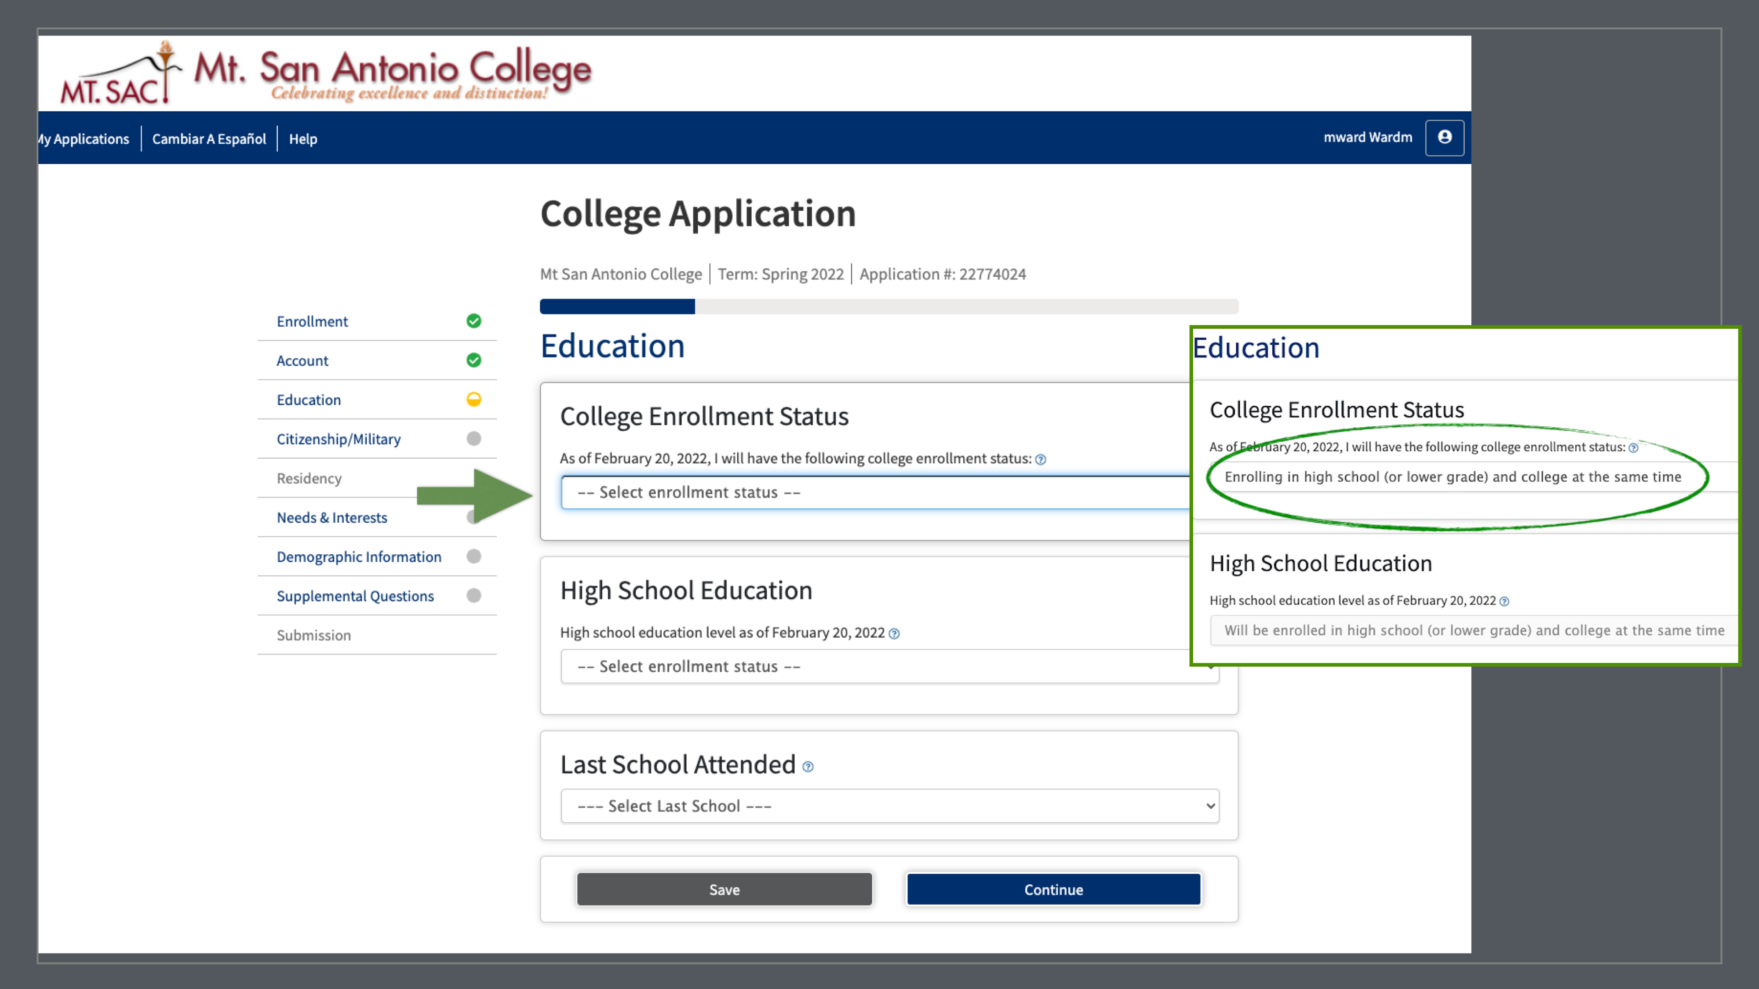
Enrolling in high school (or lower grade) and college at the same time
Notes:
If you do NOT see this option, it’s
ENROLLING IN HIGH SCHOOL(OR LOWER GRADE) AND COLLEGE AT T

Slide 22
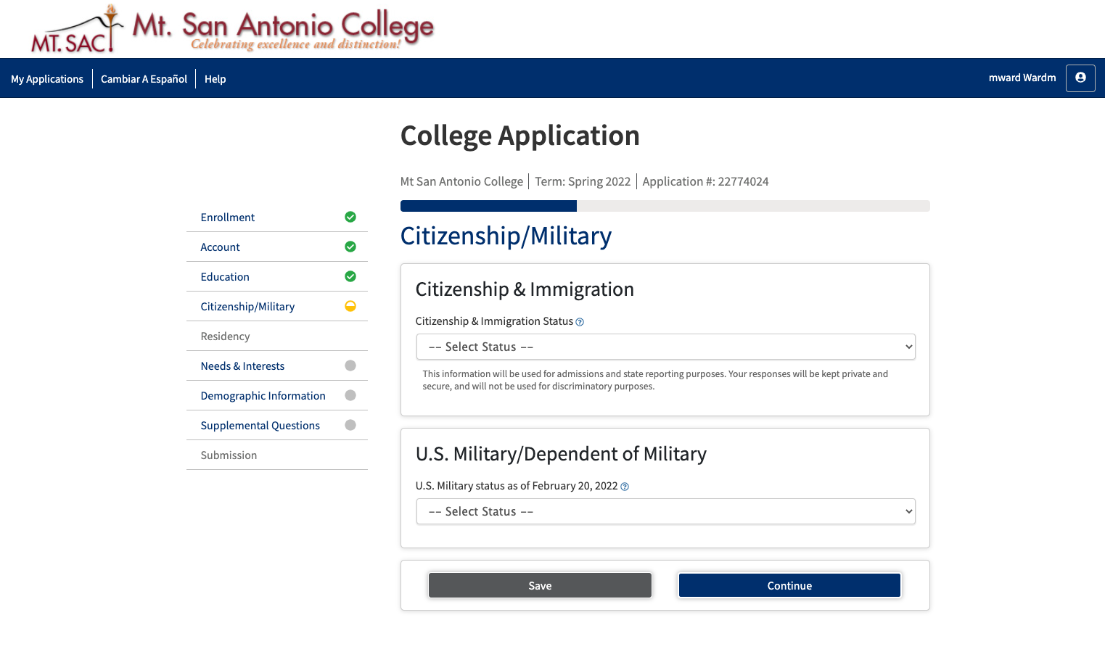

Slide 23
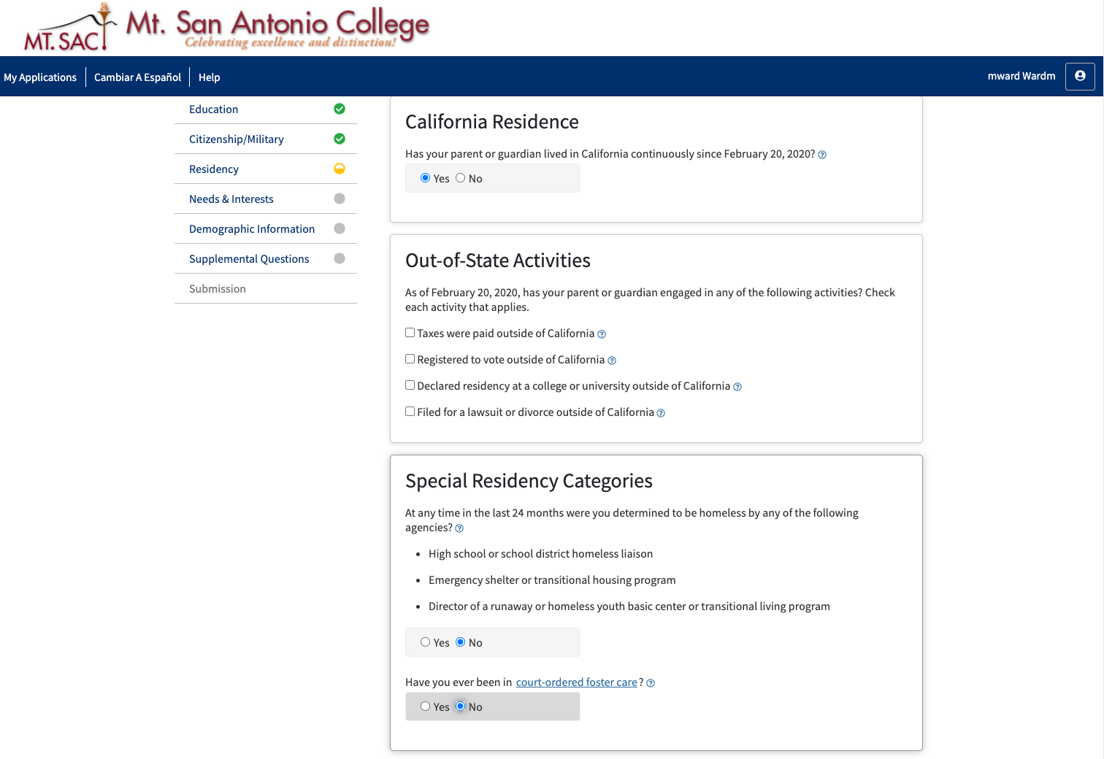
Notes:
Please note students must have been a resident in the state of California for at least 1 year to participate.
MT - International students are not eligible to participate. Sometimes undocumented students will identify themselves as international students. This will keep them from participating.

Slide 24
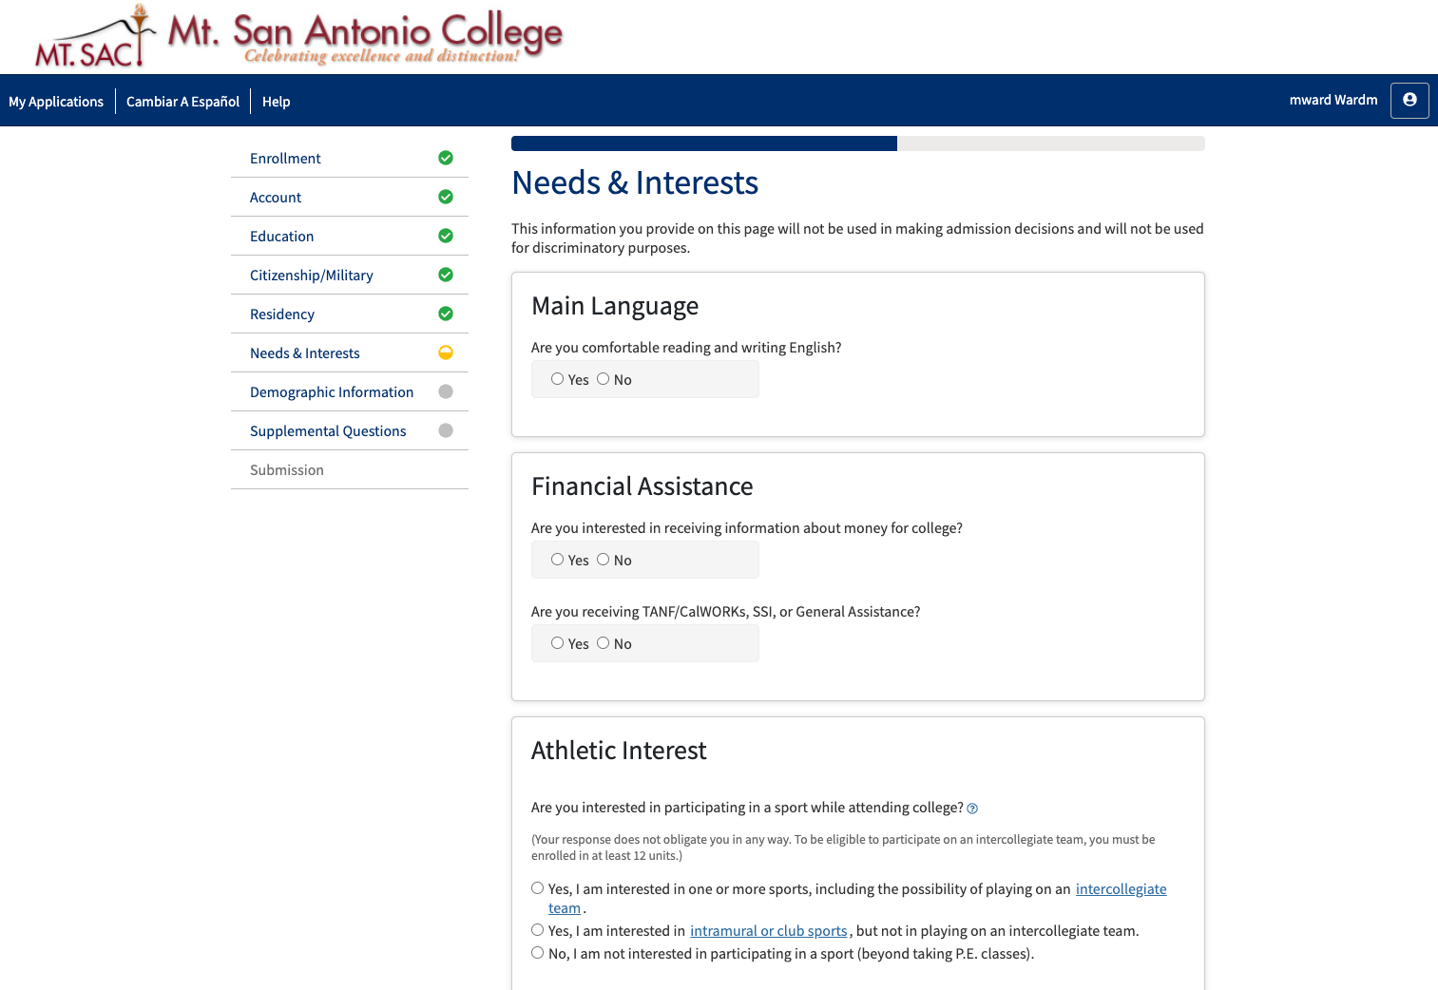

Slide 25
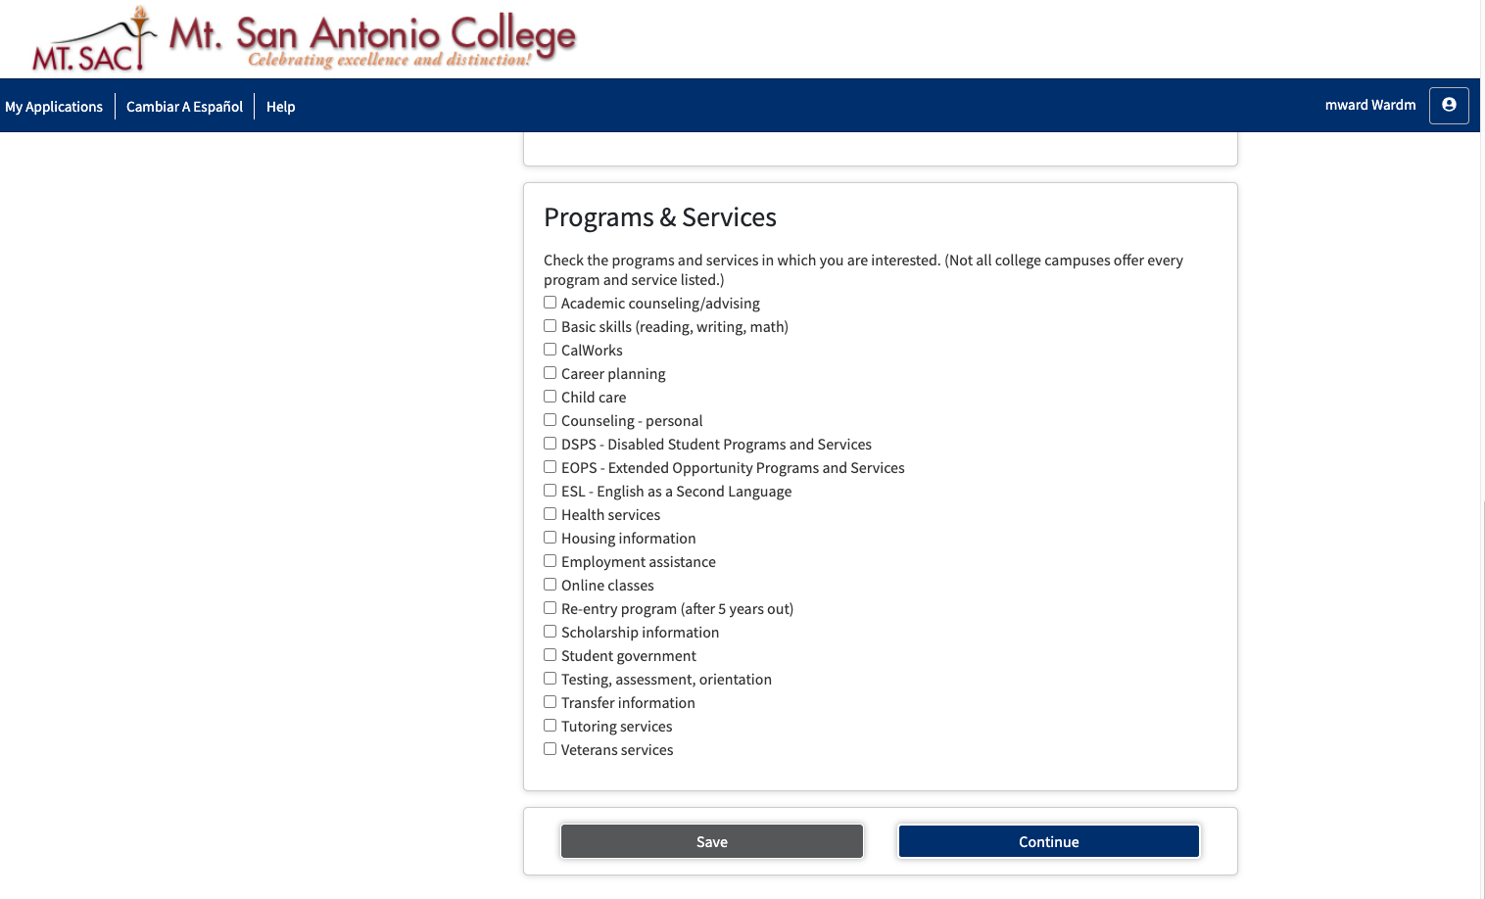
Notes:
Choose all that apply or leave blank.

Slide 26
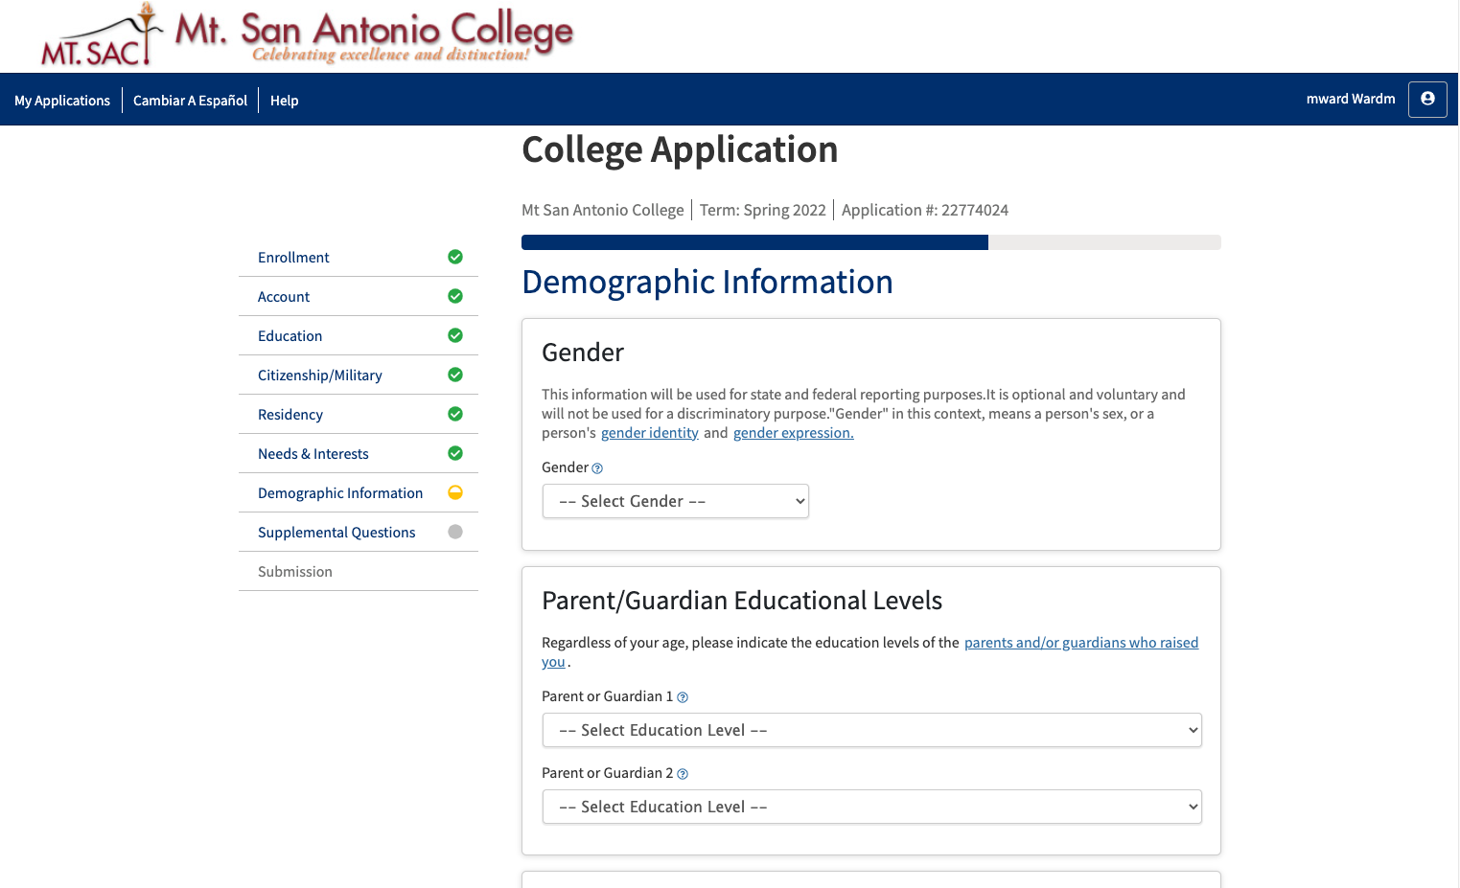

Slide 27
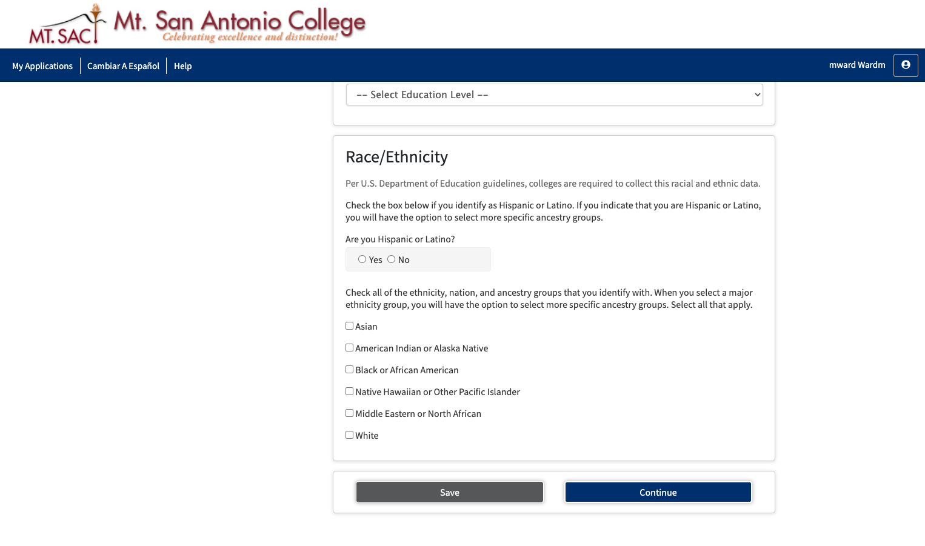

Slide 28
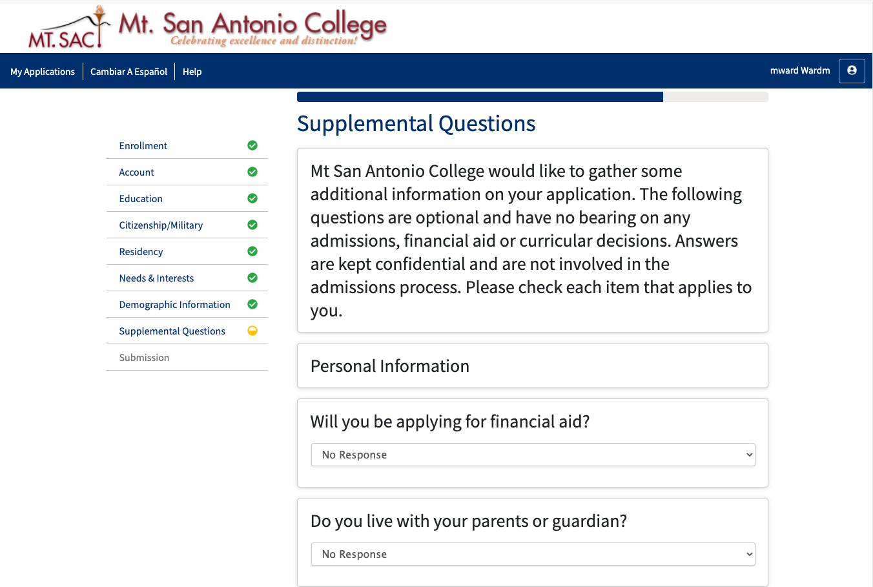
Notes:
Yes or No questions w/non applicable choice
Answer all questions to move forward. Do NOT leave any blank.

Slide 29
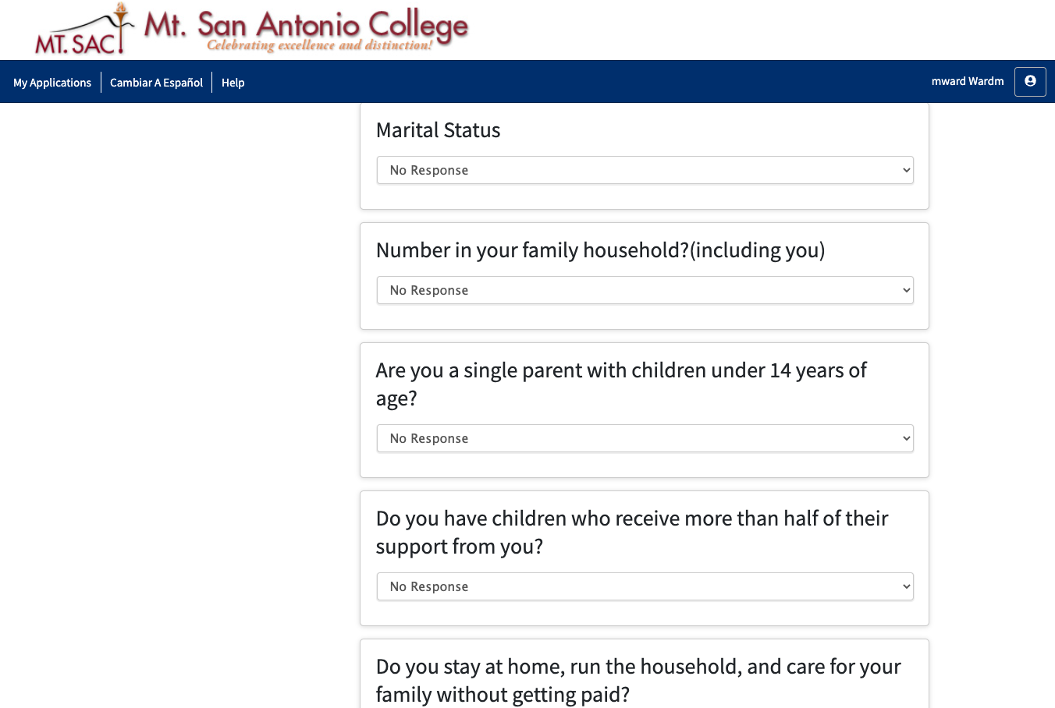

Slide 30
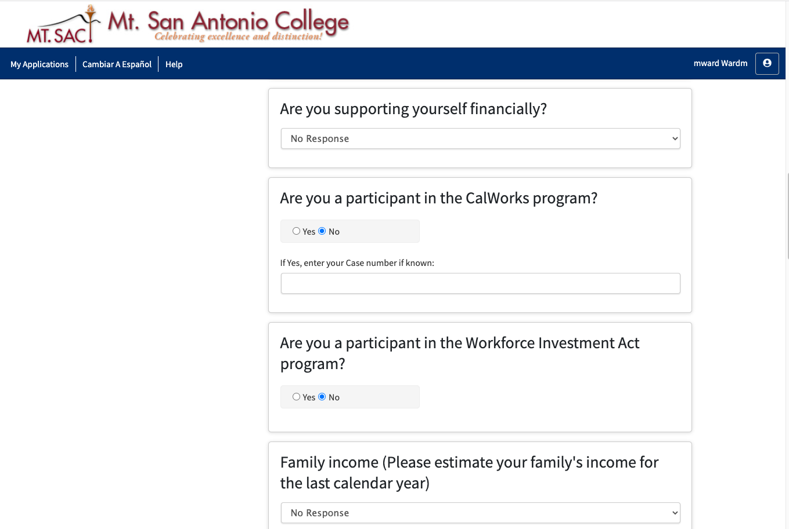
Notes:
Yes or no up to students

Slide 31
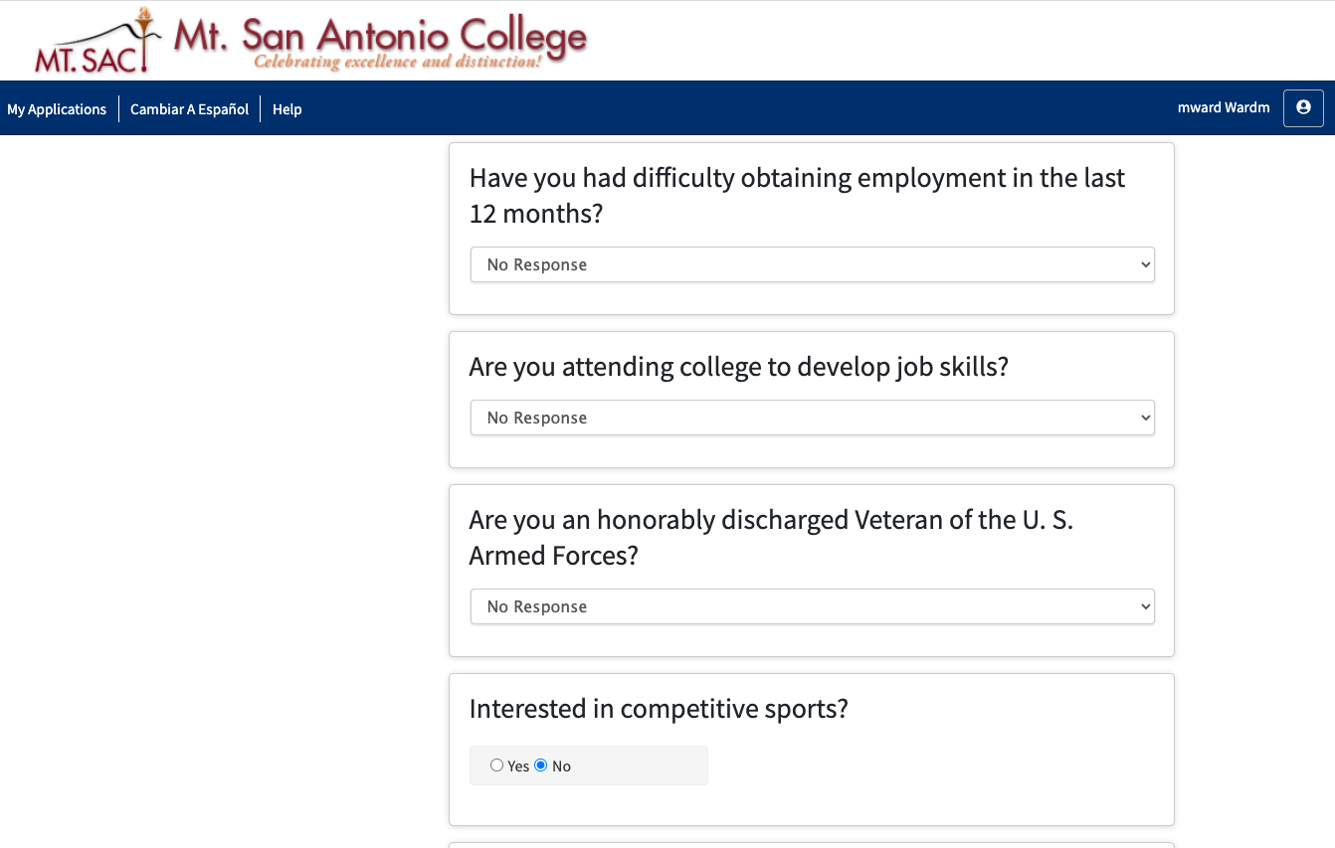

Slide 32
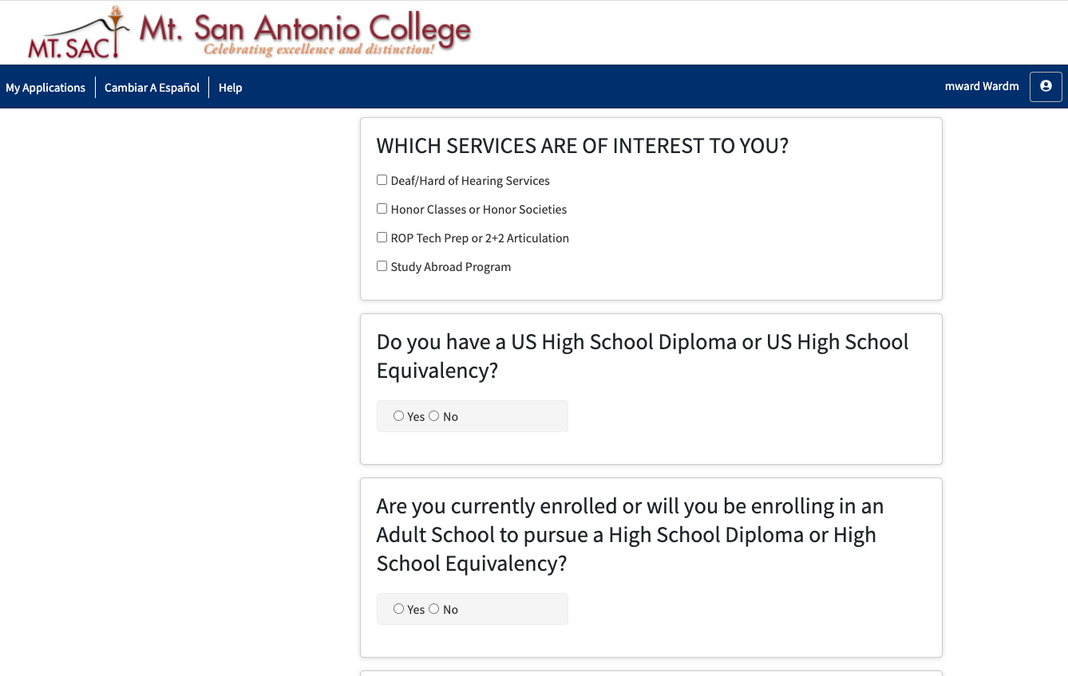
Notes:
MT - Start here and answer the remaining questions.
You can click on 2+2 articulation, but it’s not a must.

Slide 33
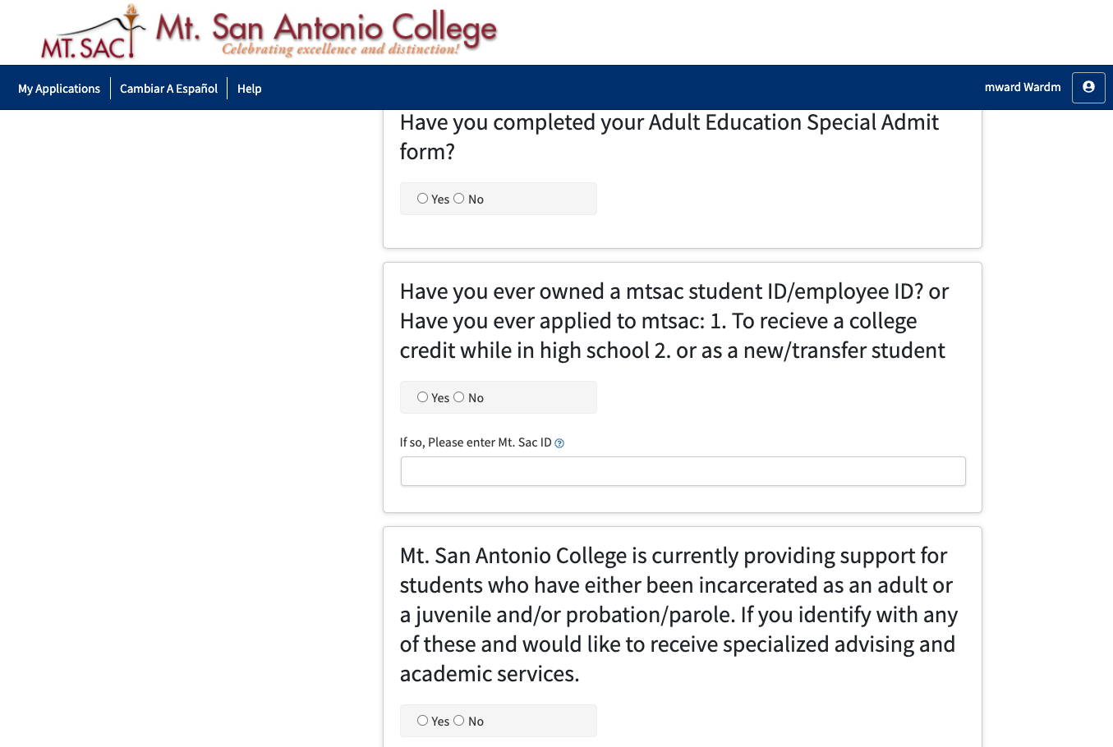
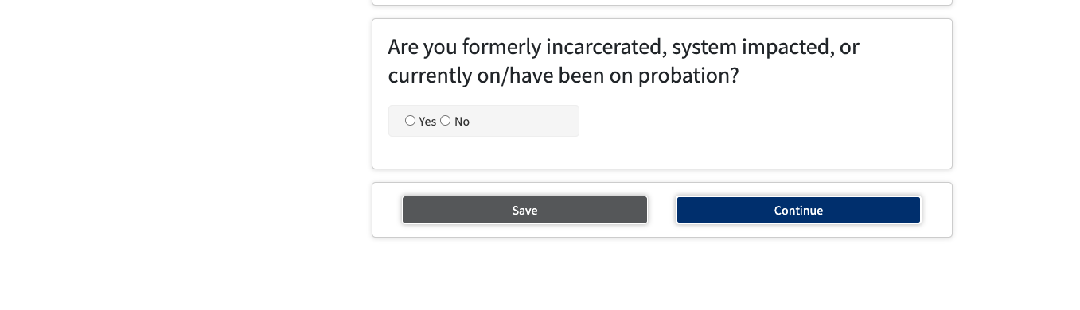

Slide 34
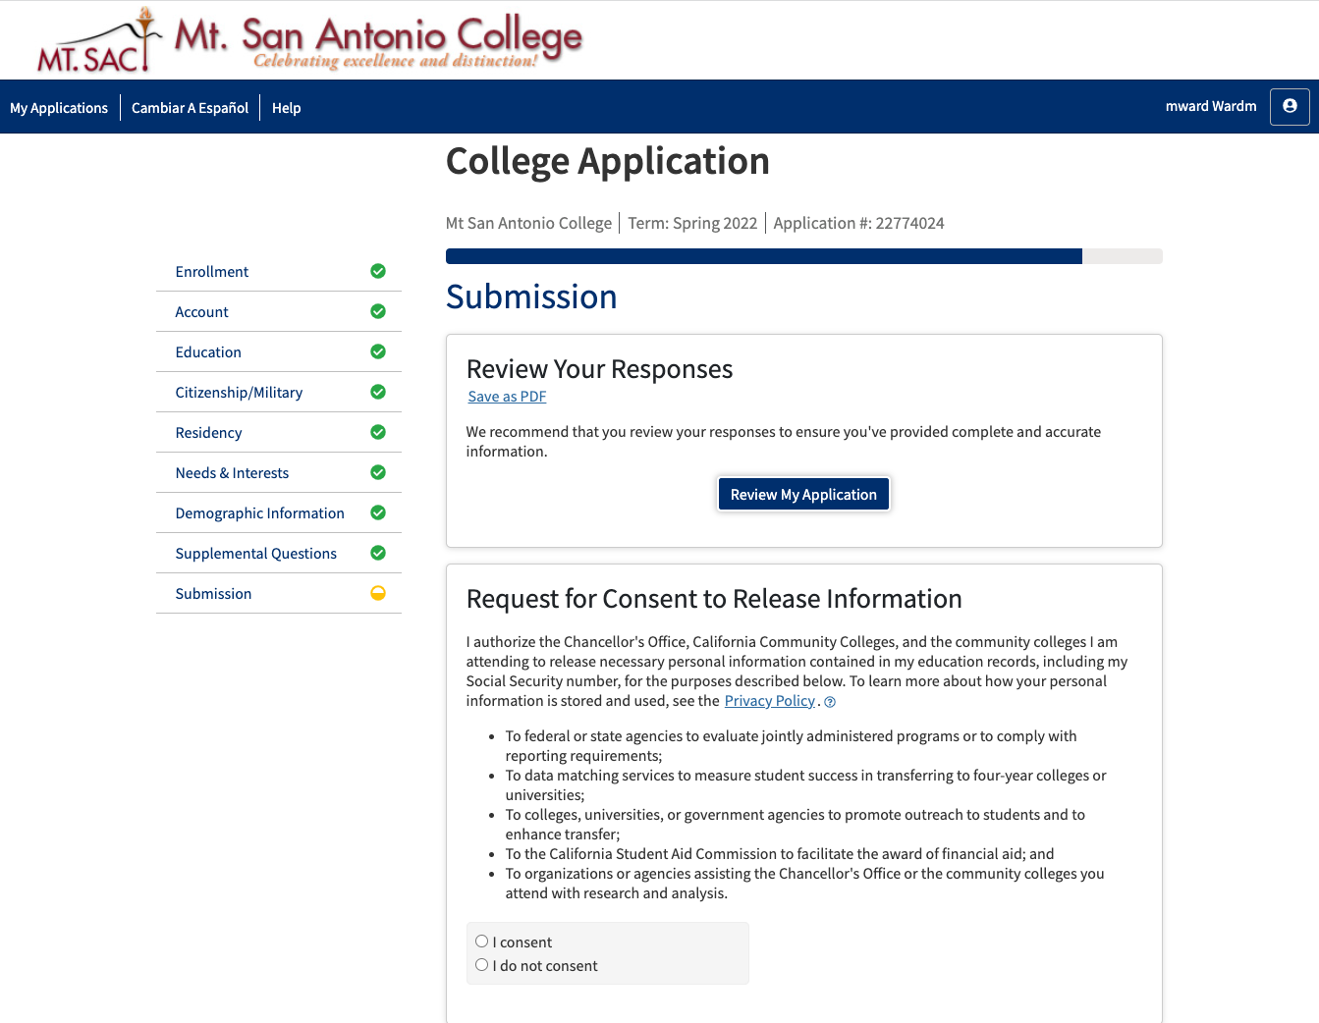
Notes:
SAVE as a PDF just in case you can’t remember what you wrote or submitted.

Slide 35
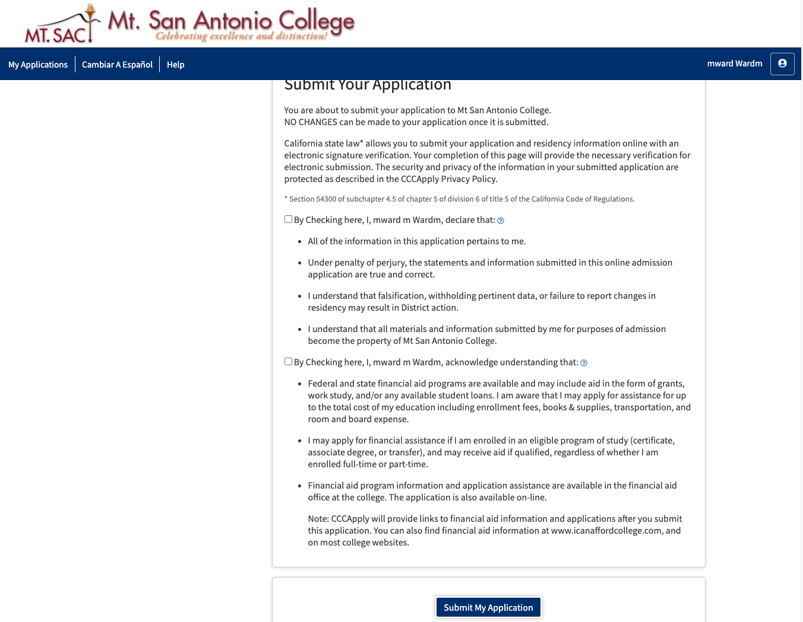
Notes:
Check -ackknowledging that all the information you provided is correct
Check that you acknowledge that financial aid programs are available
Submit my application

Slide 36
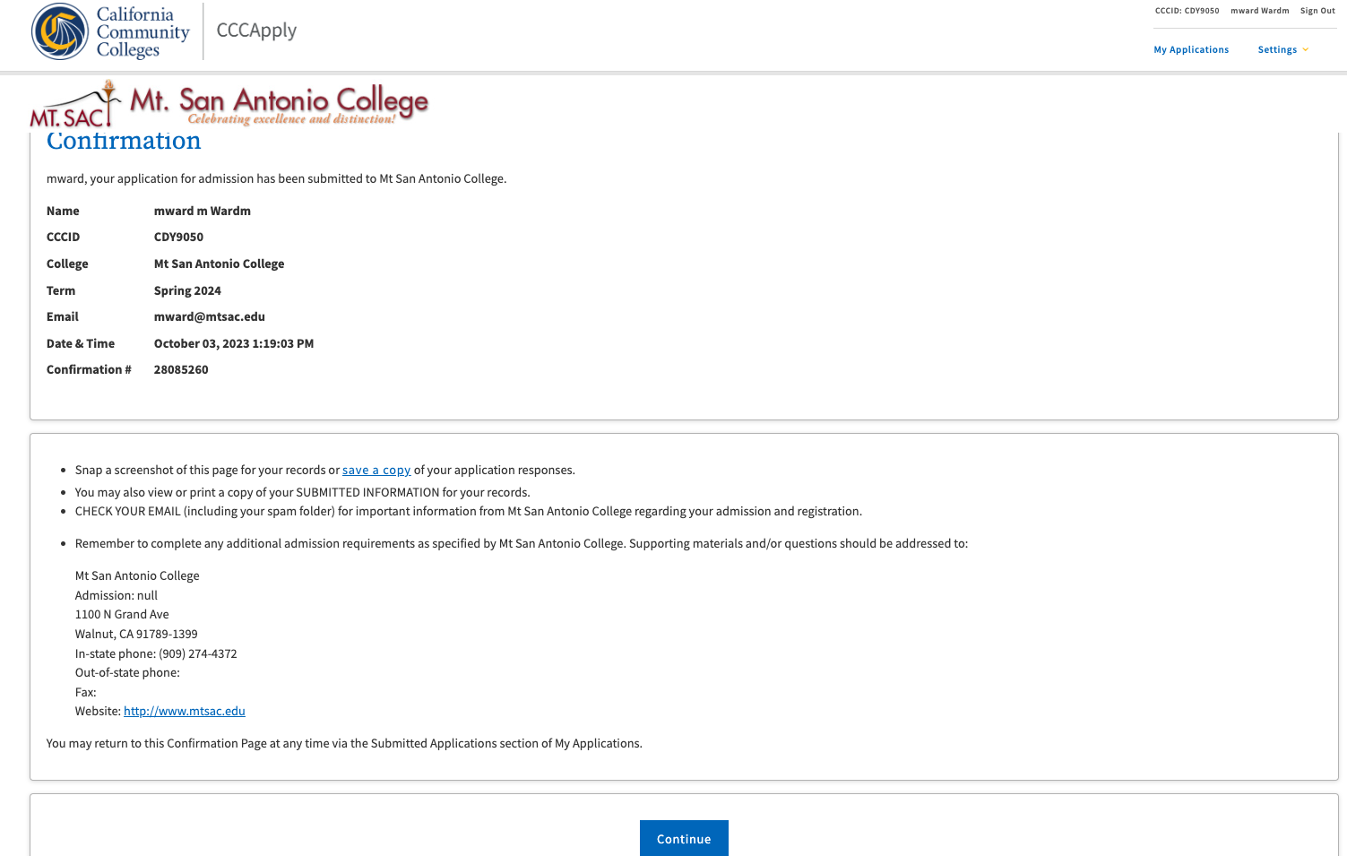
Confirmation page - PRINT
Notes:
Confirmation Page:
PRINT OUT / MAKE A COPY
** (Do not lose)
NO printer - screen shot
Confirmation Page
CHECK TERM

Slide 37
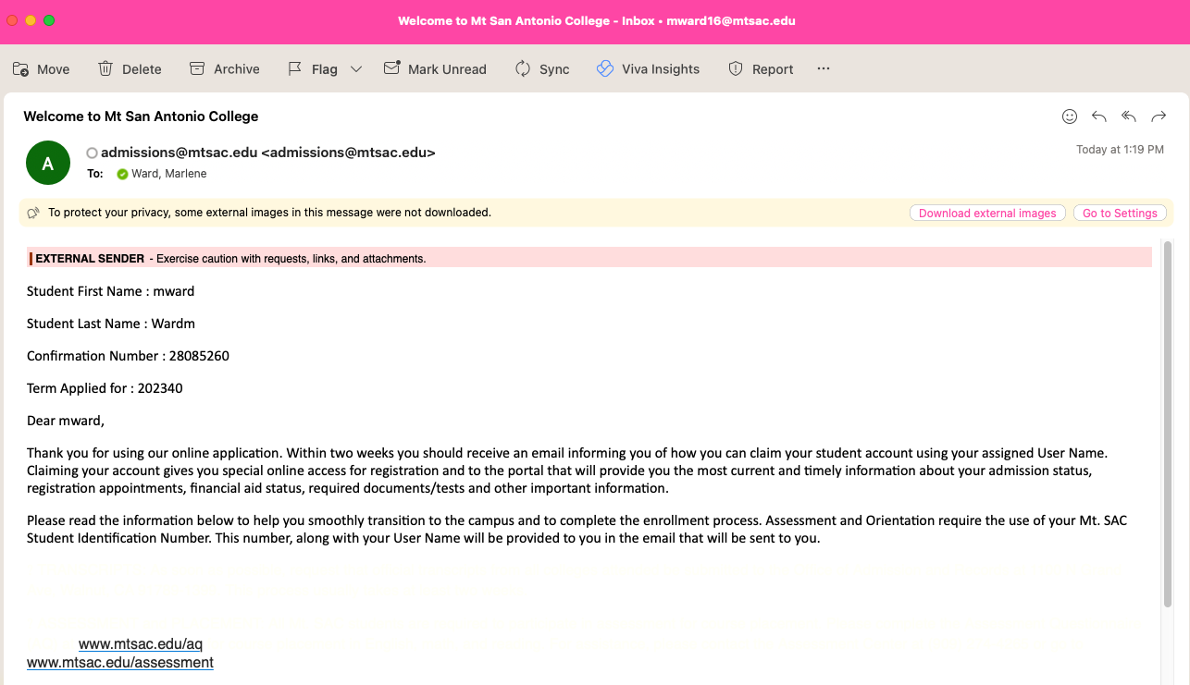
EMAIL: Confirmation of Application- print
Notes:
Instant confirmation sent to you by Admissions and records confirming your application has been complete.
If student doesn’t receive this message there is likely a problem with the email they used in the application.

Slide 38
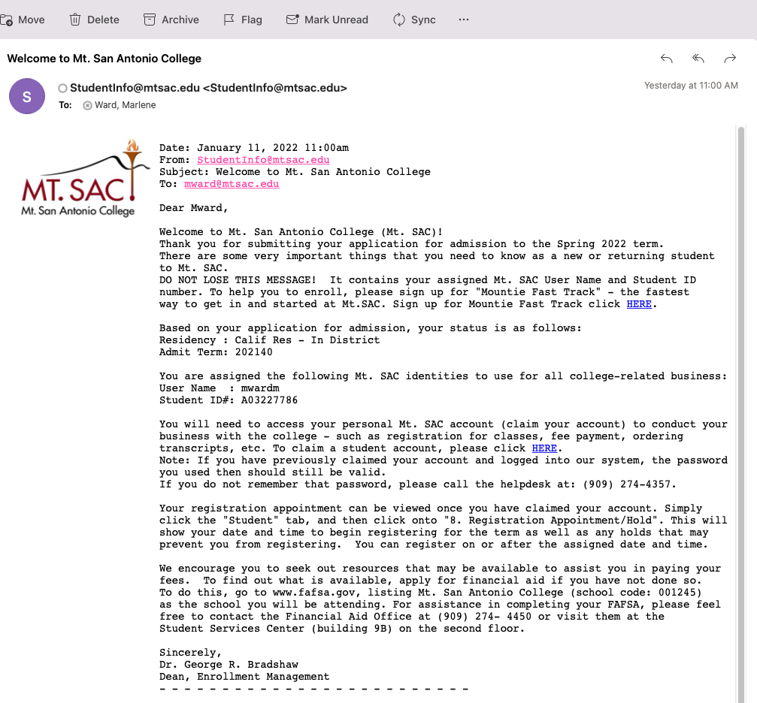
EMAIL: User Name & MT. Sac ID - print
Notes:
May take up to 2-weeks to receive your USER NAME & ID.
Access your mt. Sac portal, transcripts, and access canvas for articulation exams.
Most importantly, they can access SARF!

Slide 39
Thank you!

Slide 40

Application Resources
www.mtsac.edu/hsarticulation
Scroll down on home page or use the video tab
Notes:
Check list for application on web page
Agreements are posted here
Videos and step-by-step instructions
Contact Information
Please reach out with any questions
Pre-Approval form is no longer needed
PLEASE attend the Student Forms In-Service on Feb 1 & 2

