Slide 1
2022 - 2023
Etrieve In-Service
Student Articulation Request Form

Slide 2
Topics of Discussion
Claiming Your Mt. SAC Account (Student Portal)
Student Articulation Request Form
Where to Access the Form
How to Fill Out the Form
Submission Timelines
Student Transcripts
WeTransfer
Due Dates
Notes:
Hopefully you’re getting your students through the Mt. SAC application and your students are receiving their Mt. SAC IDs and claiming their accounts.
Before we launch into the student form and using Etrieve, we are going to quickly review claiming the account because this is an absolute MUST for every student participating in articulation this year.
So after reviewing claiming the account we’ll also go over…

Slide 3
Claim your account
Notes:
Marlene already went over claiming the Mt. SAC account when discussing the application process, but we’ll do another quick run through because again, the students HAVE to do this or they will not have access to the student form.

Slide 4
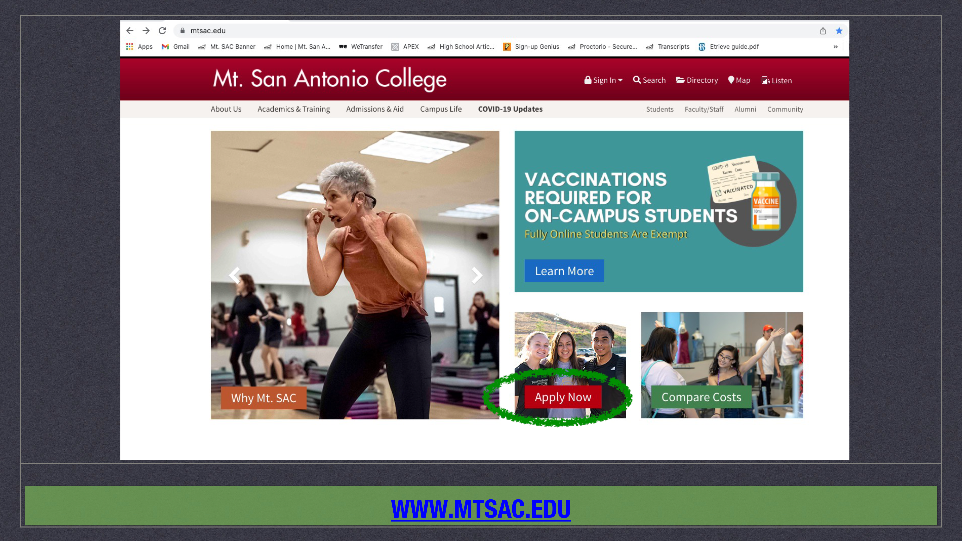

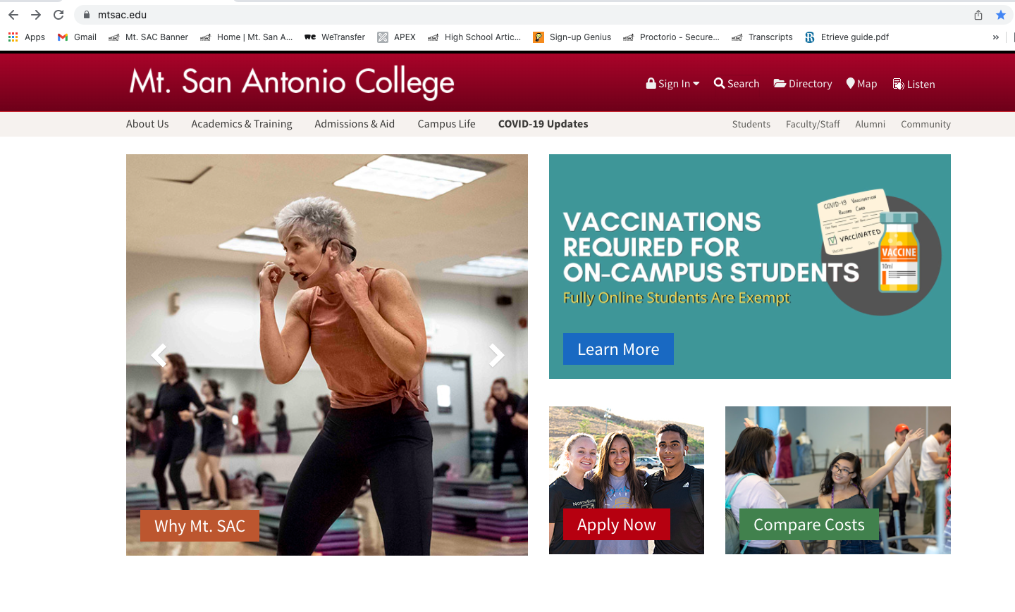
Claim account
Notes:
Students will start at the Mt. SAC website: mtsac.edu

Slide 5
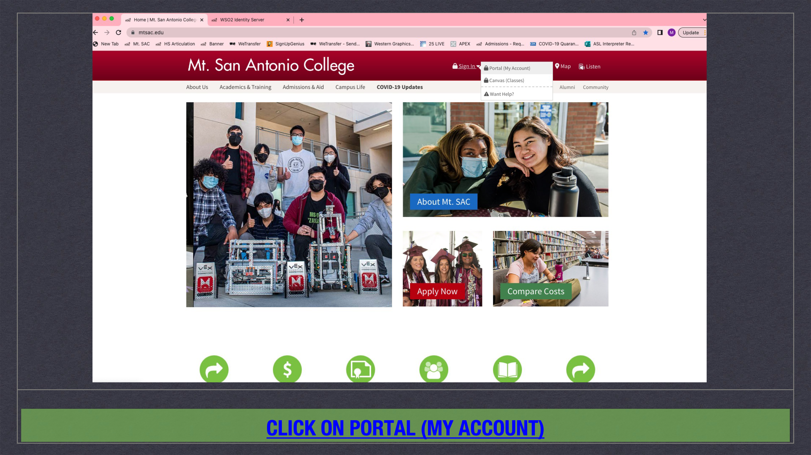

Click on portal (my account)
Notes:
On the home page they will go to the “Sign In” drop down menu and choose “Portal (My Account)”

Slide 6
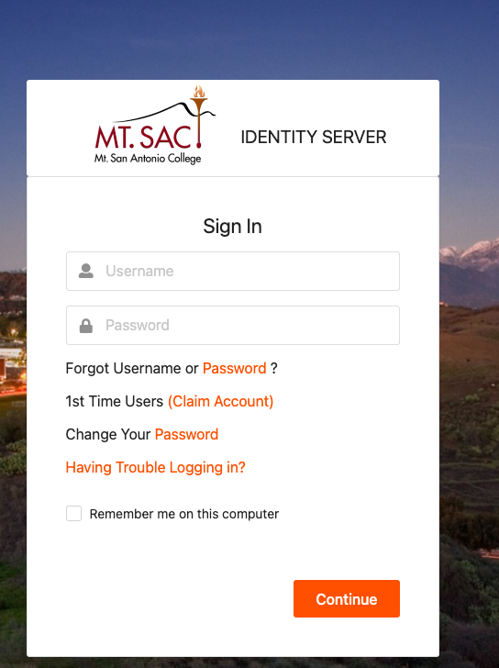
1st Time Users
Notes:
Next they will choose “1st Time Users (Claim Account)”

Slide 7
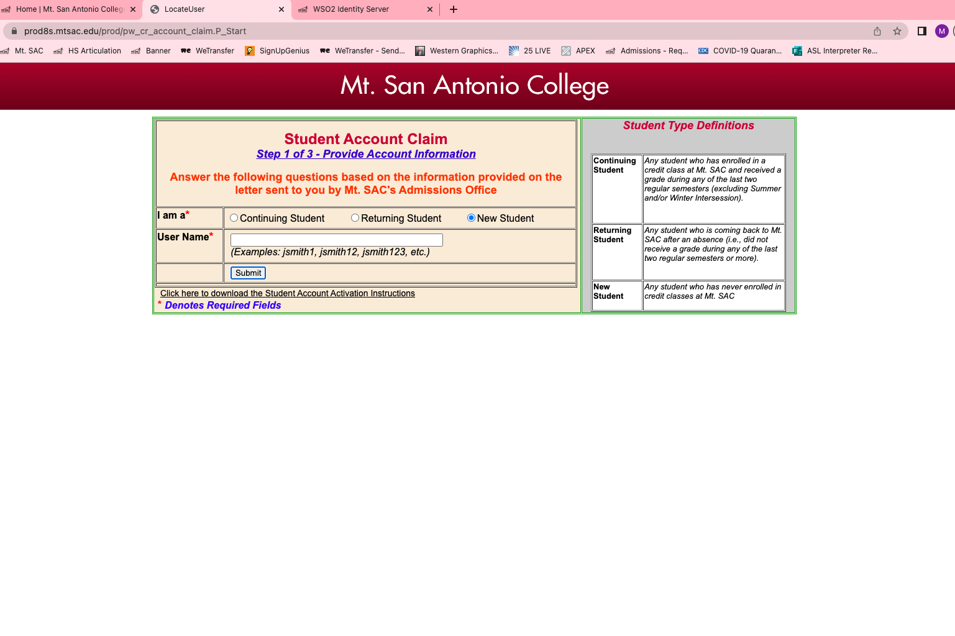
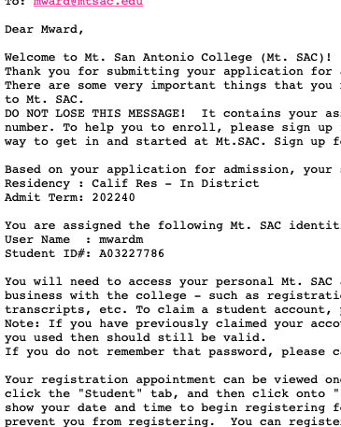
Notes:
On this screen they will choose “New Student” and then enter the User Name provided in the Mt. SAC welcome email they received.

Slide 8
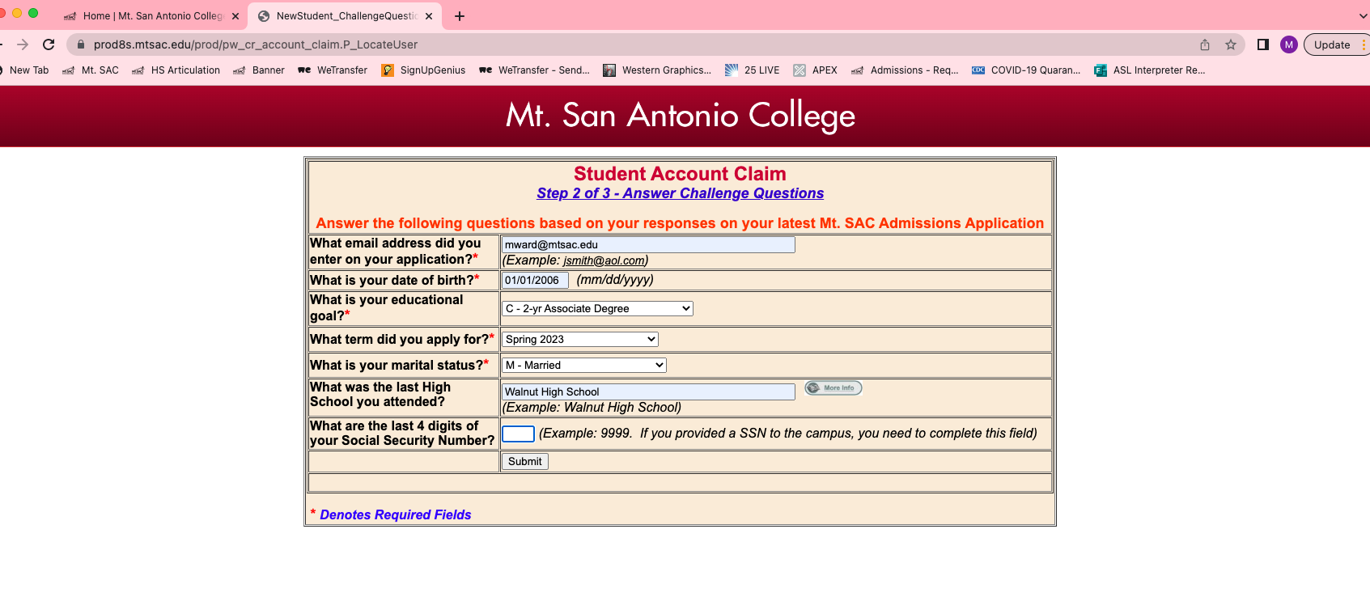
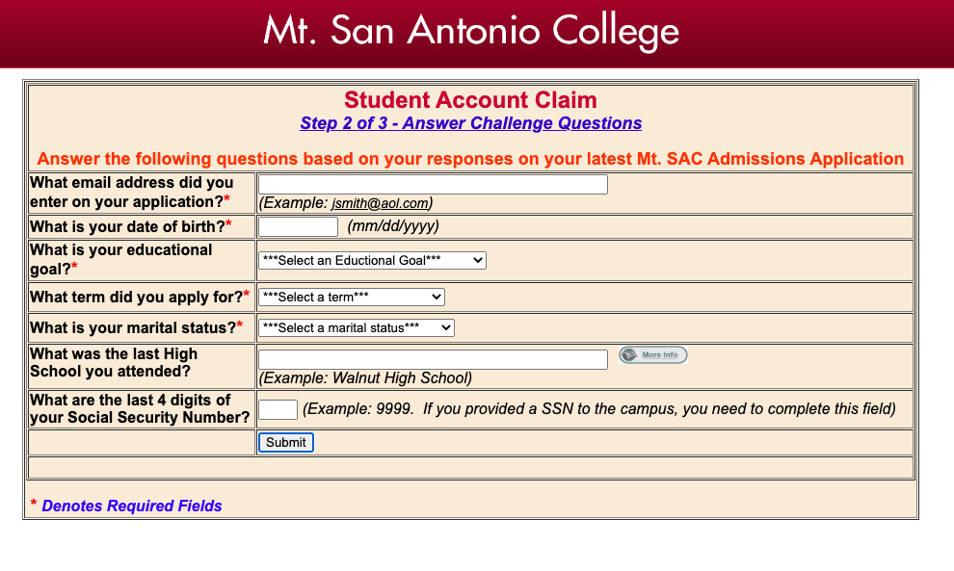
Notes:
On this screen students will be prompted to answer questions with the responses they made on their Mt. SAC application:
Email address, date of birth, educational goal, the term they applied for, marital status, the last high school they attended and the last four digits of their social security number – it is okay to leave this blank if they did not enter a SSN on their application.

Slide 9
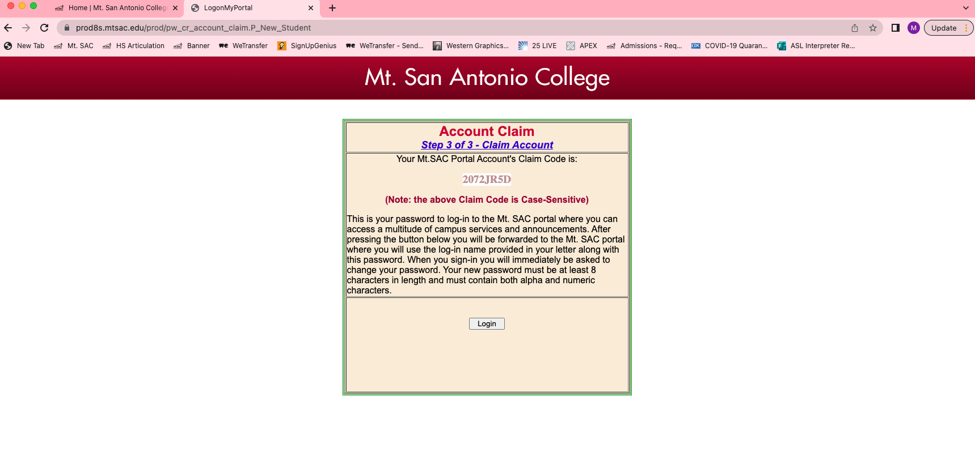
Notes:
Next, the student will receive a claim code, which is basically a temporary password. The student should copy this case-sensitive code so they can paste it into the next step where they sign in.

Slide 10
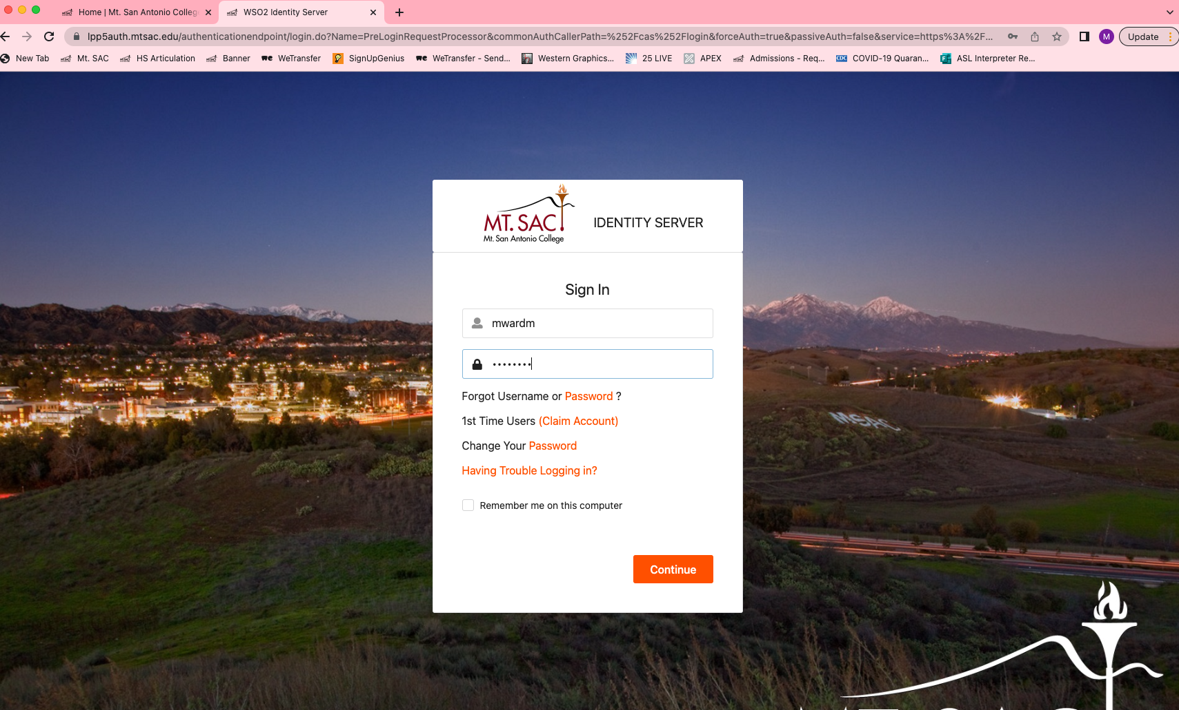

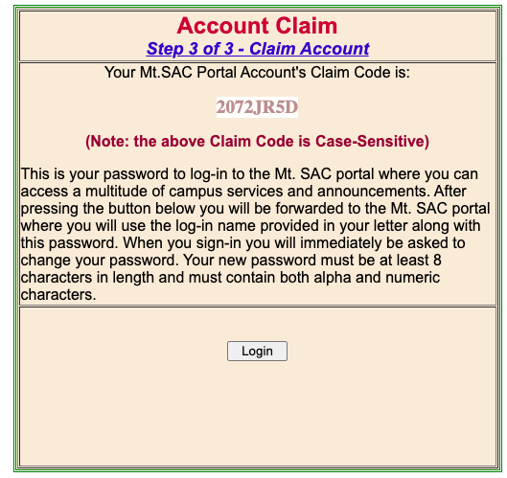
Notes:
The student will sign in with the user name from the Mt. SAC welcome email and paste in the claim code they just received.

Slide 11
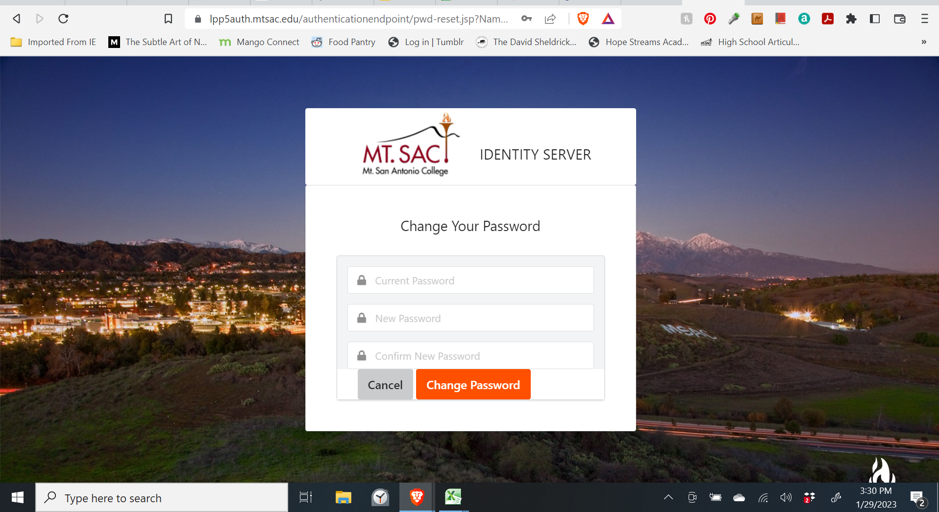
Notes:
Next, the student will be immediately directed to create a new password. They must write down their new password and keep it handy because they will need it to access the student form when they’re ready.

Slide 12
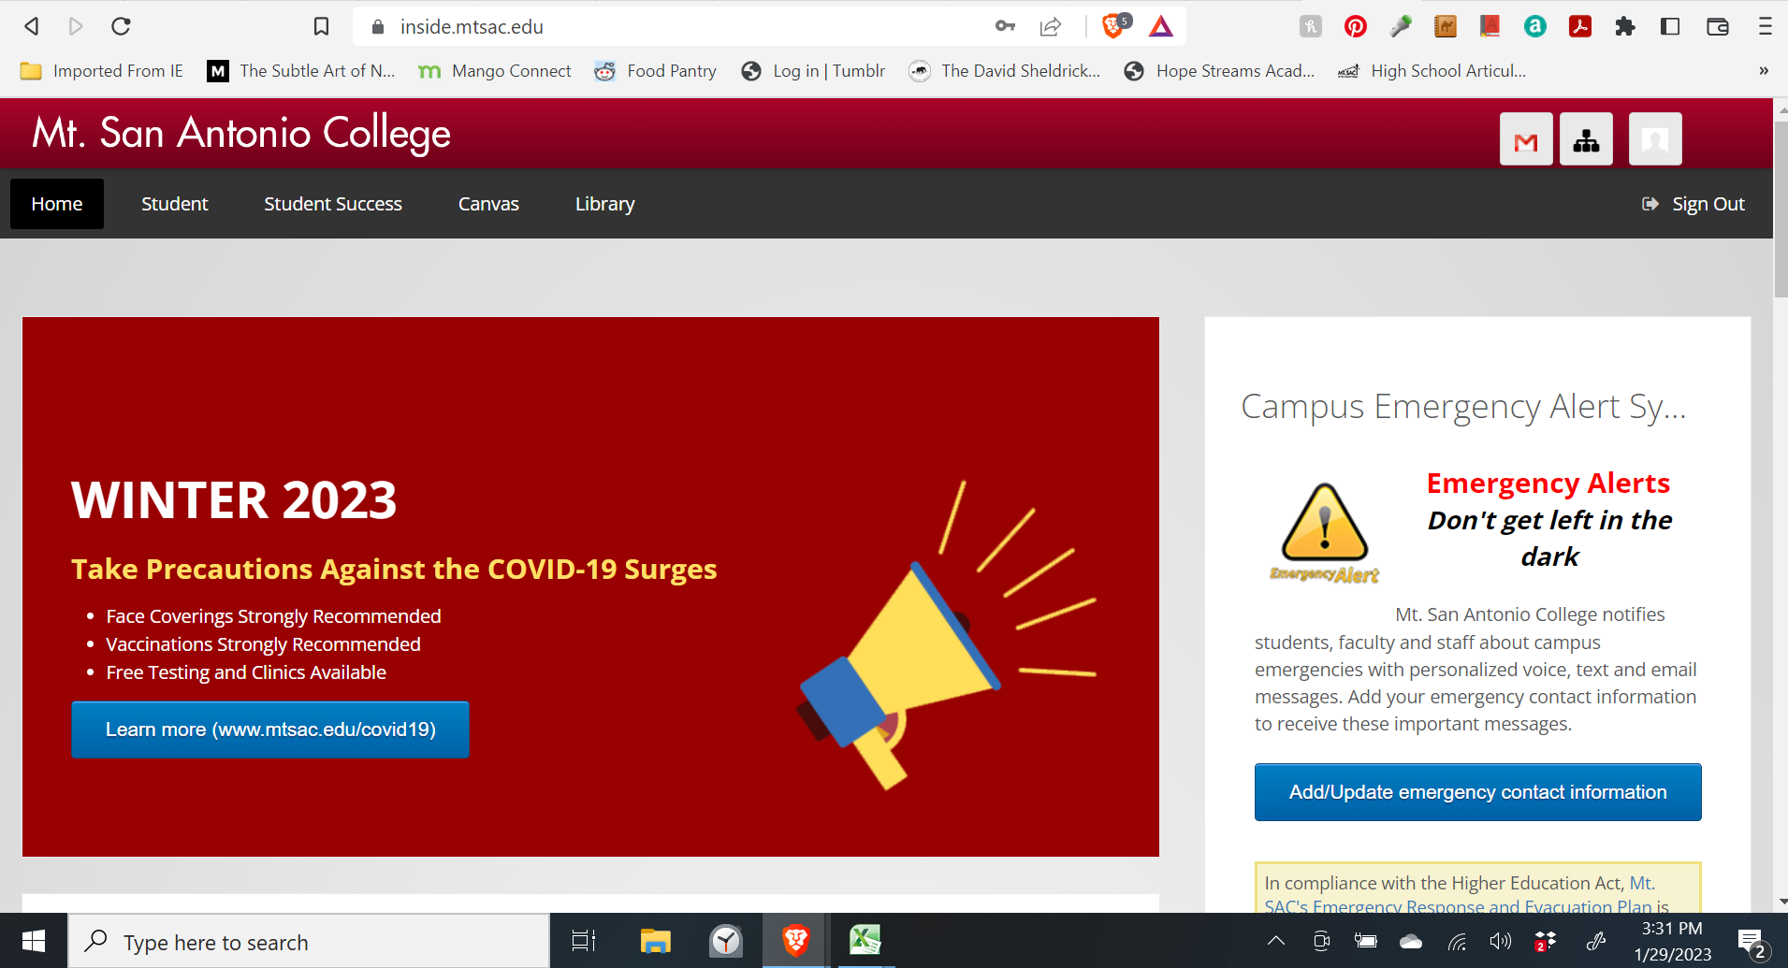
Notes:
If the student was successful they will now be logged into their student portal

Slide 13
Need Assistance or Having Tech Problems Getting Into Your Account?
Contact the Mt. SAC IT Help Desk
Phone: 909-274-4357
Phone support hours: Monday – Thursday 7:30am to 10:00pm
Friday 7:30am to 7:00pm
Notes:
If your students have issues getting into their account, please have them reach out to the IT Help Desk for assistance.

Slide 14
Instructor Checklist
Before they even begin the student form, your students should have completed the following and have this information on hand:
  ✓ Applied for Spring 2023 term and received Mt. SAC ID (ex. A01234567)
  ✓ Claimed their account (student portal) – have user name and password ready
  ✓ Articulation Agreement number(s) (ex. 2223ADJU001)
  ✓ Choose Spring as the term

Slide 15
Student articulation request form
Notes:
So now let’s get into the student articulation request form

Slide 16
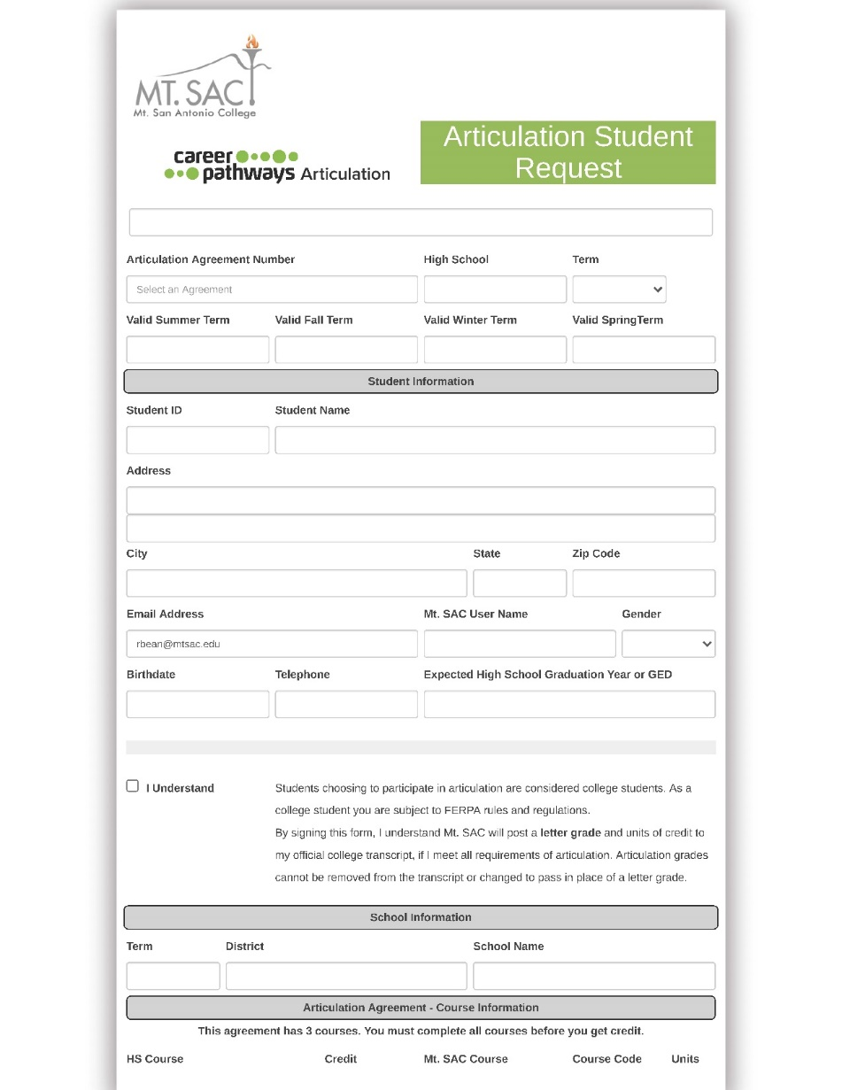
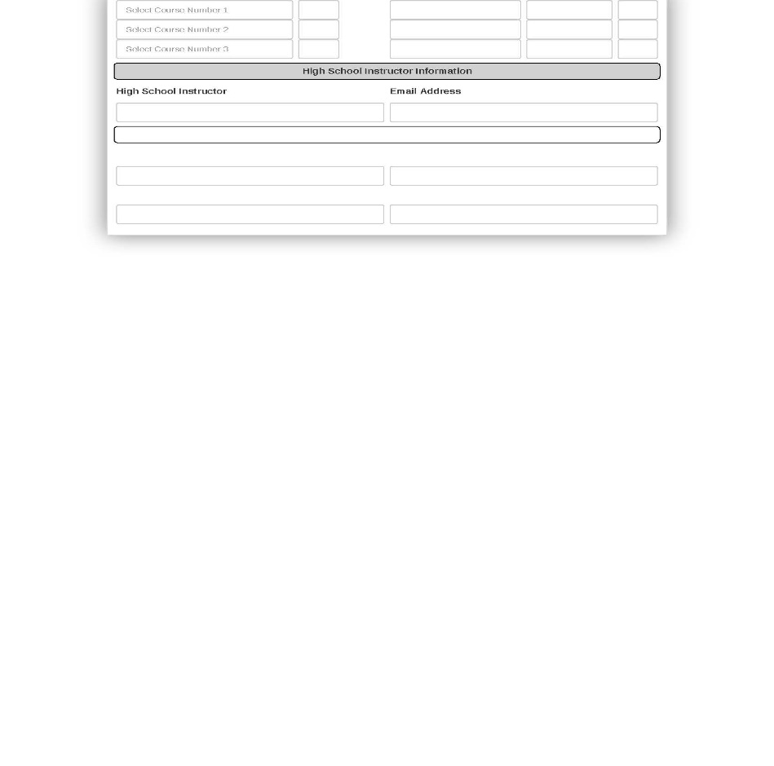
Student Articulation
Request Form
ELECTRONIC forms only – phone and tablet friendly
Forms are now initiated by the STUDENT and routed electronically using Etrieve
Student signatures no longer necessary!
The forms are mostly pre-populated making it quick and easy for the student and instructor to complete
Students are only allowed to fill out ONE student form per TERM per AGREEMENT
Notes:
For those that are new to articulation, this is the form that every student needs to complete in order to request articulation credit.
There are a couple big changes with the form this year. First, and the most important change, it is now the STUDENT’S responsibility to initiate the form, nothing comes from the articulation office anymore. We’ll remind you to get your forms done, but ultimately the student must take the initiative to get the process started.
The 2nd big change is that student signatures are no longer necessary! The form is initiated within their student portal so in essence, their identification has been verified. So no more emails from me saying the student signed wrong and has to re-sign – this alone will save so much time and headache.
Please make sure everything is accurate before submitting the form.

Slide 17
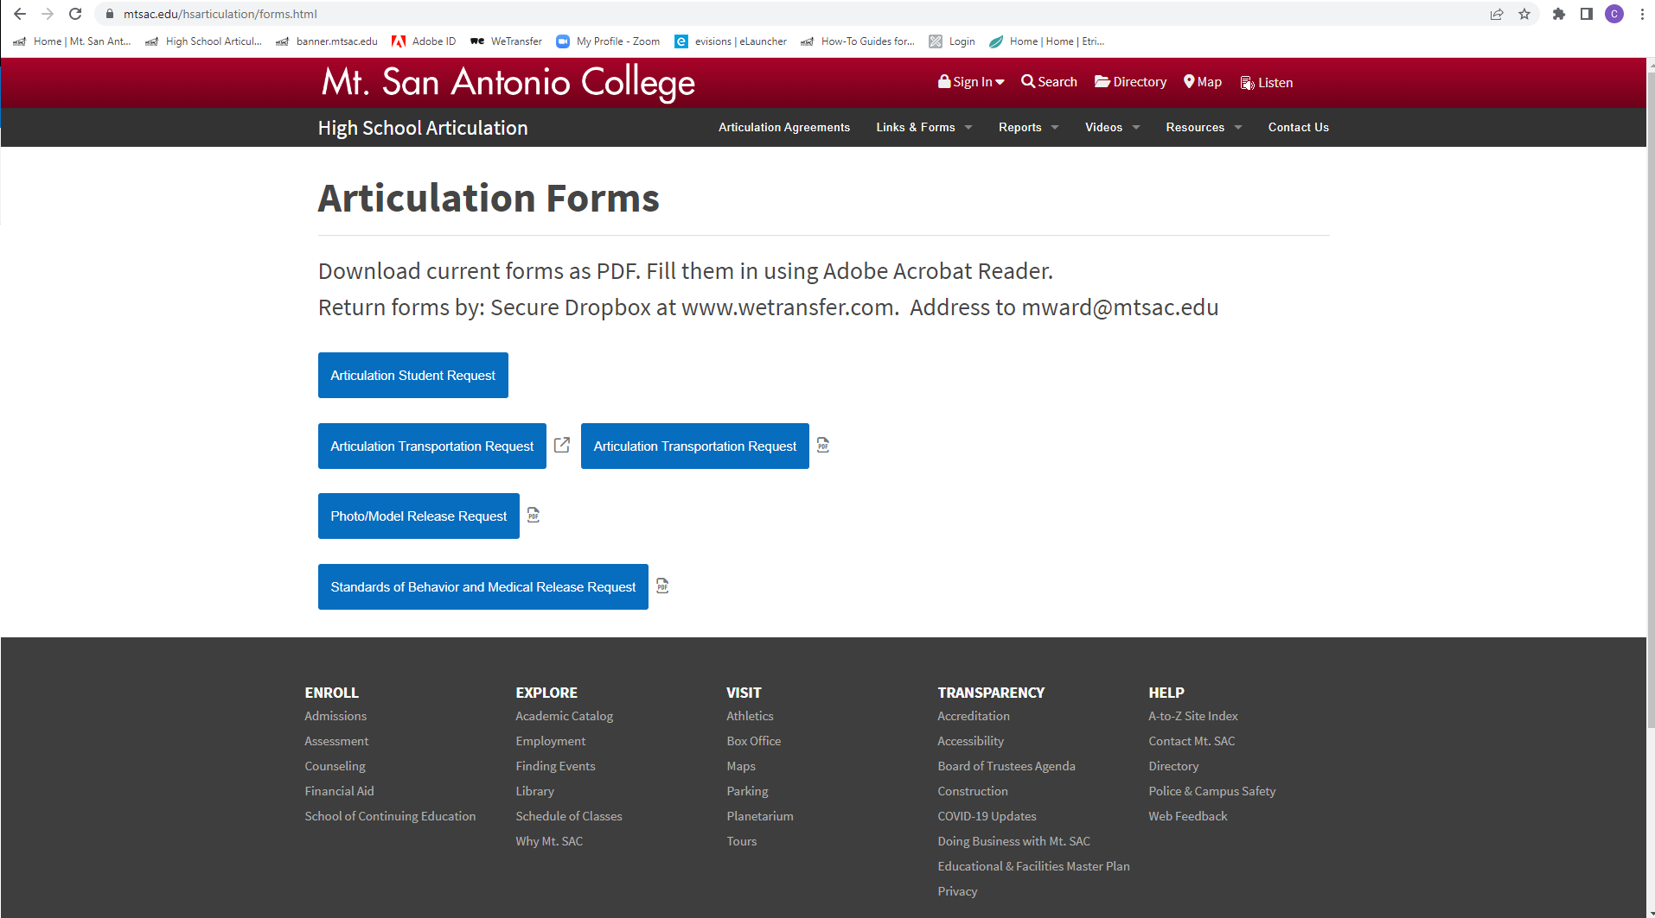
Where to Access the Student Form
https://www.mtsac.edu/hsarticulation/forms.html
Notes:
So when your students are ready, the link to the form can be found on the Articulation website under Links & Forms – the student will click on Articulation Student Request to be taken to the Etrieve home page.

Slide 18
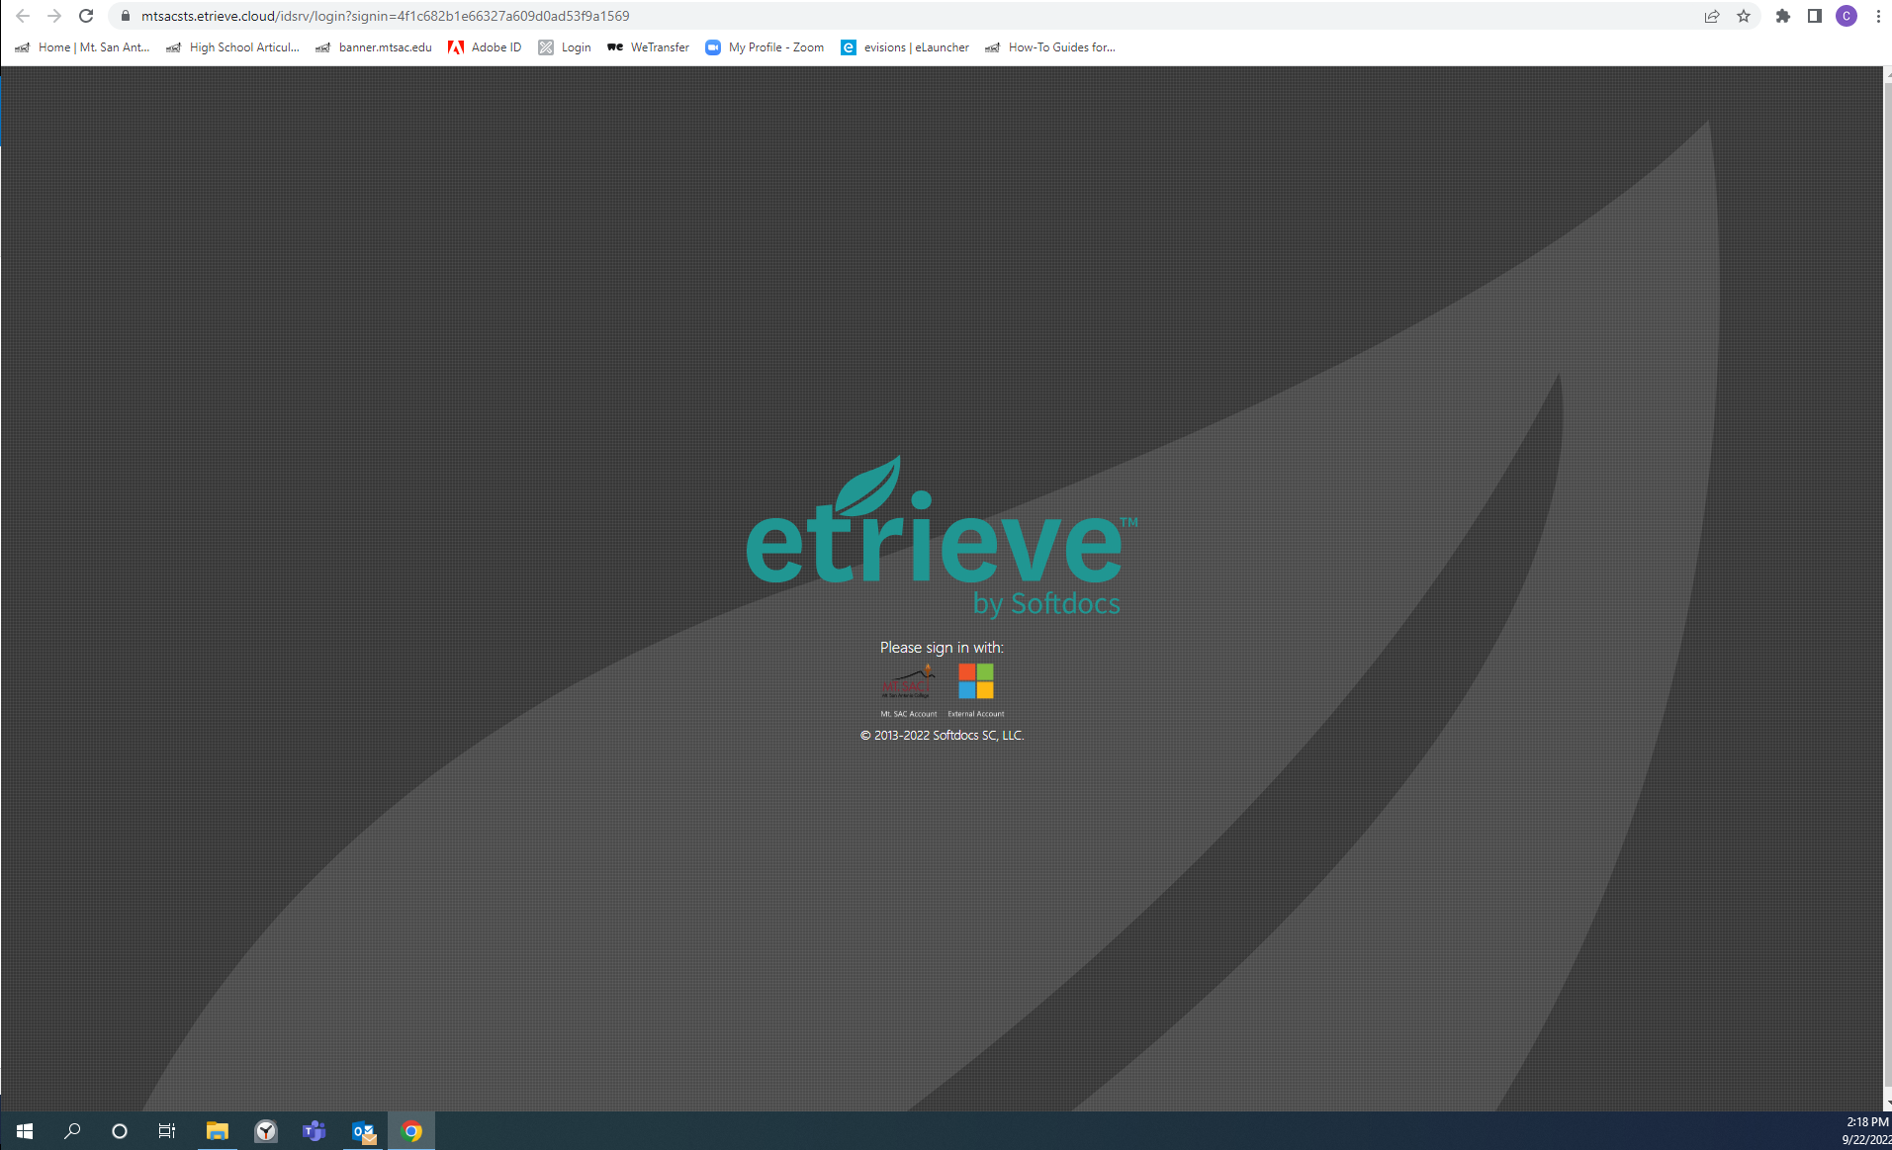
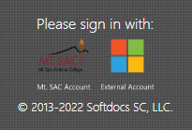
Etrieve Home Page
Notes:
On the Etrieve home page, the student will click on the Mt. SAC logo to sign-in

Slide 19
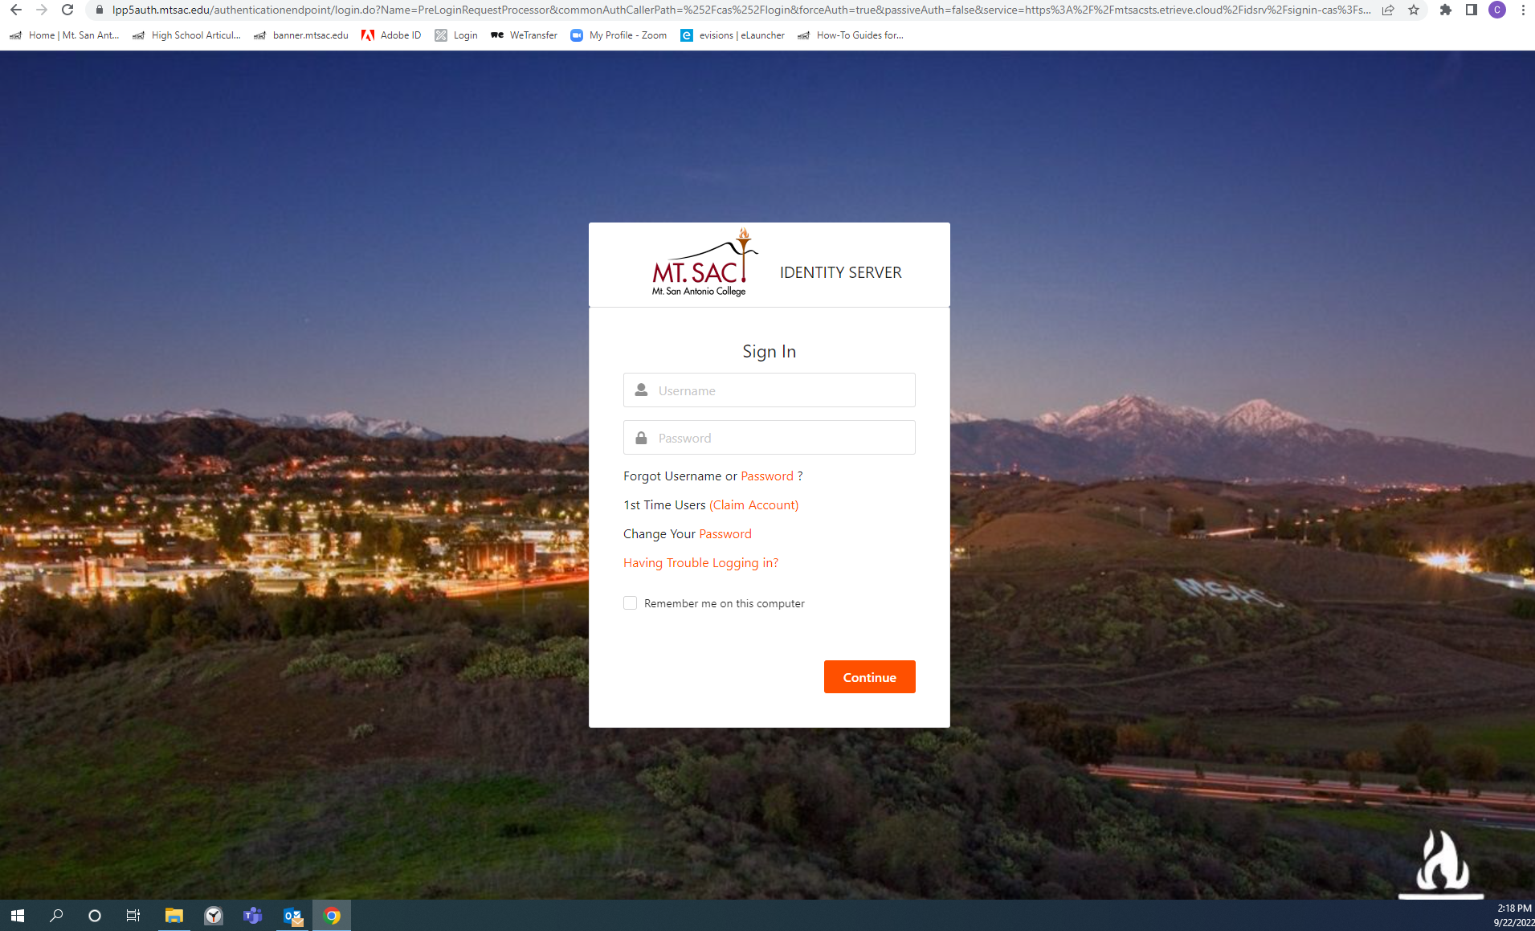
Student Single Sign-On
Notes:
This is the single sign-on page where the student will enter their user name and the password they created when they claimed their account

Slide 20
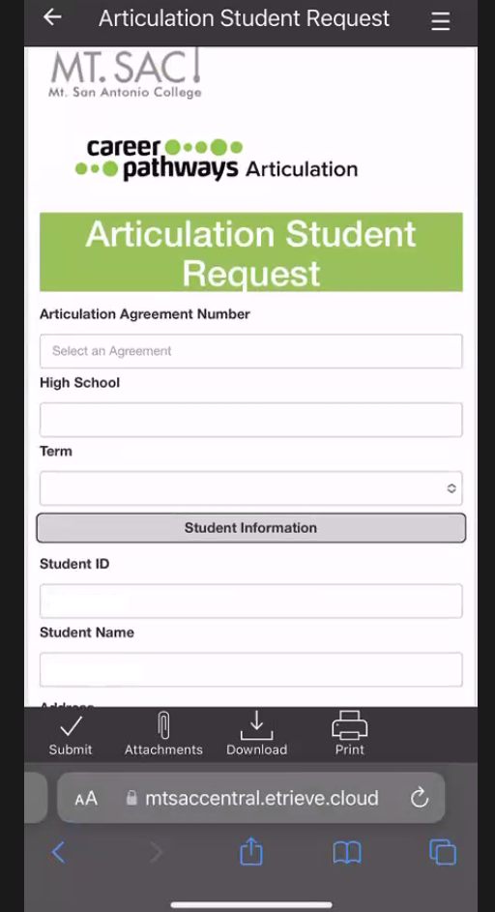
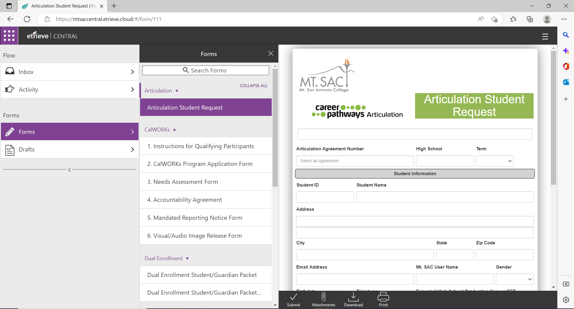
Student Section
Notes:
Etrieve automatically opens to the student form: computer view, cell phone view

Slide 21
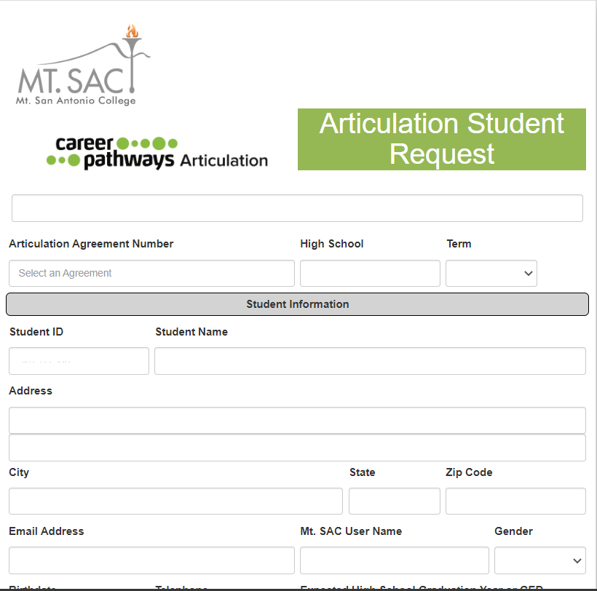
1. Enter Articulation Agreement Number
Once the Agreement number is entered, most of the form will pre-populate with the student’s information that they entered on their application
The email address will default to the student’s Mt. SAC student email address (username@student.mtsac.edu)
2. Select the Term – SPRING
3. Select Gender
Notes:
The email address will default to the student’s Mt. SAC student email address, not their personal email. So any correspondence from Etrieve will go to their Mt. SAC student email. However, students can go into their Mt. SAC email, and in the settings they can set it up to FORWARD emails from Mt. SAC to a personal email address so any communication from the college is sent to their personal email.
The term is tied to the articulation agreement – some of you have agreements that are valid for more than one term, but most of you have agreements that are valid only for spring.

Slide 22
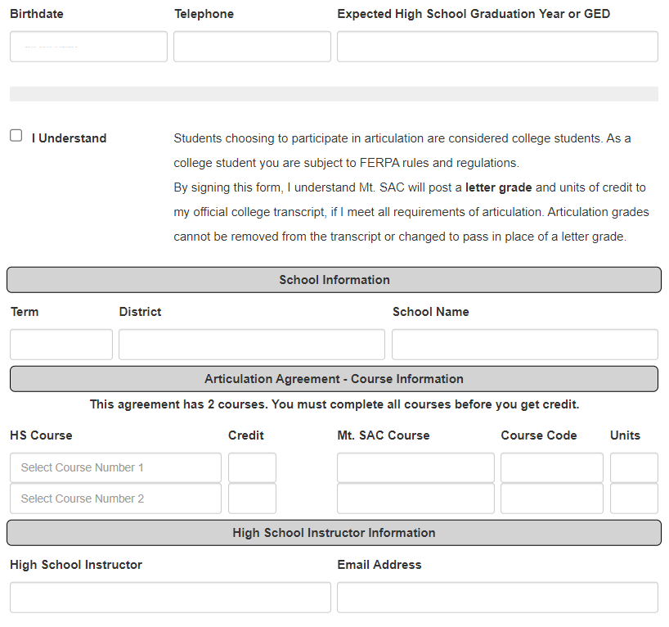
4. Enter Expected High School Graduation Year (adult students enter year they graduated HS)
5. READ and click checkbox for student disclaimer

Slide 23
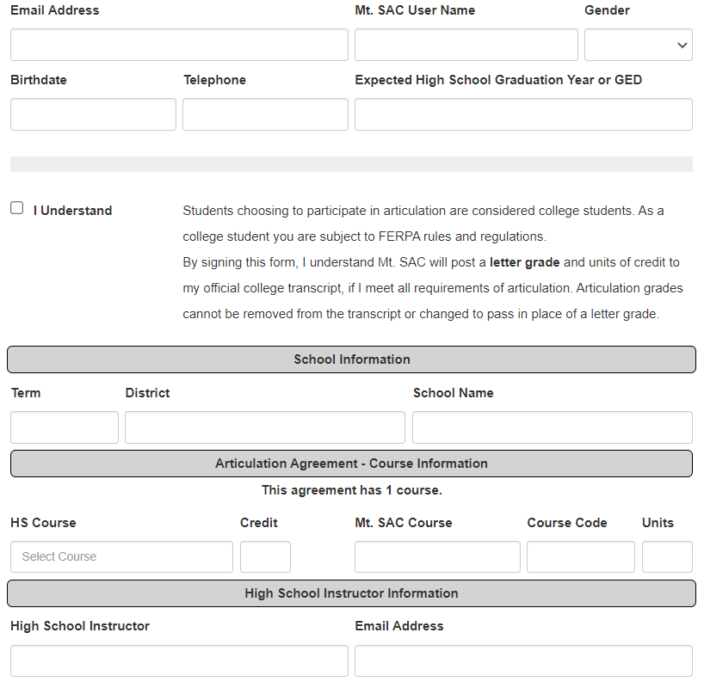
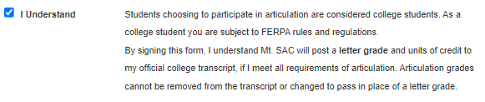
Student Disclaimer
Notes:
The students need to READ and understand what they are agreeing to – by submitting the form they are stating that IF they have met all the articulation requirements, Mt. SAC will post grades and units to their OFFICIAL Mt. SAC transcript. That means passing grades of C or better WILL BE posted and they can’t be changed or removed.

Slide 24
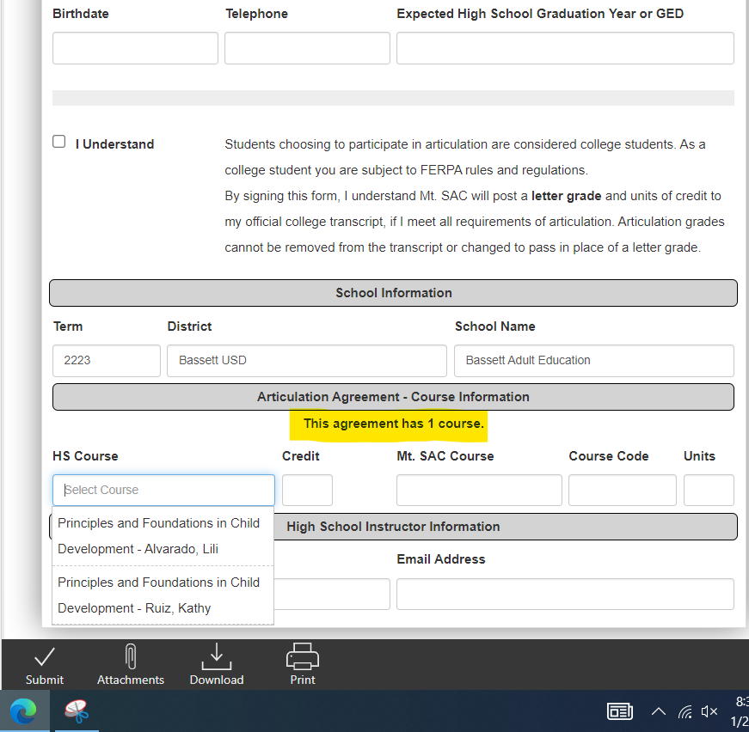
6. Choose High School Course(s)
Based on the agreement number the student enters, the form will automatically adjust how many courses are required (up to four)
If the course has more than one instructor, be sure the student chooses the correct instructor so the form is routed to the right person
7. Click SUBMIT in bottom black menu bar

Slide 25
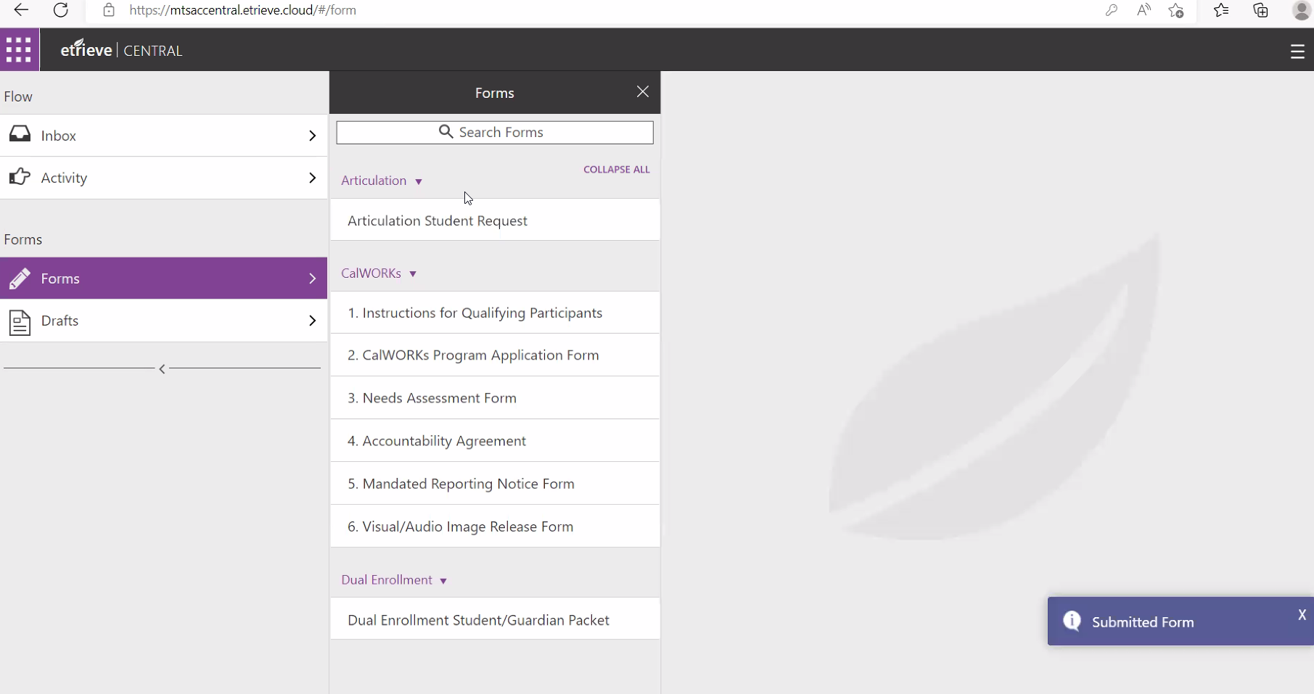
Etrieve Student Successful Submittal
Notes:
The student form is now automatically routed to the instructor.

Slide 26
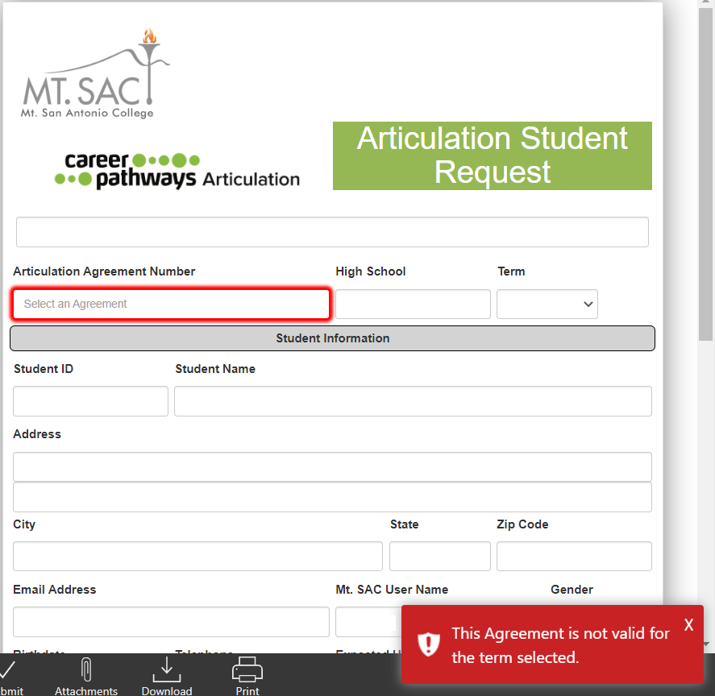

Potential Roadblocks
The red notification box remains on-screen for about 10 seconds
Notes:
Etrieve is a new platform for us and there might be some issues that prevent the student from completing the form. Etrieve is set up to check the application status of each student so when they enter the term on the form, if the student doesn’t have a valid Spring 23 application, the system will not let the student proceed and they’ll see this red box appear saying “this agreement is not valid for the term selected”
Another scenario could be that one or some of the required fields have been missed, the system will not let the student submit until all required fields are complete.
Like we keep saying, the system is new and it isn’t perfect, so there may be circumstances in which a student with a valid Spring 23 application will still be blocked – like Dual Enrollment, Special Admit or Continuing Ed students.
If you know your student has applied for the correct term and the system won’t let them proceed, please let me know so I can verify their information and get a workaround in place for them.

Slide 27
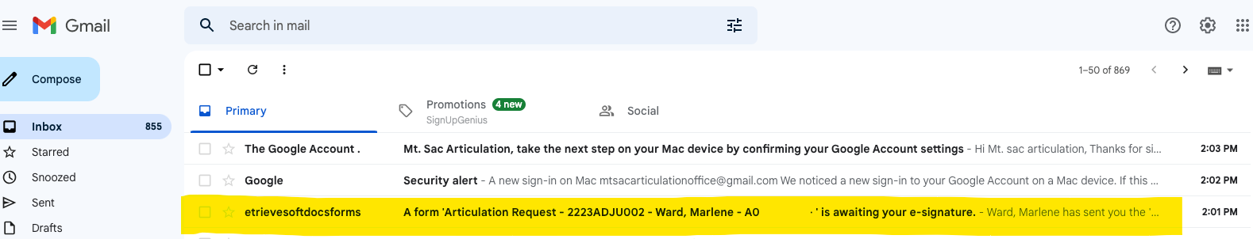
Instructor Email Inbox
Notes:
So if everything works as it should, instructors, emails will arrive in your inbox from EtrieveSoftdocsForms as the sender, the subject will include the agreement number, your student’s name, and their Mt. SAC ID#. If you can’t find the email in your inbox, please check your SPAM folder.

Slide 28
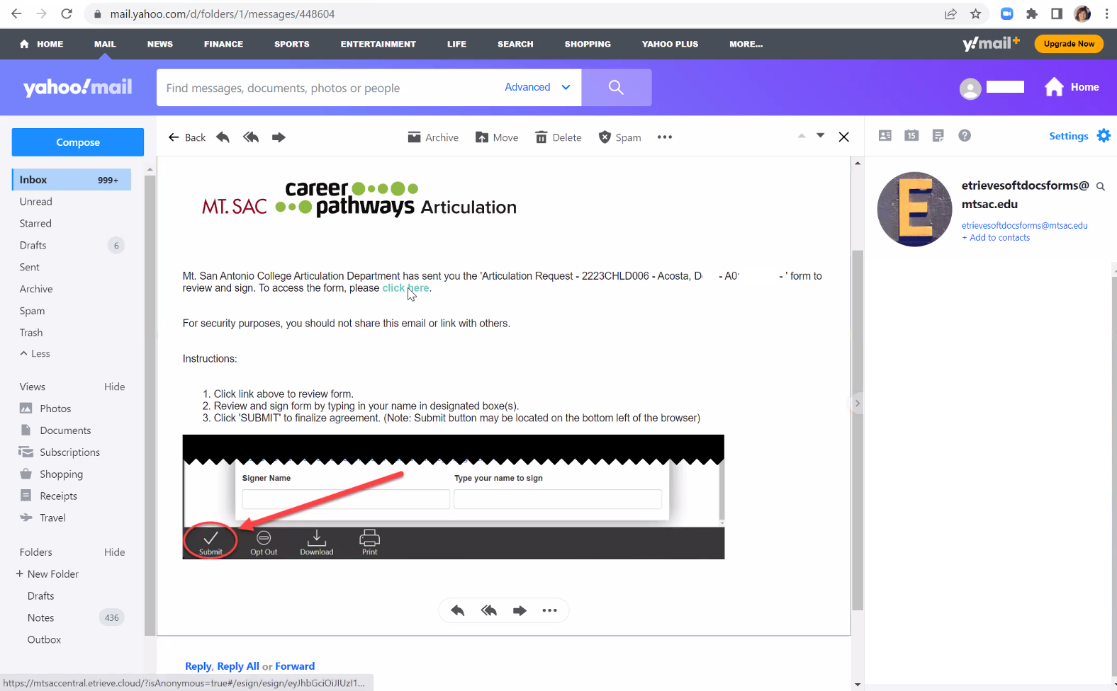
Instructor Open Email
Notes:
When you open the email you will see instructions and the “click here” link to access the form. There’s also a graphic that shows where the “submit” button is at the bottom of your screen.
We apologize to the teachers that have 40, 50, maybe 70+ students seeking credit, unfortunately you will have to open each individual email to click the unique link and fill out/sign each of your students’ forms – it’s an inbox killer, but unfortunately that’s the way Etrieve is set up for outside users for now.
Also, the links will “time out” after a while, but in the fine print of the email there are instructions on how to get a new link sent to you.

Slide 29
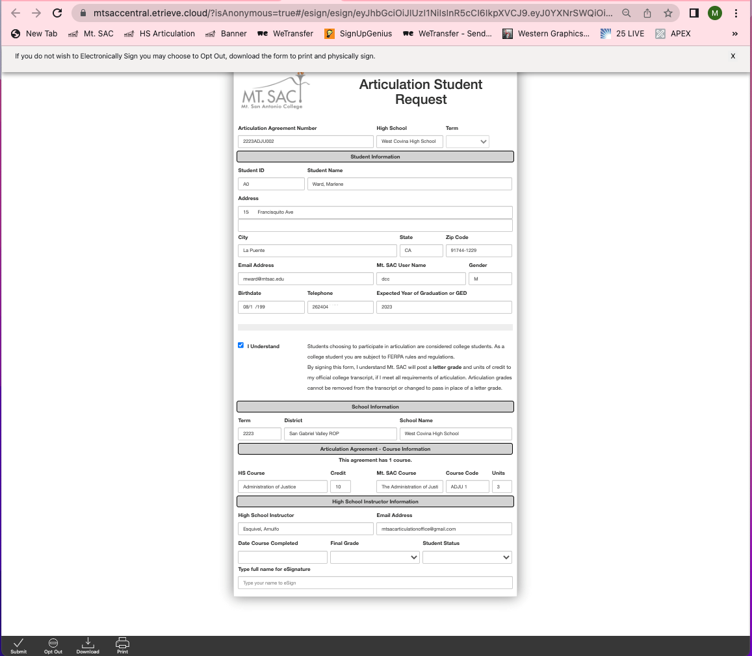
Instructor
Section
Notes:
Once you’re in Etrieve, you will see that the top portion of the form has been filled out by your student, you will need to scroll down to the High School Instructor Information section at the bottom.

Slide 30

Enter Date Course Completed
Enter Final Grade (Exam = current grade / Non-Exam = final grade)
Enter Student Status – HS or Adult
Type full name for eSignature
Click SUBMIT in bottom black menu bar
Notes:
2. Entering the final grade always causes some confusion – if your students are taking any type of exam, you’re going to enter the grade the student is CURRENTLY receiving in your class. Please make sure it is an eligible grade – usually C or better but some courses require a B or better. If I see a D or lower in this box, I will ask you to confirm. This is why we don’t want the forms too early, we want the most current grade on the form before the student takes any exam.
If your student is not taking an exam and we honor the high school grade then you will have to hold on to your students’ forms until their final grades have been determined at the end of the school year. The grade you enter on the form MUST match the grade on their transcript.

Slide 31
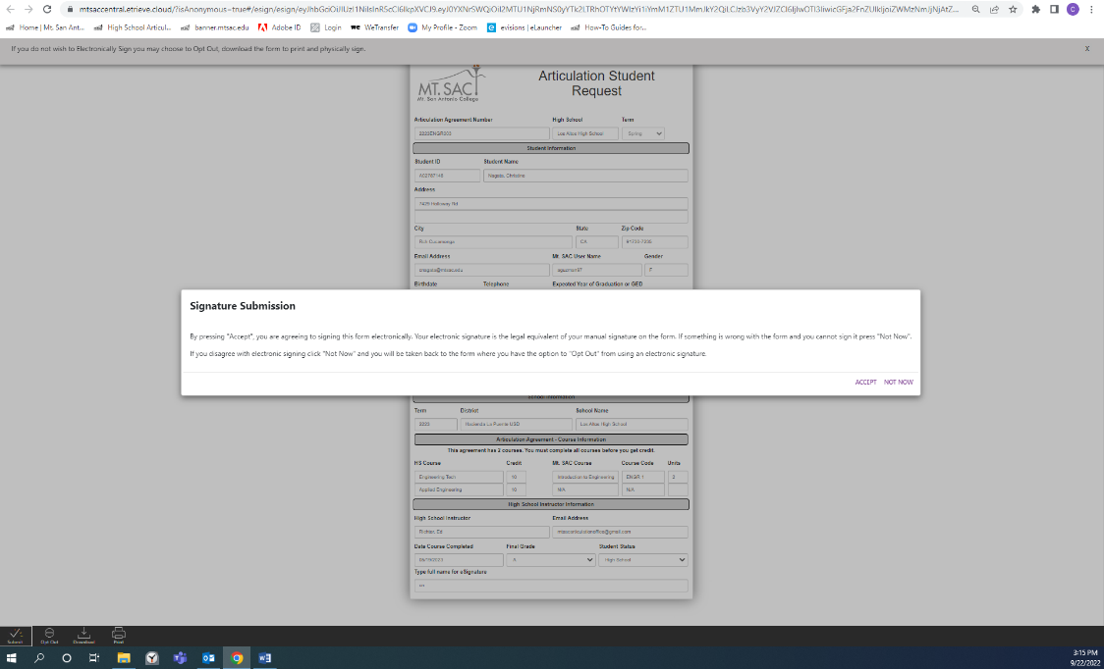
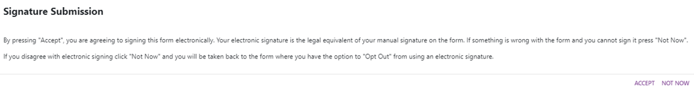
Instructor Submittal
Click ACCEPT for signature submission
Notes:
Then you’ll get this signature submission box which is letting you know that this is a legal signature before you click Accept to submit the form.

Slide 32
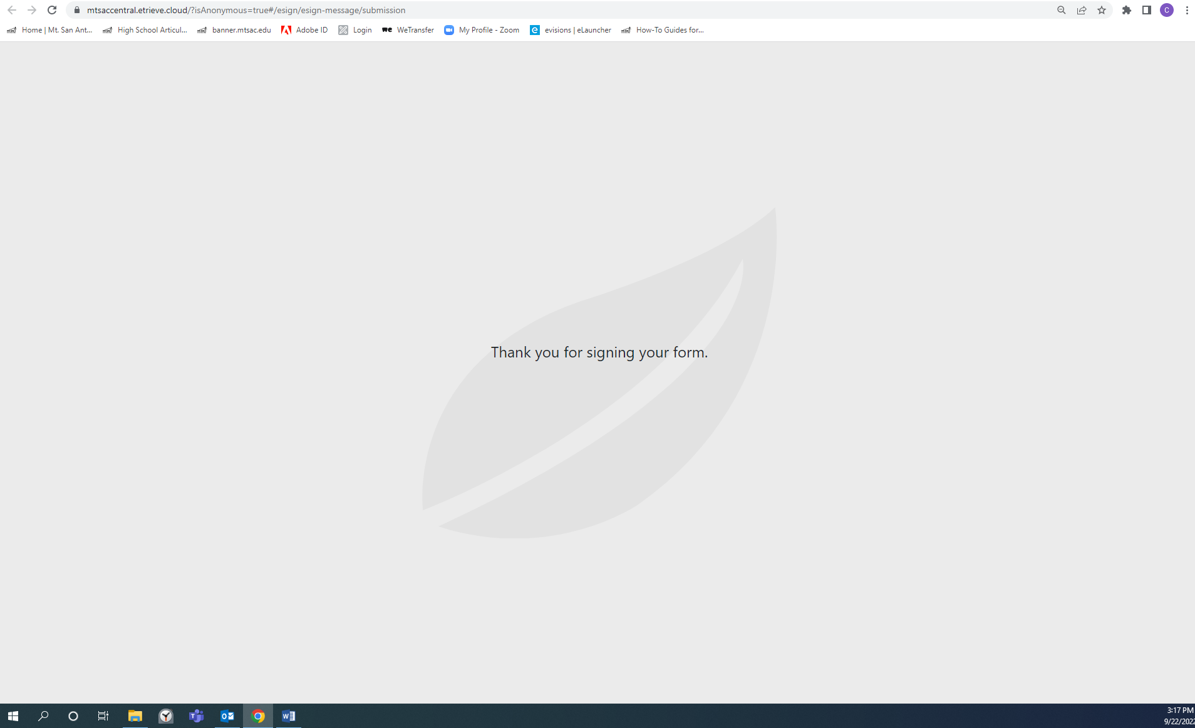
Etrieve Instructor Successful Submittal
Notes:
Once the instructor submits the form, it will be routed to the Articulation Office. After we approve the form, all parties will receive an email from Etrieve with a link to the fully executed form where you can download or print a copy for your records.

Slide 33
When to Submit the Student Form
EXAM GROUP
Are your students taking a Canvas exam, in-person exam, submitting a portfolio/assignments to be graded by a Mt. SAC professor?
Submit forms 5 – 6 weeks prior to exam, NO LESS than THREE weeks
ADJU ASCI (Animal Science) FCS MUSA
AERO CHLD IDE PHOT
AIRC CISB KIN R-TV
ANIM CNET MEDI SIGN
ARCH ENGR MFG THTR
Notes:
No less than three weeks – we need that time to load your students into Canvas, set up exams and check your students’ transcripts for eligibility.
These are the program areas that take exams.

Slide 34
When to Submit the Student Form
NON-EXAM GROUP
Does your agreement state that we will honor the student’s high school grade as the Mt. SAC grade?
Have students submit the form 3 - 4 weeks before your semester ends, but DO NOT fill out/sign until final grades have been determined. The grade you enter on the form MUST match the high school transcript grade.
AGOR BUSA CUL HRM
ASCI (Horse Production) CISW FIRE WELD
Notes:
These are the program areas that have agreements that honor the high school grade.

Slide 35
Student Transcripts
When the student forms have been completed, the next step will be to submit your students’ unofficial transcripts.
Transcripts confirm eligibility in two ways:
  Confirms student is currently enrolled in correct course and if required, has taken prerequisite courses
  Grades confirm eligibility – usually C or better, sometimes B or better is required
For security purposes, please send transcripts as PDF files to Marlene Ward mward@mtsac.edu using WeTransfer https://wetransfer.com/
Notes:
For those teachers that turn in forms/transcripts at the end of the school year, I’d like to add that even though it’s summer, please submit your unofficial transcripts as soon as possible so your students receive their credit in a timely manner. When your students don’t get their credit posted during the summer, they are negatively impacted when registering for classes in the Fall or trying to transfer units to another college because their transcripts will not show their articulation credit.
Depending on the system you have, it may be worth finding out if you have the capability of sending us the transcripts yourself so you don’t have to wait for the registrar’s office – I know some of you do that already. But if you can’t get them to us before you leave for the summer break, please arrange for someone in your registrar’s office to send transcripts to Marlene in your absence by giving them your list of students and Marlene’s email address. This just helps keep the process moving during the summer months and benefits your students in the long run.

Slide 36
WE TRANSFER
Notes:
So I just mentioned sending your transcripts using WeTransfer. Marlene is the keeper of all the transcripts and for confidentiality and security we use WeTransfer to receive transcripts from you. It’s free, you don’t need to have an account and it’s simple to use. So let’s go over it quickly.

Slide 37
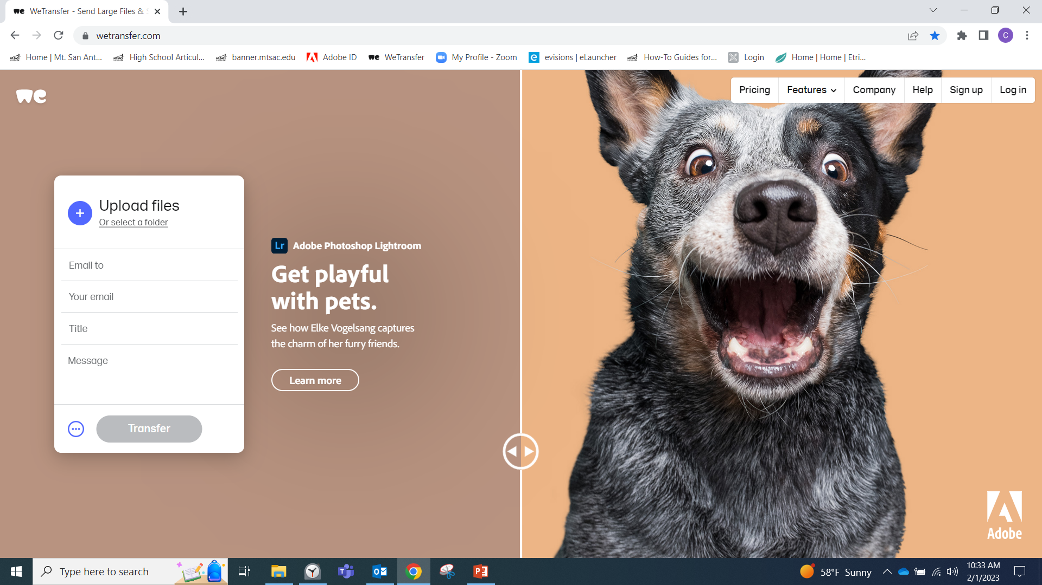
WeTransfer
Notes:
First you’re going to go to wetransfer.com to start

Slide 38
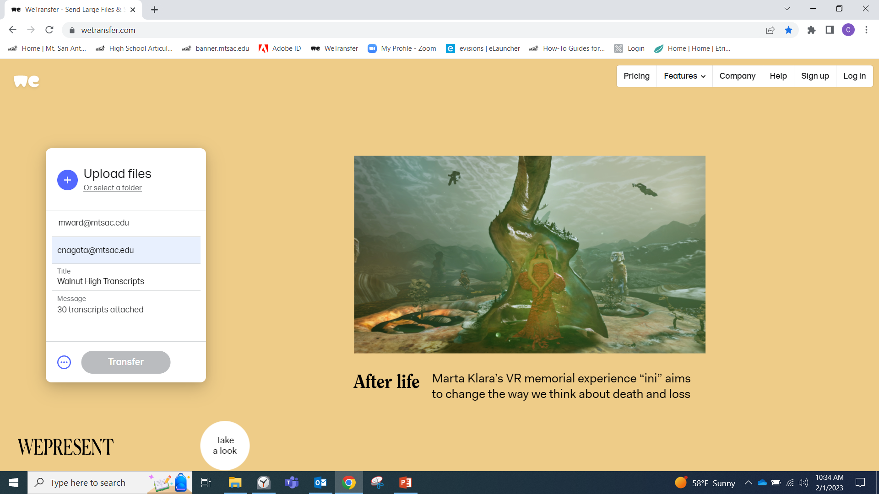
Notes:
You can do this in any order
Address the files to Marlene – mward@mtsac.edu
Then enter your email
In the title section tell her what files you’re sending. Keep in mind that Marlene gets transcripts from every teacher we work with so please let her know where the transcripts are coming from, it would be helpful to include your agreement number, especially for those that have more than one agreement.
Then include a message like how many transcripts are attached and then you’re ready to upload your PDF files.

Slide 39
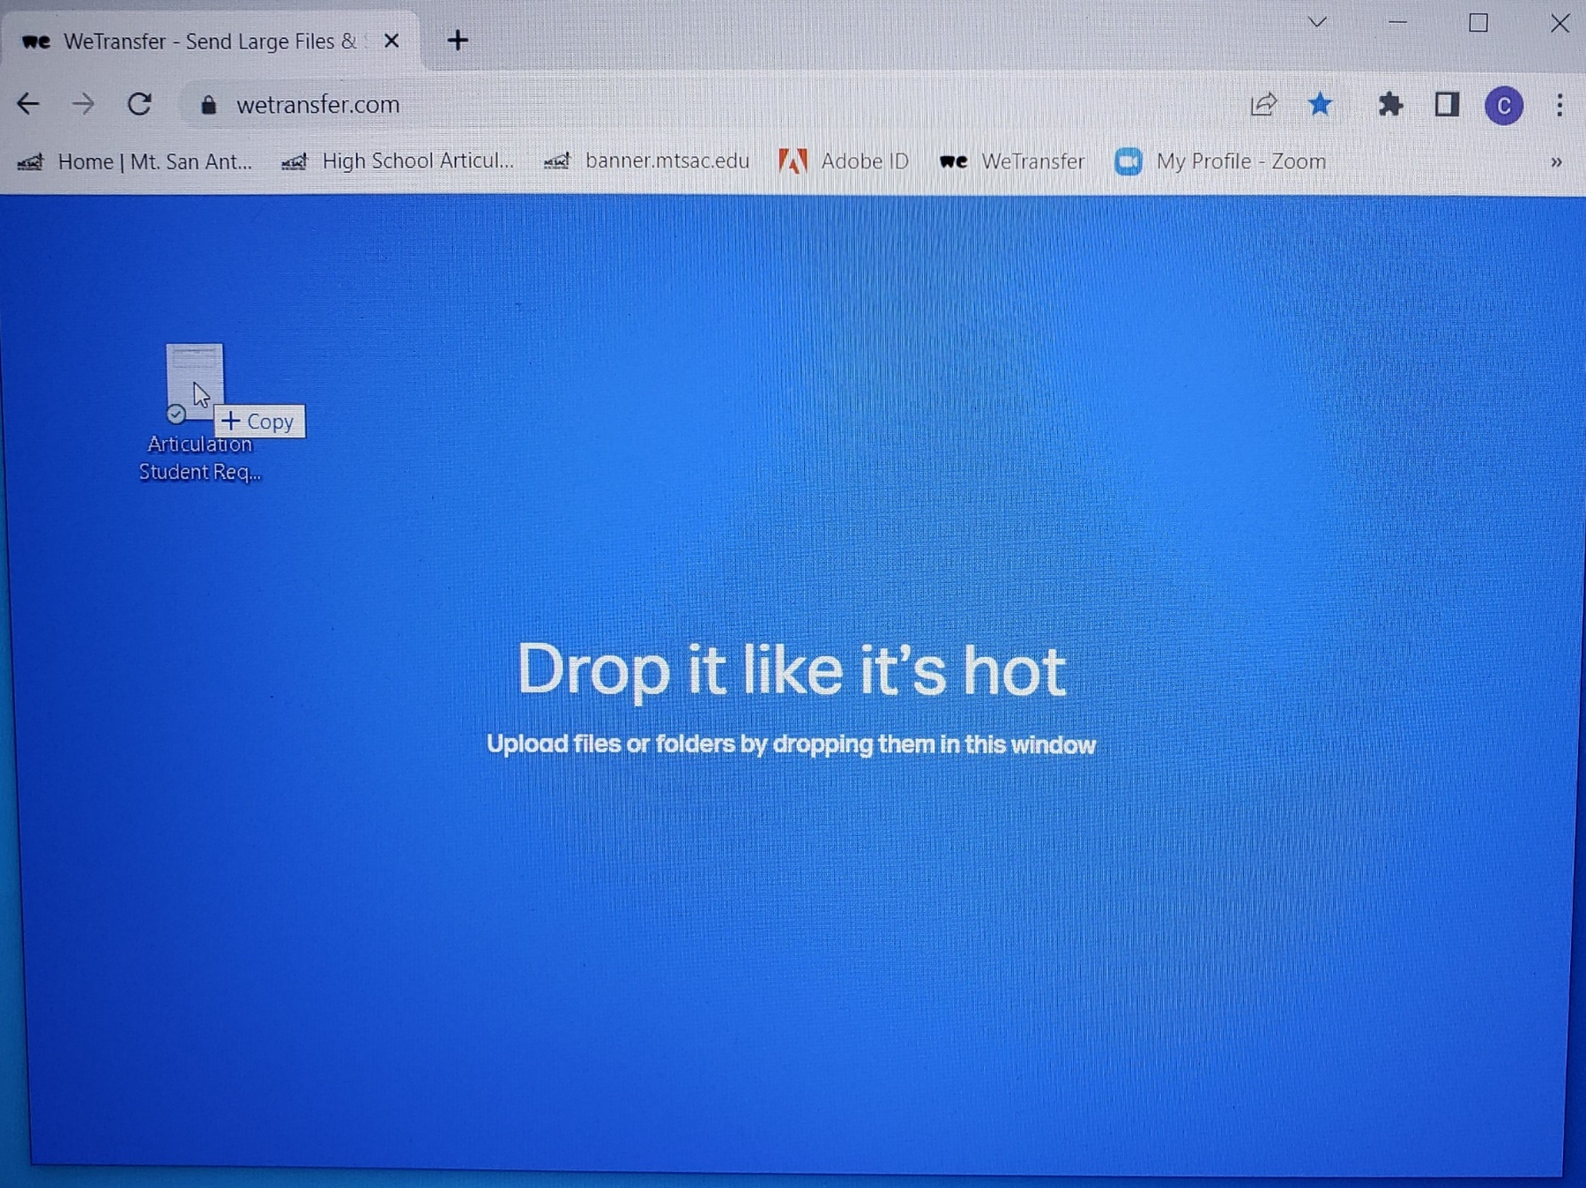
Notes:
You can easily drag and drop your files or select a folder on your computer to add them manually

Slide 40
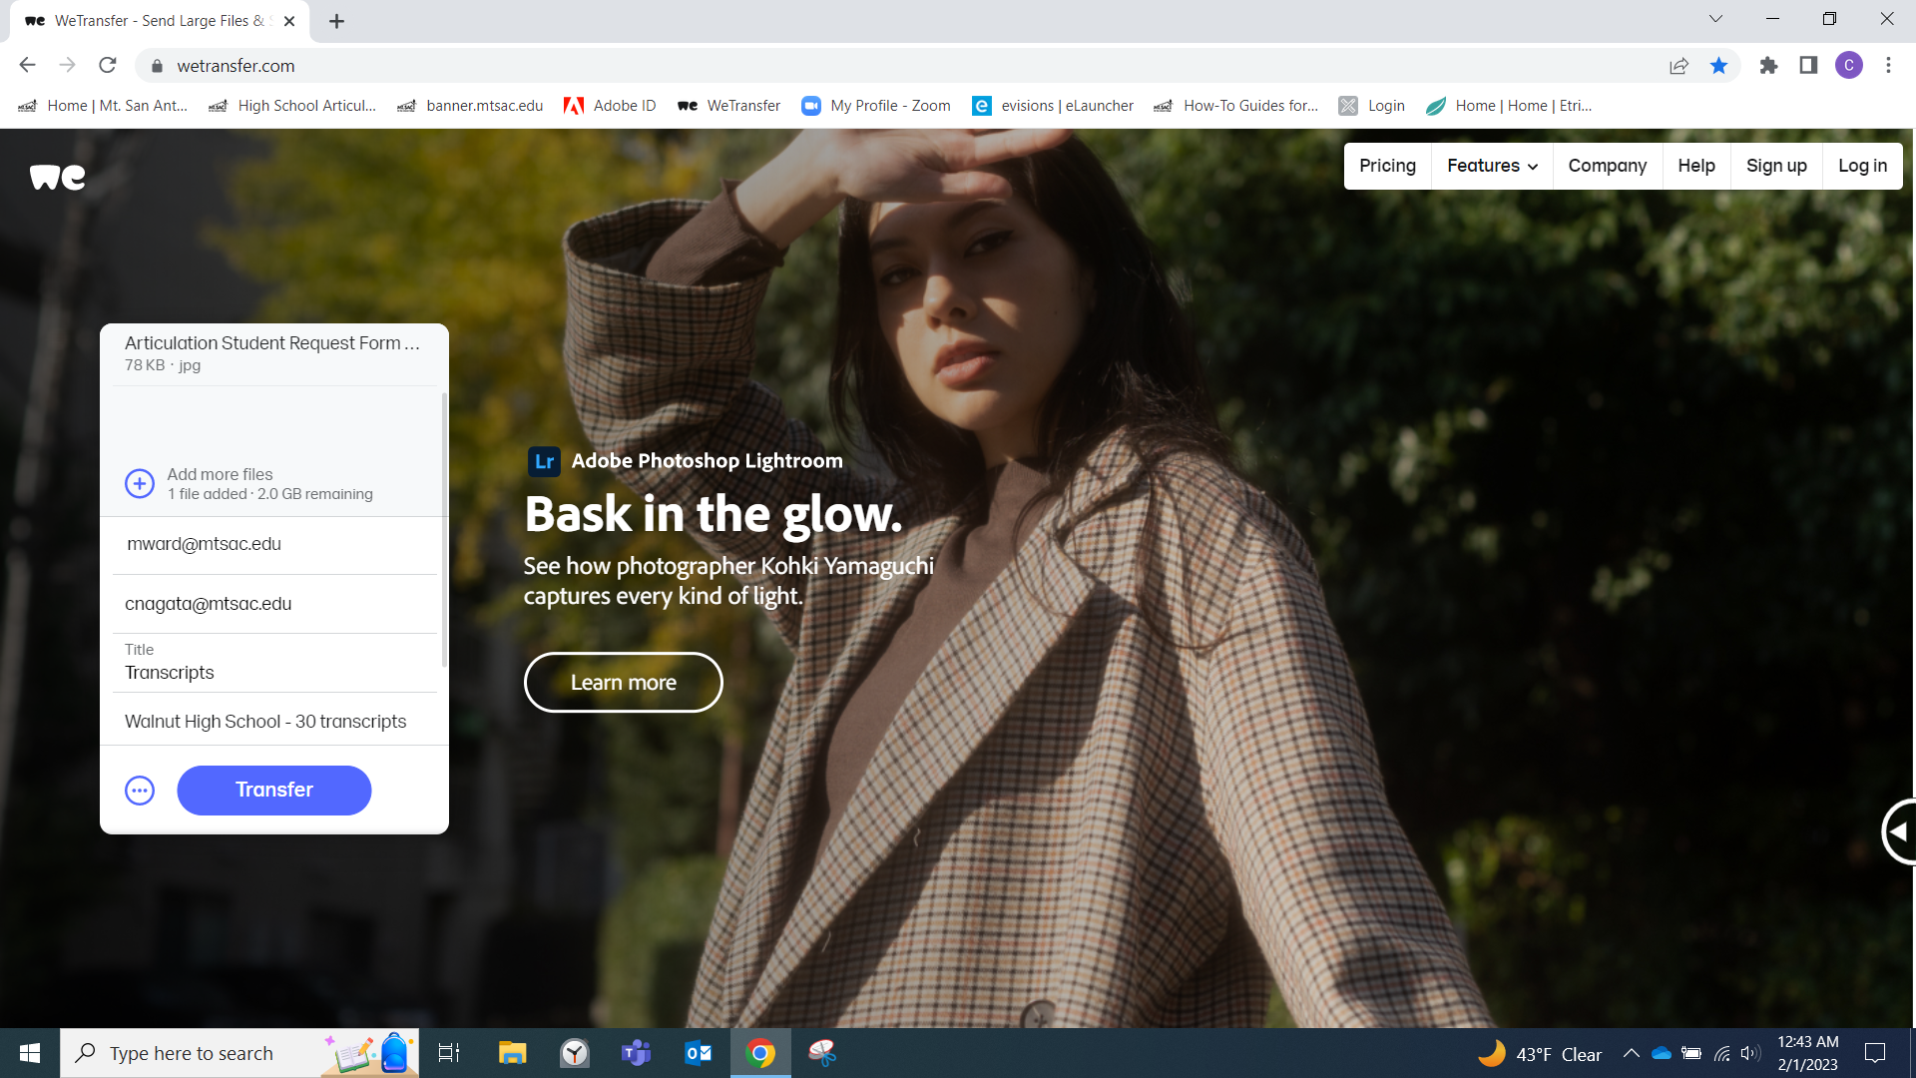
Notes:
This shows that your files have been attached and then you can click “transfer” to send the files.
You’ll get a confirmation email saying the files were sent and then you’ll get another email when Marlene has downloaded the files.

Slide 41
Due Dates
Instructors with EXAMS – Student forms and transcripts are due NO LESS than THREE WEEKS prior to the scheduled exam.
Instructors with agreements that honor the high school grade – Student forms and transcripts are due as soon as possible at the end of your semester. About two weeks before the end of your school year I will send you an email reminder to submit your paperwork.
Notes:
Lastly, I just wanted to mention that because the student initiates the form, we will be receiving daily reports from Etrieve so that we can keep track of which students have submitted forms. So if you ever need to know the status of your student forms or specifically which students have submitted forms, please don’t hesitate to ask, it’ll be easy to send you a current list at any time.

Slide 42

Questions, Problems, Need Support?
Contact: Christine Nagata
cnagata@mtsac.edu
909-274-5893
Schedule: Tue 8 – 4
Wed 9 – 3:30
Thurs 8 – 4

