Slide 1

Articulation Exams, Canvas & Proctorio

Slide 2
Todays Topics
Scheduling Exams
Non-Canvas Exams
Canvas Exams without Proctorio
Canvas Exams with Proctorio

Slide 3
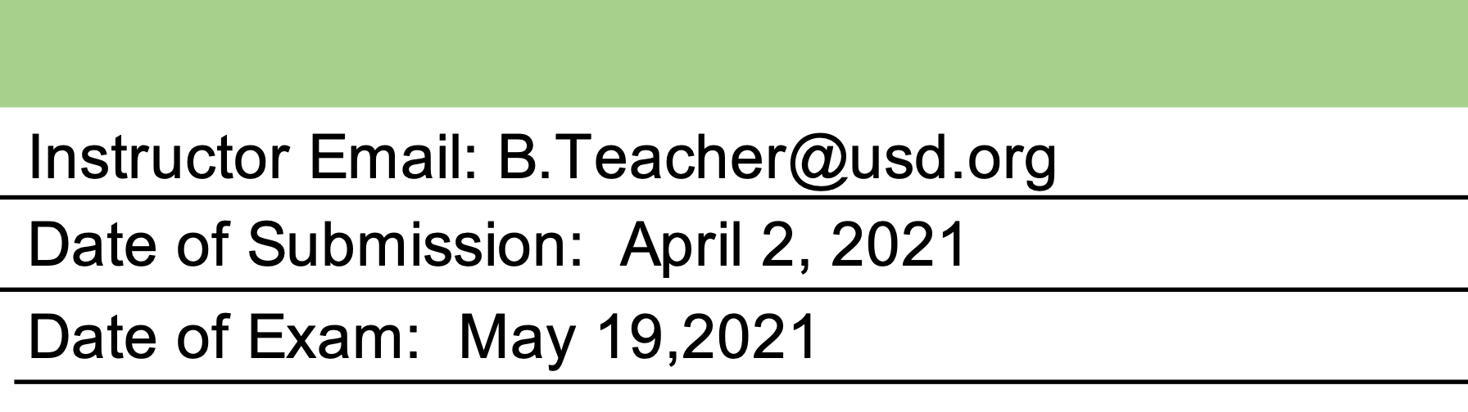
Scheduling Exams
Advanced planning is greatly appreciated.
Structured Dates (ANIM & KIN)
Demonstration Dates (SIGN)
Portfolios
Preferred date(s)
Articulation Pre-Approval Form

Slide 4
Non-Canvas Exams
ARCH - TBA Likely to be portfolio submission
R-TV - Exams will be submitted via dropbox or YouTube
SIGN students will access a SignUpGenius form to select an exam date and time.

Slide 5
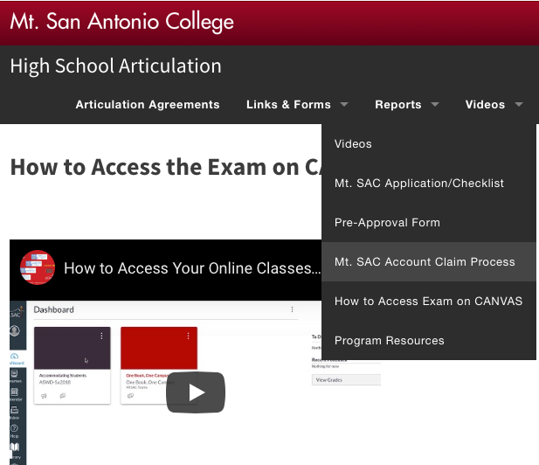

Canvas Exam Steps
Claim Account
Sign-in to Canvas Directly
Accept Invitation to Articulation Course
Take Proctorio Set-Up Quiz if Required

Slide 6
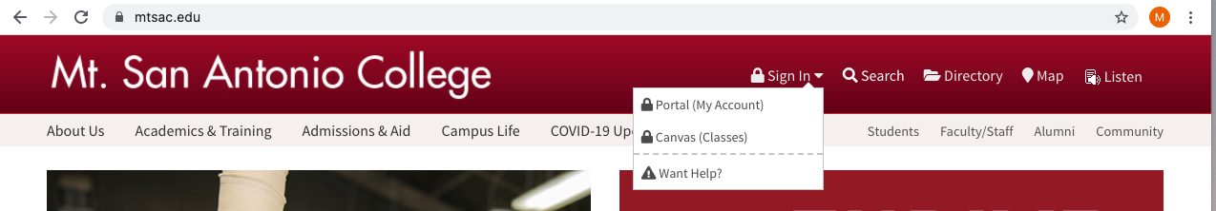
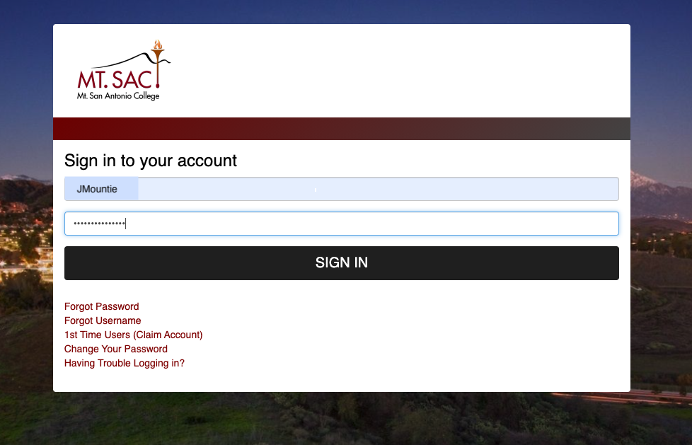

Slide 7
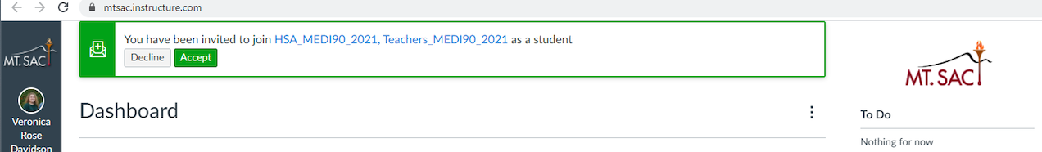
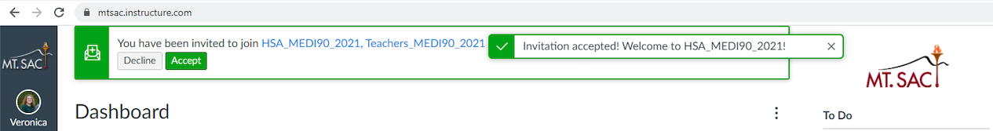
Accept Invitation to Join Course

Slide 8
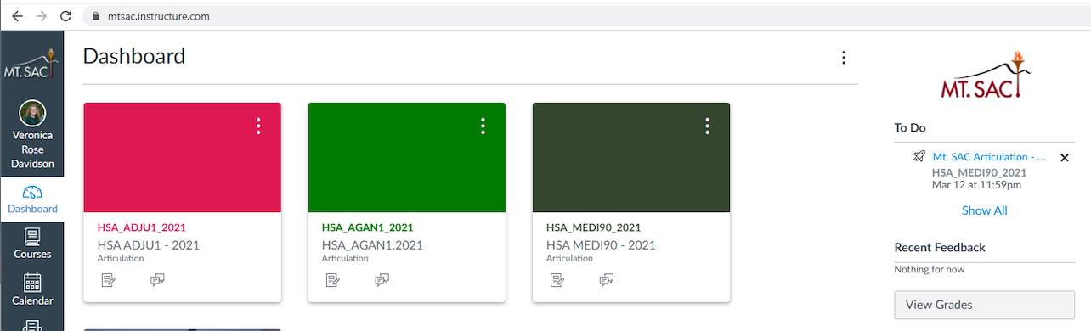

Slide 9
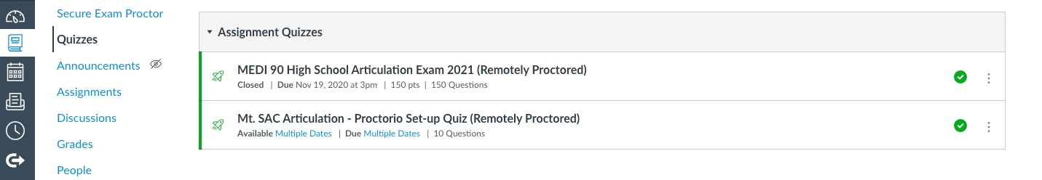
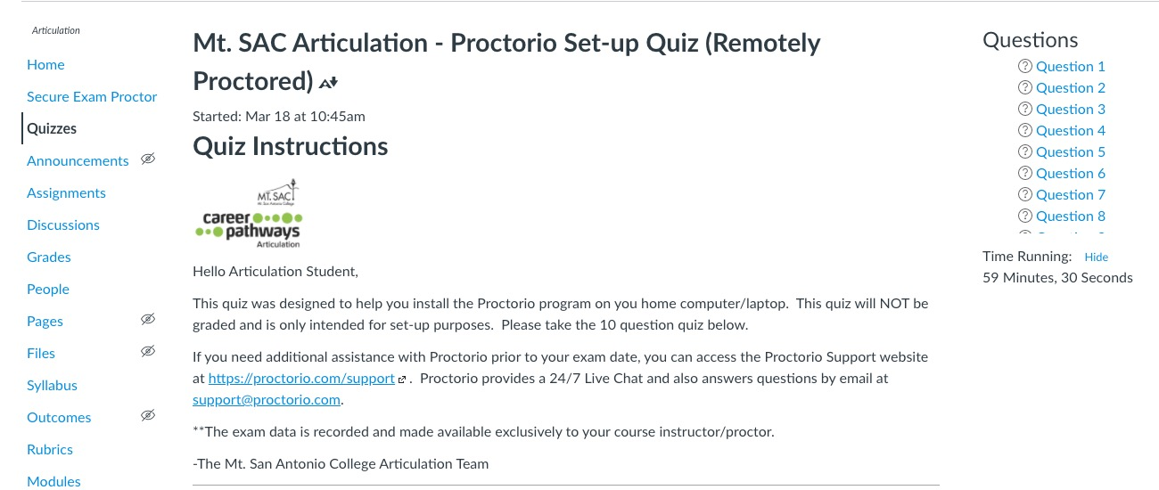

Slide 10
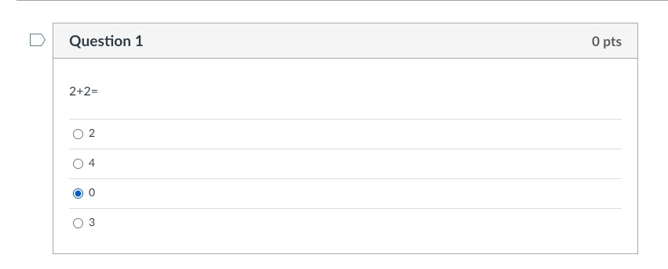

Slide 11
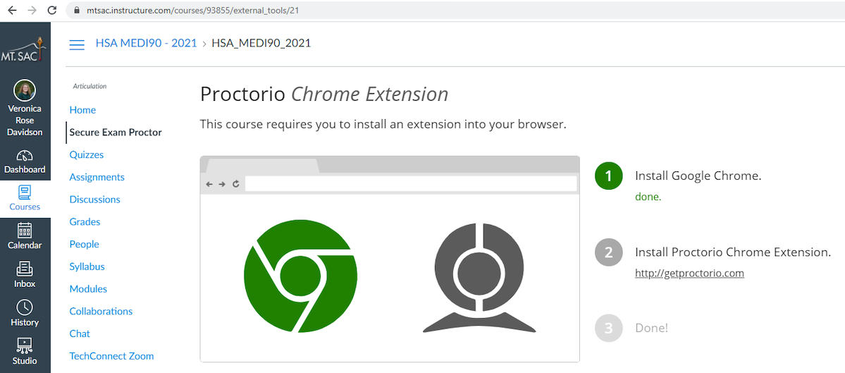
Adding Proctorio

Slide 12
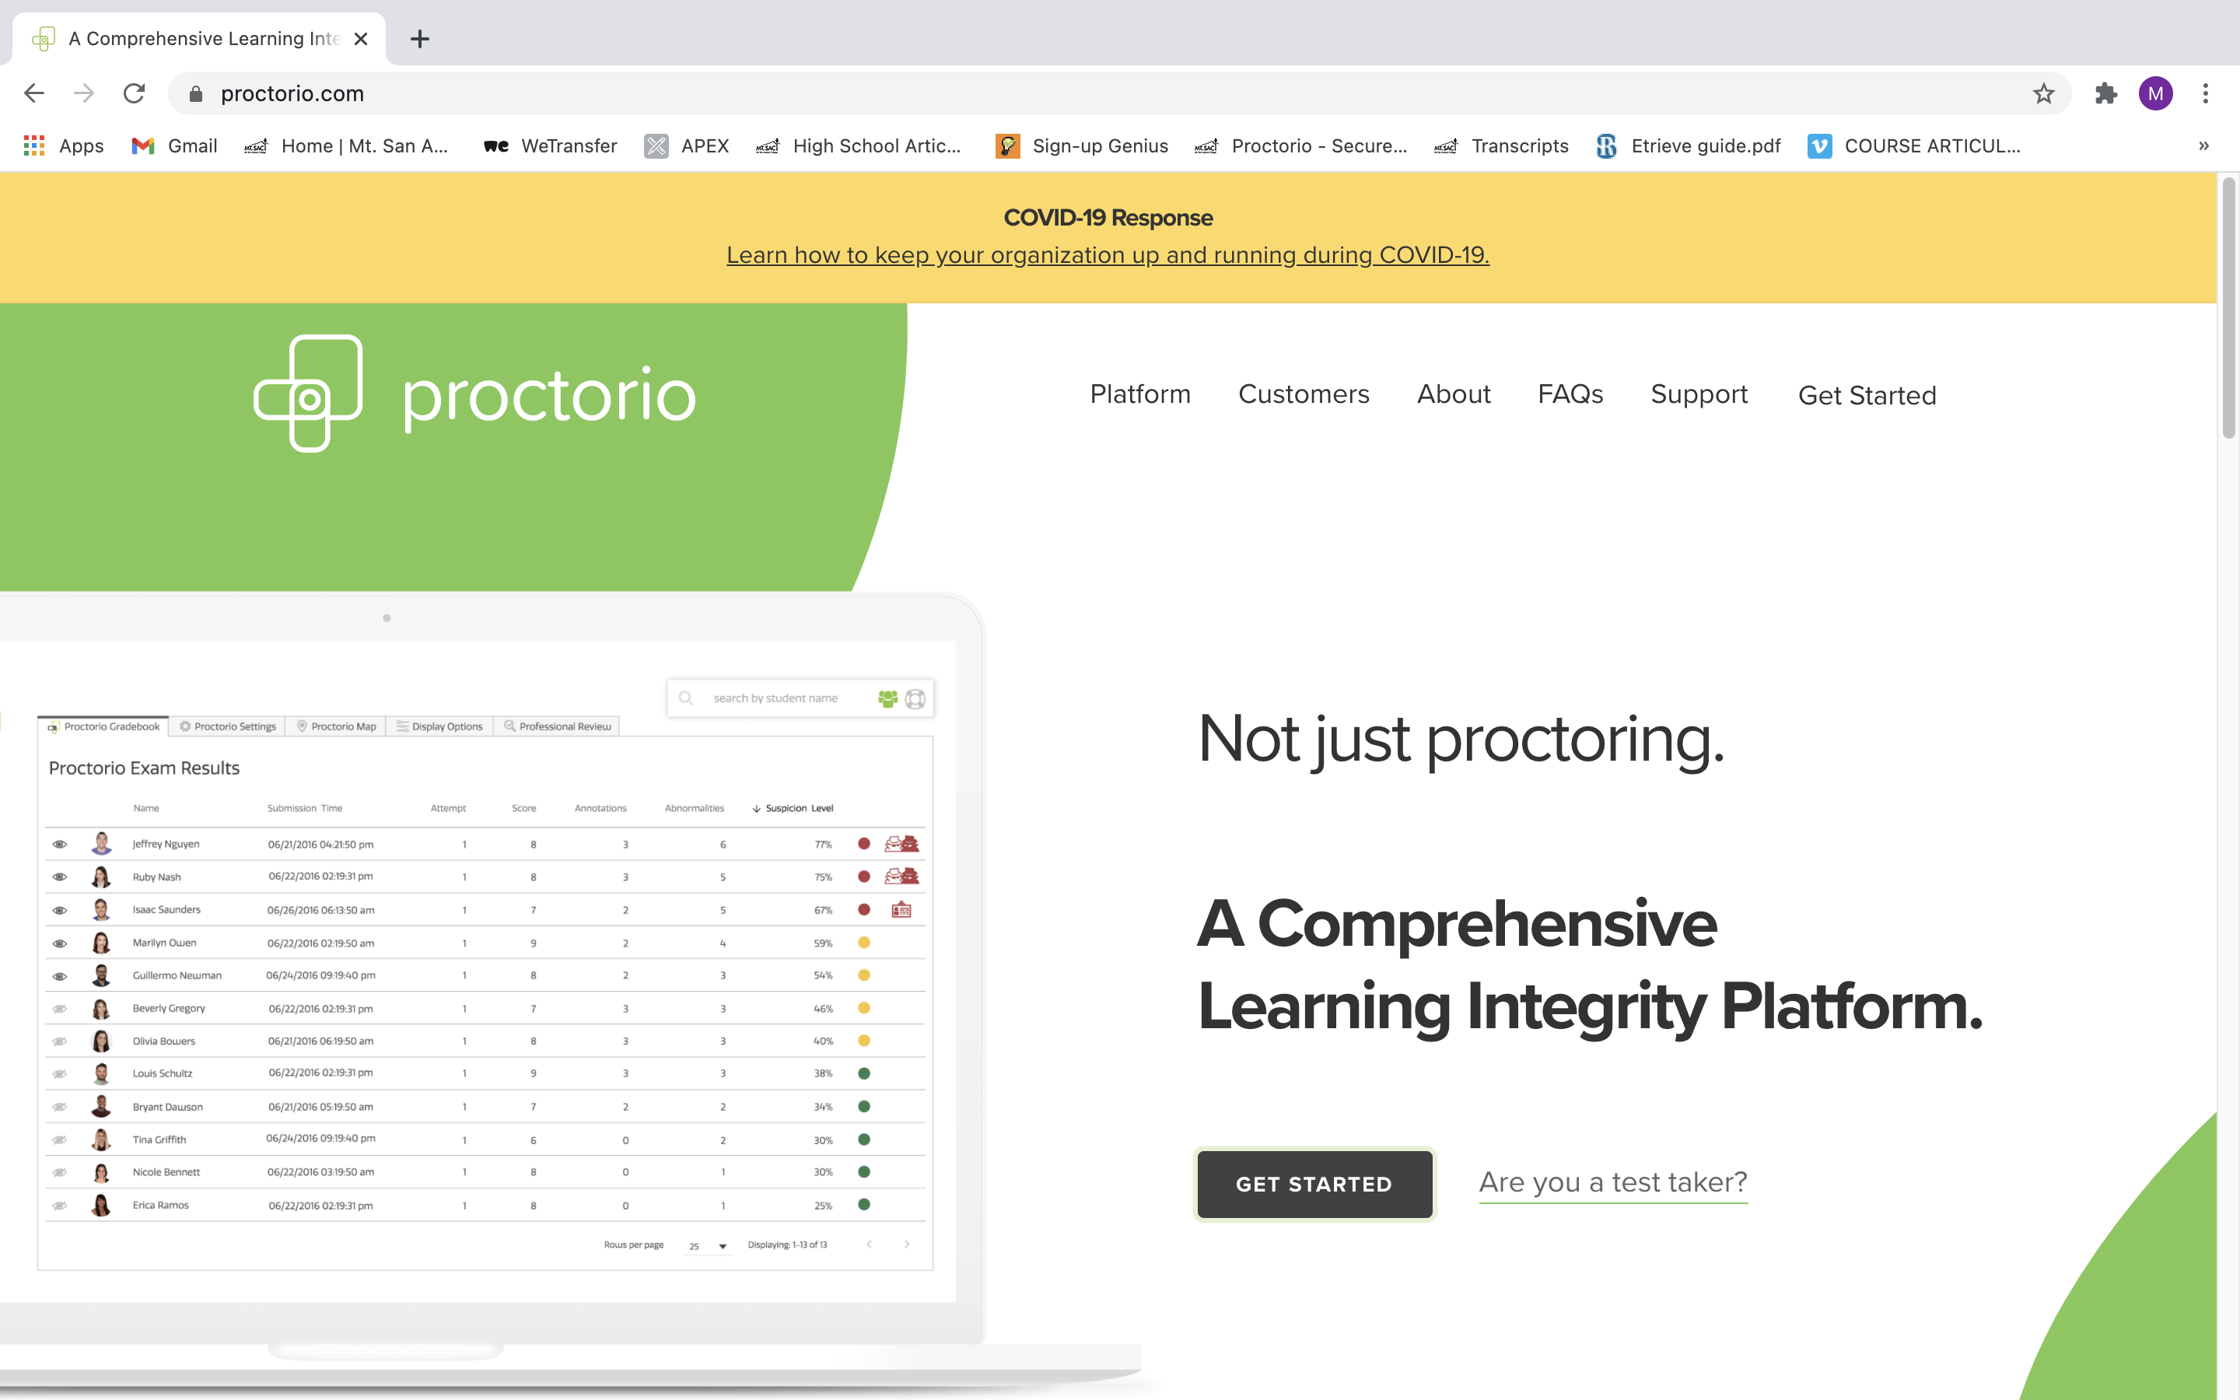

Slide 13
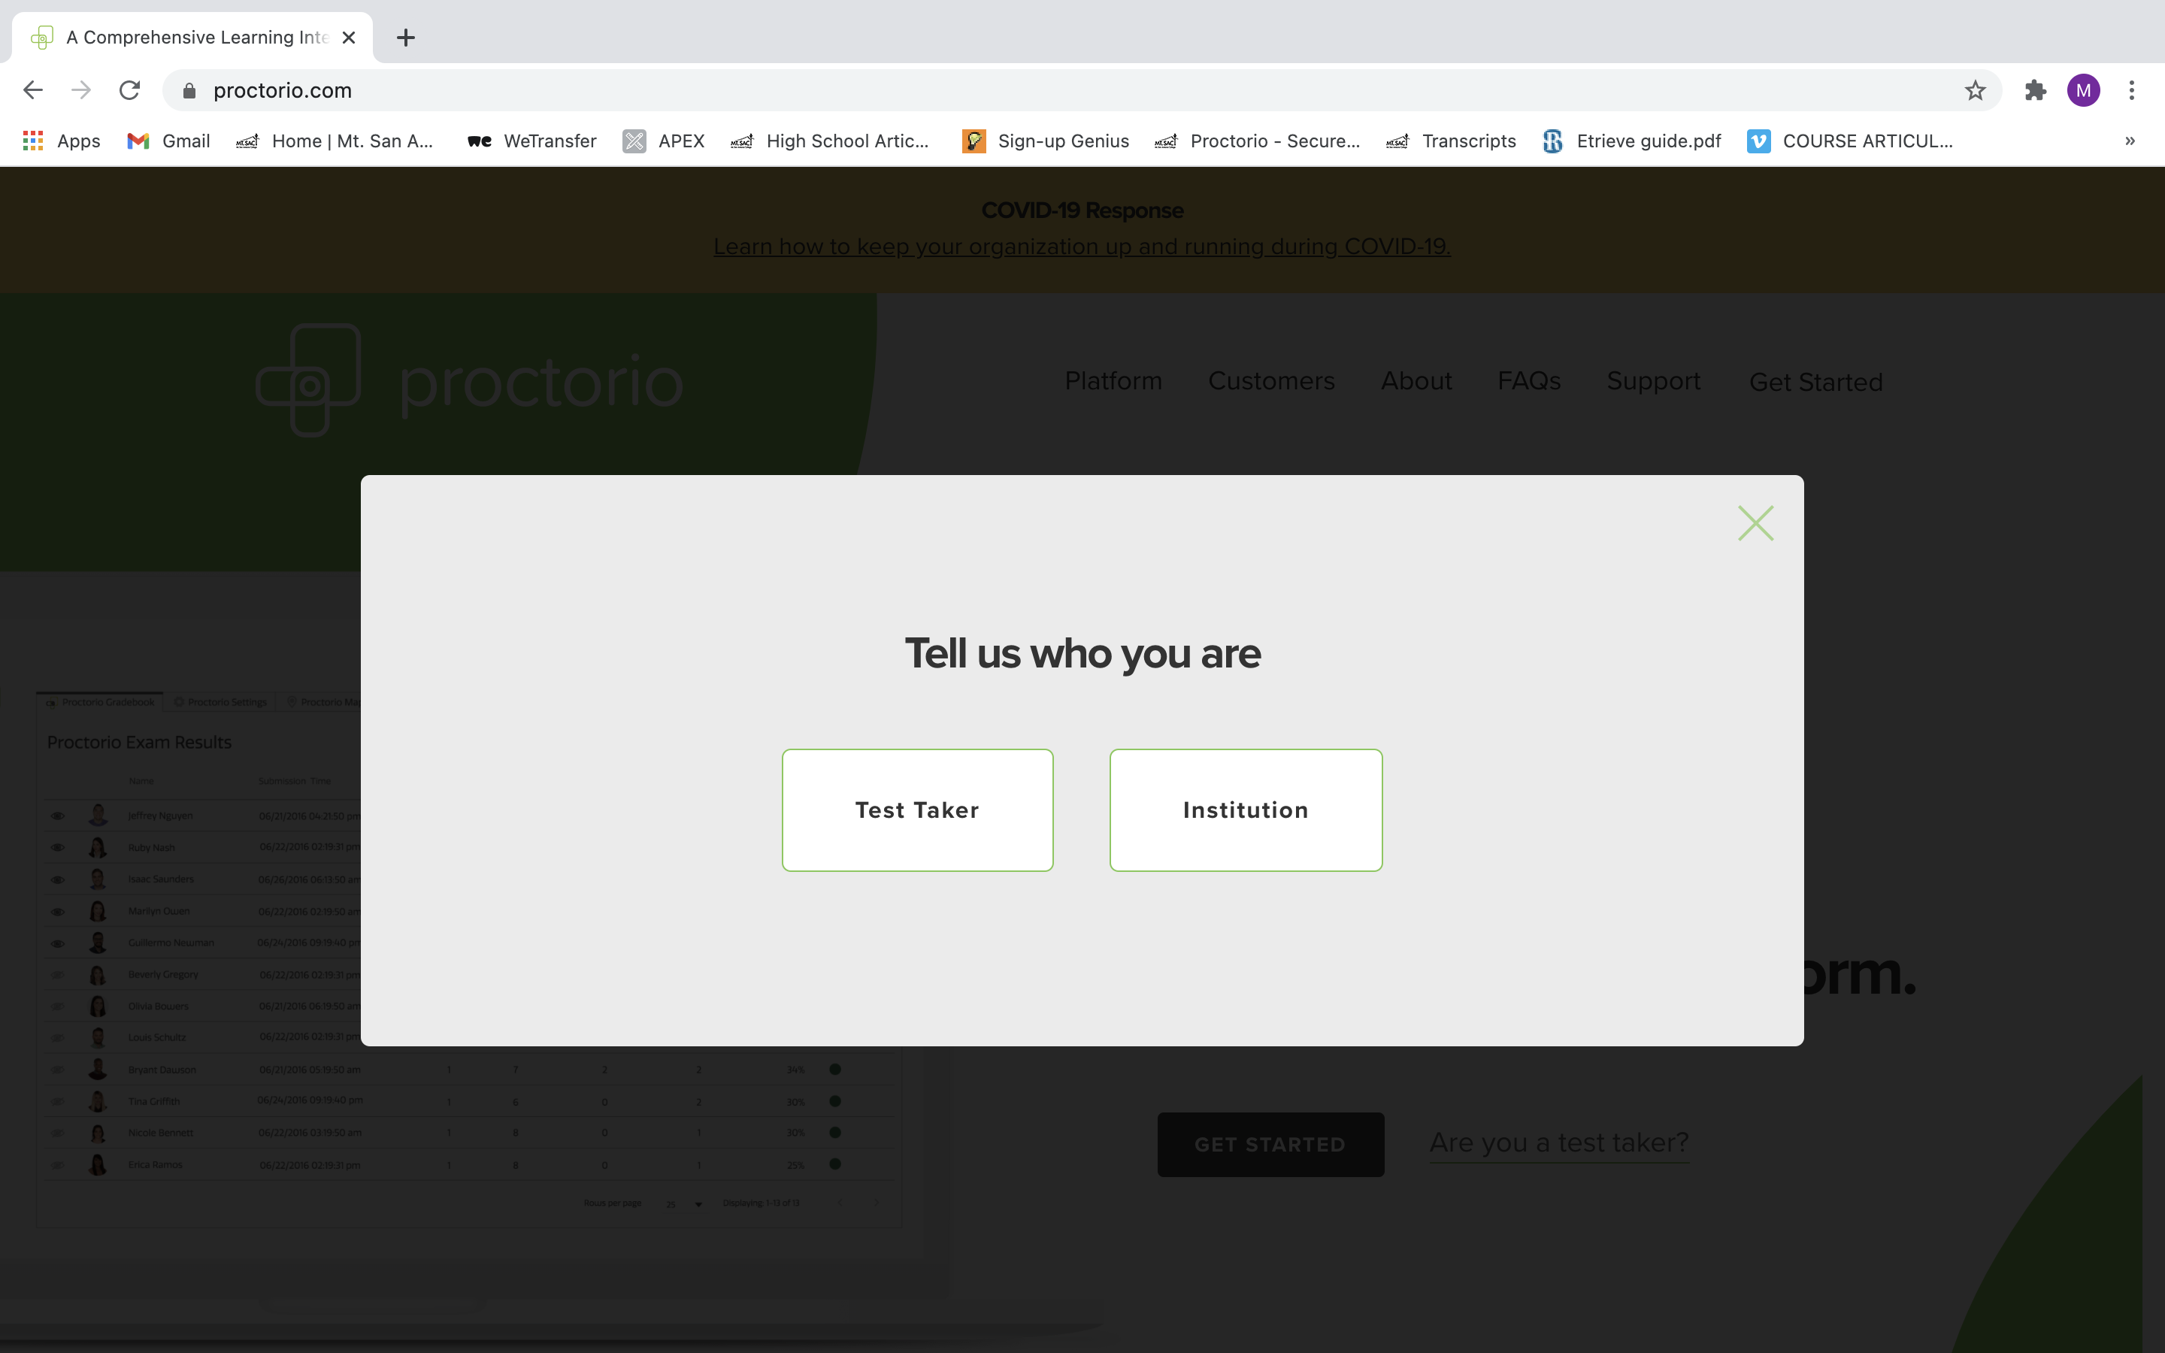

Slide 14
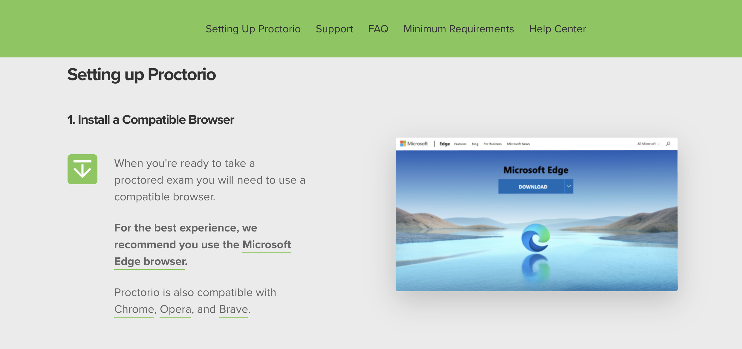

Slide 15
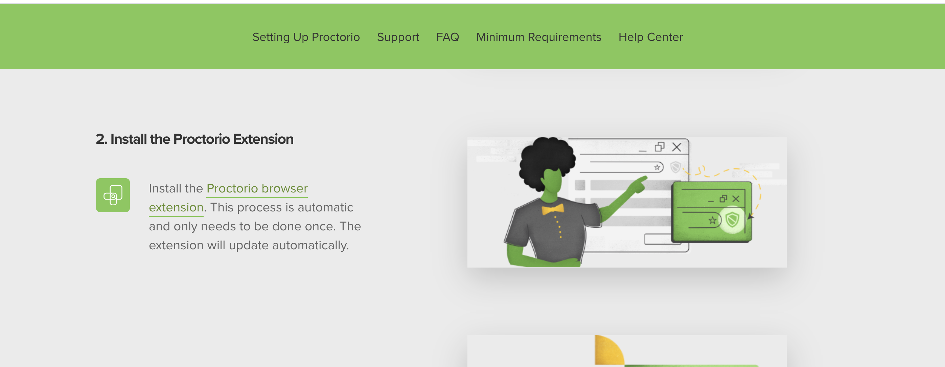

Slide 16
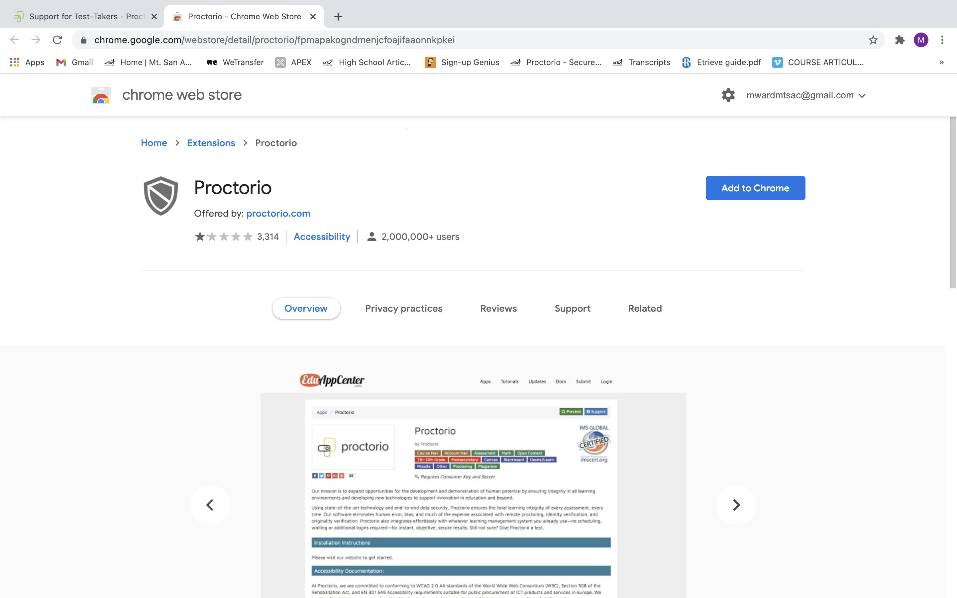

Slide 17
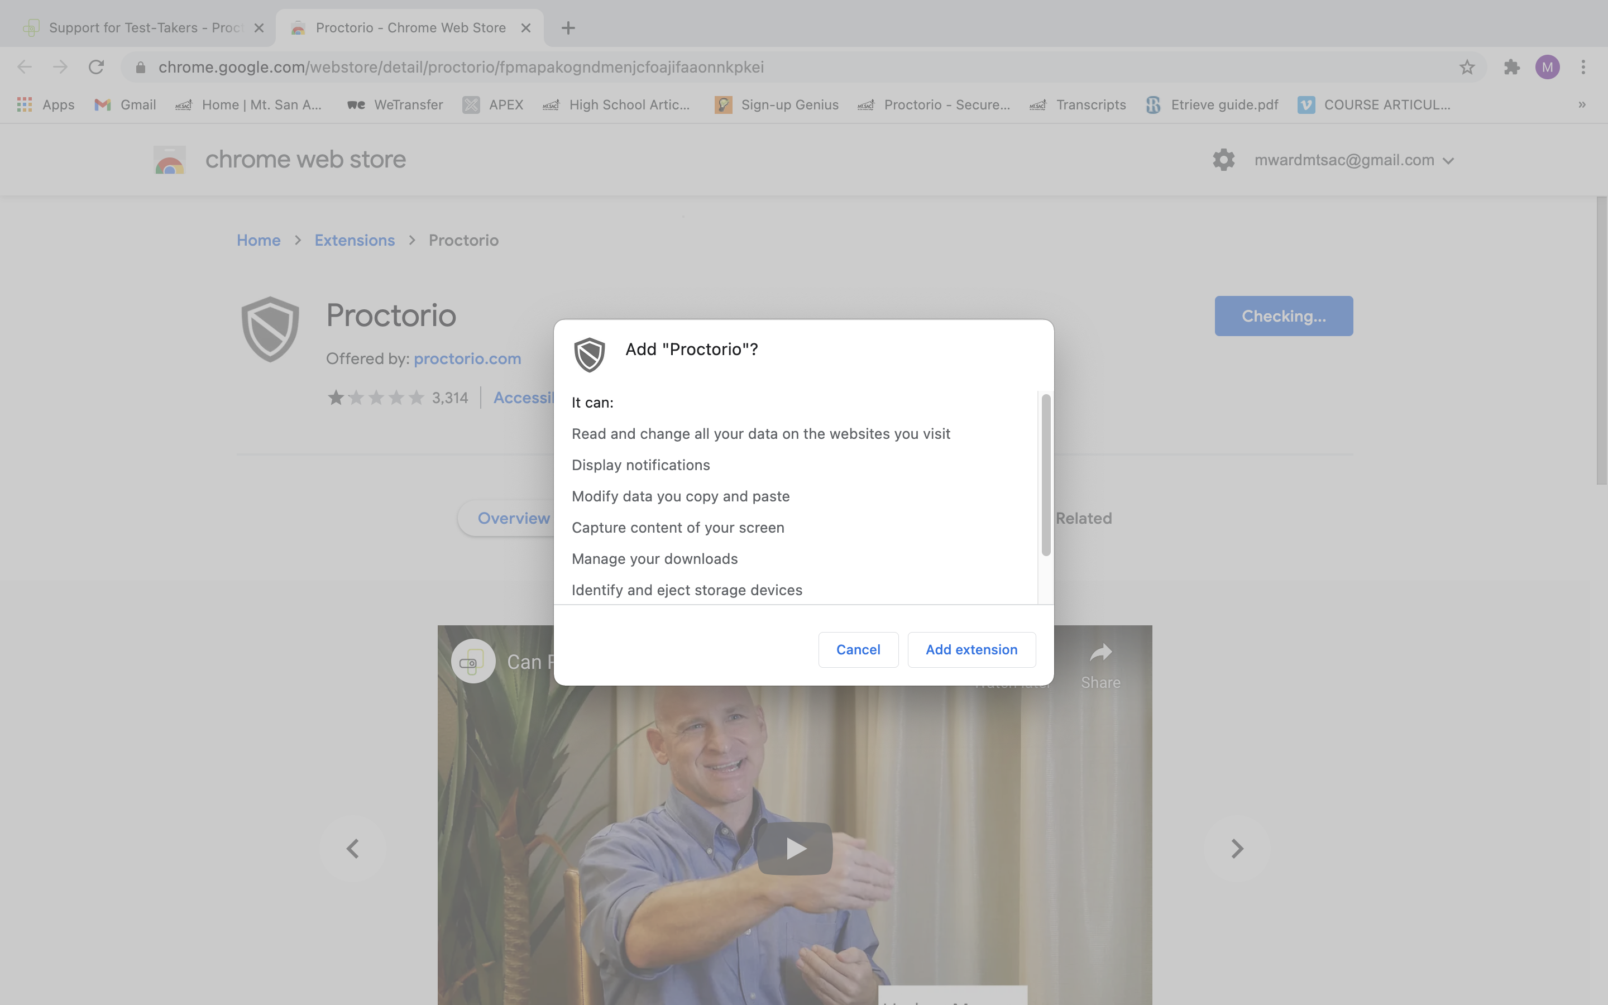

Slide 18
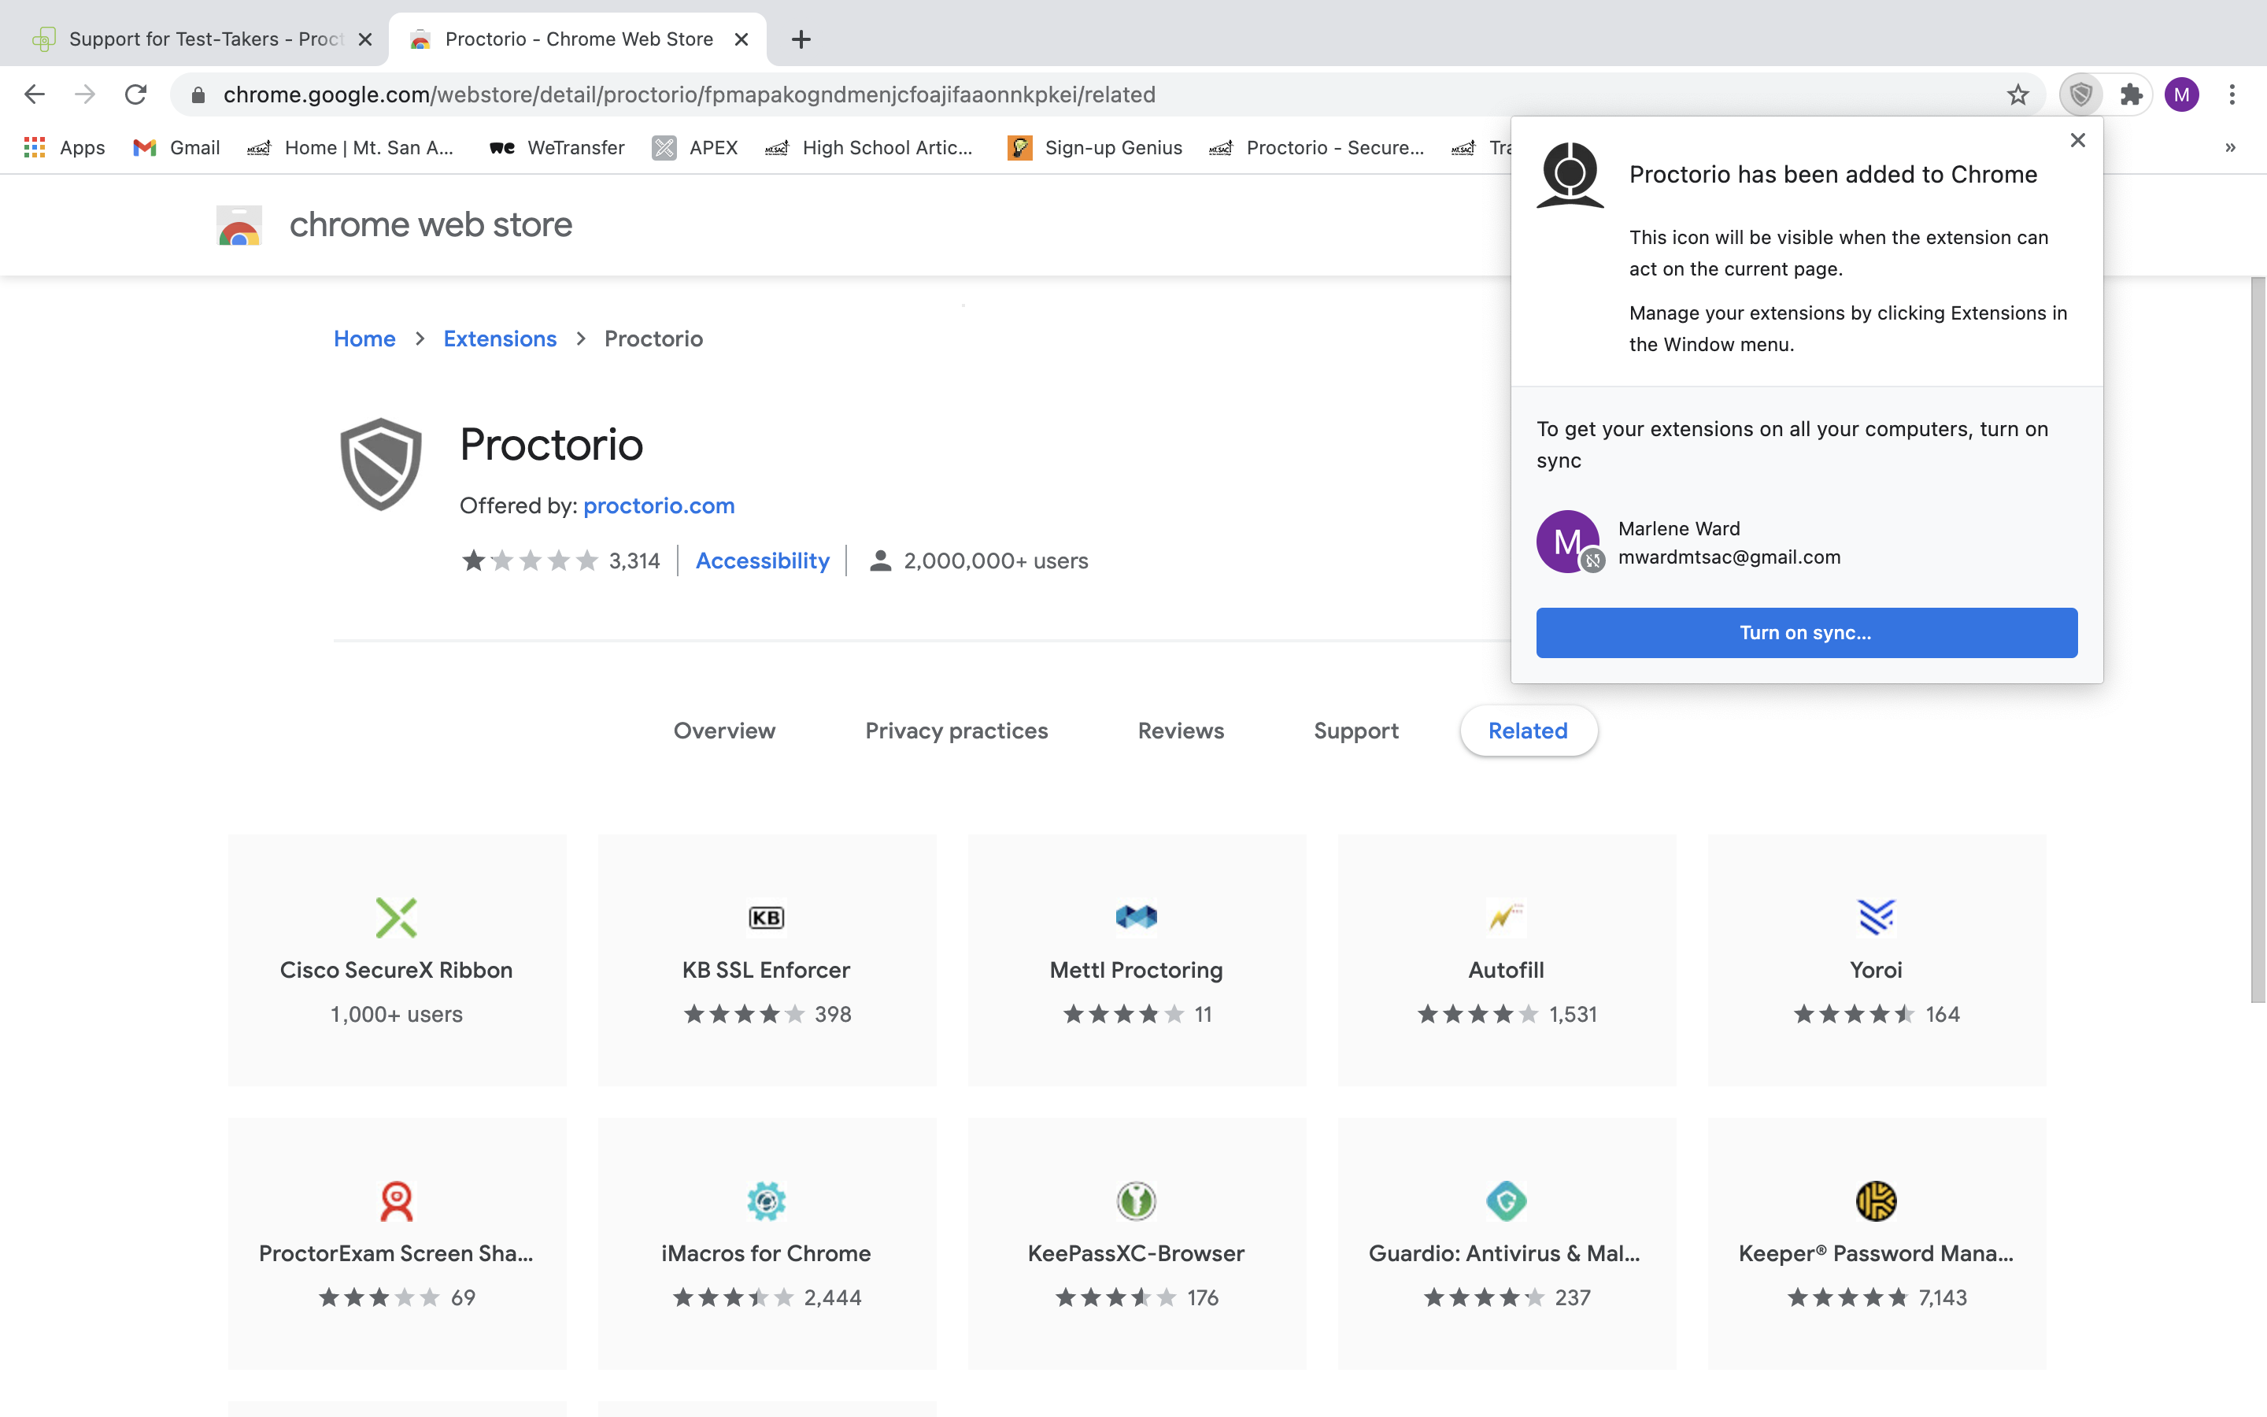

Slide 19
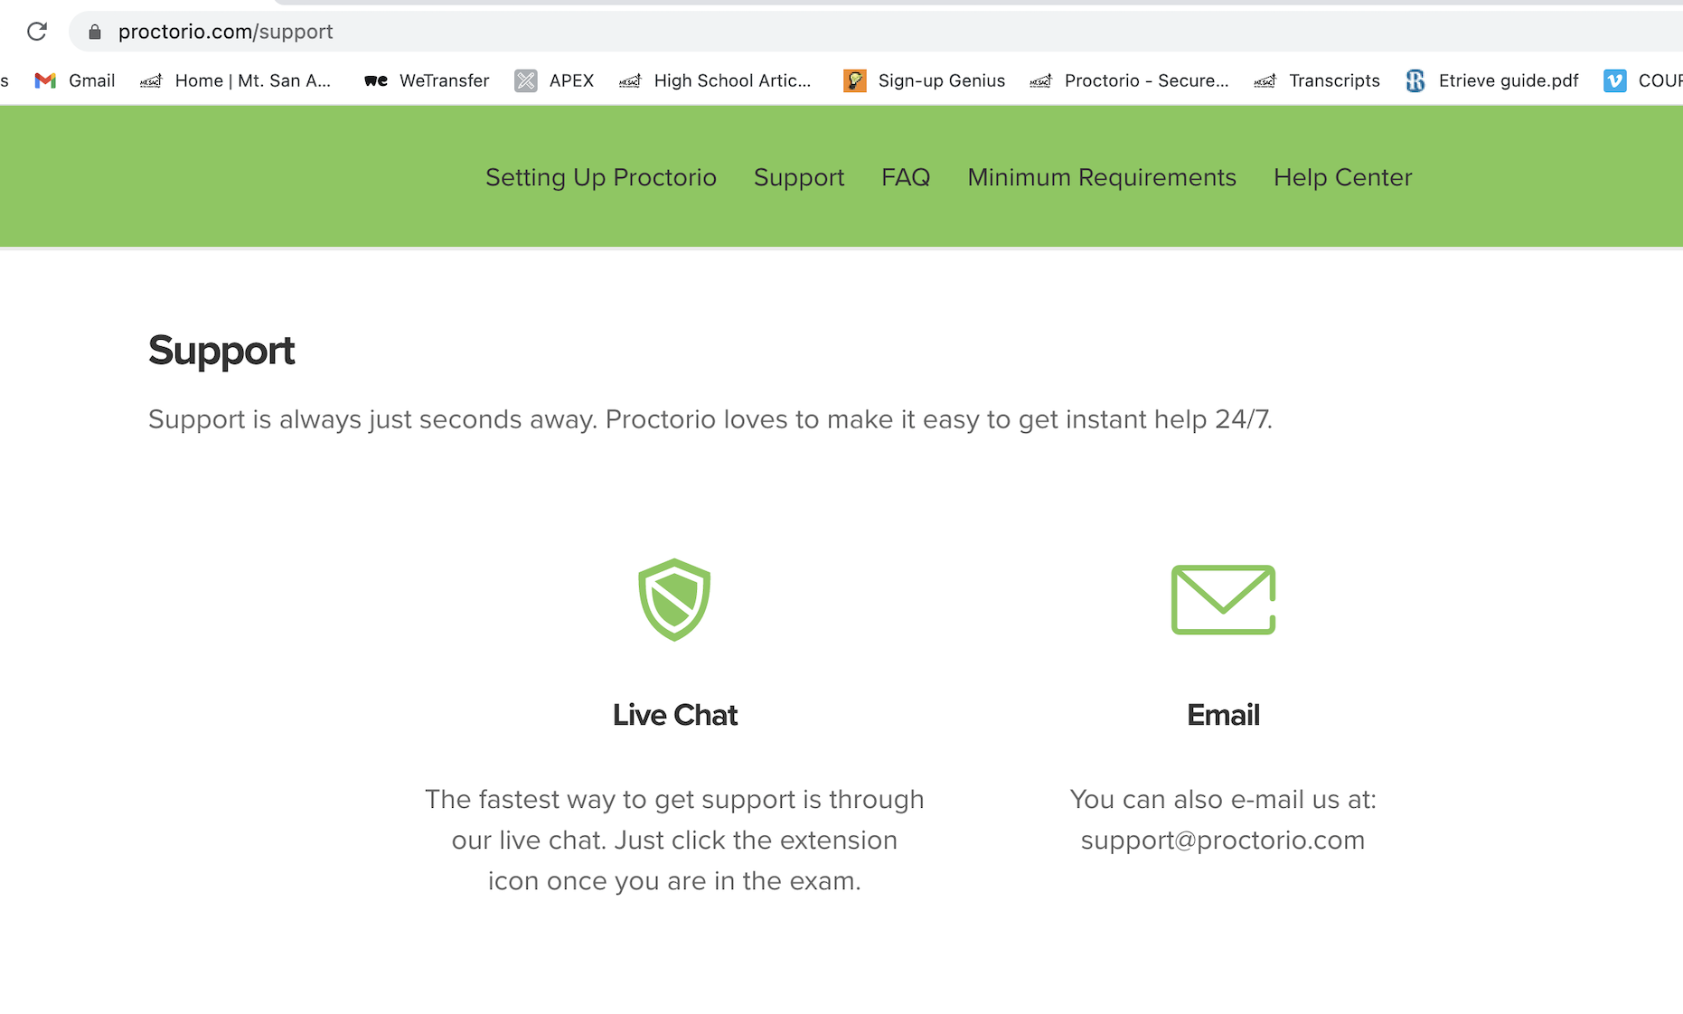
proctorio.com/support

Slide 20
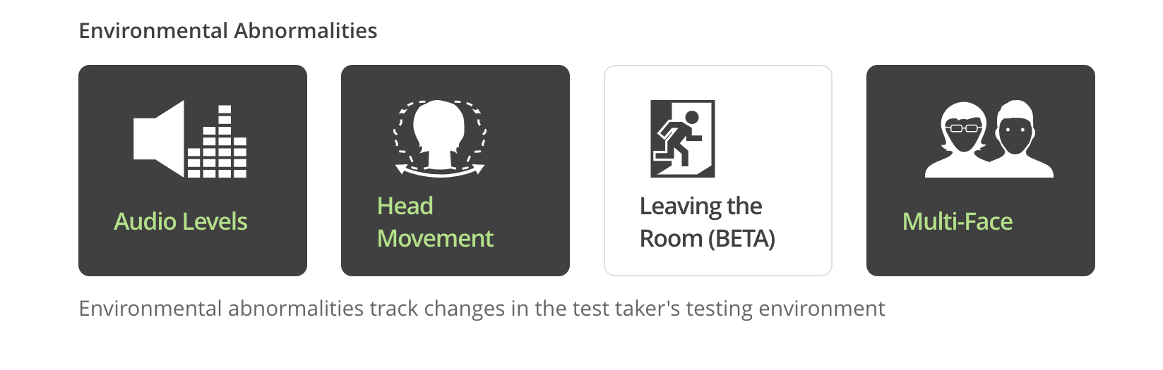
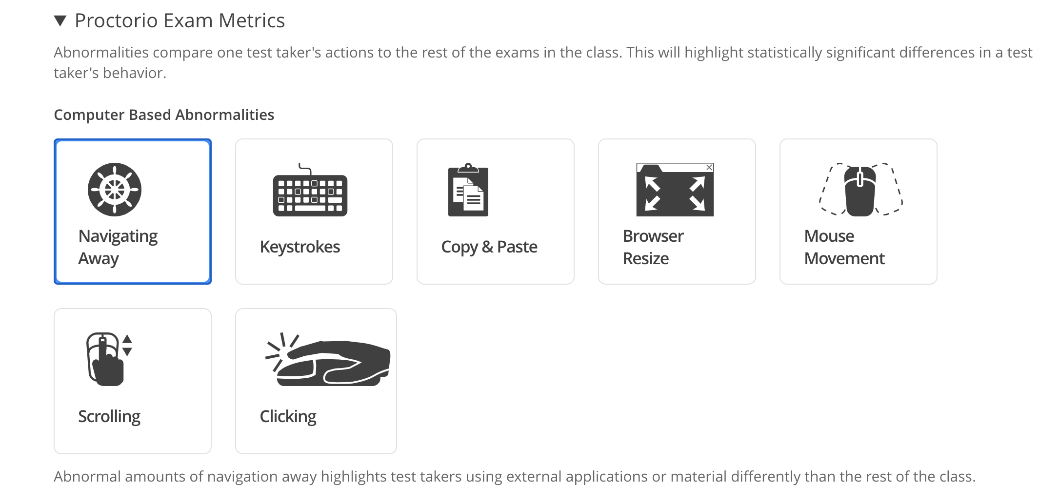

Slide 21
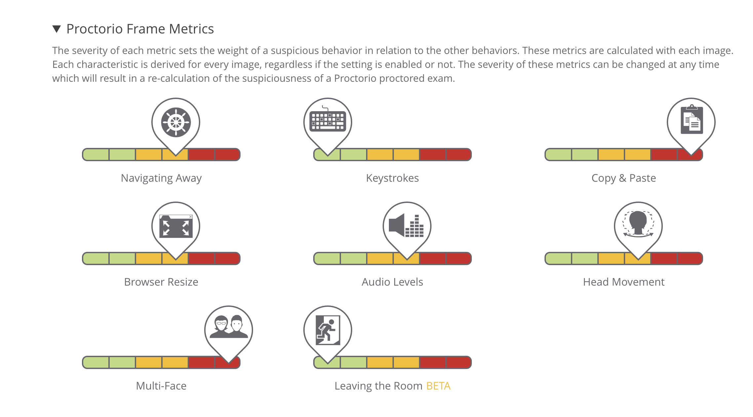

Slide 22
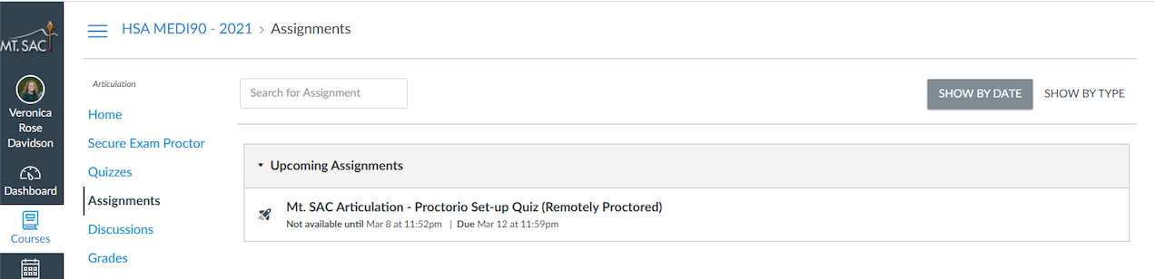

Slide 23
What should I do if a student is kicked out of the exam?
Let student know exams are reviewed regularly
The Articulation Office will identify the reason for removal from the exam
If the reason is within our scope of responsibility (weak wifi, too much movement) a make-up date/time will be scheduled
If the reason is beyond our responsibility faculty will need to review video and make a determination.
If approved, students will only be given ONE additional attempt at the exam
Students accessing a second attempt MUST be scheduled for the same date/time

Slide 24
Our Contacts can be found at:
https://www.mtsac.edu/hsarticulation/contact.html

