Slide 1
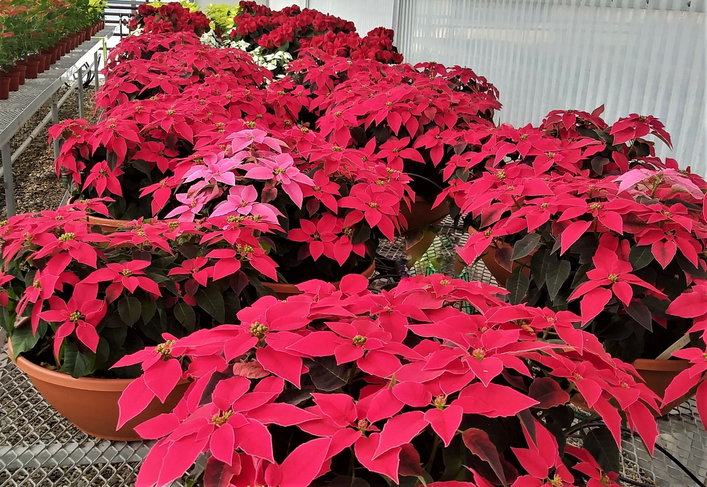

Annual Poinsettia Sale

Slide 2
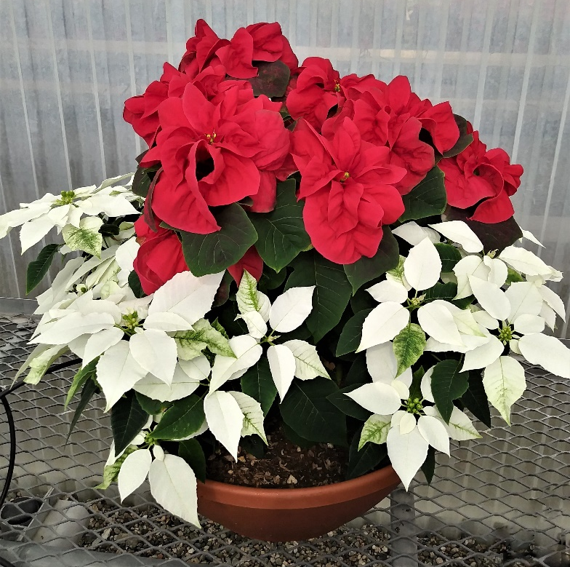
ANNUAL pOINSETTIA sALE Information
November 29 - December 17, 2021
It is time to order your Holiday Poinsettias. We have seven different varieties available as well as some spectacular poinsettia bowls (only available at the greenhouse). They make great gifts, have long-lasting flowers, and remain showy for several months.
These unique and beautiful plants are grown locally at Mt. San Antonio College by horticulture students. Proceeds from the sale are used to benefit the Mt. SAC horticulture program.
Order your poinsettias on-line and pickup at Greenhouse 5 on the Mt. SAC farm. Pickup hours are 8a-11:30a Monday through Friday during sale dates of 11/29 - 12/17/21. Last day/time to pickup is December 17th before 11:30a. Quantities are limited so put your orders in early. First ordered, first served.
To order:
Retail Purchases: go to https://tickets.mtsac.edu/horticulture/Online/default.asp
Wholesale: contact Jesus Ramirez at jramirez@mtsac.edu
Questions? Call (909) 274-4893 or email hortunit@mtsac.edu

Slide 3

Ferrara Poinsettia
Traditional Red!
Traditional poinsettia
Vibrant red color with an abundance of flowers
Give as gifts or decorate your home or office
6” pot for $7.00

Slide 4
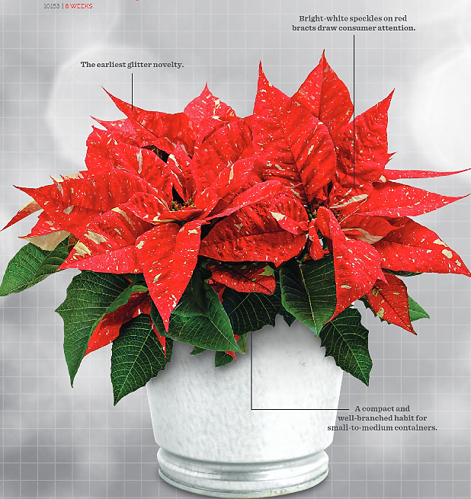
Candy Cane Poinsettia
Brand New Variety!
Red bracts embellished with white speckles
Large and showy for an impressive display
An unusual gift
Limited quantities
6” pot for $7.50

Slide 5

Winter Rose Early Red Poinsettia
Back by popular demand!
Unique holiday look
Ruffled bracts resemble roses
Narrow plant habit
Limited quantities
6” pot for $7.50

Slide 6

Tapestry Poinsettia
Back by popular demand!
Stand alone-decorating accent
Bright red flowers
Yellow and green variegated foliage
Limited quantities
6” pot for $7.50

Slide 7
HOW TO ORDER
Retail: Order your poinsettias on-line at https://tickets.mtsac.edu/horticulture/Online/default.asp
Wholesale: Contact Jesus at jramirez@mtsac.edu
Pickup at Greenhouse 5 on the Mt. SAC farm. Monday through Friday 8a-11:30a from November 29 through December 17th.
Questions? Call (909) 274-4893 or send an email to hortunit@mtsac.edu

Slide 8
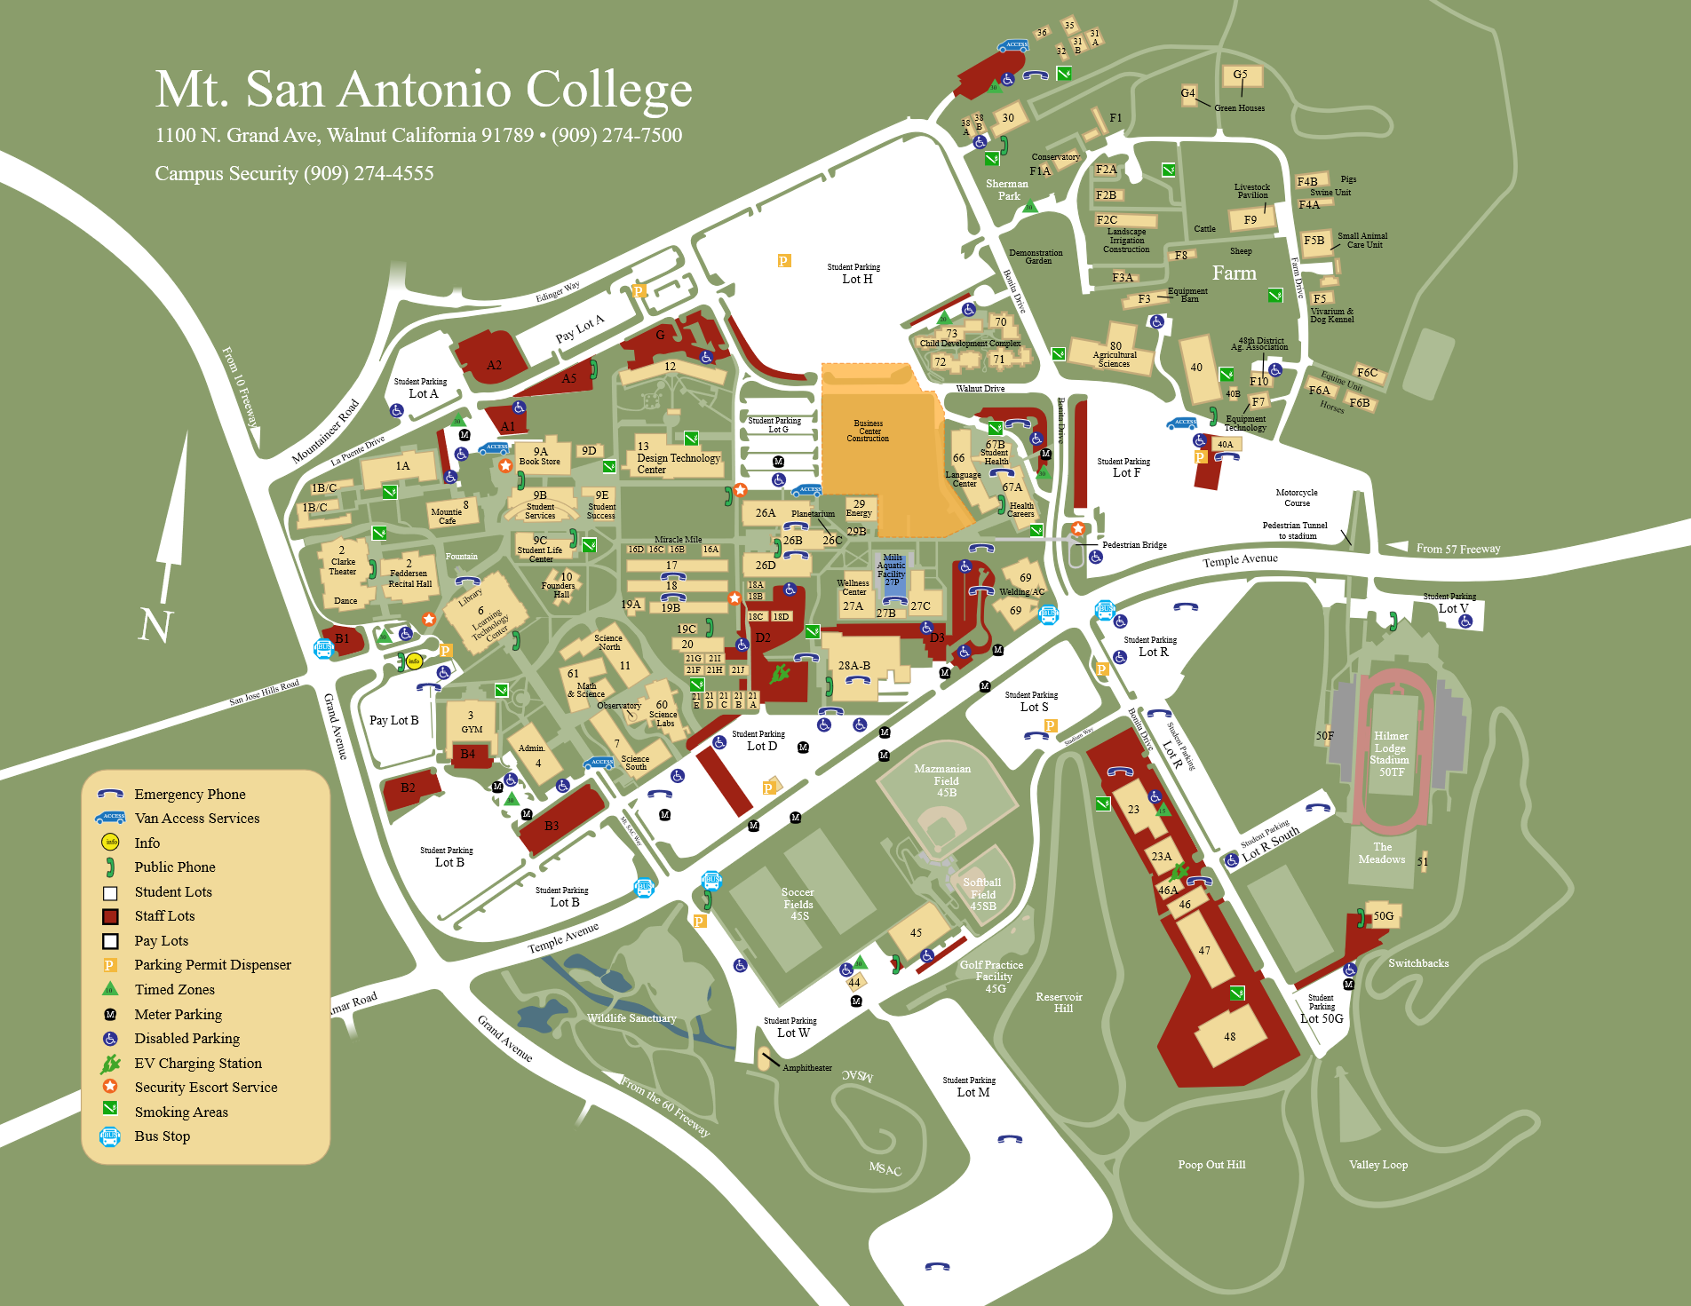
Campus Map
G-5

Slide 9

Directions and map close up:
Drive directly to G5 and park
Option 1: Enter campus off of Grand and Mountainer Road to Edinger Way to Sherman Park. Make a left into the park, at fork make a left, and take Farm Road to Greenhouse 5. Look for the poinsettias signs and make a left turn at the T-intersection and then a right to Greenhouse 5.
Option 2: Enter campus off of Temple Avenue and Bonita Drive (Stadium Way). Make a right turn at Bonita/Walnut into parking Lot F. Travel east and pass first driveway, make a left turn at the second driveway onto Farm Road. Take Farm Road to Greenhouse 5 in the horticulture unit. You will pass horses, sheep, cows, the livestock pavilion then large plants in boxes. Look for the poinsettia signs and make a right turn at T-intersection and then another right to Greenhouse 5.
Parking is available next to the greenhouse.

