Slide 1

Making College Ready for Students
Rather Than
Making Students Ready for College
Guided Pathways
Bill Scroggins
November 2017

Slide 2
What is Guided Pathways?
Making College Ready for Students | Not Students for College
Integrates All Aspects of Student Success &Equity | Not a Disconnected “Program”
A Framework to Organize Services & Interventions | Not a Categorical Program
Improves Success and Completion for All Students | Not a Small Boutique Program
Transformational of Institutional Practices | Not Business as Usual
Guides Informed Student Decisions at Each Step | Not a Cafeteria List of Choices
Attacks Barriers to Progress at Each Choke Point | Not Just Providing Process Info
Uses Data to Discover/Evaluate Barriers/Interventions | Not Based on Usual Outcome Data
Discovery Based on Student and Faculty Input | Not a Top Down Admin Process
Aligns Plans, Budgets, Implementation & Metrics | Not a Maze of Isolated Processes

Slide 3
History of Student Success Initiatives
College Promise (2018) ???? M
Guided Pathways (2017) $150 M
Strong Workforce (2016) $200 M
Student Equity (2014) $155 M
Institutional Effectiveness-IEPI (2014) $28 M
Student Success & Support (2012) $285 M
Technology (OEI/CAI/EPI/eTrans, 2010) $14 M
Basic Skills Initiative (2007/2015) $50 M
CalWORKS Student Services (1996) $44 M
Extended Opportunity: EOPS (1969) $123 M

Slide 4
Why Guided Pathways?
California is short 1.1 million bachelor’s degrees to meet demand by 2030
At CCC 71% of college ready complete, but only 41% of unprepared
CCC Black/Latino: ready: 62%/64% complete; unprepared: 33%/37%
CCC College Ready: 20%; Need Math: 25%; Need English: 15%; Both: 39%
Get College Ready: 2/3/4 Below: Math 44%/27%/17%; English 51%/37%/31%
At CSU, Black/Latino students are 49% but only 38% of degrees
At Mt. SAC 76% of college ready complete; 46% of unprepared complete
Mt. SAC Black/Latino ready 67%/64% complete; unprepared 40%/40%
http://www.ppic.org/publications/?topic=ppic-higher-education-center; http://scorecard.cccco.edu/scorecard.aspx

Slide 5
Why Guided Pathways? Historical View
Carnegie System of Credit Hours for Schools and Colleges. What followed was a tremendous growth in high school enrollment and a clear distinction between high school and college.
Post WWII: High school curriculum became more standardized. The GI Bill mushroomed college enrollment. Community colleges growth was dramatic to meet the need.
1980s Growth of diversity in high school graduates and college enrollments. Emphasis on targeted populations increases, e.g., MESA, EOPS, Puente
Today With higher high school graduation rates and more than two-thirds of graduates going to college, the community college paradigm created 70 years ago does not meet the needs of today’s students.
Year of HS Graduation | High School Grad Rate | Initial College Enrollment Rate
1909 | 8.8% | NA
1947 | 54% | 34%
1980 | 76% | 49%
2015 | 83% | 69%
HS Graduates and College Enrollment by Race/Ethnicity, Age 18-21, 1975, 1997, 2013
% of Age 18-21 | High School Graduates |  | % of HS Grads In College
 | 1975 | 1997 | 1975 | 1997 | 2013
All | 78.0 | 77.5 | 33.5 | 44.7 | 65.9
White | 80.6 | 79.2 | 34.6 | 46.1 | 68.8
Black | 60.4 | 68.7 | 24.9 | 33.4 | 55.6
Hispanic | 57.2 | 60.7 | 24.4 | 27.5 | 59.8

Slide 6

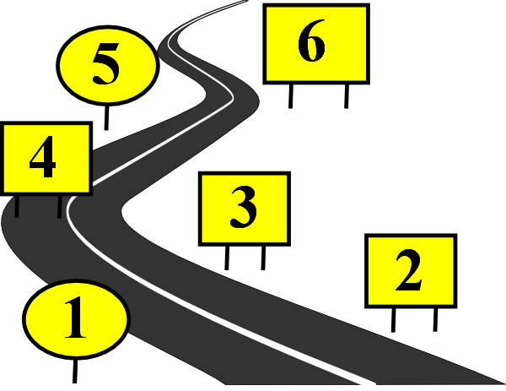
Milestones to Completion
Following the Major Map
Entering a Major
On-Boarding
Orientation
Assessment & Placement
Education Plans
Basic Skills:
Math, English, ESL
HS/Adult Ed to College Entry
Apply/Register/Attend
Financial Aid
HS Outreach
Dual Enrollment/ Early College HS

Slide 8
Dual Enrollment & Early College HS
School boards determine which students may benefit from dual enrollment and dual credit, upon recommendation from their principal and parental consent.
Students enrolled in Early College High Schools earn college credit through dual enrollment.
ECHS school days are 180 rather than 240 minutes.
AB 288 expands dual enrollment to closed classes during school periods under specified conditions jointly approved by both boards.
After a pilot year in 2016-17, Mt. SAC is now offering dual enrolled classes at the following schools.
International Polytechnic HS (Ipoly) | ENGL 68, Prep for College Writing
 | ENGL 1A, Freshman Composition
 | MATH 110, Elementary Statistics
 | POLI 1, Political Science
 | MATH 160, Precalculus
Rowland HS | SOC 1, Sociology
Nogales HS | ANTH 5, Cultural Anthropology
Edgewood HS | COUN 51, Career Planning
 | BIO 5, Contemp Health Issues
 | MEDI 90, Medical Terminology
 | FIRE 1, Fire Protection Org
West Covina HS | COUN 51, Career Planning
 | Math 71A, Intermediate Algebra
 | Math 71B, Intermediate Algebra
Ganesha HS | ENGL 68, Prepfor College Writing
 | ENGL 1A, Freshman Composition
Diamond Bar HS | ENGL 1A, Freshman Composition
 | ENGL 1C, Critical Thinking &Writing

Slide 9
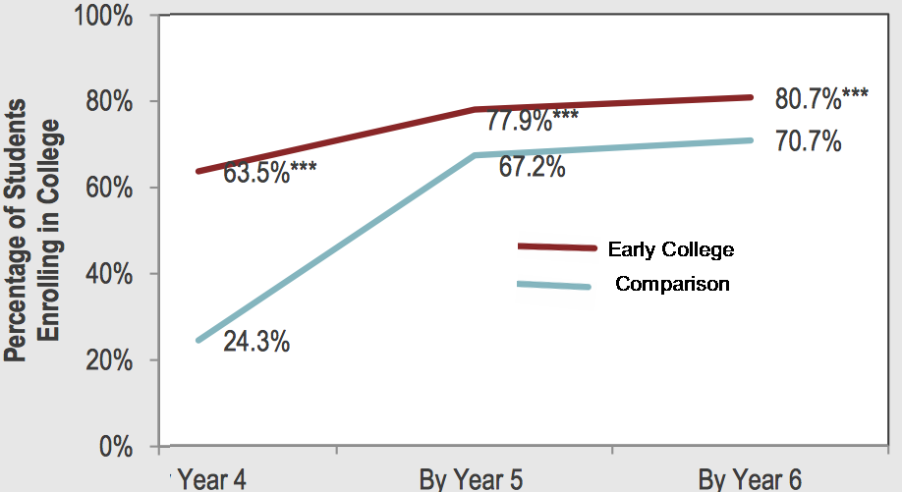
Early College High School
ECH Makes Students More Ready for College
  86% graduate from high school, more than the 81% for comparison students
  80% enroll in college, compared with 71% of comparison students
  20% earn a associate degree by the time they graduate from high school
  Two years out of high school 25% have earned a bachelor’s degree
  High school graduation and college enrollment does not differ significantly based on gender, race/ethnicity, family income, first-generation college-going status, or pre-high school achievement
  .
www.air.org/sites/default/files/downloads/report/ECHSI_Impact_Study_Report_Final1_0.pdf
www.air.org/resource/early-college-continued-success-early-college-high-school-initiative-impact-study-2014

Slide 11

College Entry: Financial Aid
Percentage of Credit Students With Fee Waivers and Pell Grants, Fall 2016
Making College Ready for Students: Financial Aid Text Message Reminders
15% (6,585) of total Financial Aid applications received in Fall 2017did not apply for admission
We sent the email on July 25, 2017 to 20,551 people who applied for financial aid over the last two years but didn't register for classes.
Of that email group, 3,187 ended up registering for classes.
Fee Pell All Credit
Waiver Grant Aid Students

Slide 12
College Entry: Reaching Students via Text Message
Fall 2017 Waitlist Activity (as of Sept 7)
  13,235 Total Occupied Waitlist Seats
  10,305 Registration Text Message Notifications
  7,177 Successful Registrations
  54.2% Moved from Waitlist to Actual Enrollment
Enrollment
Day-by-Day

Slide 13
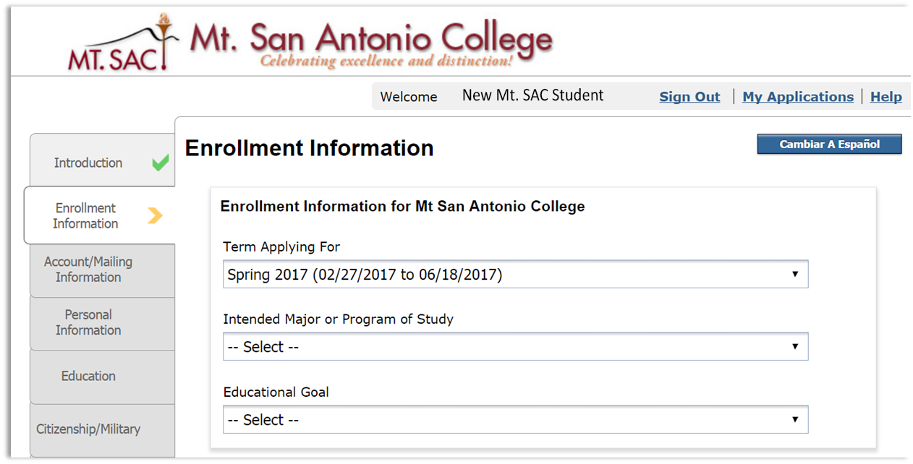

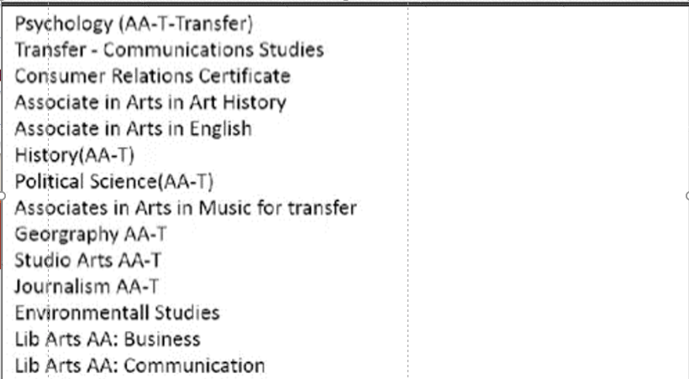
College Entry: Initial Choice of College Major
An example of the need for guided choices is the requirement that students choose an initial academic major in the application process.
For “Intended Major or Program of Study,” Mt. SAC has 247choices.

Slide 14


Slide 15
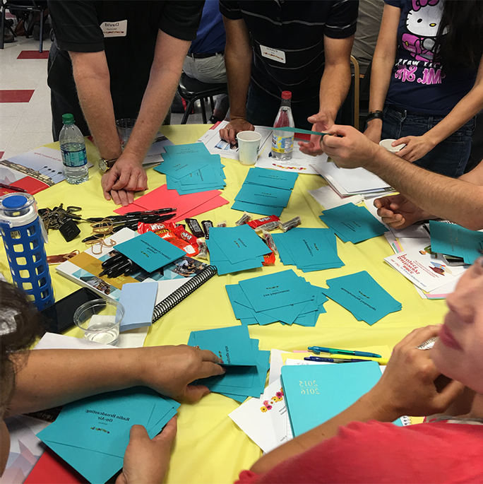
On-Boarding: Initial Education Plans
Students are required to have at least an initial one-semester education plan. Students are encouraged to explore majors—challenging given 247choices
To guide students in selecting a program of study, academic majors are divided into eight clusters or “meta-majors.” The process (shown to the right) was to have students and faculty, in separate groups, sort those 420 majors into 8 “buckets.” The final labels chosen use the terminology selected by the students.

Slide 16


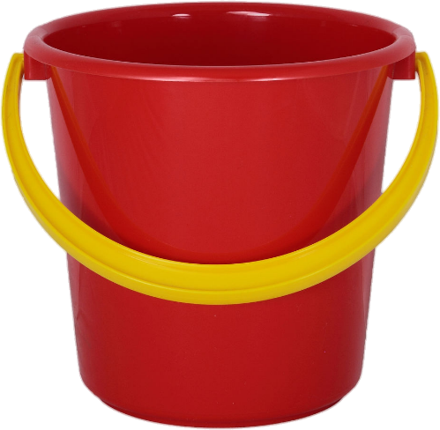


On-Boarding: Early Choice of Career Cluster
.
Using Names Understood by Students
Makes College More Ready for Students
Aviation, Electronics, & Manufacturing
Sciences
Teaching & Education
Humanities & Communication
Health, Wellness, & Public Service
Art & Design
Plants & Animals
Business & Information Technology

Slide 17
On-Boarding: Growth in Students Served
New students are required to go through orientation before they can register for classes.
New students must be assessed and have an initial education plan to earn registration priority.
Students go through initial counseling and then must have an informed multi-semester education plan by the third semester.

Slide 19
Basic Skills: Assessment & Placement
The Current System
Students attending Mt. SAC are required to participate in assessment
English
  The Assessment of Written English (AWE) evaluates writing skills. Students are given a writing prompt and the writing sample is evaluated by at least two faculty members.
  Based on the evaluation, they are eligible for English (1A, 68, 67, or LERN 81), for AMLA, or for ESL
Math
  Students take one of the math placement exams commensurate with their most recent, successful completion of Pre-Algebra, Algebra, Intermediate Algebra or Pre-Calculus.

Slide 20
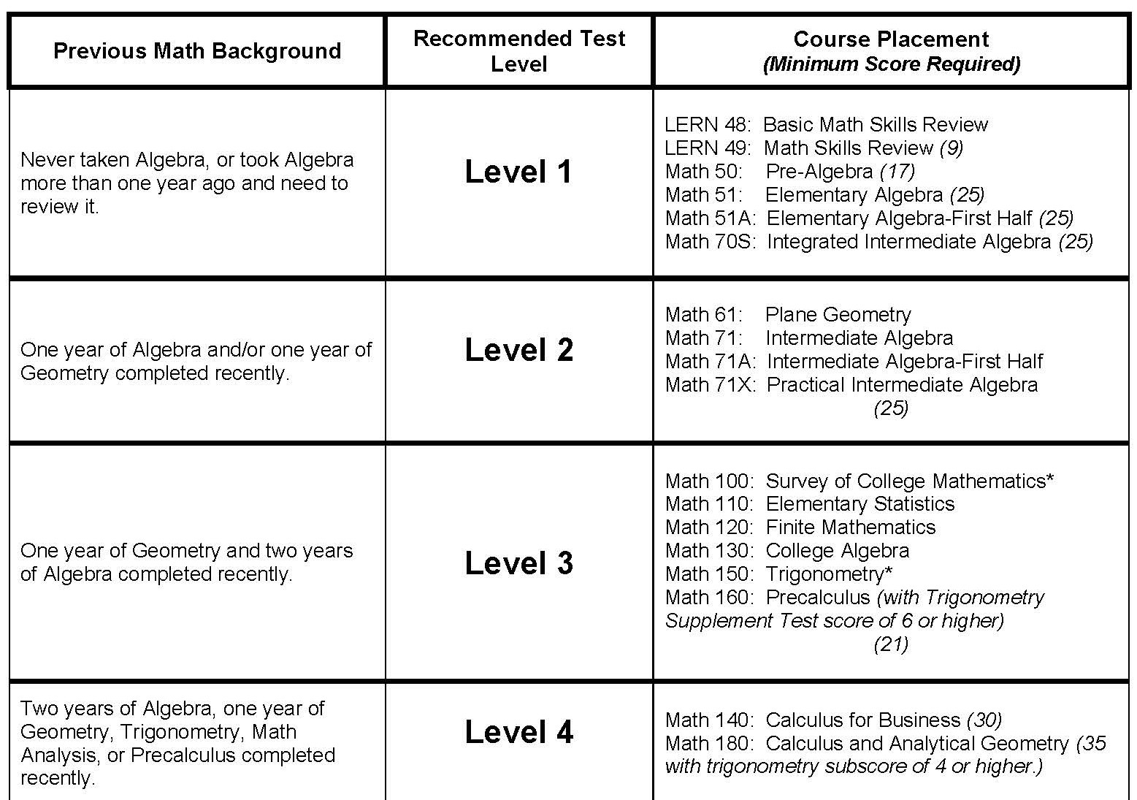
Currently, students choose one of four levels of math assessment placement tests depending on their previous math background.

Slide 21
Basic Skills to College Level Math 71
MATH 51
LERN 48
LERN 49
MATH 50
MATH 71
Math Basic Skills Path
Milestone | Throughput | Milestone | Throughput | Milestone | Throughput | Milestone | Throughput | Milestone
72% | 72%
63% | 45%
68% | 31% | 71% | 71%
52% | 16% | 55% | 39%
61% | 10% | 71% | 28% | 79% | 79%
53% | 5% | 62% | 17% | 65% | 51%
64% | 3% | 63% | 11% | 70% | 36% | 70% | 70%
56% | 1.9% | 59% | 6.4% | 65% | 23% | 60% | 42%
68% | 1.3% | 71% | 4.5% | 73% | 17% | 75% | 32% | 67%
LERN 48 Ultimate Success
Top
Progression
71%: Pass Rate
C or better
55%: Percent taking next course
LERN 49 Ultimate Success
Progression
Throughput:
% from start reaching this level
MATH 50 Ultimate Success
Progression
MATH 51 Ultimate Success
Progression
MATH 71 Ultimate Success
Percent starting at LERN 48 completing MATH 71
*academic years 2008-2009 through 2012-2013

Slide 22
Basic Skills to College Level English 1A
LERN 81
ENGL 67
ENGL 68
ENGL 1A
English Basic Skills Path
Milestone | Throughput | Milestone | Throughput | Milestone | Throughput | Milestone
73% | 73%
59% | 43%
72% | 31% | 79% | 79%
59% | 18% | 67% | 53%
77% | 14% | 82% | 43% | 84% | 84%
67% | 9% | 70% | 31% | 70% | 59%
77% | 7% | 82% | 25% | 83% | 49% | 70%
LERN 81 Ultimate Success
Progression
ENGL 67 Ultimate Success
Progression
ENGL 68 Ultimate Success
Progression
ENGL 1A Ultimate Success
Percent starting at LERN 81 completing ENGL 1A
*academic years 2008-2009 through 2012-2013

Slide 23
Multiple Measure Placement
Place students from high school grades and courses!
English and Math: unweighted cumulative grade point average
English Placement: grade in 12th grade regular (non-ESL) English class
Math Placement: last math course completed and grade received in last math course; math course currently enrolled
Placement Outside of Grades: take existing English/Math test along with a Multiple Measures Survey to determine placement
Students who have not completed three years of high school in the U.S.
Students who have not completed three years of English classes in high school
ESL students
Special Education students who have been enrolled in special classes

Slide 24
Multiple Measures English Placement
HS GPA | OR | GPA & Grade in Senior English | OR | Placement Test | = | Eligible/ Placed
≥ 2.6 | OR | 2.40–2.59 & ≥B in Senior English | OR | English 1A placement | ➔ | 1A OR 1A/66
2.40–2.59 | OR | 2.20–2.39 & ≥B in Senior English | OR |  | ➔ | 1A/66
2.20–2.39 | OR | 2.0–2.19 & ≥B in Senior English | OR | English 68 placement | ➔ | 68 OR 90
1.80–2.19 | OR | 1.70–1.79 & ≥B in Senior English | OR | English 67 placement | ➔ | 67 OR 90
≤ 1.79 | OR |  | OR | LERN 81 placement | ➔ | LERN 81

Slide 25
Multiple Measures Math Placement
Placement by cum GPA alone (no information on last math class passed at Algebra 1 or higher):
  2.4 GPA (11th grade) or 2.5 GPA (12th grade): Elementary Algebra
  2.0 GPA (11th grade) or 2.1 GPA (12th grade): Pre-Algebra
  Plaement by Cum GPA + “C” or better in last math class passed
  GPA varies from 11th to 12th grade
Math 71 Intermediate Algebra
  2.8 GPA (11th grade) or 2.9 GPA (12th grade)
Math 110 Statistics
  Completed Algebra II and 3.0 GPA (11th or 12th grade)
  Completed Precalculus and 2.3 GPA (11th grade) or 2.6 GPA (12th grade)
Math 130 College Algebra
  Completed Algebra II and 3.2 GPA(11th or 12th grade)
  Completed Precalc and 2.9 GPA (11th grade) or
  Completed Precalc or Statistics and 3.0 GPA (12th grade)

Slide 26
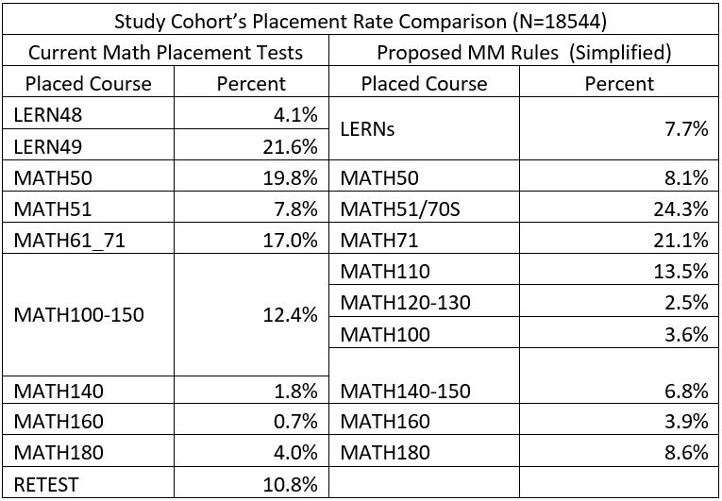
New Placement Results: Math
Advanced placements makes college more ready to place students based on skills students bring from previous academic achievement.
Lowest Levels drop 49.5% to 15.8%
Middle levels up 24.8% to 49.4%

Slide 27
New Placement Results: English
Advance placement makes college more ready for students with demonstrated academic preparation
1A 68 67 81

Slide 28
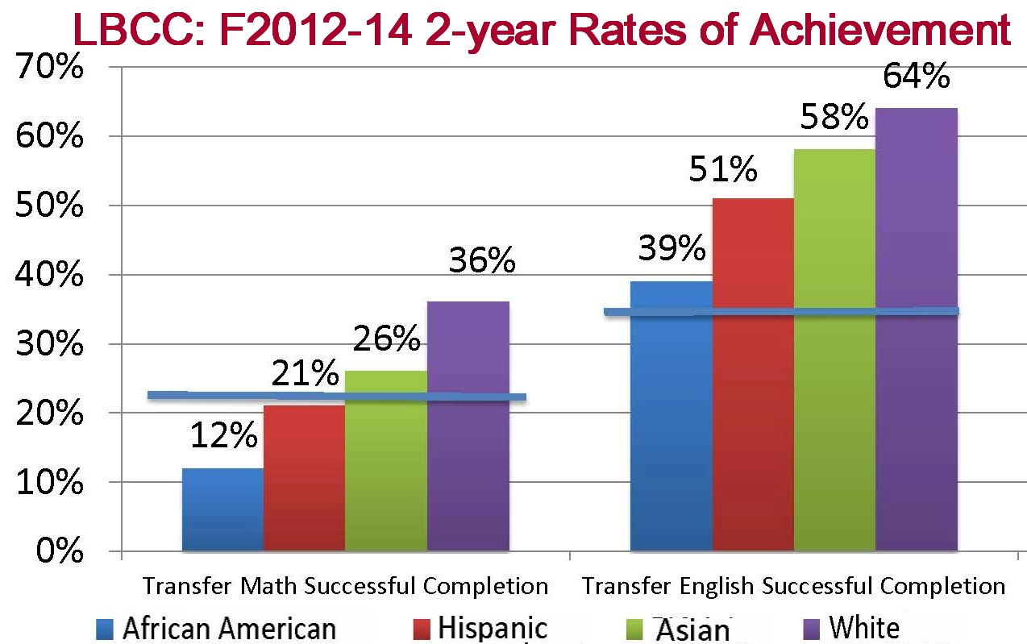
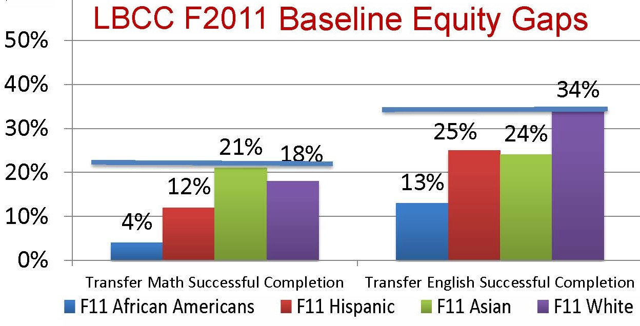
New Placement System: Expected Success
Long Beach City College found both overall increase in successful completion of transfer level Math and English but also significant increases for all groups.

Slide 29
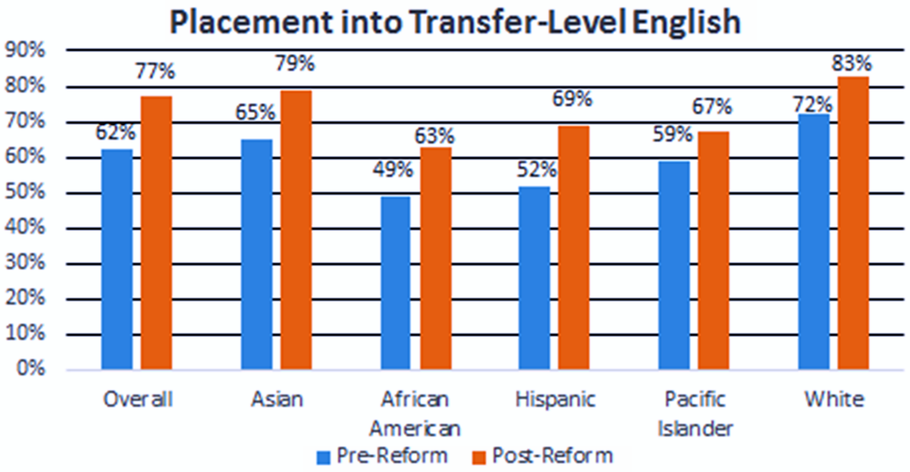
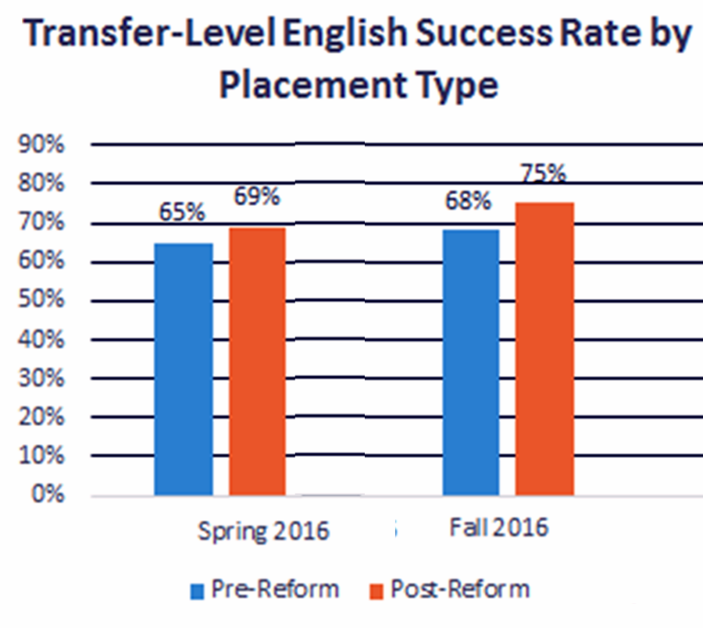
New Placement: Expected Success
MiraCosta College found improvements in English 1A placement rates for all groups.
MiraCosta College also found improvement in successful completion in English 1A.

Slide 30
Basic Skills Multiple Paths
Accelerated
Learning
Community
Summer Bridge: Counseling & English
Peer Advisors, Tutoring, Free Texts,
Study Center, Laptops, Workshop
Corequisite Model: 2.4-2.6 High School
GPA can take English 1A only with
English 66 as a corequisite
Compressed Sequence: Statway
Bridge | Success |  | Retention
Asian | 41 | 98% | 42 | 100%
Black | 30 | 91% | 30 | 91%
Latino | 946 | 93% | 1008 | 99%
White | 12 | 100% | 12 | 100%
Total | 1031 | 93% | 1095 | 99%

Slide 31


Slide 32

Entering a Major: Online Catalog by Career Cluster
Traditional college catalogs organize programs of study alphabetically. Using the Courseleaf software, Mt. SAC is organizing our online catalog by Career Clusters.

Slide 33
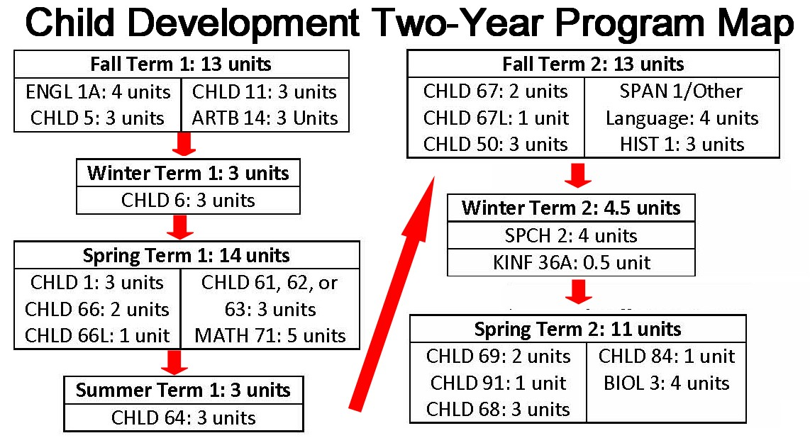
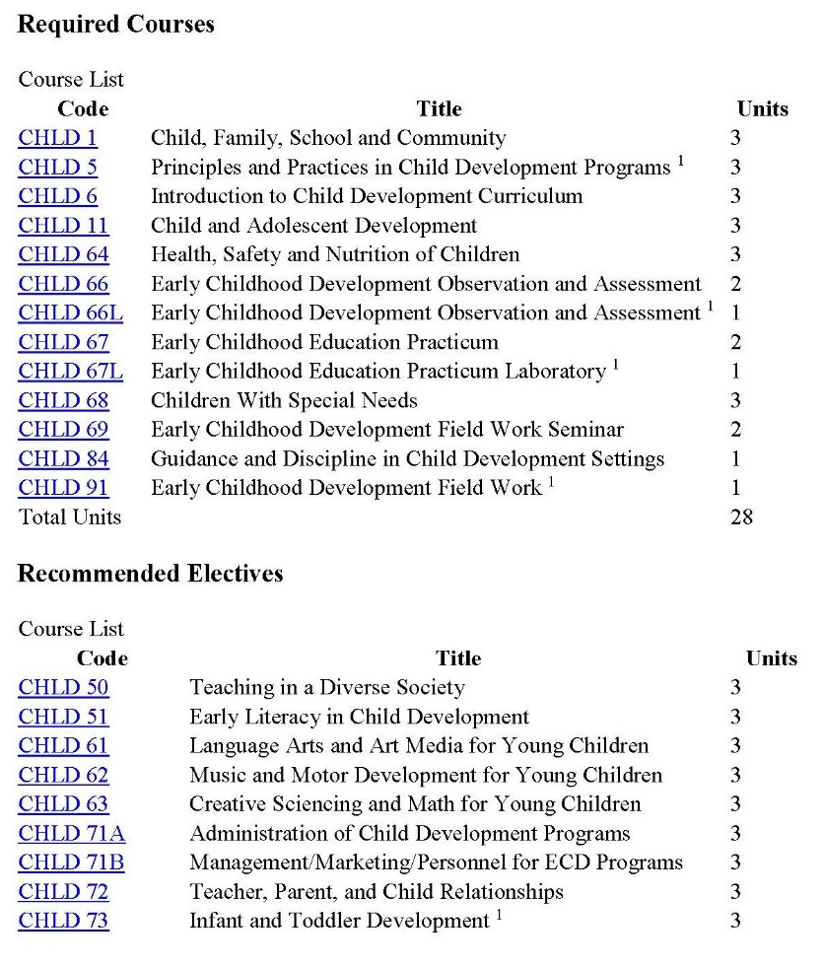
Entering a Major: Program Maps
Program Maps Developed By Faculty to Be Clear to Students Entering the Program
Current Catalog Listing

Slide 34












Staying on the Path: Supportive Cohorts
Mt. SAC encourages students to join a cohort-based learning and support program. The cohorts are based on interest, major, and/or demographic group. The program model includes a program coordinator or manager, a dedicated gathering place, counseling, mentoring, academic support, and extracurricular activities.

Slide 35














Staying on the Path: Academic Interventions
Mt. SAC’s Success Centers are focused on related programs of study such as the STEM Center (Science, Technology, Engineering & Math) and are on delivery of academic support such as Learning Assistance /Center.

Slide 36


Slide 37
Mt. SAC Trends in Staying on the Path
A key measure of staying on the path to completion is the number of units taken in the first year. To complete and associate degree or the first two years of a baccalaureate degree, 30 units are needed.
Mt. SAC initial efforts in student success and equity have shown measurable gains in this key metric.

Slide 38
Mt. SAC Trends in Completion
Completion for those college prepared is flat: 76%-72%-73%-75%
Completion among students unprepared for college has trended up: 39%-40%-41%-48%
Year-to-year persistence has also trended up: 72%-77%-79%-80%
Example: the 2006-07 six year cohort data was collected on student performance through 2012-13.
http://scorecard.cccco.edu/scorecard.aspx

Slide 39


Slide 40


