Slide 1
Maximizing Current Technology in Guided Pathways Using Degree Works Templates
MATT BIDART, Web Designer/ Developer
CARON GOMES, Systems Analyst/Programmer
SARA MESTAS, Counselor
CHUONG TRAN, Assistant Director, Enterprise Application Systems
Mt. San Antonio College, Walnut, CA
SESSION IDS: DWFDWF264781 & DWF253796

Slide 2
Disclaimer
The views and opinions in this presentation are those of the presenter and do not necessarily reflect the position of Ellucian.

Slide 3
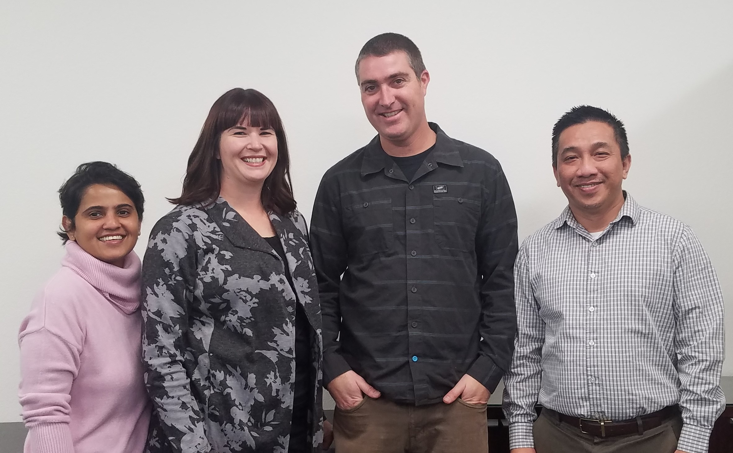
Presentation Team
Caron Gomes
Systems Analyst/Programmer
cgomes4@mtsac.edu
(909) 274-5840
Sara Mestas
Counselor
smestas@mtsac.edu
(909) 274-6349
Matt Bidart
Web Designer/Developer
Student Services
mbidart@mtsac.edu
(909) 274-6224
Chuong Tran
Director Enterprise Application Systems
ctran@mtsac.edu
(909) 274-5569

Slide 4
Session Abstract
Implementation of Guided Pathways begins with program mapping. Degree Works templates provide an immediate solution for implementation without purchasing additional technology. Degree Works templates provide a functional home for program maps so that users can view real-time information of courses needed for program completion while ensuring accuracy. Presentation will cover templates for Guided Pathway, tags allowing users a meta-major filter, and data extract making it possible to uploads program maps to websites for public displays.

Slide 5
Agenda
1 | Introductions (Sara)
2 | Guided Pathways (Sara)
3 | Program Mapping & Creating Templates in Degree Works (Sara)
4 | Programming for Guided Pathways website (Chuong)
5 | Web Design for Guided Pathways website (Matt)
6 | Updates & Maintenance (Caron)
7 | Questions

Slide 6
Program Mapping & Creating Templates in Degree Works
Guided Pathways
Sara Mestas
Counselor, General & Guided Pathways
smestas@mtsac.edu
(909) 274-6349

Slide 7

Why This Presentation? ​
Many legislative efforts in a short timeframe​
Lots of change​
Chaotic, learning new systems adds to strain
https://www.mtsac.edu/guided-pathways/

Slide 8
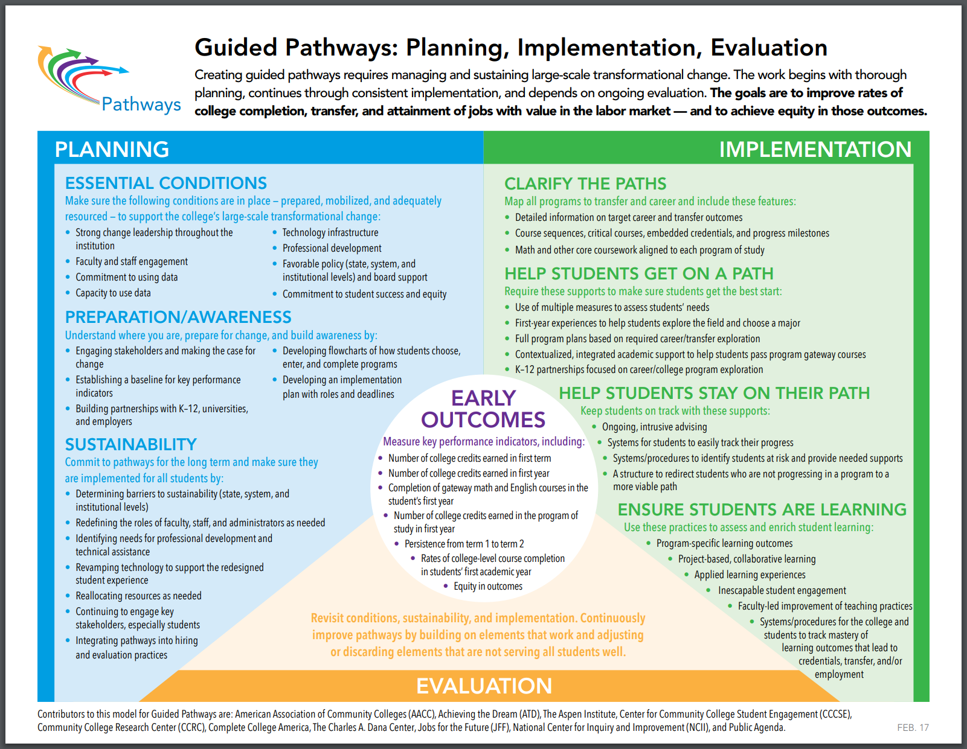
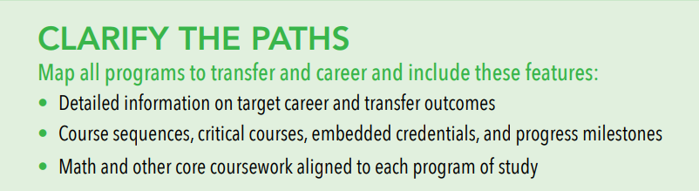
Guided Pathways
At Mt. SAC:
MAP workshops
Marketing tool
Connect programs across the College
Use for career & major clusters

Slide 9
Degree Works Templates
Steps to pathways implementation:
Created a template for all pathway maps- almost 400!
Created “dummy” courses in Banner system for GE areas where a specific course is not necessary
Use choice and placeholder options to add detail
Ability to audit maps to catalog to ensure that requirements are met based on catalog, update as needed
Students can access maps through Degree Works as well as Mt. SAC Guided Pathways website

Slide 10
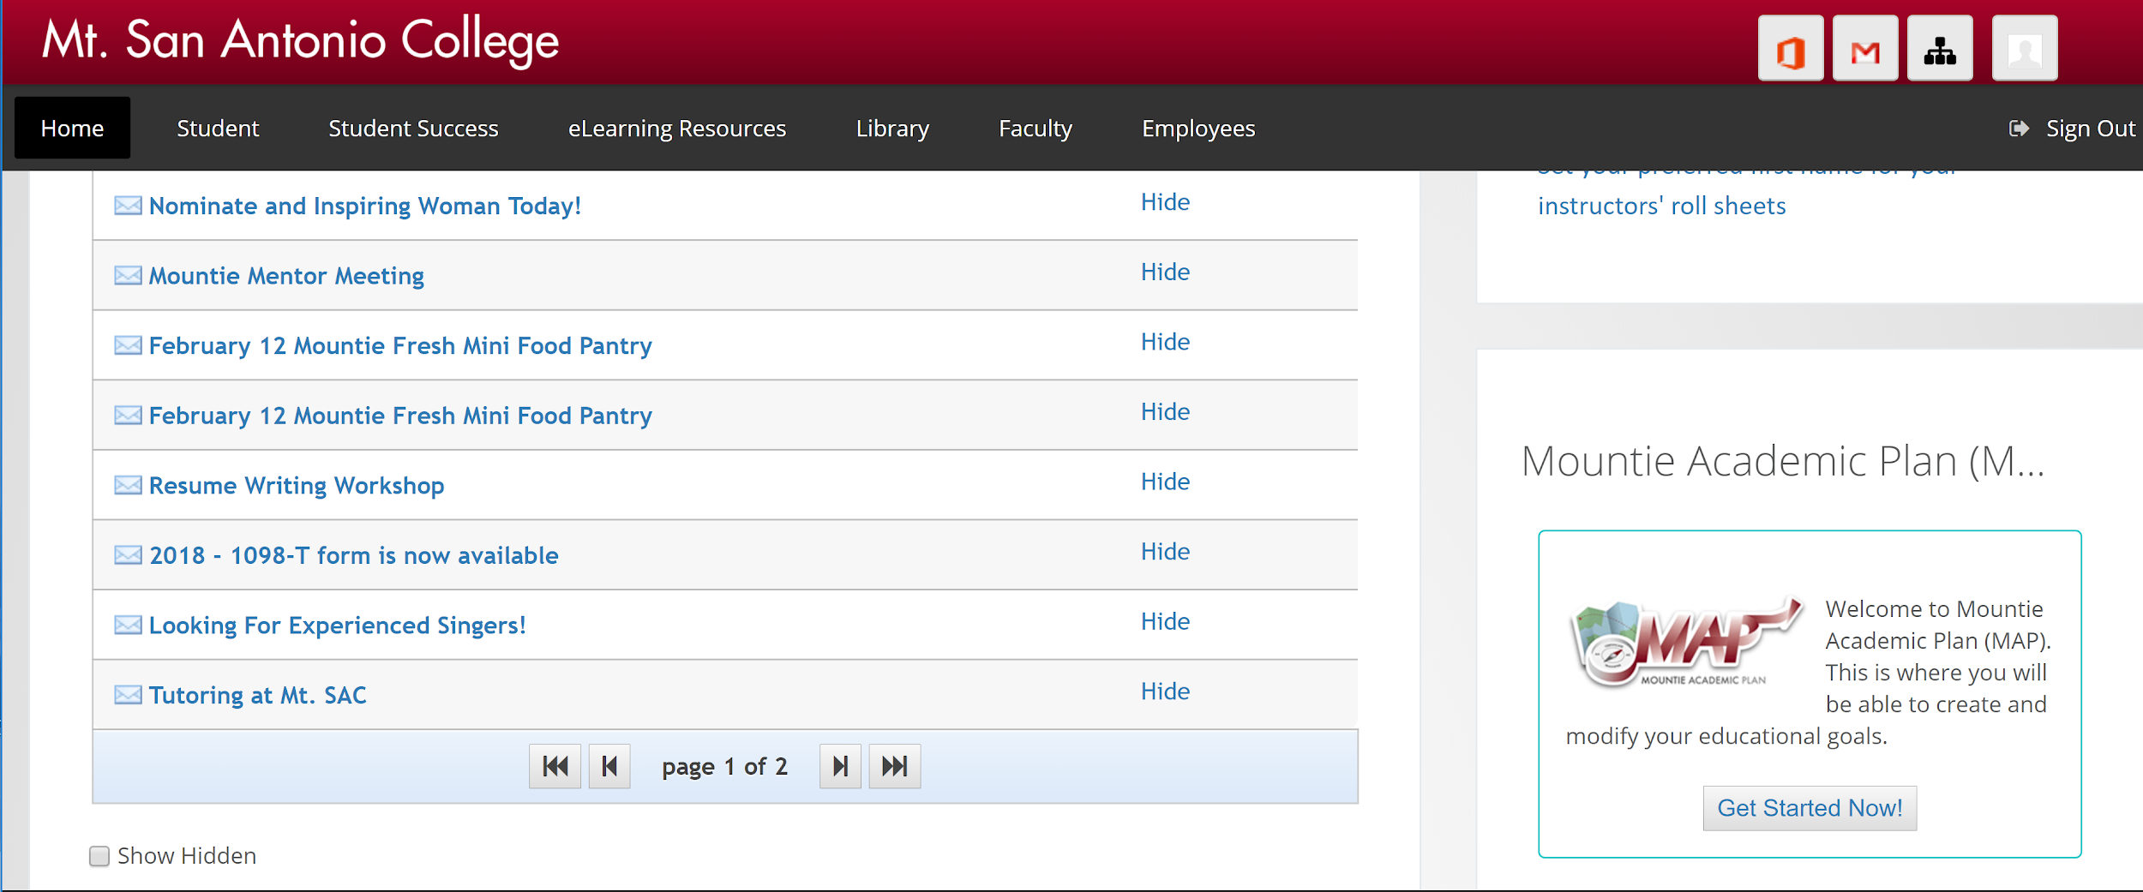
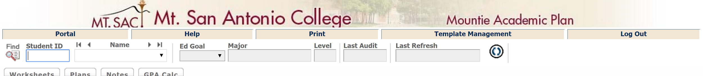
Locating Pathway MAPS
College-wide access (students, faculty, staff, administrators- anyone with Mt. SAC portal access

Slide 11
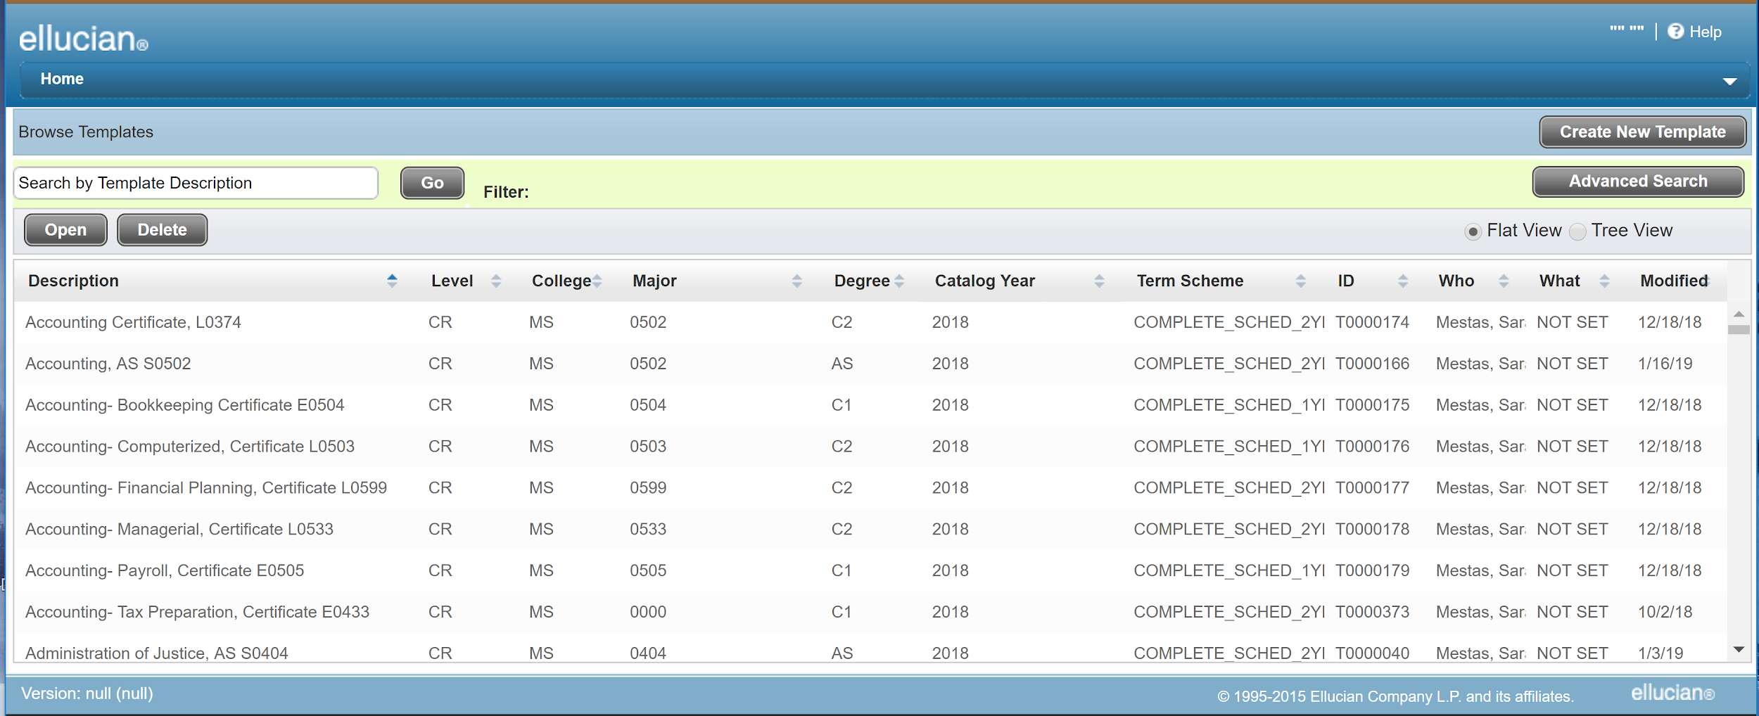
Degree Works Template Page

Slide 12
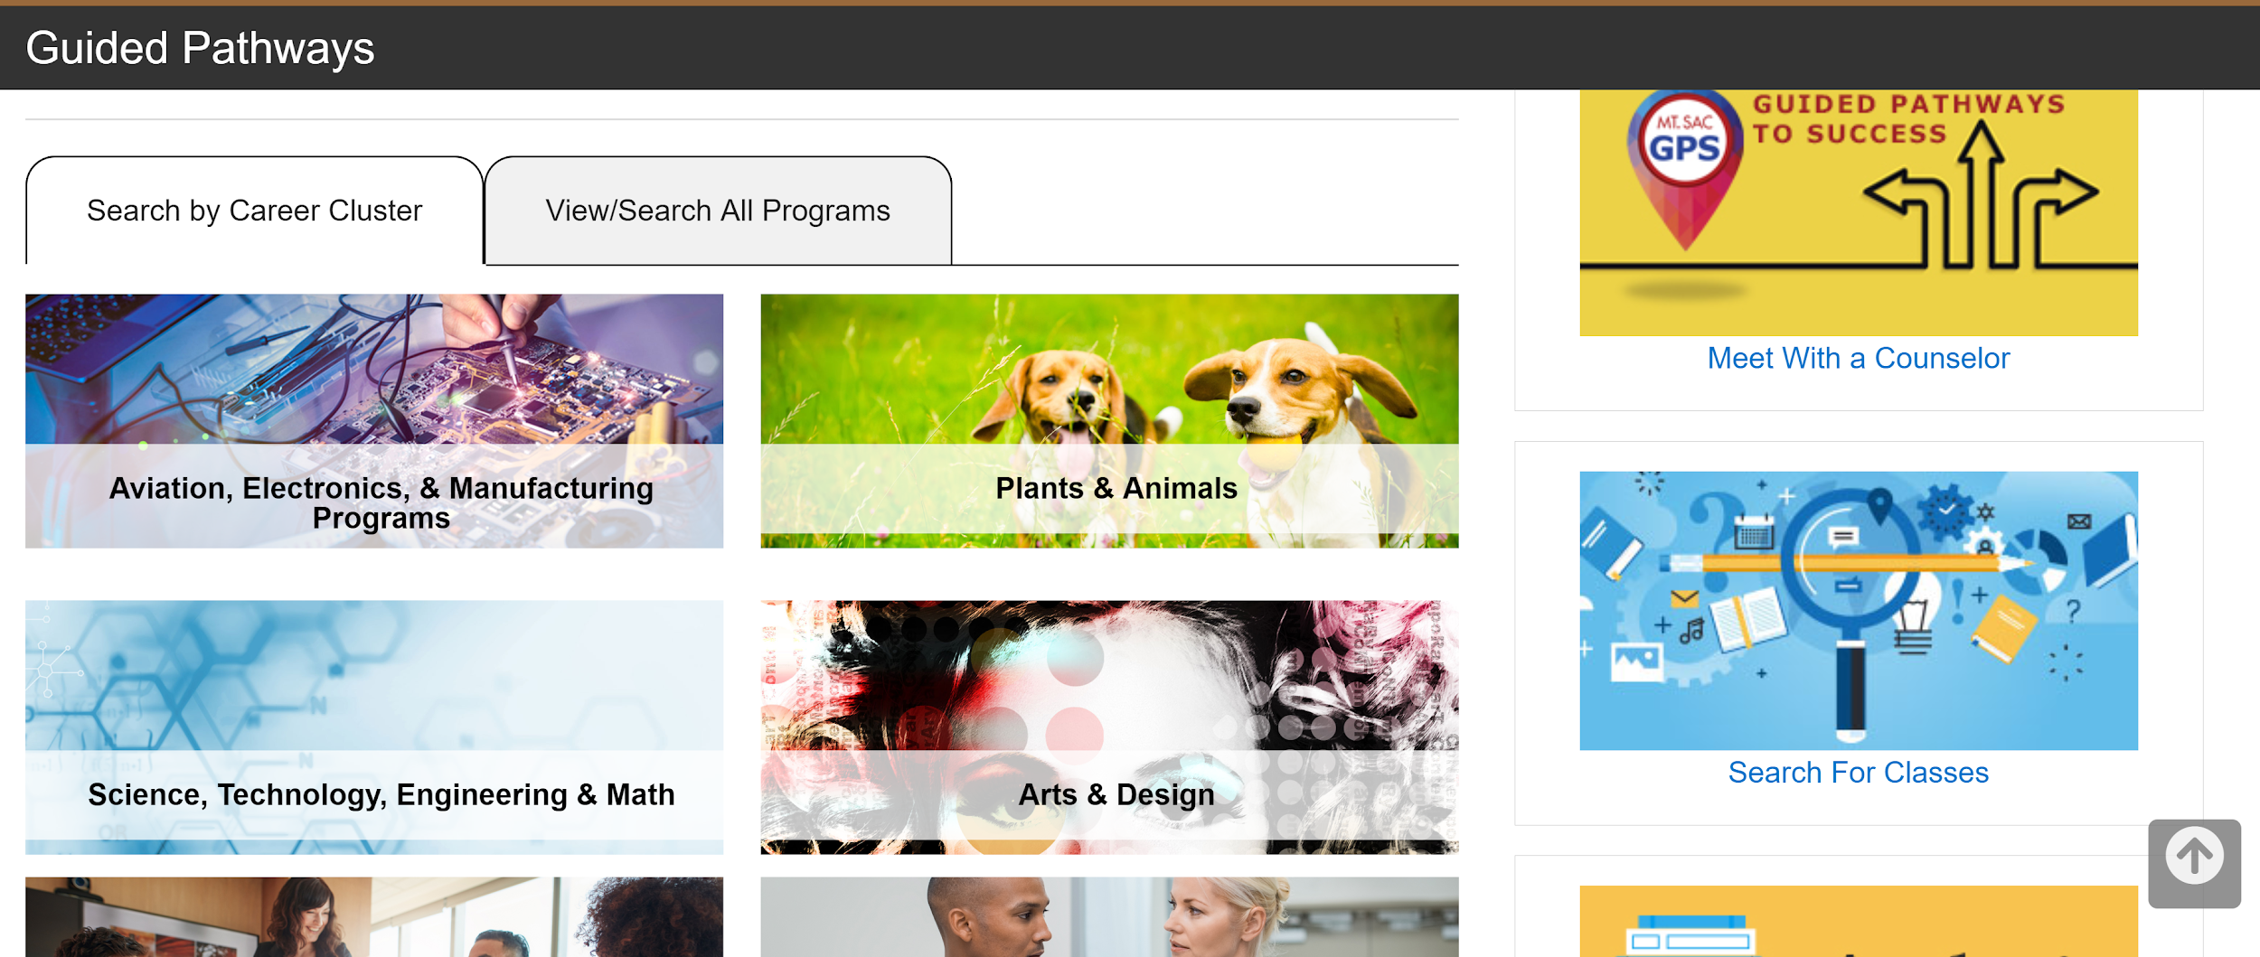
Guided Pathways Website
https://www.mtsac.edu/guided-pathways/

Slide 13
Programming for Guided Pathways website
Data extraction process
Chuong Tran
Director Enterprise Application Systems
ctran@mtsac.edu
(909) 274-5569

Slide 14
How to Make Use of Existing Degree Works Templates for the Guided Pathways Project
Data extracted from Degree Works Templates must allow the mapping between student educational plan templates information and guided pathways information.
Data should be extracted in XML format so that it can be readily used by other web development tools such as PHP, Java, etc.

Slide 15
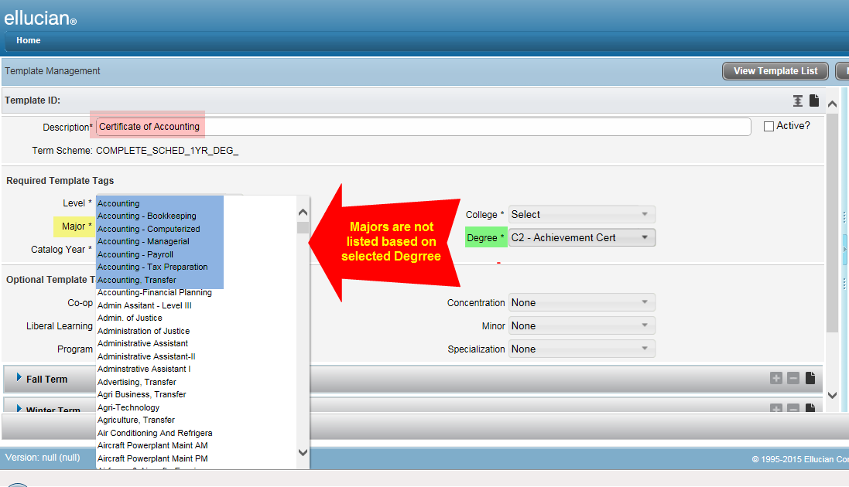
Templates Not Uniquely Identified by Banner Codes

Slide 16
Solution
Using Banner Program Code in the template descriptions
Guided Pathways program then uses that code to map with program requirements.

Slide 17
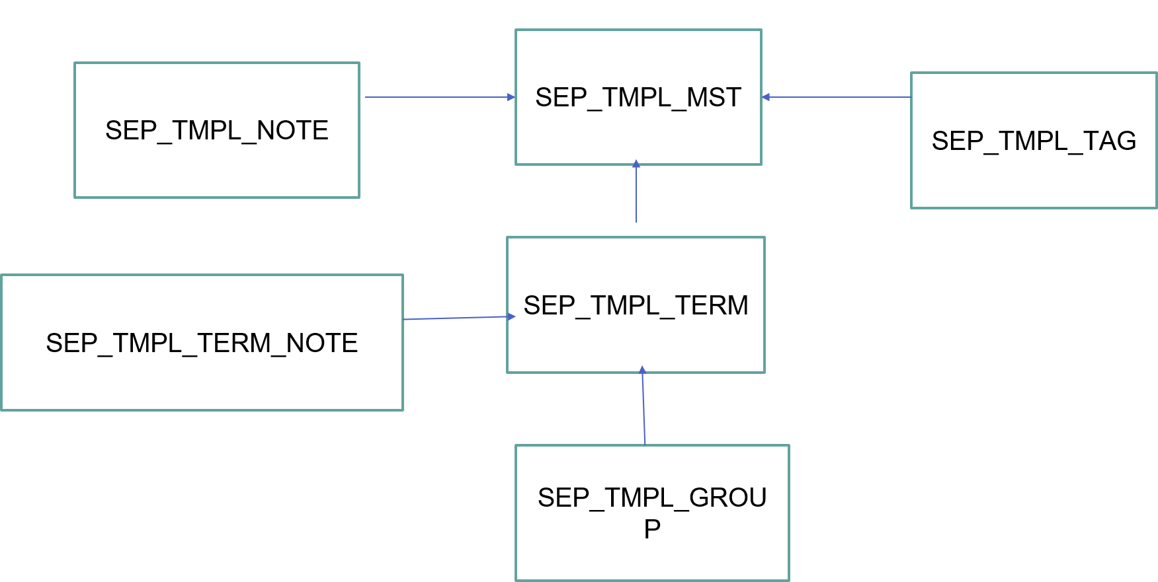
Complex Table Structures

Slide 18
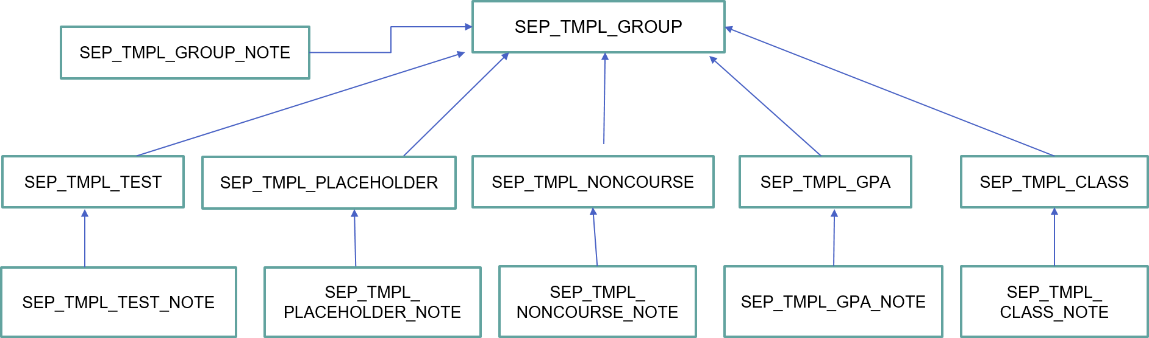
Complex Table Structures

Slide 19
Solution
Study template data structures from “Degree Works Advanced Reporting Technical Guide” document.
Get familiar with each table: how data are stored and organized
Use outer joins to get all the information needed

Slide 20
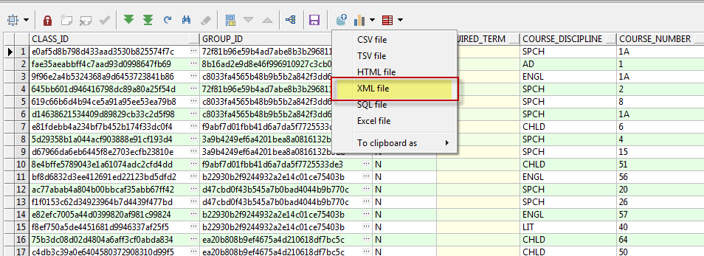
Convert Data to XML Format
Use Oracle DBMS_XMLGEN package
In PL/SQL Developer:

Slide 21
Technical Challenges
Manually clean up the data
Automate the extract process
Integrate with Courseleaf
Extract comments, placeholders, requirements info

Slide 22
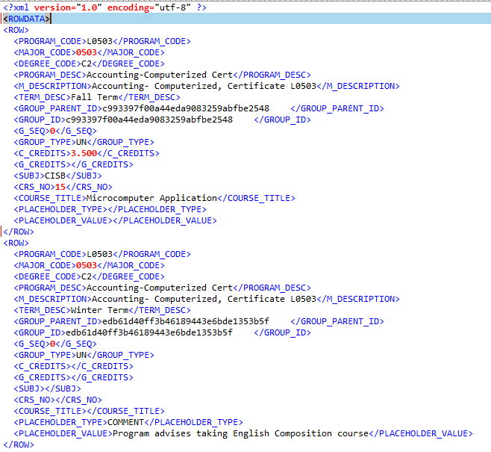
Convert Data to XML Format

Slide 23
Guided Pathways Website Design
Matt Bidart
Web Designer/Developer
Mbidart@mtsac.edu

Slide 24
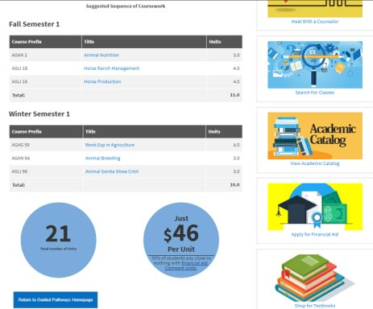
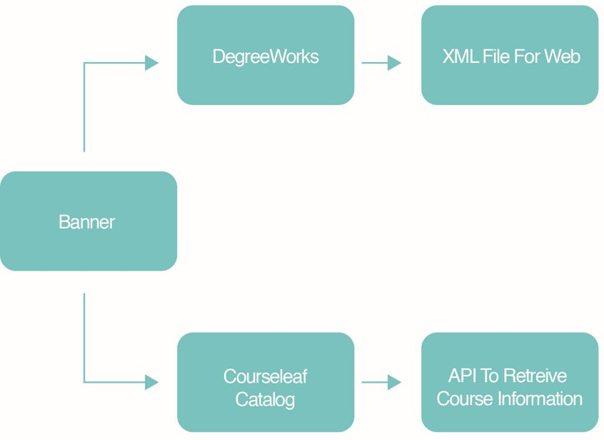
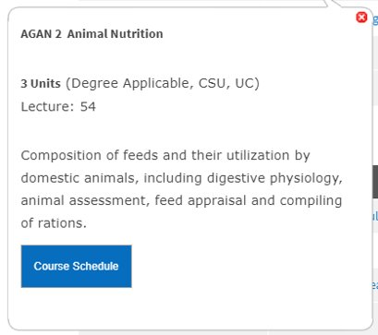
Data Overview

Slide 25






Web Tools Used
OmniUpdate CMS
Foundation (Responsive Framework)
XML (Export from DegreeWorks)
PHP (To Process XML)
Jquery/Javascript (Datatables, API)
Courseleaf Catalog API Calls

Slide 26
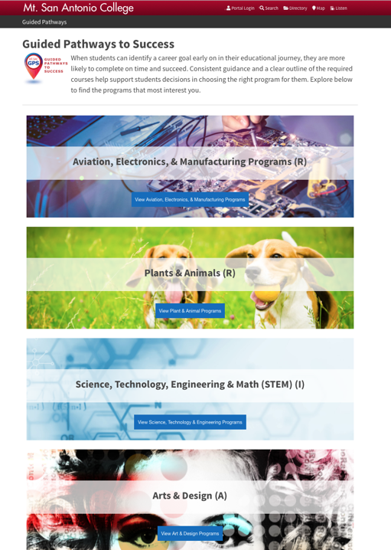

Initial Design
Began in July 2018
Programs Organized by Clusters
Single scrolling page of clickable clusters that reveal relevant programs

Slide 27

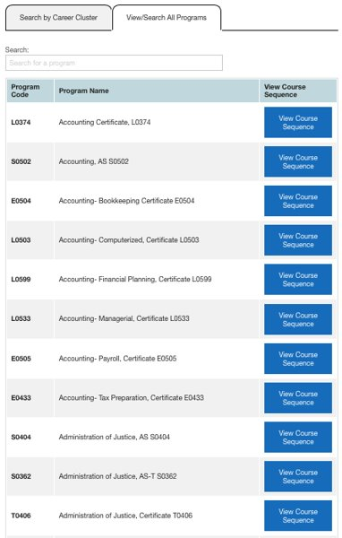
Current Design
Initiated October 2018
More Efficient Use of Space
Cluster Option or Search Option
  Both options lead to results page
2 template pages
  Initial home/search page
  Results Page

Slide 28
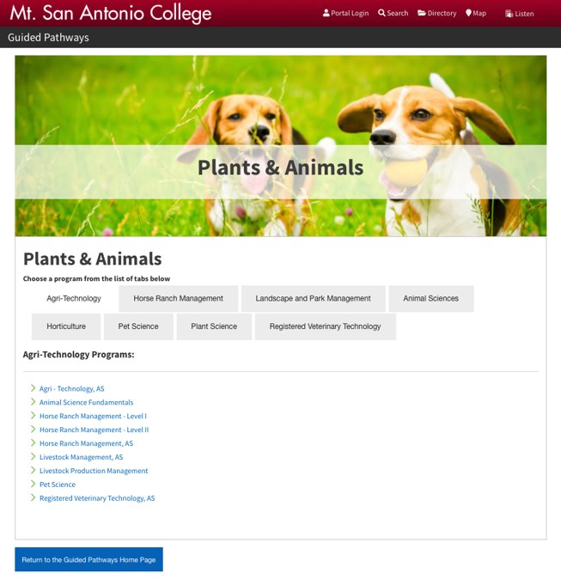
Cluster Option
9 dedicated cluster pages
Programs organized within tabs
Return button to revisit search page

Slide 29
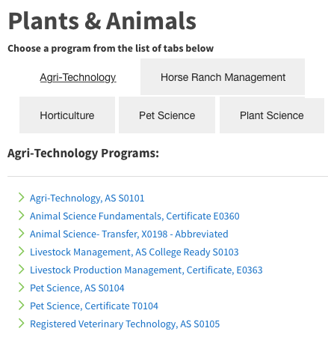
Cluster Option Dynamic Lists
PHP function to populate program list by keywords
Program number/description sent to results page as a URL variable

Slide 30

Search Option
Search Bar Limiter (Datatables: Jquery App)
Good for those unsure of which cluster to search
Ability to search through all available programs from DegreeWorks XML
Runs on PHP/Jquery

Slide 31
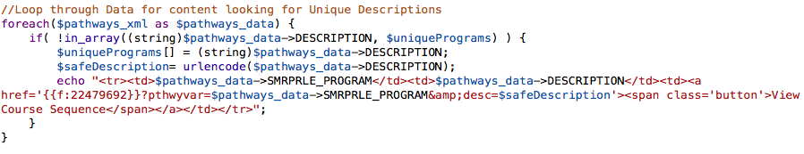
Search Option Dynamic Table
Unique Program Description Nodes Table List
3 Columns (Program Number, Program Name, Button Link to Results Page)
Button Link Contains Program Number and Description

Slide 32
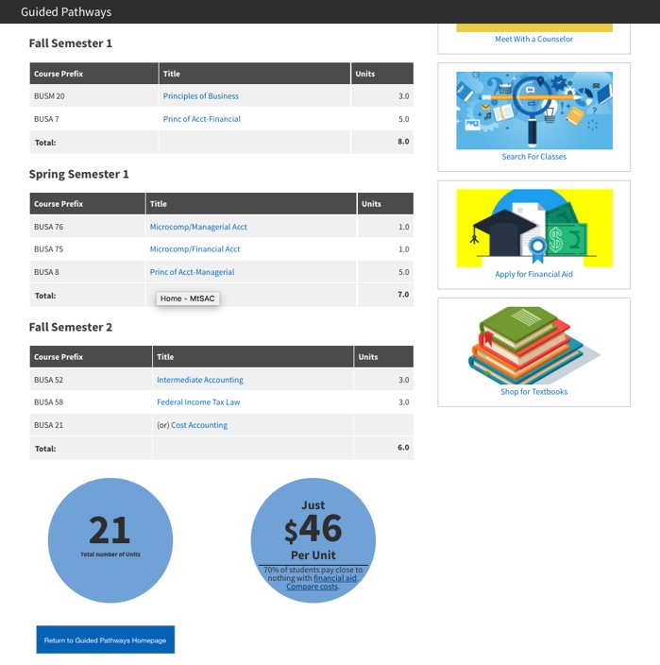

Results Page
Suggested course sequence
Three table columns
Units tally at bottom of table
Course catalog info links
Take the next step helper links

Slide 33
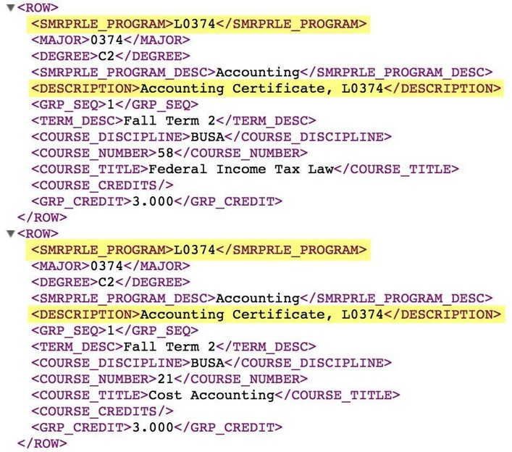
Results Page Logic
Step 1: Match Program Code/Description
Requires Two URL Variables to render results
There are multiple programs with the same Program number

Slide 34
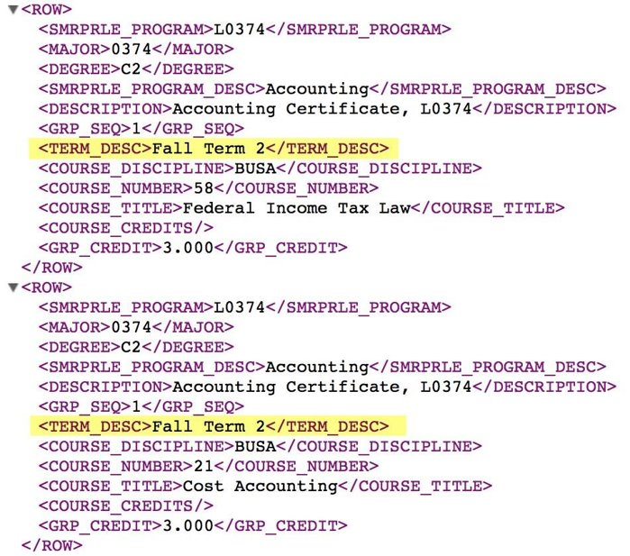
Results Page Logic
Step 2: Match Program Code/Description
Limit your results to display Fall, Winter, Spring, Summer terms
Once targeted, pull Course Prefix and number, Course Title and Credits
Tally up credits along the way

Slide 35
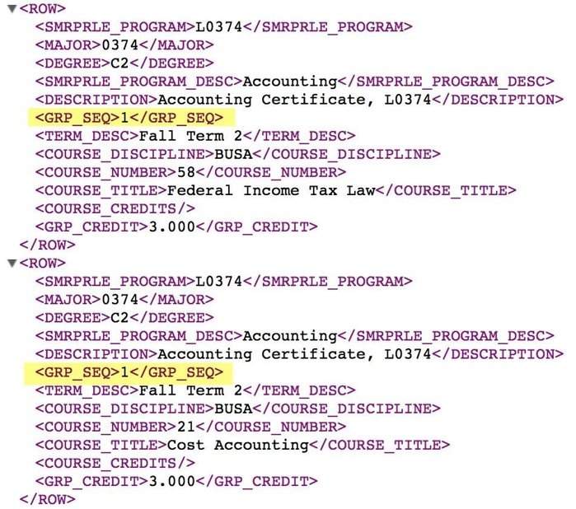
Results Page Logic
Step 3: Identify Course Options
Analyze Group Sequence Node
Required Courses have a zero value
Credit values for optional classes are listed in group credit node rather than course credit node

Slide 36
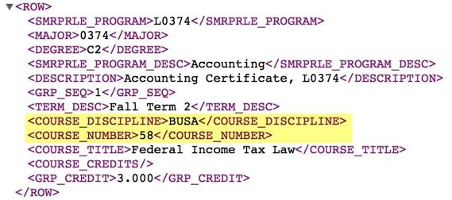
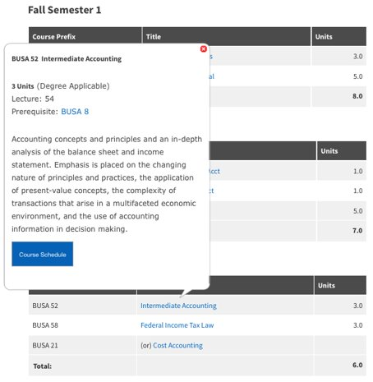
Results Page Logic
Step 4: API Links To Catalog Info
Courseleaf Catalog Offers API with Information Bubble Option
Bubbles preview course information
Courseleaf API is triggered by passing Course Prefix and Course Number to an on click javascript event
Uses Course Discipline and Course # XML Nodes
Sample API call listed below
Sample API URL - https://www.mtsac.edu/guided-pathways/search/?P=BUSA%2058

Slide 37
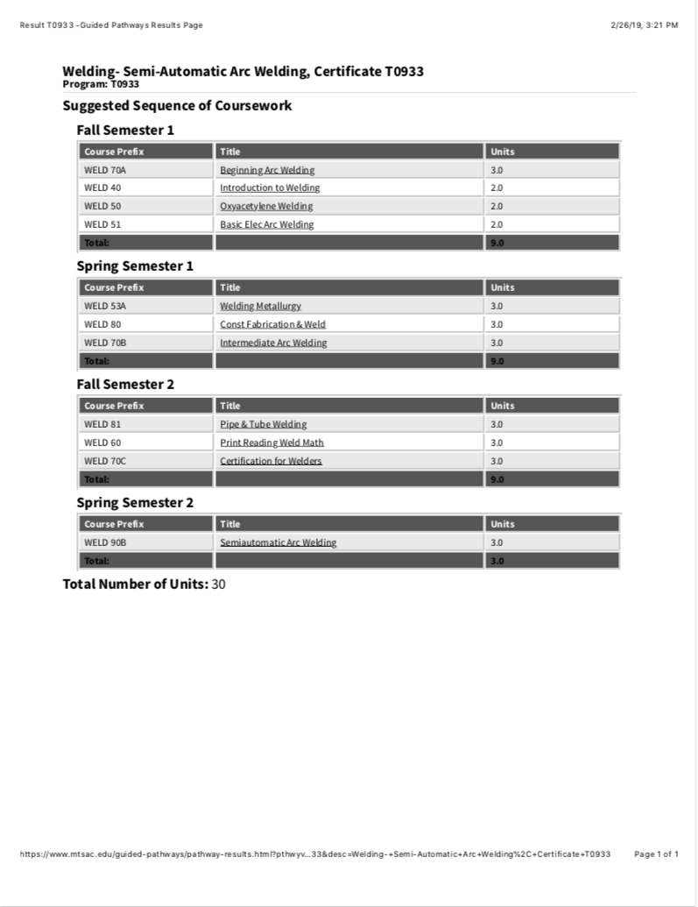
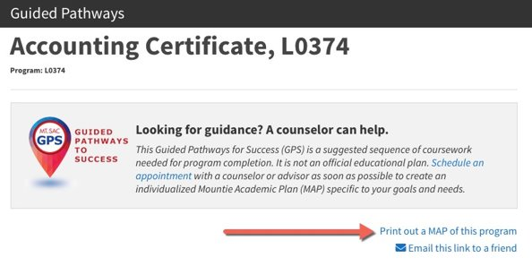
Printout / Email A Friend Options
Printout: Print CSS styling to minimize paper
Reduced to only table/unit totals
Email To Friend Option (JScript grabs URL)

Slide 38
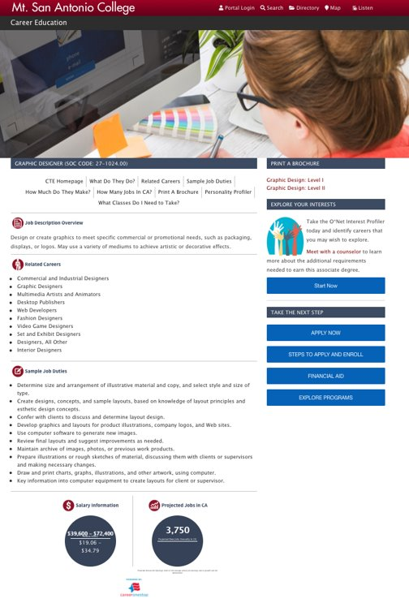
Future Plans
Link to GP site from every department page
Include description of program before MAP information
Cross Promote with our CTE site (mtsac.edu/cte)
  Salary Info
  Employment Info
  CTE data comes from CareerOneStop (Onet)

Slide 39
Updates and Maintenance
Caron Gomes
Systems Analyst/Programmer
cgomes4@mtsac.edu

Slide 40
Updates and Maintenance
Update the template scheme
Clean up & Maintenance

Slide 41
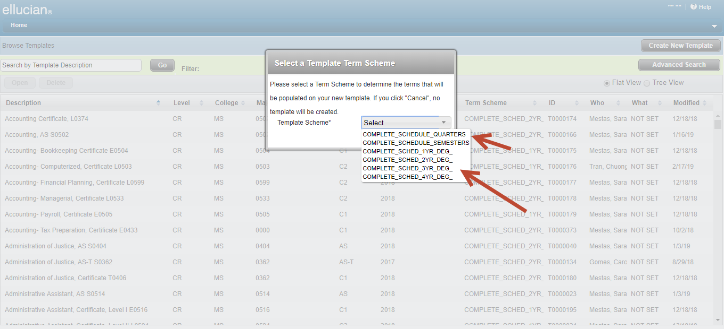
Updates and Maintenance
PROBLEM
The configured template scheme used the 4 year degree settings - 16 rows
Created extra empty rows that needed to be deleted
Slowed down the whole process and consumed resources

Slide 42
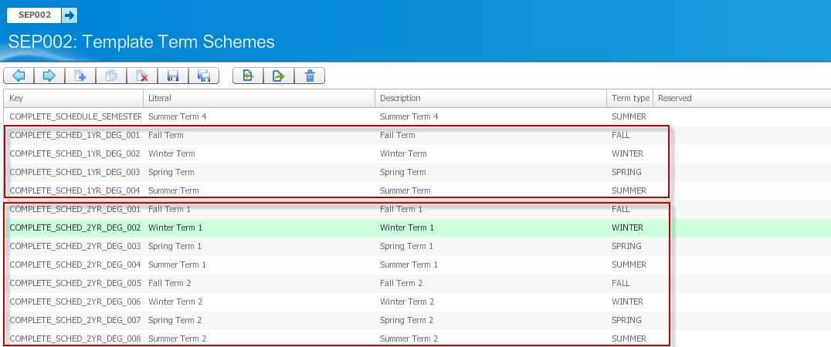
Update the Template Scheme
SOLUTION
Change the template terms schemes set in UCX-SEP002 - SureCode UCX Tables Technical Guide - Release 4.1.0
Provide the choice of 1/2/3 or 4-yr templates
Choice of 4 rows min to 16 rows max

Slide 43
Maintenance
Restructure all the templates based on the new template schemes available.
Verify that the major codes in Degreeworks match the catalog
Update the description to include the unique program
Verify code extracted from Degreeworks before updates to the MAP site

Slide 44
Questions
Sara Mestas
Counselor
smestas@mtsac.edu
(909) 274-6349
Chuong Tran
Director Enterprise Application Systems
ctran@mtsac.edu
(909) 274-5569
Caron Gomes
Systems Analyst/Programmer
cgomes4@mtsac.edu
(909) 274-5840
Matt Bidart
Web Designer/Developer
Student Services | Guided Pathways | Title V
mbidart@mtsac.edu
(909) 274-6224

Slide 45
MATT BIDART, Web Designer/ Developer
CARON GOMES, Systems Analyst/Programmer
SARA MESTAS, Counselor
CHUONG TRAN, Assistant Director, Enterprise Application Systems
Mt. San Antonio College, Walnut, CA
SESSION ID: DWFDWFDWF264781 & DWF253796

