Slide 1








STARTING COLLEGE
during the COVID-19 pandemic
2020
The worldwide COVID-19 pandemic has created a new reality for college students, especially when deciding where to enroll. Students likely have additional stresses as a result of the pandemic, and their mental health may be impacted as well.
Students considered their own learning and future career opportunities as very important reasons to go to college.
87% (All)
To learn more about things that interest them
84%(MSAC)
82% (All)
To be able to get a better job
80% (All)
To gain a general education and appreciation of ideas
78%(MSAC)
76% (All)
To get training for a specific career
82%(MSAC)
82%(MSAC)
While some students considered advice from others in their college selection process...
Students’ emotional well-being remains a concern.
86% (All)
Felt anxious in the past year
81% (MSAC)
8% (All)
Considered advice
from a high school counselor as very important
24% (MSAC)
5% (All)
Considered advice
from a teacher as very important
15% (All)
Considered advice from a parents/relatives
15% (MSAC)
20% (MSAC)
...aspects of the college’s reputation were more influential.
74% (All)
Considered overall
academic reputation very important
57% (All)
Considered the
academic reputation of their intended major very important
38% (MSAC)
52% (All)
Considered the
reputation for social and extracurricular activities very important
44% (MSAC)
62%
Felt depressed in the past year
65% (MSAC)
17%
Identify as having a psychological disorder
12% (MSAC)
52% (MSAC)
While the COVID-19 pandemic might impact which academic and extracurricular activities colleges can offer, students still plan to be engaged.
90%
Believe that there is at
least some chance they will participate in students clubs/groups
72% (MSAC)
71%
Believe that there is at
least some chance they will study abroad
48% (MSAC)
30%
Believe there is at
least some chance they will join a fraternity or sorority
23% (MSAC)
Information about students entering college helps enrollment planning, retention efforts, and provides a baseline for understanding college effectiveness. Register for the CIRP Freshman Survey at www.cirpsurveys.org.
Survey Source: CIRP Freshman Survey 2020* www.heri.ucla.edu/infographic/
facebook.com/HERI.CIRP @HERIUCLA
linkedin.com/company/heriucla/ @HERIUCLA
*Due to decreased institutional participation related to the COVID-19 pandemic, the 2020 CIRP Freshman Survey data are not nationally representative.

Slide 2


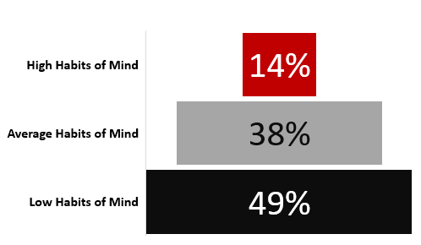
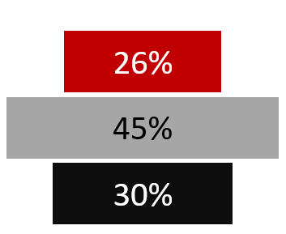
About the Respondents
The majority of the students identified as Hispanic/Latinx (62%)
More women than men participated in the survey
Intended Enrollment
Type of High School
Mt SAC from Home
19% Part-time
94% Public
55% 10 or less miles
81% Full-time
5% Private
41% 11 to 50 miles
1% Home
4% Over 51 miles
Habits of Mind
Mt. SAC
Comparison Group
Survey items and estimation "weights":
How often in the past year did you:
* Seek solutions to problems and explain them to others (2.17)
* Support your opinions with a logical argument (1.81)
* Look up scientific research articles and resources (1.71)
* Take a risk because you felt you had more to gain (1.68)
* Accept mistakes as part of the learning process (1.24)
* Take on a challenge that scares you (1.20)
* Ask questions in class (1.26)
* Explore topics on your own, even though it was not required for a class (1.09)
* Evaluate the quality or reliability of information you received (1.13)
* Seek alternative solutions to a problem (1.14)
* Analyze multiple sources of information before coming to a conclusion (0.98)
Financial Issues Associated with Attending College
I was offered financial assistance
The cost of attending this college
Not offered aid by first choice
Could not afford first choice
Mt. SAC
Comparison Group
Mt. SAC
Comparison Group
Mt. SAC
Comparison Group
Mt. SAC
Comparison Group
Information about students entering college helps enrollment planning, retention efforts, and provides a baseline for understanding college effectiveness. Register for the CIRP Freshman Survey at www.cirpsurveys.org.
Mt. SAC Students
Comparison Group
Very Important
Somewhat Important
Survey Source: CIRP Freshman Survey 2020* www.heri.ucla.edu/infographic/
facebook.com/HERI.CIRP @HERIUCLA
linkedin.com/company/heriucla/ @HERIUCLA
Students’ First-Year Funding Sources
Importance of each in deciding to attend this college
*Due to decreased institutional participation related to the COVID-19 pandemic, the 2020 CIRP Freshman Survey data are not nationally representative.

