Slide 1
PIE Planning & Resources
Where We Make an Impact – Closing the Loop

Slide 2
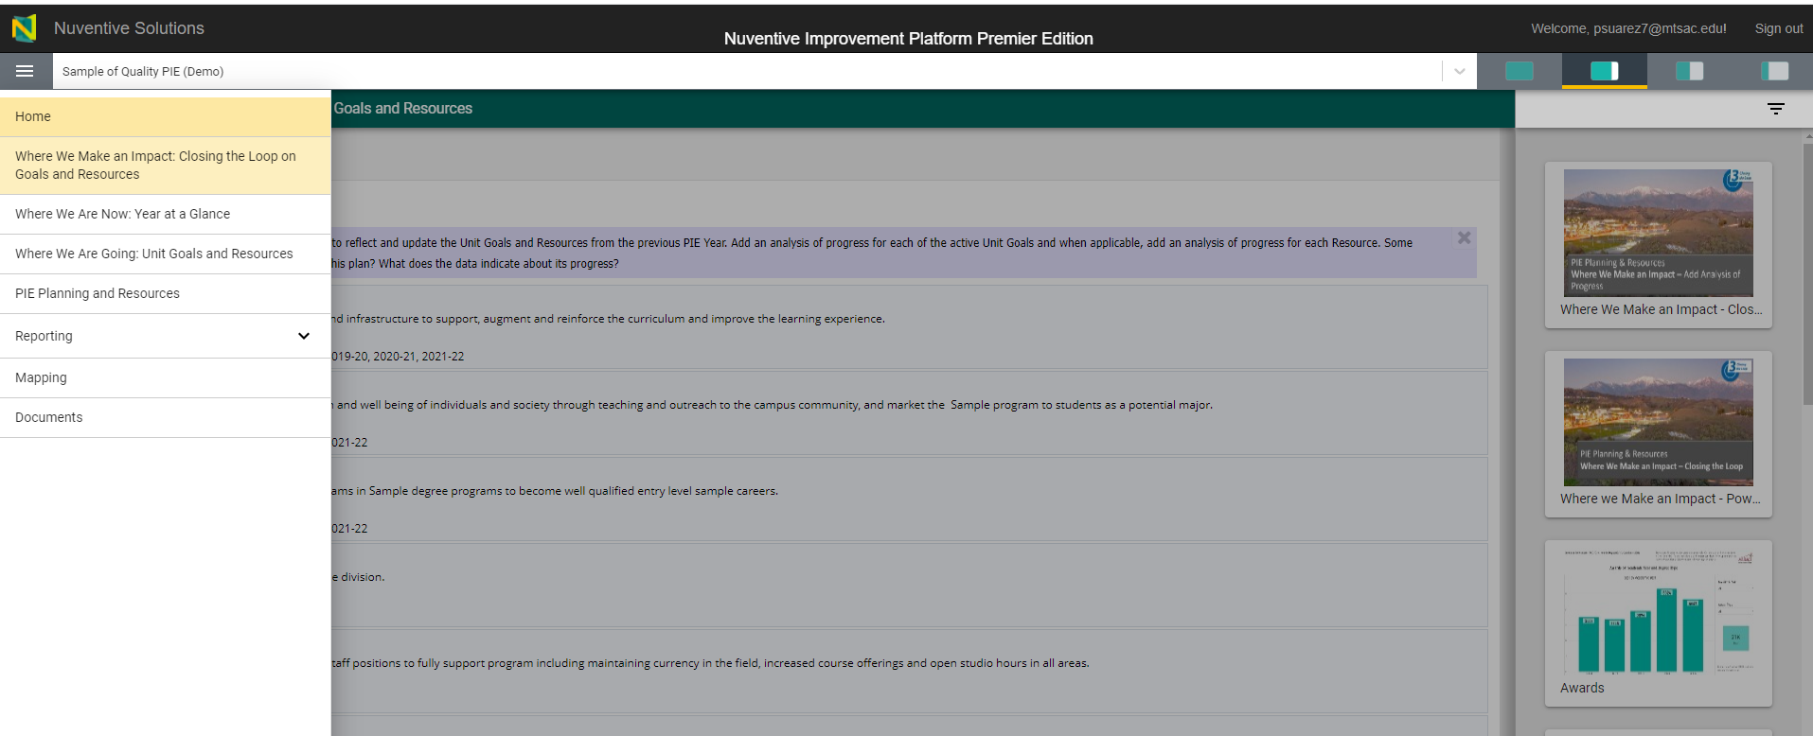
3. Where We Make an Impact
1. Click on toggle menu and Select “Where We Make an Impact”
Unit Goals from previous years will appear.

Slide 3
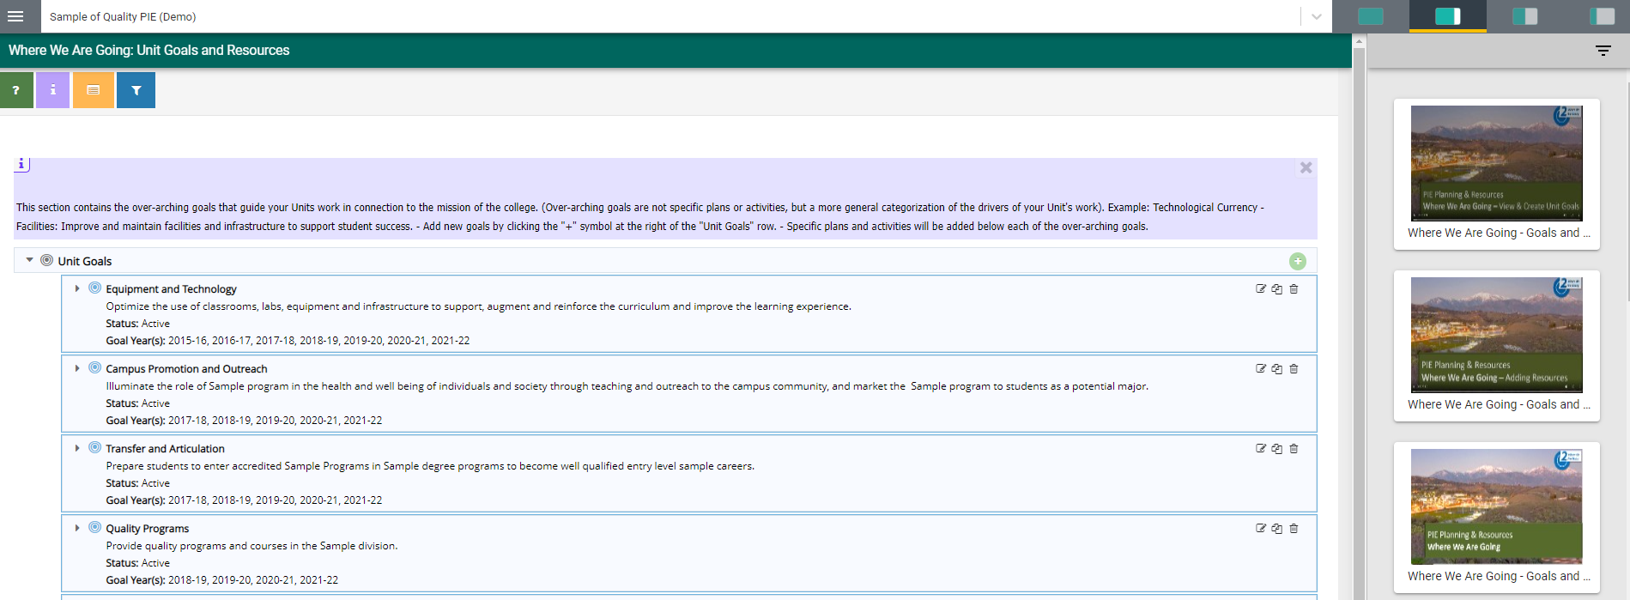
3. Where We Make an Impact
Can select on options to view screen as 25%, 50%, 75% or 100%.
Available Reports will display on right hand side of screen.

Slide 4
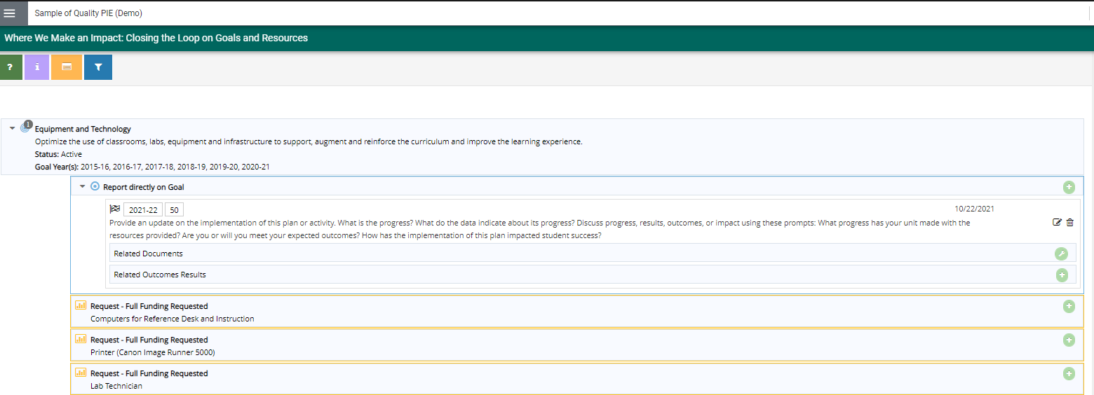
3. Where We Make an Impact
Analysis of Progress will display for preceding Reporting Years (if applicable)
*Give an update on Goals and Resources.

Slide 5
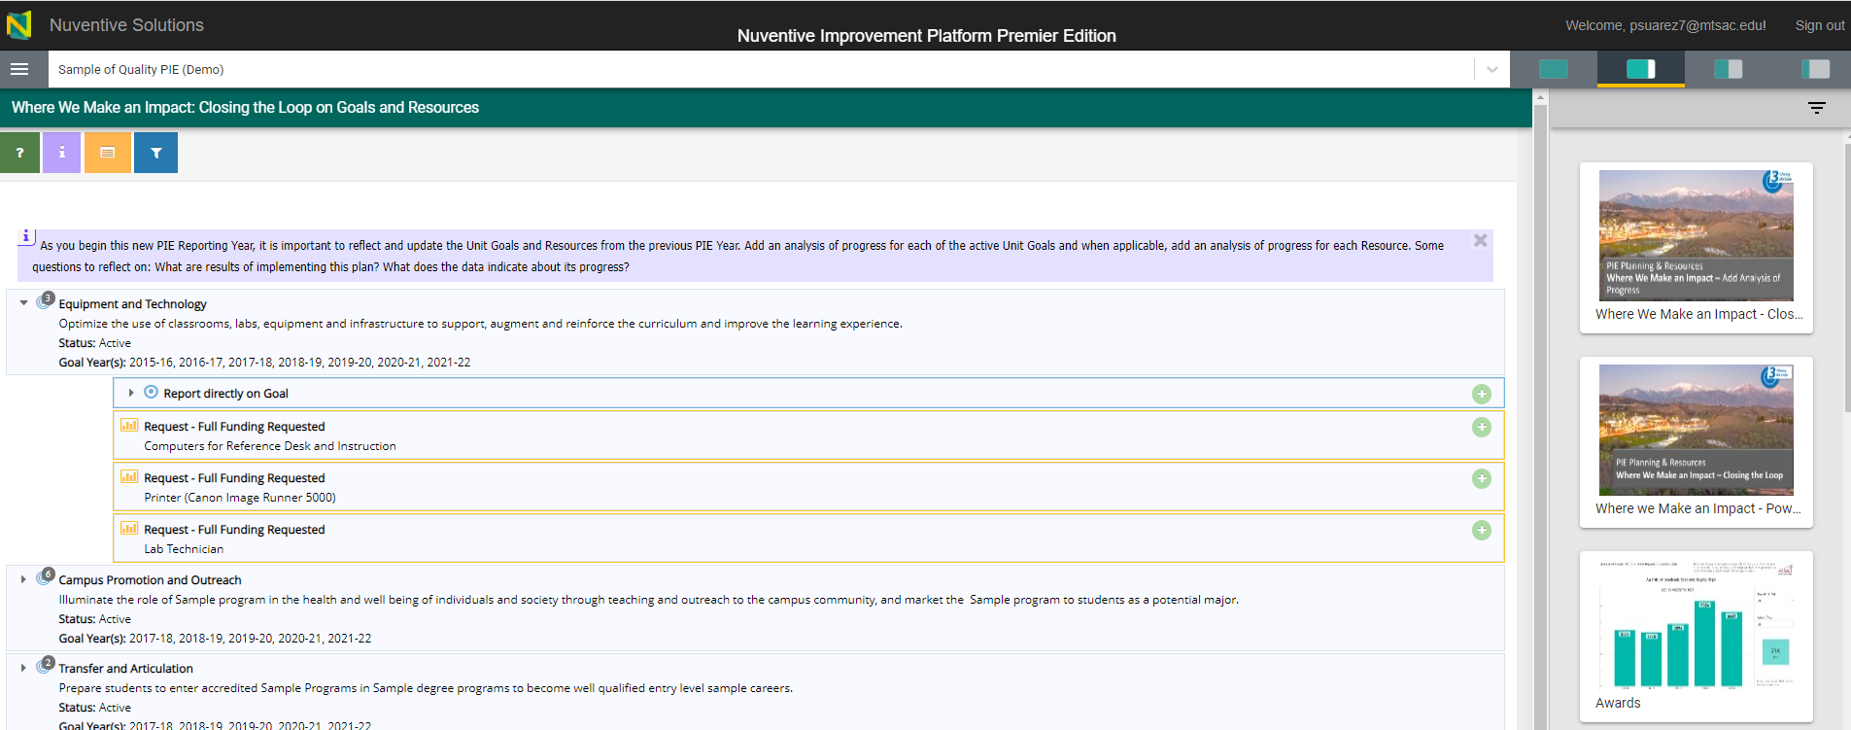
3. Where We Make an Impact – Add Analysis of Progress on Goals
1. Click to View Unit Goals
3. Click to Add Analysis of Progress
2. View Goals (blue) or Resources (orange)
*You can add an analysis of progress on the Unit Goals and / or Resources

Slide 6
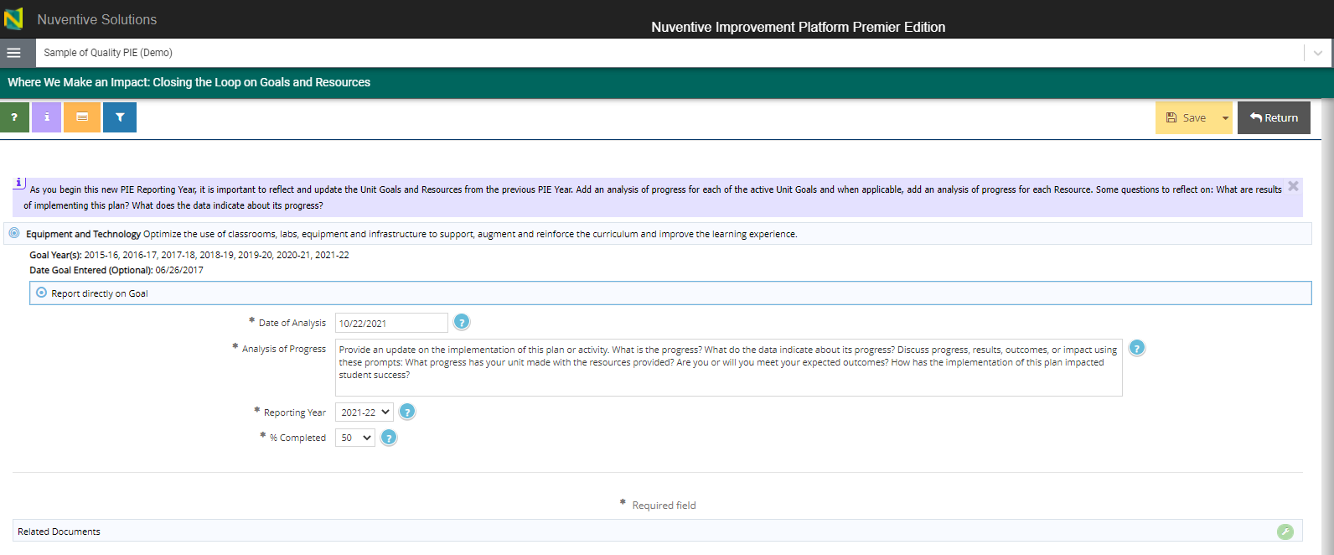
3. Where We Make an Impact – Add Analysis of Progress on Goals
4. Enter Analysis of Progress
7. Make sure to Save and Return
5. Ensure Reporting Year is current reporting year.
6. Select what % of Goal is completed

Slide 7
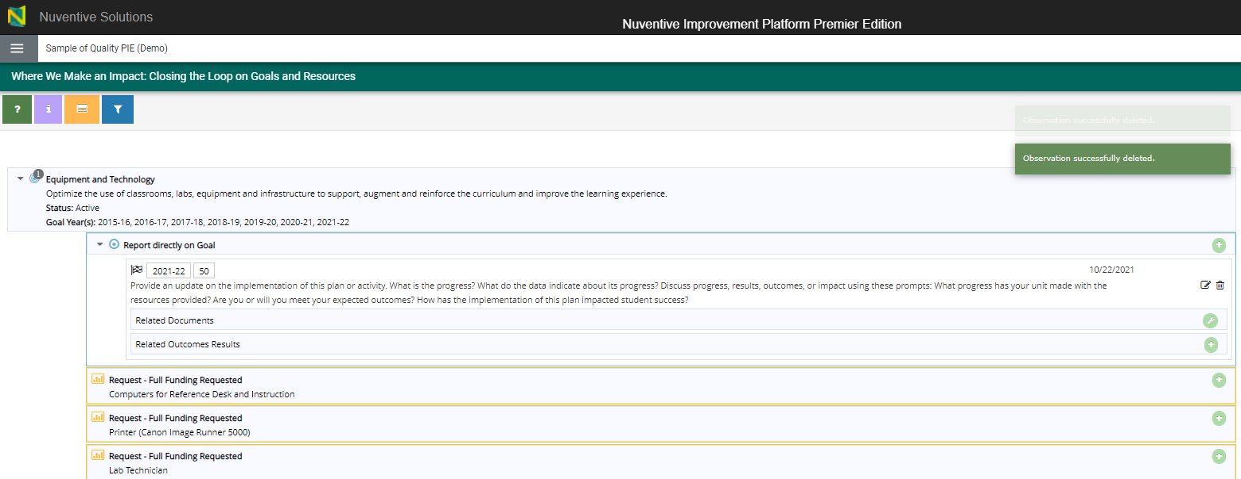
3. Where We Make an Impact – View & Add Related Documents
1. Click to Add Related Documents

Slide 8
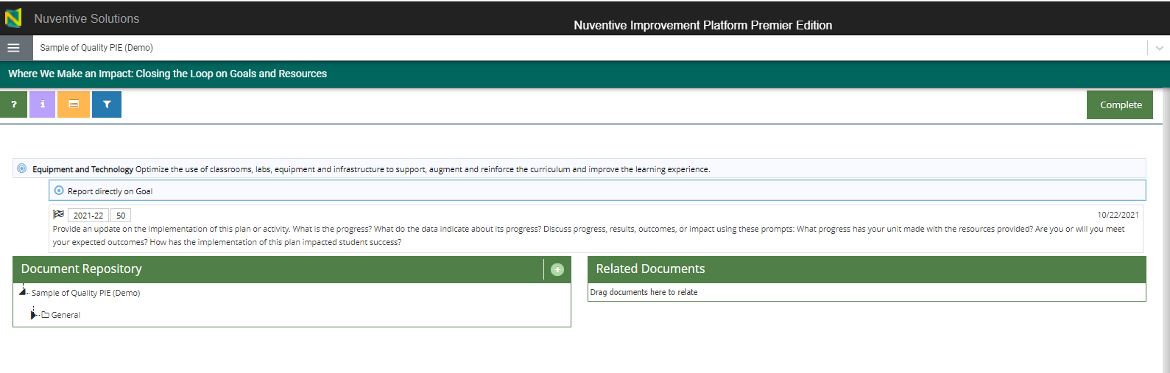
3. Where We Make an Impact – View & Add Related Documents
3. Click to View Document Repository
2. Click to Upload new documents

Slide 9
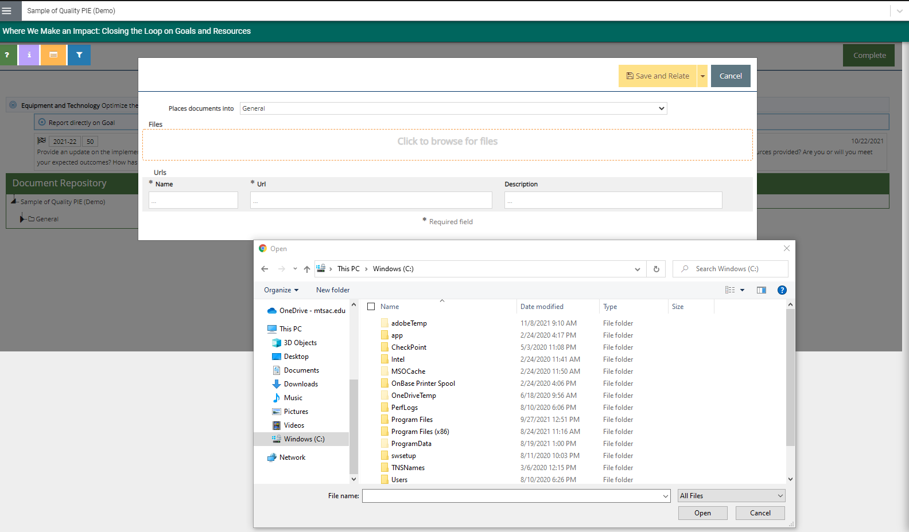
2. Where We Are Going – Uploading Documents to Resources
3. Where We Make an Impact –View & Add Related Documents
Document Retrieval Screen will display
4. Select Location to place uploaded documents to
5. Click to browse and add files on your computer
6. Select File and Select Open

Slide 10
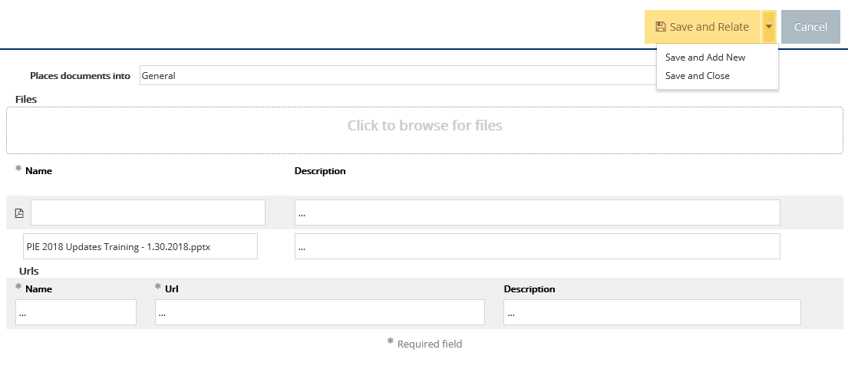
2. Where We Are Going – Uploading Documents to Resources
3. Where We Make an Impact –View & Add Related Documents
7. Select Save and Relate
Save and Add New: saves the document and stays on this screen to keep adding more documents
Save and Close: saves the document and returns to previous screen

Slide 11
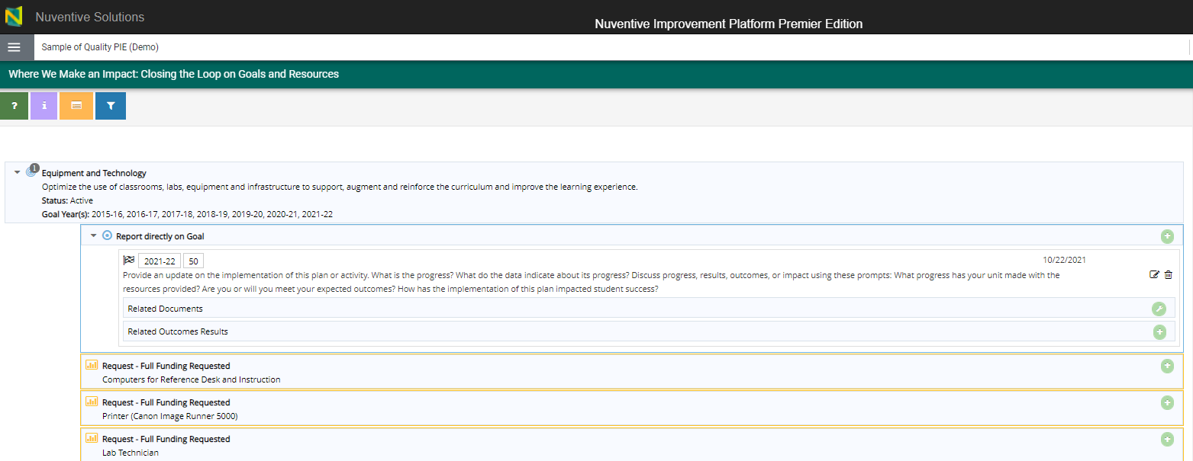
3. Where We Make an Impact – Related Outcomes Results
1. Click to Add Related Outcomes Results
*You can add Related Outcomes Results to Unit Goals or Resource Requests

Slide 12
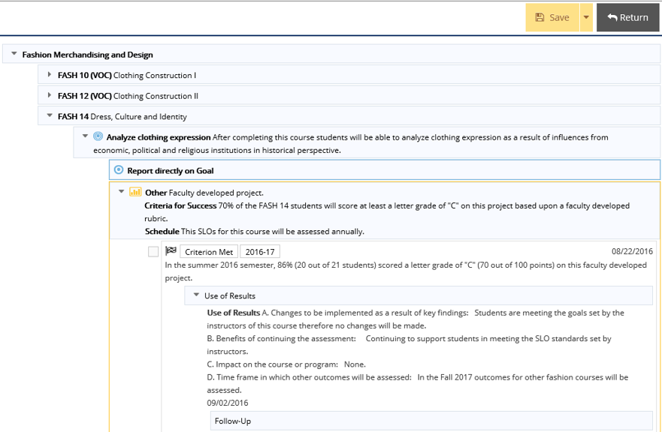
3. Where We Make an Impact – Related Outcomes Results
4. Don’t forget to Save and Return
2. Select drop down arrow to expand on specific SLO’s.
3. Place check mark to link SLO to Unit Goal or Resource Request as applicable

Slide 13
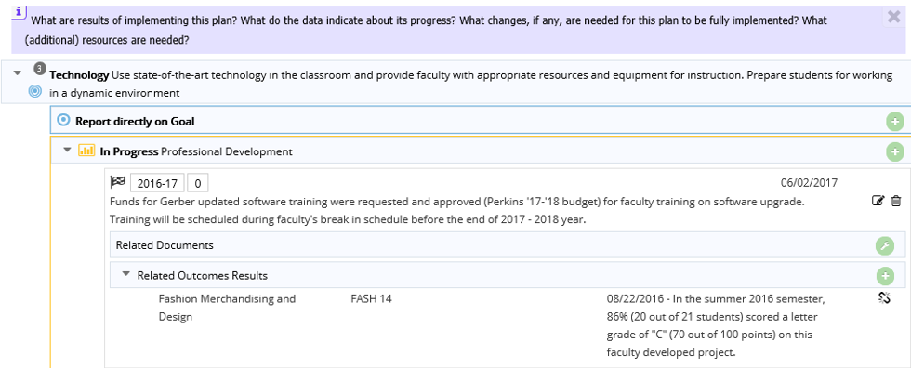
3. Where We Make an Impact – Related Outcomes Results
You are able to un-link SLO by selecting this icon
Related Outcome(s) will display

Slide 14
3. Where We Make an Impact – Add Analysis of Progress on Goals
*Ideally you will be adding an analysis of progress on all Unit Goals and Resources Requests for current reporting year.
*Unit Goals will display in a blue halo
**Resource Requests will display in an orange halo

