Slide 1
PIE Planning & Resources
Where We Are Now

Slide 2
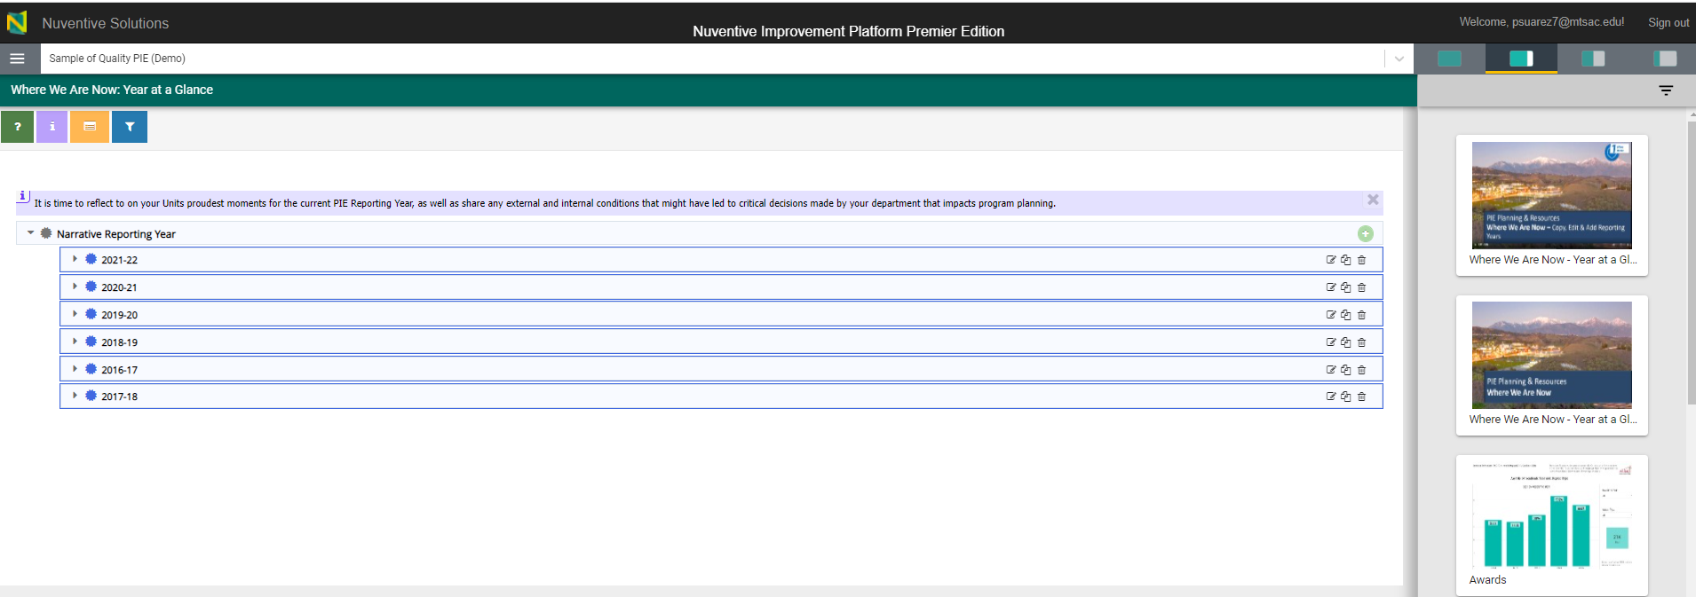
1. Where We Are Now – View Reporting Year
Summary of Previous Years will Display
Create
Edit
Copy
Delete

Slide 3
1. Where We Are Now – View Reporting Year
Can select on options to view screen as 25%, 50%, 75% or 100%.
Available Reports will display on right hand side of screen.

Slide 4
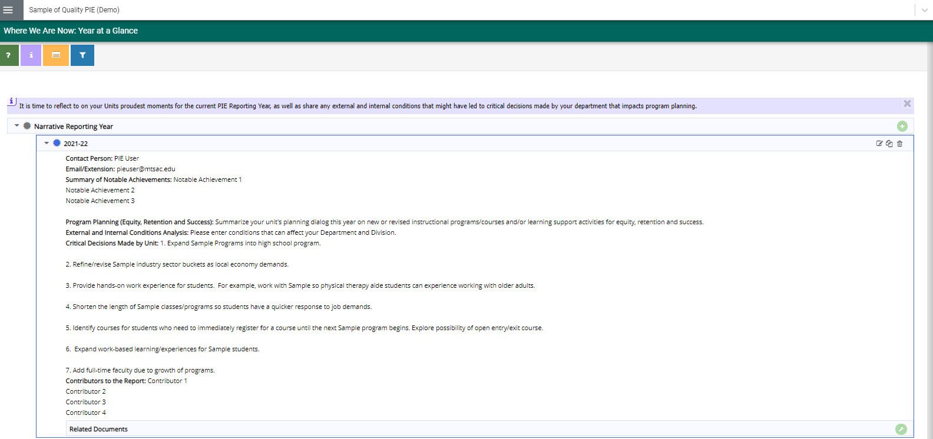
1. Where We Are Now – Copy Reporting Year
2. Click to Copy Year
1. Click to View selected Year data

Slide 5
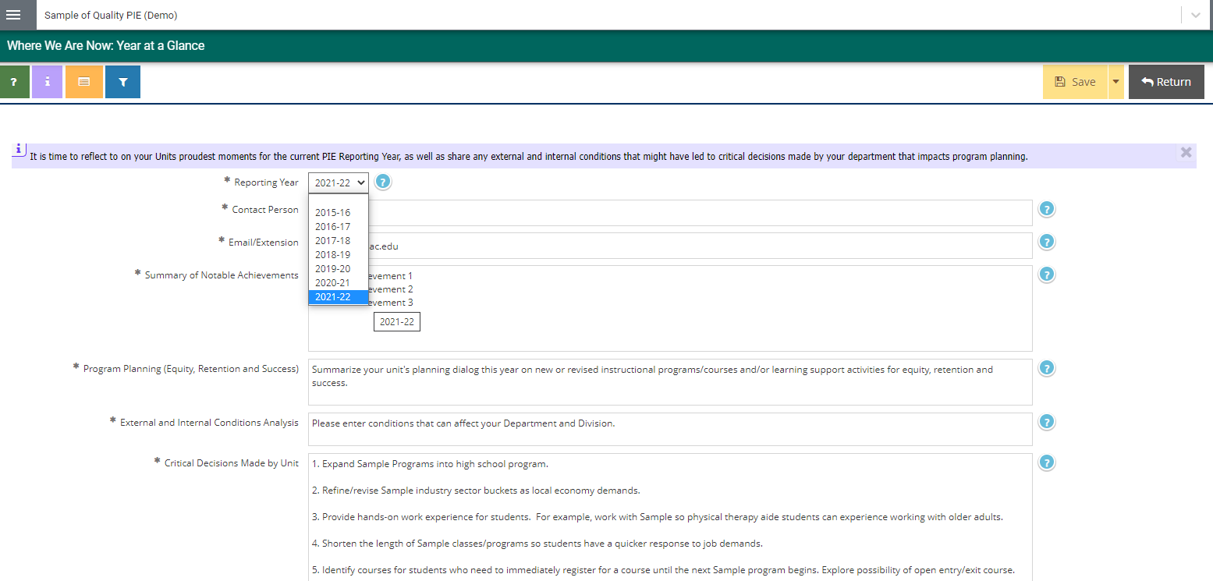
1. Where We Are Now – Copy Reporting Year
3. Enter New Year
5. Click Save
4. Update narrative into the related fields
6. Click Return for previous page

Slide 6
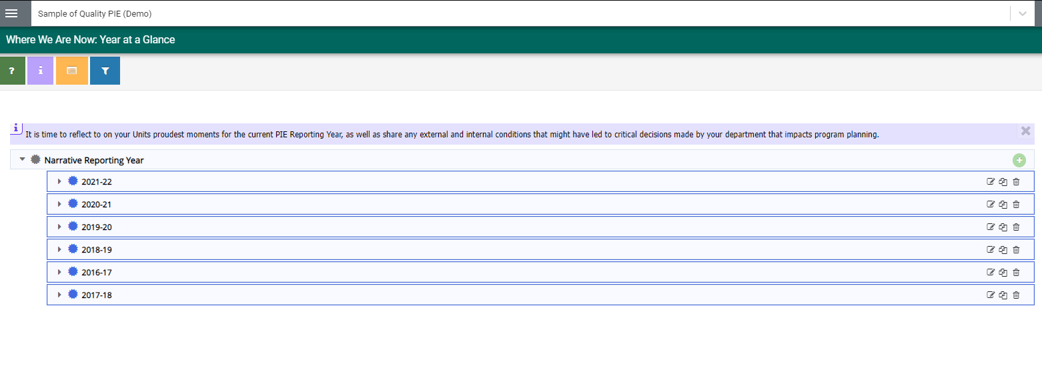
1. Where We Are Now – Create Reporting Year
1. Click to Create New Reporting Year
*only create new year to start a new PIE with no previous entries.

Slide 7
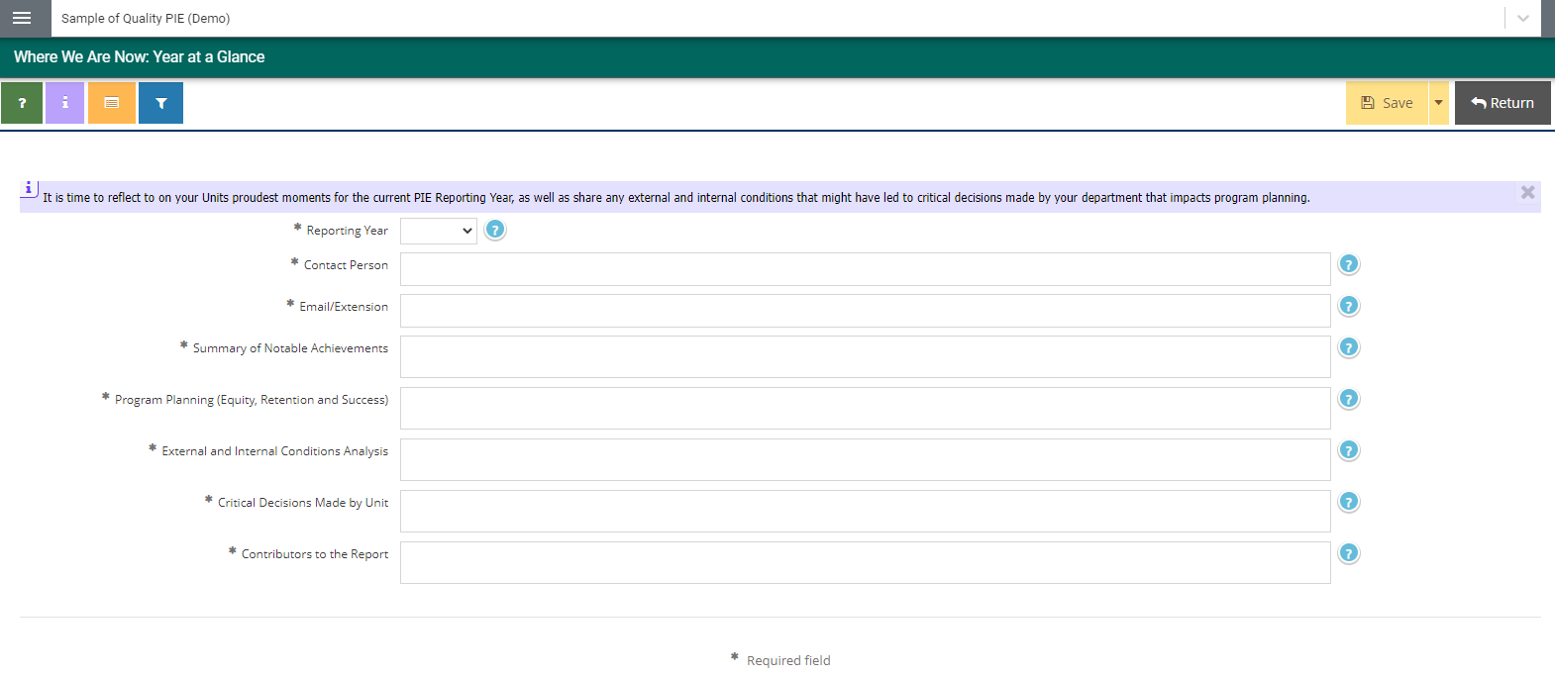
1. Where We Are Now – Create Reporting Year
3. Click Save
4. Click Return for previous page
2. Enter narrative into the related fields
*You can view great examples of quality pie under: PIE – Sample of Quality PIE (Demo)

Slide 8
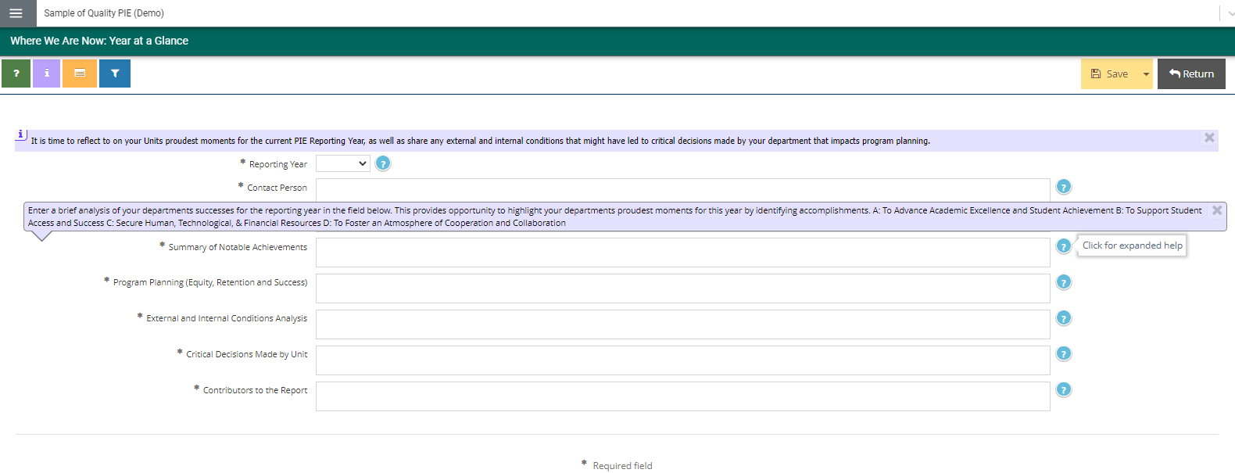
1. Where We Are Now – Reporting Year Help
By clicking on the ? icon, additional help will be provided.

