Slide 1
PIE Planning & Resources
Where We Are Going

Slide 2
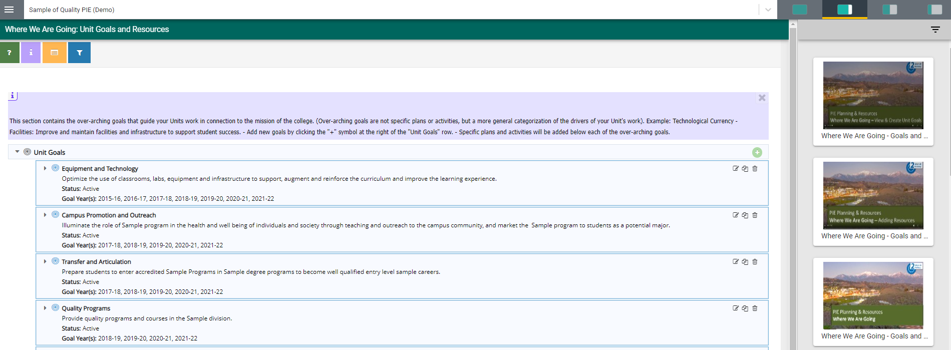
Review and Update Exisiting Goals
2. Where We Are Going – Report Overview
Can select on options to view screen as 25%, 50%, 75% or 100%.
Available Reports will display on right hand side of screen.

Slide 3
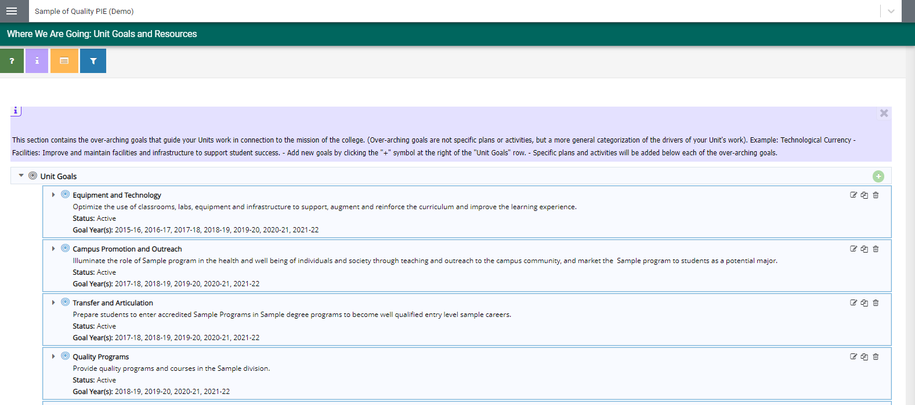
Review and Update Exisiting Goals
2. Where We Are Going – View and Edit Unit Goals
1. Click to View Unit Goals
2. Click to Edit Unit Goals
Existing goals from last year will appear. If substantial changes are being made to the goal name, a new goal should be entered.

Slide 4
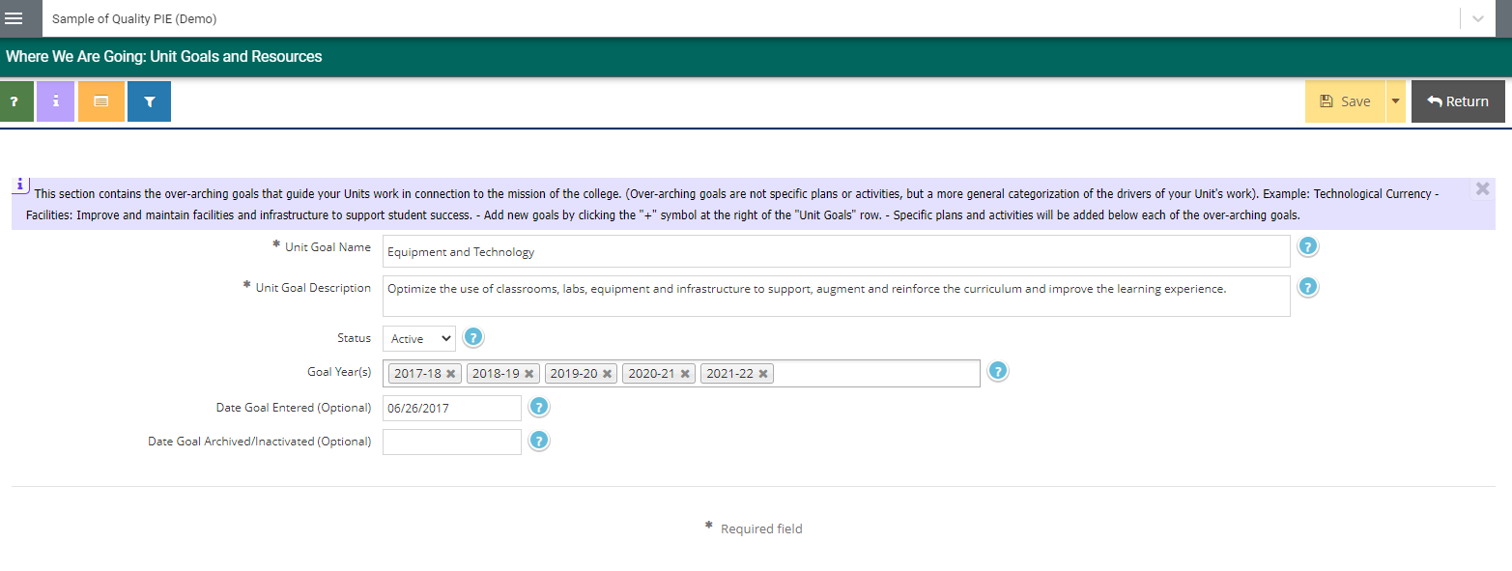
Review and Update Exisiting Goals
2. Where We Are Going – Edit Unit Goals
5. Select Goal Years for Unit Goals that will be a part of your Unit for the upcoming year(s).
3. Substantive edits should not be made to Unit Name or Unit Goal.
4. Select if Goal is still Active or Inactive for new Reporting Year.
6. Make sure to Save & Return

Slide 5
2. Where We Are Going – Inactivating Unit Goals
1. If Unit Goals are no longer required, please update status to INACTIVE.
4. Save & Return
2. Remove Current Goal Year and any Future Goal Years.
3. Enter Date Goal Inactivated.

Slide 6
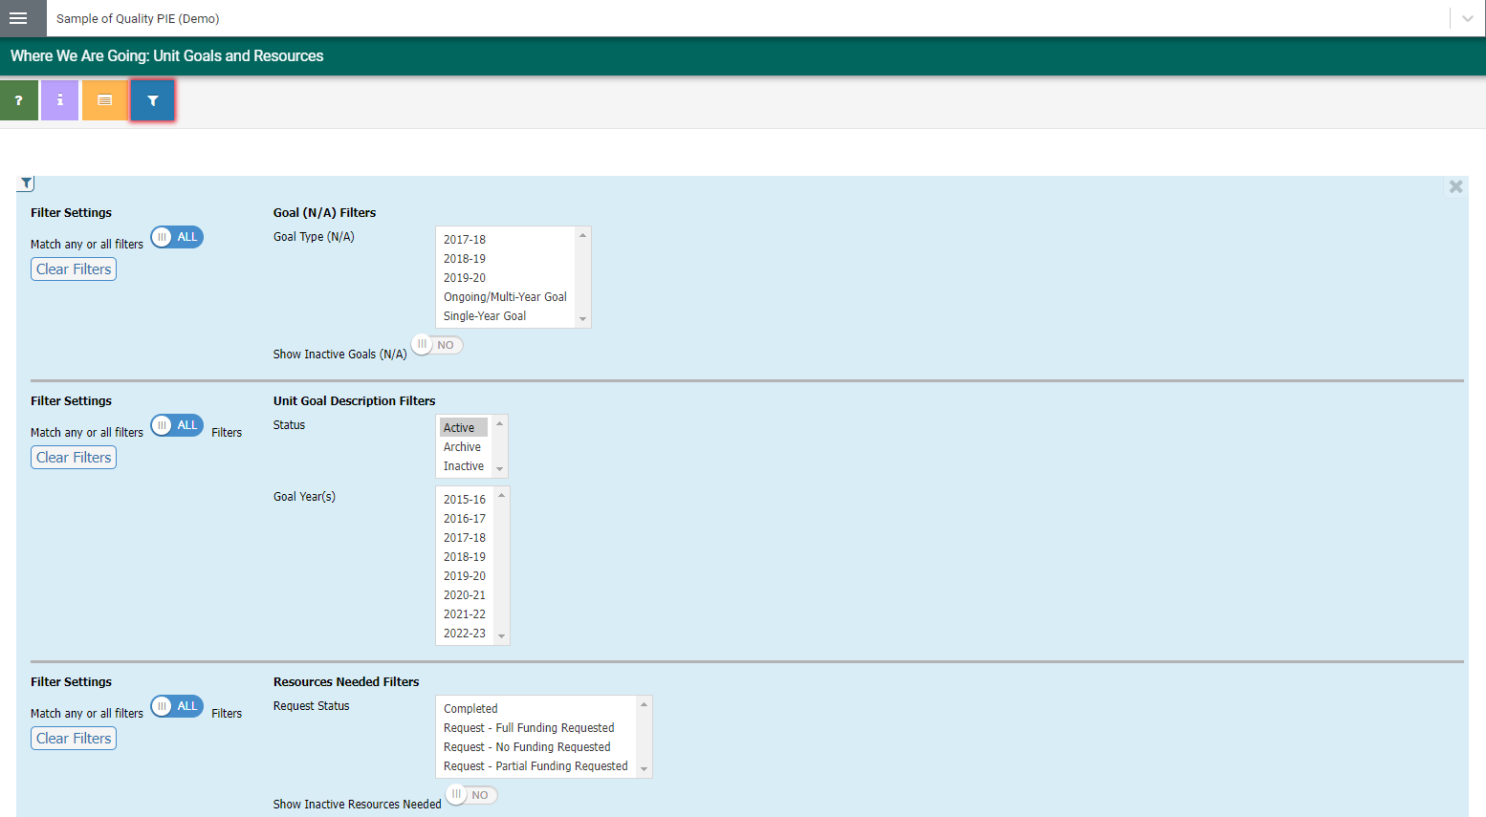

2. Where We Are Going – Filter Unit Goals
5. Select
Filter icon:
6. Select Active option in Status.
7. Select to Close
* Unit Goals will still appear. You will have to enter a filter to no longer view inactive unit goals.
* This is a one time process and will automatically be applied universally.

Slide 7
2. Where We Are Going – Add Unit Goals
1. Click to Add Unit Goals

Slide 8
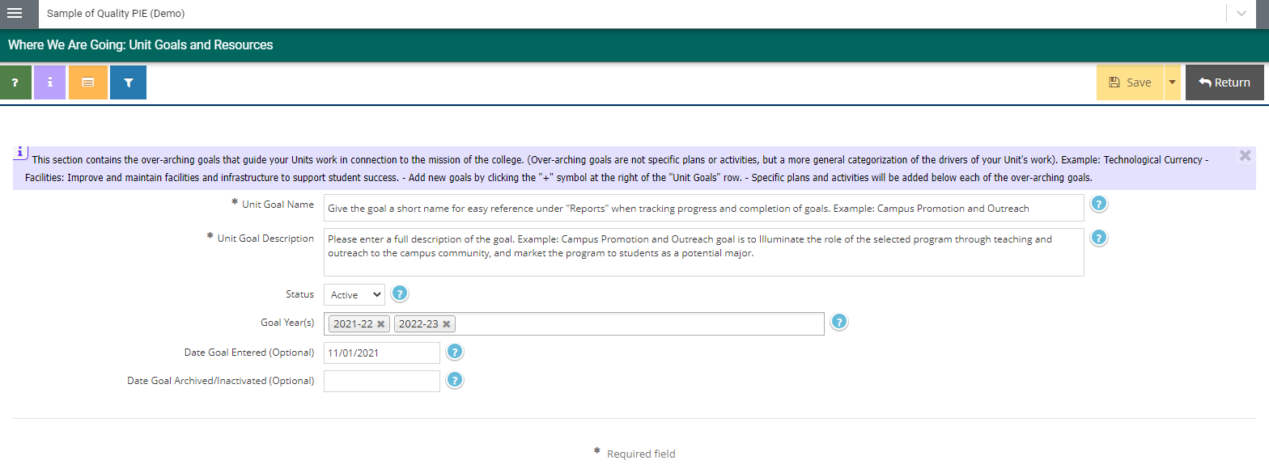
2. Where We Are Going – Add Unit Goals
4. Make sure to Save & Return
2. Enter information into the following fields
3. Select Goal Years (Multiple years may be selected)

Slide 9
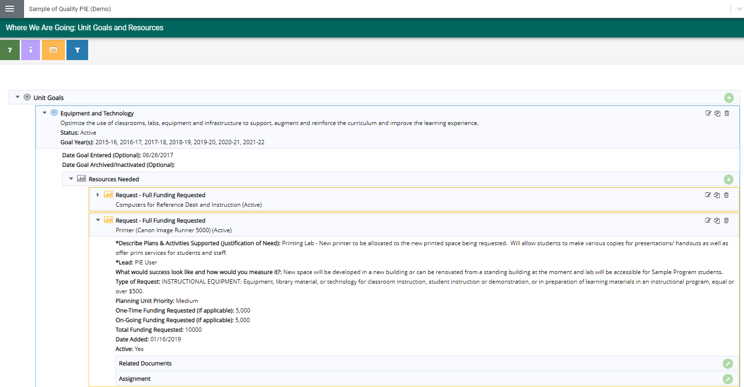
2. Where We Are Going – View Resources
Resources Needed
1. Click to View Unit Goal Details
2. Select dropdown arrow to view details

Slide 10
2. Where We Are Going – Edit Resources
4. Click to Edit Resource
3. Click to View Resource

Slide 11
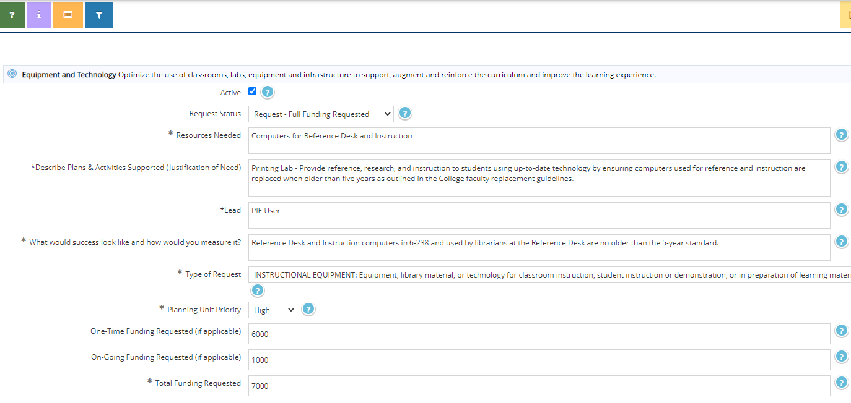
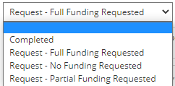
2. Where We Are Going – Edit Resources
5. Select Active if Resource is still required. If no longer required, please Inactive. Do not delete!
6. Update Request Status
**If resource is no longer needed because it has been completed, please select Completed in this selection menu.

Slide 12
2. Where We Are Going – Edit Resources
8. Save and Return
7. Update Type of Request

Slide 13
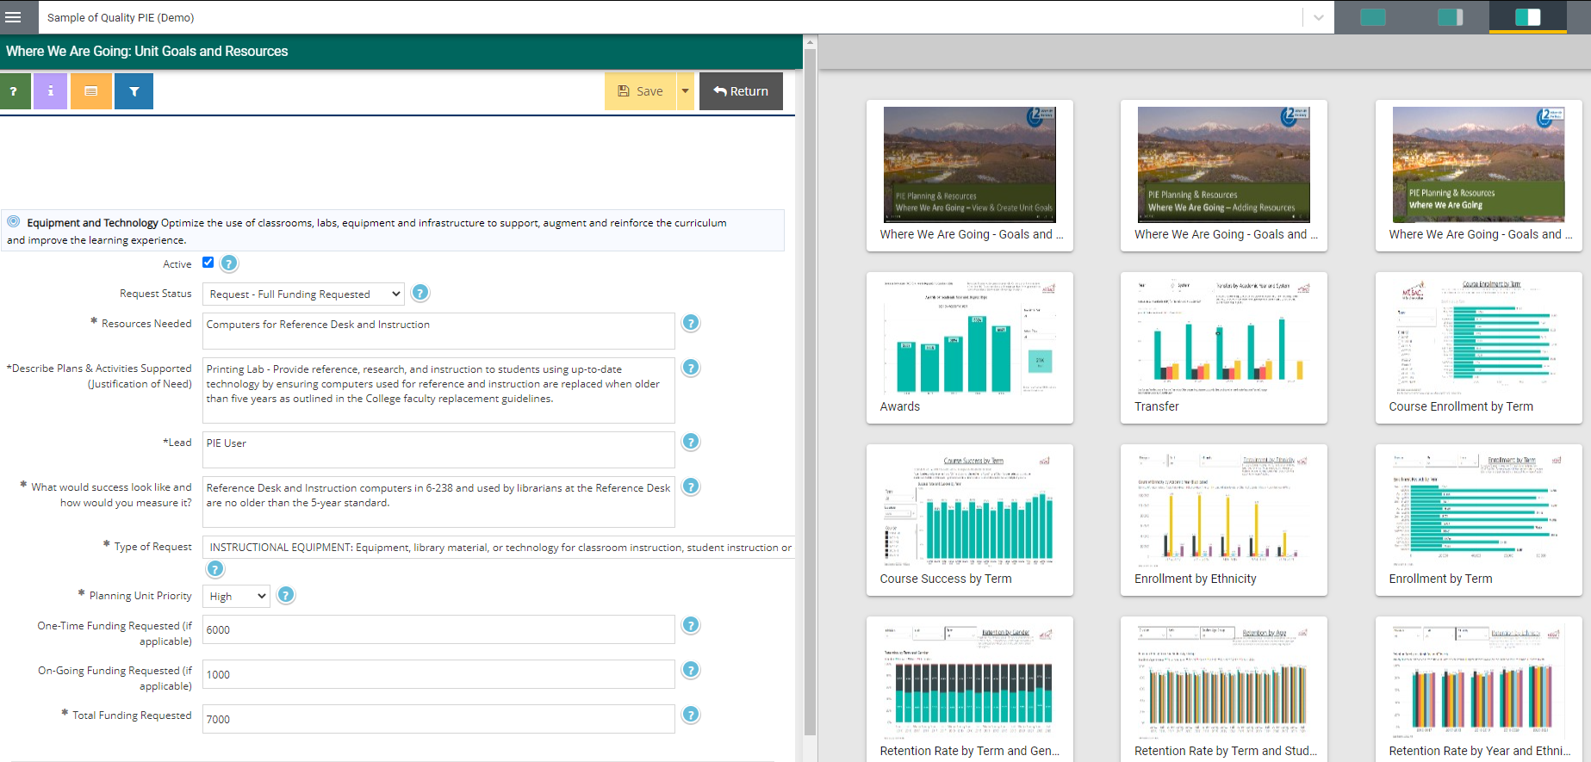
2. Where We Are Going – Edit Resources
Reports and Estimates will be available on the right hand side for better estimates.
*Work with relevant departments to give an estimate of funding requested.

Slide 14
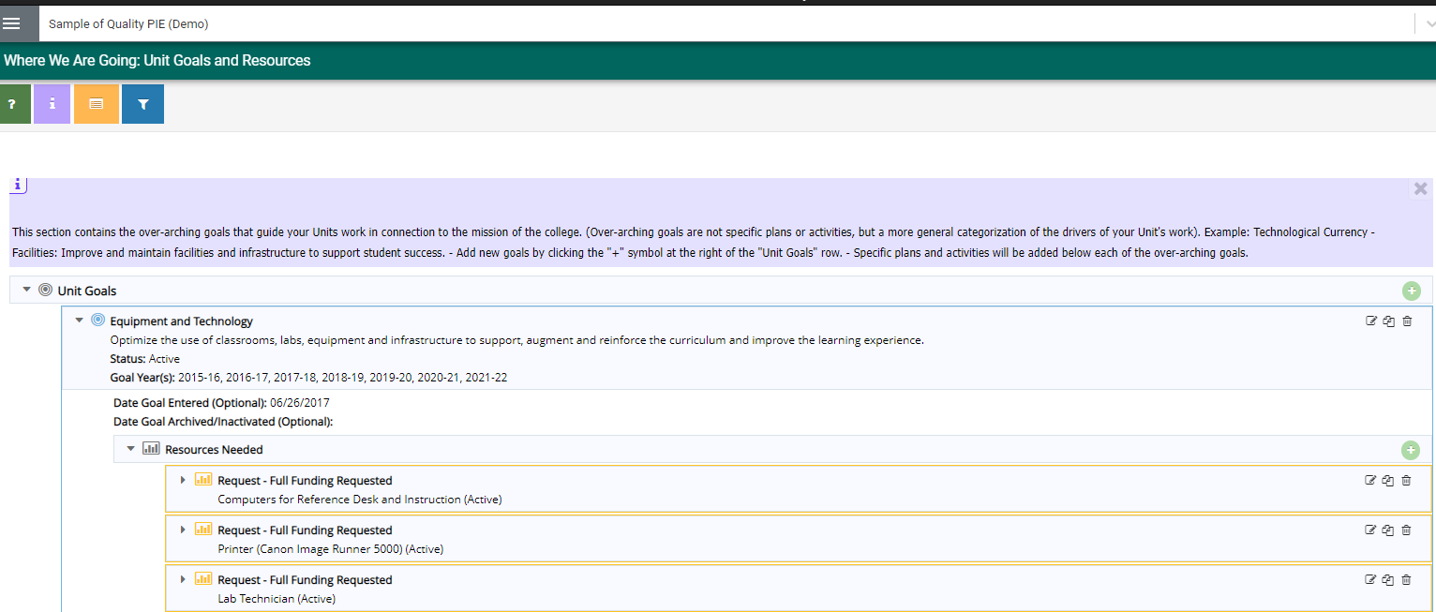
2. Where We Are Going – Add Resources Needed
1. Select Unit Goal to expand
2. Select to Add Resource Needed
All resources requests for this Unit Goal will display.

Slide 15
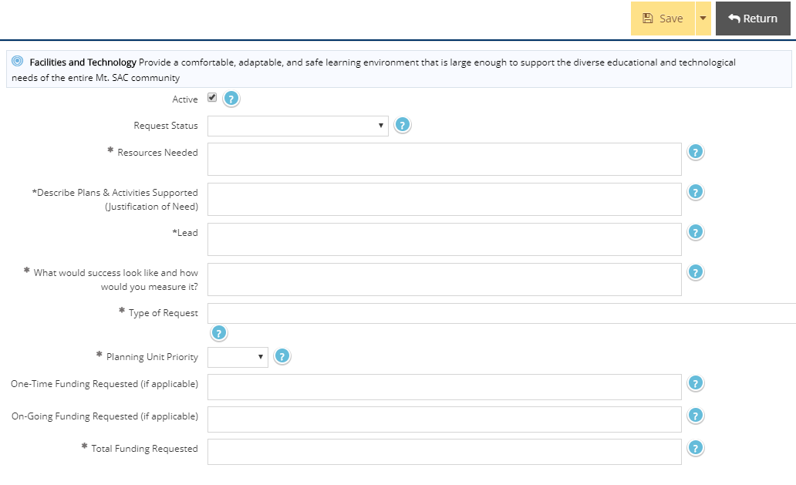
2. Where We Are Going – Add Resources Needed
5. Make sure to Save & Return
3. When Adding Resources, enter information into the following fields.
4. Select Type of Request

Slide 16
Review and Update Exisiting Goals
2. Where We Are Going – Copy & Moving Resources
2. Click to Copy Resources
1. Click to View Resources Needed

Slide 17
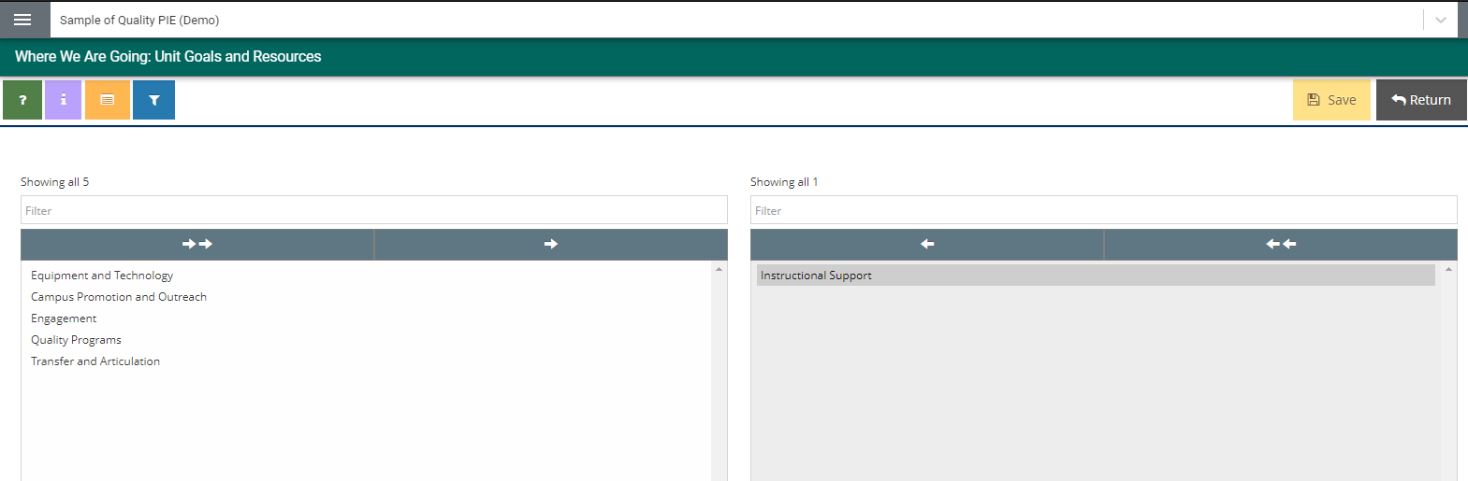
Review and Update Exisiting Goals
2. Where We Are Going – Copy & Moving Resources
3. Select Unit Goal you wish to Copy Resource to.
6. Save & Return
5. Unit Goal will appear
4. Select the Right Arrow to “Move Selected” Unit to the right bucket.
You will see all of your Unit Goals displayed.

Slide 18
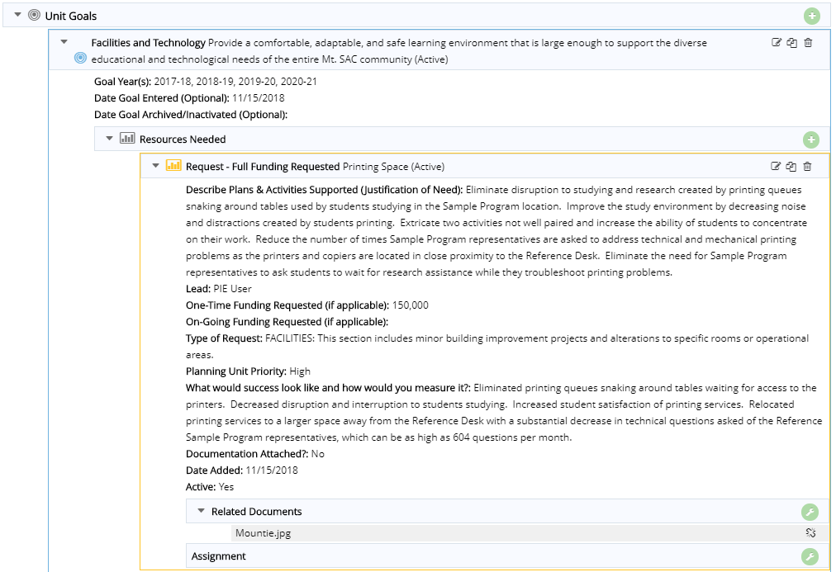
2. Where We Are Going – View & Upload Related Documents
1. View Resource and expand to view details.
2. Click to Add Related Documents to the Resource

Slide 19
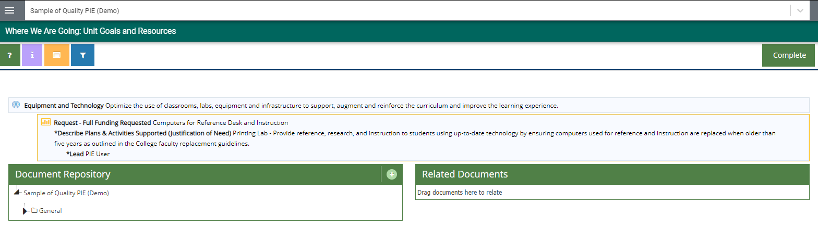
2. Where We Are Going – Uploading Documents to Resources
2. Click to be able to add and upload documents.
3. Documents Repository (Where all files are stored in Nuventive Improve)

Slide 20
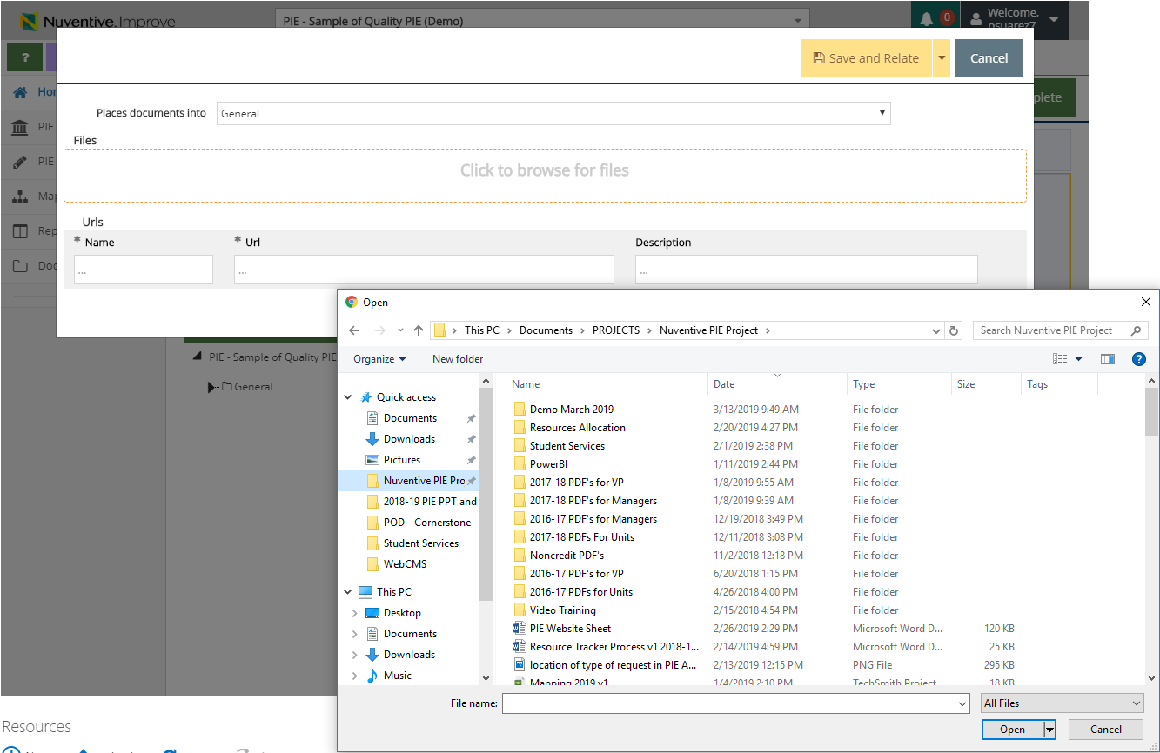
2. Where We Are Going – Uploading Documents to Resources
4. Click to browse and add files on your computer.
5. Select file and Select Open.

Slide 21
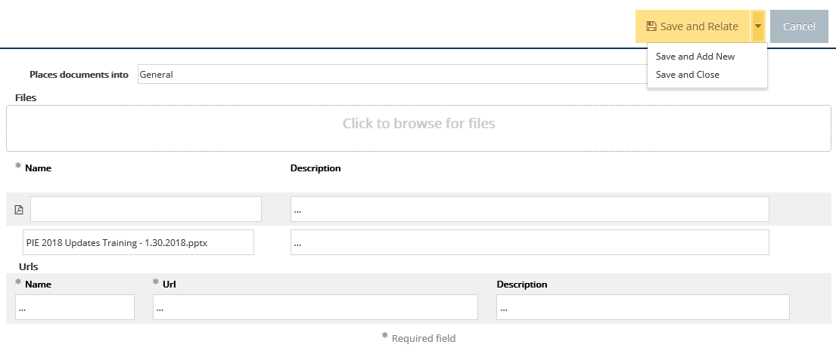
2. Where We Are Going – Uploading Documents to Resources
7. Select Save and Relate
Save and Add New: saves the document and stays on this screen to keep adding more documents.
Save and Close: saves the document and returns to previous screen.

Slide 22
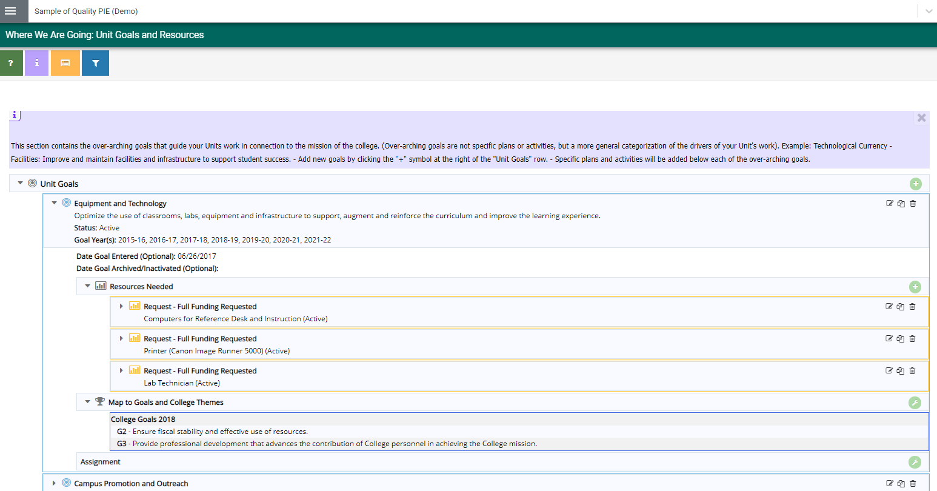
2. Where We Are Going – Manage Assignment
1. Click tool icon to Manage Assignment

Slide 23
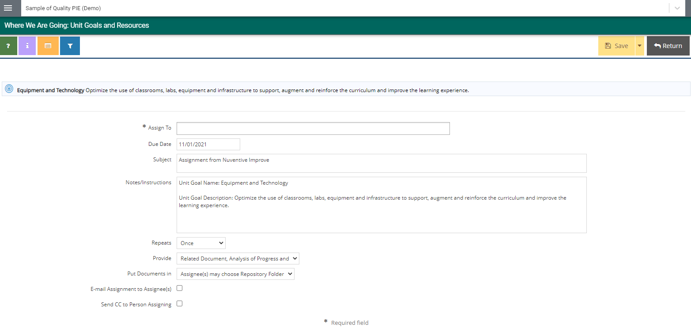
2. Where We Are Going – Manage Assignment
3. Save & Return
2. Enter information into the following fields.
* An email is sent to PIE user assigned and notifies the PIE user when logging in.

Slide 24
PIE Planning & Resources
Mapping

Slide 25
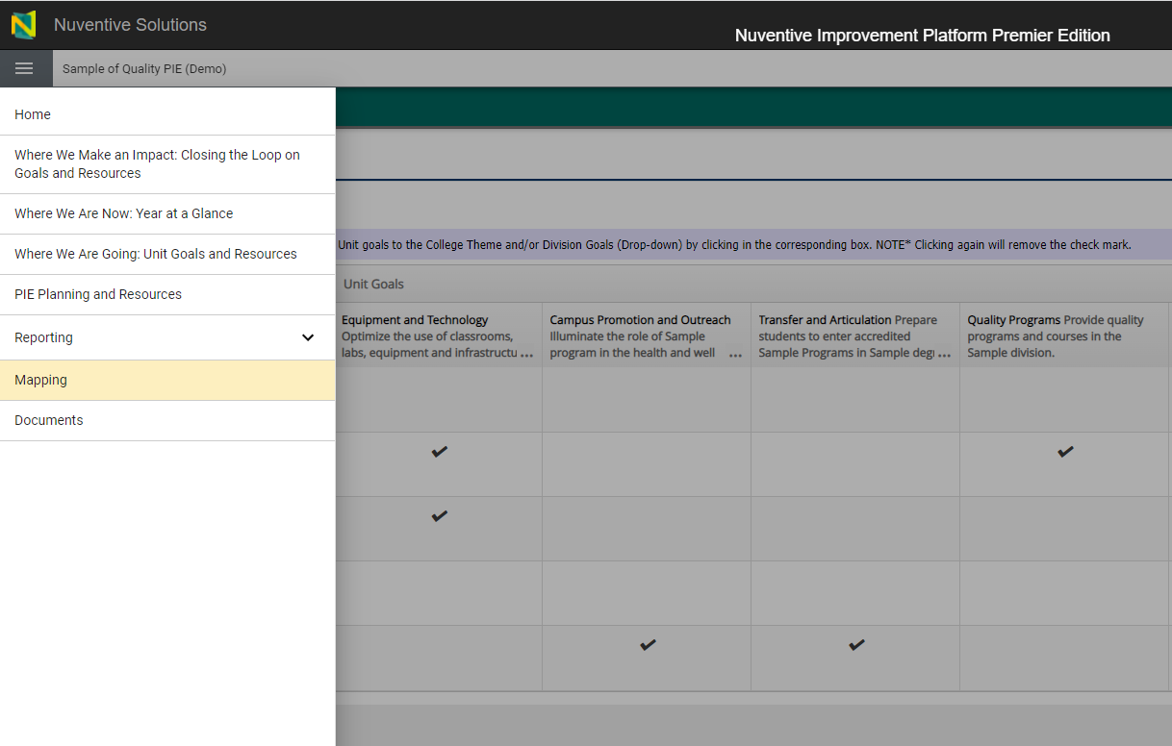
3. Mapping – Mapping
1. Select the Toggle Menu
2. Select Mapping

Slide 26
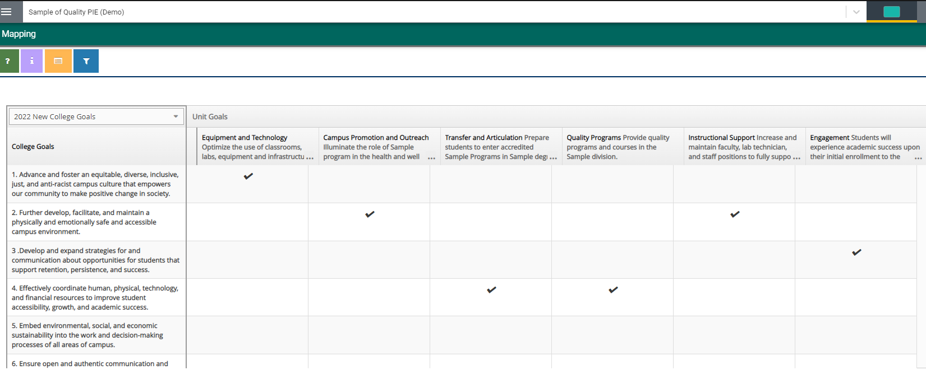
3. Mapping – Mapping
3. Please Select: College Goals 2022
* All Unit Goals should be mapped to Mt. SAC College Goals.

Slide 27

3. Mapping – Mapping
5. College Goals are displayed from top to bottom
4. Unit Goals are displayed from left to right
7. Select Save
6. Place a checkmark to map (link) Unit Goals to College Goals

