Slide 1
Navigating PIE Planning for Institutional Effectiveness
User Guide

Slide 2
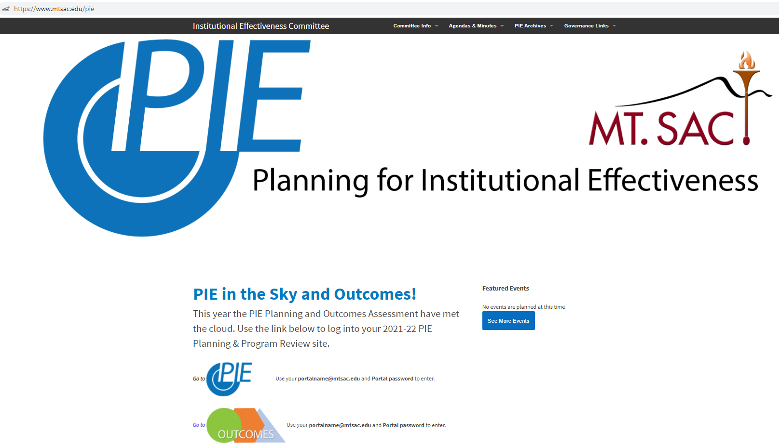
PIE - Access
1. . www.mtsac.edu/pie
2. Click to access PIE

Slide 3
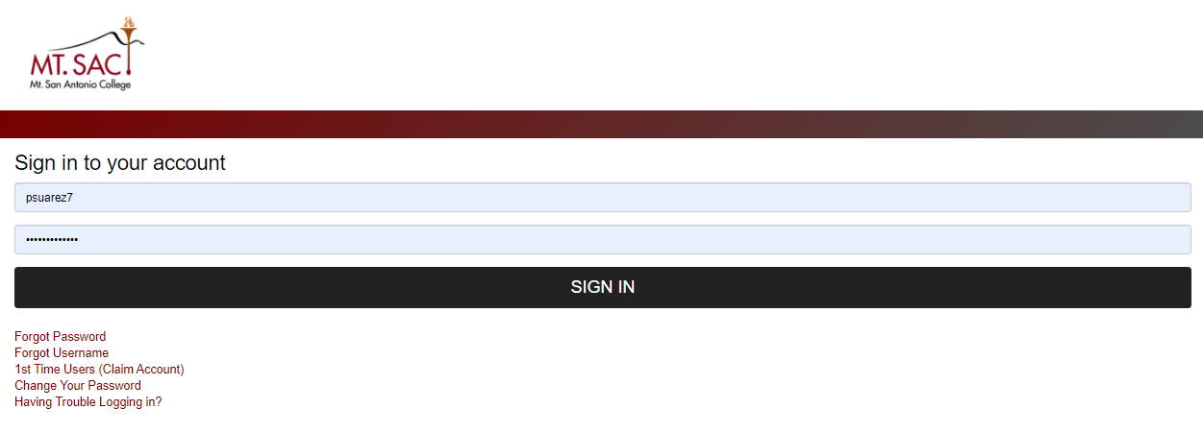
PIE – Single Sign On
After clicking on “Go to PIE” use your Mt. SAC credentials to access the Nuventive application.
3. Use portal user name &
password to login

Slide 4
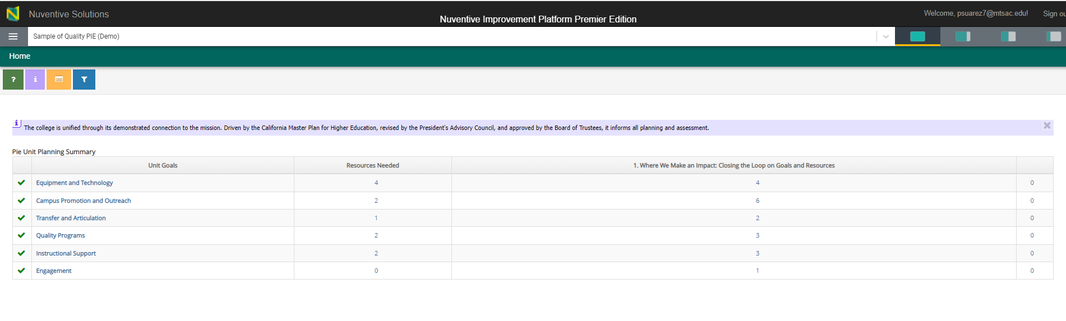
PIE – Home Screen
Dashboard will appear. The dashboard gives you a total count of items within your Unit PIE.

Slide 5
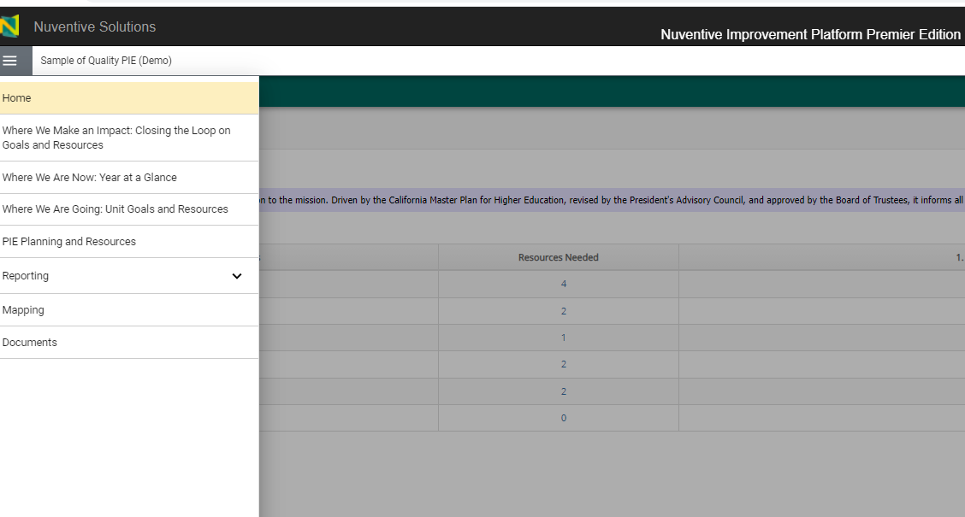
PIE – Home Screen
Click on the hamburger menu on the left hand side of the screen to access the sections within the Unit PIE.
Where We Are Now: Analysis and Summary
Where We Are Going: Foundational Planning
Where We Make an Impact: Closing the Loop on Goals and Plans

Slide 6
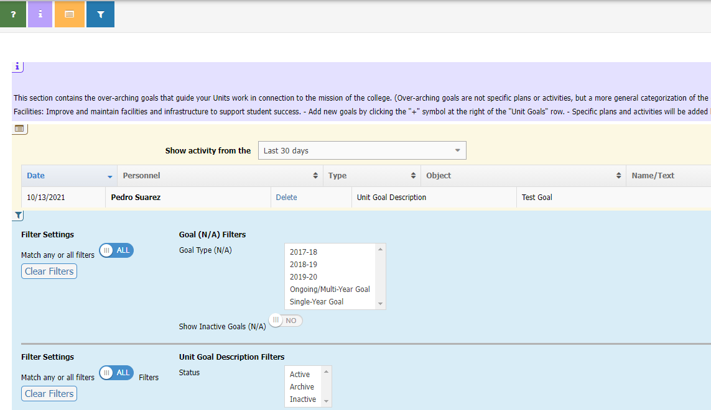
PIE - Unit Planning and Resources – Tool Bar
a. Open Page Help (help content)
b. Open Page Instructions (explanation of requirements)
c. Open Page Log (journal of activity)
d. Open Page Filter (narrow down searches)
b
c
d

Slide 7
PIE - Unit Planning and Resources – Filter
d. Open Page Filter (narrow down searches)
Filters can be applied and will remain until they are cleared
d.

Slide 8
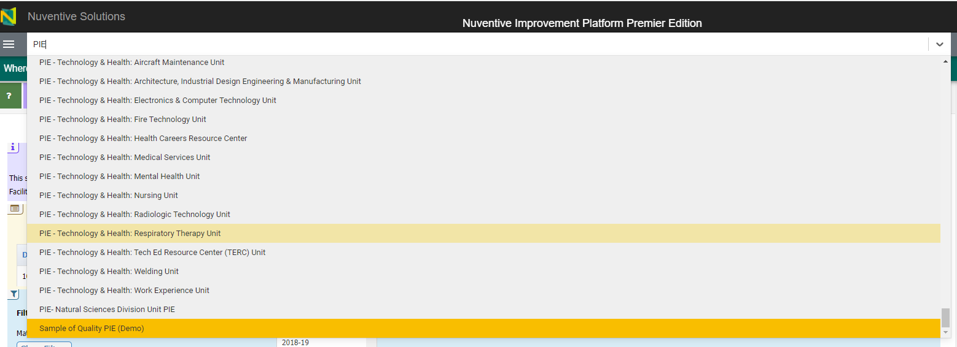
PIE - Unit Planning and Resources
Select the dropdown arrow and select respected department (user has the ability to type in department name)
*Make sure the Unit starts with “PIE”

Slide 9
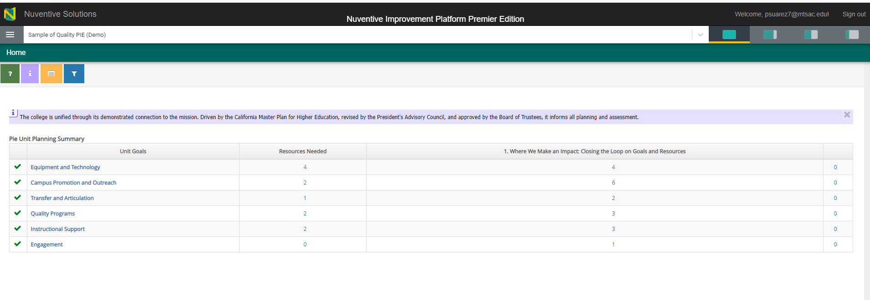
PIE – View Options
Options allow for full screen, 25%, 50% or 75% screen size.

Slide 10


Resources
PIE Content Questions
Meghan Chen: mchen@mtsac.edu
Easy as PIE
Research/ Data Review Questions
Annel Medina Tagarao
atagarao@mtsac.edu
Technical Questions:
Pedro Suarez: psuarez7@mtsac.edu
Video Training Resources:
http://www.mtsac.edu/pie

