Slide 1
Planning for Institutional Effectiveness Unpacking Data
2021-2222

Slide 2
Turn your plans into progress…
Reporting Results is a whole lot easier!
The data sits next to your plan…(lots of options, dashboards, pdf reports, links, etc.)
Data is available by division, department, subject, course and CRN.

Slide 3
The dashboards include:
Current Enrollment
Course Fill Rates
Historical FTE & Enrollment Analysis
Success & Retention Rates
Awards
Transfer

Slide 4
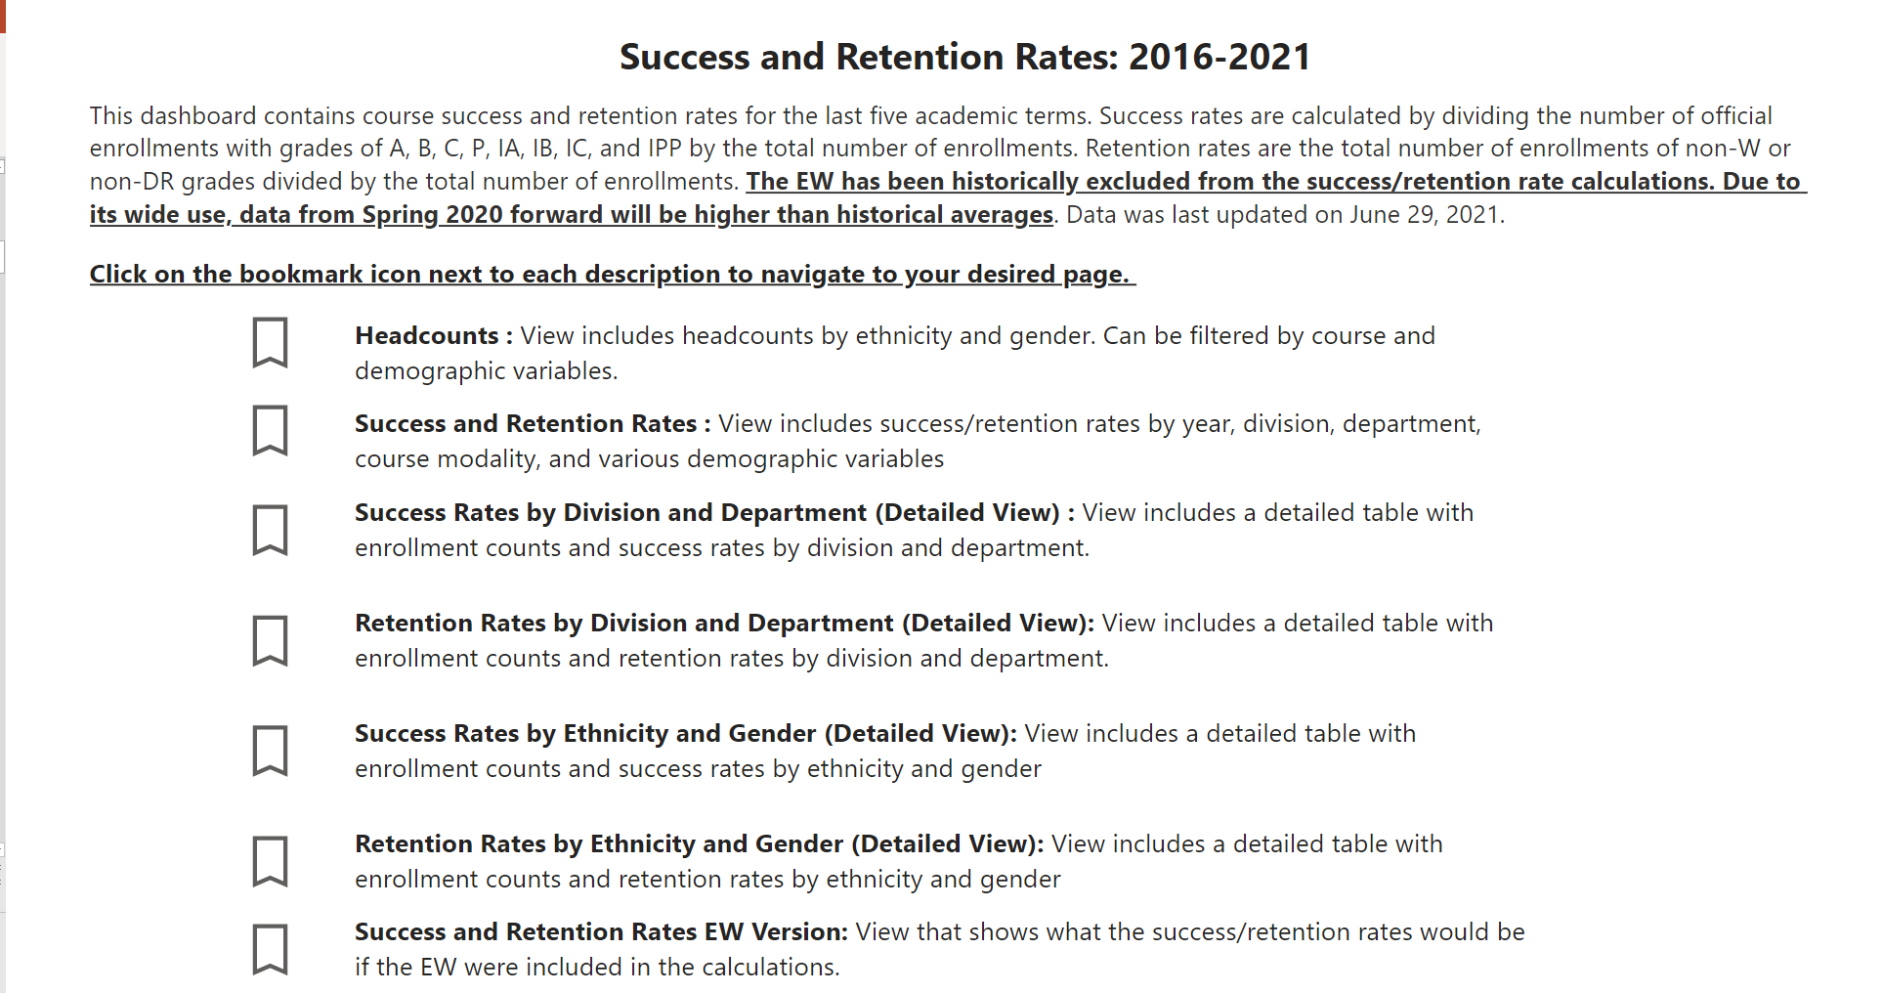
Dashboard Example
Select any of these pages
Each icon has a different information from headcounts, rates, division, department, etc.

Slide 5
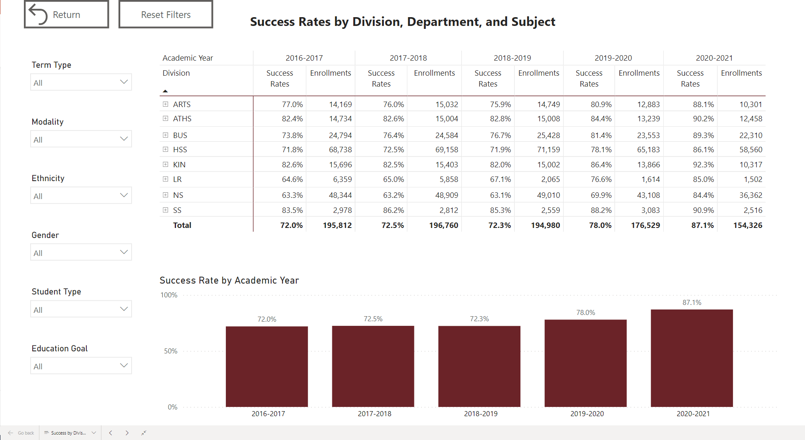
Success Rates by Division, Department, & Subject
Select Term
Select Modality,
Select Ethnicity
Select Gender
Select Student Type
Select Education Goal

Slide 6
Success Rates by Division (Cont.)
1. Select Division
2. You can remove filter by using Eraser Button on Filter

Slide 7
Tips…
Click on the + signs to expand the rows
Click on the > on the bottom of the page to scroll through available dashboards
Click on the <-> on the bottom right side to expand the dashboard

Slide 8
Data Exercise: Success, Challenges, and Lessons Learned
Start with one course, then apply to other courses
What are your initial thoughts on the data?
What might be contributing to student success in your program?
What might be detracting student success in your program?
Is this the data we need to make a decision? Why or why not?
What is the most important information?
What is missing?

Slide 9
Helpful PIE Definitions
Enrollment (Demographics) – A student is enrolled in a course if they received an end-of-term notation that is displayed on their official transcript.
Success (Data) – The percentage of students who received a passing/satisfactory grade. Success rates includes grades of A, B, C, P, IA, IB, IC, and IPP by the total number of enrollments.
Retention – The percentage of students who do not withdraw from class and who receive a valid grade.
Awards – The number of degree/certificates given to a student upon the successful completion of a program at Mt. SAC. This includes all Associates, certificates and noncredit awards.
Transfer (Data) – The number of students enrolling in either the University of California (UC) California State University (CSU) system, or private institutions.

Slide 10
More Information
Data Literacy for Equity

Slide 11
Contact US
Research/ Data Review Questions
Annel Medina Tagarao
atagarao@mtsac.edu
Easy as PIE
Technical Questions:
Pedro Suarez: psuarez7@mtsac.edu
Video Training Resources:
http://www.mtsac.edu/pie

