Slide 1
Navigating PIE
Planning for Institutional Effectiveness
User Guide

Slide 2
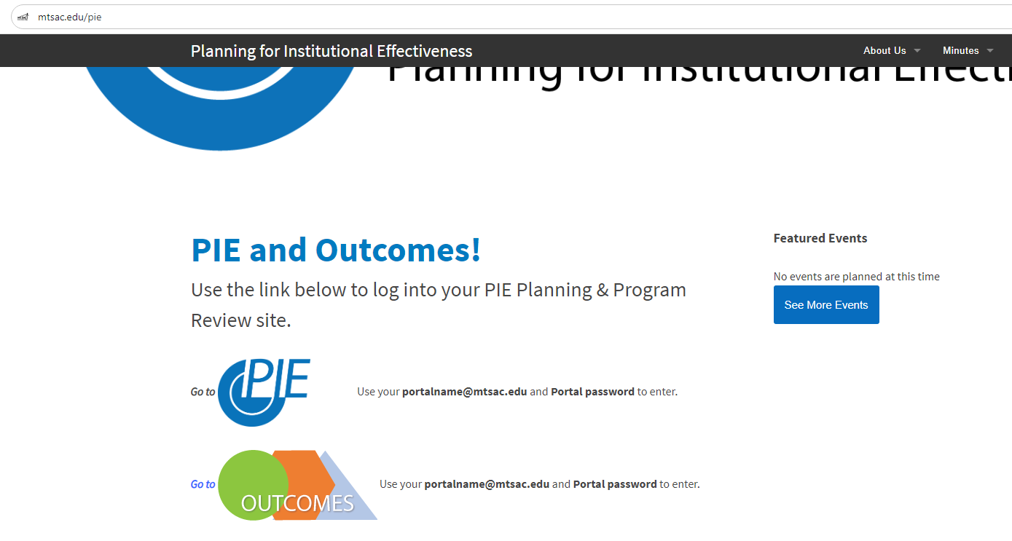
PIE - Access
1. . www.mtsac.edu/pie
2. Click to access PIE

Slide 3
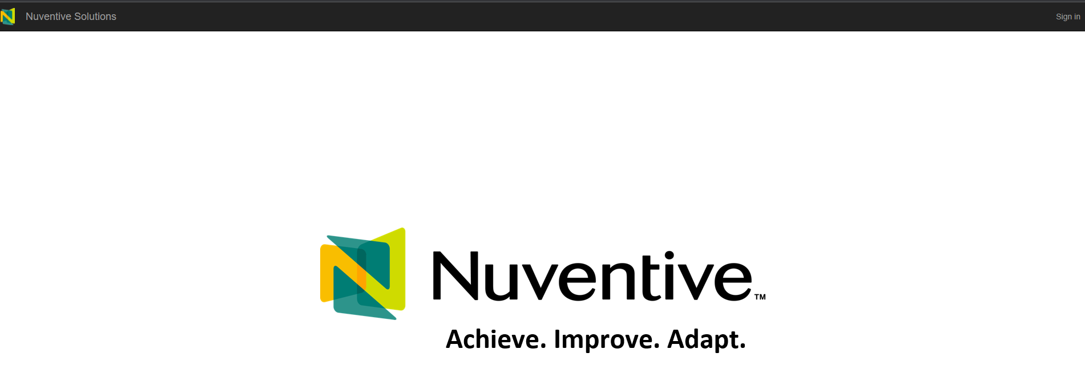
PIE – Sign in
3. After clicking on “Go to PIE” click on Sign in on the top right corner.

Slide 4
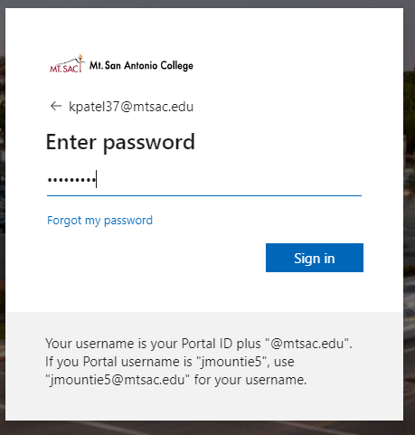
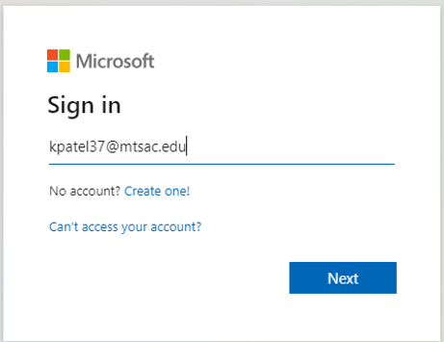
PIE – Single Sign On
4. Use portal username &
password to login.

Slide 5
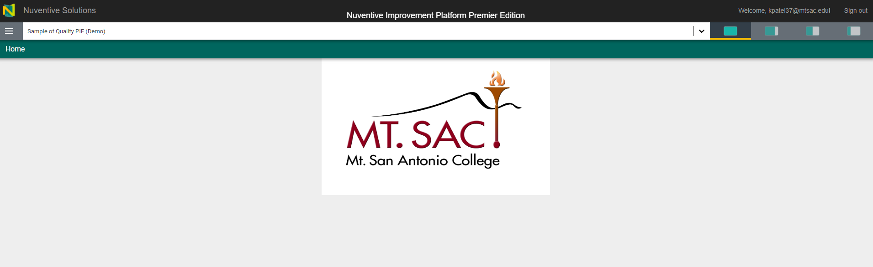
PIE – Home Screen
The home screen with the Mt. SAC logo will appear. The home screen is customizable with any information, files, or pictures.

Slide 6
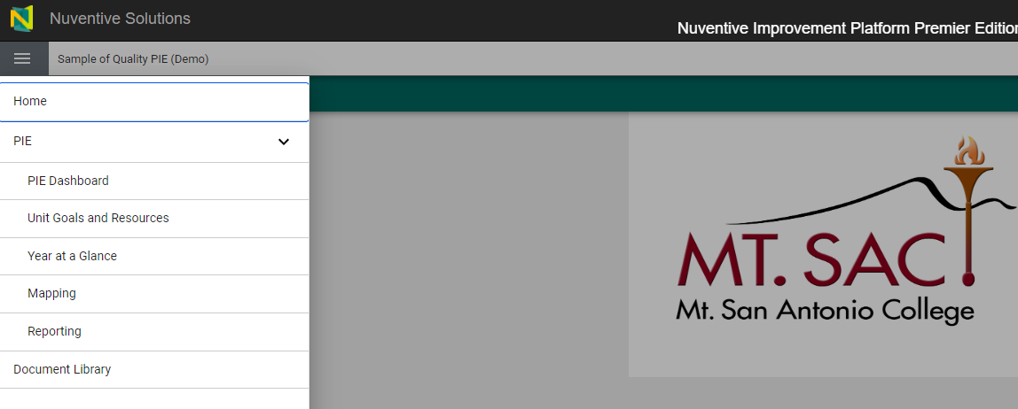
PIE – Menu
Click on the hamburger menu on the left-hand side of the screen to access the sections within the Unit PIE.
Expand the PIE caret. To access the menus.
PIE Dashboard
Unit Goals & Resources
Year at a Glance
Mapping
Reporting

Slide 7
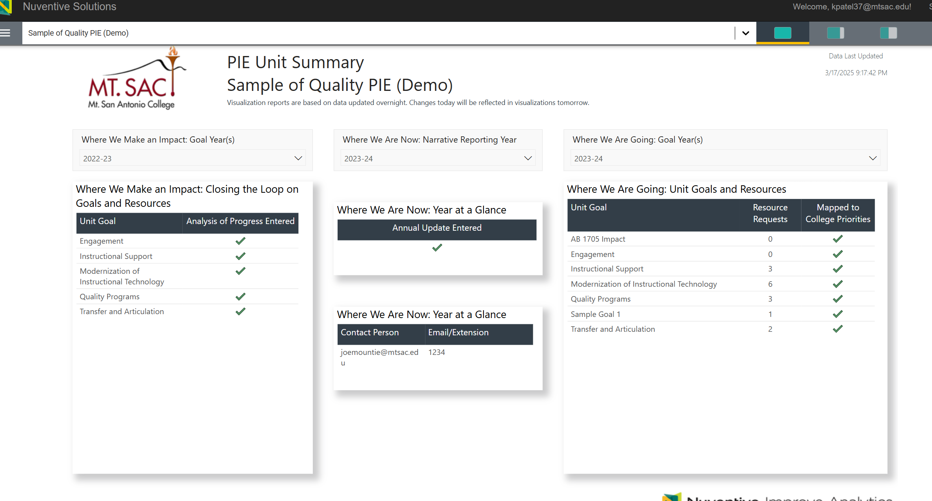
PIE – Dashboard
Dashboard allows you to visually know which area of your PIE is complete and which area needs to be completed.
Green check mark represents that area of your PIE is complete.
Red cross represents that area of your PIE is incomplete and needs to be completed.

Slide 8
Data Review

Slide 9

Key Dashboards include:
Data for the last five academic years
How are our courses doing? Course success and retention, enrollment and fill rates
How are our students doing? Success and retention rates by demographics
How many students are completing our programs? Number of degrees and certificates awarded by Division and Program (ethnicity and gender).
How are students in specific student programs doing? (formerly Student Program Dashboard Dashboards)

Slide 10
Helpful Definitions
Enrollment-A student is enrolled in a course if they received an end of term notation that is displayed on their official transcript.
Success (Data)-The percentage of students who received a passing/satisfactory grade. Success rates includes grades of A, B, C, P, IA, IB, IC, and IPP by the total number of enrollments.
Course Retention– The percentage of students who do not withdraw from class and who receive a valid grade.
Fall to Spring Retention- The percentage of students enrolled in both fall & spring at Mt. SAC in the selected year, excluding students who completed an award or transferred to a four-year institution.
Awards – The number of degree/certificates given to a student upon the successful completion of a program at Mt. SAC. This includes all Associates, certificates and noncredit awards.
Transfer (Data) – The number of students enrolling in either the University of California (UC) California State University (CSU) system, or private institutions.

Slide 11
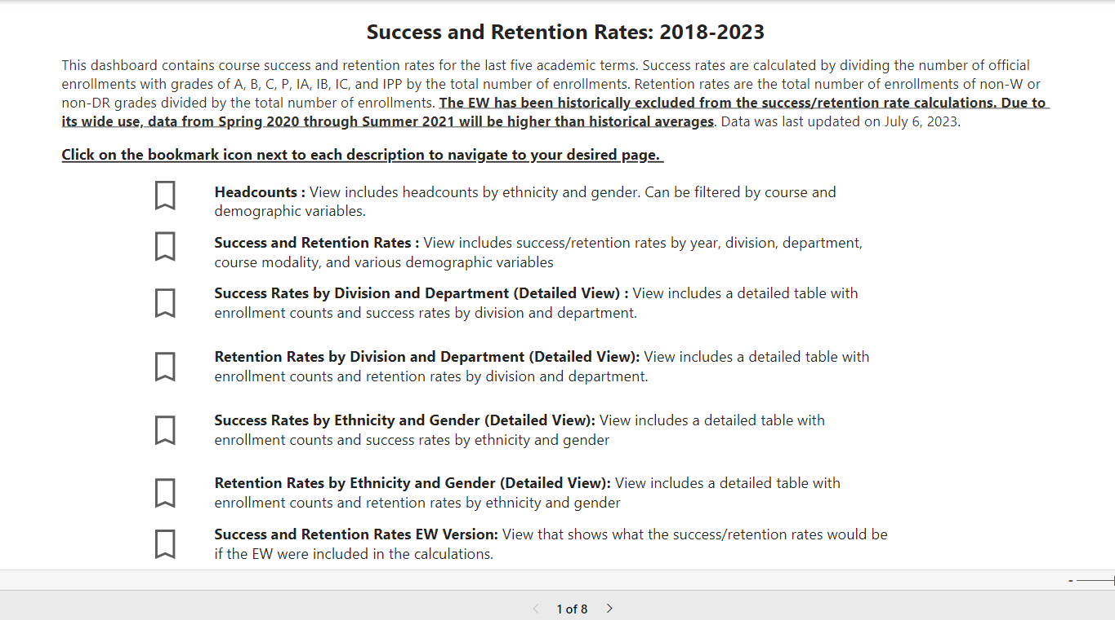
Using Data for Unit Goals and Resources: Sample of Dashboards
Select any of these Bookmark icons/pages
Each icon has different information from headcounts, rates, division, department, etc.

Slide 12
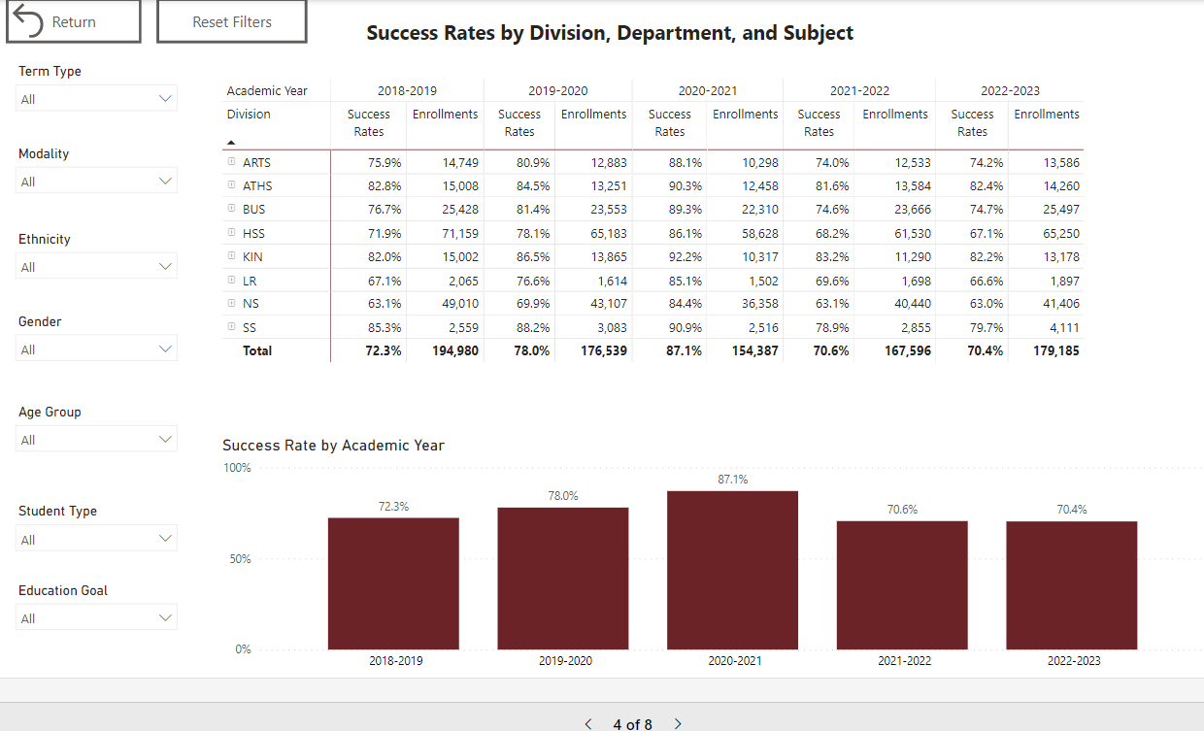
Success Rates by Division, Department, & Success
Select Return to go back to the main menu
Select Term
Select 'Reset Filters’ to clear any items
Clear selections by Using the Eraser Button

Slide 13
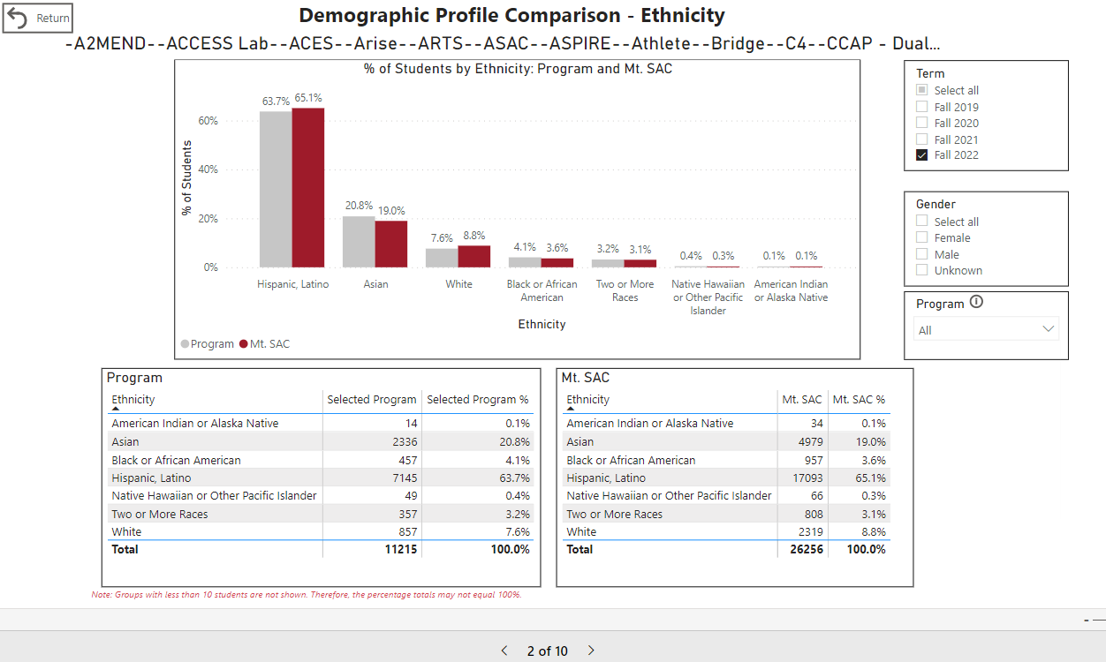
Student Program Dashboard Programs Demographic Profile Ethnicity Example
Select Term
Select Program

Slide 14
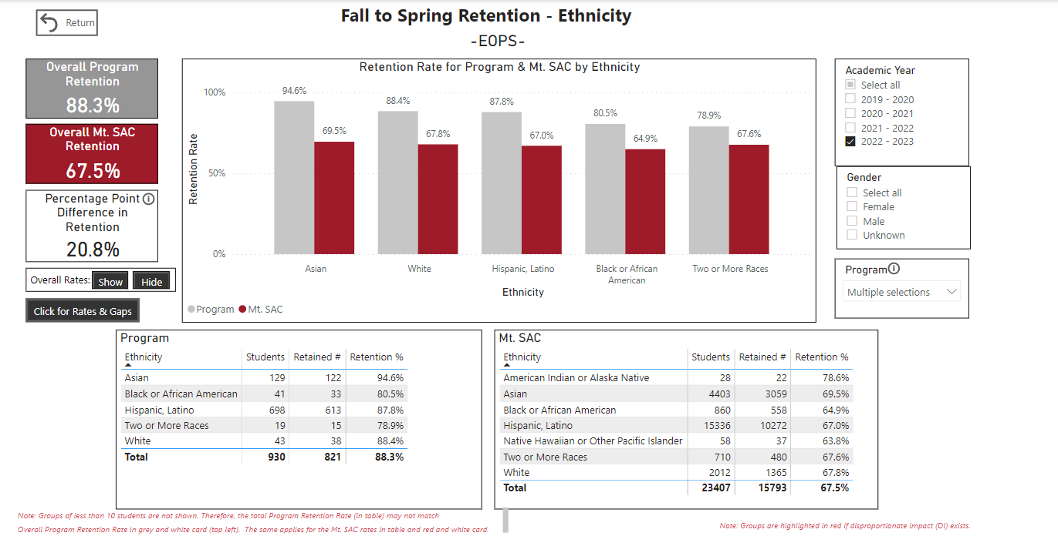
Student Programs Dashboard Fall to Spring Retention Example (Fall 22 to Spring 23 & EOPS)
Select AY
Select Program & All Mt. SAC

Slide 15
Data Exercise: Success, Challenges, and Lessons Learned
What are your initial thoughts on the data?
What might be contributing to student success in your program?
What might be distracting student success in your program?

Slide 16
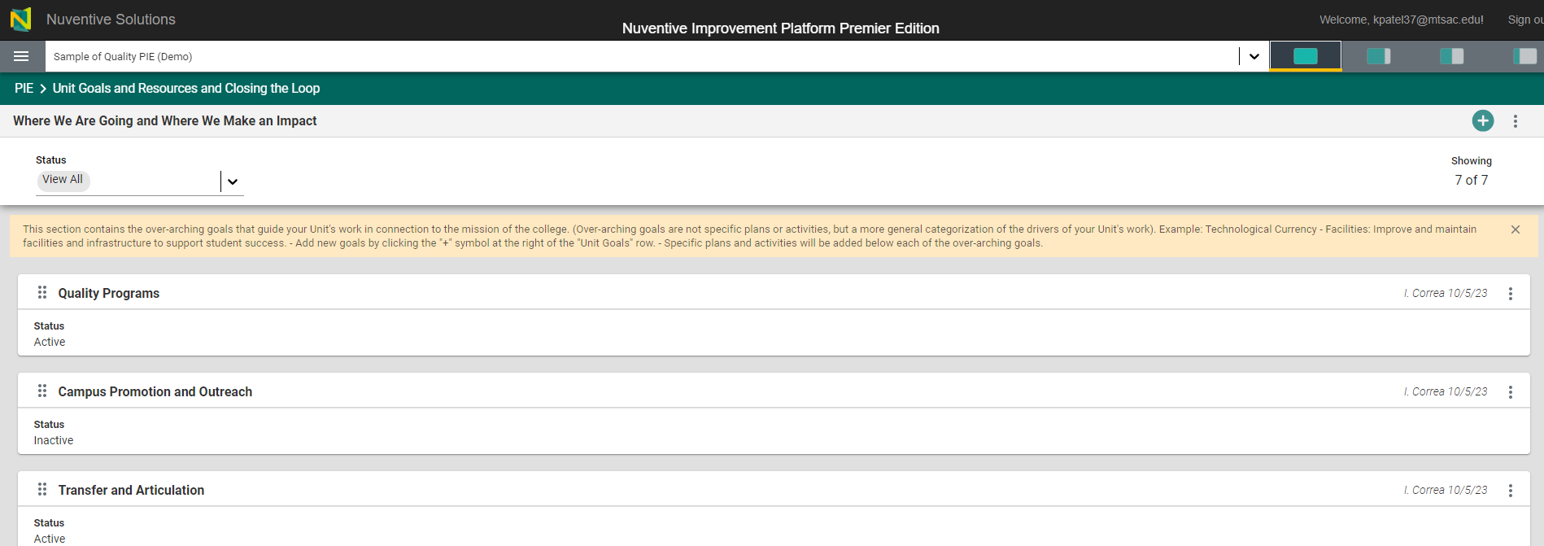
PIE – Goals and Resources
a.
Add the new goal
b.
b. Filter to view only active or inactive goals.
c. Double-click in the white rectangle (card) to open and edit or update the goal.
c.
d.
d. Click on the dots to copy or open the goal.

Slide 17
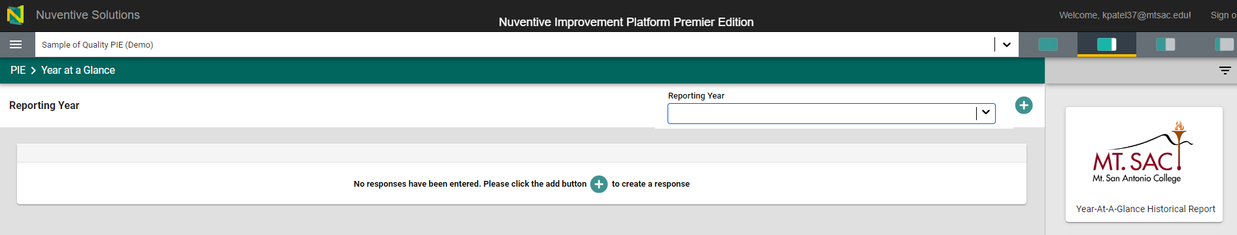
PIE – Year at a Glance
Access the Year at a Glance historical data for the past 3 years.
e.
f.
f.
f. Add the summary for the reporting year
e. Open Page Filter (narrow down searches)

Slide 18
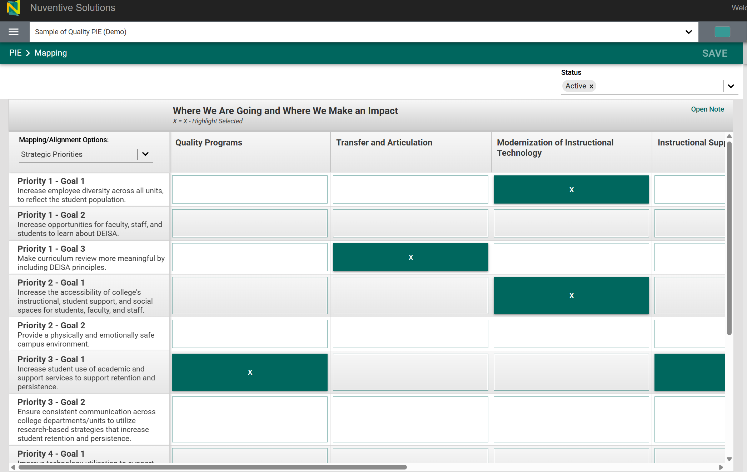
PIE - Mapping
Departmental goals are displayed horizontally.
Strategic Priorities (College Goals) are displayed vertically.

Slide 19
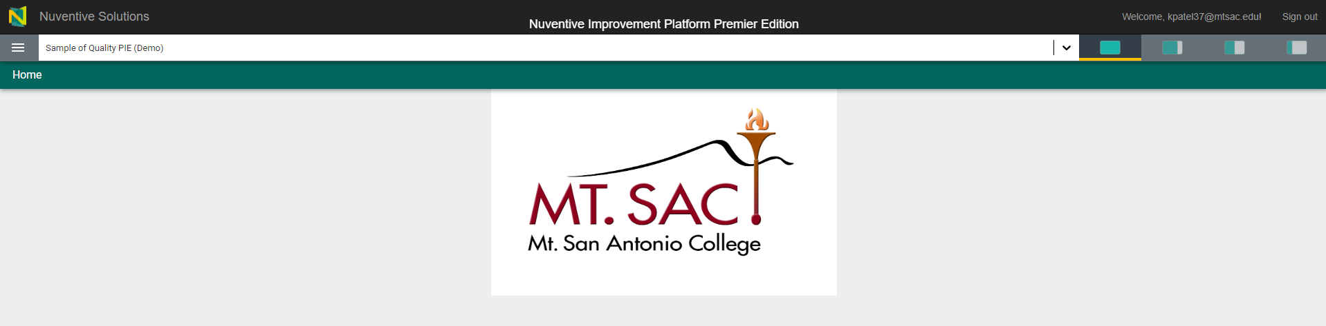
PIE – View Options
Options allow for full-screen, quarter, and half screen size.

Slide 20
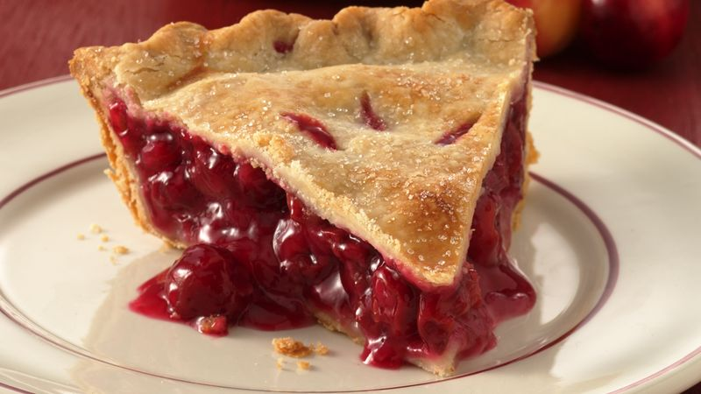

Resources
Easy as PIE
Research/ Data Review Questions
Patricia Quinones:
pquinones@mtsac.edu
Technical Questions:
Krupa Patel: kpatel37@mtsac.edu
Video Training Resources:
http://www.mtsac.edu/pie

