Slide 1
SISC Overview
Mt. San Antonio College
April 4, 2018

Slide 2
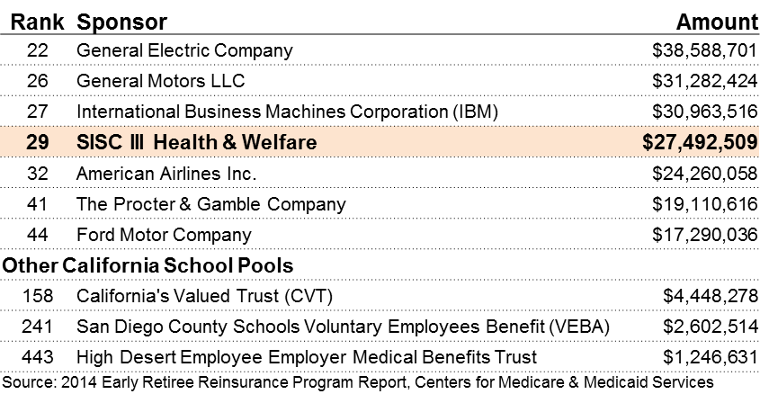
Background
SISC is not an insurance company.
We are a cooperative of more than 400 California public schools joining together to reduce costs and spread risk over a large population…Schools Helping Schools.
Unlike some school pools, we are not a corporation; we are a public entity.
All SISC staff members are public school employees of the Kern County Office of Ed.
Like public schools, SISC is subject to the Brown Act.
Board meetings are open to the public and financial statements are a public record.
We understand and support the needs of public schools
One way we do this is by releasing our rate renewals in the early spring
This gives everyone adequate time to prepare for the coming year
SISC is run in the best interests of our membership
Our focus is the value we provide our members - not perks, politics or profits
One out of every 1,000 Americans is covered by a SISC medical plan.
Another way to illustrate the size of SISC is to look at the funds we received from the Federal Government as a result of participating in the Affordable Care Act ERRP

Slide 3
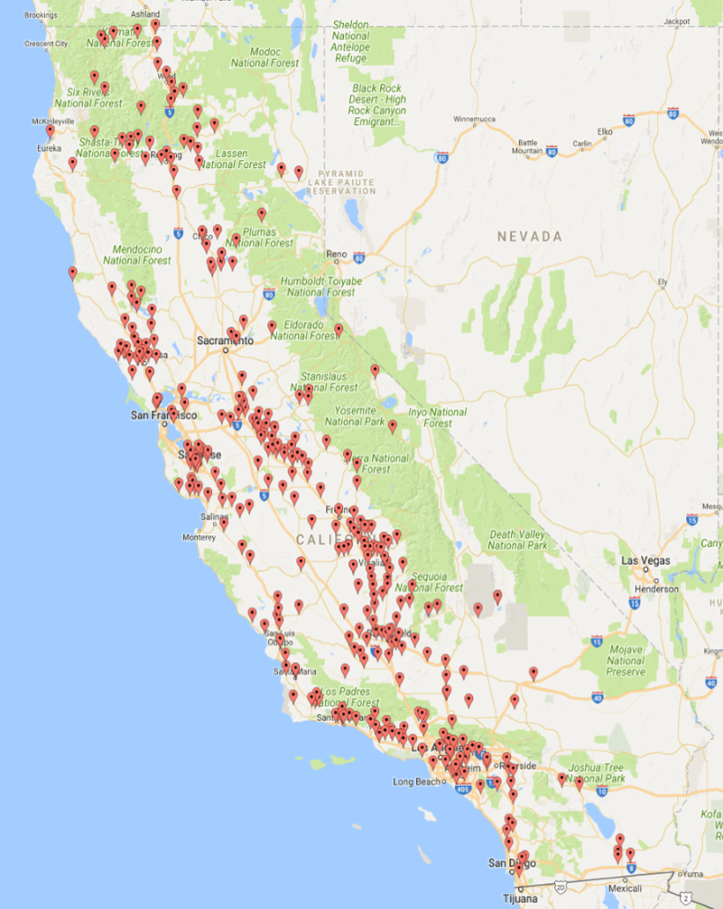
Geographic Diversity Provides Stability
SISC treats having membership spread out over all of California like a diversified investment.
Regional differences in the cost of medical care are taken into consideration, but the size and diversity of our pool allow us to spread the risk and minimize the regional adjustments.
Renewal rates are based primarily on the experience of the entire statewide pool.
All groups within the same region receive the same renewal range regardless of their size.
SISC Provides Stability
SISC doesn’t bring in new groups below cost.
New member districts receive the same renewal range as those who are already in the pool.
Our low costs and stability are major reasons groups join SISC and stay with us for decades.
SISC groups can depend on predictable and fair rate renewals.

Slide 4
Size and Financial Strength produce Lower Costs and Stability
We serve 431 educational agencies with:
216,930 PPO members
69,419 Kaiser members
29,768 HMO members
316,117 Medical Plan members
More than 165 educational agencies
have joined in the last 10 years.
95¢ of every $1.00 is paid to hospitals, doctors and pharmacies
5¢ goes toward administrative costs
Other pools are not necessarily administered like SISC
This year, CalPERS increased rates as much as 18% on some plans.
Last year, a Large School Pool increased rates 29% for a district in Monterey.
For the last 3 years, SISC renewals have been single digits for every district.
Renewal Summary - Average for All and Highest
Year |  |  |  | PPO Plans |  | HMO Plans |  | Kaiser Plans
2017- 2018 |  | Average: |  | 5.3% |  | 8.1% |  | 6.1%
 |  | Highest: |  | 9.6% |  | 9.9% |  | 9.9%
2016- 2017 |  | Average: |  | 3.2% |  | 4.3% |  | 4.0%
 |  | Highest: |  | 7.5% |  | 8.4% |  | 8.0%
2015- 2016 |  | Average: |  | 2.9% |  | 3.5% |  | 3.9%
 |  | Highest: |  | 6.6% |  | 6.9% |  | 7.5%

Slide 5
Regional Membership
RIVERSIDE | LOS ANGELES | SAN DIEGO
Alvord Unified | Antelope Valley CCD | Carlsbad Unified
Coachella Valley Unified | Antelope Valley Union High | Chula Vista Elementary
College of the Desert | Antelope Valley Transportation | Del Mar Union
Corona-Norco Unified | Arcadia Unified | Fallbrook Union High
Lake Elsinore Unified | Azusa Unified | Palomar CCD
Menifee Union | Hughes-Elizabeth Lakes | Vista Unified
Moreno Valley Unified | Lancaster Elementary
Nuview School District | Palisades Charter High | VENTURA
Temecula Valley Unified | Palmdale Elementary | Briggs Elementary
Val Verde Unified | Palmdale Aerospace Adademy | Mesa Union
 | Pasadena Unified | Mupu Elementary
ORANGE | Pasadena Community College | Ojai Unified
Brea Olinda Unified | Pomona Unified | Oxnard Elementary
Buena Park | Santa Clarita CCD | Pleasant Valley
Huntington Beach City Elem | Westside Union Elementary | Rio Elementary
Fullerton Elementary | Wilsona | Santa Clara Elementary
Fullerton Jt Un High |  | Somis Union
La Habra City | SAN BERNARDINO
So Orange County CCD | Lewis Center
Westminster | Silver Valley Unified
 | Trona Jt Unified

Slide 6
Flexibility to Provide Choice of Plan Options
Each District/Bargaining Unit may offer up to 6 medical plan options, plus a Bronze plan
Medical plan options include Kaiser, Anthem Blue Cross or Blue Shield.
Kaiser options include traditional plans, deductible plans and Health Savings Account (HSA) plans.
4 HMO plans and 17 PPO plans can be paired with 5 pharmacy plans. This creates 105 possible plan combinations.
3 PPO HSA compatible plans are available
The HSA-Compatible PPO Bronze plan may be offered to all employees without regard to hours worked.
SISC also offers a variety of plans from:
Dental (Delta Premier and Delta PPO)
Vision (VSP and MES)
Life (Basic employee only and supplemental life)

Slide 7
Retiree Medical Options
Retirees under age 65 (without Medicare) are permitted to enroll in the same plan options offered to active employees
Retirees age 65+ (with Medicare) are offered Individual Retiree Medical Plans:
Kaiser Permanente Senior Advantage Plan
Blue Shield 65 Plus HMO Medicare Advantage Plan
CompanionCare – A SISC Medicare Supplement Plan
These plans include Part D prescription coverage with no coverage gap.
The member must reside in Medicare Advantage Plan service area.
SISC provides direct billing for retirees enrolled in a SISC Individual Retiree Medical Plan. There is no fee for this service.
SISC does not require a district contribution in order for retirees to participate.
SISC requires that the retiree be a qualified CalSTRS or CalPERS retiree in order to participate as a retiree.
All retired members must maintain enrollment in Medicare.

Slide 8
Customer Service – One Story
The best advocates we have for SISC are the districts we serve.
Here’s what one of our districts has to say about us:
The Transition to SISC
“I was very impressed with how easy SISC made
the transition. We had been dreading it, but they did everything they could to help us. We found them to be very flexible in adding us to their benefits
programs, looking for ways to accommodate us.”
The Renewal Process
“We have had a really great experience with our renewals. They are timely; we get them really early in
the spring so we can plan for the year. The rates are
also very stable. SISC is so large that a bad claims year for a district does not affect their individual rate.”
Ongoing service
“Our Account Manager is just wonderful. She always makes me feel like we are her only client — and I know she has others. She bends over backwards to help us and be responsive. She also makes sure we are in the loop on situations where employees call
SISC directly. I think our SISC team is just amazing.”
Benefits Technician,
MVUSD

Slide 9
Value-Added Features (no additional cost)
Benefits and Services
Expert Medical Opinion Benefit - from world-class physicians
Some findings for people who got an expert opinion:
35% with concerns about a Multiple Sclerosis diagnosis didn’t have it.
43% with concerns about a Rheumatoid Arthritis diagnosis didn’t have it.
.
$0 generic drugs at Costco and Mail Order
(on Anthem/Shield PPO and HMO Plans - HSA Plan deductible must be met)
In the United States, 80% of drugs are dispensed as generics
Employee Assistance Program (EAP)
(Included on PPO, HMO and Kaiser)
24/7 physician line
(on Anthem/Shield PPO and HMO)
Section 125 Flexible Benefits Plan
(Moves certain expenses to pre-tax status)
Premium Only Plan – Employee Paid Health, Dental, Vision & Life Premiums
Dependent/Child Care Costs (such as Day Care, etc.)
Unreimbursed Medical Costs (such as Deductibles, Co-Pays, Orthodontic, etc.)
COBRA administration
Direct bill for self-paid retirees
(on Individual Retiree Plans)
Wellness - Health Smarts
Onsite flu shot clinics
Onsite biometric screenings – A “Know Your Numbers” Campaign with
incentives for participation
Free HbA1c blood glucose testing is included for those who meet criteria.
In 2017, 553 people who did not know they were diabetic (181) or pre-diabetic (372)
learned they were as a result of our voluntary HbA1c test.
SOLERA4ME Diabetes Prevention Program

