Slide 1

PIE Planning & Resources
Where We Are Now

Slide 2
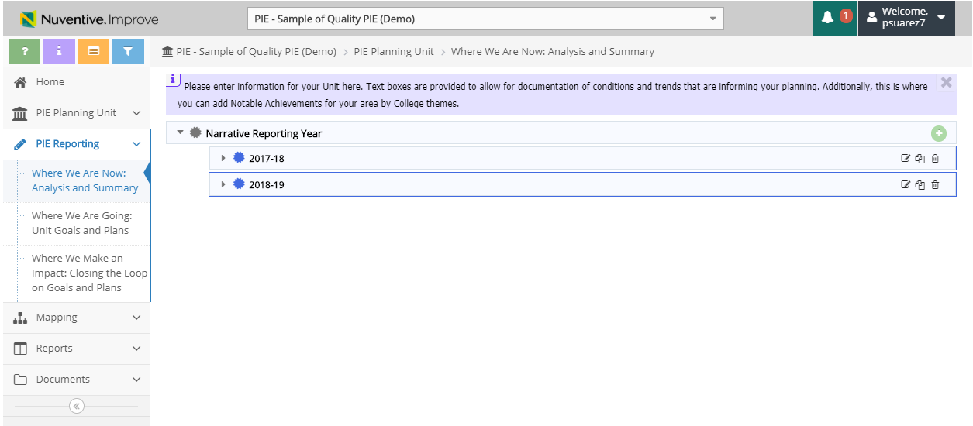
1. Where We Are Now – View Reporting Year
Summary of Previous Years will Display
Create
Edit
Copy
Delete

Slide 3
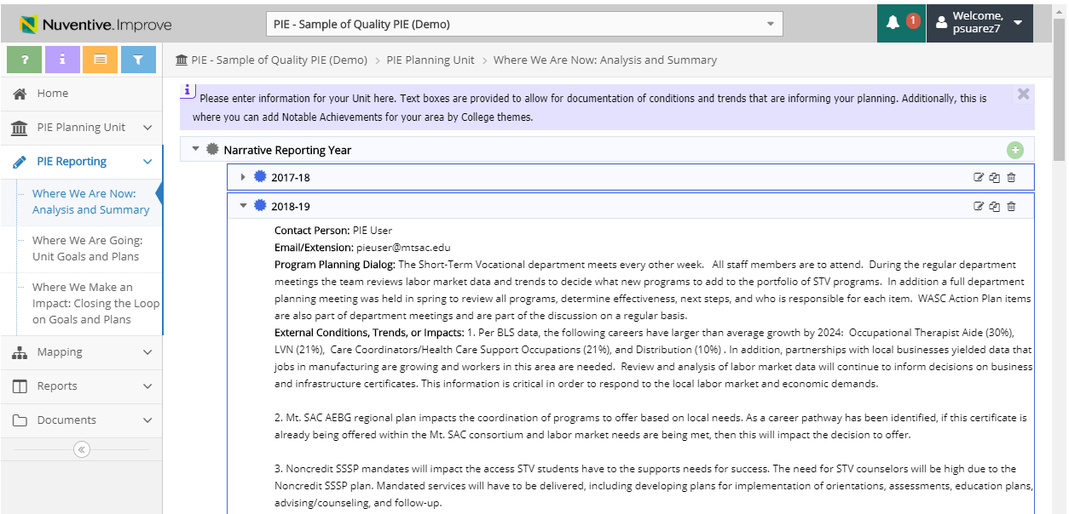
1. Where We Are Now – Copy Reporting Year
2. Click to Copy Year
1. Click to View selected Year data

Slide 4
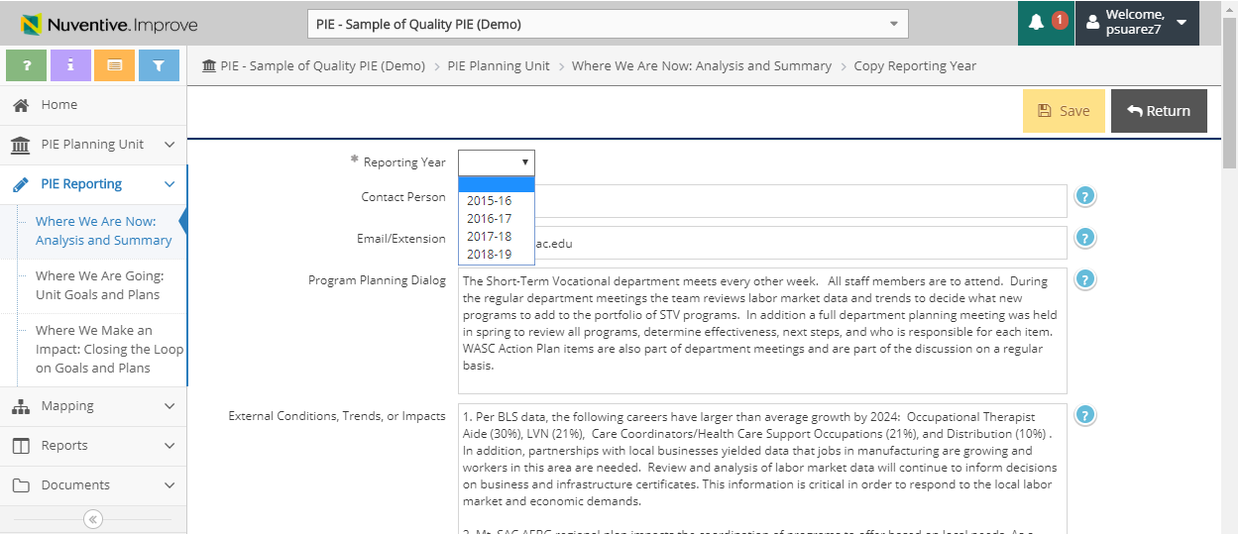
1. Where We Are Now – Copy Reporting Year
3. Enter New Year
5. Click Save
4. Update narrative into the related fields
6. Click Return for previous page

Slide 5

1. Where We Are Now – Create Reporting Year
1. Click to Create New Reporting Year
*only create new year to start a new PIE with no previous entries

Slide 6
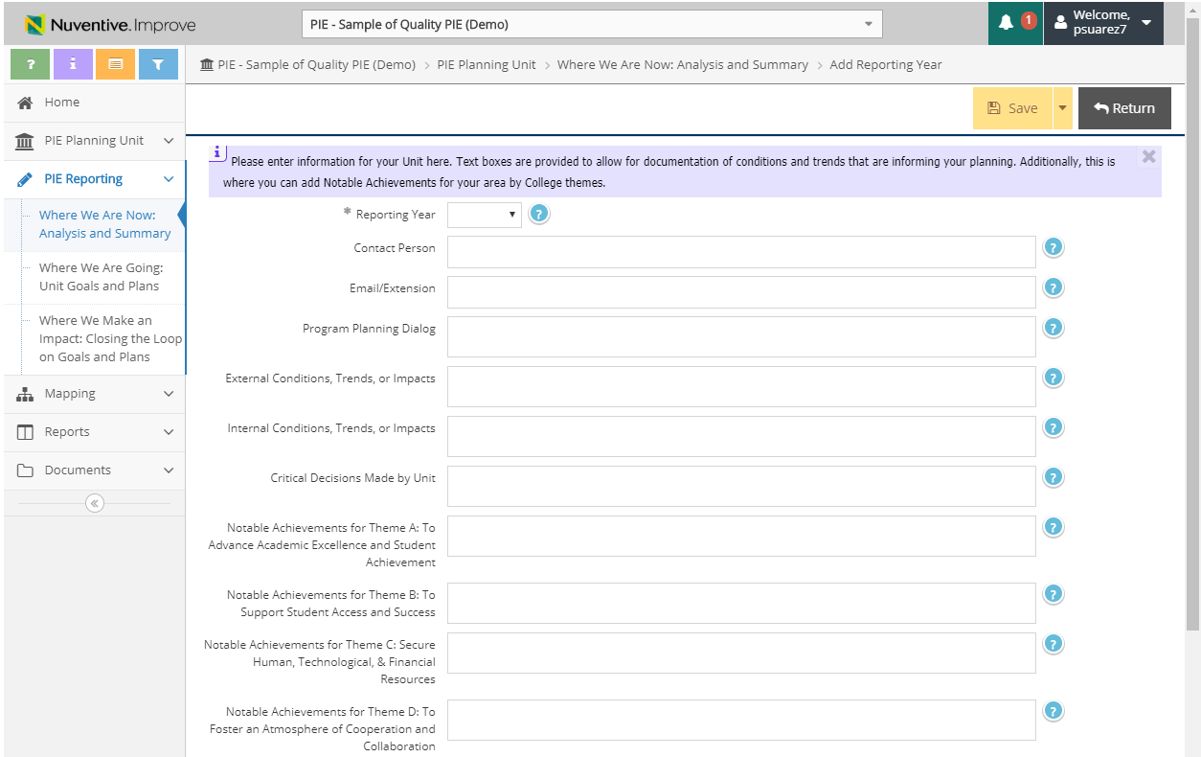
1. Where We Are Now – Create Reporting Year
3. Click Save
4. Click Return for previous page
2. Enter narrative into the related fields
*You can view great examples of quality pie under: PIE – Sample of Quality PIE (Demo)

