Slide 1
PIE Planning & Resources
Reports

Slide 2
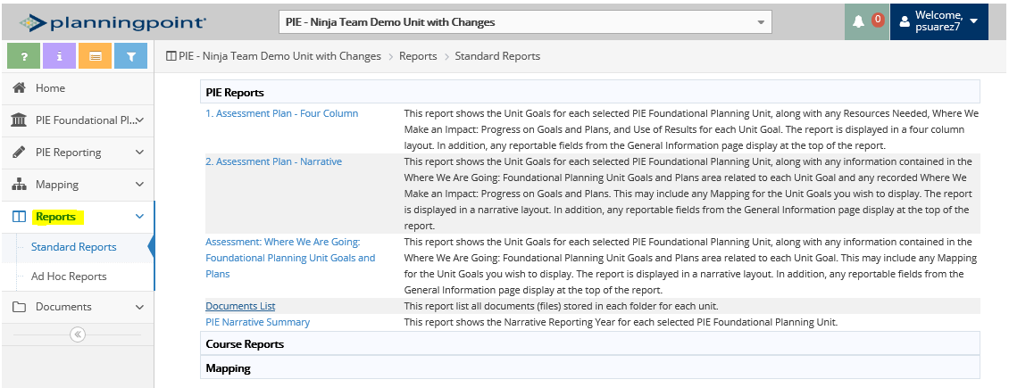
3. Reports – View & Generate 4 Column Report in PDF
1. Select Standard Reports
3. Select Report
(recommended reports: 1 and 2)
2. Description of Reports will display

Slide 3
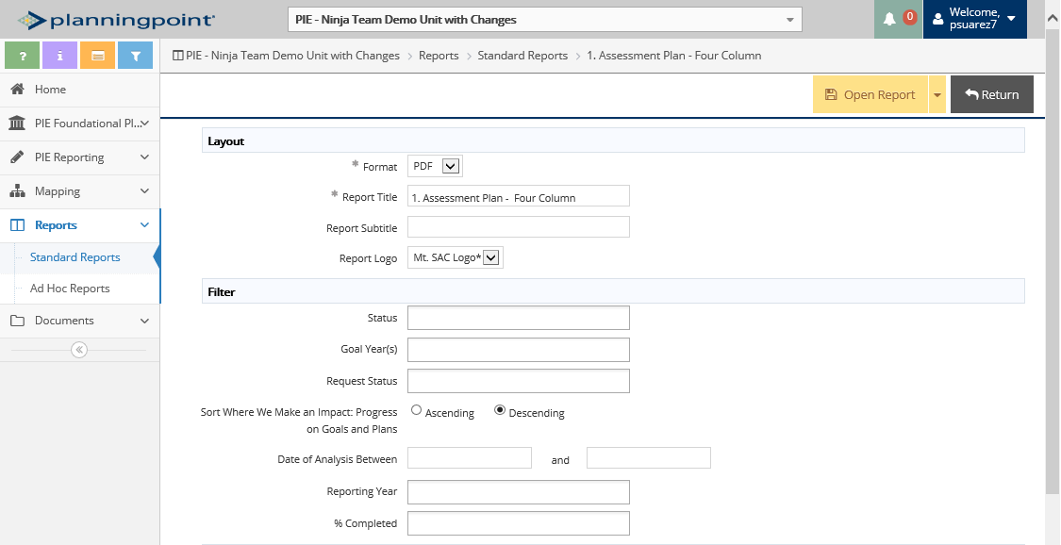
3. Reports - View & Generate 4 Column Report in PDF
4. Select Format
(PDF, HTML and Word)
5. Insert Report Title
7. Click on Open Report
6. Enter Filters *(if applicable)
*Reports have default settings, only use if specifying certain data

Slide 4
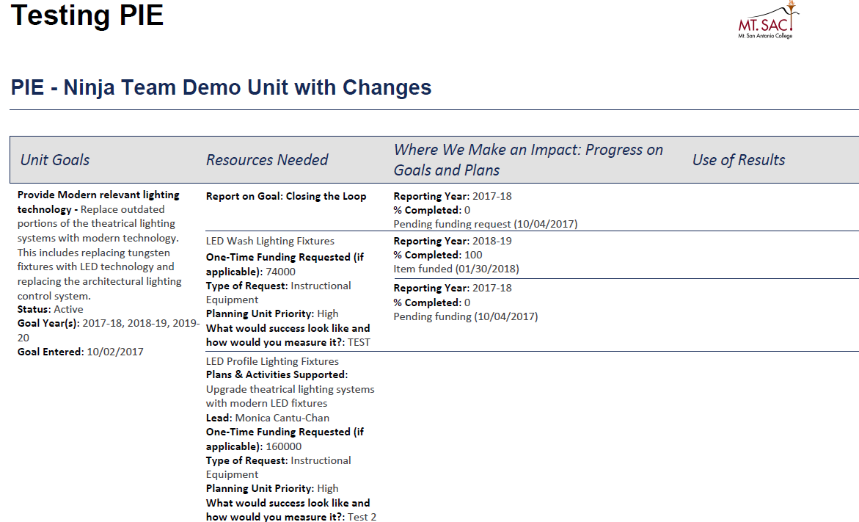
3. Reports – Display of 4 Column Report in PDF
8. Report will Display

Slide 5
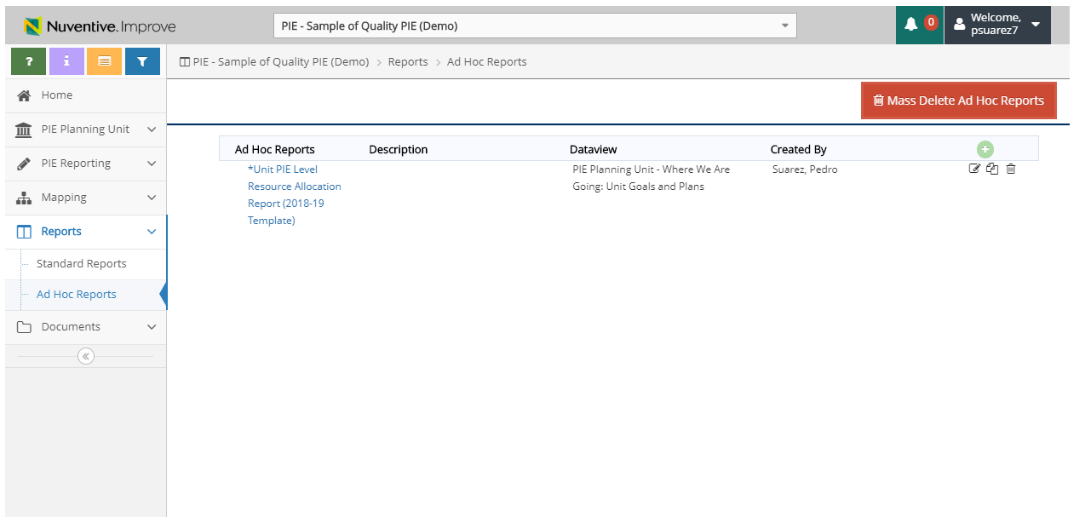
3. Reports – Unit Resource Allocation Reports
1. Select Ad-Hoc Reports
2. Select Unit PIE Level Resource Allocation Report

Slide 6
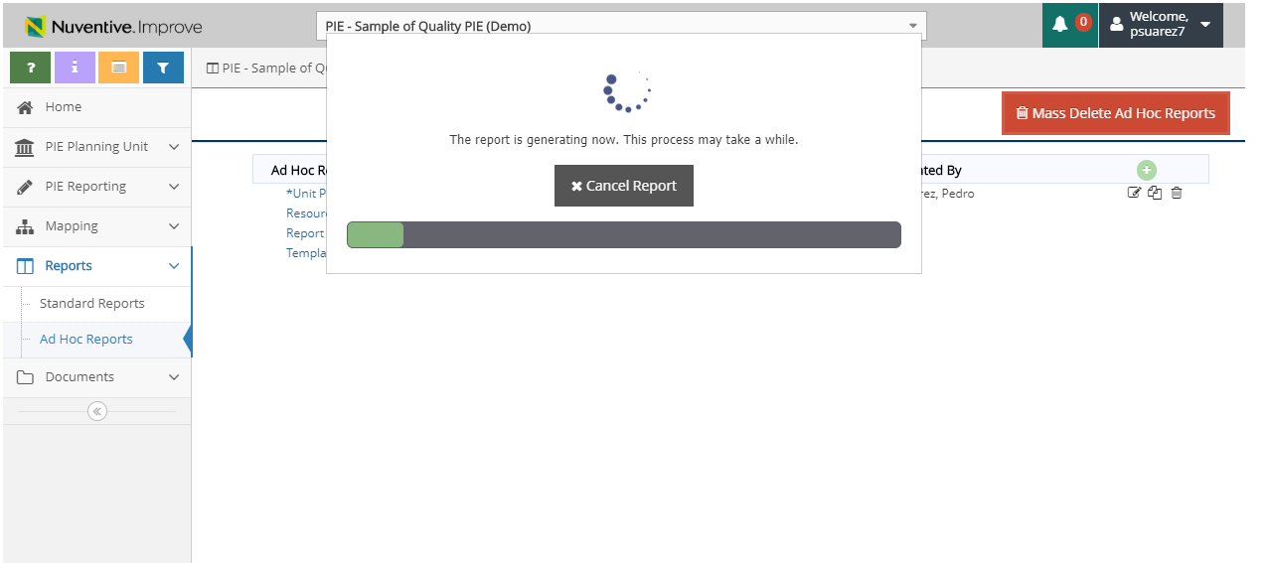
3. Reports – Unit Resource Allocation Reports
3. Report will generate once selected
*Ensure you don’t have any pop-up blockers that could prevent the download.

Slide 7
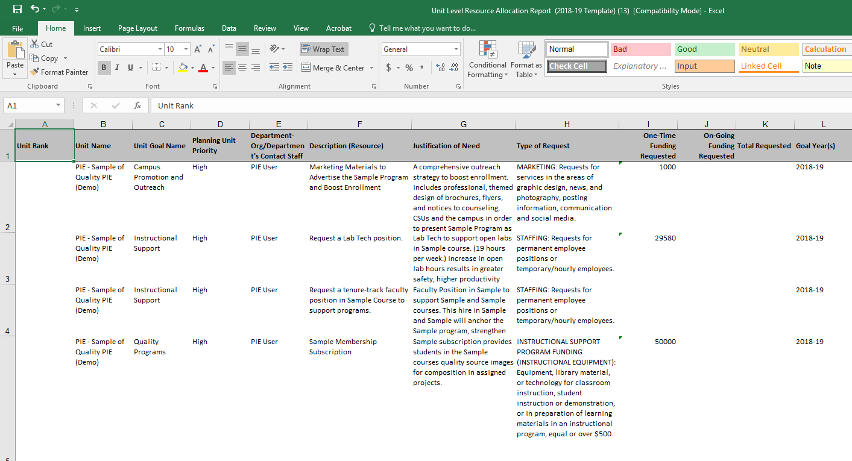
3. Reports – Unit Resource Allocation Reports
All columns are populated using the data entered into the selected PIE Unit.
Report will appear in excel in a recommended template. Unit PIE’s will have the availability to insert a “Unit Rank” to send to their Division for Resource Prioritization.

